Slide 1


LUKASZ
KUKLIS
P&PES (ATC)
POLAND
Software Prod & Plat Eng Assoc Manager, Level 8/Full Time
PROJECT EXPERIENCE
FUNCTIONAL/
TECHNICAL SKILLS
Developed and implemented a robust Go-based API consumption framework that efficiently retrieved data from multiple external APIs, optimizing data flow processes. Technologies: Go, Git
Client: auctioning platform (07.2020-01.2021)
Short project data: (agile, team size: 6 people, SI, nearshore)
Enhancing an online auctioning platform with advanced Anti-Money Laundering (AML) capabilities employing a .NET microservices
architecture. I was responsible for designing and implementing RESTful API services, orchestrating secure and efficient communication via Azure Service Bus,Technologies: .NET Core, Rest API, Azure Service Bus, Azure Monitor Logs
Client: wealth management platform catering to UK client (02.2021-08.2023)
Short project data: (agile, team size:6 people, SI, nearshore) Spearheaded a team as a full-stack developer Pioneered the development of new features based on client specifications and ensured the ongoing maintenance of the .NET platform. Collaborated closely with stakeholders to ensure the platform met evolving client needs. Technologies:: Net Framework 4.8, .NET 6, MSSQL, NServiceBus
PROFESSIONAL BACKGROUND
Client: Enterprise tax compliance and reporting platform (06.2025-12.2025)
Short project data: (agile, team size: 8 people, SI, nearshore) Built cloud-native microservices and Angular applications for an enterprise tax compliance platform serving Fortune 500 clients, implementing distributed identity services, multi-region user management, and automated tenant onboarding using .NET 8, AWS, and Docker.
Client: HR & Payroll software provider (07.2024-04.2025)
Short project data: (agile, 6 people teams, SI, nearshore) Supporting two offshore teams as an technical advisor. Perform regular PR reviews to enforce best practices, improve code quality, and ensure consistency across teams. Support teams to resolve technical blockers. Promote testing culture, design patterns, and long-term maintainability strategies. Technologies: Angular 14+, TypeScript, C#, .NET API, Git, GitHub Actions.
Client: A leading cloud storage provider (10.2023-02.2024)
Short project data: (agile, 4 people teams, SI, nearshore)
.NET, C#, ASP.NET, .NET Core
JavaScript/TypeScript
NodeJS, NestJS
Azure
SQL
Go lang
3th party integration
REST APIs,
Unit tests,
Enterprise web applications,
Relational database design,
SOLID,
Versatile Senior Software Developer with 14 years of industry experience specializing in both backend and frontend development. Proficient in crafting high-performance backend solutions using C# and .NET, complemented by a passionate and skillful approach to frontend development. While my expertise is deeply rooted in backend architectures, my enthusiasm for frontend technologies has driven me to gain proficiency in JavaScript frameworks such as React, enabling me to contribute effectively to full-stack projects. My technical acumen spans across Node.js, JavaScript, and TypeScript, allowing me to create seamless, end-to-end software applications that resonate with client objectives. Recognized for a client-centric approach and ability to translate complex requirements into user-centric solutions, I bring a balanced skill set that supports a dynamic development environment. Committed to excellence and continuous skill enhancement, I strive to deliver exceptional results through collaborative teamwork.
CERTIFICATES
MCTS: .NET Framework 4, Data Access, 03.2013
Stripe Certified Professional Developer (Apr 2024 – Apr 2026)
LANGUAGE SKILLS
Polish (Native)
English (B2)
Copyright 2024 Accenture. All rights reserved.

Slide 2
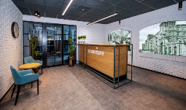

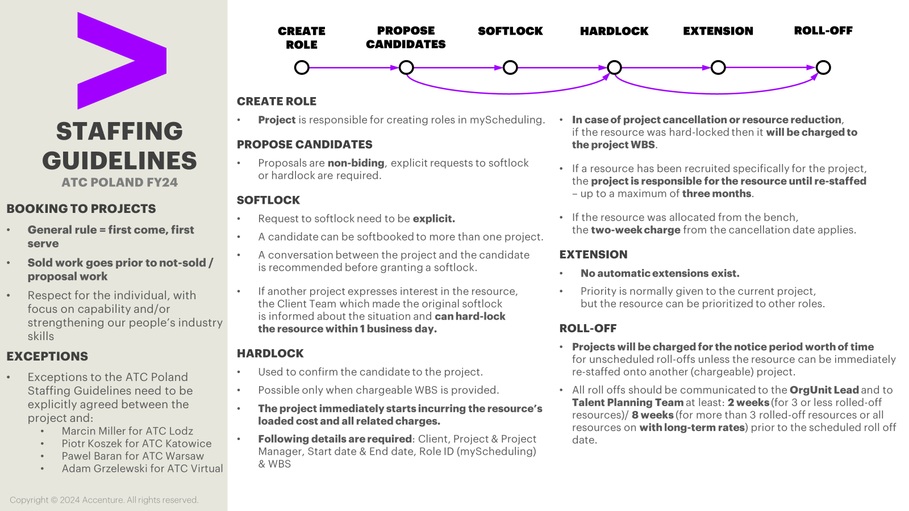
Key Points from ATC Poland
Terms and Conditions
Advanced
Technology
Center
Poland
Please include DNPs:
ATC POLAND
PART OF EMEA CENTRAL/EAST
Infrastructure Charge (seat charge, laptop, connectivity) | € 15 person/weekday, seat in office up to 5 days/week
Team Event budget (mandatory, budget to be reserved, charged as spent) | € 10 person/month
Travel between ATC locations (mandatory, budget to be reserved, charged as spent; This amount is the minimum budget to be secured assuming travel only within one country) | € 55 person/month
ATC POLAND
SALES DECK
Please include ATC Engagement Charge:
ATC Poland Deck
Managed Delivery projects:
3% of ATC Leadership | covers time for status monitoring, rotation management, performance management and escalations.
10% of OU Lead (LVL6) for project <15FTE For projects >=15FTE OU Lead involvement is higher, prices individually based on the scope and complexivity of the project | cover time for performance management, staffing actions, rotation management, leadership involvement in global-corporate Delivery Excellence services, motivational activities, any potential management issues
10-20% of DEX Team (LVL10) | to cover mandatory global activities
Capacity Services projects:
4% of LVL7 (BC63) - or its equivalent - charged per each FTE | cover time for performance management, staffing actions, rotation management, leadership involvement in global-corporate Delivery Excellence services, motivational activities, any potential management issues, etc.
Costing&Pricing in ATC Poland
For best results we recommend staffing with in advance with DCSO document:
DCSO document
Please contact ATC Poland Solution Architecture team (Poland.ATC.SA) to obtain the information on:
Appropriate BCs and LCRs in ATC Poland
Cost of interns/subcontractors
AO/SI/IO standard range of AHR&ADR
For more details see full Terms and Conditions document:
Terms and conditions

