Slide 1
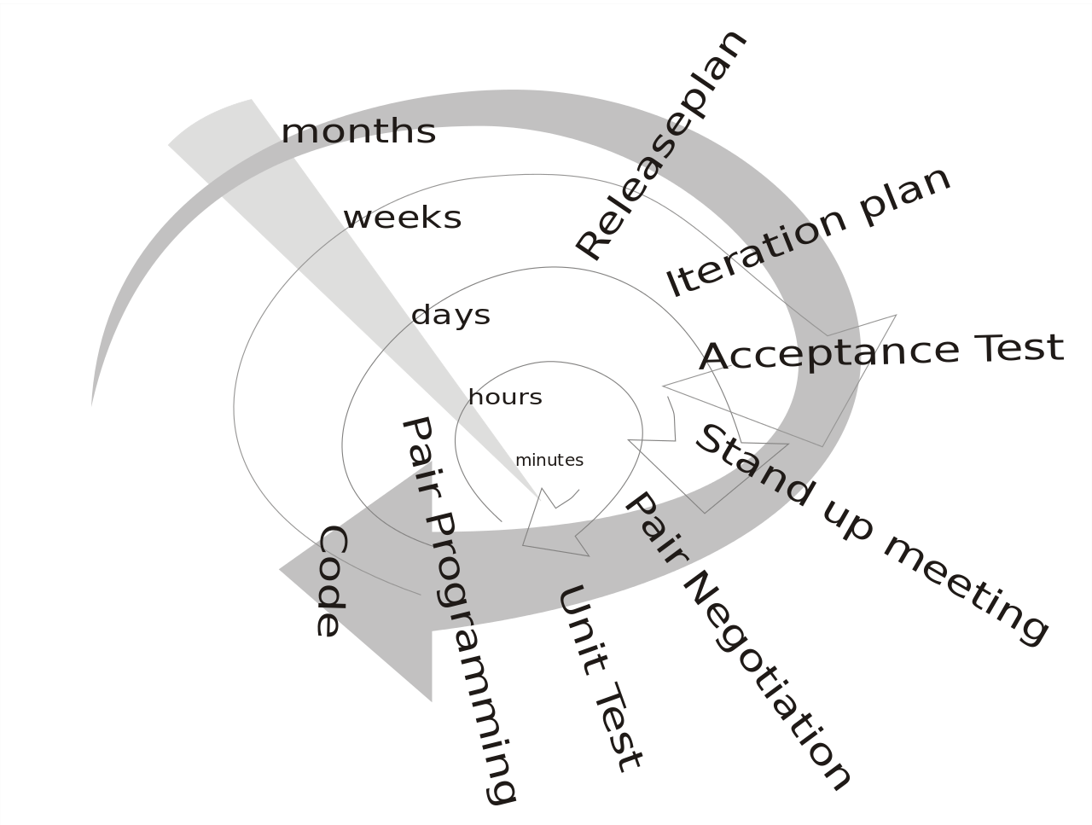
Extreme Programming(XP)
~ Gaurav Gaur

Slide 2
Overview
Produce high-quality software more productively.
Multiple short development cycles rather than one long one like in Waterfall.
Takes software engineering practices to extreme.

Slide 3
History
XP was created by Kent Beck at Chrysler Comprehensive Compensation (C3) System payroll project in 1996.
Extreme Programming was created by developers for developers

Slide 4
Activities
There are 4 basics activities in XP
Coding
Testing
Listening
Designing

Slide 5

Activities: Coding
Coding
Customer as a part of team
Problem Solving
Communication

Slide 6

Activities: Testing
Testing
Quality Assurance
Automation – unit testing
TDD
Code coverage

Slide 7
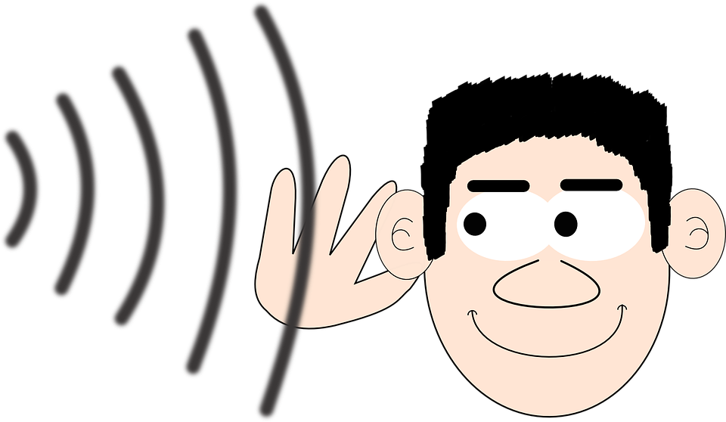
Activities: Listening
Listening
Customer needs
User Stories
Acceptance Criteria

Slide 8

Activities: Designing
Designing
System design
Decoupled system

Slide 9
Values
The rules of XP are based on sound values
Communication
Simplicity
Feedback
Courage
Respect

Slide 10

Values: Communication
Communication
Customter-Developer
Answers business questions
Face-to-face conversation
Communicate progress

Slide 11
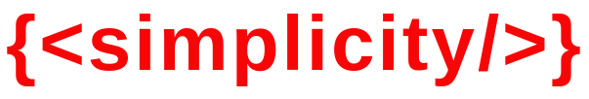
Values: Simplicity
Simplicity
Solve today’s problem
Complexity costs lot

Slide 12
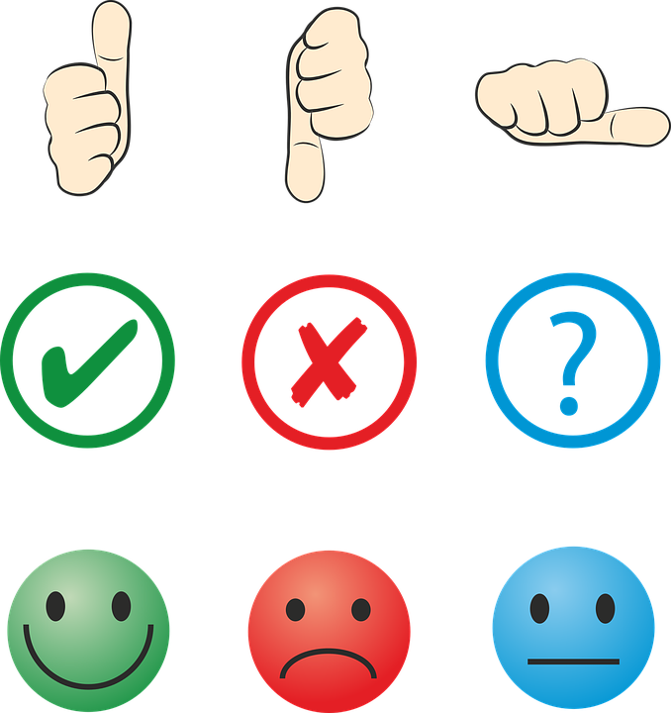
Values: Feedback
Feedback
XP provides rapid feedback
Rapid feedback
Freequent releases
Builds confidence

Slide 13

Values: Courage
Courage
Making hard decisions
Fix features
Admit mistakes

Slide 14

Values: Respect
Respect
motivation, enjoyment, and job satisfaction

Slide 15
Practices
There are 12 extreme practices that a team follows
Fine Scale Feedback
Continuous Process
Shared Understanding
Programmer Welfare

Slide 16

Practices: Fine Scale Feedback
Fine Scale Feedback
Pair Programming
Planning Game
Test Driven Development
Whole Team

Slide 17
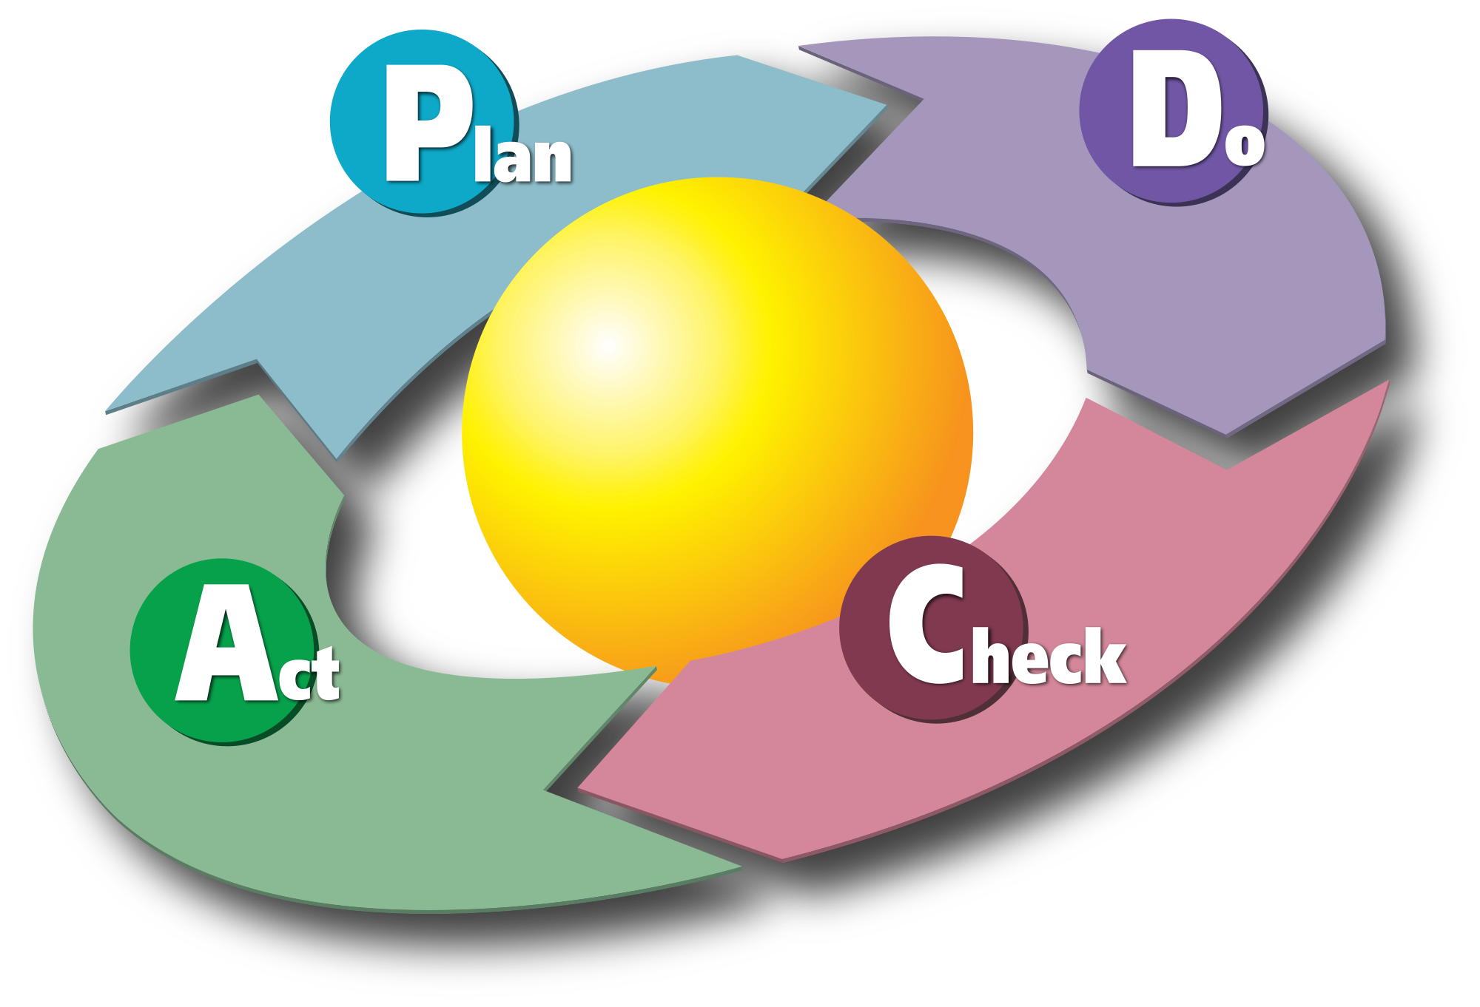
Practices: Continuous Process
Continuous Process
Continuous Integration
Refactoring & Design Improvement
Small Releases

Slide 18

Practices: Shared Understanding
Shared Understanding
Coding Standards
Collective Code Ownership
Simple Design
System Metaphor

Slide 19
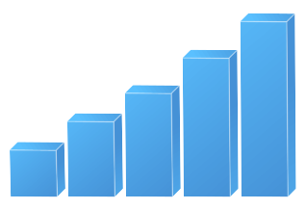
Practices: Programmer Welfare
Programmer Welfare
Sustainable Pace

Slide 20

Is it all good!
A methodology is as good as people involved.
Only works with senior developers.
Requires a cultural shift.
Insufficient documentation.
Impossible to develop realistic estimates.

Slide 21

Q&A
Thanks

