Slide 1
IoT: The Dawn of Tech Revolution
Gaurav Gaur
July 21, 2016

Slide 2


Welcome

Slide 3
Today’s Overview
1
2
3
Baking Your Pi
Milk Pi Recipe
4
Ques and comments
References

Slide 4
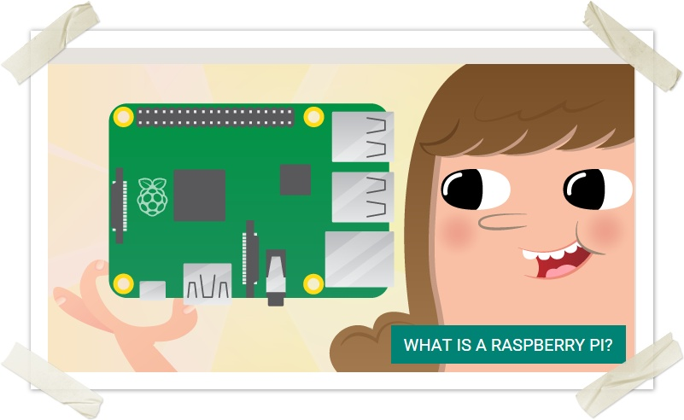
Raspberry Pi

Slide 5

Checklist
Pi - seems obvious
Micro SD Card
Some kind of adapter for SD to Micro SD and then probably that to USB
Power adapter. Pi has micro USB style port BUT not all charges have enough umpf to get it going so use an appropriate one.
WiFi USB plug or wired internet connection
USB Mouse and Keyboard
Some kind of HDMI device.

Slide 6
Baking the Pi
Head over to https://www.raspberrypi.org/downloads/ and download Raspbian (current build is 5th of May 2015 - Take the ZIP unless you want some torrent activity on your machine. It's around 1 gig
Next you are going to need to configure the SD card, you can just drop the ZIP contents on it in theory but in reality I could never get this to work so you require configuration 'stuff'
Linux/Unix - Follow these commands here https://www.raspberrypi.org/documentation/installation/installing- images/linux.md
Windows - https://www.raspberrypi.org/documentation/installation/installing-i mages/windows.md You'll need Win32DiskImager but that is included in the instructions and guide.
Apple - https://www.raspberrypi.org/documentation/installation/installing- images/mac.md
Of the 3 the Windows is way more 'visual' and GUI based but the choice is yours.
Once the SD card is formatted open the ZIP and drop the contents of it onto the root.

Slide 7
Baking the Pi
Start connecting up the PI, leave the power until last. First off Ethernet, Keyboard, Mouse and HDMI Don't bother with WiFi yet.
HDMI to the TV/Display and power that up ensuring the input is correct (HDMI 2 on most of the LGs in the DDCN)
Last plug the power in, If all goes well you should see the following:
After this quick flash of multi colour screen you should then get either login request or a scrolling set of text detailing various installs.
At some point the boot will begin pulling any dependencies it needs (assuming you remembered to connect the Ethernet cable).
When asked for a username and password use the following:
Pi Login details
username: pi
password: raspberry
If this has all worked you should see a command line prompt 'pi@raspberrypi~$'

Slide 8
Baking the Pi
Now we need to get to a desktop, so type the below and hit return
Pi GUI/Desktop
startx
Once all the above has run you should now have a desktop.
Plug the wifi USB device in, in the top left menu -> Preferences -> WiFi and scan for the preferred WiFi. If either the system doesn't scan, WiFi isn't available or another fail go for Menu -> Log off -> reboot (leaving the wifi USB in place)

Slide 9
Networking Your Pi
Connecting via Ethernet
Connecting via LAN
Connecting via WAN
Once your connection is established connect the Pi via SSH

Slide 10

Milk Pi Recipe

Slide 11
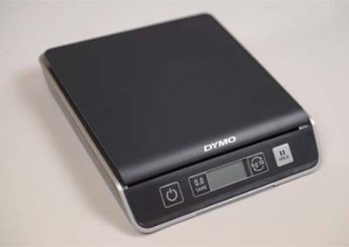
Checklist
Pi and Micro SD Card
A digital weighing scale with USB support (The Dymo M10 or Dymo M25 is recommended)
Milk Bottle
Java

Slide 12
USB Scale
For communication with our USB scale, we are going to use the usb4java Java library. This is an open-source, JSR 80–compliant implementation of the standard javax.usb specification that has support for ARM Linux distributions. You can download the latest version of usb4java from the project website: http://usb4java.org/.
You will need to grab the following JAR files:
usb4java-1.2.0.jar
usb4java-1.2.0-linux-arm.jar
commons-lang3-3.2.1.jar
usb-api-1.0.2.jar
usb4java-javax-1.2.0.jar

Slide 13
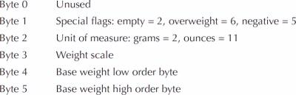
USB Codes
Notes:
If there is relevant video content, such as a case study video, demo of a product, or other training materials, include it in the presentation as well.

Slide 14
References
Raspberry Pi with Java: Programming the Internet of Things (IoT)
https://blogs.oracle.com/java/brewing-java-with-the-raspberry-pi
Code - https://github.com/GaurG/PiSample

Slide 15
Questions?

