Slide 1
IoT: The Dawn of Tech Revolution
Gaurav Gaur
March 10, 2016

Slide 2


Welcome

Slide 3
Today’s Overview
1
2
3
Devices
4
Concerns
Getting Started
What is IOT?
7
Ques and comments
Technologies
6
5
Market players of IOT

Slide 4
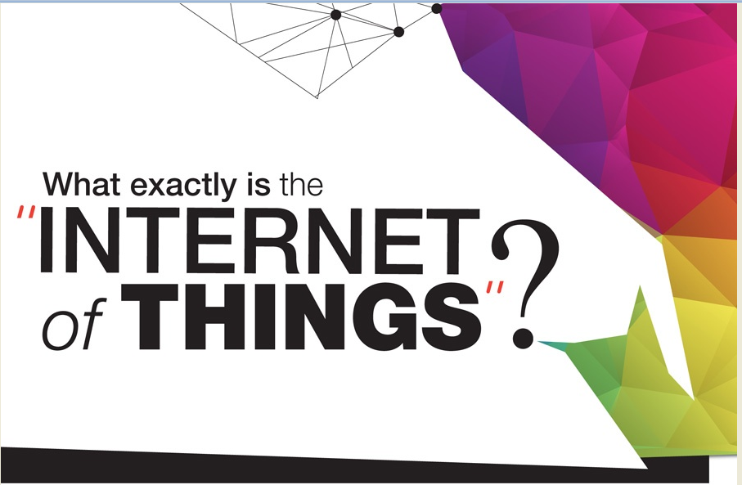

Slide 5
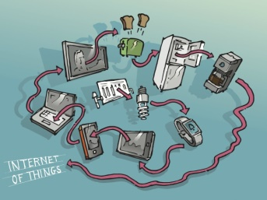
IoT
Oxford Dictionary - The interconnection via the Internet of computing devices embedded in everyday objects, enabling them to send and receive data.
Wikipedia - The network of physical objects—devices, vehicles, buildings and other items embedded with electronics, software, sensors, and network connectivity—that enables these objects to collect and exchange data.
SAP - A world where physical objects are seamlessly integrated into the information network, and where the physical objects can become active participants in business processes. Services are available to interact with these 'smart objects' over the Internet, query and change their state and any information associated with them, taking into account security and privacy issues.

Slide 6
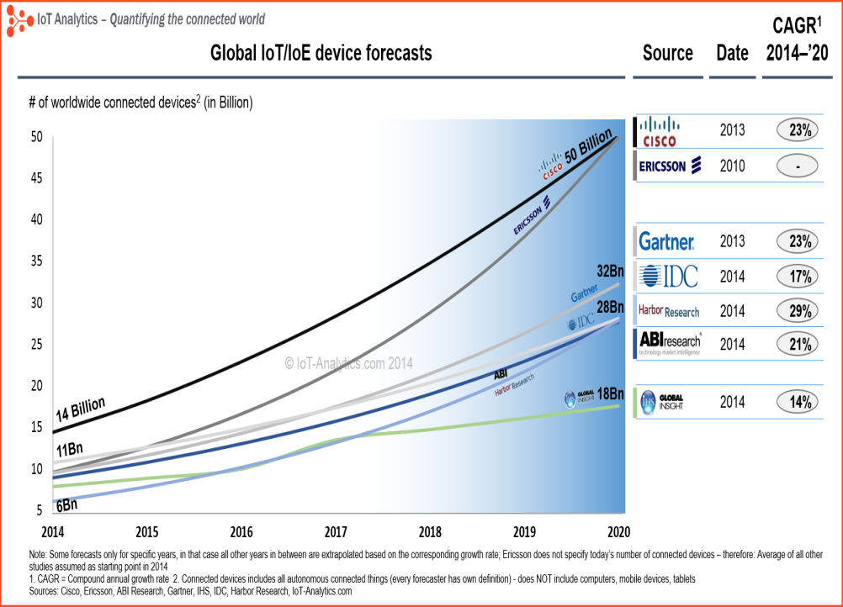

Slide 7
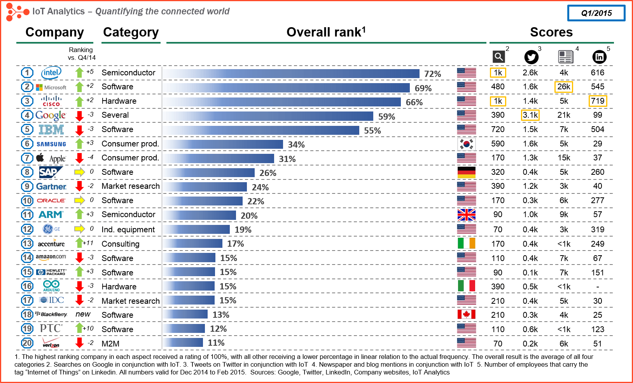

Slide 8
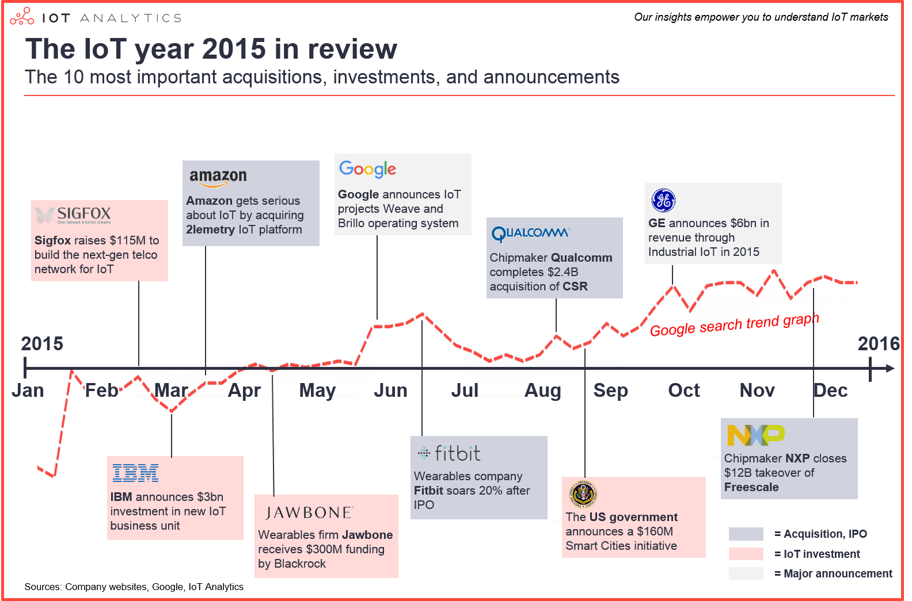

Slide 9
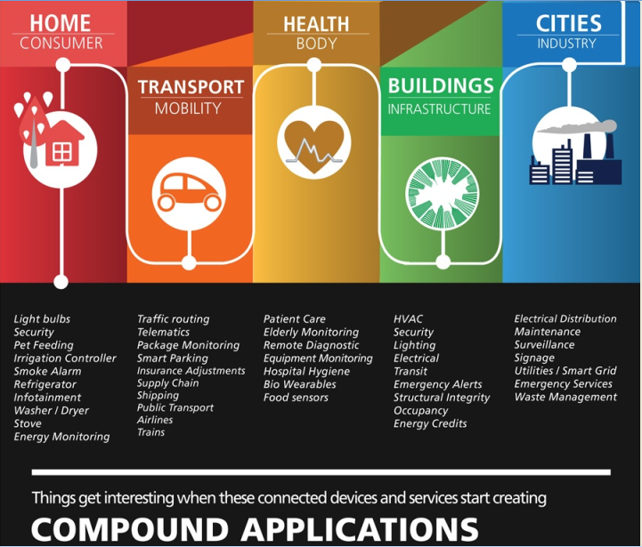

Slide 10
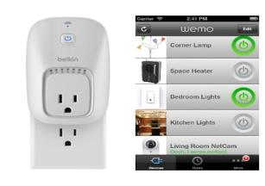
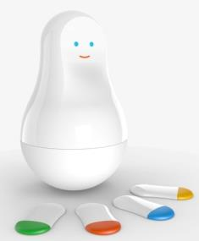
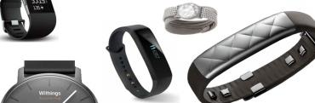

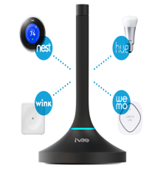
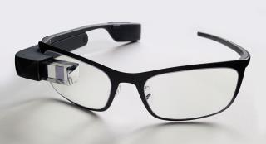
Devices
Belkin WeMo
Smart Bands
Lapa
Ivee
Sense Mother
Google Glass
Notes:
Belkin Wemo - Belkin's WeMo home automation system can monitor and control WeMo-branded smart wall switches and plugs, LED light bulbs, motion sensors and lighting devices, all from your browser or smartphone app.
Sense Mother - Detect entry and presence in your home, measure physical activity and healthy habits such as brushing teeth etc.
Ivee - Voice-activated interface that let you connect to your devices.
Lapa - helps you find misplaced things, it will alert you if you leave them behind

Slide 11
Concerns
Energy
Credibility
Consumer privacy
Data Storage
Technology

Slide 12


Slide 13
Technology
Java, C#, C++, C, Javascript, Python, PHP, Go, iOS, Adroid etc.

Slide 14
Platforms
Google Brillo
Apple Home Kit
Microsoft Azure
IoTivity
AllSeen Alliance

Slide 15
Getting Started
https://www.hackster.io/
http://hackaday.com/
http://readwrite.com/2014/03/29/10-arduino-projects-microcontroller-electrical-engineering
http://www.instructables.com/

Slide 16
Start Up Kits
Raspberry pi starter kit
Arduino starter kit
Intel Galileo developer kit
ARM mbed IoT Starter Kit

Slide 17
Questions?

