Slide 1
Diabetes Prediction System
Gaurab Mani Rimal(15929/074)
Aashish Pudasaini(15908/074)
Santosh Tamang(15945/074)

Slide 2
Abstract
Diabetes mellitus is the most common disease and is ever on the rise due to increase in unhealthy lifestyle of people all over the world.
There is no cure to diabetes and it being chronic disease will slowly degrade vision, urinal function etcetera of the body.
Advancement in Data Science have given scientists an edge to look for patterns among diseases and their symptoms, effects on a very large scale.
In the proposed System, an efficient way of detecting diabetes through machine learning is proposed. Under machine learning we have implemented Support Vector Machine.

Slide 3
Problem Statement
There is a huge gap between diabetes onset and clinical diagnosis.
Lack of Interactive application where user can know whether they are diabetic or not.
High false positives.

Slide 4
Objective
Improving accuracy of machine learning using SVM.
To provide user with an interactive system which will predict whether they are diabetic or not.
Reducing the time between diabetes onset and clinical diagnosis.

Slide 5
Proposed System
The proposed system study is a classification of Indian PIMA dataset for diabetes as binary classification problem.
The system is proposed to achieve through machine learning using Support Vector Machine algorithm.

Slide 6
Data Understanding
The data consists of 768 samples. The dataset has nine attributes pregnancies, Glucose, Blood Pressure, Skin Thickness, Insulin, BMI, Diabetes Pedigree Function, Age, Outcome out of which 8 are independent variable and one is dependent variable i.e. Outcome which determines the patient has diabetes or not.

Slide 7
Data Preparation
Missing value and other impurities highly affect the data so we have to preprocess the data for accurate and successful prediction.
Preprocessing is done in two steps:
Missing Values Removal: Removing Instance that have zero as worth. Eliminating irrelevant feature we make feature subset and this process is called feature subset selection which reduces dimensionality of data and helps to work faster.
Splitting the Data: After cleaning the data, data is normalized in training and testing the model in 80-20% ratio. When data is splinted we train the algorithm on the training data and keep test data set aside. This training process will produce the training model based on logic and algorithms and values of the feature in training data. Basically aim of normalization is to bring all the attributes under same scale.

Slide 8
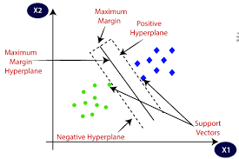
Applying Machine Learning- Support Vector Machine
SVM creates a hyperplane that separate two classes. It can create a hyperplane or set of hyperplane in high dimensional space. This hyper plane can be used for classification or regression also. SVM differentiates instances in specific classes and can also classify the entities which are not supported by data. Separation is done by through hyperplane performs the separation to the closest training point of any class.

Slide 9
Model Building
Step1: Import required libraries, Import diabetes dataset.
Step2: Pre-process data to remove missing data.
Step3: Perform percentage split of 80% to divide dataset as Training set and 20% to Test set.
Step4: Select the machine learning algorithm i.e. Support Vector Machine.
Step5: Build the classifier model for the mentioned machine learning algorithm based on training set.
Step6: Test the Classifier model for the machine learning algorithm based on test set.

Slide 10
Result Analysis
To analyze the performance of the classification, the accuracy and AUC measures are adopted. Four cases are considered as the result of the classifier.
TP(True Positive): The number of examples correctly classified to the class.
TN(True Negative): The number of examples correctly rejected from the class.
FP(False Negative): The number of example incorrectly rejected from the class.
FP(False Positive): The number of example incorrectly classified to that class.
The Accuracy, sensitivity and specificity of the system is given by:

Slide 11

Accuracy = $\frac{TP+TN}{TP+TN+FP+FN}$ = 78%
Sensitivity = $\frac{TP}{TP+FN}$= 80%
Specificity = $\frac{FP }{FP+TN}$ = 76.5%

Slide 12
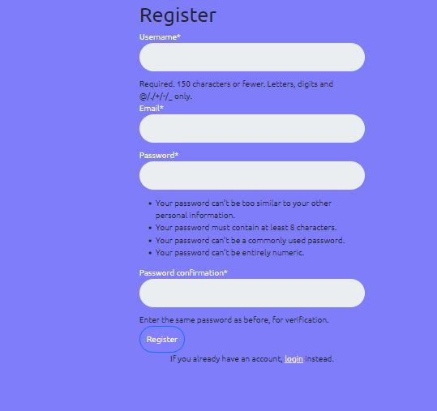
Register

Slide 13

Login

Slide 14
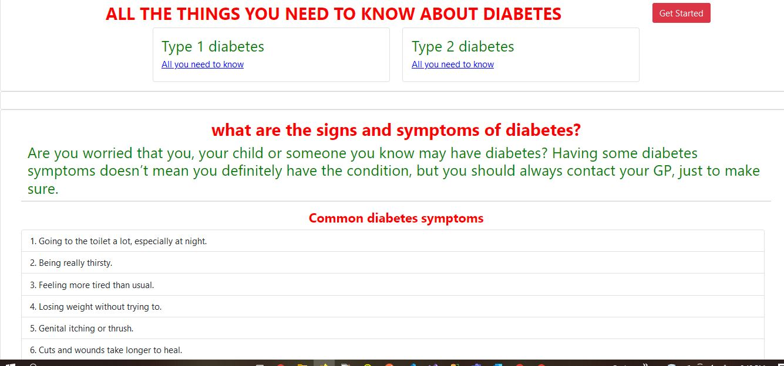
Home

Slide 15
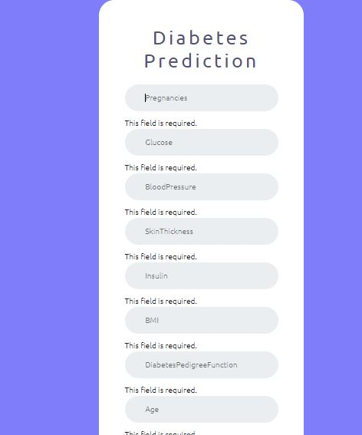
Prediction

Slide 16
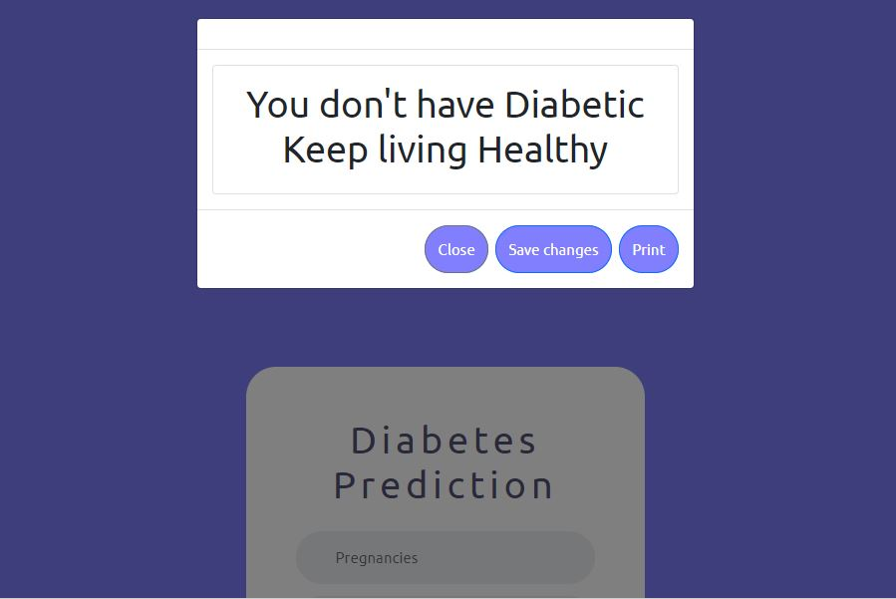
Output

Slide 17
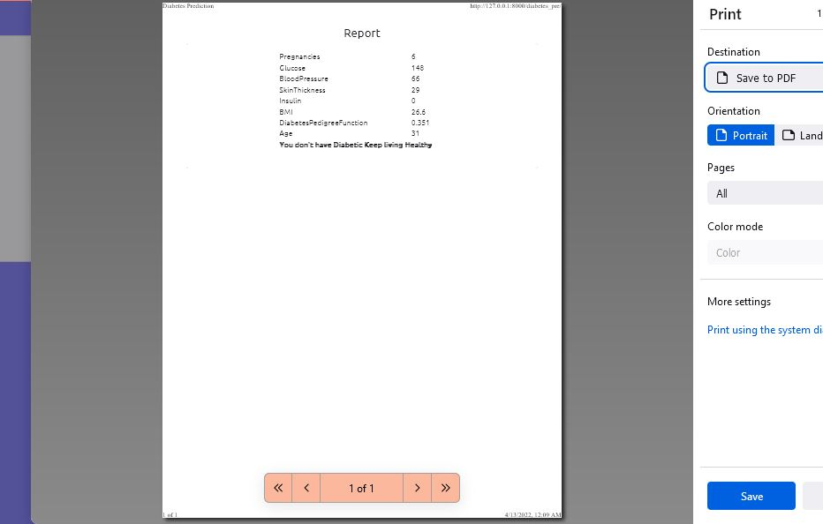
Billing

Slide 18
Conclusion
The main aim of this project was to design and implement Diabetes Prediction Using Machine Learning Methods and Performance Analysis of that methods and it has been achieved successfully. The proposed approach uses classification SVM and 78% classification accuracy has been achieved. The Experimental results can be assist health care to take early prediction and make early decision to cure diabetes and save humans life.

