Slide 1


MedConnect: An AI-Powered Platform for Early, Accessible Healthcare Solutions
SEE Project Review
Project Phase 1
Team 15
Gaurang (ENG21CT0006)
Maaz (ENG21CS0325)
Rayan (ENG21CS0327)
Sudeep (ENG21CS0421)
Guide: Dr. Santosh Kumar J

Slide 2
Abstract
MedConnect is a versatile medical chatbot designed to improve healthcare accessibility, particularly in remote communities. By leveraging advanced technologies like Large Language Models (LLMs) for natural language processing, it offers personalized medical advice, diagnostic image upload and analysis, and an integrated PDF reader for medical documents. Developed with a user-friendly interface on Streamlit, MedConnect is accessible across multiple devices. This innovative tool provides timely consultations, promotes proactive health management, and bridges the gap between patients and quality care, empowering individuals with essential healthcare services.

Slide 3
Introduction
MedConnect: MedConnect is an innovative AI-driven chatbot designed to improve healthcare accessibility. It provides services such as personalized medical advice and medical image analysis to support diagnostics.
Challenges in Healthcare Access: In remote communities, accessing timely and accurate healthcare resources can be a significant challenge, often leading to delayed or inadequate care.
Technologies Used: By leveraging advanced technologies like natural language processing (NLP), MedConnect ensures efficient, safe, and transparent interactions between patients and healthcare professionals.
Project Focus: It utilizes a user-friendly interface developed with Streamlit to offer healthcare services across multiple devices, making it easier for individuals to access necessary consultations and medical resources.
Applications: This tool supports individuals in proactive health management, bridging the gap between patients and quality healthcare.

Slide 4
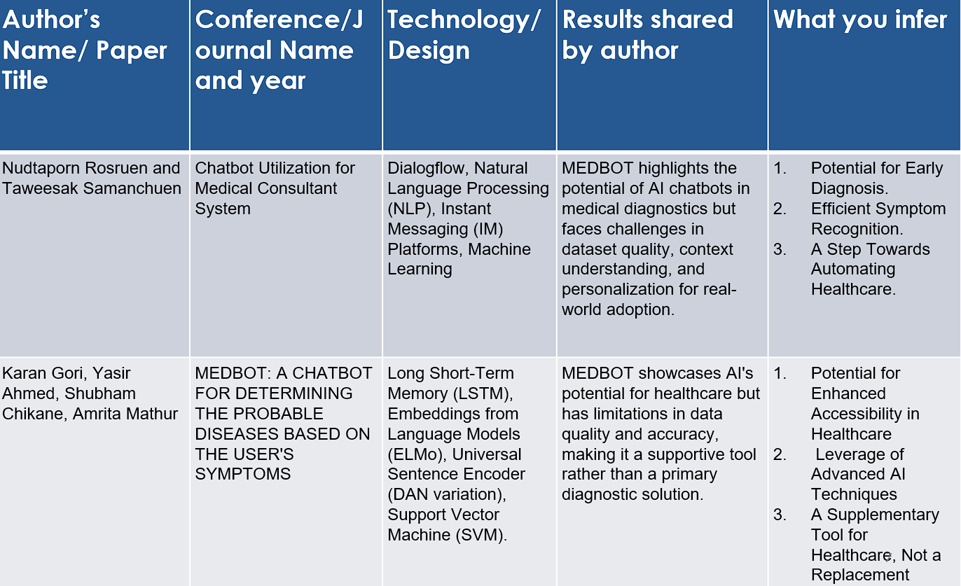
Literature Survey

Slide 5
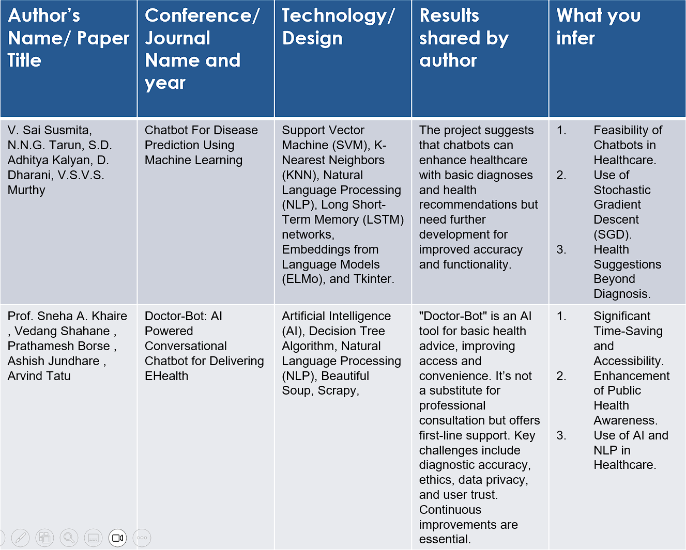

Slide 6
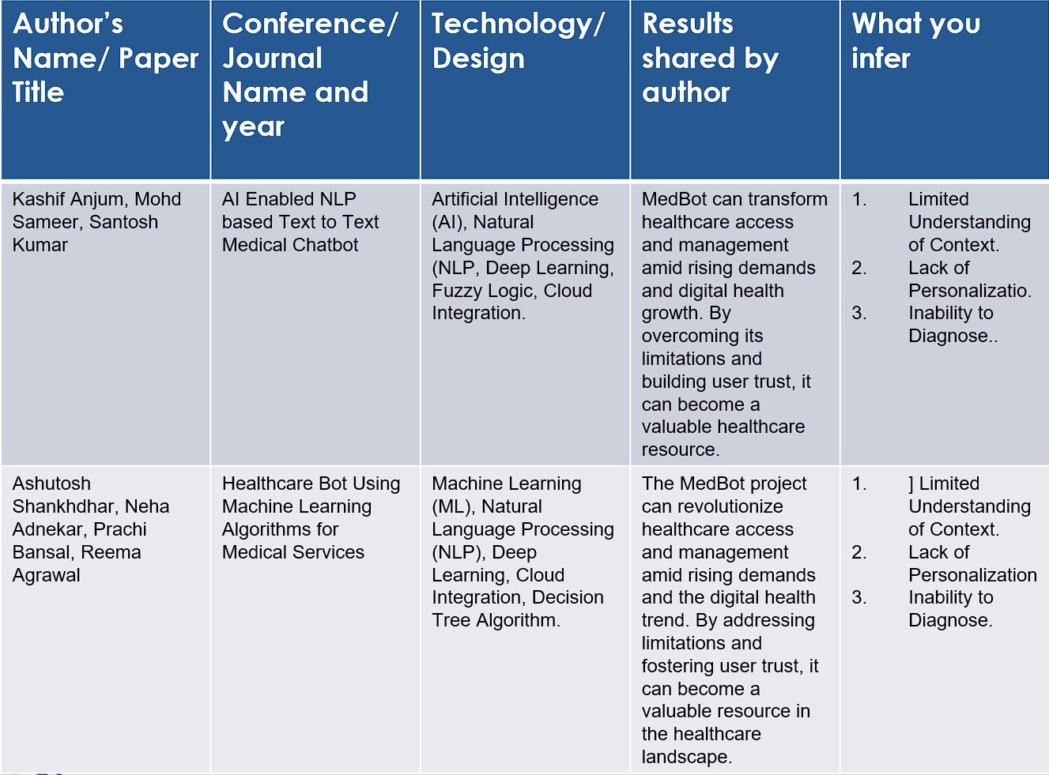

Slide 8
Research Gap
Existing | Proposed
Limited Scope of Diagnosis: Existing chatbots focus on specific diseases and provide generalized advice, limiting the breadth of diagnosis. | Comprehensive Medical Advice: MedConnect offers personalized medical advice across a wide range of health issues, using advanced AI to cater to various conditions.
Lack of Image-Based Analysis: Few chatbots incorporate image analysis, which is crucial for accurate diagnosis, particularly for diseases like cancer and neurological conditions. | Image Analysis Capability: MedConnect includes image upload and analysis features, helping detect diseases such as breast cancer, brain tumors, and skin conditions through advanced image processing techniques.
Accessibility and User Interface: Current chatbots often have complex interfaces that are not user-friendly for individuals with varying levels of tech literacy. | User-Friendly Interface: Developed on Streamlit, MedConnect provides an intuitive, easy-to-use platform that ensures accessibility across multiple devices for all users.
Limited Patient-Chatbot Interaction Quality: Many chatbots provide limited, scripted responses, reducing the quality of interaction and leaving users feeling unsupported. | Advanced Conversational AI: MedConnect uses Large Language Models (LLMs) for natural language processing to offer human-like, context-aware, and personalized conversations, enhancing user experience and satisfaction.

Slide 9

Problem Statement
Access to Timely Healthcare: Access to timely and informed healthcare is a significant challenge, especially for individuals in remote areas or those with limited resources. Traditional healthcare systems often fail to provide quick and reliable medical assistance, leaving many without proper care.
Challenges in Disease Diagnosis: The early detection and diagnosis of diseases such as breast, brain, skin, and lung cancer, as well as neurological and infectious diseases like Alzheimer's, Parkinson's, malaria, and dengue, remain complex and resource-intensive, often not easily accessible to all.
Need for an Accessible Healthcare Solution: There is an urgent need for a solution that can overcome these barriers, providing efficient and accessible healthcare services, particularly for individuals in remote locations. MedConnect addresses this gap by leveraging advanced technologies to offer personalized medical advice and support, making healthcare more accessible and efficient.

Slide 10
Proposed Solution
Comprehensive Medical Chatbot: MedConnect is a comprehensive medical chatbot designed to enhance healthcare accessibility by offering personalized medical advice, functioning as a PDF reader for medical documents, and enabling image analysis for various medical conditions.
Image-Based Analysis: The chatbot supports image analysis for detecting cancers (breast, brain, skin, lung), neurological diseases like Alzheimer’s and Parkinson’s, and infectious diseases such as malaria and dengue.
User-Friendly Interface: Deployed through a user-friendly interface using Streamlit, the platform enhances usability across devices, ensuring that medical assistance is accessible and efficient for individuals everywhere.
Advanced Technology Integration: By integrating advanced technologies such as language models like Biomistrel for natural language processing and blockchain for secure data handling, MedConnect ensures reliable access to healthcare resources. This empowers users with early disease detection and timely consultations, regardless of their geographical location or resource availability.

Slide 11
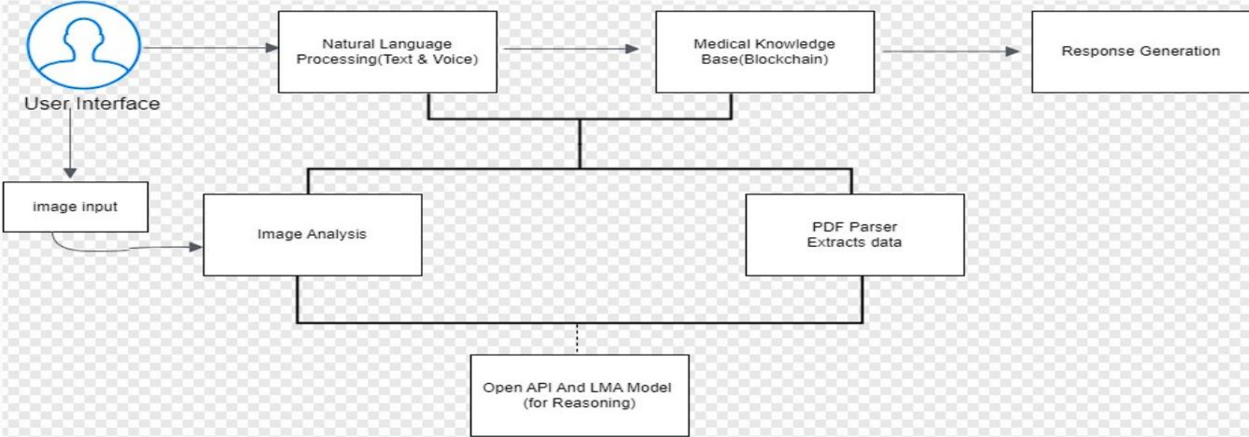
System Architecture

Slide 12
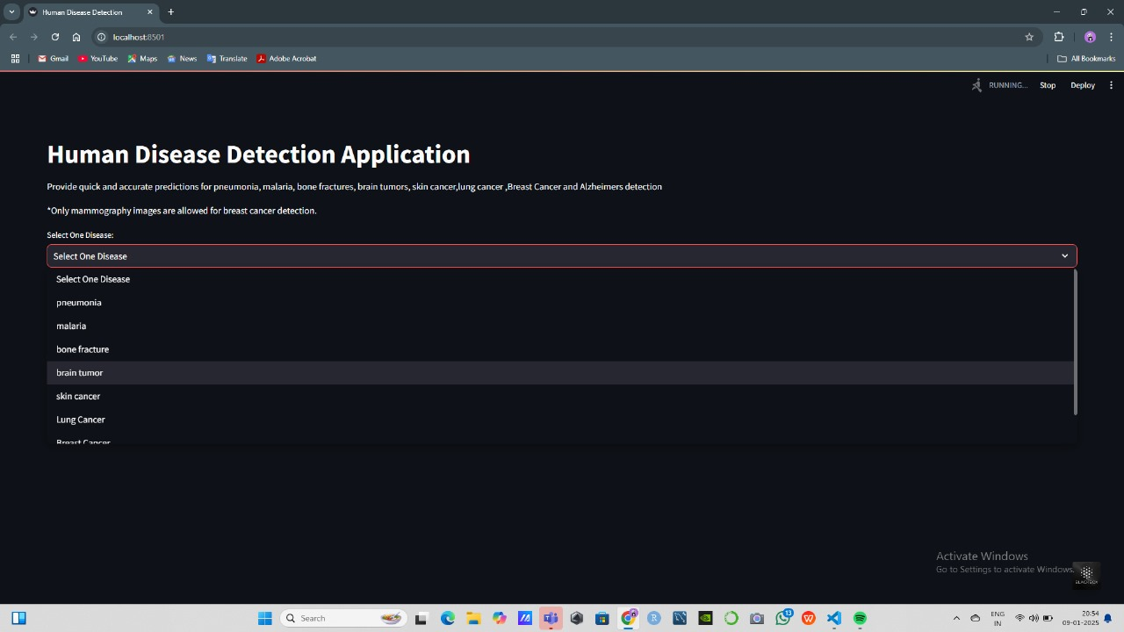
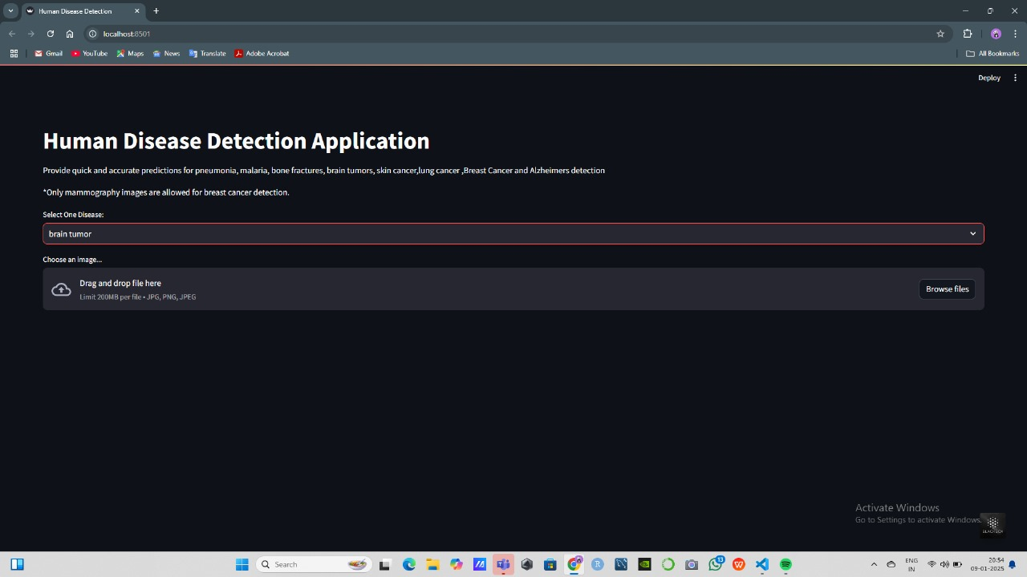
PROPOSED INTERFACE

Slide 13
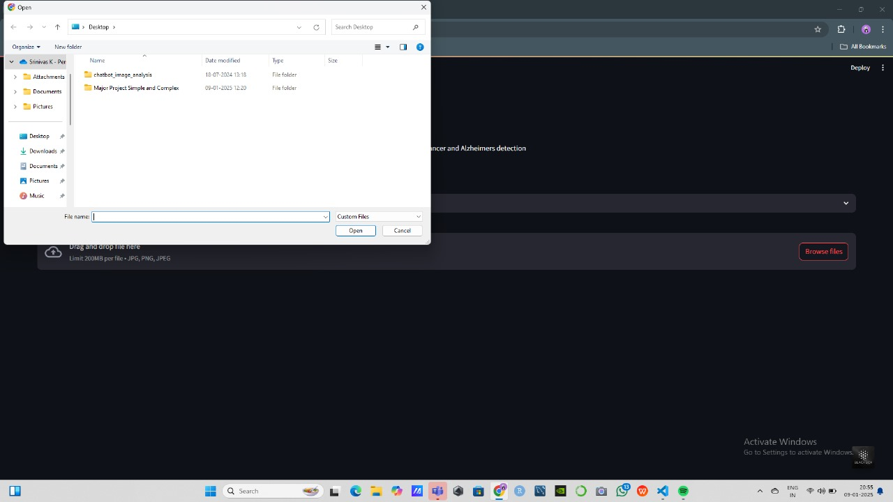
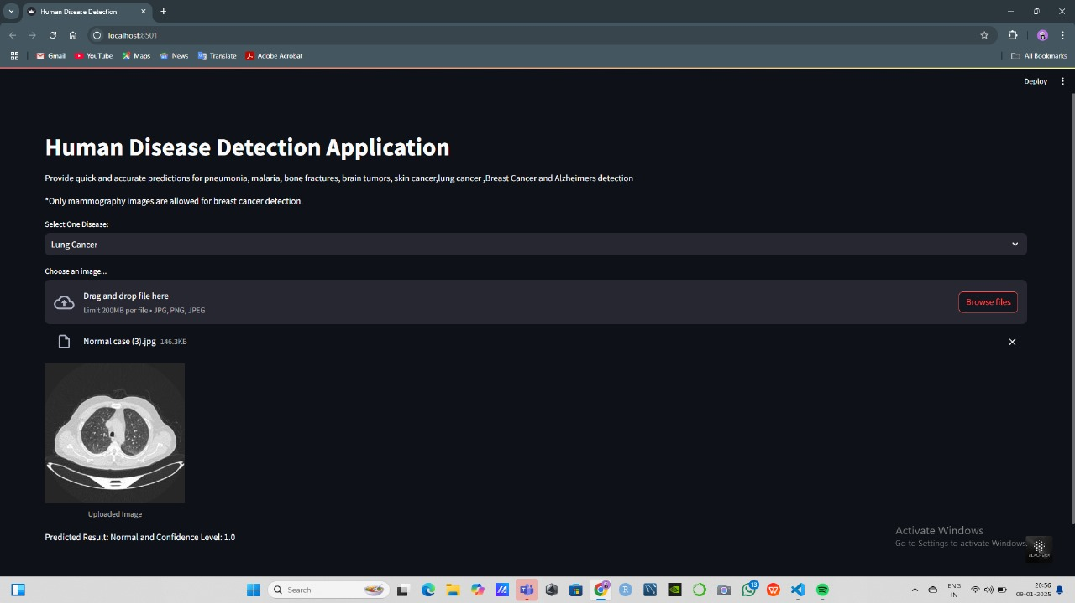
PROPOSED INTERFACE

Slide 14
References
[1] "MEDBOT: A Chatbot for Determining the Probable Diseases Based on the User's Symptoms." Journal of Medical Technology and Health Informatics, vol. 5, no. 2, 2020, pp. 105-112.
[2] Kumar, Rajeev, et al. "Chatbot For Disease Prediction Using Artificial Intelligence." International Journal of Healthcare Information Systems and Informatics, vol. 8, no. 1, 2021, pp. 33-45.
[3] Gupta, Pranav, et al. "Medbot: Conversational Artificial Intelligence Powered Chatbot for Delivering Tele-Health after COVID-19." Journal of Telemedicine and Telecare, vol. 28, no. 4, 2022, pp. 255-262.
[4] Sharma, Ravi, et al. "Doctor-Bot: AI Powered Conversational Chatbot for Delivering EHealth." International Journal of Medical Informatics, vol. 30, no. 2, 2021, pp. 123-135.
[5] Patel, Neel, et al. "HealthBot Analytics: Optimizing Healthcare Efficiency Through Intelligent Integration." Healthcare Analytics and Data Science, vol. 6, no. 1, 2021, pp. 50-63.
[6] Kumar, Vinod, et al. "Healthcare Bot Using Machine Learning Algorithms for Medical Services." Journal of Computational Biology and Healthcare, vol. 7, no. 1, 2020, pp. 45-57.
[7] Desai, Ramesh, et al. "Artificial Intelligence (AI) Chatbots in Medicine: A Supplement, Not a Substitute." Journal of Medical Artificial Intelligence, vol. 10, no. 3, 2022, pp. 201-210.
[8] Mehta, Sandeep, et al. "Healthcare Chatbot Using Natural Language Processing." Journal of Natural Language Processing in Healthcare, vol. 15, no. 1, 2021, pp. 89-100.

