Slide 1

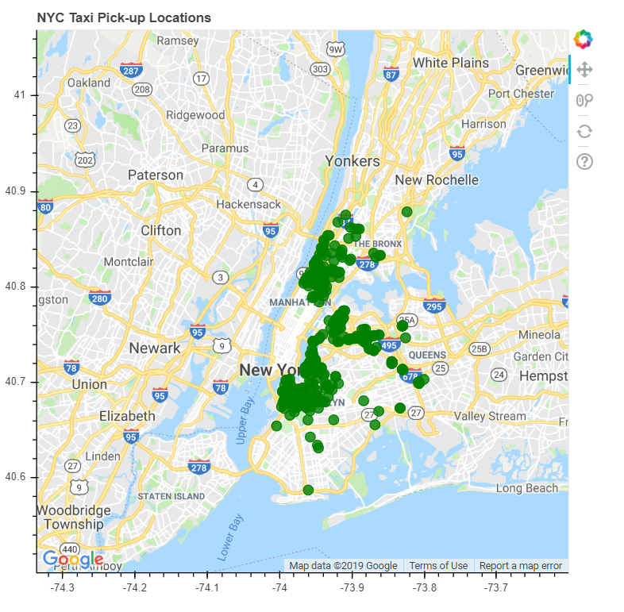
Bokeh Gmap Plot

Slide 2
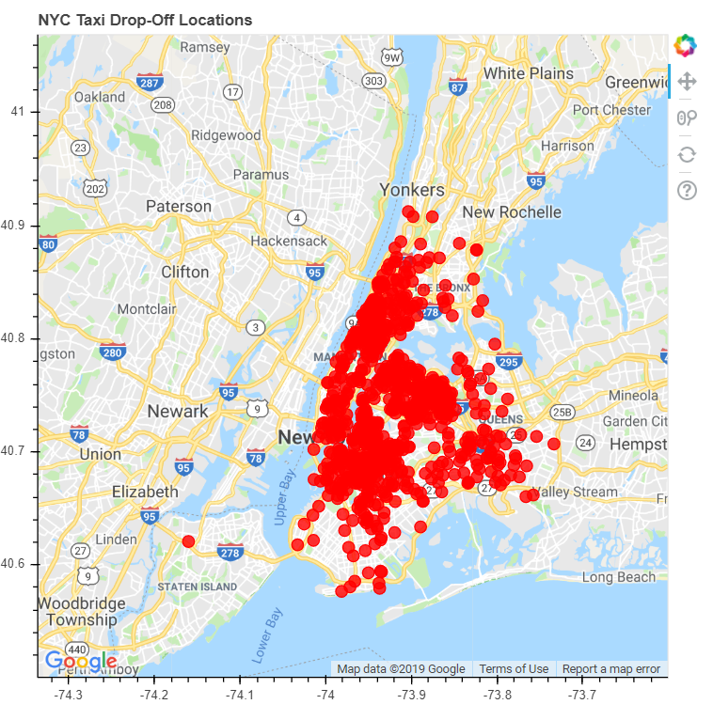
Bokeh Gmap Plot

Slide 3
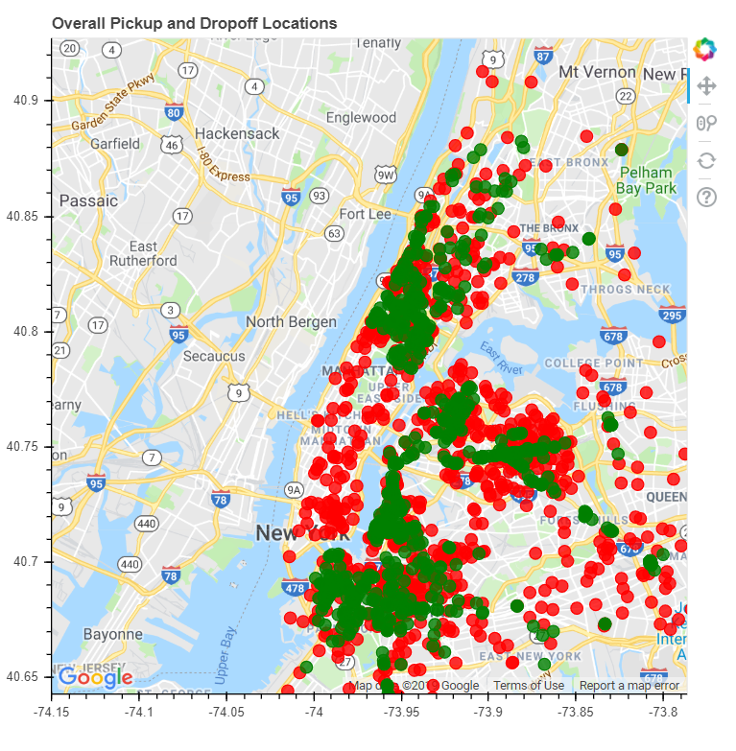
Bokeh Gmap Plot
Inference:
The majority of taxi action happens on the island of Manhattan. And La Guardia Airport and JFK airports are popular pickup spots. Hence, that is the reason which Pick-up and Drop-offs are more concentrated in these zones.

