Slide 1
Data Pipeline and Processing/Visualization NYC Taxi Trips
Gaurang Sharma (11012446)
Chinmoy Sarangi (11012375)

Slide 2
Basic Architecture
Four Phases:
Ingestion
Storage
Processing
Visualization

Slide 3














Architecture: Components
Ingestion
Storage
Processing
Visualization
Four Phases:
Ingestion
Storage
Processing
Visualization

Slide 4

Ingestion
File was downloaded from
the NYC Taxi Trips Website
Stored Locally for faster access
Accessed and Read using Pandas and
Extracted into a DataFrame
Extracted data is exported into Mongo
Using Pymongo module

Slide 5
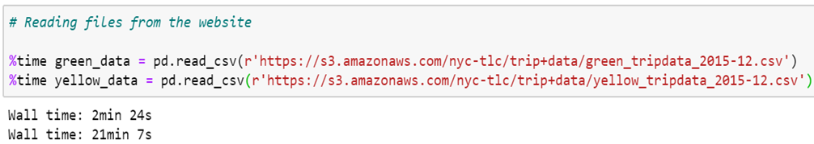
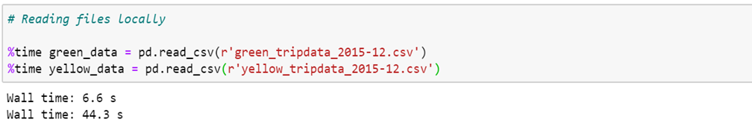
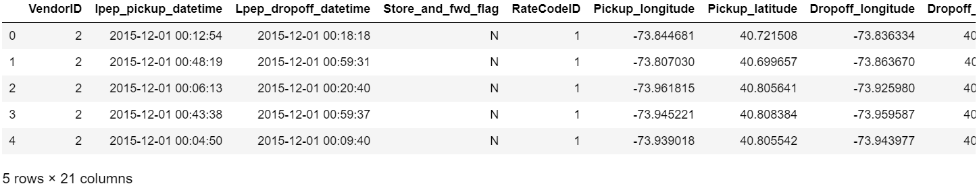
Ingestion

Slide 6
Storage
Extracted data exported into MongoDB
using Pymongo queries
Data is now available for further queries
Data gets queried through Pymongo
module
Extracted into a Pandas DataFrame

Slide 7
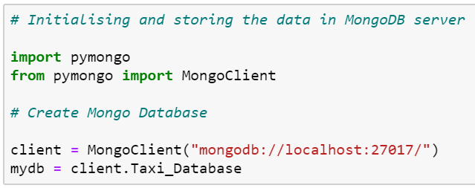
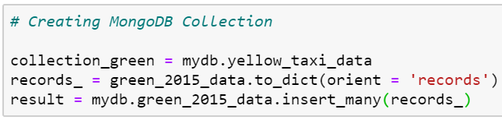
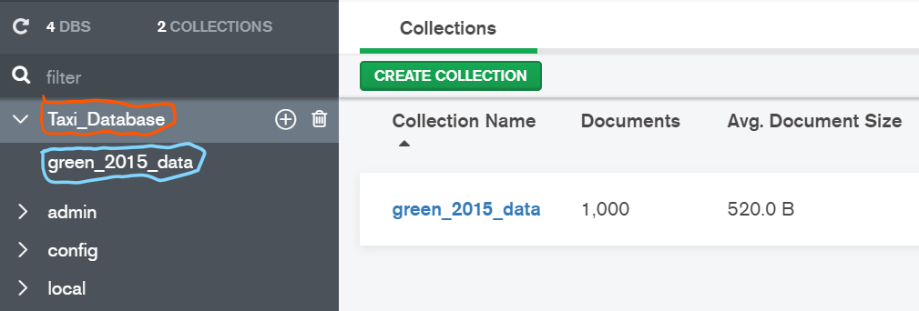
Storage
Creates the MongoDB Database
Taxi_Database
Creates the collection named
green_2015_data

Slide 8
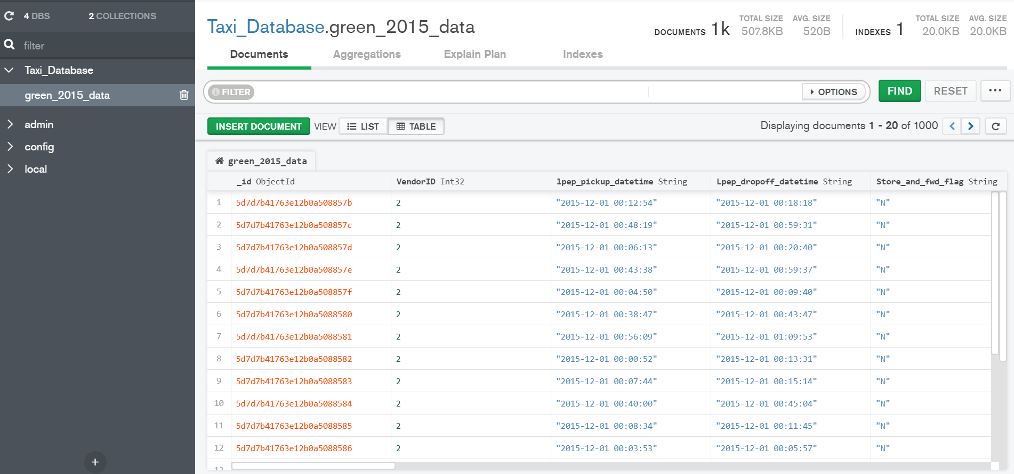
Storage

Slide 9
Processing
Extracted data from MongoDB
using Pymongo queries
Data is now available for further queries
Data gets queried through Pymongo
module
Extracted into a DataFrame

Slide 10
Visualization
Bokeh
Data is now available for further queries
Data gets queried through Pymongo
module
Extracted into a DataFrame

