Slide 1
Data Pipeline and Processing/Visualization NYC Taxi Trips
Gaurang Sharma (11012446)
Chinmoy Sarangi (11012375)

Slide 2
Business Questions
Where is the highest pickup and drop and what could be the reasons?
Which attributes have the highest or lowest dependency on other attributes?
What days have highest tip amounts and is it depending on duration/distance?
What could be the rush hours?
Which day had the highest number of trips?

Slide 3
Basic Architecture
Four Phases:
Ingestion
Storage
Processing
Visualization

Slide 4














Architecture: Components
Ingestion
Storage
Processing
Visualization
Four Phases:
Ingestion
Storage
Processing
Visualization

Slide 5

Ingestion
File was downloaded from
the NYC Taxi Trips Website
Stored Locally for faster access
Accessed and Read using Pandas and
Extracted into a DataFrame
Extracted data is exported into Mongo
Using Pymongo module

Slide 6
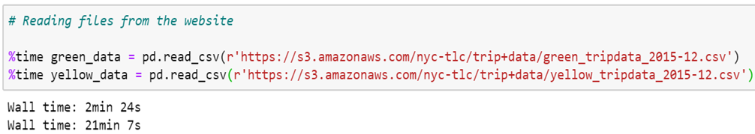
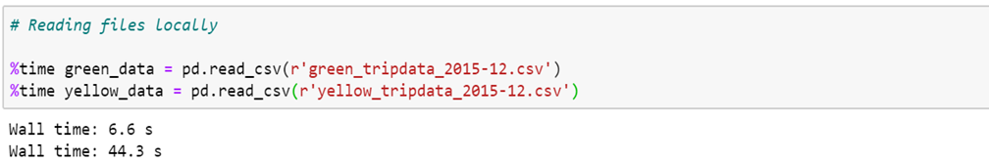
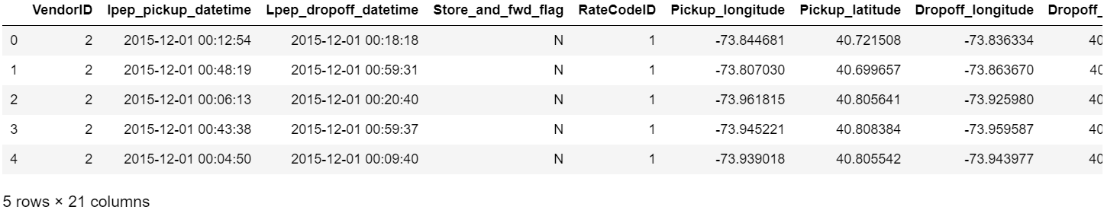
Ingestion

Slide 7
Storage
Extracted data exported into MongoDB
using Pymongo queries
Data is now available for further queries
Data gets queried through Pymongo
module
Extracted into a Pandas DataFrame

Slide 8
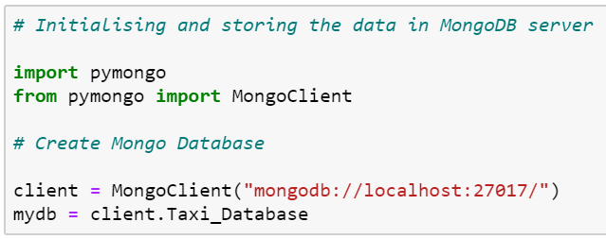
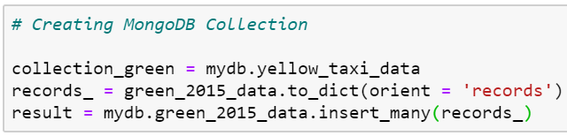
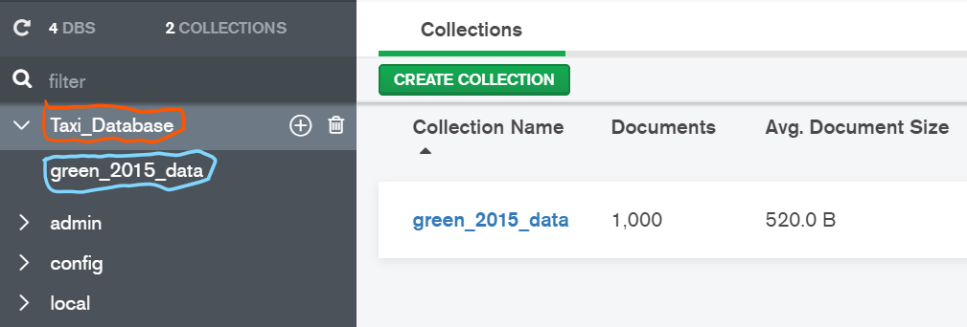
Storage
Creates the MongoDB Database
Taxi_Database
Creates the collection named
green_2015_data

Slide 9
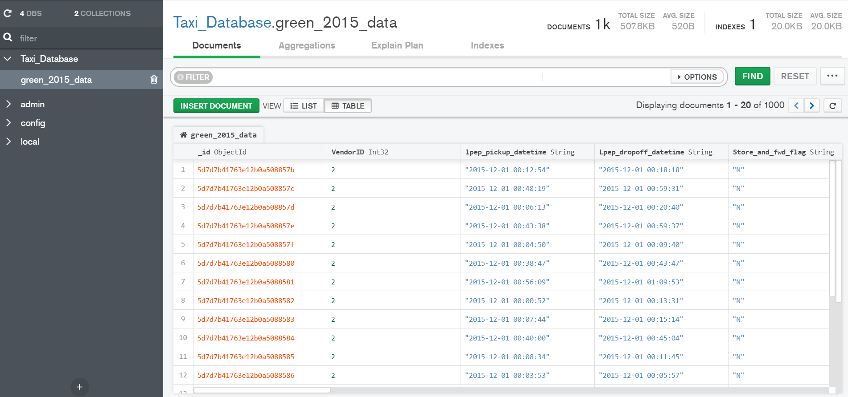
Storage

Slide 10
Processing
Extracted data from MongoDB
using Pymongo queries
Data is then processed and analysed
for inferences
Correlation between variables is checked

Slide 11
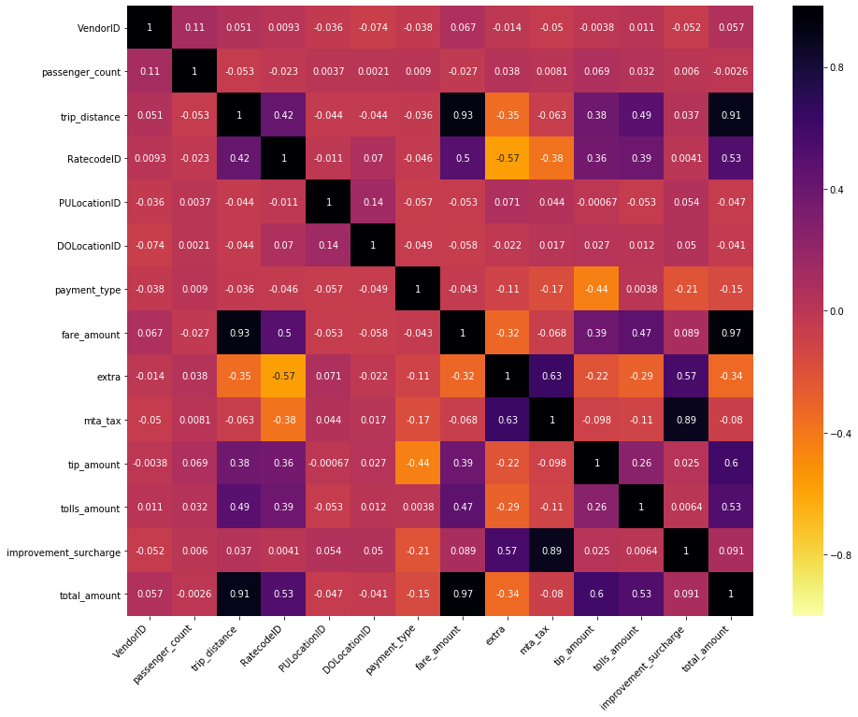
Processing
Correlation Heatmap
Fare amount increases with trip distance.
Tip depends on distance and the total amount.
Payment Type is almost equal between cash and card.

Slide 12
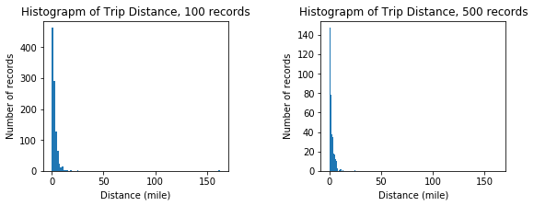
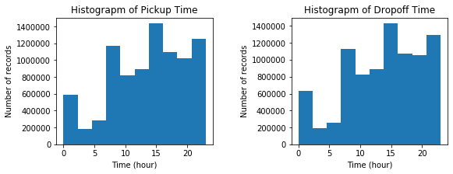
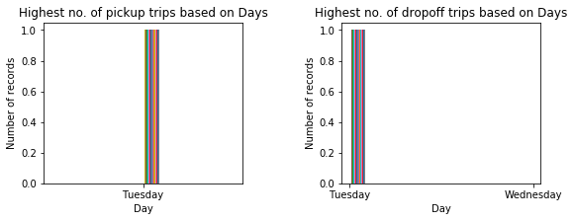
Processing
Mini plots for Processing/Analysis
Most trips are for short distances.
3 – 4 PM is the peak hour for pickups and drops.
Tuesday is the busiest day of the week and also awards highest amount of tips to the taxi drivers due to duration of the trips.

Slide 13
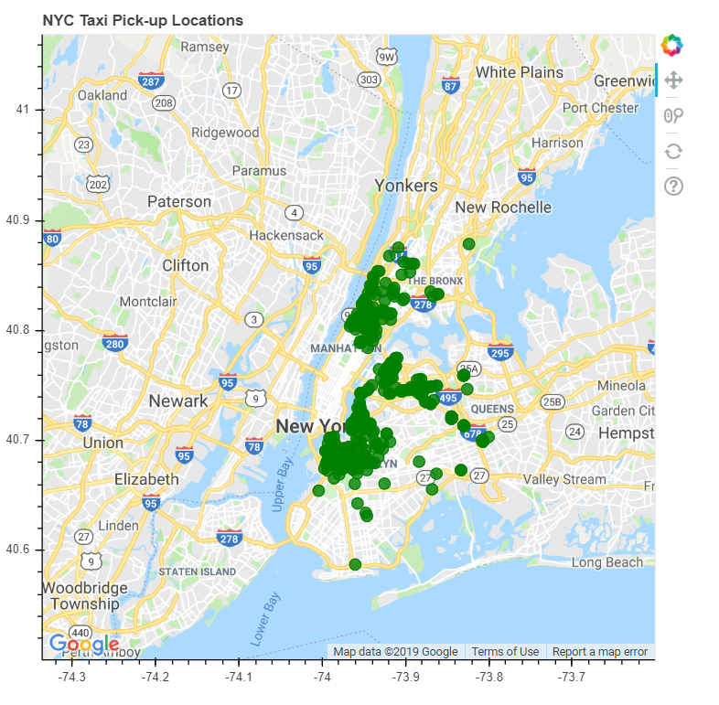
Visualization
Bokeh Gmap Plot

Slide 14
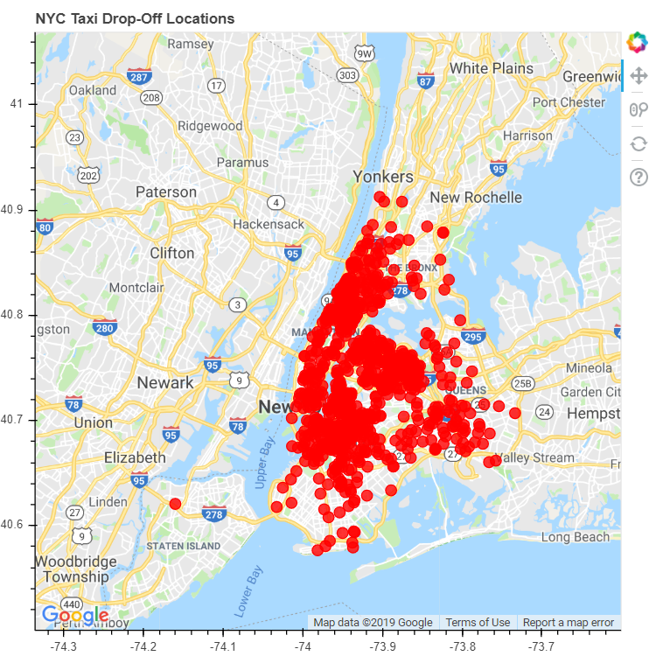
Visualization
Bokeh Gmap Plot

Slide 15
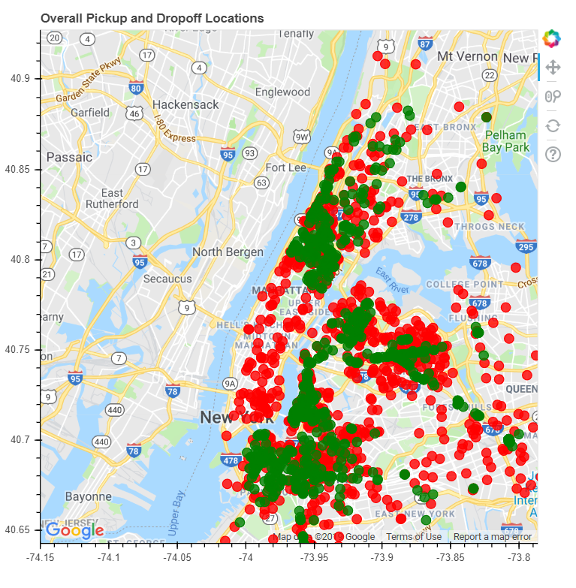
Visualization
Bokeh Gmap Plot
Inference:
The majority of taxi action happens on the island of Manhattan. And La Guardia Airport and JFK airports are popular pickup spots. Hence, that is the reason which Pick-up and Drop-offs are more concentrated in these zones.

Slide 16
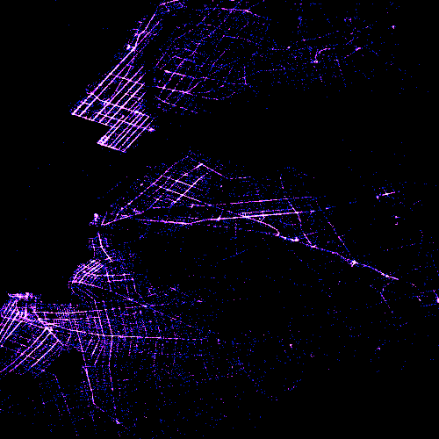
Visualization
All Taxi Pickups

Slide 17
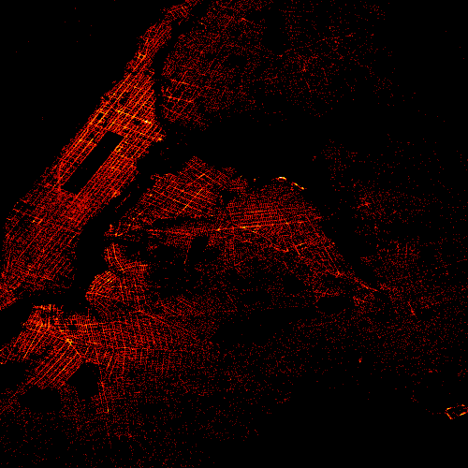
Visualization
All Taxi Drops

Slide 18


