Slide 1
Project Overview
The project provides a modern, user-friendly platform for customers to browse, book, and manage car rentals, and for administrators to manage inventory and bookings.
The solution leverages a React frontend, a Spring Boot backend, and a MySQL database, with secure authentication and robust error handling. This document details the system’s architecture, features, database design, implementation and future enhancement opportunities.

Slide 2
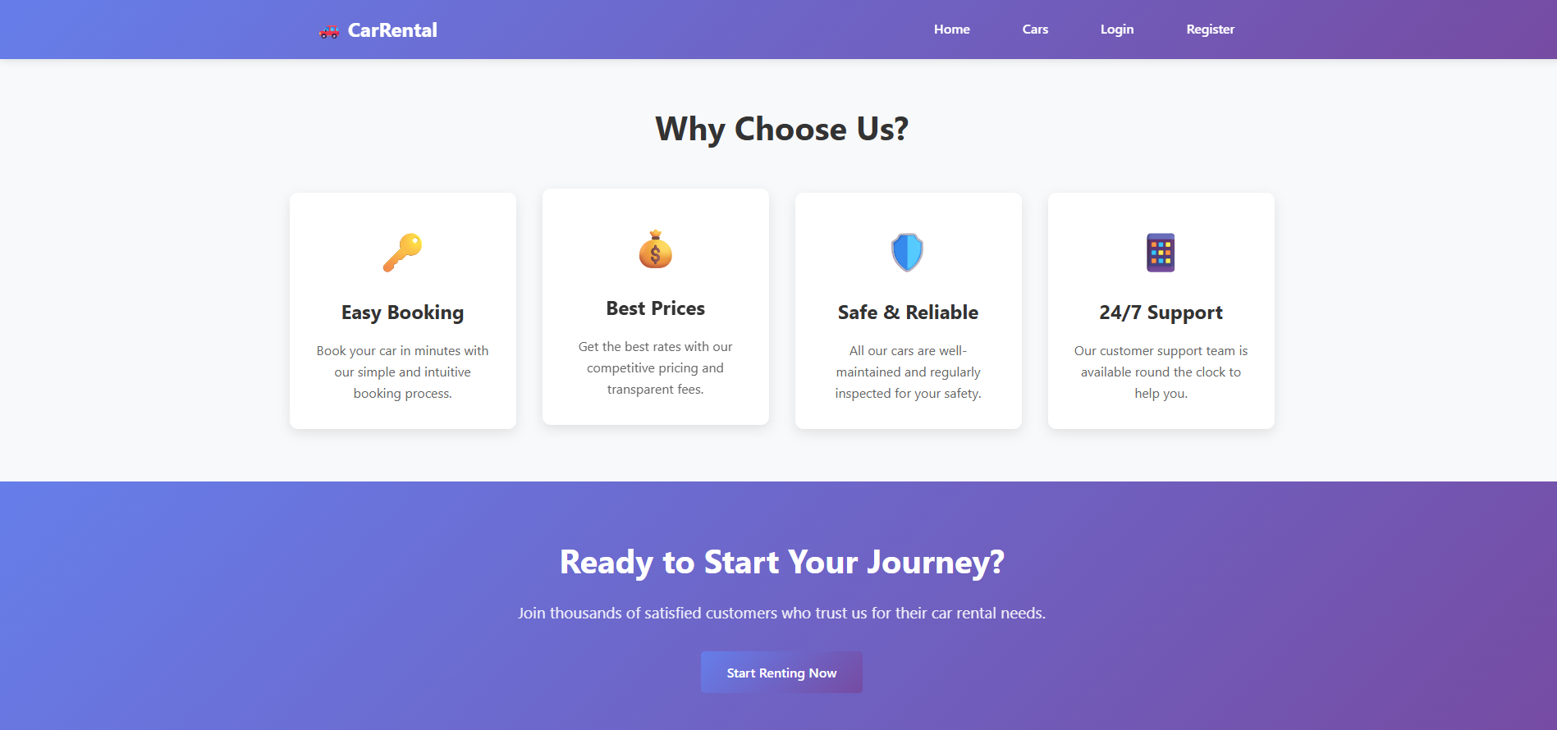
Can we start our Presentation with Car Renting Now?

Slide 3
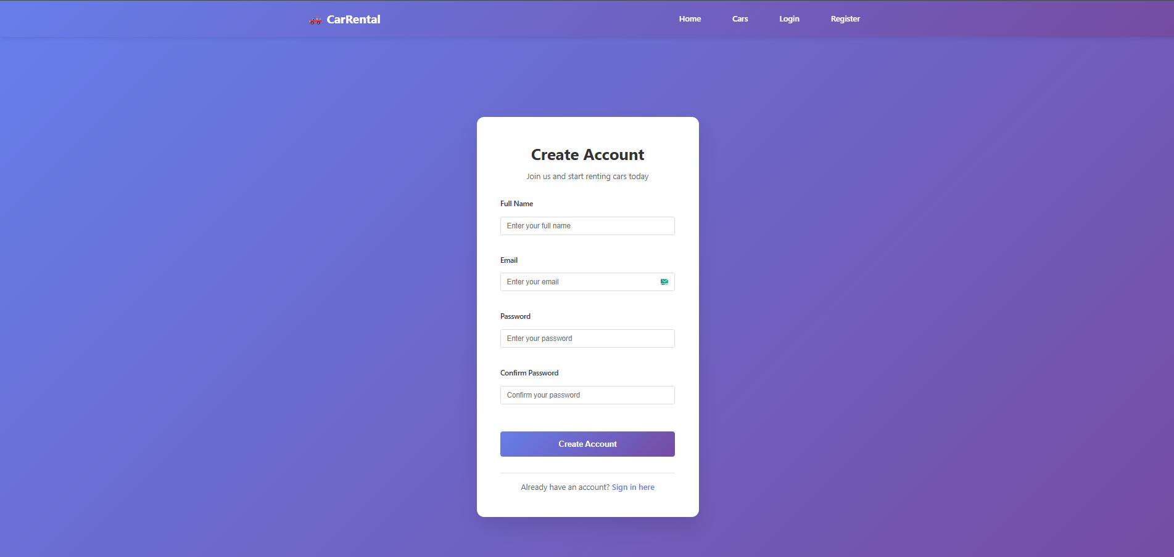
Register Page
In this page user can register with the mandatory details like Name, Email and password

Slide 4
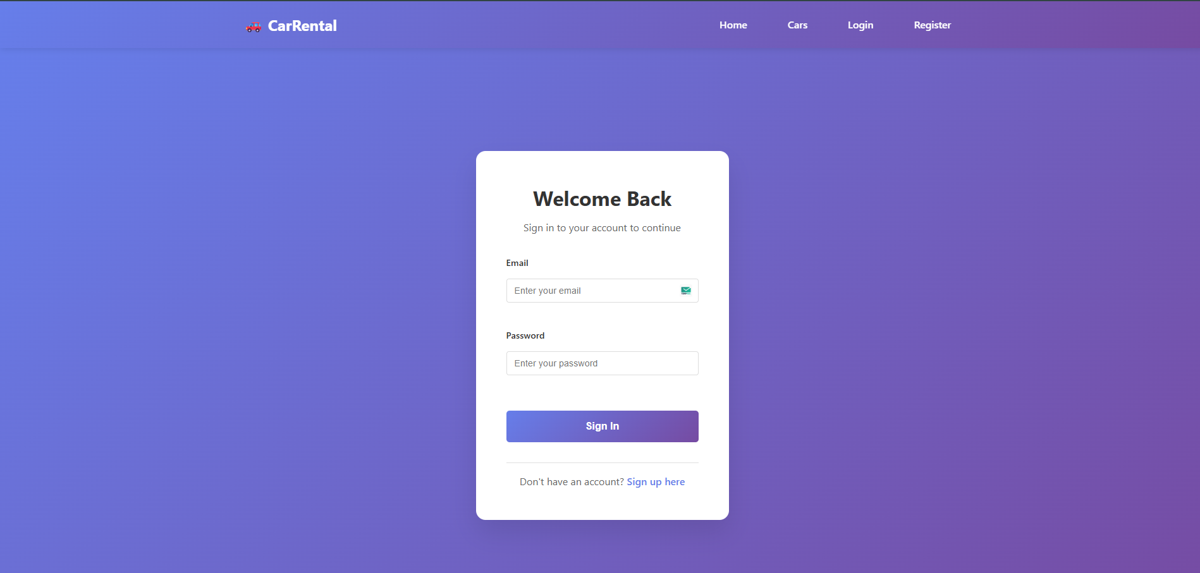
Login Page
After successfully register the User is able to login with the correct credentials.

Slide 5
Admin Dashboard
After succsfully login user is redirecting to the Dashbaord page and in this page Total Cars, Total Booking and Total Pending Booking are shown
Admin manage the cars and booking with the Manage cars & Manage booking section

Slide 6
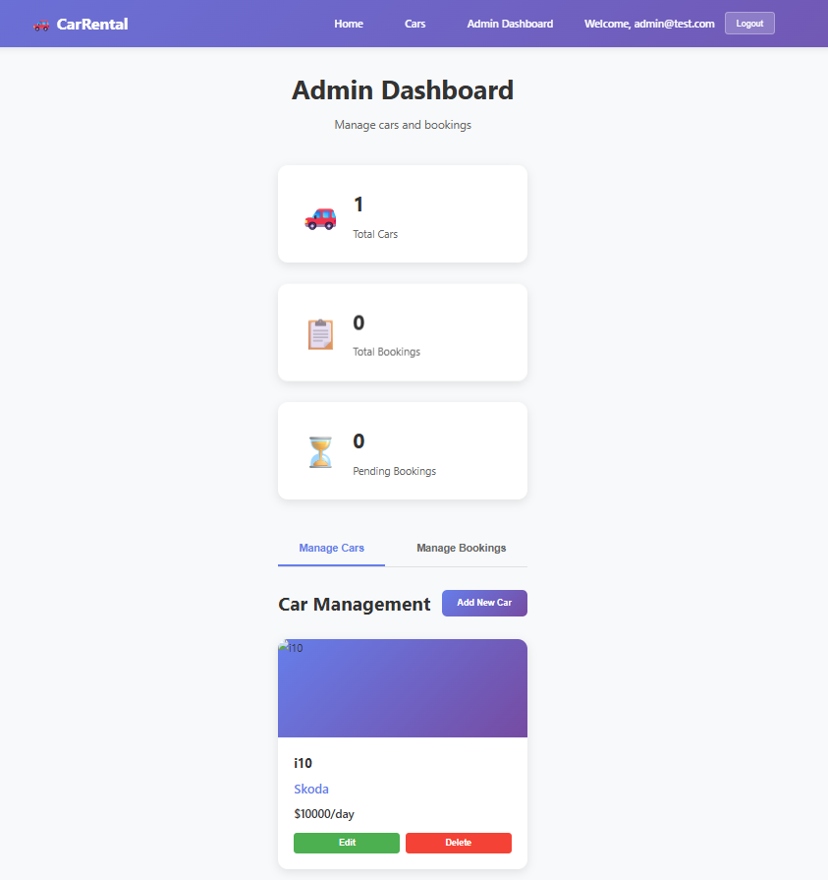

Slide 7
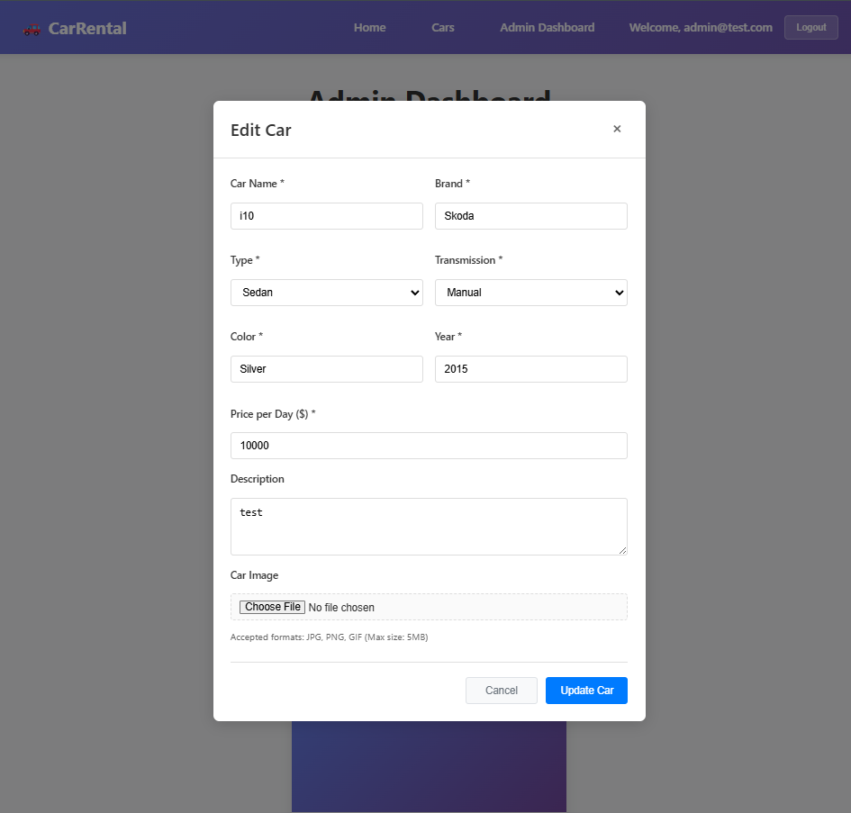
Edit car
In this page user are edit the previous car details.

Slide 8
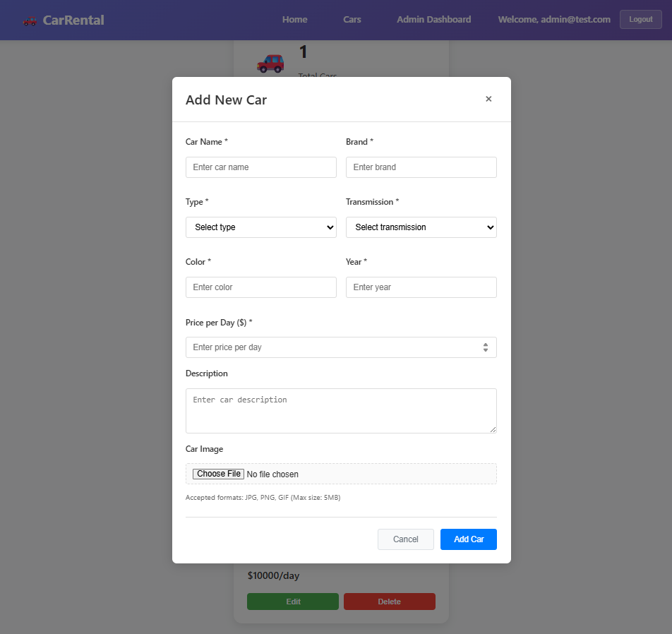
Add New Car
In this page user are fill the Cars details which has published to the customer with the images

Slide 9
Customer User
Customer is register and login with the same page we discuss earlier in this PPT
After login the customer is redirecting to the Dashboard page and in this page for the customer have two tabs which is car and MY booking.

Slide 10
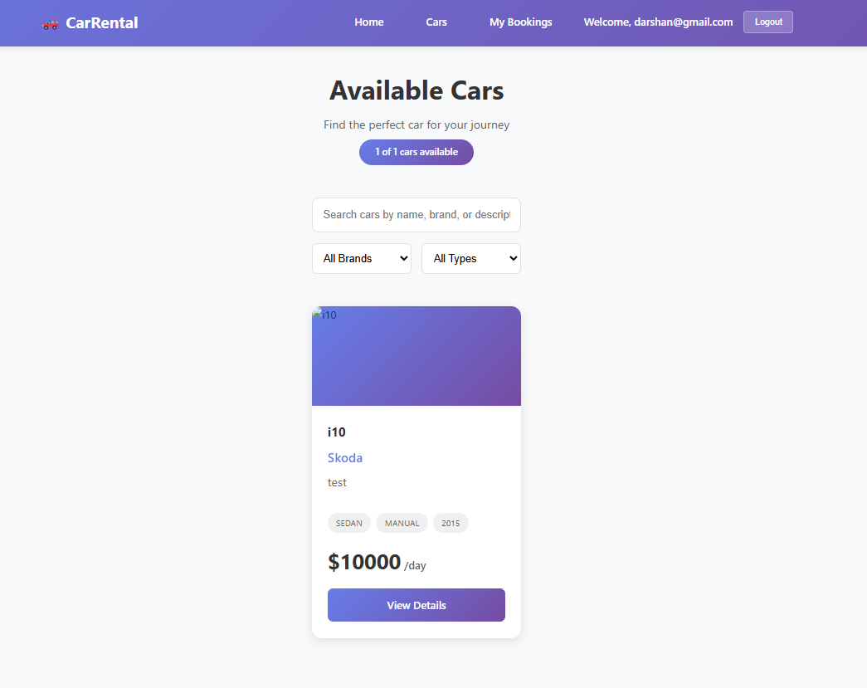
Available car
In this section customer is able to the shown the available total cars with the details and book a car

Slide 11
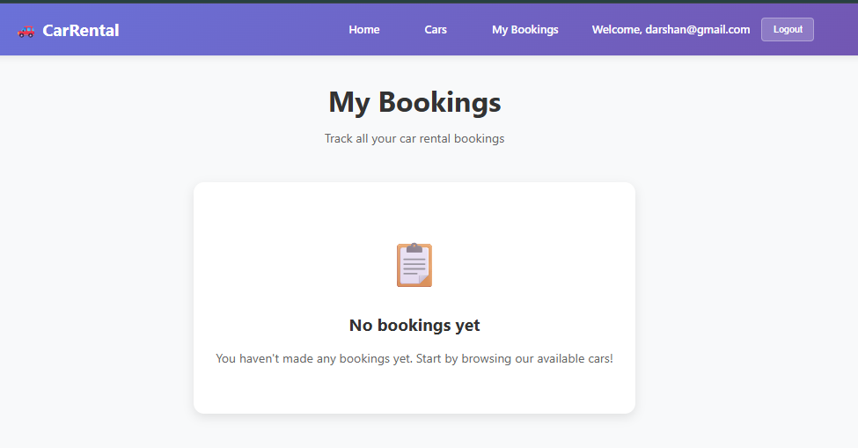
Booking history
In this section Customer booking history is avavalible.

Slide 12
Thank You!
Car Rental System
By: GAURANG DALVADI & DARSHAN KALATHIYA
Questions & Discussion

