Slide 1
CALL CENTER CASE STUDY
Case Study Based on CallIn Call Centre and Royal Bank of Scotland
Old Data Irregularity Audit by Brent Associates
PART 2

Slide 2
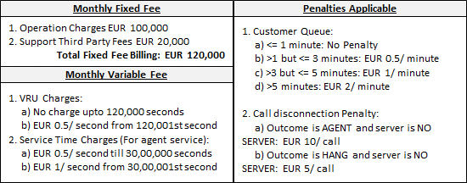
Main Task
To verify if the given calculation is correct according to agreed terms of contract:

Slide 3
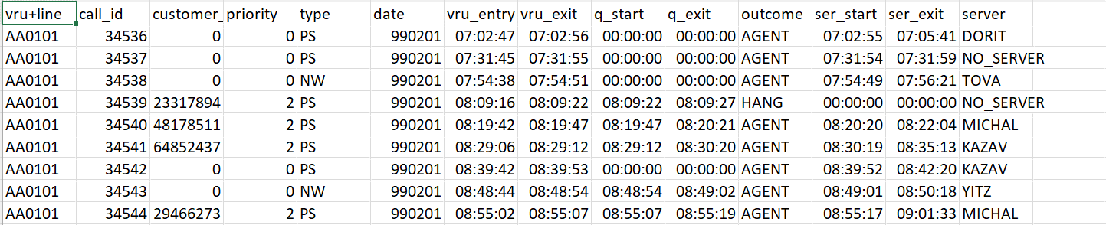
Additional Questions
Q1. In given document, CallIn PLC has claimed the employees were recruited in 2 shifts with each shift having total of 13 agents and 1 shift-supervisor. You see an inconsistency in these figures. Chose the correct option from below:
You don’t see any inconsistency and data is correct
Count of employees is 25
Count of employee is 23
Count of employees is 24

Slide 4
Additional Questions
Q2. How many calls for internet consulting were hung up by customer despite the availability of a server:
10
94
0
17
Hint: Server != No_Server AND outcome == Hang

Slide 5
Additional Questions
Q3. How many Phantom Calls were assigned to the agents?
0
11
278
94
Hint: Server != No_Server AND outcome == Phantom

Slide 6
Additional Questions
Q4. Which agent has the highest average service time?
Pinhas
Eli
Avidnan
Avni
Hint: service_time average

Slide 7
Additional Questions
Q5. Which agent has the least number of calls assigned?
Idit
Tova
Gelber
Pinhas
Hint: count of number of calls assigned to each agent

Slide 8
Additional Questions
Q6. Which agent’s customers had to wait for the longest in order to speak to the agent?
Naama
Pinhas
Gelber
Darmon
Hint: Find q_time for each server

Slide 9
Additional Questions
Q7. Based on description of data, queuing time of Phantom calls should be the highest. Is this assumption correct?
Yes
No
Hint: Find q_time average for each outcome

Slide 10
Additional Questions
Q8. Which of the following customers has made maximum number of calls (Chose customer ID)?
101030
58704610
7191646
57918849
Hint: group by/ pivot

Slide 11
Additional Questions
Q9. Calls from which of the following customers have been tagged as Phantom calls most number of times (Chose customer ID)?
13408620
24442634
54613724
25627027
Hint: groupby customer id/ pivot

Slide 12
Additional Questions
Q10. What percentage of high priority customer calls have been hung?
9.97%
19.88%
20.79%
11.02%
Hint: count(priority == 2 AND outcome== Hang)

Slide 13
Additional Questions
Q11. How many high priority customer calls have been tagged as Phantom?
0.3%
2.4%
1.2%
0.8%
Hint: count(priority == 2 AND outcome== Phantom)

Slide 14
Additional Questions
Q12. Queuing time of high priority customers is shortest.
True
False
Hint: Average of q_time by priority

Slide 15
Additional Questions
Q13. High priority customers are focussed more by the agents with more time spent on servicing them.
True
False
Hint: Average of ser_time by priority

Slide 16
Additional Questions
Q14. Average VRU time for high priority customers is the highest.
True
False
Hint: Average of vru_time by priority

Slide 17
Additional Questions
Q15. Which of the following agents have received maximum number of high priority calls:
Kazav
Yifat
Sharon
Tova
Hint: count of priority== 2 by agent (server)

Slide 18
Thank You!!

