Slide 1


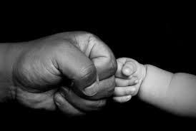

Kidult
”ONCE MORE
let’s go back to better days,
Our childhood days”
PROJECT BY:
Gauranshi Chopra

Slide 2
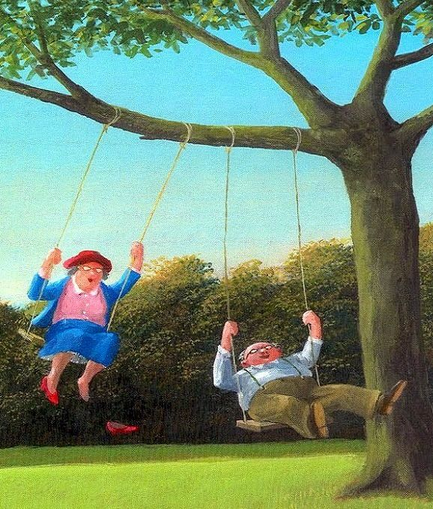
WHAT IS KIDULT?
KIDULT IS ONE OF THE MOST ICONIC EVENT WHICH WILL TAKE PLACE EVERY YEAR FOR 2 DAYS. IT IS AN AMUSEMENT PARK FOR AGES 40 AND ABOVE HAVING THE MOTTO OF BRINGING OUT AND ENHANCING THE INNER CHILD IN A PERSON, PROVIDING A HUGE VARIETY OF GAMES AND SHOWS FOR PEOPLE TO BRING BACK THOSE “GOOD OLD DAY”.

Slide 3

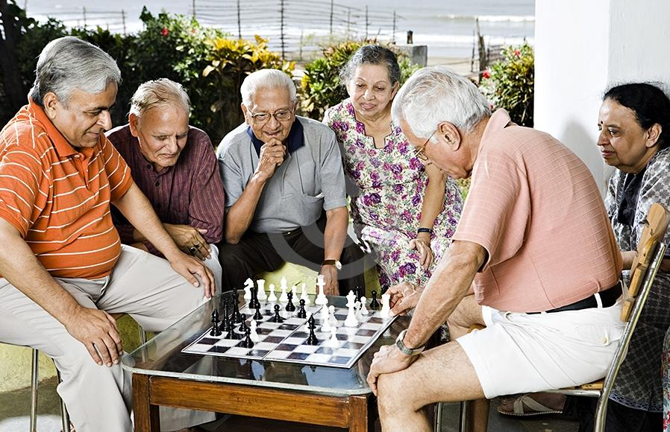
OBJECTIVES OF KIDULT
To have place where adults can enjoy.
They can have their childhood life.
No need to worry about workload (Stress free days).
To help needy people through the medium like NGOs as much as possible.
“To bring out the inner child in you.”

Slide 4

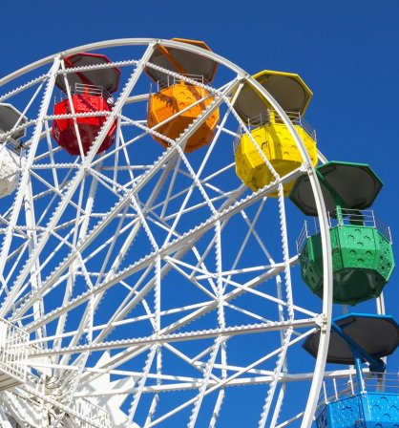
EVENT DETAILS
VENUE: Near Pawna Lake (Collaborating with Pawna lake camping for night stay customers)
DAYS CHOSEN FOR THE EVENT: Saturday and Sunday.
Day 1 – Two sections for board games as well as Amusement games can be experienced. Food will be provided on the back courts of the event.
Day 2- Amusement games followed by an exclusive event of music will be set up.
NO. OF ENTRIES ALLOWED IN A DAY : 150- 200.
BUYING ENTRY TICKETS WILL BE PROVIDED ONLINE AS WELL AS THE VENUE

Slide 5


RESOURCES FOR THE EVENT
WOOHOO
TIME
FOR
FUN
Proper supplies and machinery will be allocated and brought in and safety check will be done for all.
Human resources related to organizing and managing the entire event are going to be people from NGOs who will be paid and all the profits will be donated to welfare for the same.
First aid kits and professional doctors will be there to ensure safety and health of the crowd.
A section for food and beverages will be taken care by chefs keeping in mind the crowd preferences.

Slide 6
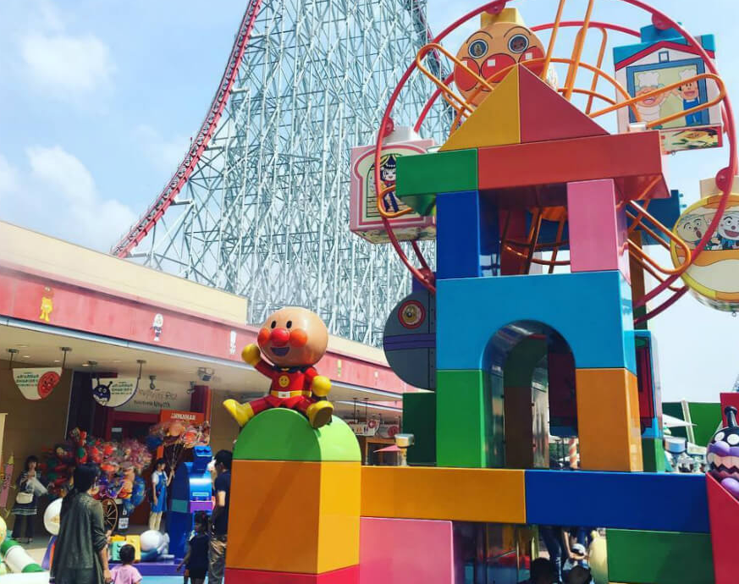
ALL ABOUT GAMES

Slide 7


Ferris
Wheel
Dashing
Cars
Amusement
Arcade
Trampoline
Park
Balloon
Shooting
Game
Paper ,
Board Games and much more

Slide 8



A STRESS REMOVAL AND FULL OF FUN DAY.
SMILES THAT WOULD MAKE YOUR INNER YOU BEAUTIFUL AND HAPPY.
EXCLUSIVE PHOTOBOOTHS AND LIVE CONCERT OF THE BEST OF 90s WILL CONCLUDE THE ENTIRE EVENT.

Slide 9


RULES AND REGULATIONS
One participant can participate only in one of the formal events. Entry won’t be done in groups; only individual entry is allowed.
Only people in the age group of 40 and above will be given entry.
Participants will have to inform about there medical requirements at the time of registration
Participants will have to inform about there medical requirements at the time of registration. (So that proper medical safety measures can taken for the main event)
Every participant has to strictly abide the rules and regulations by the event coordinators which will be given in a kit at the time of entry.
A consent form must be signed for the overnight stay customers at the time of registration.

Slide 10

THANK
YOU

