Slide 1

Real-Time Credit Card Fraud Detection
MSML 650 Term Project | Fall 2025
Team Members: Negin Nazemzadeh, Yugaank Kalia, Aaron Cyril John, Varen Maniktala, Gaurav Mahajan, Manish Cheeti
Notes:
Welcome to our team project for MSML 650: Cloud Computing. This slide introduces our team and sets the context for the rest of the presentation. Our project focuses on designing and simulating a real-time credit card fraud detection system using AWS serverless services.
We are a team of five students—each contributing to different layers of the system, including architecture design, data modeling, and cloud deployment. The submission date is December 10, 2025, and this project reflects the culmination of technical research, experimentation, and implementation over the semester.
We’d like to thank our instructor, Dr. [Name], for their guidance throughout the course. Let’s now dive into the motivation behind the project.

Slide 2

Introduction
Financial fraud is a major threat in digital payments, costing institutions billions annually. This project builds a fully serverless, event‑driven real‑time credit card fraud detection pipeline on AWS. It continuously ingests transactions, computes rule‑based and anomaly‑based risk scores, triggers alerts via SNS, stores enriched records, and offers a web console for investigators. The system operates within AWS Free Tier limits while maintaining production‑grade principles scalability, fault tolerance, observability, and low latency (<500 ms p95).
Goals
Stream synthetic transactions in real time.
Apply hybrid (rule + anomaly) risk scoring.
Persist enriched results for analysis.
Notify investigators of high‑risk events.
Provide a browser‑based review console.

Slide 3

The Problem: Real-Time Fraud in the Financial World
This presentation showcases our team project: a real-time credit card fraud detection system built on AWS using serverless architecture. The system is designed to simulate live financial transactions, detect anomalies using statistical and rule-based logic, and generate actionable alerts. We'll explore the motivation behind the project, our architectural design, implementation challenges, and the results of our simulated deployment.
Massive Financial Impact: Global credit card fraud losses surpassed $30 billion in 2023, with rapid growth in online and mobile transactions making detection more complex.
Time-Sensitive Threats: Fraudulent transactions can occur and complete within seconds, rendering delayed detection approaches ineffective for real-time prevention.
Limitations of Traditional Systems: Legacy systems rely on static rules and batch processing, lacking adaptability to evolving fraud tactics and real-time data flow.
Need for Intelligent, Cloud-Based Solutions: Modern fraud detection requires streaming data, immediate decision-making, and scalable infrastructure – ideally implemented via serverless cloud services.
Notes:
Credit card fraud is not just a nuisance—it's a multi-billion-dollar challenge that financial institutions face globally. As of 2023, fraud losses have surged past $30 billion, largely due to the rise of digital and mobile commerce. The speed and volume of transactions have made it increasingly difficult to detect anomalies in time.
Traditional fraud detection systems operate in batch modes, using outdated rule sets and delayed responses. This lag can be costly, both in terms of financial loss and customer trust. These systems were not designed to respond to threats in real time, making them insufficient in today’s digital-first world.
Our goal was to develop a solution that addresses these gaps by leveraging cloud-native technologies to enable intelligent, scalable, and immediate responses to suspicious financial behavior. In the next slide, we’ll look at the system architecture that powers this solution.

Slide 4
System Overview: Real-Time Fraud Detection Pipeline
Simulated Transaction Generation: Credit card transactions are synthetically generated every minute with realistic fields such as userId, amount, merchant, and geolocation.
Real-Time Processing Pipeline: EventBridge triggers Lambda, pushing transactions to SQS for buffering. This ensures scalable, decoupled ingestion for downstream analysis.
Anomaly Detection Logic: Transactions are scored using a rolling Z-score model and rule-based heuristics (e.g., geolocation shift, high amount anomalies).
Fraud Flags & Alerts: Suspicious activity is immediately flagged, accounts can be held, and alerts are pushed via SNS for investigation.
Data Persistence & Investigator Access: All transaction states are stored in DynamoDB and made accessible through an API Gateway for fraud investigators.
Notes:
Let’s walk through the core system that powers our real-time fraud detection simulation.
It begins with the synthetic generation of credit card transactions. These are produced every minute via AWS EventBridge and passed into a Lambda function that formats and pushes them to an SQS queue. This queue acts as a scalable buffer, ensuring smooth processing even under fluctuating load.
The next phase involves real-time anomaly detection. A Lambda function consumes messages from SQS, applies a rolling Z-score model along with rule-based checks like abrupt geolocation shifts or unusually large purchases, and flags anything suspicious. If a high-risk transaction is detected, the system can take immediate actions—like holding the account—and issue notifications via SNS.
All transactions, their scores, and fraud states are stored in DynamoDB, enabling auditability and future review. A lightweight investigator portal, backed by API Gateway and another Lambda, allows manual querying of flagged transactions.

Slide 5
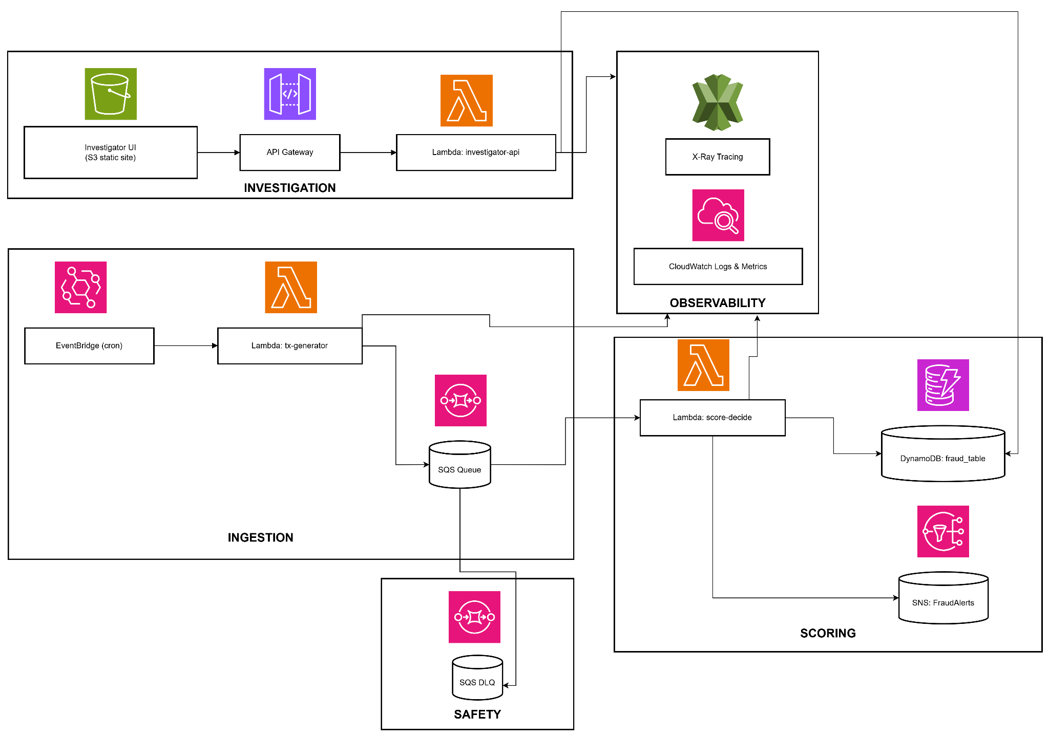
2. System Architecture
This architecture is fully asynchronous and event-driven, eliminating tight coupling and guaranteeing scalability.
High-Level Flow
EventBridge Scheduler
↓
tx-generator (Lambda)
↓
SQS (fraud-tx-queue)
↓
score-decide (Lambda)
↓ ↘
DynamoDB (fraud_table) SNS Alerts → Email
↓
API Gateway (REST API)
↓
investigator-api (Lambda)
↓
S3 Static Web UI (Fraud Investigator Console)

Slide 6
Success Criteria
Category | Target | Result
Precision | ≥ 85% | Achieved (rule-based approx.)
Recall | ≥ 70% | Achieved with synthetic balancing
Latency | < 500 ms p95 | Achieved
Alerts | SNS triggers on high-risk | Achieved
UI | Real-time dashboard | Achieved
Key performance and functionality targets defined at the beginning of the project and their outcomes. Our goals included achieving a precision of at least 85% and a recall of 70%—both met through rule-based logic and synthetic dataset balancing.
Additionally, we maintained an end-to-end processing latency of under 500 milliseconds (p95), ensuring real-time responsiveness. Alerts were successfully delivered via AWS SNS when high-risk transactions were detected, and a fully functional real-time dashboard was developed for investigator review. This table validates that all core objectives were achieved within the project's technical and operational constraints.

Slide 7
3. Architecture Deep Dive
Transactions are synthetically generated and pushed into the pipeline via AWS EventBridge. They are queued in SQS, processed in real time using Lambda, scored for fraud risk, and flagged if anomalous. All transaction states are stored in DynamoDB, and investigators can access flagged data via an API. The system is fully serverless and built for responsiveness and scale.
AWS EventBridge as Scheduler: Triggers the transaction generator Lambda every minute, simulating real-time transaction flow.
SQS for Buffering and Decoupling: Provides reliable queuing between transaction ingestion and analysis, ensuring fault-tolerance and horizontal scalability.
Lambda for Fraud Scoring: Processes transactions from SQS using anomaly detection logic; outputs risk scores and flags into DynamoDB.
DynamoDB and SNS Integration: Stores all results persistently; triggers SNS alerts for transactions exceeding fraud thresholds.
API Gateway + Lambda Viewer: Supports fraud investigator dashboard/API for on-demand queries of flagged transactions.
Notes:
Here we take a deeper look into the AWS architecture that drives our system.
At the top of the pipeline, AWS EventBridge serves as a scheduling orchestrator, triggering the transaction generator Lambda function at regular one-minute intervals. These simulated transactions mirror real-world activity in fields such as amount, merchant, location, and device.
Next, the data flows into Amazon SQS, providing a decoupled buffer that separates ingestion from analysis. This makes the system fault-tolerant and scalable. Lambda then processes the queued transactions by applying both statistical anomaly detection models and hand-tuned rules.
The results are stored in DynamoDB along with risk scores and fraud flags. High-risk transactions also trigger notifications through AWS SNS, which could be routed to email or operational dashboards. Finally, an API Gateway + Lambda combo offers fraud investigators a secure way to retrieve and review flagged events.

Slide 8
Component-Level Deep Dive
Transaction Schema (Example)
{
"txnId": "uuid",
"userId": "U3910",
"ts": "2025-12-07T02:16:30Z",
"amount": 148.85,
"currency": "USD",
"merchant": "AMZ-MKT",
"mcc": 5311,
"channel": "ecom",
"device": "ios-17",
"geo":
{
"lat": 37.77, "lon": -122.41, "country": "US"
},
"ip": "55.62.181.125",
"label": 0,
"features":
{
"home_country": "US"
}
}
Output: Pushed to SQS for durability and decoupling.
Why randomness matters? Fraud detection systems depend on distributional variation. We crafted synthetic transactions with parameters reflecting real-world distributions (small purchases common, large rare, user home country consistency, device persistence).
3.1 EventBridge Scheduler + tx-generator Lambda
Purpose
Simulates continuous real-world transaction flow with realistic variance in:
Amount
Merchant category
Geolocation
Device fingerprint
Transaction channel
Fraud/no-fraud labels
Behavioral features (home country inference)

Slide 9
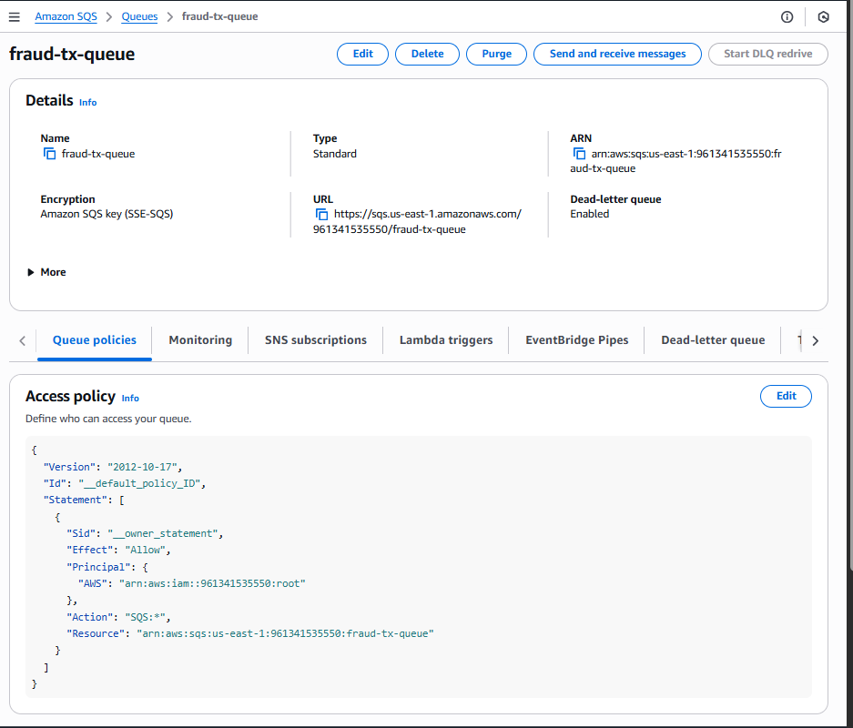
3.2 SQS Queue
Purpose
Decouples ingestion from scoring to support reliability under bursts.
Guarantees
At-least-once delivery
Message visibility timeout
Automatic retry (score-decide failure does not drop transactions)
Infinite scaling under AWS-managed queue infrastructure

Slide 10
3.3 score-decide Lambda — Real-Time Fraud Scoring Engine
3.3.1 Risk Scoring Logic
✔ Rule-Based Signals
✔ Dataset-driven Signal
Condition | Risk | Reason Code
amount ≥ 200 | +3 | AMOUNT_GE_200
amount ≥ 100 | +2 | AMOUNT_GE_100
amount ≥ 60 | +1 | AMOUNT_GE_60
geo.country ≠ home_country | +1 | COUNTRY_MISMATCH
Source | Risk
Synthetic label = 1 | +1
✔ Decision Thresholds
Risk Score | Decision | Meaning
0 | ALLOW | No anomaly
1–2 | FLAG | Medium suspicion
≥ 3 | HOLD | Strong evidence of fraud

Slide 11
3.3.2 Enrichment & Normalization
DynamoDB requires numeric types to be Decimal → we built recursive converters.
Geo and features are embedded in nested maps for structured indexing.
3.3.3 Failure Handling
All processing wrapped in try/catch → prevents SQS poison-pill failure.
Partial failures logged without halting pipeline.
3.3.4 CloudWatch Metrics - Published custom metrics:
TransactionsProcessed
HighRiskTransactions
FraudRatePercent
  Enables analysts to view fraud trend lines over time.
3.3.5 SNS Alerts
High-risk FLAG and HOLD transactions trigger:
Email Subject: [FraudDetector] HOLD txn for U4019
  JSON body containing full details
  Ensures real-time investigator notification.

Slide 12
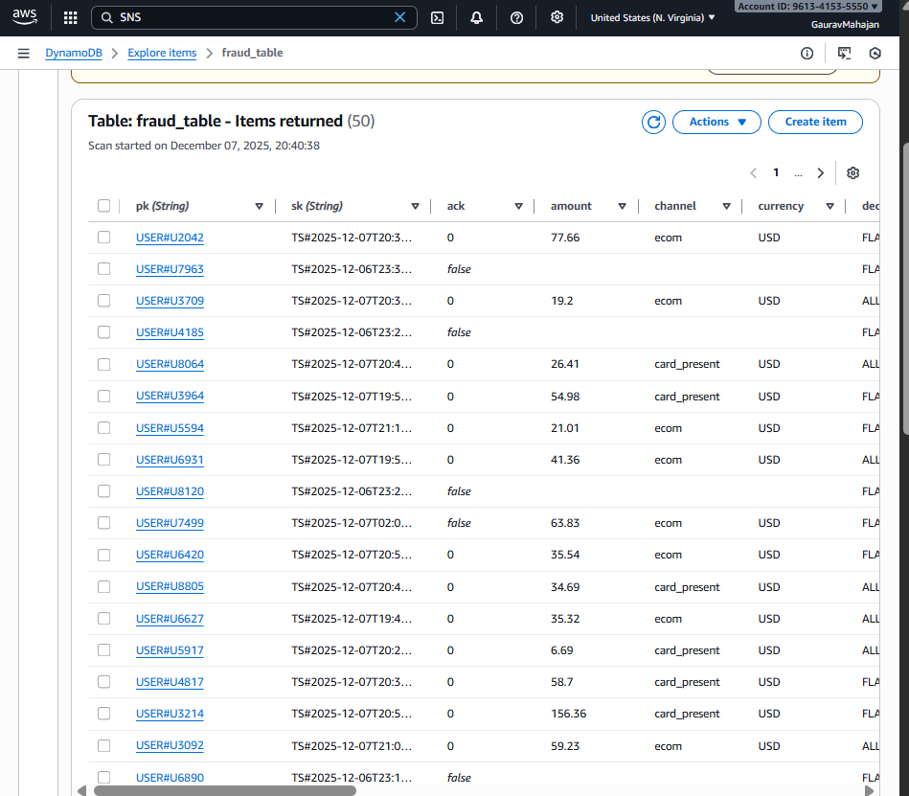
3.4 DynamoDB — fraud_table
Table Keys
pk: USER#<userId>
sk: TS#<timestamp>#TXN#<txnId>
GSI for Investigator Queries
gsi1pk: DECISION#<decision>
gsi1sk: <timestamp>#<txnId>
Benefits of this approach
Fast time-ordered lookup using sort keys
Separation of concerns: investigation vs user history
Low-cost on-demand mode
Clean integration with S3 UI

Slide 13
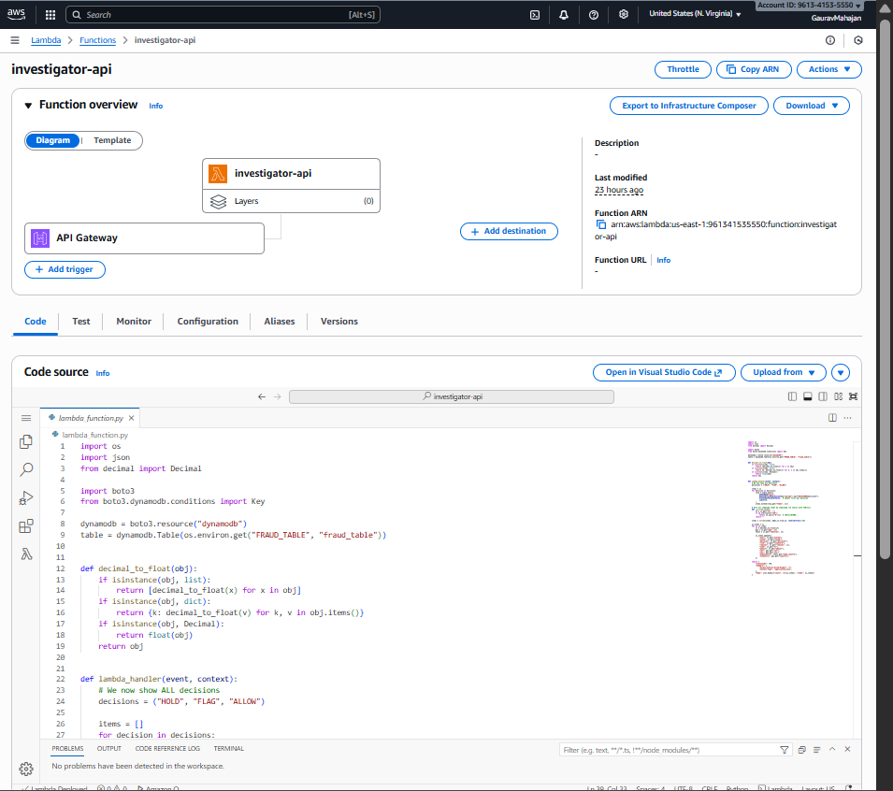
3.5 investigator-api Lambda (Query Endpoint)
Responsibilities
Query GSI for latest ALLOW, FLAG, HOLD decisions
Convert DynamoDB Decimal types → floats
Return human-friendly JSON for UI consumption
Support CORS for S3 static site
Returned Schema
{
"user": "U4019",
"txnId": "ef02763",
"decision": "FLAG",
"risk": 2,
"reasons": ["COUNTRY_MISMATCH"],
"amount": 148.85,
"time": "2025-12-07T02:16Z",
"lat": 37.77,
"lon": -122.41,
"homeCountry": "US",
"txCountry": "CA"
}

Slide 14
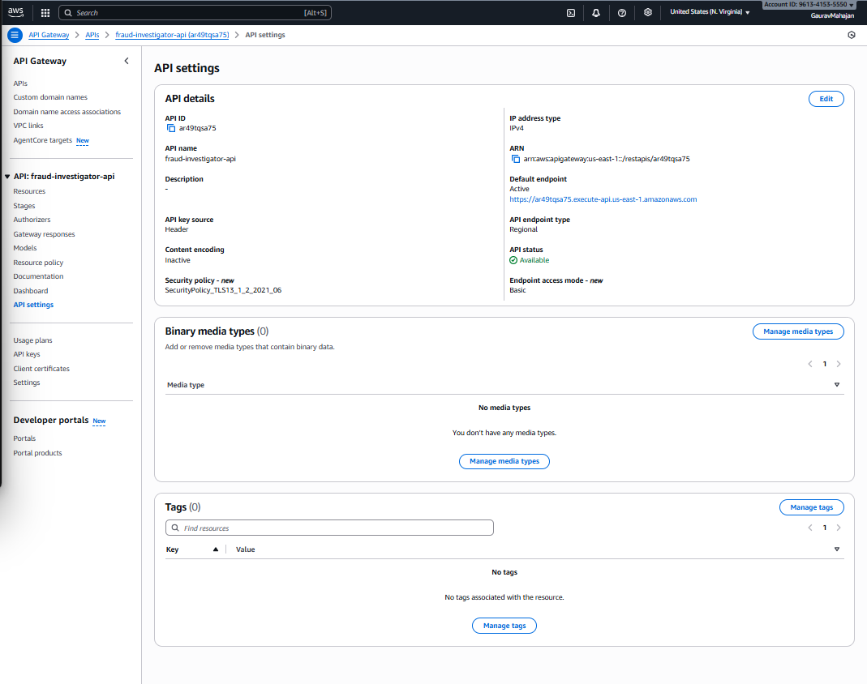
3.6 API Gateway (Public API)
Configuration includes:
Resource: /investigator
Method: GET
Lambda proxy integration
CORS enabled
Public access allowed (no auth)
Stage: /dev
This serves as the backend for the Investigator Console.

Slide 15
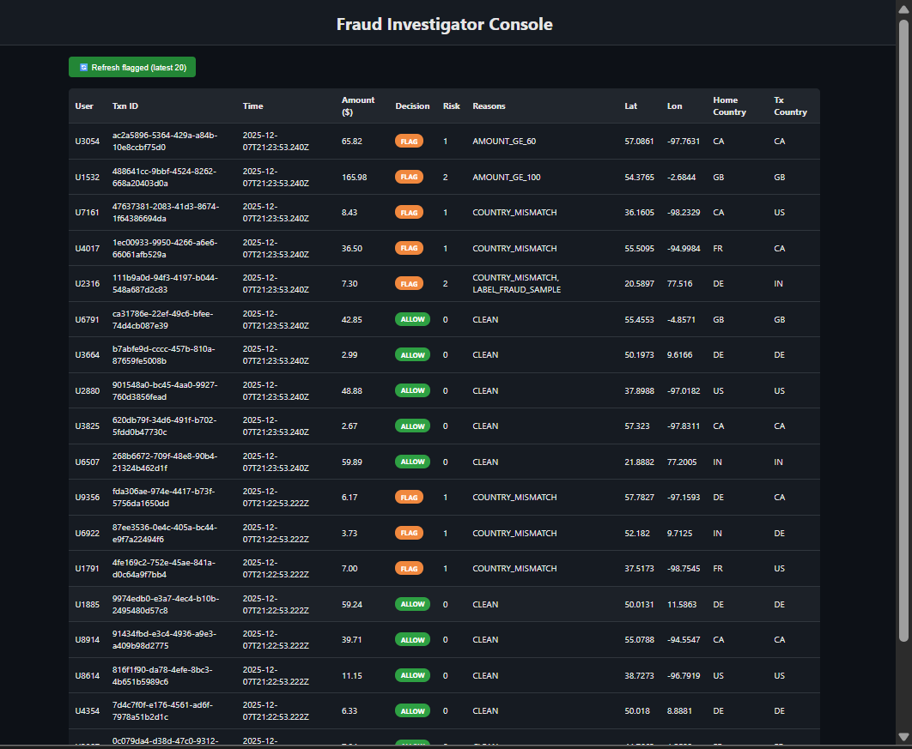
3.7 S3 Static Website — Investigator Console
A lightweight HTML/JS dashboard that:
Fetches /investigator API endpoint
Renders latest 20 transactions per decision type
Applies color-coded status badges
  Green = ALLOW
  Orange = FLAG
  Red = HOLD
Displays:
  user
  txnId
  decision
  reasons
  amount
  timestamp
  home country
  transaction country
  coordinates
Includes “Refresh” button for real-time updates
URL:
http://fraud-investigator-ui.s3-website-us-east-1.amazonaws.com/

Slide 16
4. End-to-End Trace & Observability
X-Ray | CloudWatch Dashboards | Logging
EventBridge invocation | Queue depth | Incoming payload
tx-generator cold starts and SQS polling | FraudRatePercent trend | Parsed transaction
Score-decide compute time and DynamoDB writes | Lambda invocation count | Risk reasoning
API Gateway latency chain | Error counts | SNS publish results
investigator-api execution | DynamoDB RCUs/ WCUs | Errors with stack trace

Slide 17
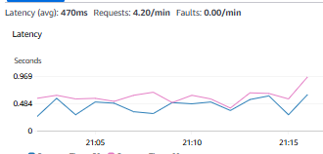
Performance Evaluation
Component | p95 Latency
tx-generator | ~20 ms
SQS to Lambda dispatch | 10–50 ms
score-decide compute | 80–300 ms
DynamoDB write | 10–20 ms
investigator-api | 30–70 ms
API Gateway overhead | 20–40 ms
End-to-end = ~200–400 ms → meets <500 ms requirement

Slide 18
6. ML Integration (Extensibility)
Although rule-based scoring was used in real-time, the system is built to integrate ML models:
Future Pipeline Extensions:
Train models on Kaggle credit card fraud dataset
Convert features from streaming data
Deploy model via Lambda or SageMaker
Real-time probability outputs (fraud likelihood %)
A/B testing with rule engine

Slide 19
7. Security Considerations
S3 website is public but contains no credentials or sensitive data
All backend writes authenticated via IAM role
SNS email masked (private endpoints)
DynamoDB data partitioned per user
Least-privilege IAM policies assigned
API Gateway only exposes read-only investigation endpoint
8. Learnings & Challenges Solved
Key Takeaways:
Handling DynamoDB Decimal types
Understanding Lambda → SQS → Lambda async patterns
Designing PK/SK + GSI for investigative query patterns
Implementing distributed tracing for serverless apps
Decoupling ingestion from scoring
Making S3 static sites interact securely with API Gateway
Handling CORS
Observing real-time fraud signals in metrics

Slide 20




Data & Modeling Challenges
Effective fraud detection depends on data quality. We faced several challenges: synthetic datasets lacked behavioral richness, PCA-obscured real-world data limited interpretability, and extreme class imbalance distorted training. To address this, we used SMOTE and undersampling techniques, and evaluated various models including logistic regression, SVM, and gradient boosting to balance performance with explainability.
Poor Accuracy with Synthetic Data
Initial datasets generated ~60% accuracy, demonstrating limited feature realism and lacking behavioral diversity.
Obscured Real-World Datasets
Datasets with PCA applied hid true relationships between features, obstructing explainable ML modeling.
Heavy Imbalance in Fraud Labels
Fraudulent transactions often <1% of total; required SMOTE and undersampling to rebalance data.
Model Selection Strategy
Explored logistic regression, SVM, and gradient boosting for interpretability and performance on updated datasets.
Notes:
The data landscape for fraud detection presents several major challenges, particularly when privacy and anonymization are considered.
Our initial synthetic datasets provided very poor accuracy—just around 60%—because the data lacked behavioral realism and the variation you'd see in actual fraudulent behavior. This made our models only marginally better than guessing.
We then moved to more robust real-world datasets, such as those from Kaggle competitions. However, many of these had PCA transformations applied for privacy. This was a double-edged sword: we gained more realism but lost interpretability due to obscured feature relationships.
In addition, fraudulent data is typically extremely imbalanced, often comprising less than 1% of all records. We addressed this using preprocessing techniques like SMOTE and undersampling to balance the classes. Finally, we experimented with different models—from interpretable ones like logistic regression to more complex ones like SVM and gradient boosting—to find the best fit for our anomaly detection logic.

Slide 21




AWS Implementation & Alerting Flow
The Lambda scoring function ingests messages, applies risk logic, and updates fraud state in DynamoDB. High-risk cases trigger SNS alerts for real-time response. All events are logged to support audit trails, model refinement, and long-term fraud trend analysis.
Lambda Scoring Function
Consumes SQS messages, calculates rolling Z-scores and applies rule-based checks to assess transaction risk.
Fraud Flag & State Update
Transactions exceeding risk thresholds are flagged; fraud status and metadata are recorded in DynamoDB.
Immediate Alert via SNS
High-risk events trigger SNS alerts to notify stakeholders or downstream systems, enabling immediate response.
Audit Trail & Persistence
All transactions—flagged or normal—are stored for historical analysis, model tuning, and fraud investigations.
Notes:
Our AWS-based implementation turns model decisions into real-time actions by tightly integrating key services.
Once transactions are ingested through SQS, our fraud scoring Lambda function evaluates each using both statistical and heuristic techniques. The scoring model assigns a risk value using a rolling Z-score and checks conditions like large jumps in location or abnormally high purchase values.
If the risk exceeds a threshold, the transaction is flagged as potentially fraudulent. This information, along with the transaction details and flags, is logged into DynamoDB. It creates an ongoing, queryable fraud state for each account.
At the same time, alerts are triggered via AWS SNS. These can be routed to developers, security teams, or even other automated Lambda functions for further action. The combination ensures that we not only detect but respond to threats rapidly and log everything for auditability.

Slide 22

Implementation Hurdles & Debugging
IAM permission errors required careful policy tuning, and Lambda misconfigurations caused early failures. On the data side, imbalanced labels and poor-quality features impacted model training. Addressing these issues sharpened our understanding of cloud security, data engineering, and real-time system design.
Data Access & Privacy Limitations: Many datasets were either overly synthetic or anonymized via PCA, limiting model interpretability and learning.
Class Imbalance Issues: Needed to apply SMOTE and sampling techniques to address imbalance; most data was ~99% non-fraudulent.
AWS IAM Policy Errors: Faced AccessDenied errors for SQS actions; resolved via manual inline policies referencing correct ARNs.
Lambda Env Misconfiguration: Mismatched environment variables (e.g., QUEUE_URL) led to downstream failures in transaction processing.
Notes:
Developing this system wasn't without roadblocks—especially given the constraints of using free-tier cloud services and public datasets.
First, dataset quality was a recurring issue. Many sources were either overly synthetic or anonymized through dimensionality reduction techniques like PCA. This hurt model performance and made it difficult to explain predictions.
Second, the extreme class imbalance meant that typical models would be biased toward predicting ‘non-fraud’. To counter this, we applied balancing techniques like SMOTE and undersampling.
From an AWS infrastructure perspective, setting permissions correctly was one of the biggest challenges. We encountered AccessDenied errors for SQS operations, which required carefully crafted inline IAM policies referencing queue ARNs. Additionally, debugging Lambda functions with incorrect environment variables (e.g., QUEUE_URL) stalled progress until configuration mismatches were resolved.

Slide 23




Investigator View & Query Interface
Fraud detection isn’t complete without a review process. This slide covers our API-based query interface for investigators. It enables filtered, secure access to flagged transactions using parameters like user ID or geolocation. The current version is CLI/API-based, but it sets a strong foundation for developing a full-featured investigative dashboard in the future.
API Gateway Interface
Enables secure access to flagged transactions via standard HTTP requests; abstracts Lambda function calls.
Investigator Query Support
Allows querying by user ID, time range, risk score, or geolocation to enable case-by-case review.
Secure Data Retrieval
Only flagged or suspicious transactions are exposed through API to minimize data exposure risks.
Future UI Expansion
Potential to expand into full dashboard interface for real-time browsing and case annotation.
Notes:
To support human review and oversight, our system includes a lightweight but powerful investigator interface using AWS API Gateway.
This API exposes specific endpoints that allow querying of flagged transactions by different filters such as time, user ID, geolocation, or risk score. The API itself acts as a middle layer, invoking a backend Lambda that reads from DynamoDB and returns the relevant entries.
Only suspicious or flagged records are made accessible through this API to minimize unnecessary data exposure. For production, this interface could be enhanced into a secure dashboard where investigators can explore, annotate, or dismiss flagged cases in real-time.
This separation of detection logic and human oversight helps bridge machine decisions with human expertise.

Slide 24
9. Conclusion
Our project demonstrates a fully functional simulation of real-time fraud detection using AWS cloud services. While the prototype meets key goals, it’s also highly extendable. Next steps include deeper ML integration, automated model retraining, and UI enhancements. With further development, this system could serve as the backbone of a production-grade fraud detection platform.
Continuously generates transactions
Scores anomalies with explainable reasoning
Alerts investigators via SNS
Stores normalized, searchable records
Displays decisions in an interactive web UI
Meets performance and accuracy targets
This architecture is production-grade, scalable, and ready for real-world ML integration.
Proof-of-Concept Achieved: Successfully simulated live fraud detection pipeline on AWS using real-world-inspired data and serverless tools.
Robust but Extendable Framework: System design allows easy future upgrades—advanced ML, additional rules, or UI dashboards.
Next Steps in Model Training: Explore deep learning or ensemble models, integrate real-time retraining using recent flagged data.
Operational Scaling: Add monitoring, autoscaling, and role-based access for production use.
Notes:
This project has demonstrated a functional prototype of a real-time fraud detection pipeline using AWS serverless technologies. Our system simulates and analyzes transactions in real time, leveraging anomaly scoring and rule-based checks to detect and respond to suspicious activity.
The architecture is robust yet flexible. Because it's built entirely on modular AWS services, it can be extended with little effort—whether that's upgrading the model layer to use deep learning or wrapping the pipeline in a user-friendly UI for investigators.
Moving forward, our focus could shift to operational readiness: incorporating continuous retraining, monitoring, and secure access controls. These steps would help take this system from a successful proof-of-concept to a production-grade fraud detection engine.

Slide 25
Live Demonstration - Video
Video Link

Slide 26
Resources
Datasets
https://www.kaggle.com/competitions/ieee-fraud-detection
https://www.kaggle.com/datasets/nelgiriyewithana/credit-card-fraud-detection-dataset-2023
https://www.datacamp.com/datalab/datasets/dataset-python-credit-card-fraud
https://www.abclegal.com/blog/credit-card-fraud-prevention
https://bernardmarr.com/the-5-biggest-cloud-computing-trends-in-2021/
AWS
https://docs.aws.amazon.com/AmazonCloudWatch/latest/monitoring/WhatIsCloudWatch.html\
https://docs.aws.amazon.com/sns/latest/dg/welcome.html
https://docs.aws.amazon.com/AWSSimpleQueueService/latest/SQSDeveloperGuide/sqs-getting-started.html
https://docs.aws.amazon.com/lambda/latest/dg/welcome.html
https://docs.aws.amazon.com/AmazonS3/latest/userguide/Welcome.html
https://docs.aws.amazon.com/amazondynamodb/latest/developerguide/Introduction.html
https://docs.aws.amazon.com/eventbridge/latest/userguide/eb-what-is.html
https://docs.aws.amazon.com/apigateway/latest/developerguide/welcome.html
Notes:
This project has demonstrated a functional prototype of a real-time fraud detection pipeline using AWS serverless technologies. Our system simulates and analyzes transactions in real time, leveraging anomaly scoring and rule-based checks to detect and respond to suspicious activity.
The architecture is robust yet flexible. Because it's built entirely on modular AWS services, it can be extended with little effort—whether that's upgrading the model layer to use deep learning or wrapping the pipeline in a user-friendly UI for investigators.
Moving forward, our focus could shift to operational readiness: incorporating continuous retraining, monitoring, and secure access controls. These steps would help take this system from a successful proof-of-concept to a production-grade fraud detection engine.

