Slide 1



Telegram Chat Bot:
By Gaurav Parwal
MCA Elite-1
UID: 21MCA2608

Slide 2


What is Telegram Bot?
A Telegram Bot is a program that behaves like a normal chat partner with additional functions. It performs predefined tasks independently and without the user’s involvement.
Function:
An important function of a Telegram bot is the possibility to execute commands in a Telegram chat, which then directly trigger actions or request information.
For example, it is possible to send the bot the command “/help” which then outputs the commands possible for this bot in the chat as text feedback. In this project we will use the following command list:
Help
Start

Slide 3
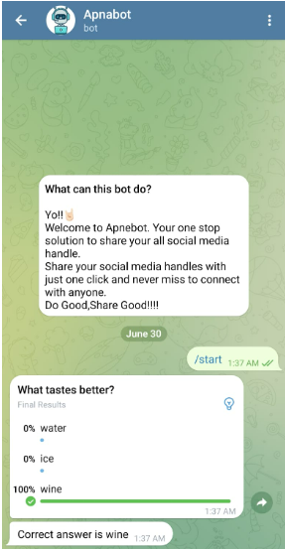

Name of our Telegram Bot:
@Apnabot
What will our Bot do?
It will take commands from user and will ask some fun quiz.

Slide 4
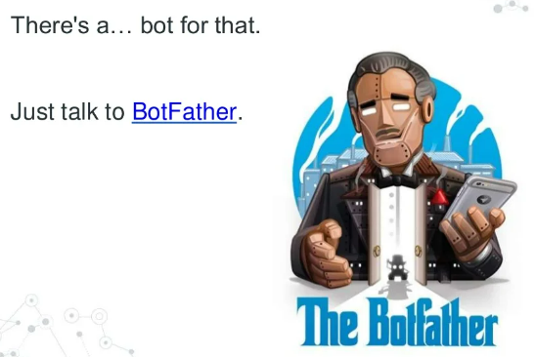
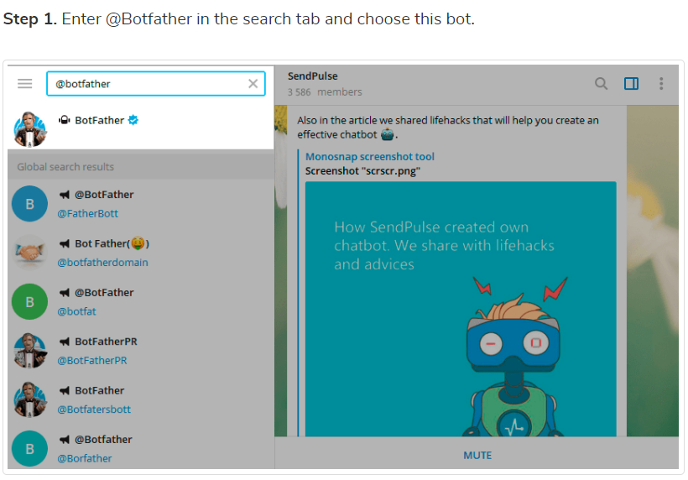
How to create a Bot?
Notes:
1.You have to search for this user on Telegram and start a chat with him.

Slide 5
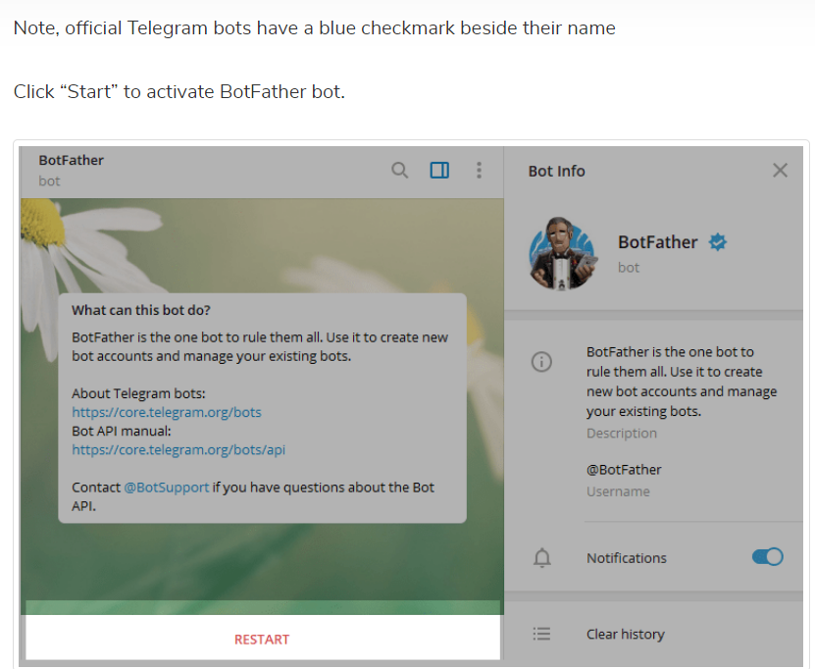
How to create a Bot?
Step 1:
Step 2:
Choose or type the /newbot command and send it.
Step 3:
Choose name for your bot, the bot can be found by its username in searches *username should be unique and it should end with the word “bot”.
Notes:
1.You have to search for this user on Telegram and start a chat with him.

Slide 6
Importing required libraries:
The library python-telegram-bot provides various Handlers from which I will be using CommandHandler.
Updater: This will contain the API key we got from BotFather to specify in which bot we are adding functionalities to using our python code.
Update: This will invoke every time a bot receives an update i.e. message or command and will send the user a message.
CallbackContext: We will not use its functionality directly in our code but when we will be adding the dispatcher it is required (and it will work internally).
CommandHandler: This Handler class is used to handle any command sent by the user to the bot, a command always starts with “/” i.e “/start”,”/help” etc.
MessageHandler: This Handler class is used to handle any normal message sent by the user to the bot.
FIlters: This will filter normal text, commands, images, etc from a sent message.
from telegram.ext.updater import Updater
from telegram.update import Update
from telegram.ext.callbackcontext import CallbackContext
from telegram.ext.commandhandler import CommandHandler
from telegram.ext.messagehandler import MessageHandler
from telegram.ext.filters import Filters
from pyfiglet
From python-dotenv.

Slide 7
Thank You!

