Slide 1
Multi-Factor based Nutrition Management System and Recipe Recommendation System (Mid Semester Project Work Evaluation Presentation) (7/5/2022)
Department of Computer Science and Engineering
Course Name: Project Work Course Code: CSP Credits: 16:0:0 Term: March – July 2022
Presented by:
MSRIT Mentor:
Dr Shilpa Shashikant Chaudhari
Associate Professor
1MS18CS025 | Aravind Shreyas R
1MS18CS040 | Dheeraj Bhat
1MS18CS043 | Divya
1MS18CS046 | Gaurav V

Slide 2
AGENDA
Introduction
Problem Statement
Objectives
Literature Survey
Proposed methodology & Concept Diagram
Hardware & Software used
System Design
Future Work

Slide 3
INTRODUCTION
Nutrition is the supply of food needed for an organism to feed cells and keep them alive. Nutrients can be obtained from products such as vitamin supplements.
Without nutrition, humans grow weak, get sick and at the very worst can even die. They miss developmental milestones and can’t put their bodies through the daily mental and physical tasks that are necessary.
Recipe recommendation involves taking various types of inputs such as nutritional values or ingredients or preferences and suggesting/ranking relevant food products and recipes as outputs.
This project aims to detect nutritional shortcomings of a user by taking various inputs that can easily be obtained through standard blood tests and overcome deficiencies if detected by recommending food and recipes using an intelligent algorithm.

Slide 4
PROBLEM STATEMENT
Nutrient management in the context of this project aims to quantize the consumption of essential nutrients in an efficient format such that it leads to a healthy and balanced lifestyle. Several recent studies have shown the importance of quality-based consumption of nutrients which could otherwise lead to serious health issues that could even be fatal at times.
The emergence of advanced scientific methods to determine the presence of various nutrients or lack thereof has led to widespread awareness amongst individuals to keep a track of their nutrient consumption. Increased consciousness towards one’s health has recently been in the limelight which creates the need for an intelligent system specially customized for the individual that can analyse your consumption’s quality and suggest options that could essentially fulfil your body’s need to lead a healthy lifestyle.
The presence of this particular system can hugely impact individuals as this would save a considerable amount of time in finding a recipe that would not only suit the user’s preference but also encapsulate all the nourishing factors that an individual would require.

Slide 5
OBJECTIVES
The project's main goal is to create an intelligent recipe recommender that would aid in the development of a diet that allows all users to make healthy choices in their daily lives while still enjoying food and keeping healthy.
The main objectives of this project are :
Develop an algorithm that maps the required nutrients tailored for every user to the information put in by them like age, gender, activity levels, diseases and allergies and personal health goals.
Develop a classification model that can classify and output food groups that are rich in specific groups of nutritional values.
Develop a ranking system that maps the user inputs explaining their preferences and scrapes the web for recipes for the right diet.

Slide 6
LITERATURE SURVEY
Title and Author | Technique Used | Result | Advantages and Disadvantages
Personalized Ubiquitous Diet Plan service based on ontology and web services, by Chuan-Jun Su, Yin-An Chen, and Chia-Wen Chih. 2017 | Diet-Aid Ontological Knowledge Engine (DOKE) | Diet-Aid was developed and deployed using the Restful architecture, allowing for ubiquitous access via any Internet-enabled device. | Advantages: The system adds nutrition information about the ingredients, such as amount of vitamins in the ingredients for users to consider. Drawbacks: The system could be further enhanced by generating a diet plan by putting the nutritionist recommended daily intakes into consideration.
Food Recommendation with Graph Convolutional Network, by Gao, Xiaooyan & Feng, Fuli & Huang, Heyan & Mao, Xian-Ling & Lan, Tian & Chi, Zewen. 2021 | Graph Convolutional Network (FGCN), which exploits ingredient-ingredient, ingredient-recipe, and recipe-user relations deeply. | The proposed FGCN outperforms the state-of-the-art baselines. Further in-depth analyses reveal that FGCN could alleviate the sparsity issue in food recommendation. | Advantages: Does not overlook the various food-related relations, especially the ingredient-ingredient relations, leading to comprehensive representations. Drawbacks: The standard nutritional values are not considered.
The nature and evolution of online food preferences, by Wagner, Claudia & Singer, Philipp & Strohmaier, Markus. 2019 | Visualisations of intrinsic statistical properties from a new source of data, i.e., server log data from a large recipe platform on the World Wide Web, and explore its usefulness for understanding online food preferences. | Recipe preference distributions exhibit more regional differences than ingredient preference distributions. Recipe preferences are partly driven by ingredient preferences and weekday preferences are clearly distinct from weekend preferences. | Advantages: Presents a comprehensive multi-dimensional approach which allows to dig into the nature and evolution of users’ online food preferences.
Notes:
Knowledge Base is driven by three ontologies:
1) the food ontology, 2) the user profile ontology, and 3) the HL7-based health screening ontology. These provide knowledge acquired from domain experts and the user’s health status to generate a personal diet plan.

Slide 7
Title and Author | Technique Used | Result | Advantages and Disadvantages
Automated and Personalized Nutrition Health Assessment, Recommendation, and Progress Evaluation using Fuzzy Reasoning, by Salloum, George & Tekli, Joe. 2021 | Recommender system using Fuzzy Reasoning | Results show that recommendations are on a par with and sometimes surpass those of human nutritionists. | Advantage : Performs meal planning with performing health state assessment or evaluation. Drawback : There is a lack of personalisation to user to make it applicable to real-world.
Hierarchical Attention Network for Visually-Aware Food Recommendation, by Gao, Xiaooyan & Feng, Fuli & He, Xiangnan & Huang, Heyan & Guan, Xinyu & Feng, Chong & Ming, Zhaoyan & Chua, Tat-Seng. 2019 | Hierarchical Attention Network | Outperforms several competing recommender solutions like Factorization Machine and Visual Bayesian Personalized Ranking with an average improvement of 12%. | Advantage : Builds comprehensive recipe representation via jointly leveraging user-recipe interaction history, food image, and food ingredients with a hierarchical attention. Drawback : Does not incorporate user's health and nutritional requirements, no relations drawn between various ingredients, does not consider users' physical profile when recommending recipes.
References.
The proposed system considers standard nutritional values related to gender and age along with nutritional information including deficiencies which makes are system unique to existing models.
The proposed solution aims to bundle the nutritional profile analysis and the recipe recommendation into one functional system making it the novel feature of this project.

Slide 8
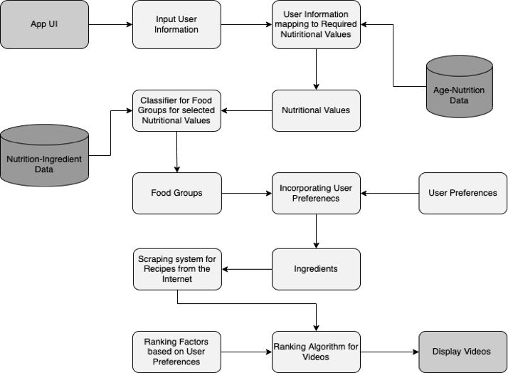
PROPOSED METHODOLOGY & CONCEPT DIAGRAM
Notes:
The app will enable user to input information like their name, age, height, weight, diseases, medical history, nutritional preference, medications, allergies etc.
A user profile will be created and processed. The initial phase in the processing will be to take the nutritional preferences indicated by the user, as well as other information such as diseases, activity levels, and so on, and map these to information recorded from a database containing information about age-appropriate nutrition. This will result in a final set of nutritional values that the diet must meet for the specific user.
Using the Nutrition-Ingredient Data, the nutritional values would then be used to classify food groups (using a ML based classifier such as Random Forest), resulting in the food groups that should be included in the diet.
After taking into account the user's preferences, such as allergies and dislikes, a collection of ingredients will be developed that will be relevant for the recipe search.

Slide 9
SYSTEM REQUIREMENTS
Hardware Requirements
Any mobile or personal computing device which has the following basic specifications.
CPU: Any modern 64-bit processor
RAM: 3 GB or more
Storage: 1 GB, Additional space recommended
GPU: integrated GPUs or higher
Internet access and support
Software Requirements
Works with any of the latest operating systems like Windows 8 – 11, Linux, MacOS, Android, iOS
Functional Requirements
A fully functional system capable of suggesting recipes based on users’ nutritional requirements and preferences.
Verified authentication system to secure user’s data against theft.
Attractive and simple UI/UX for interaction.
Inputs from the user about their nutritional profile and their preferences.
User systems capable of handling and running complex mathematical tasks on-premise.
Non Functional Requirements
Reliable application with strong recovery pipelines when an error is encountered.
Scalable application as the user base grows.
Consistent responses for similar inputs.
Traceable solution for logging mechanisms.

Slide 10
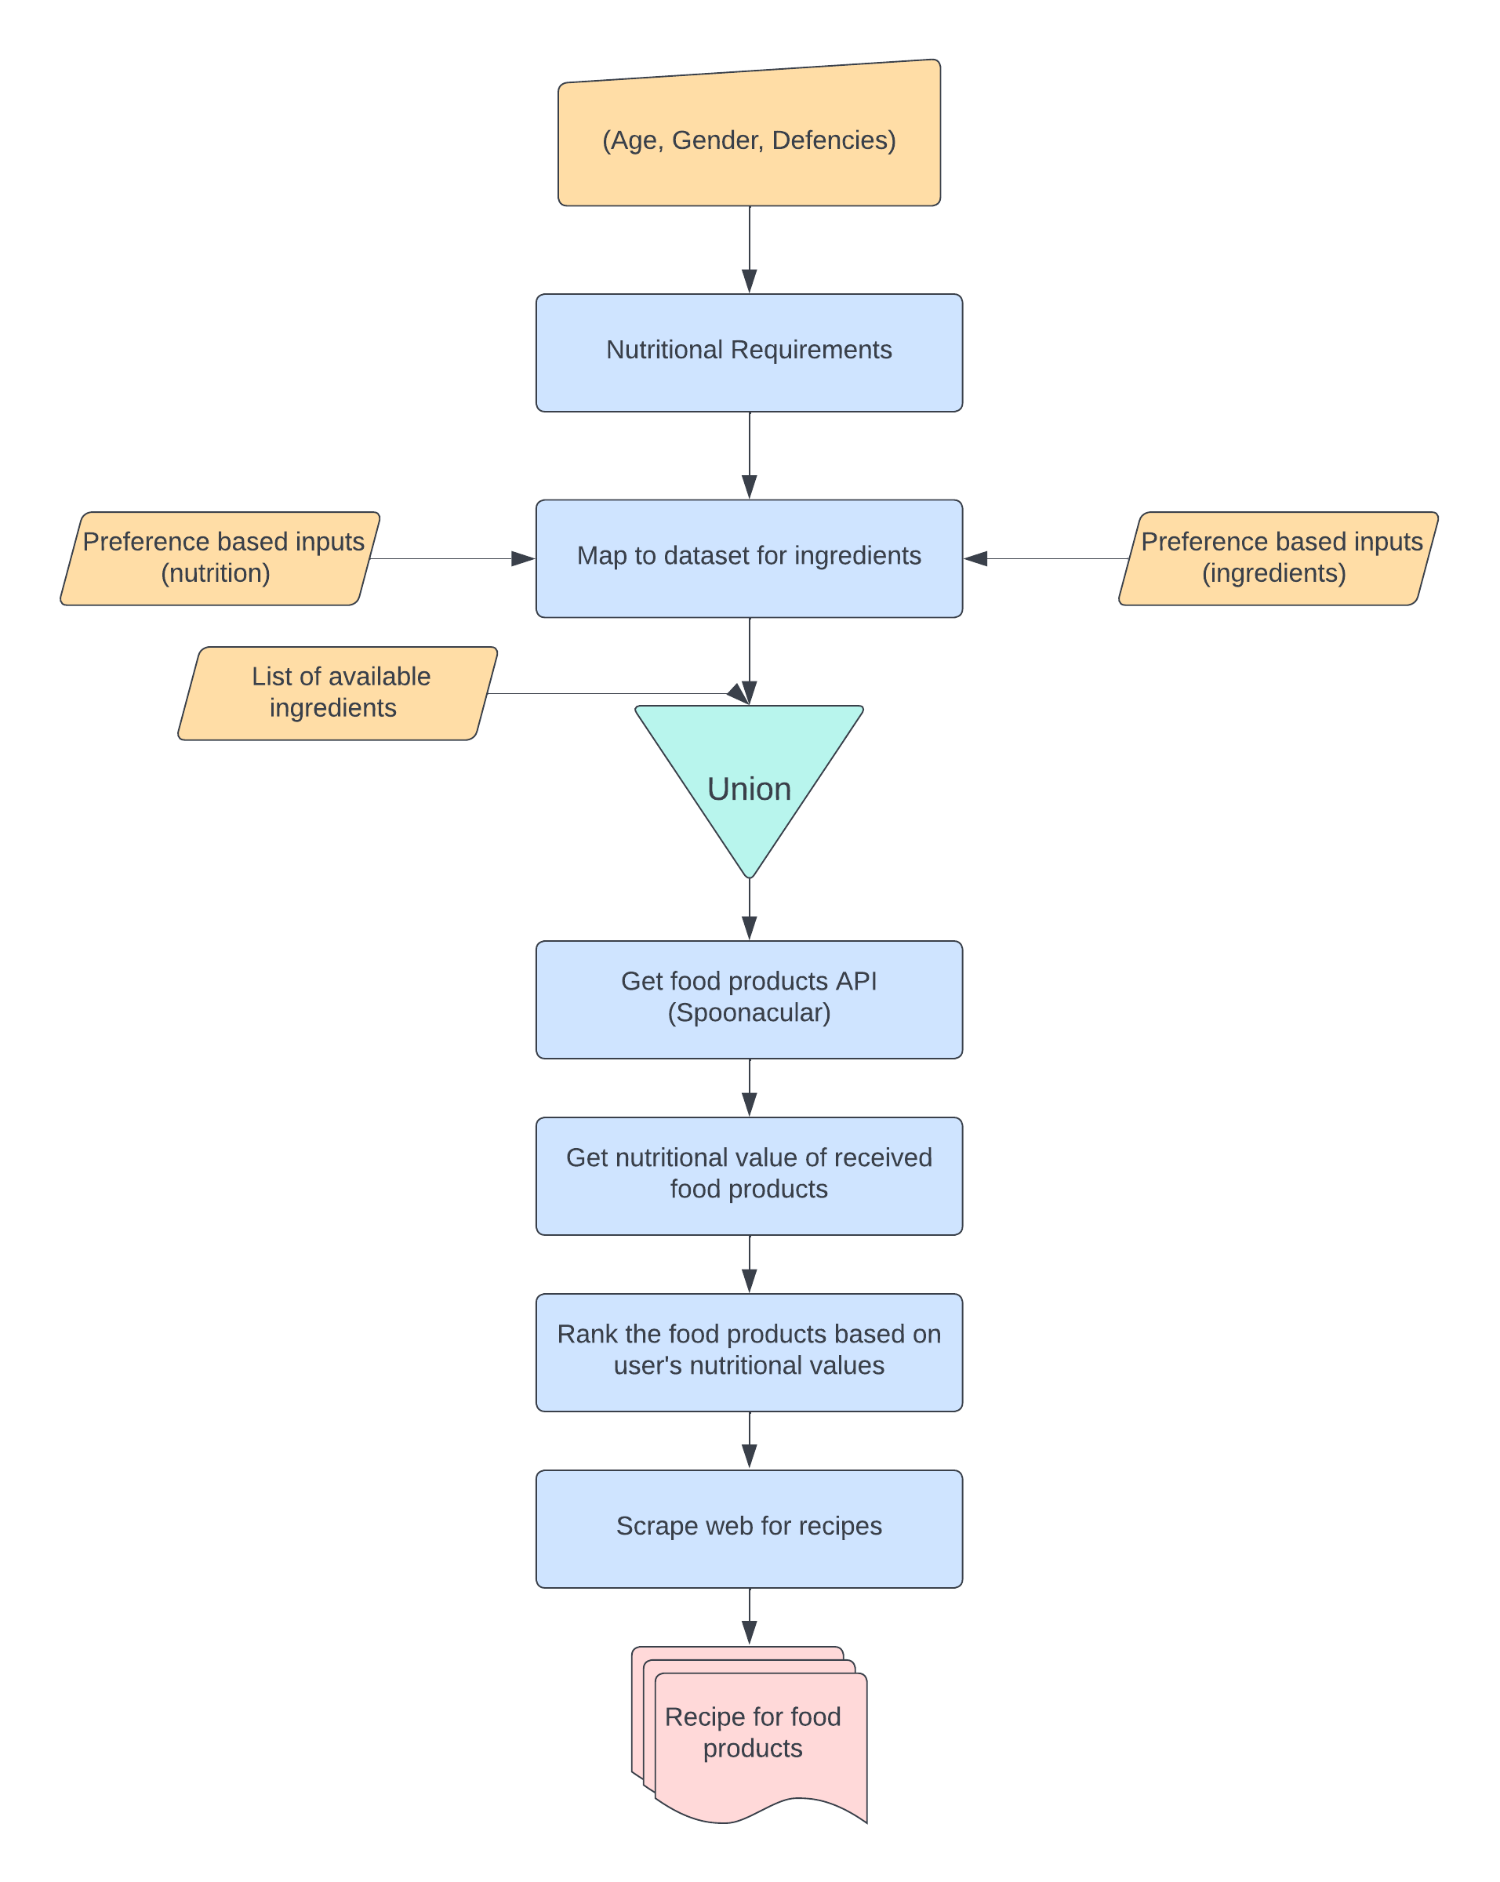
SYSTEM DESIGN
High Level Design

Slide 11
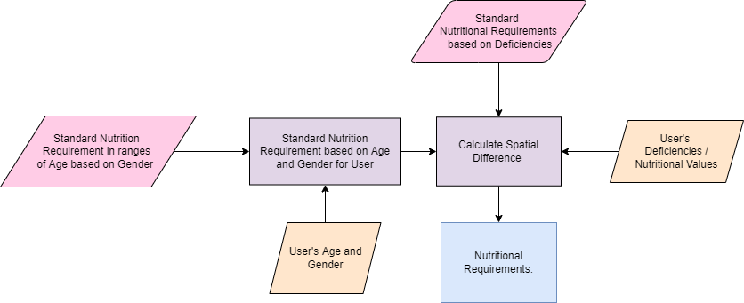
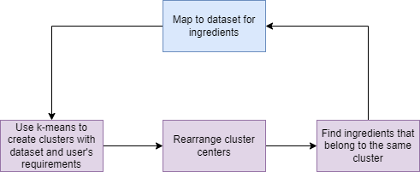
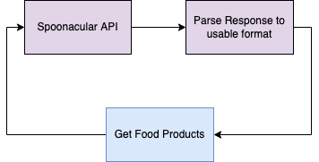
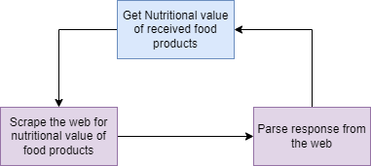
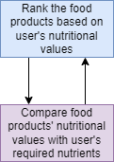
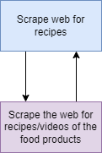
Low Level Designs

Slide 12
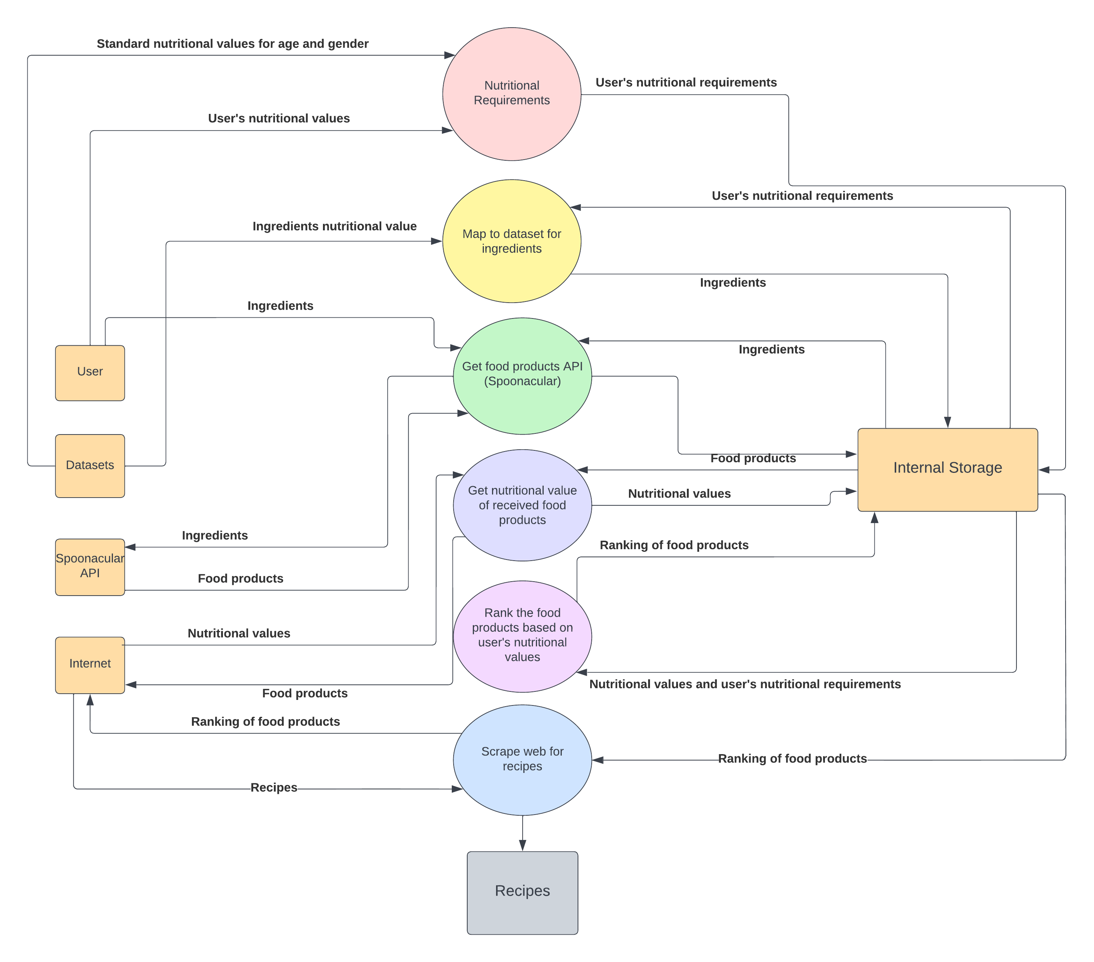
YOURDON AND COAD
DATA FLOW DIAGRAM

Slide 13

FUTURE WORK
Implementation of the first three functional modules of the system architecture i.e. Nutritional Requirements, Mapping Dataset Ingredients and Getting Food Products through API are successfully done. Remaining modules are yet to be implemented.
Integration of all functional modules in an end-to-end application with a sophisticated user-friendly UI/UX.
Testing on real-time user data.
Documentation of the research and results in a scientific paper.
Thank You
20

