Slide 1
SQL Mini Project
College Management System

Slide 2
College Management System
Problem Statement
A database that enables you to manage the functioning of college database system.
It should create a systematic and standardized record of different students, departments, faculty & Course .

Slide 3
AGENDA
Problem Statement
Concepts Used
ER Diagram
List of all method used
Code Walkthrough

Slide 4
Concepts Used
Stored Procedure
View
Conditional Statements
Joins
Aggregate Window function
Comparison Operator
SQL commands

Slide 5
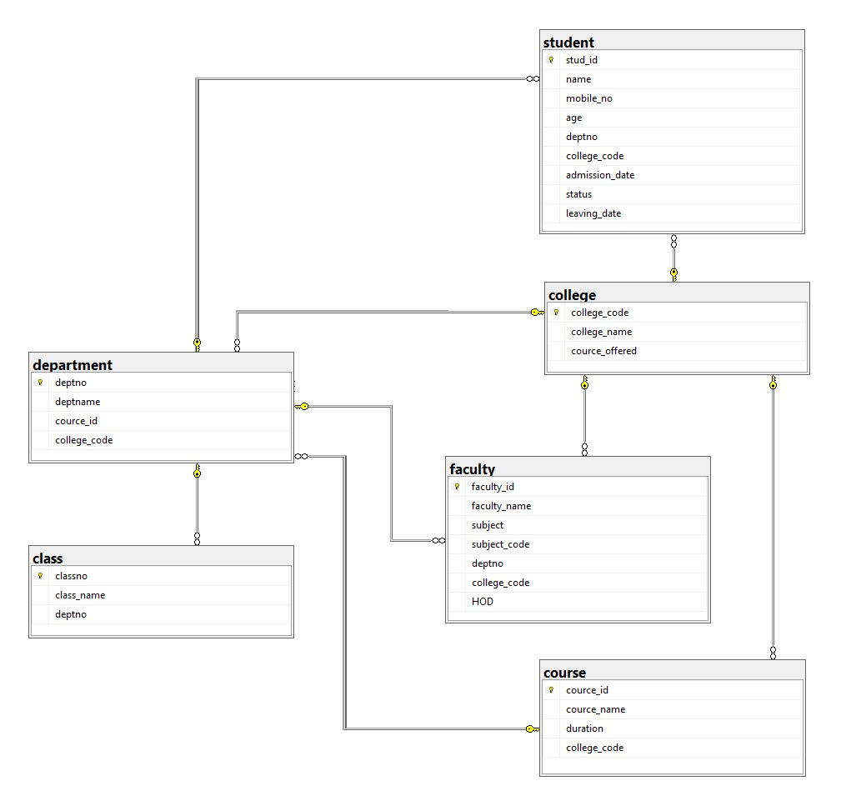

Slide 6
List of all methods Used
  Views
        vw_faculty_reports_to
        vw_department_wise_course
        vw_classroom_details
        vw_Count_faculty_incourse
        vw_pursuing_students
  Stored Procedures
        sp_add_passout_student
        sp_crud_student
        sp_crud_department
        sp_student_status

Slide 7
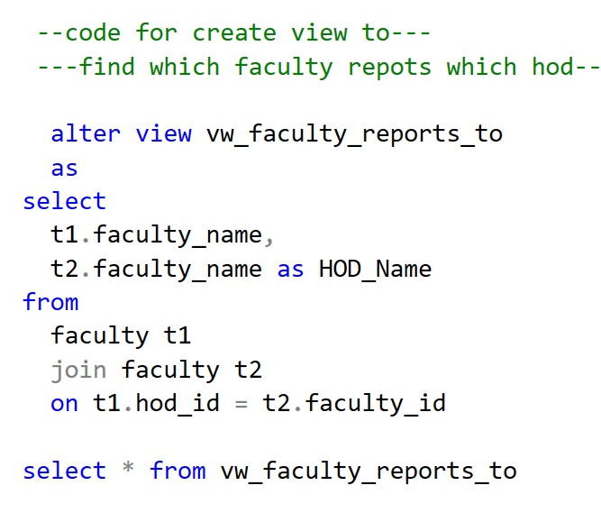
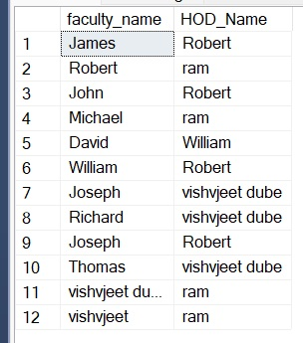
Code Walkthrough

Slide 8
Thank you

