Slide 1
Mulesoft Accelerator for Financial services Core Banking System
Gaurav Ahir

Slide 2
Design
Build a Core Banking System API specification for Accounts , Transactions and History operations.
Design RAML for below endpoints
1) GET- /accounts - add queryParameters - accountType?
POST - Create a new account.
/{ accounts } - Return details for an existing account.
Patch- Update details for an existing account.
2) GET /transactions - Manage transactions for an account
Add queryParameters- transactionType?
POST - Create a new transaction entry for this account.
/{transactionId} - Retrieve an existing transaction entry
3) GET /history: Obtain transaction history for an account, including running balance
For any Error occurred the original payload must be moved to MQ.

Slide 3
AGENDA
Design
Sequence Diagram
Supported Operations
Code Walkthrough

Slide 4
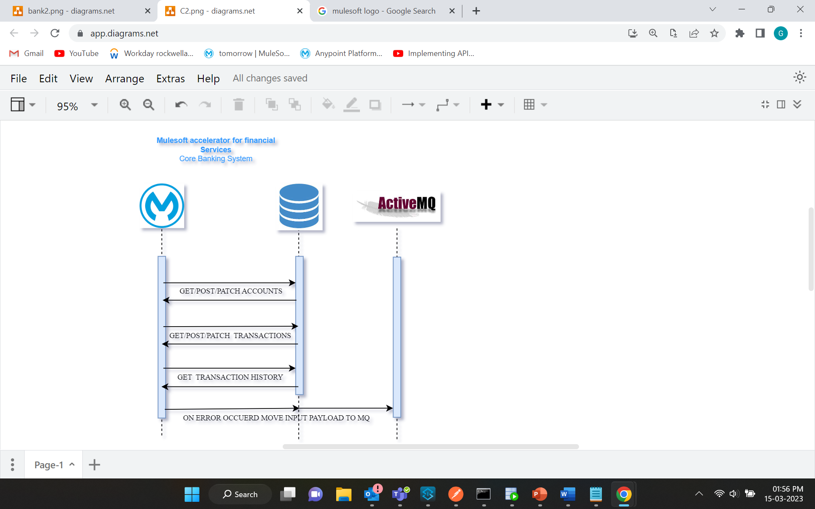

Slide 5
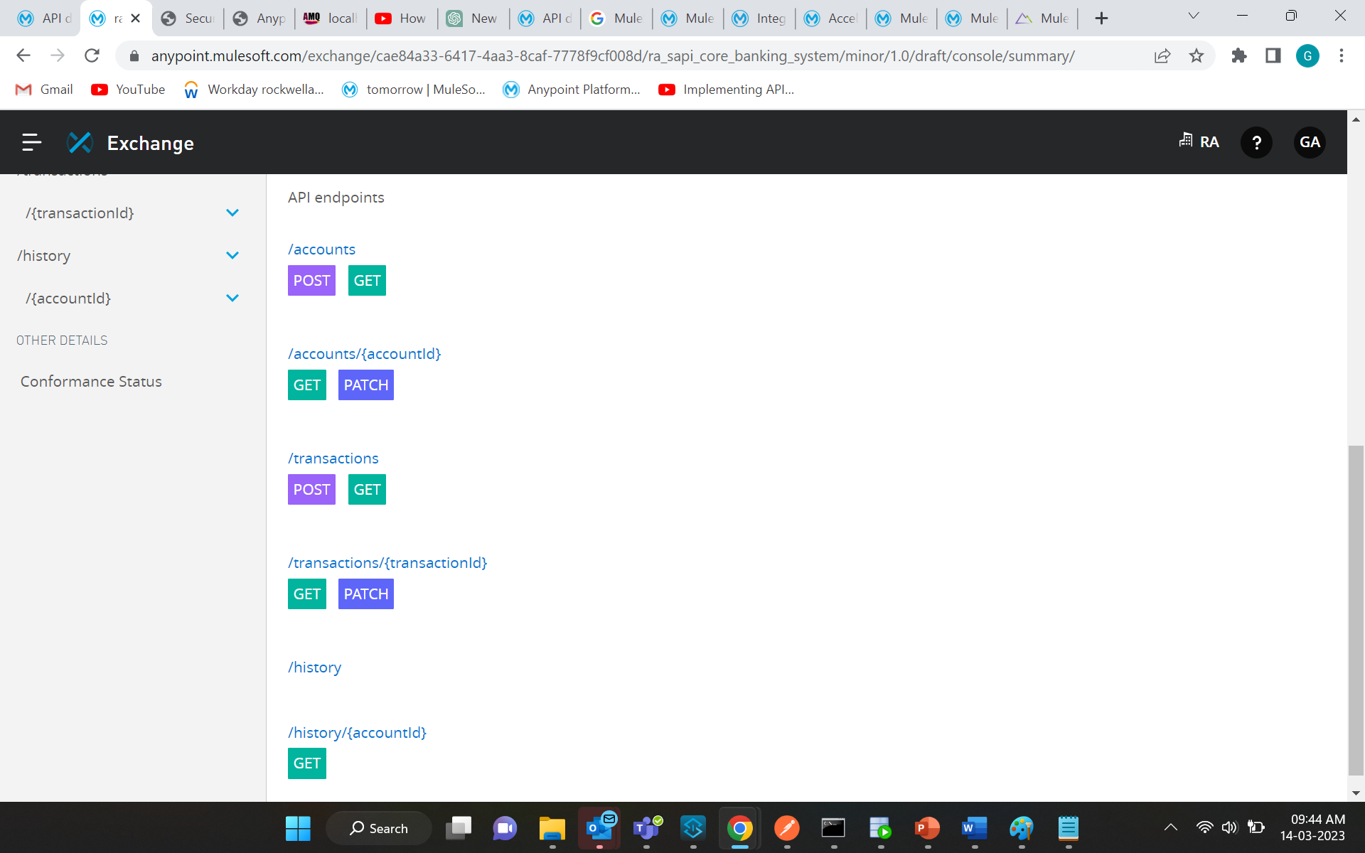
Supported Operation
Accounts
Add new accounts
Get account with a specific account type
Get specific account
Update balance for specific account
Transactions
Add new transactions
Get transaction with specific transaction type
Get specific transaction
Update specific transaction Details
History
Get transaction history for account
On error moved original payload to MQ

Slide 6
Code Walkthrough
RAML Design
API specification

Slide 7
Thank you

