Slide 1
SQS generator website
A site for building special quasirandom structures on BCC and FCC lattices.
You either fill the form yourself or paste your own Anthropic API key and describe the structure in a sentence, which costs about one tenth of a US cent per request. The model only fills the boxes. You check them and press Build.
Each build returns a POSCAR and a report. The report gives the Warren Cowley parameters shell by shell, and the atom counts you actually got after rounding onto a finite number of sites.
Before the search starts, the code measures 20 plain random configurations in the same cell at the same composition. The final objective is reported against those numbers, because the raw value depends on cell size and composition and means little on its own.
Every build carries a short random id, written into the POSCAR comment and the report header, so a structure and its report can be matched later. The site itself stores nothing.
https://sqs-builder-352776563610.us-central1.run.app/
9th sept 2026

Slide 2
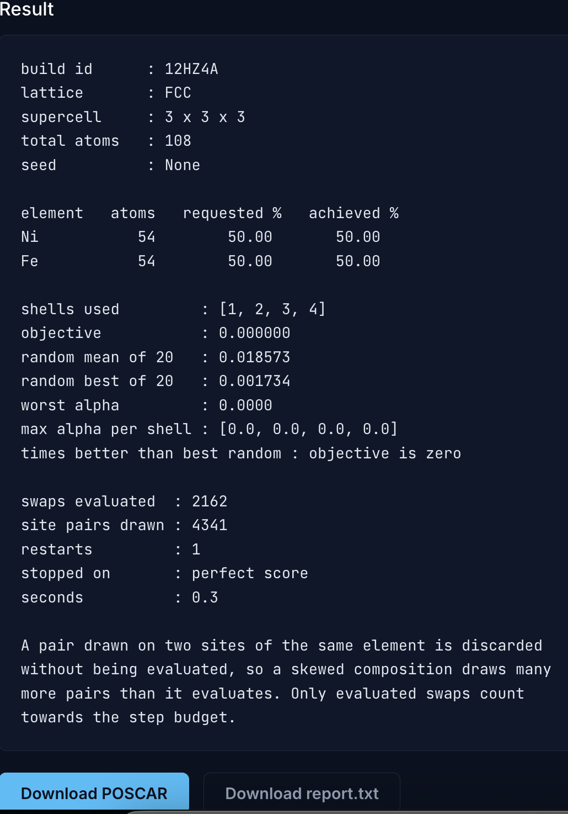
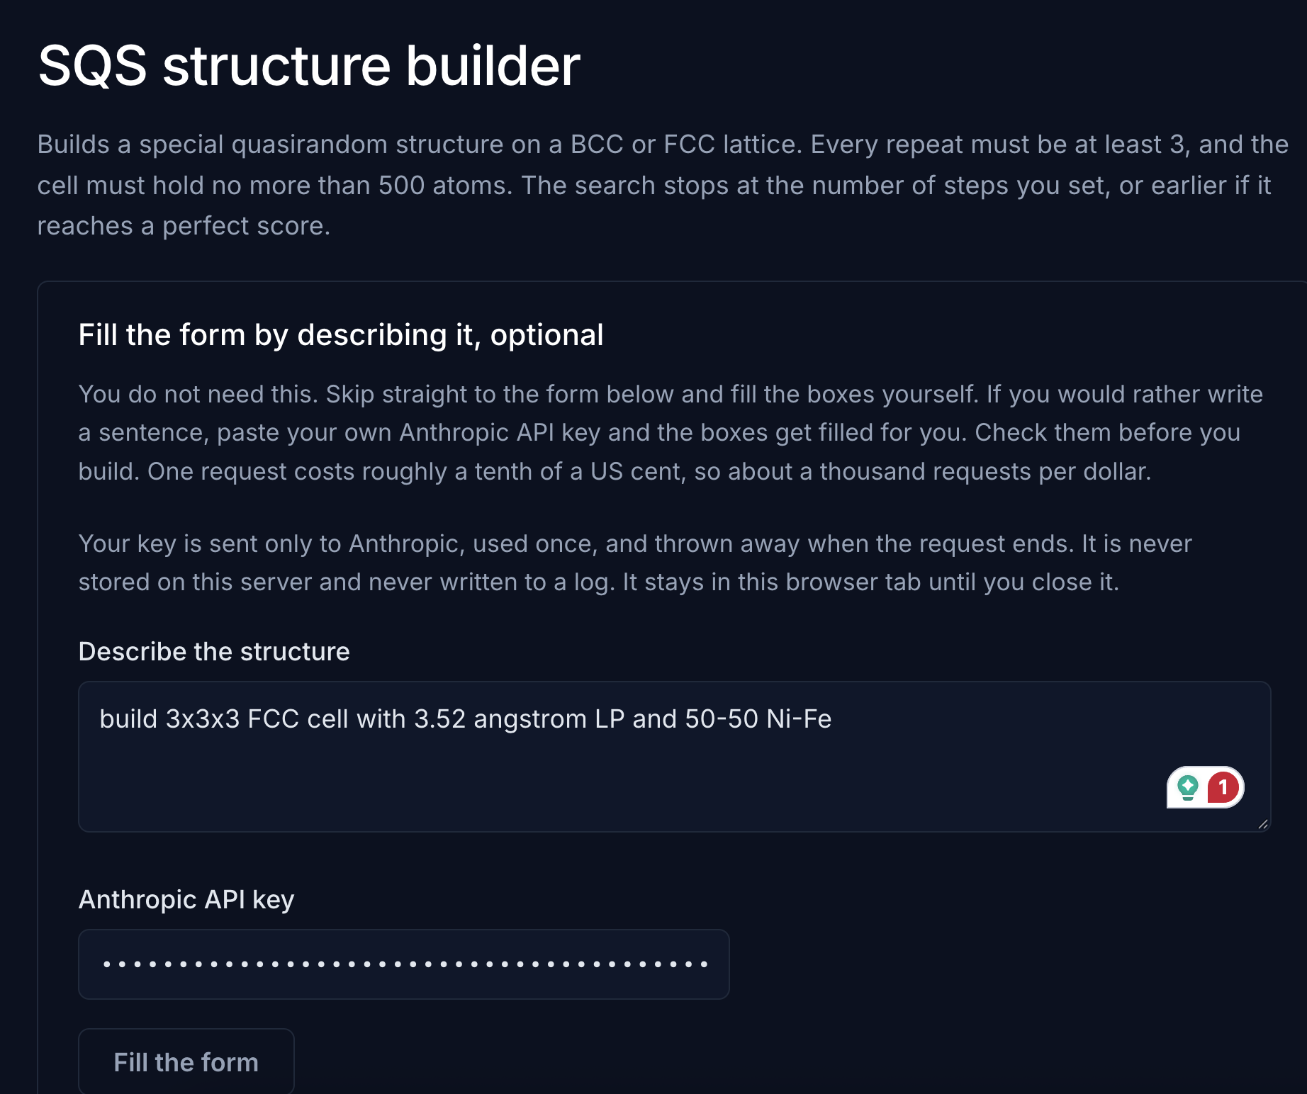
Working
Fill the form using LLM then check and click build
A perfect SQS structure

Slide 3
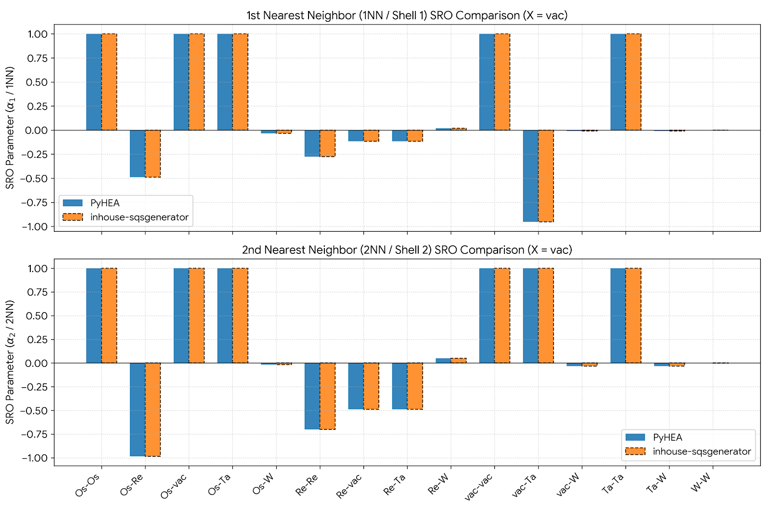
WC comparison for W10 with vacancies:
Os Re Vac Ta W 3 7 4 4 232
Exact Match: SRO values calculated by PyHEA and inhouse-sqsgenerator are identical across every pair for both the 1st and 2nd coordination shells.
9th sept 2026

