Slide 1
Insurance Claim Triage
TECHNICAL WALKTHROUGH
Red · trust below 0.3
AI agents investigate.
Plain code scores.
A person decides.
Review needed · 0.3 to 0.8
Green · above 0.8
Health, term life and motor claims
Synthetic data only · November 2026
Green is never an approval
Insurance Claim Triage · technical walkthrough
1
Notes:
Welcome. This walkthrough follows one insurance claim through the system we built: how the data is prepared, what each AI part does, how the score is computed, and what we measured. Everything runs on synthetic data. The one-line idea: AI agents investigate, plain code computes the score, and a person decides every claim.

Slide 2
Claims review is slow and uneven because proof is scattered
THE PROBLEM
📚
🕵️
🏥
⚖️
Evidence is scattered
Signals hide in text
History matters
Mistakes cost both ways
Policies, past claims, documents and provider history live in different places.
A large bill may be explained, or not, only in the discharge summary.
A hospital with several confirmed frauds deserves a closer look, even for a modest bill.
Paying a bad claim loses money; flagging an honest one delays a customer.
The brief: score each claim from 0 to 1 on a reviewer dashboard, always with a human in the loop, and treat evaluating the agents as the critical criterion.
Insurance Claim Triage · technical walkthrough
2
Notes:
A claims reviewer has to open the claim, the policy, past claims, the hospital or garage record and the documents, then decide. Doing that for every claim does not scale, and skipping it lets problems through. Four things make it hard: evidence lives in different places, some signals hide in text such as a discharge summary, a provider's history matters, and mistakes cost both ways: paying a bad claim loses money, flagging an honest one delays a customer. The team brief asked for a dashboard that scores each claim from 0 to 1, with a human always in the loop, and an agentic system where evaluating the agents is the critical criterion.

Slide 3
Every claim gets a trust score, a colour and plain reasons
THE SOLUTION
Red below 0.3
🤖
AI agents investigate
1
Strong signs of a problem, with reasons and evidence
They read the claim, look things up and propose findings with proof.
Review needed 0.3 to 0.8
🧮
Plain code scores
2
Something to check, or evidence is missing
Arithmetic turns the findings into the score, so it is repeatable.
Green above 0.8
👩‍⚖️
A person decides
3
Nothing found by the checks we ran. Never an approval
Every decision is saved, including ones that disagree with the system.
Insurance Claim Triage · technical walkthrough
3
Notes:
The output is a trust score from 0 to 1 where high means the claim looks legitimate. Below 0.3 is red, 0.3 to 0.8 is review needed, above 0.8 is green. Green means nothing was found by the checks we ran. It is never an approval. On the right are the three principles that shape every design choice: the AI investigates, plain code computes the score so it is repeatable, and a person makes every decision, which is saved with an audit trail.

Slide 4
Three lines of insurance, tested on 380 made-up claims
SCOPE AND DATA
600
2,253
380
12 · 13 · 4
customers
claims
evaluation cases
rules · tools · AI parts
🏥
Health
👪
Term life
🚗
Motor
Hospital bills, 1,444 claims
Payment to a nominee, 99 claims
Vehicle repairs, 710 claims
Synthetic data only. Names, phones and accounts live in a separate vault; the app and agents see tokens and coarse bands.
Insurance Claim Triage · technical walkthrough
4
Notes:
The data is entirely synthetic: 600 customers, 1,406 policies and 2,253 claims across health, motor and term life, built from a seed so it is reproducible. 380 of those claims are evaluation cases with hidden answer keys: 300 original cases across 10 scenarios and 80 hard cases that need reading a document or looking up a hospital's history. Personal details sit in a separate vault; the app and the agents only ever see tokens and coarse bands. The system has 12 rules, 13 read-only tools and four AI parts.

Slide 5
One agent inside a harness; code scores; a person decides
ARCHITECTURE
📥 Claim in
🛡️ THE HARNESS: the agent tries, the harness checks
🧠 Knowledge base
a claim ID only
long-term memory: patterns, clauses, precedents, lessons
🕵️ Investigator: the only tool-using agent
🧮 Plain code
📋 State
🧠 Memory
validate, pick the checklist, build the fact sheet
the claim, its checklist, the call budget
this claim's notes; a knowledge base for the long term
⚖️ Scorer: plain code
arithmetic; no model sets the score
🔁 Control loop
🧰 Tools
think, act, observe, stop; 16 turns at most
13 tools, all read-only
👩‍⚖️ Reviewer: a person
📏 Rules baseline
agree, change with a reason, or hold
12 rules on the same facts
🚧 Limits
✅ Verify
🛟 Recover
📝 Record
read-only; 7 or 9 calls
IDs checked; second opinion
retry, other vendor
run log, audit trail
🗂️ Audit trail
Insurance Claim Triage · technical walkthrough
5
Notes:
Read left to right. Plain code prepares the facts first and also feeds the 12-rule baseline. In the middle is the only tool-using agent, the Investigator, with the four parts the course names: state, memory, tools and a control loop. Around it is the harness, the course's central idea: the agent attempts the task and the harness checks whether the outcome is acceptable. Ours sets limits (read-only tools, 7 or 9 calls), verifies results (cited IDs must have been returned by a tool, a second vendor's model challenges and code judges its excuse), manages recovery (one retry, then the other vendor, then an honest analysis unavailable) and records the run. Then plain-code arithmetic scores, and a person decides. The knowledge base on the right is the long-term memory, and lessons enter it only through a reviewer and a safety gate. The illustrated version of this diagram is in the appendix.

Slide 6
Workflow or agent? We used the lightest tool that works
DESIGN CHOICE
Part | Choice | Why
Facts, 12 rules, scorer, checks | Workflow (plain code) | the path is fixed
Explainer, Reranker | One model call | one prompt, one answer
Verifier | One call plus a code gate | needs no lookups
Knowledge search | Retrieval | retrieve, then answer
Investigator | Agent | the next lookup depends on the last result
🧭 Default left
Rules came first: 99 to 99.5% right band on clean claims, and free.
🕵️ Agents earn their place
On hard cases: rules 50%, agents with retrieval 100%.
⚠️ Honest caveat
the hard cases were built to need reading
Reach for the lightest tool that works
Insurance Claim Triage · technical walkthrough
6
Notes:
The course's rule: if the path is fixed it is a workflow, and if the model chooses the path it is an agent; reach for the lightest tool that works. We applied it part by part. The facts, rules, scorer and checks are fixed recipes, so they are plain code. The Explainer and the Reranker are single model calls. The Verifier needs no lookups, so it is a single call followed by a code gate. Knowledge search is retrieval. Only the Investigator is an agent, because which lookup comes next depends on what the last one returned, with about 4 to 5 calls per claim. And we kept the comparison honest: the rules came first and score 99 to 99.5 percent on clean claims; the agent earns its place on the hard cases, where rules reach 50 percent and agents with retrieval 100 percent.

Slide 7
How autonomous is it? Suggest to Act-with-approval
AUTONOMY
📍 Our tool use: read-only
📍 Our claim decision: a person decides every claim
🤖 Level 4: Fully autonomous
❓ Level 3: Act, ask on risk
👍 Level 2: Act with approval
Runs to completion; a human sees results.
💡 Level 1: Suggest
Acts on safe actions; asks only on risk.
The model picks the action; a human clicks run.
🤖
The model writes; a human approves first.
❓
Human: every action
Human: every action, batched
Human: high-stakes only
Human: audit, not approval
⬆ Trust required grows
⬆ Cost of failure grows
⬆ Evaluation rigor grows
Insurance Claim Triage · technical walkthrough
7
Notes:
This is the course's four-level ladder. At level 1 the model writes and a human approves; at level 2 the model picks the action and a human clicks run; at level 3 it acts on safe actions and asks only on risk; at level 4 it runs to completion. Our claim decision sits at levels 1 to 2: the system recommends and a person decides every claim. Our tool use sits at level 3, but only because every tool is read-only, so no call can change anything. As autonomy rises the course says trust required, cost of failure and evaluation rigor all grow. A possible later step, auto-clearing clearly honest claims with random audits, would be level 3 for the decision, and would need real claim data, a measured error rate, fairness checks and legal sign-off; it is not planned for the MVP.

Slide 8
Plain code prepares the facts, then one agent looks things up
WALKTHROUGH 1 OF 3
FACT SHEET
🧠 Think
🔧 Use a tool
📖 Read the result
built by code first: bill 3.2 times peers for CLM-001714
what do I need?
look something up
what came back?
MODEL
Claude Haiku 5.5; Sonnet 5.5 for multi-policy customers
repeat, at most 7 times (9 if multi-policy)
STATE AND MEMORY
the claim, a call budget and this claim's notes
✅ Submit findings
a fixed form with real record IDs
CANNOT
score, approve or reject
Insurance Claim Triage · technical walkthrough
8
Notes:
Step 1 involves no AI. Code validates the claim, picks the checklist for its type, and builds a fact sheet as of the filing date: for CLM-001714 the bill is 3.2 times the typical amount across 10 comparable claims, and the area has a 19 percent confirmed-fraud rate against 7 percent on average. Step 2: the Investigator is the only true agent. It decides which tools to call, reads what comes back and repeats, then submits findings once through a fixed form. Its state is the claim, its checklist and the call budget; its memory is this claim only. It has at most 7 tool calls, or 9 for multi-policy customers, and every tool is read-only. It cannot score, approve or reject.

Slide 9
A second opinion from another vendor, checked by code
WALKTHROUGH 2 OF 3
1
2
3
4
Finding
Verifier
Code gate
Result
Bill is 3.2 times peers, confidence 1.0
GPT-4o-mini suggests weakening: only 10 peers compared
Too thin means fewer than 5 peers. Ten is not fewer than five
Challenge ignored. The finding stays at full confidence
The model may keep, weaken or drop a finding. It can never add one or raise a confidence.
An early version doubted everything; the code allow-list fixed it
Insurance Claim Triage · technical walkthrough
9
Notes:
The Verifier is a sceptic from a different company, GPT-4o-mini, so the second opinion is independent. It may only keep, weaken or drop a finding, never add one or raise confidence. The important part is the code gate. In our example the Verifier suggested weakening the bill finding because only 10 peers were compared. But the code only accepts a challenge when the named fact is on a short allow-list and really holds; for a bill outlier that means fewer than 5 peers. Ten is not fewer than five, so the challenge was ignored and the finding stayed at full confidence. An early version without this gate doubted almost everything with invented excuses, and most fraud landed in review instead of red.

Slide 10
Arithmetic sets the score, then a model words it
WALKTHROUGH 3 OF 3
Worked example · CLM-001714
🧱
Two caps
A missing required document caps trust at 0.80. An exact duplicate caps it at 0.29.
trust = (1 − 0.90 × 1.0) × (1 − 0.25 × 1.0)
Bill far above peers
weight 0.90 × confidence 1.0
🎨
Three bands
Below 0.3 red, 0.3 to 0.8 review needed, above 0.8 green.
High-fraud area
weight 0.25 × confidence 1.0
Combined
0.10 × 0.75 = 0.075
🧾
Then the Explainer
0.075 is below 0.30: Red
Claude Haiku words the findings; a code check rejects any invented ID or number.
Insurance Claim Triage · technical walkthrough
10
Notes:
The score is plain arithmetic: each finding contributes its weight times its confidence, and the trust score is the product of one minus each contribution. This noisy-OR form means one strong finding dominates and two weak ones add up. For the example claim: a bill outlier with weight 0.9 and confidence 1, and a high-fraud-area finding with weight 0.25 and confidence 1, give 0.1 times 0.75, which is 0.075. That is below 0.3, so red. Two caps protect against over-trusting: missing a required document caps trust at 0.8 so the claim can never be green, and an exact duplicate caps it at 0.29. Only then does the Explainer, Claude Haiku, rewrite the findings in plain sentences, and a code check rejects any invented ID or number.

Slide 11
Hybrid search finds a hospital's record and shared accounts
RETRIEVAL
🔤
Keyword search
🕸️
Link search (graph)
🧭
Meaning search
Matches the exact words in pattern cards, policy clauses and past claims.
Follows links: the hospital's record, a shared bank account, the same vehicle.
Would match the same story in different words.
Built
Built
Planned
1
Merge the lists
2
Reorder
3
Top 5 to the Investigator
Rank fusion: an item found by several arms rises
Claude Haiku puts the most useful first
Context to weigh, never proof
The payoff on hard cases: 71% without retrieval, 100% with it
Insurance Claim Triage · technical walkthrough
11
Notes:
The knowledge search runs two arms that are built, keyword search and a graph walk, plus a third arm, search by meaning, that is planned and not built. The lists are merged by reciprocal rank fusion, a small model reorders the top ten, and the top five go to the Investigator as context. They are never proof: only precedent claim IDs can be cited as evidence, and only decisions made before the claim was filed are used. The payoff shows on the hard cases: without retrieval the agents scored 71 percent and called every bad-hospital fraud green; with retrieval they scored 100 percent on both dev and held-out.

Slide 12
Memory: lessons enter long-term memory only through a gate
MEMORY
🧠 Working memory
The gate every lesson passes
this claim's notes and tool results, during one run
1
A reviewer ticks a finding and writes a note
💬 Session memory
2
Six content checks on the text: real IDs, no personal data, no instructions
none: one run is one claim
3
36 frozen test searches, with and without the lesson
🗄️ Long-term memory
the knowledge base, retrieved once per claim
4
Active: agents may search it; the scorer never reads it
🚧 Not built: lesson expiry, memory evals
🛟 Graph down? It stays pending: fails closed
Insurance Claim Triage · technical walkthrough
12
Notes:
The course describes three kinds of memory. Working memory is the current turn; ours is the Investigator's notes and tool results for one claim. Session memory spans a conversation; we have none, because one run is one claim. Long-term memory spans sessions; ours is the knowledge base, retrieved once per claim. The course's guardrails are to save only high-signal information, ask before saving, block sensitive data, forget stale memory, and evaluate memory. We do the first three: a reviewer must tick a finding and write a note, then six content checks and 36 frozen test searches run before agents can find it, and if the graph is down the lesson stays pending, so it fails closed. We do not yet expire old lessons, and we have not measured whether lessons improve decisions; the gate only proves they do not make search worse.

Slide 13
Small model by default, larger only where it helps
MODELS AND COST
Investigator
Claude Haiku 5.5, Sonnet 5.5 if multi-policy
free
Rules, no AI
Verifier
GPT-4o-mini
Explainer
Claude Haiku 5.5
≈ $0.004
per claim, small model
Reranker
Claude Haiku 5.5
≈ $0.07
per claim, larger model (about 18 times)
Rules, tools, scorer, checks
Plain code, no AI
Final decision
A person
$10.4
all agent runs to date
Judge (planned)
GPT-4o, not built
Each AI job falls back to the other vendor once.
Insurance Claim Triage · technical walkthrough
13
Notes:
Claude Haiku 5.5 does most of the work: the Investigator, the Explainer and the reranker. Claude Sonnet 5.5 takes over the Investigator only for customers with more than one policy. GPT-4o-mini is the Verifier, deliberately from a different company, and it is also the standby for every job. Plain code does the rules, tools, score and safety checks. Costs: rules are free, the small model about four tenths of a cent per claim, the larger model about seven cents, roughly 18 times more. All agent runs so far, including early samples, cost about 10.4 dollars.

Slide 14
Review queue design: what a reviewer needs to see
HUMAN IN THE LOOP
📌 Task
👉 Recommended action
Review actions
claim, customer ID, line, amount
the suggested next step
✅ Approve: Agree with the system's band
💬 Reasoning summary
🔎 Evidence
✏️ Override: Change the band, with a required reason
why this score, in plain words
cited IDs open in a viewer
⏸️ Hold: keep open, with a note
🛠️ Tool calls
📊 Confidence
the tools the agent used
trust score and per-finding confidence
🔼 Escalate: name a colleague; the claim moves to them
Every decision is saved, including disagreements
Insurance Claim Triage · technical walkthrough
14
Notes:
The course says a review queue should show six things: the task, a recommended action, a reasoning summary, the evidence, the tool calls and the confidence. Our Claim page shows all six: the header, the suggested next step, why this score in plain words, evidence IDs that open in a record viewer, the tools the agent used, and the trust score with each finding's confidence. On the right are the review actions. Approve is Agree, Override is Change the band with a required reason, Hold keeps the claim open with a note, and Escalate hands the claim to a named colleague with a reason; the claim stays open and moves to that person. Every decision is saved, including ones that disagree with the system. Optional structured tags say what was wrong with the output, and a claim can have an owner, shown in the queue with an Assigned to me filter. Not built: editing the reasons. Of the course's anti-patterns we avoid hiding evidence and vague approval prompts; unclear ownership is now handled with an owner, though there is no deadline, and we do review every claim, by design at this autonomy level.

Slide 15
Five ways agents fail, and what stops each
FAILURE MODES AND HARNESS
What goes wrong | What stops it | Gap
🔁 Gets stuck in a loop | 7 or 9 calls, 16 turns, repeated calls caught | no progress check
🤥 Invents a tool or input | unknown tools refused; every tool is read-only | none known
💸 Wastes tokens | call budget, small model by default, cost per claim | no per-claim token cap
🎲 Makes a bad decision | IDs verified, second opinion judged by code, code scores | no up-front plan check
🧰 Uses the wrong tool | the checklist names the lookup; inputs are validated | the choice is not checked
🚧 Set boundaries
✅ Verify results
🛟 Manage recovery
📝 Record the run
Insurance Claim Triage · technical walkthrough
15
Notes:
The course names five failure modes. Loops: we cap tool calls at 7 or 9 and turns at 16, and repeated identical calls are caught. Invented tools or inputs: unknown tools and bad arguments are refused, and every tool is read-only. Wasted tokens: the call budget, a small model by default, and a cost count per claim; an answer limit that was too low wasted tokens in about 3 in 10 explanations until we fixed it. Bad decisions: every cited ID must come from a tool, a second vendor's model challenges and code judges its excuse, and code does the scoring. Wrong tool: each checklist names the lookup for each finding and inputs are validated. The gaps are honest: no check that progress is being made beyond the budget, no per-claim token cap, no up-front plan to validate, and nothing checks that the right tool was chosen. The four boxes at the bottom are the harness: set boundaries, verify results, manage recovery, record the run.

Slide 16
Rules win on clean claims; agents with retrieval win on hard ones
RESULTS
Clean claims
Rules 99 to 99.5%, agents 91.5 to 93%. No fraud in green on any agent run.
Hard cases
Agents with retrieval 100% against 50% for the rules; 71% without retrieval.
Larger model
95% on the two weakest scenarios, about 18 times the cost.
Insurance Claim Triage · technical walkthrough
16
Notes:
This chart is the central result and it is not flattering to the agents on clean data. On the original claims the plain rules score 99 to 99.5 percent against 91.5 to 93 percent for the agents, and dev and held-out agree. The agents never put a fraud in green or an honest claim in red on those claims; their misses were fraud sent to review instead of red, mostly cross-policy cases on the small model. On the 80 hard cases the picture flips: rules get half right, agents without retrieval 71 percent, and agents with retrieval 100 percent on both splits. Remember the hard cases were designed to favour reading and lookup, so they show what those abilities are worth, not how often they matter. The larger model on the two weakest scenarios reached 95 percent against 65 to 78 percent for the small model, at about 18 times the cost.

Slide 17
What went wrong along the way, and what we did about it
HONEST FINDINGS
🎯
🧐
📝
An early 30 of 30 was overfit
The Verifier doubted everything
Explanations came back empty
We had tuned on those exact cases. We excluded it and ran full dev and held-out sets.
Most fraud landed in review. A code allow-list of valid excuses fixed it.
Traces showed about 3 in 10 rewrites falling back. The token limit rose from 900 to 2,500; scores were never affected.
Reporting these is part of the result.
Insurance Claim Triage · technical walkthrough
17
Notes:
Three findings worth being open about. First, an early sample scored 30 out of 30, but we had tuned on those exact cases, so we excluded it and ran full dev and held-out sets instead. Second, the Verifier doubted nearly every finding with invented excuses, which sent most fraud to review; a code allow-list of valid excuses fixed that. Third, a Langfuse trace of one claim showed the Explainer returning empty answers because the model's hidden thinking used up its 900-token limit. Across saved runs about 3 in 10 rewrites fell back to the original sentences. We raised the limit to 2,500 tokens and re-checked three claims. Scores were never affected because the Explainer never touches them, but the full runs were not repeated. Reporting these is part of the result.

Slide 18
Lifecycle and MINT: start simple, justify every layer
LIFECYCLE
🎯 Scope
🧪 Prototype
🏗️ Build
📏 Evaluate
🚀 Deploy
📡 Monitor
Done
Done
Done
Mostly done
Local only
Partly
MINT: justify every layer with evidence
🌱 Rules first
🕵️ Agent plus retrieval
🛡️ Second-vendor validator
99 to 99.5% right band on clean claims, and free
hard cases from 50% to 100%, about $0.004 a claim
its own effect on accuracy is not yet isolated
Insurance Claim Triage · technical walkthrough
18
Notes:
The course's agent development lifecycle has six stages. Scope, prototype and build are done: the problem and boundary were defined, we built the rules baseline before the agents, and we built for traceability. Evaluate is mostly done: dev, held-out and hard cases against hidden answer keys, 192 tests; not done are stability and explanation quality. Deploy is local only. Monitor is partial: cost, time and failure counts per run, optional traces, but no drift tracking. MINT says start simple, justify every layer and add complexity only when reality forces it, because most failures are complexity you invited in. Layer one, the rules, is free and strong on clean claims. Layers two and three, the agent with retrieval, are justified by the hard cases, from 50 to 100 percent. Layer six, the second-vendor validator, is the one whose separate effect on accuracy we have not isolated yet, and we say so.

Slide 19
Honest limits, a clear next step
LIMITS AND NEXT STEPS
WHAT WE KNOW
NEXT, IN ORDER
Rules beat agents on clean data
Agents with retrieval win on hard cases
The guard rails hold: 192 tests, none failing
1
Rotate the keys, set spending limits
2
Close the gaps: lesson expiry, monitoring
WHAT WE DO NOT
Free checks on saved results, then stability and the larger model (about $6)
3
Accuracy on real claims
Fairness of the agents across groups
Stability and explanation quality
4
Pilot on real claims with an encrypted vault and logins
Models propose and explain. Code scores. A person decides.
Insurance Claim Triage · technical walkthrough
19
Notes:
To close: what we know and what we do not. We know the rules beat the agents on clean data, that agents with retrieval win on hard cases, and that the guard rails hold: 192 tests, none failing. We do not know real-world accuracy, whether the agents treat groups fairly, whether the same claim gets the same answer each time, or how good the explanations are. Next steps in order: rotate the API keys and set spending limits; run the free checks on saved results, such as a rules-first design and a fairness table; run a stability check and the larger model on the remaining scenarios for about six dollars; and, only then, a pilot on real claims with an encrypted vault and logins. The one line to remember: models propose and explain, code scores, a person decides.

Slide 20
Appendix
A1 The 12 detection rules
A2 The 13 read-only tools
A3 Data layers and who can read them
A4 The graph model
A5 Questions people ask
A6 How we evaluated
A7 Agent architecture and harness (illustrated)
A8 The multi-agent view (illustrated)
A9 Gaps against the course framework
Insurance Claim Triage · technical walkthrough
20
Notes:
Reference slides for questions: the 12 rules, the 13 tools, the data layers, the graph model and a short Q and A.

Slide 21
The 12 detection rules
APPENDIX A1
Finding code | Line | Fires when | Weight
DUPLICATE_CLAIM | health | same provider, procedure, dates and amount | 0.90
BILL_OUTLIER_VS_PEERS | health | bill is 2.0× or more the peer median | 0.90
PRE_EXISTING_NEAR_INCEPTION | health | undeclared condition within 90 days of start | 0.90
NOMINEE_CHANGE_NEAR_EVENT | term | nominee changed within 45 days before death | 0.90
DOC_DATE_MISMATCH | term | death dates differ by 7 or more days | 0.90
EARLY_DEATH_VS_HEALTH_HISTORY | term | death within 180 days, earlier serious claim | 0.90
REPEAT_INCIDENT_CLAIM | motor | same vehicle and date claimed before | 0.90
DAMAGE_IN_PRIOR_INSPECTION | motor | 2 or more parts already damaged, no repair | 0.90
SHARED_ENTITY_CLUSTER | motor | 3 or more unrelated customers, one account | 0.90
CROSS_POLICY_INCIDENT_MISMATCH | health + motor | same accident, conflicting dates or places | 0.90
HIGH_FRAUD_AREA | all | area has a high confirmed-fraud rate | 0.25
COVER_VS_INCOME_MISMATCH | all | sum insured 20 to 30 times income | 0.15
Insurance Claim Triage · technical walkthrough
21
Notes:
The rules-only baseline. Weights are illustrative and were tuned on dev only. Thresholds live in config/weights.yaml; rules in scoring/rules.py.

Slide 22
The 13 read-only tools
APPENDIX A2
Tool | What it answers
get_claim | one claim: amounts, dates, provider, document types
get_claim_documents | the scrubbed text of the documents on file
get_claim_facts | the prepared fact sheet, as of the filing date
get_area_signal | whether the area has a high confirmed-fraud rate
get_customer_summary | coarse profile and history counts
get_policy | cover, dates, status, nominee relation
get_person_timeline | a customer's events, newest first
find_similar_claims | same invoice, near-duplicate, same vehicle and date, same account
get_provider_stats | a provider's volume and typical bill versus peers
get_vehicle_inspections | inspections and repairs for a vehicle token
find_shared_entities | customers sharing a phone, address or bank token
search_documents | keyword search over documents or claim descriptions
search_knowledge | hybrid search over patterns, clauses, signals and precedents
Insurance Claim Triage · technical walkthrough
22
Notes:
Every tool validates its arguments, limits its output, answers as of the claim's filing date, returns no personal data and remembers the IDs it returned.

Slide 23
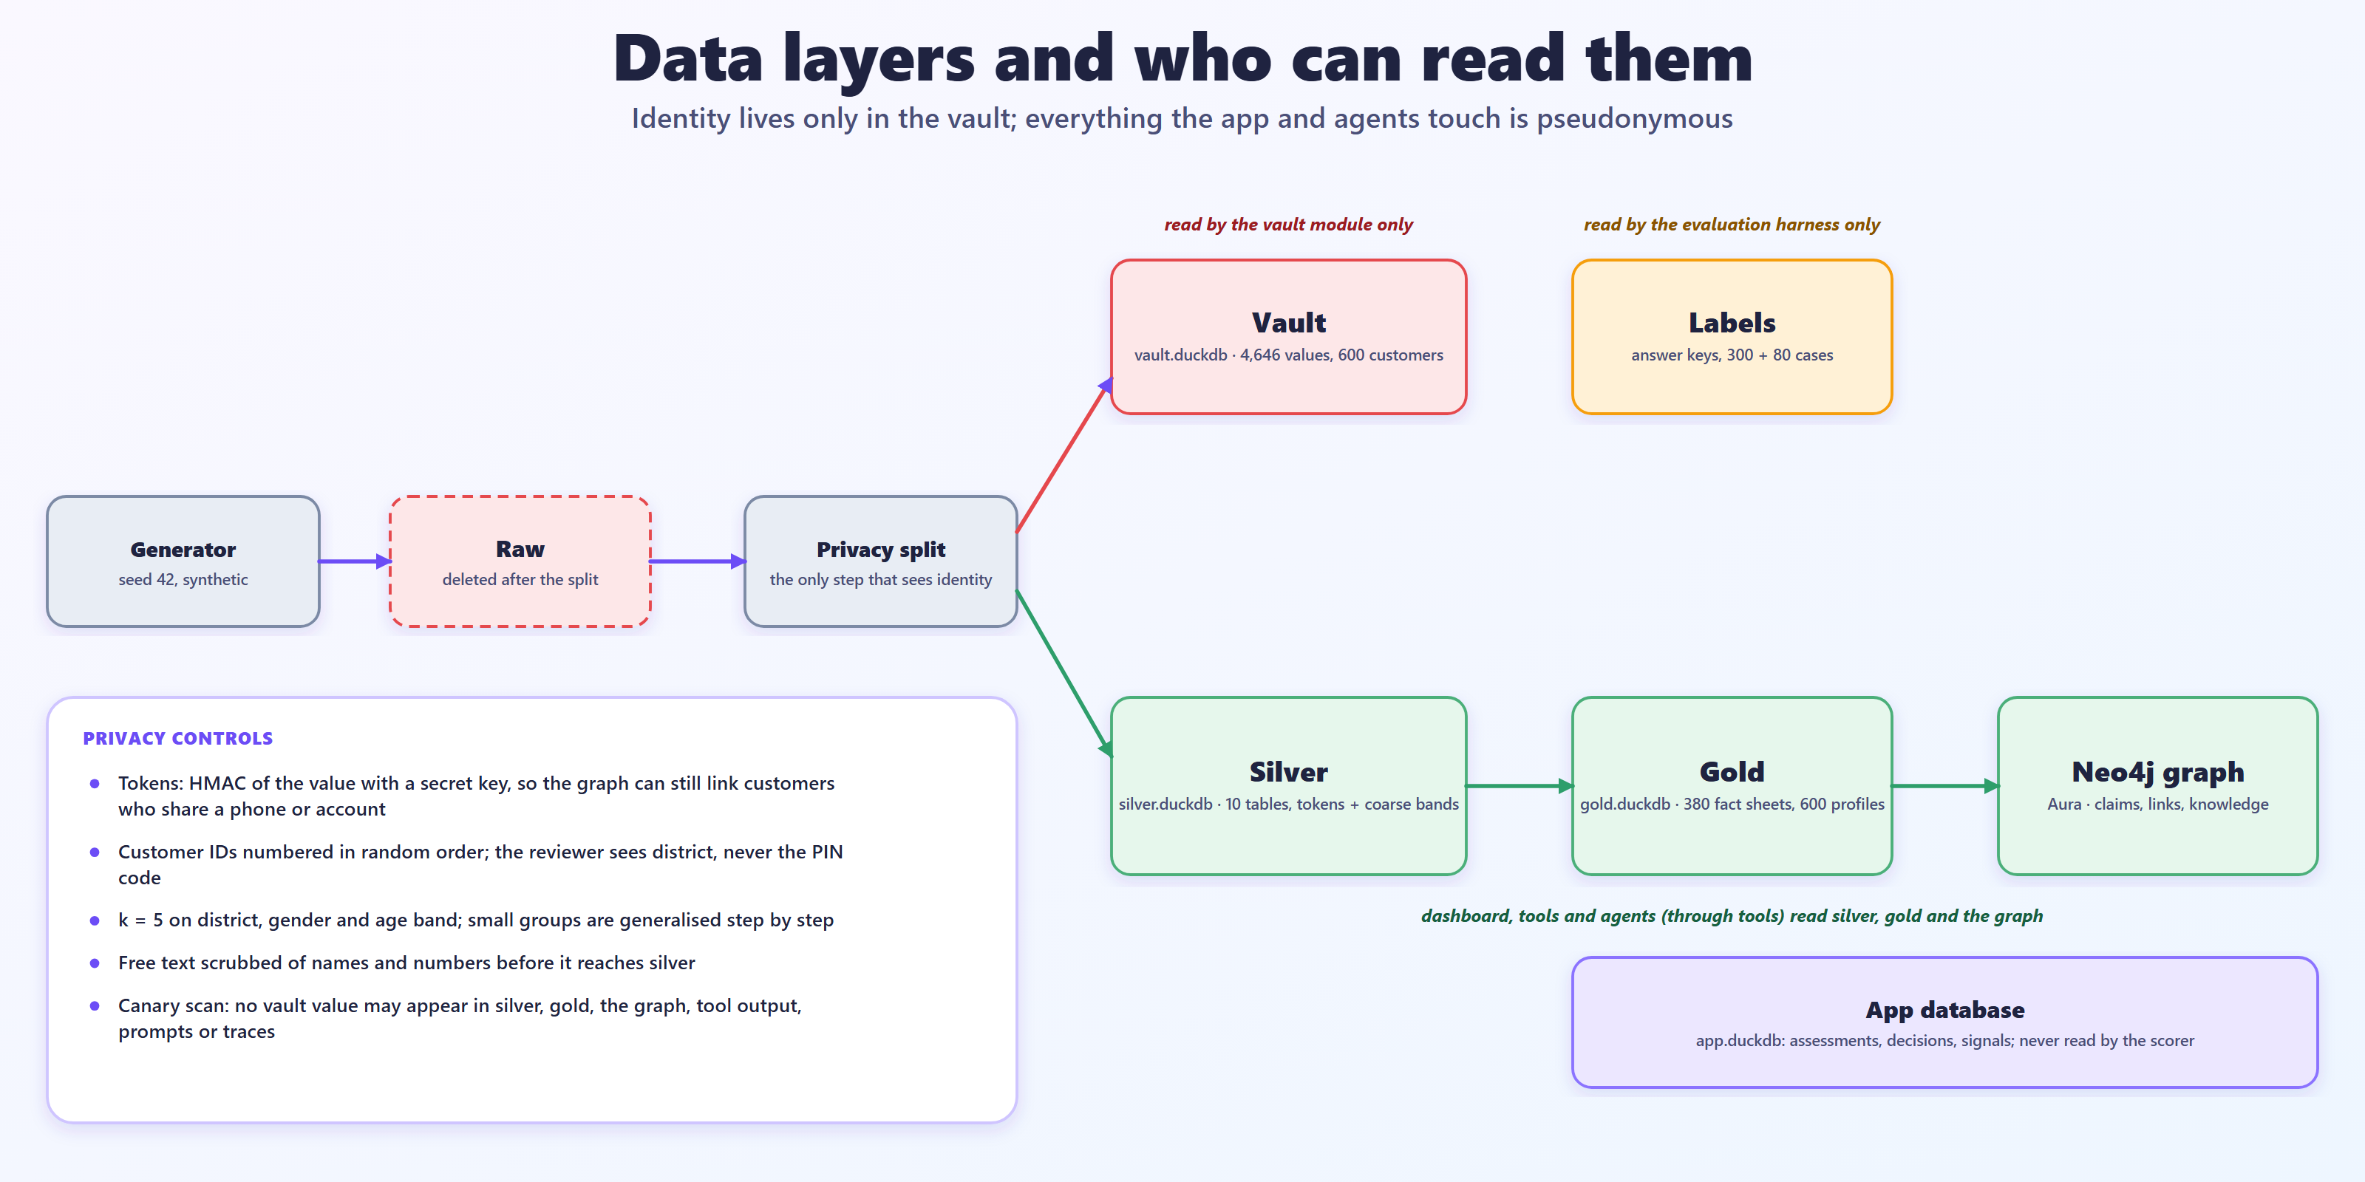
Data layers and who can read them
APPENDIX A3
Insurance Claim Triage · technical walkthrough
23
Notes:
Identity lives only in the vault. Silver is the only layer the app sees. Labels are read by the evaluation harness only. The app database holds assessments, decisions and signals and is never read by the scorer.

Slide 24
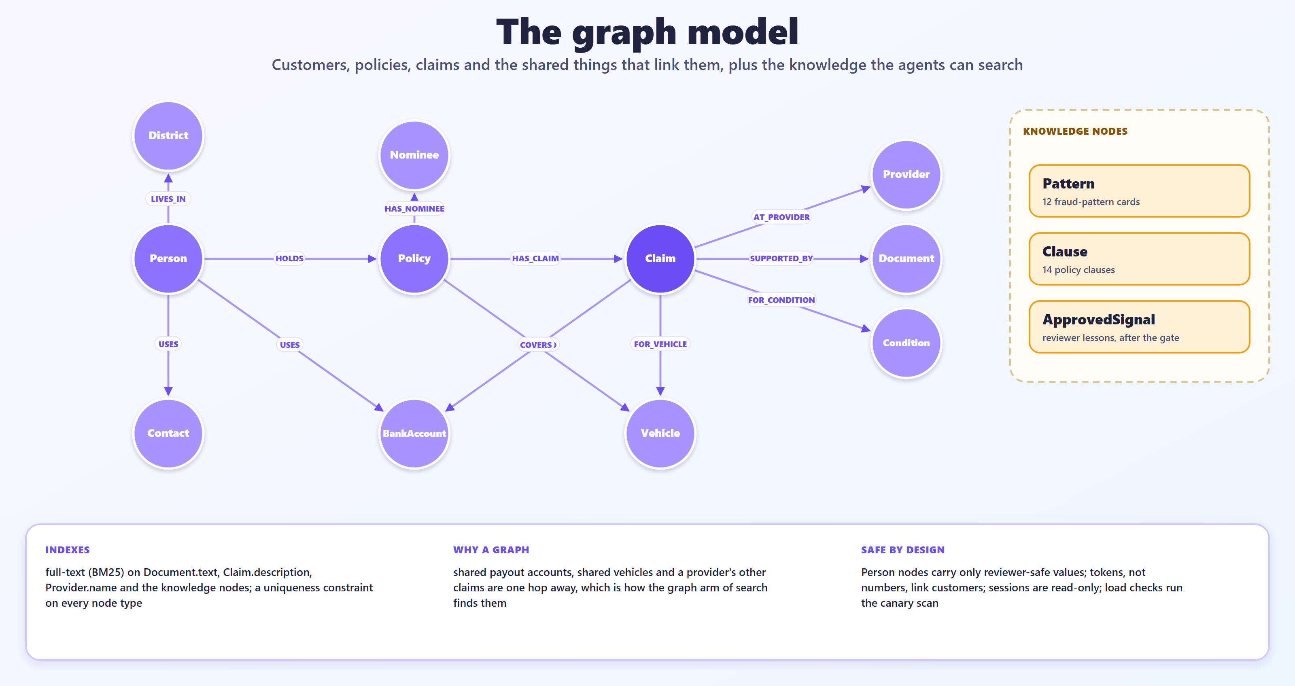
The graph model
APPENDIX A4
Insurance Claim Triage · technical walkthrough
24
Notes:
Customers, policies, claims and the shared things that link them, plus the knowledge nodes agents can search. Full-text indexes cover documents, claim descriptions, provider names and knowledge nodes.

Slide 25
Questions people ask
APPENDIX A5
Why not just ask ChatGPT?
Can the AI reject a claim?
One answer cannot be checked. Here every finding cites real records, a second model argues back, and code sets the score.
No. It recommends; a person decides every claim. Green never means approved.
If a claim is flagged, is it fraud?
What if the AI is wrong?
No. A flag means look closer, with reasons and records.
Layers: evidence check, second opinion, code scoring, a reviewer, an audit trail, and measured results.
Is real data used?
Could it go live?
No. Everything is synthetic, and personal details sit in a separate vault.
Not as is. It needs real claims, an encrypted vault, logins and fairness checks.
Insurance Claim Triage · technical walkthrough
25
Notes:
Short answers to the questions that come up most. Fuller answers are in the technical design document and the explainer document.

Slide 26
Tuned on dev, judged once on held-out, with hard cases added
APPENDIX A6
Original claims
Hard cases
Systems compared
300 cases, 10 scenarios
80 cases, 2 probes
Rules only
dev 200 · held-out 100
dev 52 · held-out 28
Agents · agents + retrieval · larger model
What we measure
Right colour band
Fraud called green
Honest called red
Cost per claim
Time per claim
Hidden answer keys sit in a separate file that only the evaluation harness opens.
Insurance Claim Triage · technical walkthrough
26
Notes:
The evaluation uses two tiers of cases, each with a hidden answer key. The original tier has 300 cases across 10 scenarios; the hard tier has 80 cases from two probes that need reading a discharge summary or looking up a hospital's record. Every third case is held out; weights and prompts were tuned on dev only, and held-out was run once at the end. We compare four systems: rules only, agents, agents with retrieval, and the larger model on two scenarios. The headline risks are fraud called green and honest claims called red, besides the share of claims in the right colour band, cost and time.

Slide 27
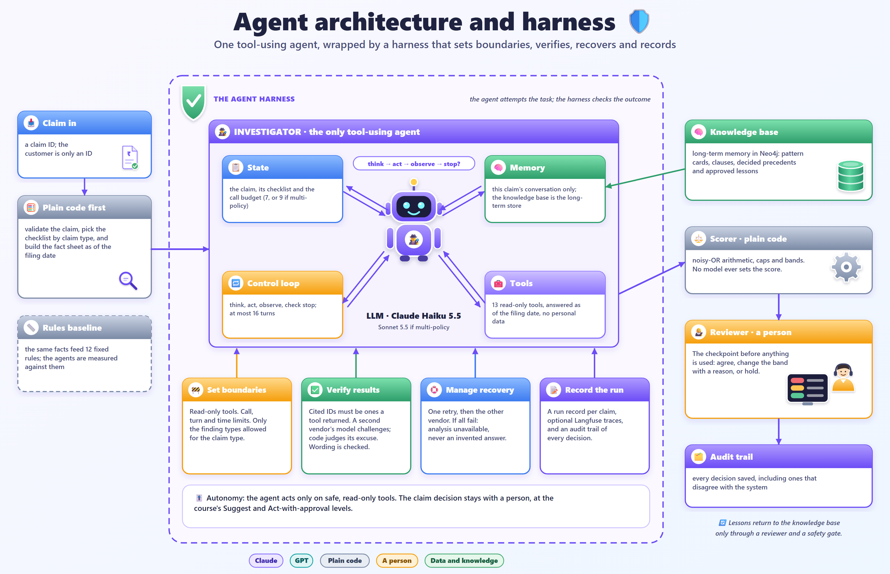
Agent architecture and harness (illustrated)
APPENDIX A7
Insurance Claim Triage · technical walkthrough
27
Notes:
The illustrated architecture: the Investigator with state, memory, tools and a control loop inside a harness that sets boundaries, verifies, recovers and records, followed by the scorer, the reviewer and the audit trail. Full-size version in docs/images/architecture-agent-harness.png.

Slide 28
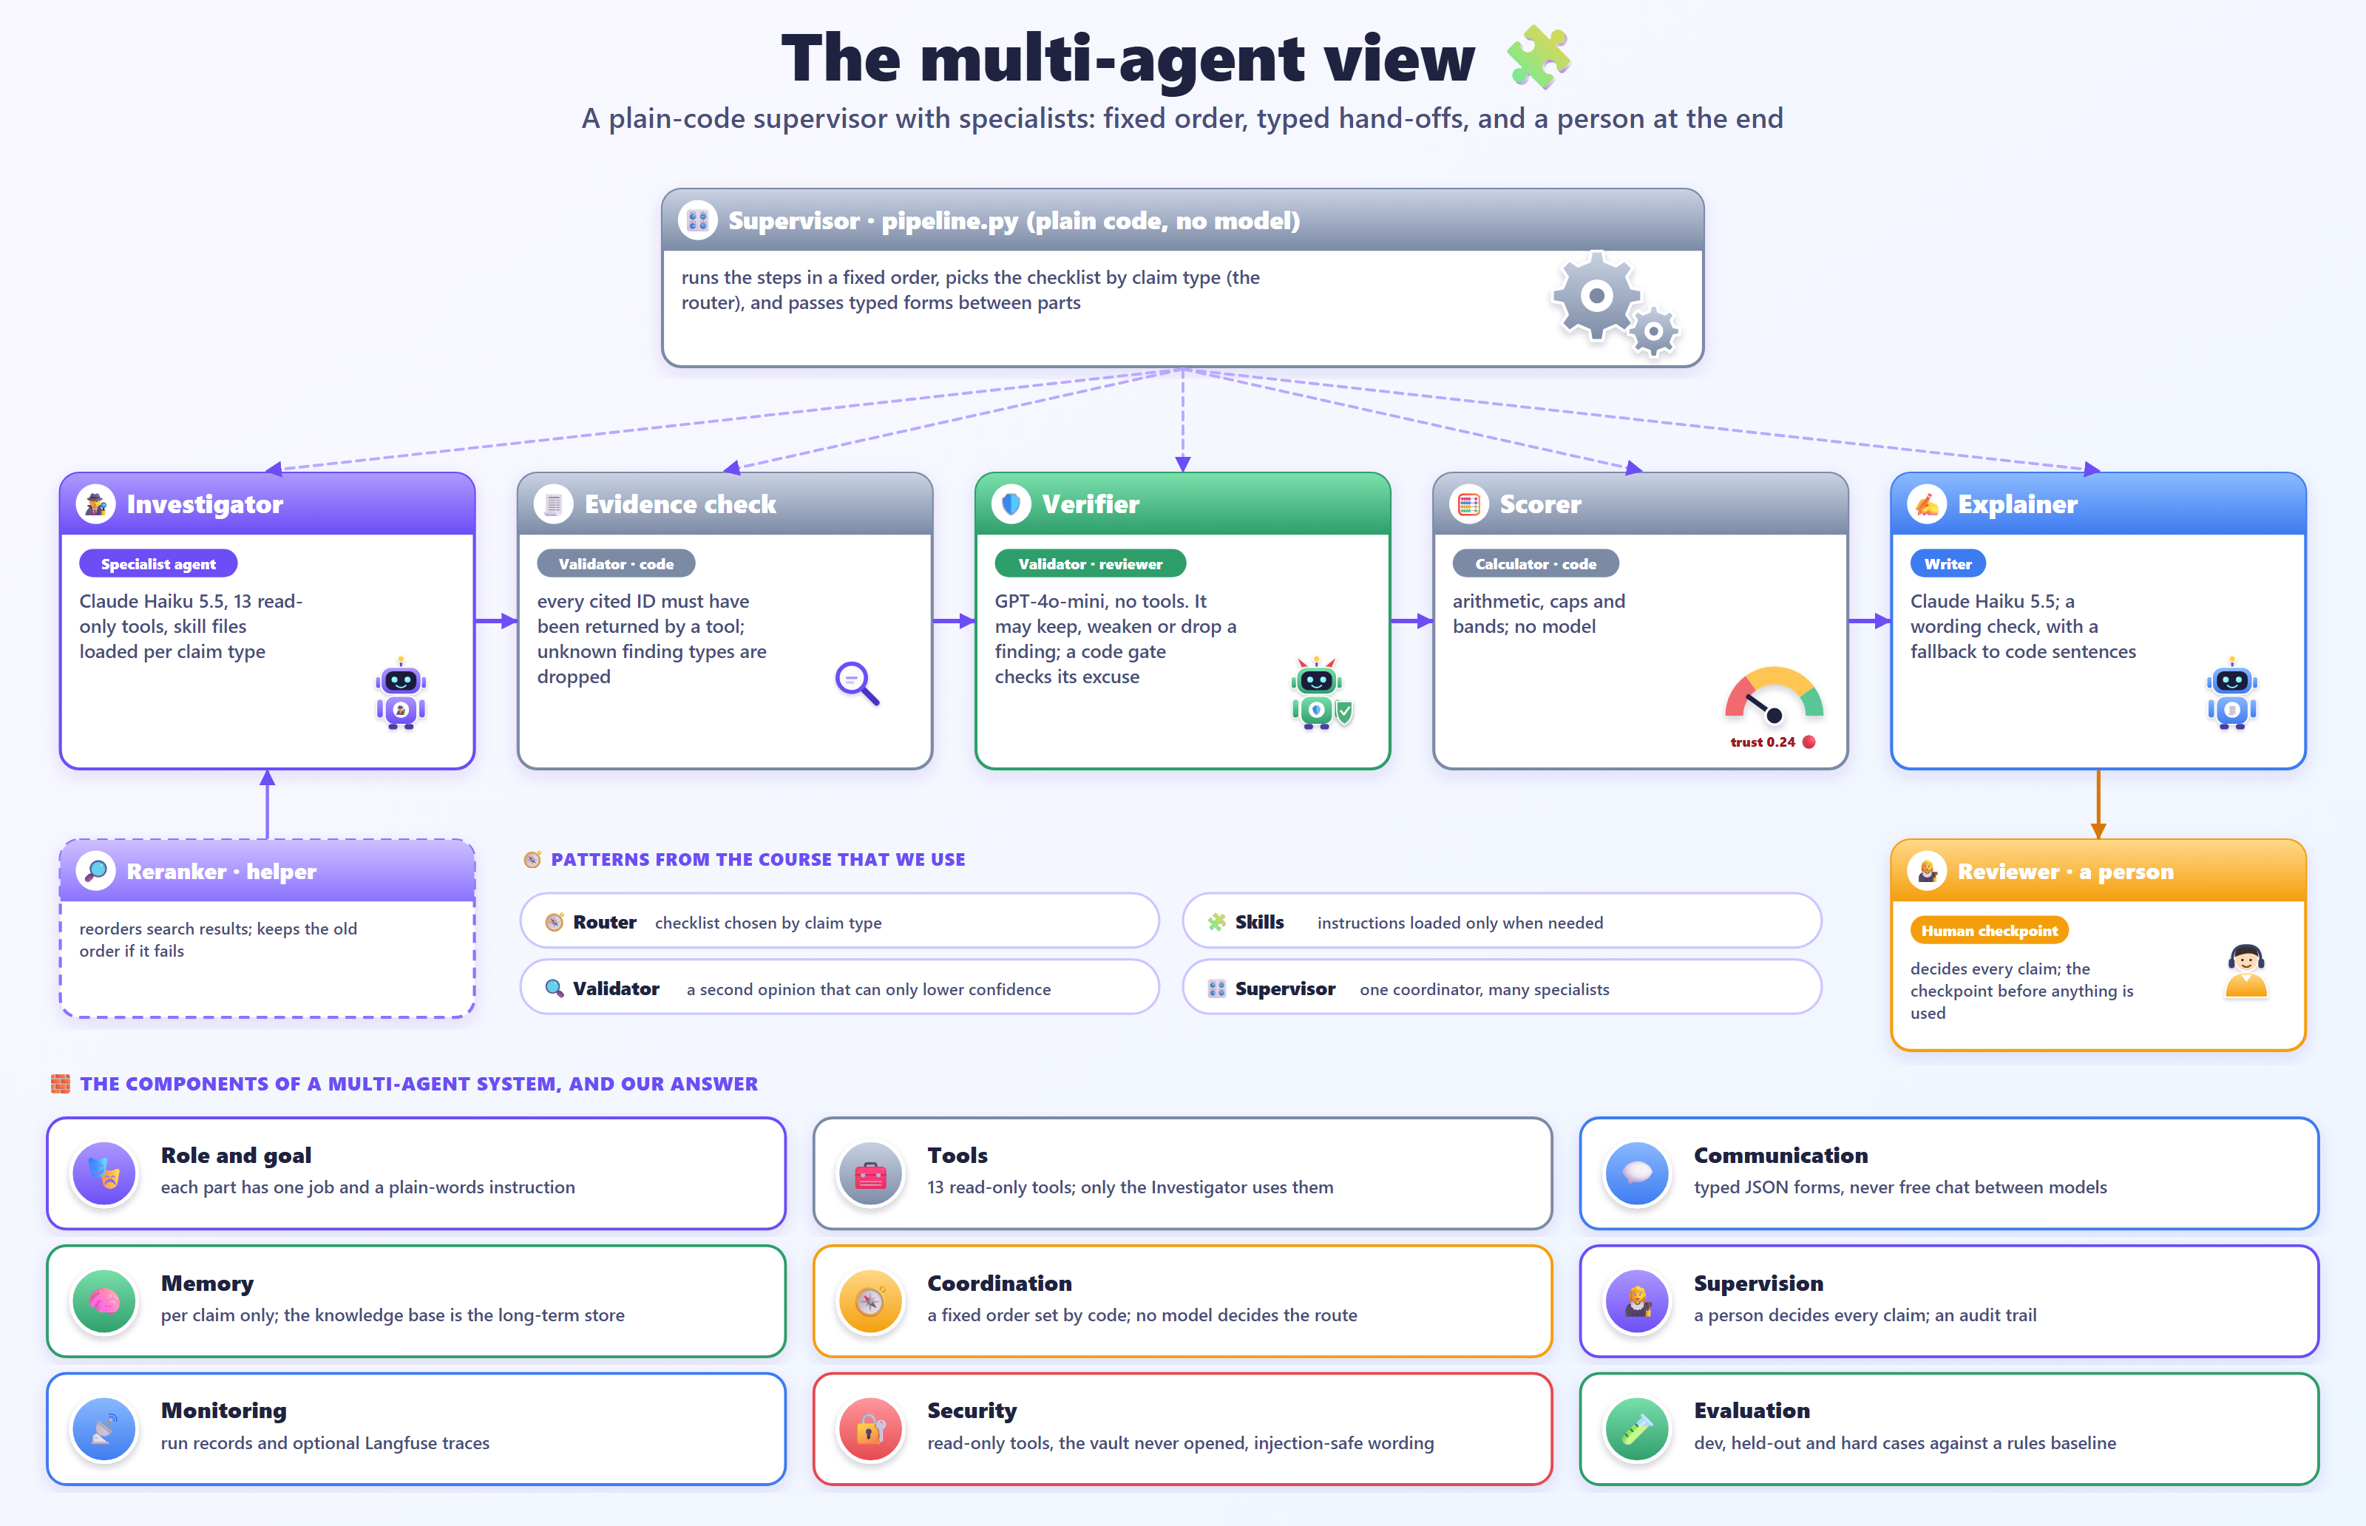
The multi-agent view (illustrated)
APPENDIX A8
Insurance Claim Triage · technical walkthrough
28
Notes:
A plain-code supervisor with specialists in a fixed order, a validator that cannot add findings, a helper and the human checkpoint, with the course's components of a multi-agent system answered. Full-size version in docs/images/architecture-multi-agent.png.

Slide 29
Gaps against the course framework
APPENDIX A9
Gap | What closes it | Effort
Escalate, tags, assignee: now built | done: an Escalate choice, five tags, an owner and a queue filter | done
Tool calls are not trace steps | send each tool call to Langfuse as its own step | small to medium
Rejections are not reused | turn disagreements into an evaluation set | medium
Lessons never expire; not evaluated | an expiry date and a with-and-without run | medium, one paid run
No progress check beyond the budget | stop when two calls add no new evidence | small
No deployment or monitoring | a private hosted copy, drift and failure-rate tracking | larger
Stability and explanation quality unmeasured | a three-run check (about $1) and a judge model | small to medium
Insurance Claim Triage · technical walkthrough
29
Notes:
The honest gaps, in order of effort. Escalate, structured tags and an assignee are now built and tested; the rest each need a code change and tests and are not built.

