Slide 1
SUMMER RESEARCH INTERNSHIP PROJECT
Comparative Evaluation of SARIMA and XGBoost Models for Monthly Rainfall Forecasting over Eastern India
An independent, standalone comparison of a classical statistical model and a modern machine-learning model.
Samyaraj Saha • Gaurav Jaiswal • Ayan Mondal • Edla Sai Abhinay
Project Guide: Ms. Koulika Paul
Period of Internship: 18th May 2026 – 31st July 2026
Submitted to: IDEAS – Institute of Data Engineering, Analytics and Science Foundation, ISI Kolkata

Slide 2
ABSTRACT
An Independent, Standalone Comparison
Accurate monthly rainfall forecasting over Eastern India matters directly for agricultural planning, flood early warning, and reservoir operation across the Odisha–West Bengal corridor — a region shaped by ENSO and the Indian Ocean Dipole.
This report presents an independent, standalone evaluation of SARIMA (classical time series) and XGBoost (gradient-boosted machine learning), applied to a 43-year (1980–2022) monthly rainfall series. The two models are developed, tuned, and evaluated entirely independently — neither informs, corrects, or combines with the other.
Stationarity was confirmed via ADF/KPSS testing. An exhaustive grid search over 64 candidate SARIMA specifications identified SARIMA(1,0,0)(0,1,1)₁₂ as optimal (AIC = −132.95, BIC = −120.67), with the seasonal moving-average coefficient (Θ₁ = −1.101, p < 0.001) dominating the linear structure.
For XGBoost, nine predictive features were retained from ten candidates via LASSO regression (α = 0.001167), and hyperparameters were tuned across 8,748 combinations — with log-rainfall itself, never a residual quantity, as the target.
Evaluated on a strictly held-out 48-month test period (2019–2022), SARIMA(1,0,0)(0,1,1)₁₂ achieved RMSE = 21.63 mm, MAE = 15.14 mm, NSE = 0.9692, modestly outperforming XGBoost (RMSE = 25.89 mm, MAE = 17.53 mm, NSE = 0.9558). The 12- and 24-month rainfall lags dominate XGBoost’s feature importance (≈82% of gain) — the annual cycle, not climate-index forcing, drives predictability.
Both models exceed NSE = 0.95, yet their climatological skill scores are near zero or mildly negative — the 2019–2022 window lacked a pronounced ENSO anomaly. This is reported directly: a parsimonious SARIMA model proves fully competitive with a data-hungry ML alternative, with no benefit found from a hybrid combination of the two.
SARIMA vs XGBoost — Monthly Rainfall Forecasting, Eastern India
2

Slide 3
INTRODUCTION
Motivation, Drivers, and the Two Modelling Paradigms
The Indian Summer Monsoon supplies 75–80% of annual precipitation, governing agriculture, water supply, and flood risk nationwide.
The Odisha–West Bengal corridor is highly monsoon-sensitive: a major rice and jute producer, directly exposed to Bay of Bengal cyclones.
Accurate monthly forecasts matter directly for crop planning, reservoir management, and disaster preparedness across the corridor.
ENSO imposes a strong interannual teleconnection — El Niño suppresses monsoon rainfall, La Niña enhances it; the Indian Ocean Dipole provides a secondary modulation.
Motivated by the IDEAS-TIH Summer Research Internship curriculum in statistics, machine learning, and applied data science, ISI Kolkata.
Two Modelling Paradigms
SARIMA (classical)
Easy to interpret, and works well when rainfall follows a steady, repeating pattern year to year
Struggles with sudden shifts or unusual monsoon years that break the usual pattern; using ENSO/IOD as direct inputs would need a more complex SARIMAX version, which this study avoids to keep the model simple
XGBoost (machine learning)
Can learn complex, non-straight-line patterns and combine many different kinds of inputs together naturally
Doesn’t automatically know that rainfall repeats every year unless that pattern is built into the features; also needs more training data than SARIMA to perform reliably
Both weaknesses are tested directly in the Results and Discussion.
SARIMA vs XGBoost — Monthly Rainfall Forecasting, Eastern India
3

Slide 4
PROJECT OBJECTIVES
A Clean, Reproducible Comparison
The key objective is to make a clean, reproducible comparison between a classical statistical model and a modern machine-learning model on an Eastern India rainfall series.
01
02
SARIMA Specification
XGBoost Pipeline
Identify the best SARIMA specification through a systematic, criterion-based order-selection process, validated by residual diagnostics.
Build an independent candidate feature set for XGBoost, reduce it via LASSO, and tune the model through exhaustive time-series cross-validation — using log-rainfall itself as the target.
03
04
Common Evaluation Protocol
Honest Interpretation
Evaluate both models under the same out-of-sample, rolling forecasting protocol, using a common set of performance metrics.
Interpret the results honestly, including any unexpected or marginal findings, without adjusting the narrative to fit an expected outcome.
SARIMA vs XGBoost — Monthly Rainfall Forecasting, Eastern India
4

Slide 5
METHODOLOGY
Study Region
Odisha–West Bengal corridor of Eastern India, spanning ≈17.8°N–27.2°N latitude and ≈81.4°E–89.9°E longitude
Covers the Mahanadi, Brahmani, and Baitarini river basins in Odisha and the Gangetic delta system in West Bengal
Terrain ranges from the Eastern Ghats in the west to the Bay of Bengal coast in the east; rainfall is heavier in the hilly interior
Rainfall regime is sharply bimodal on an annual basis, dominated by the June–September (JJAS) monsoon season
A predominantly agrarian corridor, where the timing and intensity of the monsoon directly shapes cropping cycles and reservoir planning
Climatological Rainfall Regime
≈77%
1,544 mm
of annual rainfall falls in JJAS (Jun–Sep)
grand mean annual total, 516 months
348 mm
304 mm
July — climatological peak month
August — second wettest month
A secondary rainfall pulse (≈100 mm) occurs in October from retreating monsoon / post-monsoon cyclonic activity; pre-monsoon (Apr–May) thunderstorms add 100–160 mm.
Our monthly rainfall dataset is made with IMD normal rainfall data. For the impact ENSO and IOD index have been used.
Data note
SARIMA vs XGBoost — Monthly Rainfall Forecasting, Eastern India
5

Slide 6
METHODOLOGY
Data Processing and Train–Test Split
Raw rainfall is right-skewed — log(1+y) transform applied to stabilise variance and symmetrise the series
Same log-transformed series used as the prediction target for both SARIMA and XGBoost — errors stay directly comparable after back-transformation
Stationarity of the transformed series confirmed via ADF / KPSS testing (see next slide)
No missing values in the dataset — no gap-filling required
Split applied strictly by date, never randomly — no information from the test period ever influences model development
Train / Test Timeline
TRAIN
Jan 1980 – Dec 2018 (468 months)
TEST (held out)
Jan 2019 – Dec 2022 (48 months)
Test data untouched until final evaluation — every reported result reflects genuinely unseen data.
SARIMA vs XGBoost — Monthly Rainfall Forecasting, Eastern India
6

Slide 7
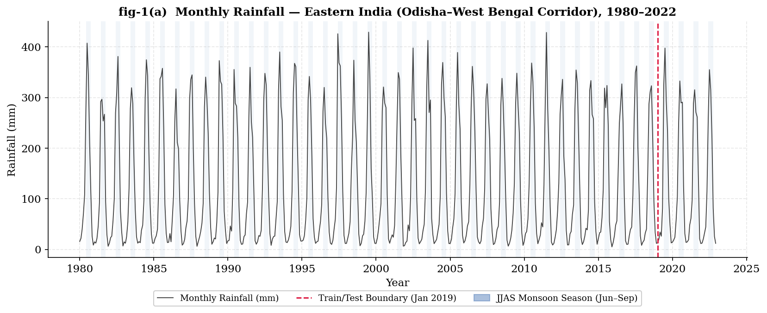
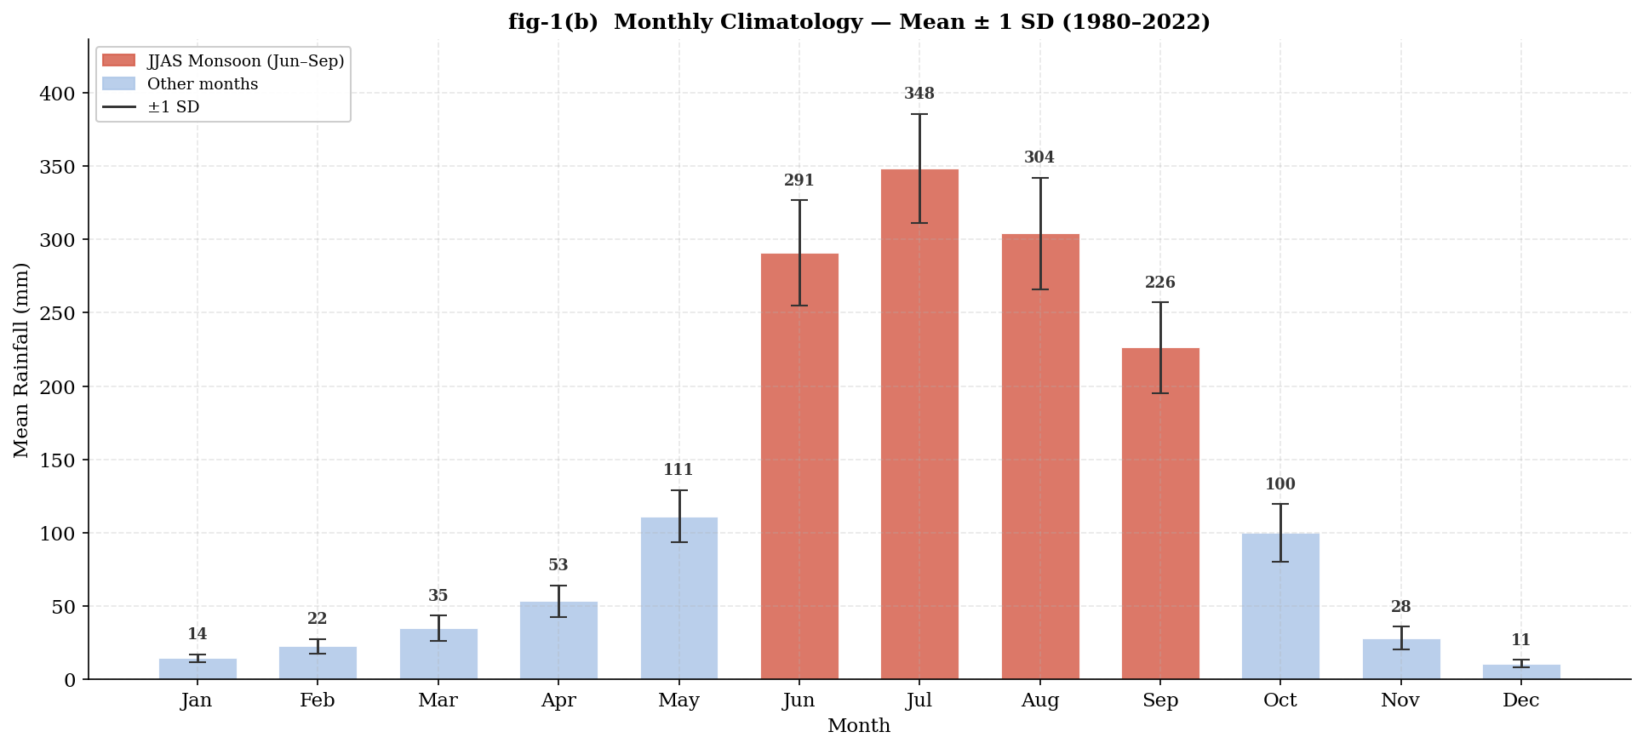
EXPLORATORY DATA ANALYSIS
The Monsoon Seasonal Cycle
Fig. 1(a) Monthly rainfall, 1980-2022, with train/test boundary
Repeated sharp annual spikes confirm a strong, consistent monsoon cycle — spike height varies year to year (interannual variability)
JJAS months dominate (≈77% of annual total); July is wettest (348 mm); error bars are far larger in monsoon months, confirming that variability itself is seasonal
Fig. 1(b) Monthly climatology, mean ± 1 SD
7
SARIMA vs XGBoost — Monthly Rainfall Forecasting, Eastern India

Slide 8
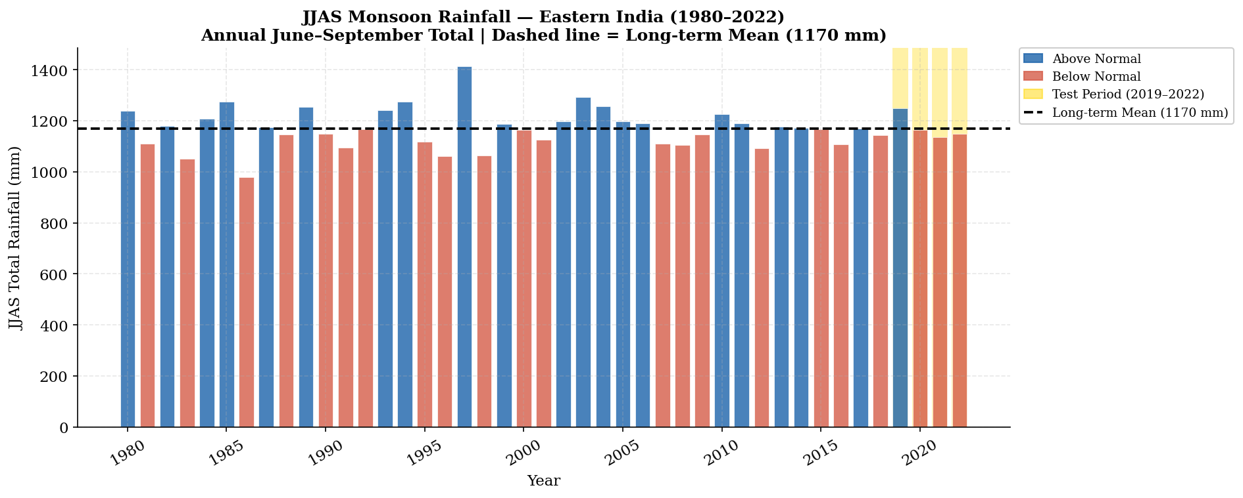
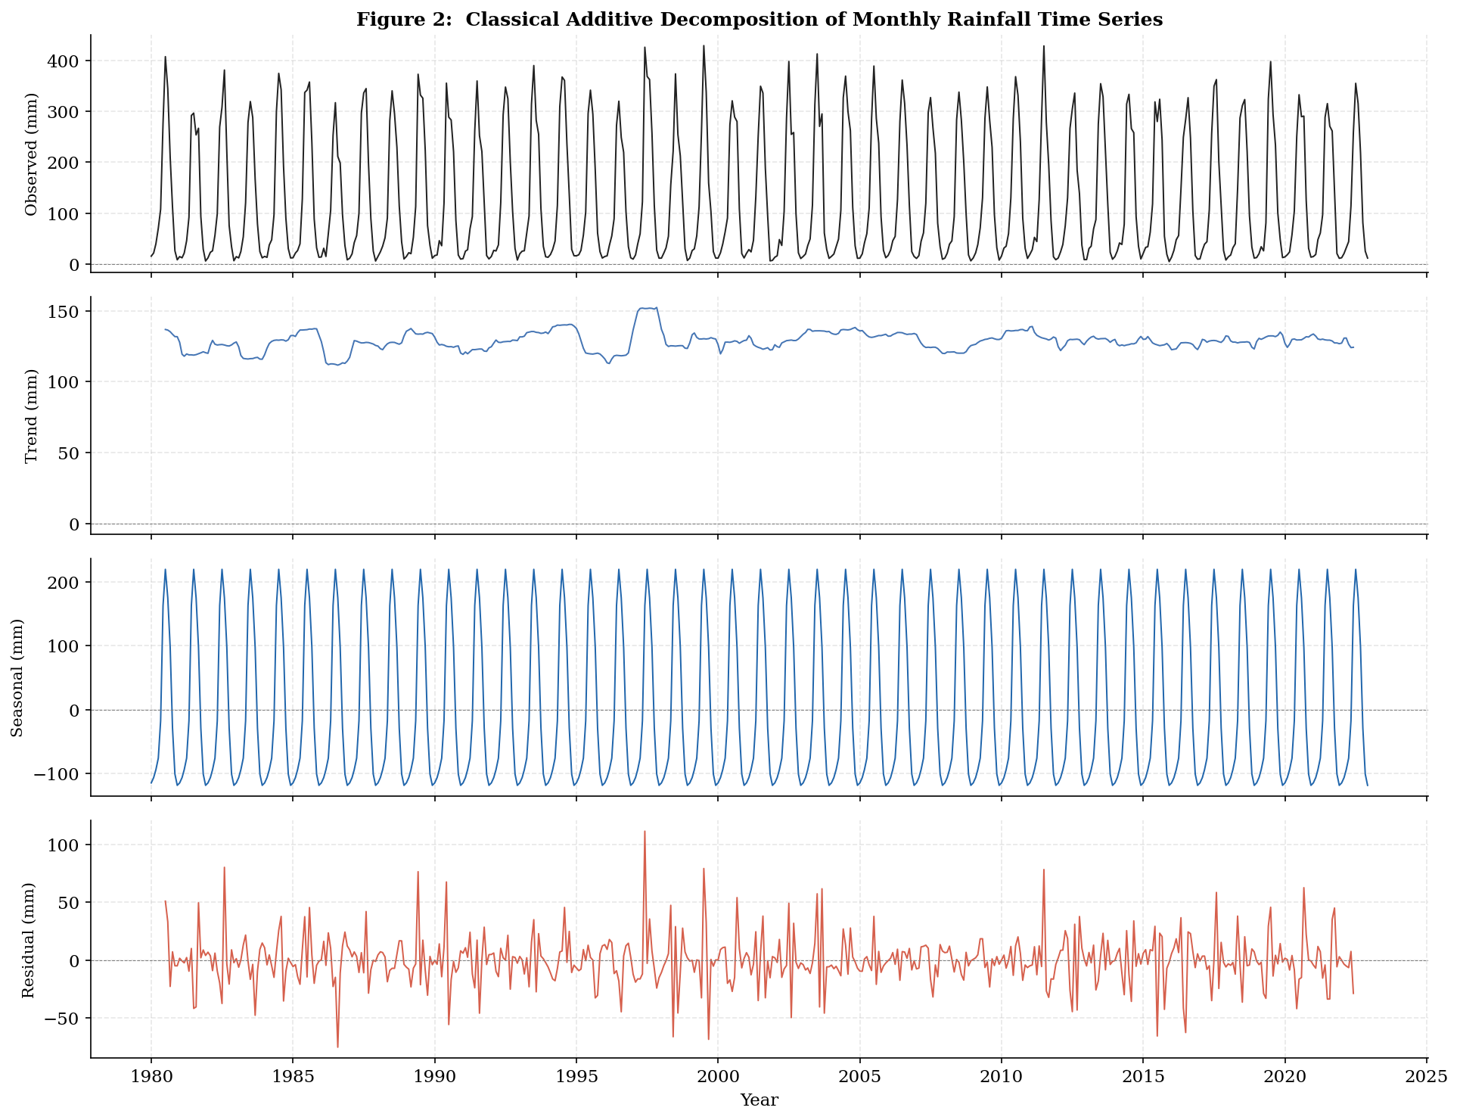
EXPLORATORY DATA ANALYSIS
Interannual Variability and Decomposition
Fig. 1(c) Annual JJAS total vs. long-term mean (1,170 mm)
Most years sit close to the long-term mean; 1997 stands out as unusually wet — the 2019–2022 test period sits close to average
Trend is small & stable; seasonal component repeats exactly every year; residual spikes reflect ENSO/IOD-driven anomalies
Fig. 2 Decomposition: Observed = Trend + Seasonal + Residual
SARIMA vs XGBoost — Monthly Rainfall Forecasting, Eastern India
8

Slide 9
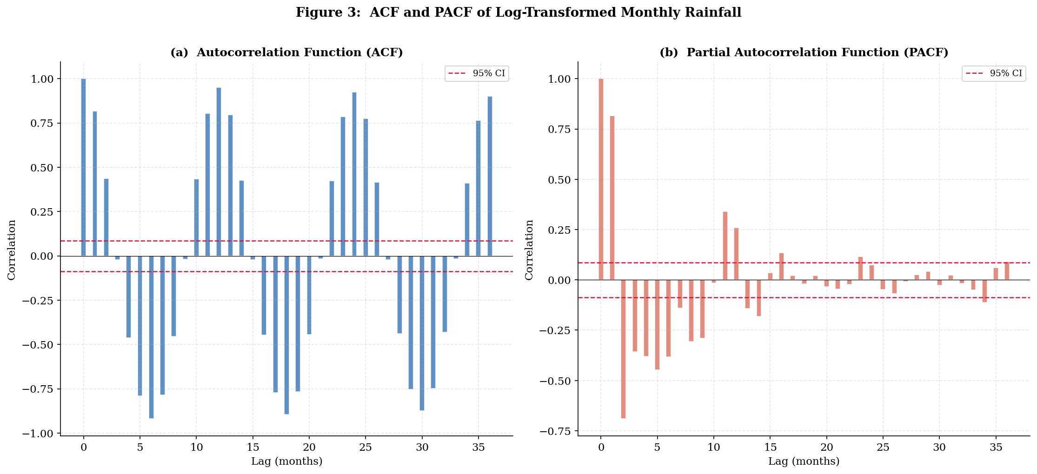
METHODOLOGY
Stationarity, ACF and PACF
Test | Series | Statistic | p-value | Decision
ADF | Raw | −6.6201 | 0.0000 | Stationary
ADF | Log-transformed | −5.4381 | 0.0000 | Stationary
KPSS | Raw | 0.0109 | 0.1000 | Stationary
KPSS | Log-transformed | 0.0094 | 0.1000 | Stationary
Table 1. Both ADF and KPSS confirm stationarity of the log-transformed series → d = 0 (no first-order differencing needed).
Hypothesis
Fig. 3 ACF (a) and PACF (b) of log-transformed monthly rainfall
ADF Test:
H₀: the time series is non-stationary (unit root)
H₁: the time series is stationary
ACF: strong peaks at lags 12, 24, 36 → seasonal differencing needed (D = 1)
PACF: sharp cutoff after lag 1 (≈0.82) → non-seasonal AR(1) sufficient (p = 1)
KPSS Test
H₀: the time series is stationary
H₁: the time series is non-stationary (unit root)
SARIMA vs XGBoost — Monthly Rainfall Forecasting, Eastern India
9

Slide 10
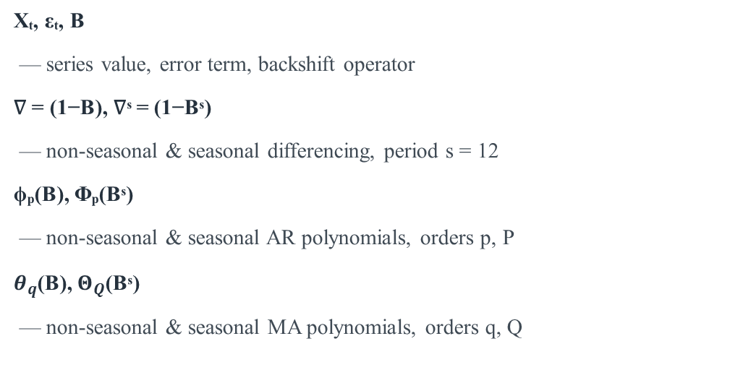
METHODOLOGY — SARIMA
SARIMA Model Specification
Φₚ(Bˢ) ϕₚ(B) $∇_{s}^{D}$∇ᵈ Xₜ = $Θ_{Q}$(Bˢ) $θ_{q}$(B) εₜ
General SARIMA(p, d, q)(P, D, Q)ₛ model
Xₜ, εₜ, B
— series value, error term, backshift operator
∇ = (1−B), ∇ˢ = (1−Bˢ)
— non-seasonal & seasonal differencing, period s = 12
ϕₚ(B), Φₚ(Bˢ)
— non-seasonal & seasonal AR polynomials, orders p, P
$θ_{q}$(B), $Θ_{Q}$(Bˢ)
— non-seasonal & seasonal MA polynomials, orders q, Q
Model Selection Criteria
AIC = 2k − 2 ln(L)
BIC = k · ln(n) − 2 ln(L)
k = parameters, L = maximum likelihood,
n = observations.
Lower AIC / BIC = better model.
SARIMA vs XGBoost — Monthly Rainfall Forecasting, Eastern India
10

Slide 11
METHODOLOGY — SARIMA
SARIMA Order Selection
Fixed from ACF/PACF analysis: p = 1, d = 0, D = 1, s = 12
Exhaustive grid search over q, P, Q ∈ {0, 1, 2, 3} → 64 candidate specifications.
Ranked by AIC and BIC.
p | d | q | P | D | Q | AIC | BIC
1 | 0 | 0 | 0 | 1 | 1 | −132.95 | −120.67
1 | 0 | 1 | 0 | 1 | 1 | −131.31 | −114.94
1 | 0 | 1 | 1 | 1 | 1 | −127.86 | −107.40
1 | 0 | 2 | 0 | 1 | 1 | −126.74 | −106.29
1 | 0 | 2 | 1 | 1 | 1 | −124.58 | −100.04
SARIMA(1,0,0)(0,1,1)₁₂
selected specification
−132.95
−120.67
Table 2. Top 5 candidate SARIMA specifications by AIC (best model highlighted).
AIC (best model)
BIC (best model)
Selected: SARIMA(1,0,0)(0,1,1)₁₂ — lowest AIC & BIC among all valid candidates, and passes the Ljung–Box white-noise test at lag 12.
64 / 64
candidates converged
SARIMA vs XGBoost — Monthly Rainfall Forecasting, Eastern India
11

Slide 12
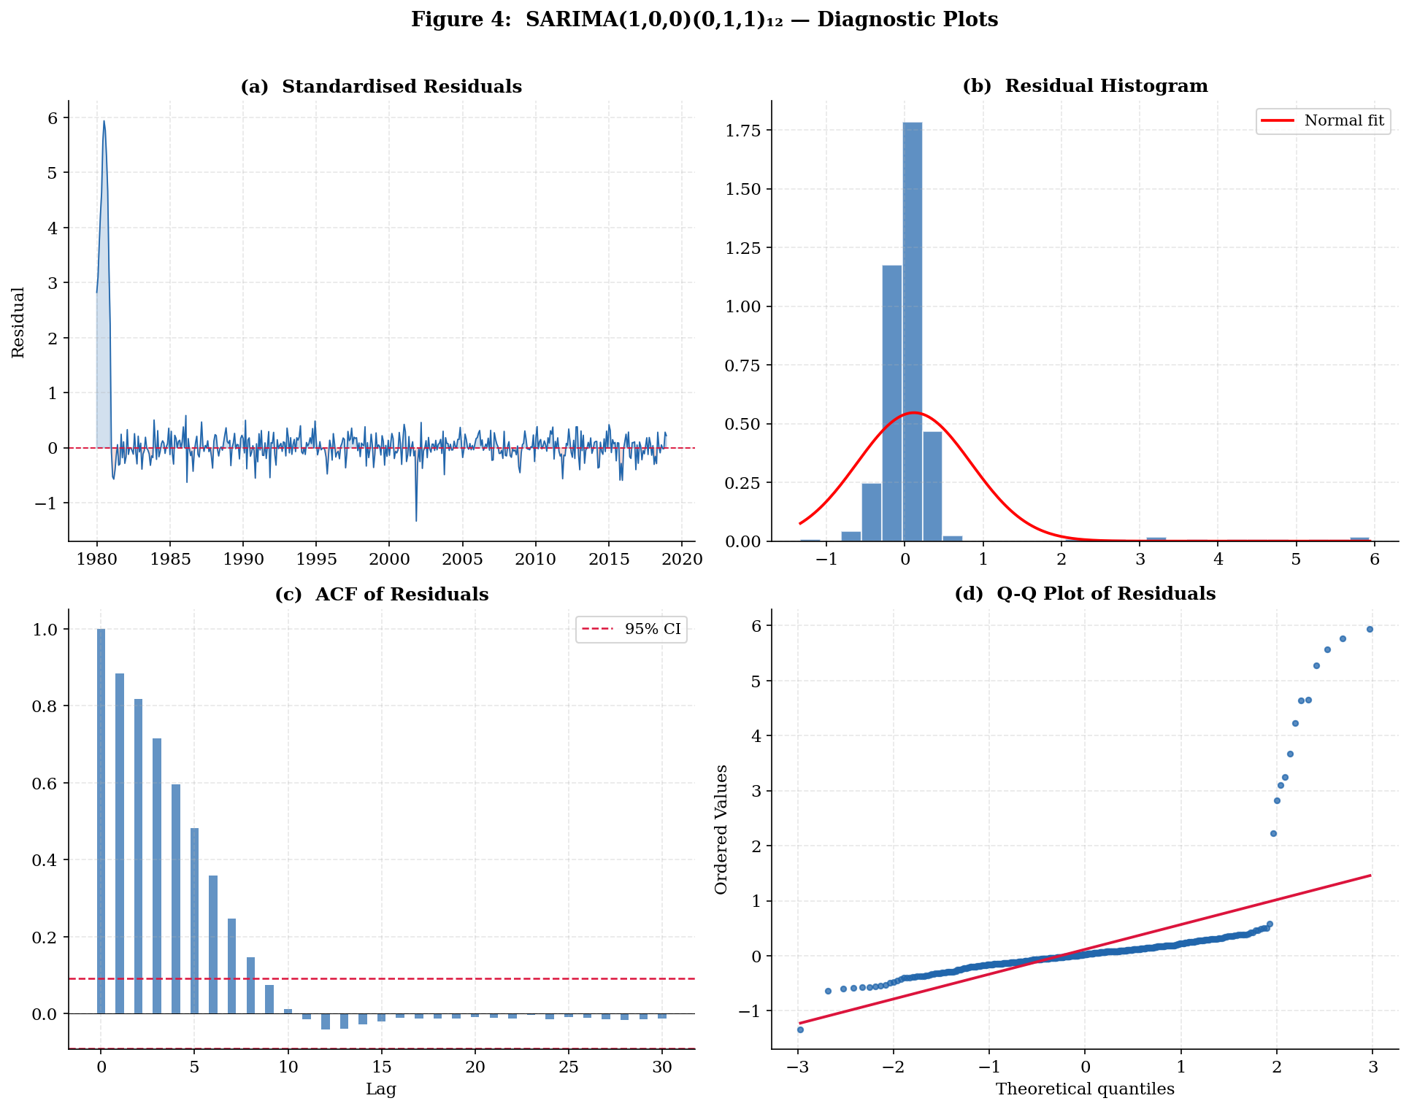
METHODOLOGY — SARIMA
SARIMA Parameter Estimates and Diagnostics
Parameter | Estimate | Std. Error | p-value
AR(1) — ϕ₁ | 0.0255 | 0.044 | 0.559
Seasonal MA(1) — Θ₁ | −1.1010 | 0.032 | < 0.001
Noise variance — σ² | 0.0342 | 0.003 | < 0.001
Θ₁ dominates the fitted dynamics — seasonal moving-average structure is the primary driver of temporal dependence at the annual lag.
Residuals bounce around zero with no clear trend (after initial settling)
Roughly bell-shaped, slightly heavy-tailed — common for rainfall data
ACF of residuals fades by lag 10; no leftover pattern at seasonal lags
Q–Q plot: good fit in the middle, mild tail deviation — acceptable
Fig. 4 SARIMA(1,0,0)(0,1,1)₁₂ diagnostic plots
SARIMA vs XGBoost — Monthly Rainfall Forecasting, Eastern India
12

Slide 13
METHODOLOGY — XGBOOST
XGBoost: Feature Construction
Gradient-boosted decision trees, each new tree correcting the errors of the trees before it
Built-in overfitting controls: tree depth limits, learning-rate shrinkage, complexity penalties
Row and column subsampling introduce additional randomness, further guarding against overfitting on a modest training sample
Trained to predict log-rainfall directly — never a SARIMA residual
Ten candidate features, built only from information available prior to time t (strict causality)
Ten Candidate Features
Lagged log-rainfall
log_lag{1, 2, 3, 6, 12, 24} — six lags
Cyclical calendar encoding
month_sin, month_cos = sin/cos(2πm/12)
Climate indices
enso (Niño 3.4), iod (Dipole Mode Index)
No SARIMA-derived quantity — no residuals, no lagged residuals — appears anywhere in the XGBoost feature set. The two models never exchange information.
SARIMA vs XGBoost — Monthly Rainfall Forecasting, Eastern India
13

Slide 14
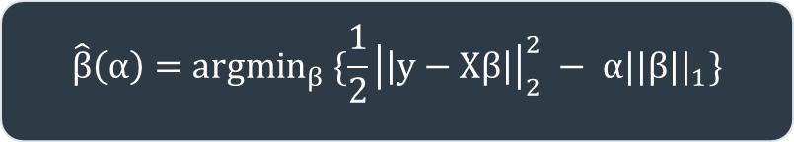
METHODOLOGY — XGBOOST
LASSO-Based Feature Selection
LASSO-Based Feature Selection
$$\hat{β}\left(α\right)={argmin}_{β} \{\frac{1}{2}{\left|\left|y−Xβ\right|\right|}_{2}^{2} − α{||β||}_{1}\}$$
Feature | Coefficient | Retained?
log_lag12 | 0.4416 | Yes
log_lag24 | 0.3572 | Yes
month_sin | −0.3218 | Yes
month_cos | −0.2627 | Yes
log_lag2 | −0.0969 | Yes
log_lag3 | −0.0647 | Yes
enso | −0.0456 | Yes
log_lag1 | 0.0419 | Yes
iod | 0.0230 | Yes
log_lag6 | 0.0000 | No
L1 penalty α‖β‖₁ shrinks weak features’ coefficients exactly to zero
Optimal α = 0.001167, chosen via 5-fold cross-validation
Only log_lag6 shrinks to zero — redundant once month_sin/cos and the 12-, 24-month lags are present
9 of 10
(444, 9)
features retained (non-zero coefficient)
training matrix shape
SARIMA vs XGBoost — Monthly Rainfall Forecasting, Eastern India
14

Slide 15
METHODOLOGY — XGBOOST
XGBoost Hyperparameter Tuning
n_est. | depth | lr | subs. | Cols. | reg_α | min_cw | CV RMSE
700 | 3 | 0.01 | 0.7 | 0.7 | 0.1 | 1 | 0.230996
300 | 3 | 0.03 | 0.7 | 0.7 | 0.2 | 2 | 0.231120
700 | 3 | 0.01 | 0.7 | 0.7 | 0.2 | 1 | 0.231380
700 | 3 | 0.01 | 0.7 | 0.7 | 0.2 | 1 | 0.231504
500 | 3 | 0.01 | 0.7 | 0.7 | 0.1 | 1 | 0.231516
Exhaustive grid search over 8 hyperparameters — 8,748 total combinations
Evaluated by 5-fold expanding-window time-series cross-validation
Best configuration selected by lowest average CV RMSE (log scale)
8,748
0.2310
hyperparameter combinations
searched
best CV RMSE (log scale)
Table 3. Top 5 hyperparameter combinations by cross-validated RMSE.
Consistently shallow trees, low learning rate, moderate subsampling — a conservative, overfitting-averse configuration suited to the 444-row training sample.
Best Configuration
n_estimators=700 · max_depth=3 · learning_rate=0.01
subsample=0.70 · colsample_bytree=0.70
reg_alpha=0.10 · reg_lambda=1.50 · min_child_weight=1
SARIMA vs XGBoost — Monthly Rainfall Forecasting, Eastern India
15

Slide 16

METHODOLOGY — FORECASTING PROTOCOL
Rolling One-Step-Ahead Forecasting
Forecast t
using data
up to t−1
Reveal true
value for
month t
Forecast month t using only data available up to month t − 1
Reveal the true observed value for t; update the model’s history — SARIMA refits, XGBoost’s lag features simply update
Repeat across all 48 test months (Jan 2019 – Dec 2022)
Mirrors real operational forecasting — only past data is ever available, unlike a static multi-month-ahead projection
Avoids the lookahead bias that random k-fold cross-validation can introduce in time-series studies
→
Forecast
t + 1
Update model
history
(refit / relag)
This cycle repeats 48 times — once per test-period month — producing one genuine, real-time-equivalent forecast per month.
${\hat{R}}_{t}$ = exp(${\hat{L}}_{t}$) − 1
SARIMA vs XGBoost — Monthly Rainfall Forecasting, Eastern India
16

Slide 17
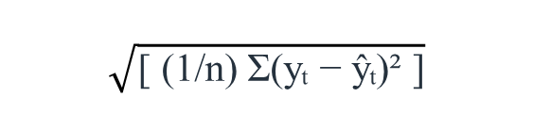
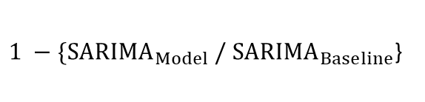
METHODOLOGY — EVALUATION
Five Evaluation Metrics
RMSE
$$\sqrt{\text{[ (1/}\text{n}\text{) }\text{Σ}\text{(}\text{y}\text{ₜ − ŷₜ)² ]}}$$
Penalises large errors more heavily; sensitive to extreme monsoon months.
MAE
(1/n) Σ |yₜ − ŷₜ|
A simple, outlier-robust average error in millimetres.
MAPE
(100/n) Σ |(yₜ−ŷₜ) / yₜ|
Error as a percentage; months with near-zero rainfall (< 1 mm) excluded to avoid divide-by-near-zero distortion.
NSE
1 − { Σ(yₜ−ŷₜ)² / Σ(yₜ−ȳ)² }
Skill relative to simply predicting the mean; 1 = perfect, 0 = no better than the mean.
Skill Score
$1 −\{{SARIMA}_{Model} /$ ${SARIMA}_{Baseline}$}
Improvement over a monthly-climatology baseline — a stricter test than NSE.
SARIMA vs XGBoost — Monthly Rainfall Forecasting, Eastern India
17

Slide 18
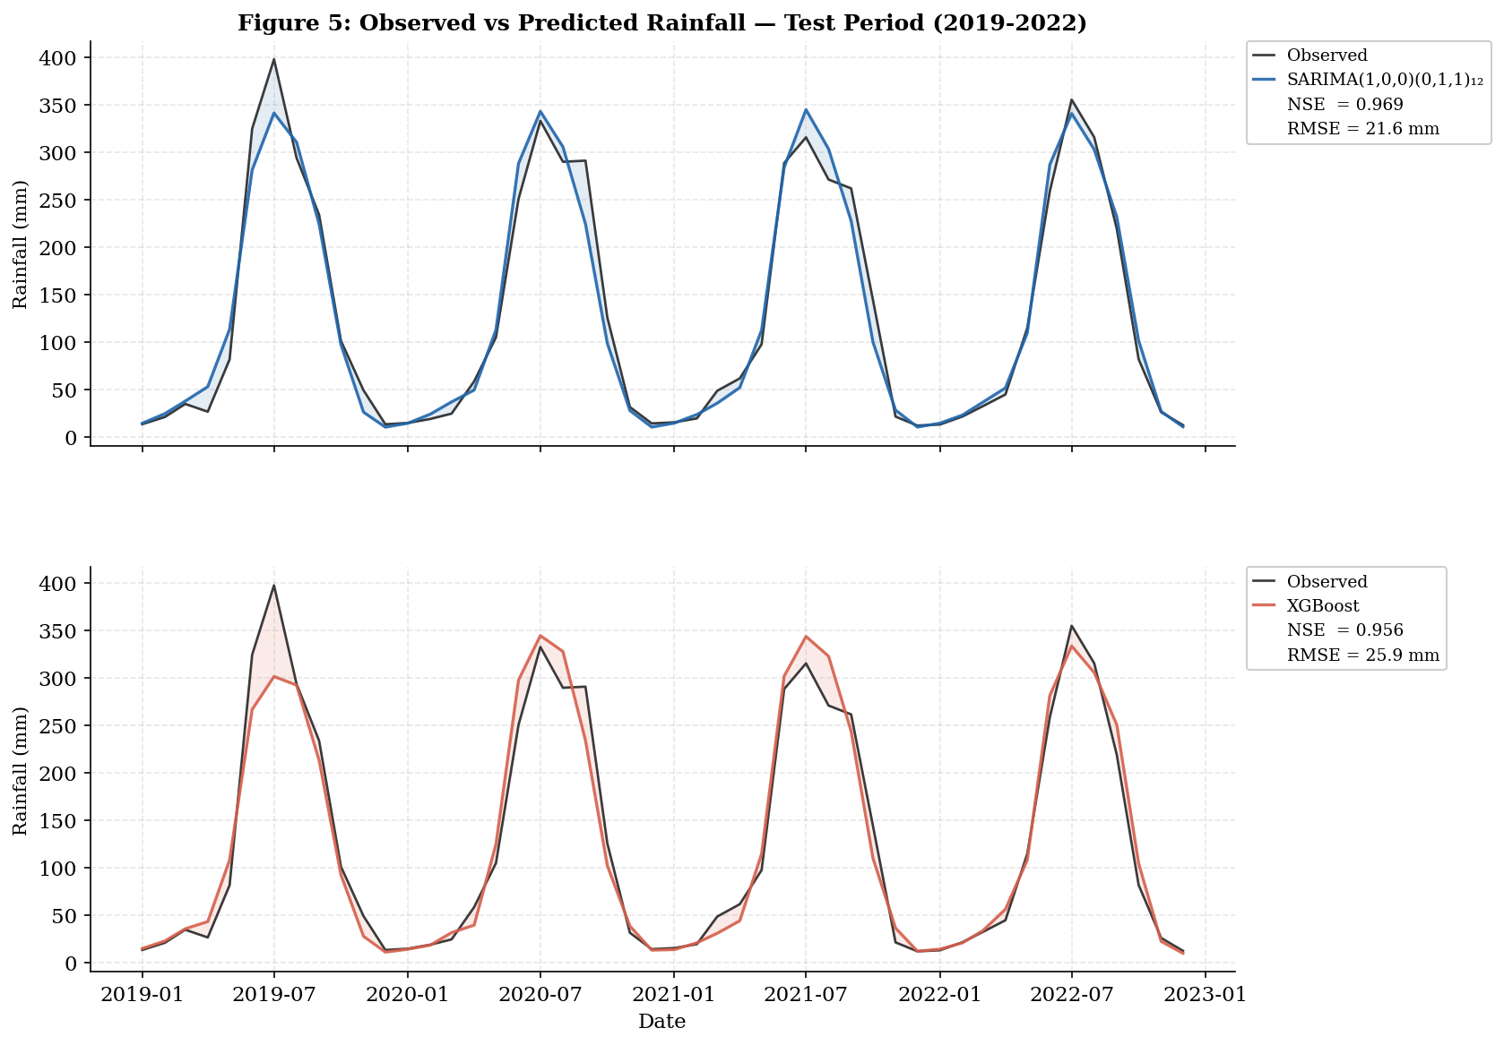
RESULTS
Comparative Evaluation
Model | RMSE (mm) | MAE (mm) | MAPE (%) | NSE | Skill Score
SARIMA(1,0,0)(0,1,1)₁₂ | 21.63 | 15.14 | 16.94 | 0.9692 | −0.0195
XGBoost | 25.89 | 17.53 | 16.95 | 0.9558 | −0.2199
Table 4. Full 48-month held-out test period (Jan 2019 – Dec 2022).
SARIMA wins on every metric
RMSE, MAE, NSE by a clear margin; MAPE by a tiny margin (16.94% vs 16.95%, distorted by dry-month values)
Largest error for both models: July 2019 monsoon peak (≈398 mm) — both underpredict, XGBoost more so
RMSE / MAE (absolute, mm) are more discriminating here than MAPE, which both models score almost identically on
Fig. 5 Observed vs. predicted rainfall, test period 2019–2022
SARIMA vs XGBoost — Monthly Rainfall Forecasting, Eastern India
18

Slide 19
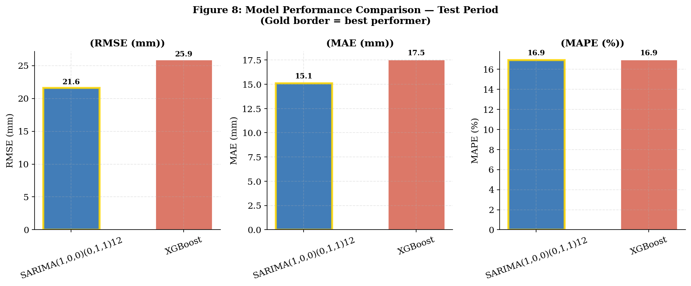
RESULTS
Model Performance Comparison
Reading the Chart
SARIMA leads on RMSE and MAE by a clear margin
On MAPE, SARIMA still wins, but only by a tiny margin (16.94% vs 16.95%)
The gap narrows on MAPE because dry-season months have very small denominators, inflating percentage error for both models alike
Fig. 8 Model performance comparison across metrics
SARIMA vs XGBoost — Monthly Rainfall Forecasting, Eastern India
19

Slide 20
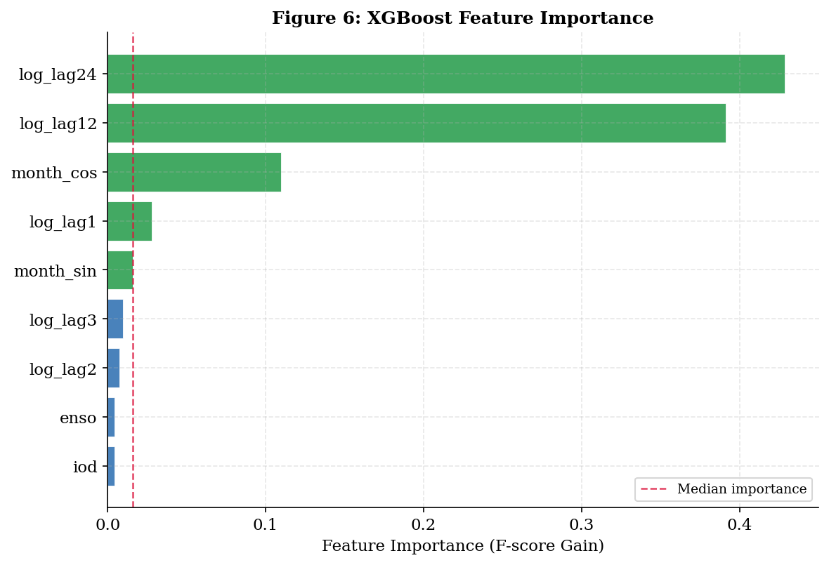
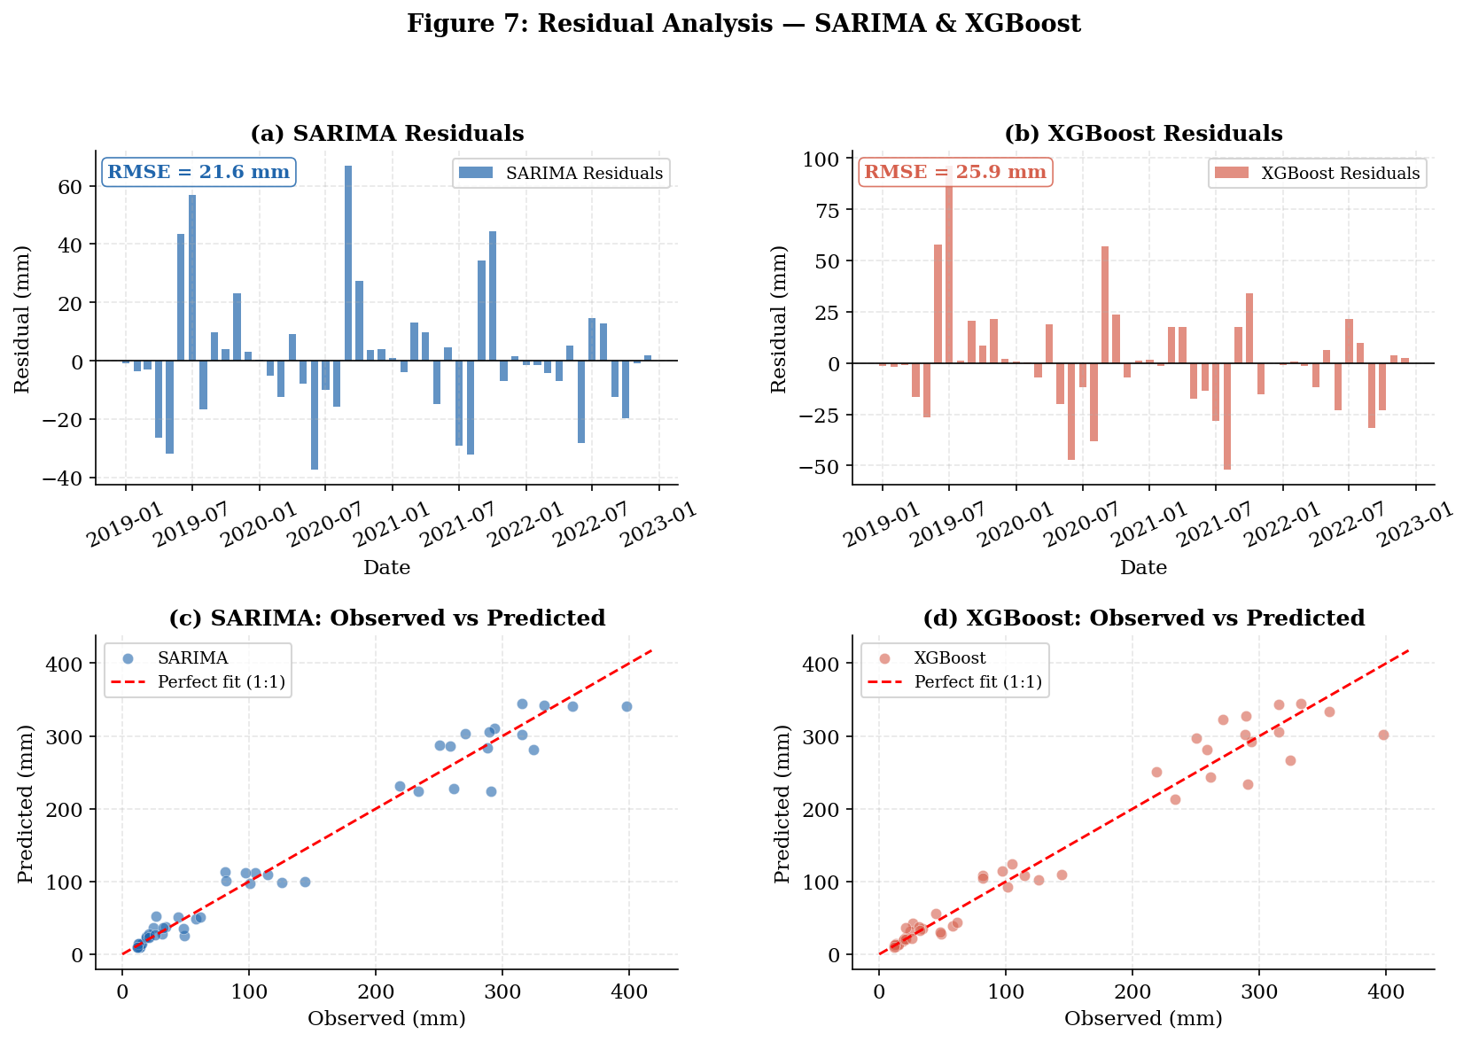
RESULTS
Feature Importance and Residual Behaviour
Fig. 6 XGBoost feature importance (gain-based)
Fig. 7 Residual analysis — SARIMA & XGBoost
log_lag12 and log_lag24 dominate (≈82% of gain) — XGBoost has effectively rediscovered the seasonal cycle on its own
ENSO / IOD rank lowest but remain non-zero — a genuine, if secondary, sensitivity to large-scale climate forcing
Both models’ residuals centre near zero, with the largest swings in JJAS months; SARIMA clusters tighter around the 1:1 line at high rainfall values
SARIMA vs XGBoost — Monthly Rainfall Forecasting, Eastern India
20

Slide 21
CONCLUSION
A Parsimonious Model, Honestly Evaluated
A well-specified SARIMA model is fully competitive — and here marginally superior — to a flexible ML alternative, on a series dominated by a stable annual cycle
XGBoost independently rediscovered the same seasonal structure through its lagged features, without any hybrid assistance
No benefit was found from combining the two models into a hybrid framework
For operational use, SARIMA offers a computationally light, transparent forecast; XGBoost retains a secondary but genuine sensitivity to ENSO/IOD forcing
The Honest Finding
Both models exceed NSE = 0.95, yet climatological skill scores are near zero or negative
This reflects the 2019–2022 test window lacking a strong ENSO monsoon anomaly — not a model flaw
A high NSE alone does not prove genuine forecasting skill on a strongly seasonal series
Climatology-based skill scores should be reported alongside NSE in future rainfall-model evaluations
This result is reported directly — not adjusted or omitted — as a genuine, instructive finding of the study
SARIMA vs XGBoost — Monthly Rainfall Forecasting, Eastern India
21

Slide 22
References
1. Gadgil & Gadgil (2006). The Indian monsoon, GDP and agriculture. EPW, 41(47).
2. Mohapatra & Mohanty (2004). Low pressure systems & monsoon rainfall. Met. Atmos. Phys., 85.
3. Kumar et al. (2006). Indian monsoon failure during El Niño. Science, 314.
4. Krishnamurthy & Shukla (2000). Variability of rainfall over India. J. Climate, 13.
5. Ashok et al. (2001). Indian Ocean dipole & ENSO. Geophys. Res. Lett., 28.
6. Guhathakurta & Rajeevan (2008). Rainfall pattern over India. Int. J. Climatol., 28.
7. Saji et al. (1999). A dipole mode in the tropical Indian Ocean. Nature, 401.
8. Ljung & Box (1978). A measure of lack of fit in time series models. Biometrika, 65.
9. Box & Jenkins (1976). Time Series Analysis: Forecasting and Control.
10. Dickey & Fuller (1979). Autoregressive time series with a unit root. JASA, 74.
12. IMD (2021). Climatological Normals 1971–2020. India Meteorological Dept., Pune.
Data Availability
IMD climatological normal values: publicly available at imd.gov.in. Rainfall dataset, feature matrices, and all analysis outputs are available via Google Drive:
drive.google.com/drive/folders/15A227_69nlFGHAzGU6KbPL5J1uoBnBdu
Thank
You
Acknowledgement
The students thank Ms. Koulika Paul for her supervision, and IDEAS – Technology Innovation Hub, Indian Statistical Institute, Kolkata, for this opportunity as part of the Summer Research Internship programme.
SARIMA vs XGBoost — Monthly Rainfall Forecasting, Eastern India
22

