Slide 1
Presentation 1-Project- 1 BCA(481)
2023-24
Eco-Harbour
Under the Supervision of
Sreeja C.S
Assistant Professor
Team Members
Gaurav Jain (2241129)
Greeshma Girish C (2241130)
Navaneeth Kishor C H (2241144)

Slide 2
Agenda
Abstract
Introduction
Existing Systems
Project Flow Diagram
Requirement Analysis
Functional Requirements
Entity Relationship Diagram
Class Diagram
Database in MongoDB
User Interface of Application
Difficulties

Slide 3
Abstract
The Fishing Industry Sustainability Tracker is a comprehensive database designed to monitor and manage fishing activities, promoting sustainability and minimizing environmental impact. It encompasses data on catches, regulations, environmental factors, market trends, and sustainability metrics. Through real-time data collection, analysis tools, and visualization techniques, the database aims to facilitate informed decision-making, enhance compliance monitoring, and foster collaboration among stakeholders. By integrating user-friendly interfaces, scalable architecture, and robust data management, this initiative strives to ensure responsible fishing practices for the long-term preservation of marine resources.

Slide 4
Introduction
Eco Harbour emerges as a dynamic platform, seamlessly connecting fishing enthusiasts to ensure responsible fishing practices for the long-term preservation of marine resources. Beyond its functional capabilities, the platform catalyzes collective action towards the common goal of preserving our oceans and marine biodiversity for future generations.
Moreover, Eco Harbour aligns with key Sustainable Development Goals (SDGs), addressing SDG 14 (Life Below Water) by advocating for the preservation of marine ecosystems and its commitment to sustainable fishing practices.

Slide 5
Existing Systems
FishTrack: This mobile app uses GPS and environmental data to suggest potential fishing spots based on specific fish species . It also allows users to record catches and share locations with fellow anglers.
FishAngler: It helps users to find fishing spots, share catches, and connect with other fishermen.
GoFish: This app combines fishing location recommendations with a social media platform. Users can discover fishing spots, learn about different species, and share their experiences with a community of enthusiasts.

Slide 6
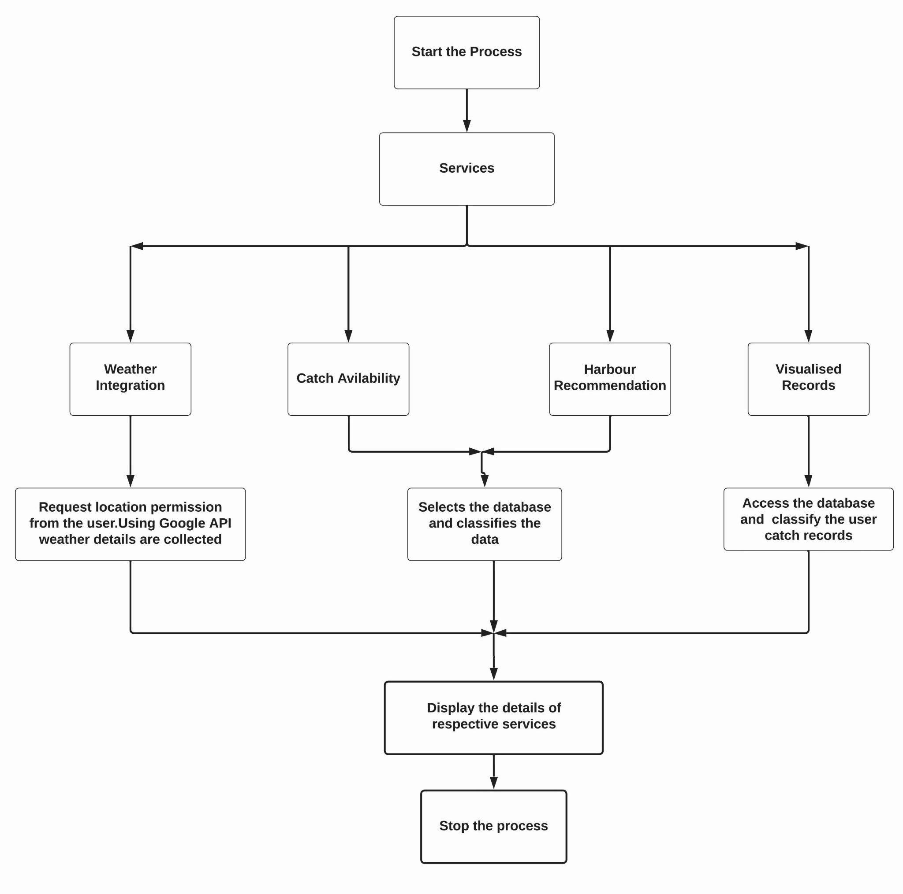
Project Flow Diagram

Slide 7
Requirement Analysis
1.Hardware Requirements
OS:- Windows 10 or above
Processor:- Core 2 Duo
Memory:- 4GB RAM
Storage:- 1 GB
2.Software Requirements
OS:- Windows 10 or later
Front End:- HTML,CSS / React Js, Java Script
Back End:- Node Js / Express Js
Software Required:- MongoDB Atlas

Slide 8
Functional Requirements
1.Fish Detection : Provides information about fish availability in a specified location or region.
2.Availability Trends : Allows fishermen to search for prospective harbours for a particular catch requirement.
3.Education and Outreach : Promotes awareness of sustainable fishing practices and highlights organizations supporting marine conservation.
4.History and Records : Stores and visualizes user catch records, offering insights into catch trends .
5.Reward System : Offers rewards, such as priority in services, to users who meet sustainable fishing goals.
6.Risk Analysis and Early Warning : It provides alert notification to the fisherman case of bad weather detection.

Slide 9
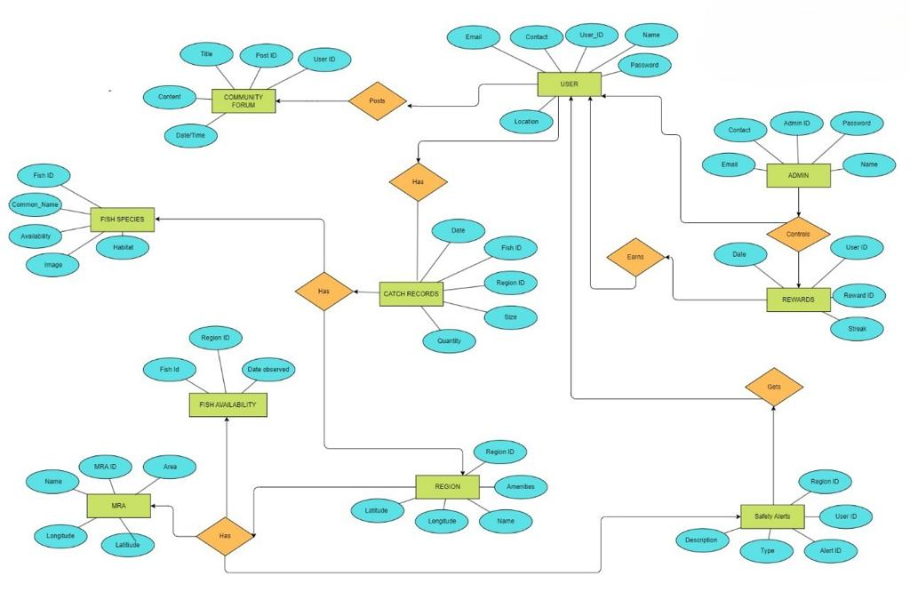
ER DIAGRAM

Slide 10
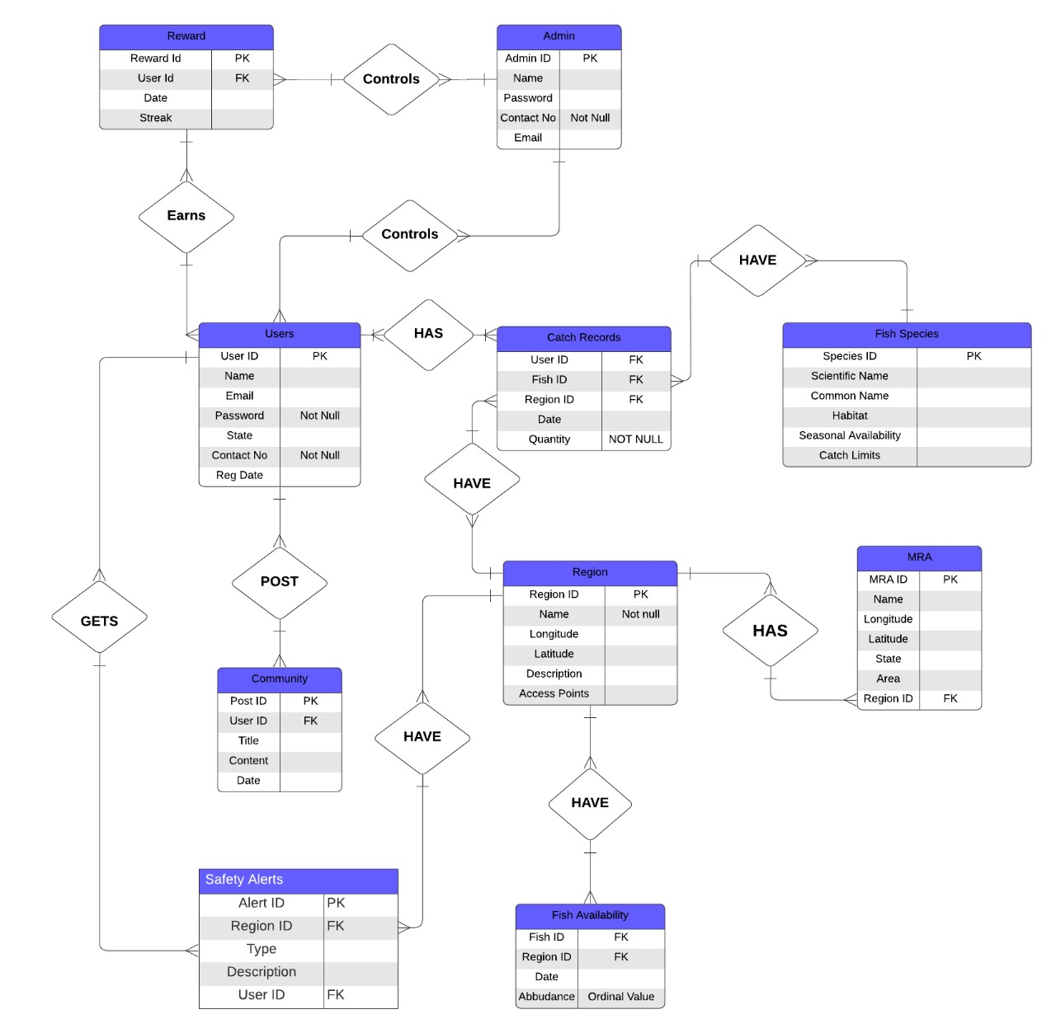
Class Diagram

Slide 11
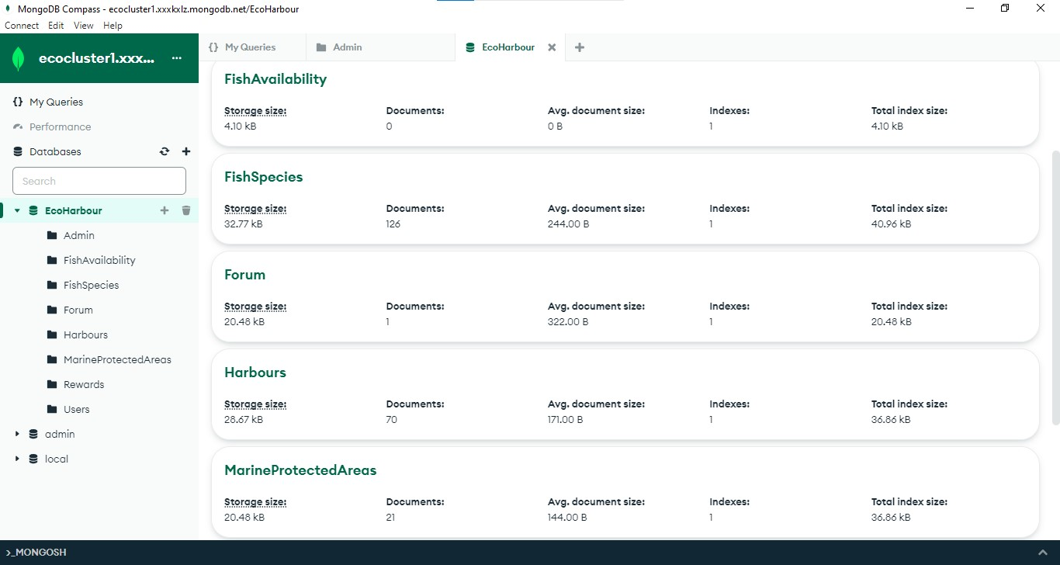
Database in MongoDB

Slide 12
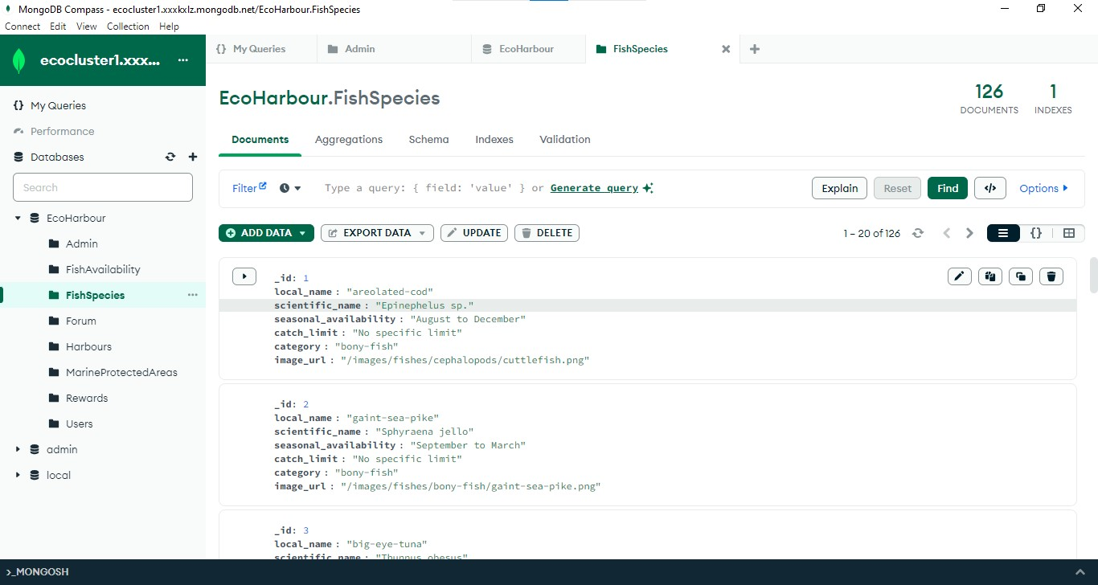
Fish Species Table

Slide 13
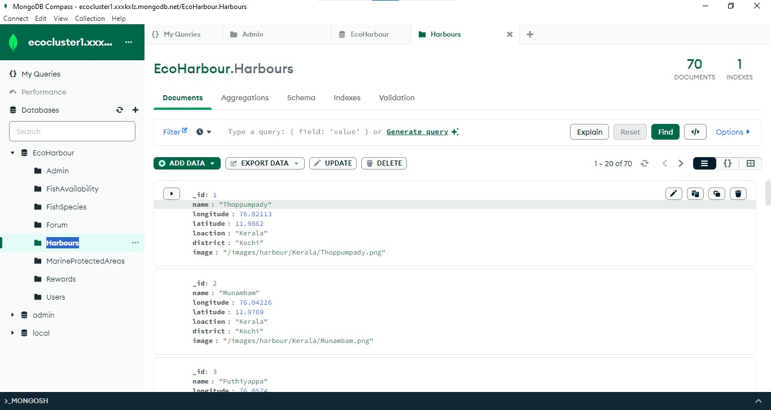
Harbours Table

Slide 14
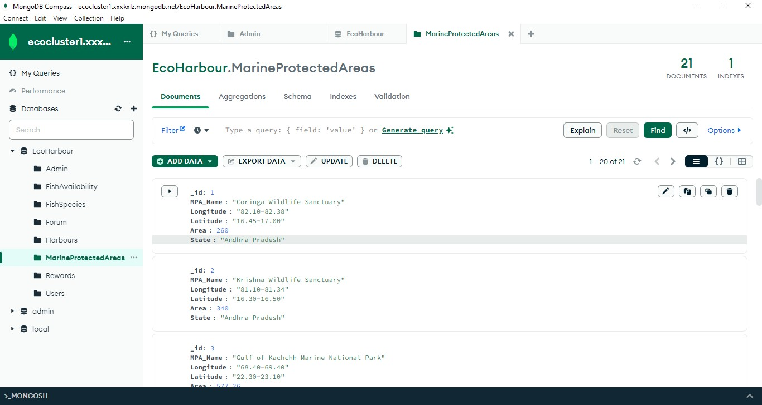
MPA Table

Slide 15
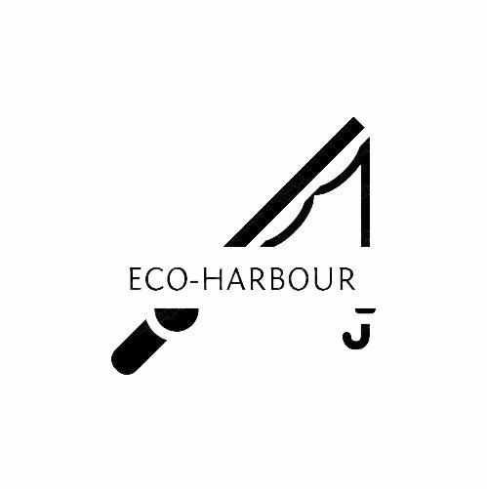
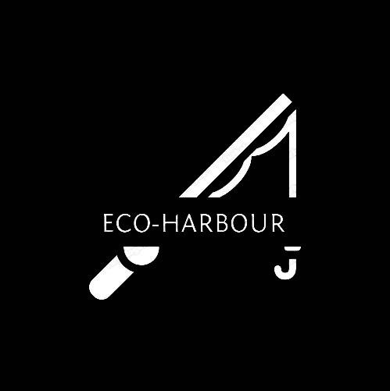
Logo : Eco-Harbour
Eco-Harbour suggests a place where environmental consciousness meets the concept of a safe port or harbor, indicating safety and preservation for marine life

Slide 16
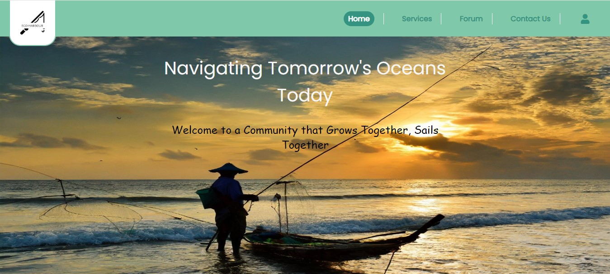
UI Design

Slide 17
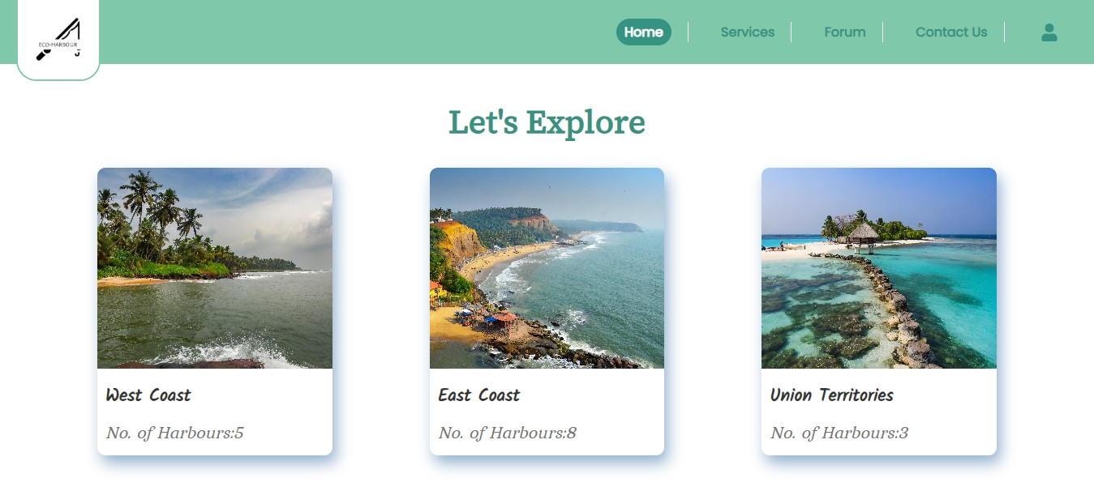
UI Design

Slide 18
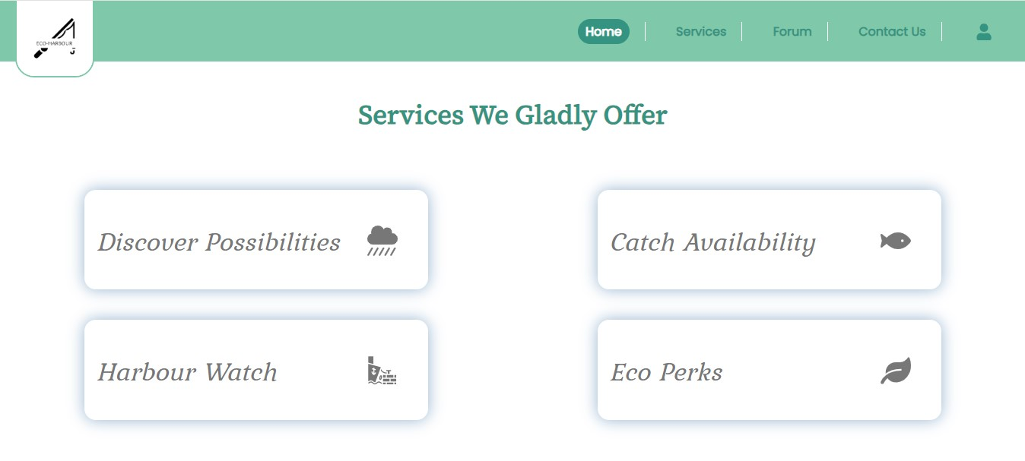
UI Design

Slide 19
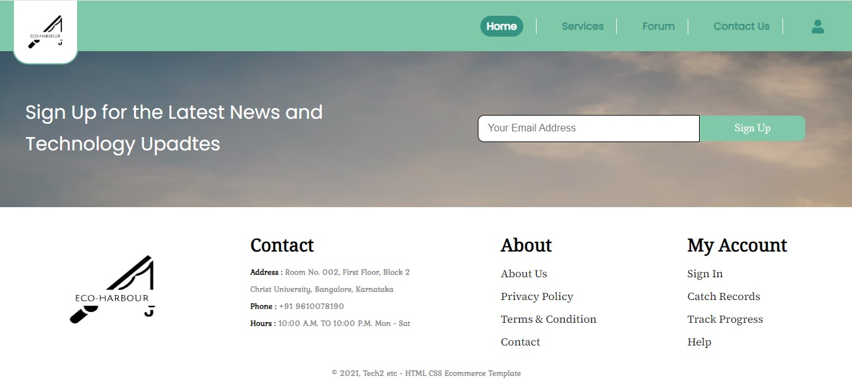
UI Design

Slide 20
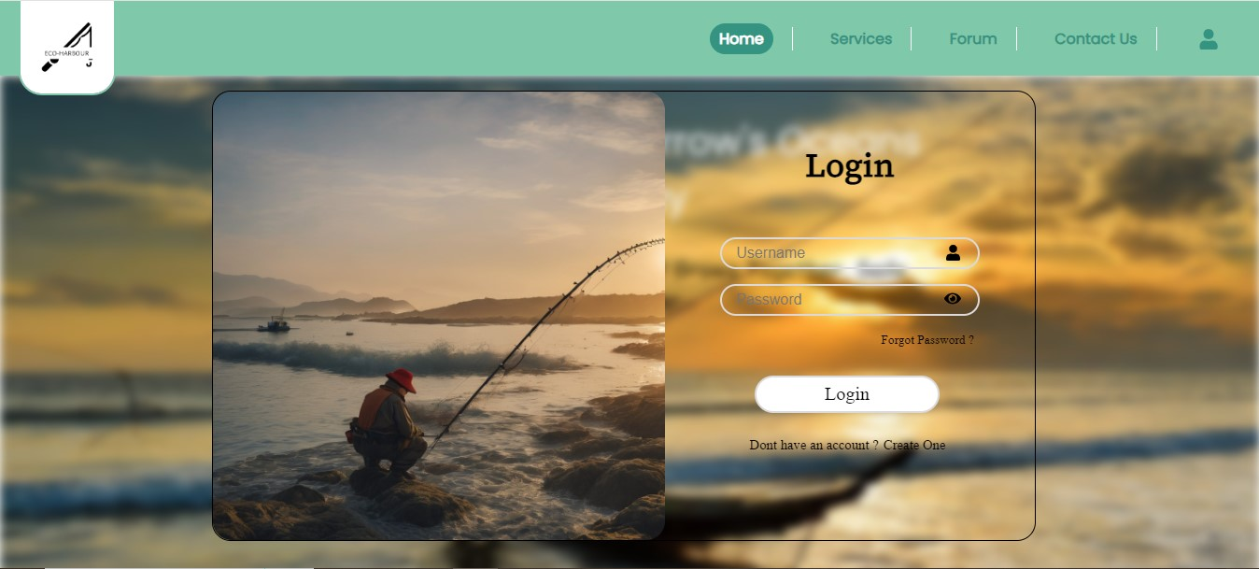
LOGIN PAGE

Slide 21
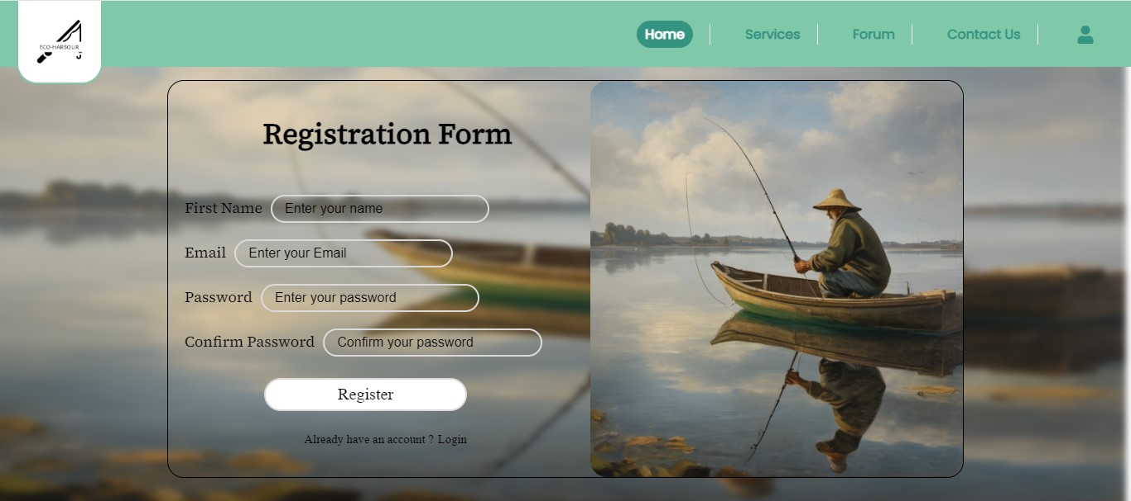
Registration Page

Slide 22
Difficulties
Getting Data from various websites and refining it form a comprehensive database.
https://mpeda.gov.in/?page_id=1007
https://pib.gov.in/Pressreleaseshare.aspx?PRID=1810953
https://mpeda.gov.in/fishers/wp-content/uploads/2021/08/006-MARINE-FISH-LANDINGS-JUNE-2021.pd
https://dof.gov.in/sites/default/files/2020-01/State-wise%20details%20of%20the%20fishing%20harbours%20completed%20or%20commissioned%20and%20under%20construction_0.pdf
Converting tables into 3NF form and adding new columns into database like image_url

Slide 23
THANK YOU

