Slide 1
IMAGE FORGERY DETECTION USING MACHINE LEARNING

Slide 2
DOMAIN INTRODUCTION
It is a method of protecting information and communications through the use of codes, so that only those for whom the information is intended can read and process it.
There are two types of methods used for processing namely,
Image processing
Data processing
The two general phases that all types of data have to undergo while cryptography and steganography
The information obtained from Security processing is hopefully both new and useful.

Slide 3
ABSTRACT
Many images are spread in the virtual world of social media. With the many editing software that allows so there is no doubt that many forgery images.
By forensic the image using Error Level Analysis to find out the compression ratio between the original image and the fake image, because the original image compression and fake images are different.
In addition to knowing whether the image is genuine or fake can analyze the metadata of the image, but the possibility of metadata can be changed.
In this case the authors apply Deep Learning to recognize images of manipulations through the dataset of a fake image and original images via Error Level Analysis on each image and supporting parameters for error rate analysis.

Slide 4
INTRODUCTION
Machine and deep learning, the design of the IDS is usually based on network experts’ knowledge of the attacks.
The amount of applications that stream services to their users has increased explosively.
This type of service requires minimal installations and computing power on the user terminal because the applications are operating at the service carrier’s cloud servers instead of the local terminal.
All the inputs and outputs are streamed to the users via the internet.
Seeing the obvious advantage of providing high-end service to customers, who are not able to access high-end devices, many corporations have started to develop their streaming services.
For instance, entertaining service such as Google Stadia makes high-end gaming, which is typically hardware demanding, now possible on any portable devices with good internet connectivity.

Slide 5
OBJECTIVES
To enhance the performance of prediction.
To effectively predict the original images and forgery images.
To reduce the forgery images.

Slide 6
EXISTING SYSTEM
The existing system doesn’t effectively classify and predict the forgery images.
Machine learning algorithms use computational methods to learn information directly from data without relying on a predetermined equation as a model.
The algorithms adaptively low their performance as the number of samples. Deep learning is a specialized form of machine learning.

Slide 7
DISADVANTAGE
Possibility of high error.
Sometimes cause data inconsistency.

Slide 8
PROPOSED SYSTEM
CNN can be deep which is the case depends on whether it follows this "feature hierarchy" construction because certain neural networks, including 2-layer models, are not deep.
Deep learning is a general term for dealing with a complicated neural network with multiple layers.
Convolutional Neural Networks (CNNs) are one of the most popular neural network architectures.
They are extremely successful at image processing, but also for many other tasks (such as speech recognition, natural language processing, and more).
The state of the art CNNs are pretty deep (dozens of layers at least), so they are part of Deep Learning.

Slide 9
ADVANTAGE
Little dependence on pre-processing, decreasing the needs of human effort developing its functionalities
Comparison was made between the classification algorithm on Deep learning

Slide 10
SYSTEM REQUIREMENTS
Software Requirements
Operating System : Windows 7
Language : Python
IDE : Anaconda - Spyder

Slide 11
SYSTEM REQUIREMENTS
Hardware Requirements
Hard Disk : 1000 GB
Monitor : 15 VGA color
Mouse : Microsoft.
Keyboard : 110 keys enhanced
RAM : 4GB

Slide 12

SYSTEM ARCHITECTURE
SELECT AND
VIEW IMAGES
DATASET
PRE-PROCESSING
FEATURE EXTRACTION
CLASSIFICATION
CONVOLUTIONAL NEURAL NETWORK
PREDICTION
RESULT GENERATION

Slide 13
FLOW DIAGRAM
Start
Select Dataset
View Dataset
Image Pre-Processing
Classification
Convolutional Neural Network
Feature Extraction
Result Generation

Slide 14
MODULES
Image Selection and Loading
Image Preprocessing
Feature Extraction
Classification
Prediction
Result Generation

Slide 15
MODULES DESCRIPTION

Slide 16
IMAGE SELECTION AND LOADING
The data selection is the process of selecting the data for Fake images and Original images dataset.
The dataset which contains the information about correct person images or fake person images.

Slide 17
IMAGE PREPROCESSING
Image Data pre-processing is the process of getting rescale data from the dataset.
Resize image dataset
Getting data
Resize image dataset: Rescale the grey scale chest fake images and original images.
Getting data: That categorical data is defined as variables with a finite set of rescaled values. That most deep learning algorithms require array input and output variables.

Slide 18
SPLITTING DATASET INTO TRAIN AND TEST DATA
Data splitting is the act of partitioning available data into two portions, usually for cross-validator purposes.
One Portion of the data is used to develop a predictive model and the other to evaluate the model's performance.
Separating data into training and testing sets is an important part of evaluating data mining models.
Typically, when you separate a data set into a training set and testing set, most of the data is used for training, and a smaller portion of the data is used for testing.

Slide 19
CLASSIFICATION
CNN In deep learning, a convolutional neural network (CNN, or ConvNet) is a class of deep neural networks, most commonly applied to analysing visual imagery.
They have applications in image and video recognition, recommender systems, image classification, medical image analysis, natural language processing, brain-computer interfaces, and financial time series.
CNNs are regularized versions of multilayer perceptron’s. Multilayer perceptron’s usually mean fully connected networks, that is, each neuron in one layer is connected to all neurons in the next layer.
The "fully-connectedness" of these networks makes them prone to over fitting data. Typical ways of regularization include adding some form of magnitude measurement of weights to the loss function.

Slide 20
PREDICTION
It’s a process of predicting fake images and original images from the dataset.
This project will effectively predict the data from dataset by enhancing the performance of the overall prediction results.

Slide 21
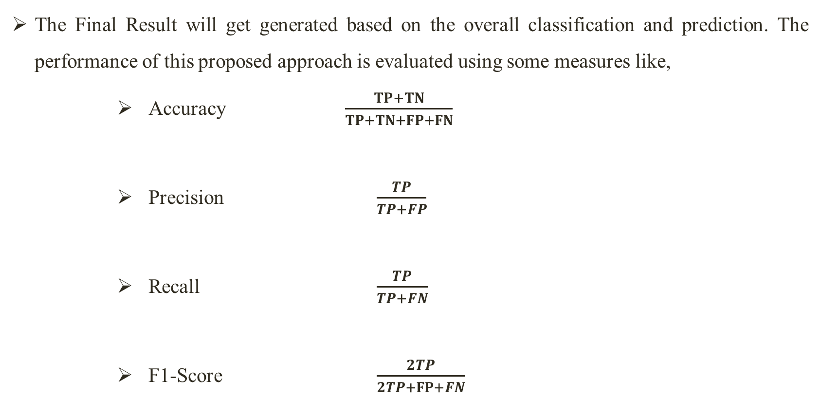
RESULT GENERATION
The Final Result will get generated based on the overall classification and prediction. The performance of this proposed approach is evaluated using some measures like,
Accuracy $\frac{TP+TN}{TP+TN+FP+FN}$
Precision $\frac{TP}{TP+FP}$
Recall $\frac{TP}{TP+FN}$
F1-Score $\frac{2TP}{2TP+FP+FN}$

Slide 22
LITERATURE SURVEY

Slide 23
Title | Year | Author | Methodology
Image Forgery Detection Based on Gabor Wavelets and Local Phase Quantization | 2015 | Isaac MM, Wilscy M. | Image Forgery detection has become a hot area of research as a result of the increasing number of forged images circulating around in the Internet and other social media and due to the legal and social issues that they are creating.

Slide 24
Title | Year | Author | Methodology
Pixel and Edge Based Illuminant Color Estimation for Image Forgery Detection | 2015 | Youseph SN, Cherian RR. | Images are one of the powerful media for communication. Image security is a main issue in the fields that using digital images. By the development of high resolution cameras, personal computers and photo-editing software's, the manipulation of images is becoming common.

Slide 25
Title | Year | Author | Methodology
Copy-move Image Forgery Detection Using an Efficient and Robust Method Combining Un-decimated Wavelet Transform and Scale Invariant Feature Transform. | 2014 | Hashmi MF, Anand V, Keskar AG. | Digital world, digital images and videos are the main carrier of information. However, these sources of information can be easily tampered by using readily available software thus making authenticity and integrity of the digital images an important issue of concern.

Slide 26
Title | Year | Author | Methodology
Effective image forgery detection of tampered foreground or background image based on image watermarking and alpha mattes | 2015 | Hu WC, Chen WH, Huang DY, Yang CY | Effective image forgery detection scheme that identifies a tampered foreground or background image using image watermarking and alpha mattes. In the proposed method, component-hue-difference-based spectral matting is used to obtain the foreground and background images based on the obtained alpha matte

Slide 27
Title | Year | Author | Methodology
Pixel Based Image Forensic Technique for Copy-move Forgery Detection Using Auto Color Correlogram. | 2019 | Malviya AV, Ladhake SA. | The credibility of a digital image plays a generous role in blind Image forensics. We focus on detection of a typical kind of forgery, referred to as copy-move forgery, which is commonly practiced in the field of blind image forensics.

Slide 28
CONCLUSION
It will describe the experimental results from the recognition of the original image and the fake image.
We analyze the accuracy percentage of the drawing training.
Percentage of training varies from 60-90%. This shows that the method we use is able to study the data despite the small amount of data.

Slide 29
PROBLEM STATEMENT
These are the problem for the many editing software that allows so there is no doubt that many forgery images.
By forensic the image using Error Level Analysis to find out the compression ratio between the original image and the fake image, because the original image compression and fake images are different.
In addition to knowing whether the image is genuine or fake can analyze the metadata of the image, but the possibility of metadata can be changed.

Slide 30
FUTURE WORK
The Future enhancement it will conduct a CNN architecture variant to get the best accuracy and do other approaches in processing image processing to recognize the original image and forgery image.

Slide 31
REFERENCES
[1] Patel HC, Patel MM. Forgery Frame Detection From The Video Using Error Level Analysis. IJAERD. 2015; (6): 242–247.
[2] Isaac MM, Wilscy M. Image Forgery Detection Based on Gabor Wavelets and Local Phase Quantization. Procedia Computer Science. 2015; 58: 76–83.
[3] Birajdar GK, Mankar VH. Digital image forgery detection using passive techniques: A survey. Digital Investigation. 2013; 10(3): 226–45.
[4] Youseph SN, Cherian RR. Pixel and Edge Based Illuminant Color Estimation for Image Forgery Detection. Procedia Computer Science. 2015; 46: 1635–42.
[5] Hashmi MF, Anand V, Keskar AG. Copy-move Image Forgery Detection Using an Efficient and Robust Method Combining Un-decimated Wavelet Transform and Scale Invariant Feature Transform. AASRI Procedia. 2014; 9: 84–91.

Slide 32
REFERENCES
[6] Zhao J, Guo J. Passive forensics for copy-move image forgery using a method based on DCT and SVD. Forensic Science International. 2013; 233(1–3): 158–66.
[7] Hashmi MF, Anand V, Keskar AG. Copy-move Image Forgery Detection Using an Efficient and Robust Method Combining Un-decimated Wavelet Transform and Scale Invariant Feature Transform. AASRI Procedia. 2014; 9: 84–91.
[8] Hu WC, Chen WH, Huang DY, Yang CY. Effective image forgery detection of tampered foreground or background image based on image watermarking and alpha mattes. Multimedia Tools and Applications. 2015; 75(6): 3495–516.
[9] Muhammad G, Hussain M, Bebis G. Passive copy move image forgery detection using undecimated dyadic wavelet transform. Digital Investigation. 2012; 9(1): 49–57.

Slide 33
THANK YOU…

