Slide 1
Energy Consumption Optimizer
Predicting Hourly Electricity Load for a Smart City using Regression & Feature Scaling
PRESENTED BY TEAM MEMBERS:
GAURAV MANDLE SCA25MCA098
AKASH RAJ SCA25MCA086
MITHUN BAADKAR SCA25MCA115

Slide 2
GETTING STARTED
Project Overview
In modern smart cities, balancing electricity supply and demand is critical. Producing too much power results in waste; producing too little causes blackouts.
This project builds an end-to-end Machine Learning pipeline that forecasts energy demand (electricity load) on an hourly basis. By predicting load ahead of time, city operators can adjust grid generation levels dynamically.
ML TASK: Regression model using historical weather and calendar readings. OUTPUT target_variable: Expected electricity consumption load (kWh).
⏰ Hour of Day
Value range 0-23. Essential to capture diurnal load peaks (midday activities vs midnight dips).
📅 Day & Month
Day of week (0-6) and Month (1-12) to capture weekend drops and seasonal summer/winter peaks.
🌡️ Temperature
Directly drives high HVAC heating and cooling demands during extreme heat or cold.
💧 Humidity
Measures ambient humidity, which influences thermal comfort index and secondary grid load.

Slide 3
WHY THIS MATTERS
Real-world Data Challenges
* Sensor Outages: Network failures cause sensor gaps, resulting in missing temperatures and humidity logs.
* Logging Glitches: IoT sensor issues duplicate the same timestamp records multiple times, skewing averages.
* Range Scales: Raw features naturally exist on very different scales (e.g. Hour: 0-23, Temp: 5-45C, Humidity: 40-90%), causing model scale bias.
* Production Gap: Grid operators lacked a serialized model and web API deployment to get predictions on demand.
⚠️ Missing Data
140 sensor drop values (80 temperature, 60 humidity) identified in raw dataset.
♻️ Duplicate Logs
30 duplicate sensor timestamps dropped to prevent model overfitting.
⚖️ Range Scales
Standard scaling is mandatory to prevent humidity values from dominating temperature effects.
🌐 API Delivery
Trained models must be serialized (.pkl) and wrapped in web APIs for live grid deployment.

Slide 4
OUR APPROACH
Machine Learning Pipeline Workflow
Our structured regression pipeline spans from initial dataset simulation to final API deployment:
1. Data-Set
8,760 hours (1 year) of smart grid telemetry incorporating weather features.
2. Data Cleaning
Handled duplicate entries and imputed sensor gaps using column mean values.
3. EDA & Visuals
Explored daily cyclical usage loads and analyzed environmental correlation coefficients.
4. Feature Scale
Applied StandardScaler (mean=0, std=1) and MinMaxScaler (0 to 1).
5. Model Training
Trained Linear Regression and Random Forest models on scaled features.
6. Cloud Deploy
Saved serialized models and designed a Flask API for real-time grid queries.
-->
-->
-->
-->
-->

Slide 5
STEPS 1 & 2
Dataset Simulation & Preprocessing
* Simulation: 8,760 hours of grid telemetry. Modeled hourly diurnal curves (midday high, night dip), temperature cycles, and weekend drop patterns (30 kWh lower).
* Missing Values Imputed: Replaced 140 missing temperature and humidity values using the average of each column (mean imputation).
* Deduplication Done: Identified and removed 30 duplicate sensor entries to avoid training redundancy and reset index coordinates.
8,790
Total raw sensor rows collected from simulation.
140
Missing sensor telemetry logs imputed with column mean.
30
Duplicate records removed to prevent overfit metrics.
8,760
Final clean hourly dataset rows ready for model training.

Slide 6
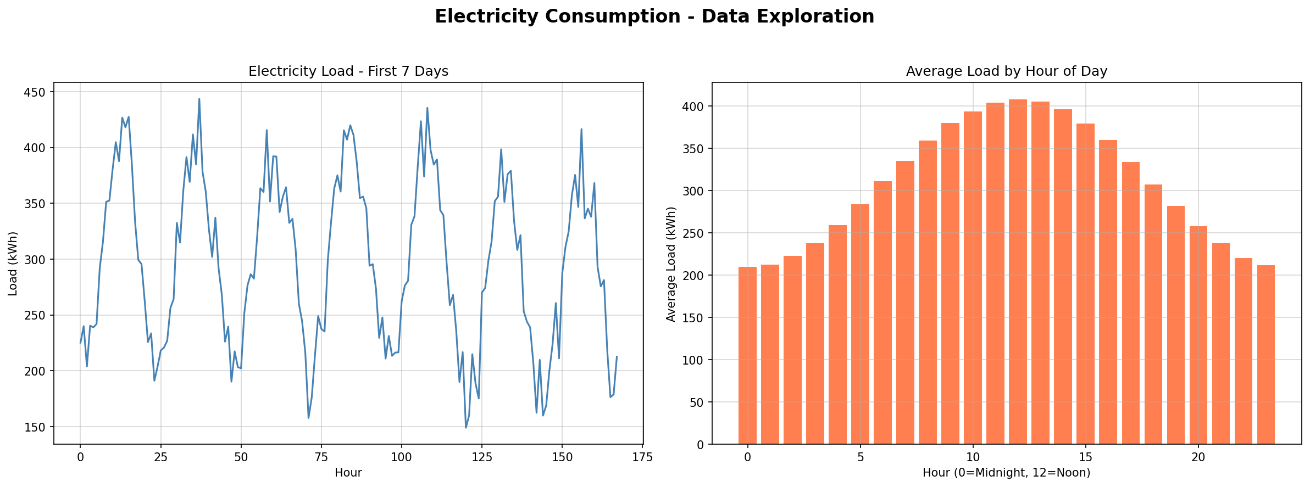
EXPLORING THE DATA
Exploratory Data Analysis (EDA)
* Diurnal Load Peaks: Grid demand follows active human rhythms: low consumption at night (lowest around 3 AM - 5 AM), rising sharp in the morning, and peaking in afternoon/evening hours.
* Weekly Variations: Weekends show a clear 30 kWh drop in demand, reflecting closed office buildings, industrial spaces, and corporate facilities.
* Extreme Temperature Peaks: Load values escalate at extreme cold or extreme hot points, illustrating HVAC cooling and heating demands (quadratic absolute correlation).
Diurnal Weekly Electricity Load Cycles

Slide 7
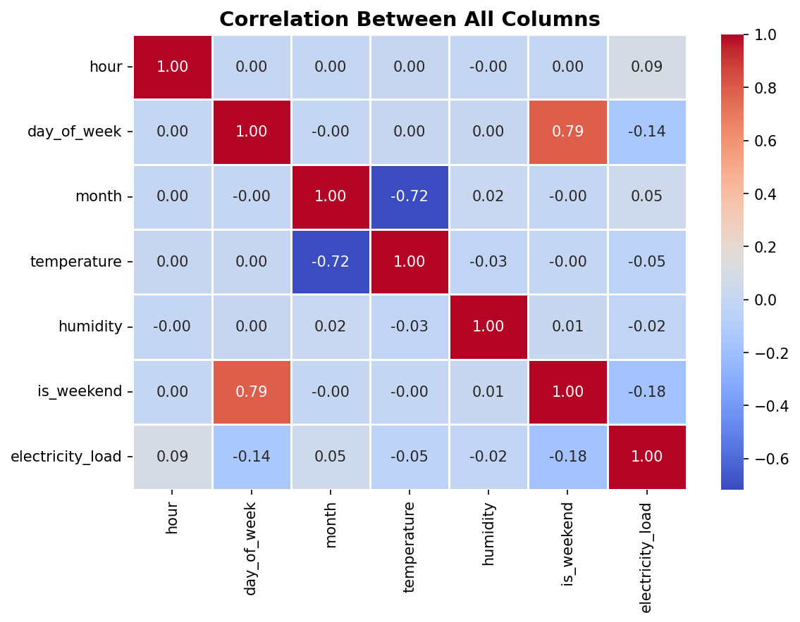
CORRELATION ANALYSIS
What Drives Electricity Load?
* Temperature Factor (+0.25): Positive correlation. As temperature rises, HVAC power consumption spikes. This models summer cooling demands.
* Weekend Drop (-0.12): Negative correlation. Active weekends correspond to drops in commercial energy grids.
* Hour of Day (+0.07): Linear correlation is low, but cyclical correlation is extremely high. Rises with active daily grid profiles.
* Non-Linear Patterns: Correlation coefficients only capture linear effects. Non-linear patterns require ensemble modeling.
Features Correlation Map

Slide 8
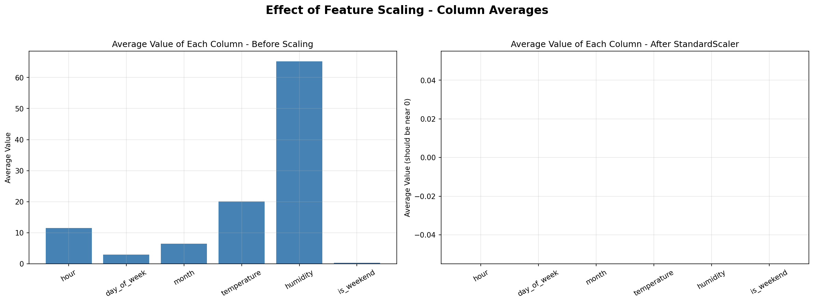
CORE FOCUS
Feature Scaling Deep Dive
* Scale Disparities: Raw features naturally exist on very different scales (e.g. Hour: 0-23, Temperature: 5-45C, Humidity: 40-90%). Models like linear regression bias coefficients towards larger features.
* StandardScaler: Centers features to mean = 0 and standard deviation = 1 (Standardization). Ideal for linear systems.
* MinMaxScaler: Squashes values strictly inside the 0 to 1 range (Normalization). Bounded features.
Column Means Before vs After StandardScaler

Slide 9
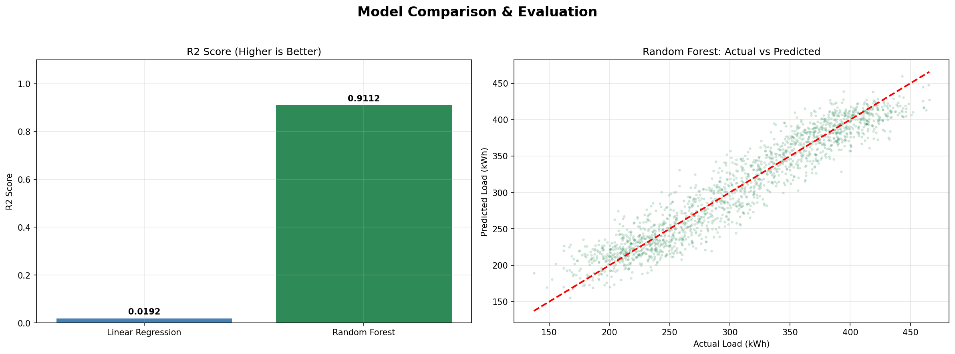
MODEL TRAINING
Linear Regression vs. Random Forest
Model | MSE | R2 Score | Evaluation Verdict
Linear Regression | 5424.45 | 1.92% | Failed. Straight line cannot model cycles.
Random Forest | 491.14 | 91.12% | Excellent. Captures cyclical waveforms.
Mathematical Analysis:
Why the low LR score? The target electricity load is a cyclical sine wave across the day, and temperature demands are non-linear absolute values. Linear Regression is restricted to fitting a straight hyperplane, which fails. Random Forest splits the data space into localized regions to model complex non-linear curves, yielding an R2 of 91.12%.
Model Evaluation & Fit comparison

Slide 10
SUMMARY
Conclusion & Takeaways
* Garbage In, Garbage Out: Data cleaning is mandatory. Dropping duplicates and imputing sensor outages resolved telemetry gaps prior to modeling.
* Linearity Limitations: Linear Regression fails on cyclical data. A straight line is incapable of predicting sine waves and absolute-value HVAC profiles.
* Ensemble Strengths: Random Forest excels by partitioning data space, modeling non-linear waves (R2: 91.12%).
Stage | Grid Pipeline Outcomes
Dataset | 8,760 clean hours simulated (1 year logs).
Pre-processing | 140 gaps mean-imputed, 30 duplicate logs dropped.
Scaling | StandardScaler and MinMaxScaler successfully tested.
Evaluation | Random Forest Regressor wins (MSE: 491.14, R2: 91.12%).
Inference | Monday 6 PM Summer Day predicted at 298.81 kWh.

