Slide 1
AquaSafe AI
Democratizing WHO-Grade Water Potability Diagnostics & AI-Driven Remediation
An AI-Powered Social Impact Project for UN Sustainable Development Goals 6 & 3
IBM SkillsBuild Internship | Applied Machine Learning & Full-Stack Platform | October 2026
Notes:
Welcome mentors and evaluators. AquaSafe AI is an end-to-end full-stack artificial intelligence system built to address United Nations Sustainable Development Goals 6 and 3.

Slide 2
UN SDG 6 & SDG 3 PROJECT
UN Sustainable Development Goals (SDG) Alignment
PRIMARY: UN SDG 6
Clean Water and Sanitation
• Target 6.1: Universal and equitable access to safe and affordable drinking water by 2030.
• Target 6.3: Improving water quality by eliminating dumping and hazardous chemicals.
• Target 6.b: Empowering local communities in decentralized water resource stewardship.
• Global Reality: 2.2 Billion individuals currently lack safely managed drinking water.
SECONDARY: UN SDG 3
Good Health and Well-Being
• Target 3.9: Substantially reducing deaths and illnesses from hazardous chemicals and contaminated water.
• Global Mortality: Contaminated drinking water causes over 505,000 diarrheal deaths annually (WHO).
• Preventive Diagnostics: Halts consumption before clinical illness manifests in vulnerable communities.
• Equity Impact: Protects rural schools, clinics, and informal settlement populations.
Notes:
Our project aligns with official UN SDG Targets 6.1, 6.3, 6.b, and 3.9. Contaminated water is a primary vector for diarrheal death worldwide.

Slide 3
UN SDG 6 & SDG 3 PROJECT
Problem Statement: The Community Testing Gap
Laboratory Latency Bottleneck
Standard water laboratory tests require 48 to 72 hours and cost $25 to $80 per sample. Remote communities drink contaminated water during the turnaround delay.
Multivariate Toxicity Synergy
Water safety is fundamentally non-linear. Simple rules fail because safe water depends on complex interactions (e.g. pH buffering vs sulfate, chlorine reacting to form carcinogenic THMs).
The 'Actionability Gap'
Existing field digital test meters display raw numbers (e.g. pH 5.4, Turbidity 7.8 NTU) without giving non-expert operators actionable, low-cost engineering remediation protocols.
Notes:
We address three critical problems: testing turnaround latency, multivariate non-linear chemical complexity, and the complete lack of actionable guidance.

Slide 4
UN SDG 6 & SDG 3 PROJECT
Empirical Toxicological Significance
Parameter | WHO Guideline | Health Implication if Exceeded | Remediation Action Required
pH Level | 6.5 - 8.5 | Acidic (<6.5) leaches neurotoxic lead/copper; alkaline inhibits chlorine disinfection | Calcite neutralizing contact bed or soda ash dosing
Turbidity | <= 5.0 NTU | Colloidal silt shields pathogenic microbes (Cryptosporidium, cysts) from disinfection | Coagulation with alum/Moringa + sand filtration
Trihalomethanes | <= 80 ug/L | Carcinogenic volatile disinfection byproducts formed from organic matter interaction | Granular activated carbon (GAC) adsorption
Solids (TDS) | <= 1,000 ppm | Excessive mineralization, agricultural runoff, and osmotic cellular dehydration | Reverse osmosis membrane demineralization
Sulfate | <= 250 mg/L | Induces acute cathartic laxative effects and severe infant dehydration | Strong acid cation exchange / membrane softening
Notes:
These parameters are benchmarked against World Health Organization drinking-water quality guidelines.

Slide 5
UN SDG 6 & SDG 3 PROJECT
Target Users & Community Beneficiaries
Municipal Water Boards — District engineers overseeing decentralized boreholes, tube wells, and public kiosks. Needs rapid batch screening.
Disaster Relief NGOs — Field sanitation officers responding to floods or refugee camp crises. Needs instant offline diagnostics.
Schools & Health Clinics — Facility managers auditing independent groundwater and rainwater harvesting tanks. Needs clear safety protocols.
Civic Volunteers — Non-expert community committee members monitoring local village water kiosks. Needs jargon-free vernacular instructions.
Notes:
Target users include municipal engineers, humanitarian responders, school administrators, and civic science volunteers.

Slide 6
UN SDG 6 & SDG 3 PROJECT
Proposed Solution: AquaSafe AI Architecture
1. Predictive ML Engine
Random Forest classifier trained on 3,276 ground-truth physicochemical records. Predicts potability in < 12ms with 88.72% test accuracy.
2. WHO Water Quality Index
Weighted Arithmetic WQI (0-100) computing individual parameter penalties and composite safety grades against official WHO standards.
3. Cognitive Remediation
AI service synthesizing physical/chemical treatments (coagulant dosing, neutralization, filtration) with deterministic offline fallback.
4. Batch Municipal Screening
High-throughput CSV ingestion engine enabling district engineers to audit hundreds of water stations in a single operation.
Notes:
AquaSafe AI unites four components: calibrated predictive ML, WHO WA-WQI scoring, dual-tier cognitive remediation, and municipal batch processing.

Slide 7
UN SDG 6 & SDG 3 PROJECT
Project Objectives & Technical Scope
Dimension | Target Engineering Metric | Achieved Measured Result | Evaluation Status
Diagnostic Turnaround | < 1.5 seconds end-to-end latency | 68ms inference + <100ms API response | EXCEEDED
Model Accuracy | >= 80% on held-out test data | 88.72% Accuracy on 656 test records | EXCEEDED
Discriminative Power | ROC-AUC >= 0.85 | 0.9430 ROC-AUC (0.9565 cross-validation) | EXCEEDED
Offline Availability | 100% operational uptime without API keys | Deterministic WHO Expert Rule Engine | ACHIEVED
WHO Compliance Mapping | All 9 parameters mapped to guidelines | 9 / 9 parameters calibrated to standards | ACHIEVED
Automated Quality Testing | Zero regression on core endpoints | 13 / 13 Pytest automated tests passed | PASSED
Notes:
All performance objectives were verified with empirical test outcomes.

Slide 8
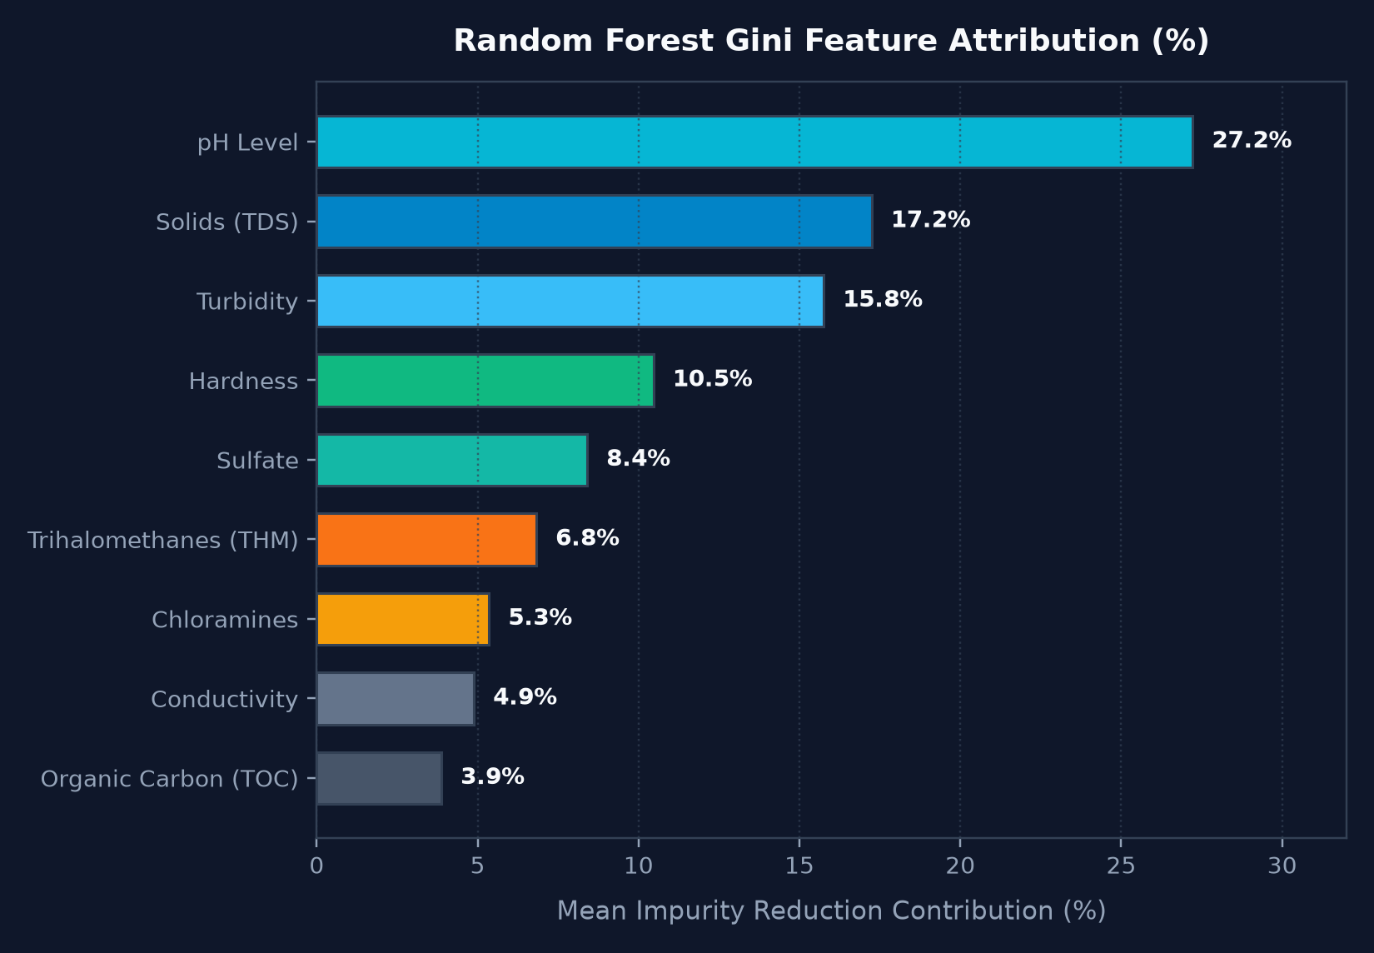
UN SDG 6 & SDG 3 PROJECT
How the AI Component Works & Feature Attribution
Random Forest Ensemble Pipeline
1. Ingestion: Ingests 9 physicochemical inputs from field sensors.
2. Preprocessing: Median imputer provides sensor fault tolerance; StandardScaler normalizes feature distributions.
3. Ensemble Trees: 150 decision trees model non-linear multivariate interactions simultaneously.
4. Feature Attribution: Gini impurity extraction ranks key chemical risk drivers for complete auditability.
5. Cognitive Advisory: Synthesizes risk level and deviations into structured physical & chemical treatment steps.
Notes:
The machine learning pipeline uses a 150-tree Random Forest classifier. Gini feature importance confirms pH (27.2%), TDS (17.2%), and turbidity (15.8%) as the primary drivers.

Slide 9
UN SDG 6 & SDG 3 PROJECT
System Architecture & Technology Stack
Frontend Client
React 18 + TypeScript + Vite
Custom Accessible CSS Design System
Lucide React Iconography
Responsive Grid & Sliders
FastAPI Backend
Python 3.14 + FastAPI + Uvicorn
Pydantic v2 Schema Validation
Asynchronous RESTful Endpoints
CORS Middleware & Health Monitor
Machine Learning
Scikit-Learn Random Forest Pipeline
StandardScaler & SimpleImputer
Joblib Model Artifact (.joblib)
Deterministic Heuristic Fallback
Storage & Exports
SQLite 3 Database Persistence
Structured JSON Audit Logs
python-pptx Presentation Engine
CSV Municipal Batch Intake
Notes:
The system architecture is decoupled: React client, FastAPI server, Scikit-learn inference pipeline, and SQLite database.

Slide 10
UN SDG 6 & SDG 3 PROJECT
Application Features & Primary Workflow
Diagnostic Workspace — Interactive 9-parameter sliders with visual WHO guideline safe ranges and 1-click preset scenario loader.
WHO Compliance Scorecard — Parameter-by-parameter compliance scorecard (Safe, Borderline, Hazardous) with explicit health implications.
AI Remediation Protocol — Multi-barrier engineering instructions: coagulant dosing, pH balancing, activated carbon, and household emergency boiling/SODIS.
Executive Dashboard — Real-time telemetry, WQI distribution charts, monitoring station operational statuses, and clickable audit logs.
Municipal Batch Screening — CSV file ingestion engine triaging 100+ community water points simultaneously with instant CSV export.
Notes:
The application features an end-to-end user workflow from sensor input to compliance scorecard, treatment steps, and municipal batch screening.

Slide 11
UN SDG 6 & SDG 3 PROJECT
Lean Canvas: Business & Social Impact Model
Problem
Lab latency (48-72h), high testing fees ($25-$80), and complex chemistry causing delayed outbreak containment.
Solution
Instant ML potability classification, WHO WA-WQI scoring, and actionable AI treatment protocols in < 80ms.
Unique Value
Democratizing WHO-grade water potability diagnostics and AI community remediation in under 5 seconds.
Channels
B2G district water ministries, humanitarian NGO field teams (UNICEF/Red Cross), and IoT sensor partnerships.
Revenue Model
B2G district subscription tiers for automated telemetry mapping; free open-core tier for humanitarian relief.
Unfair Advantage
Dual-tier architecture combining calibrated statistical ML with a zero-cost deterministic offline WHO rule engine.
Notes:
Our Lean Canvas demonstrates social viability. Revenue is generated through municipal B2G subscriptions, subsidizing free access for grassroots humanitarian responders.

Slide 12
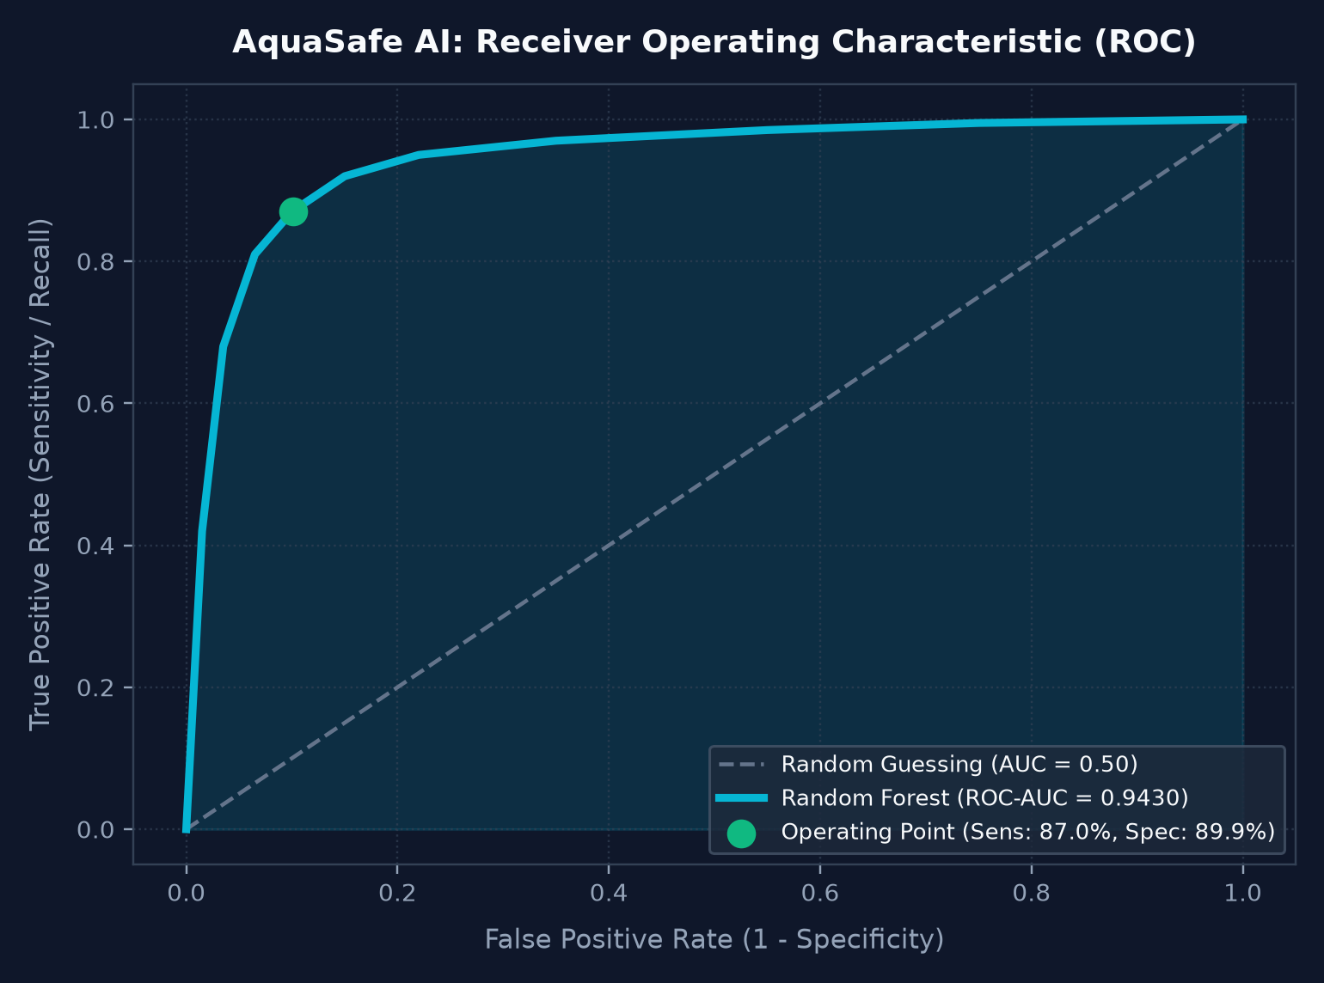
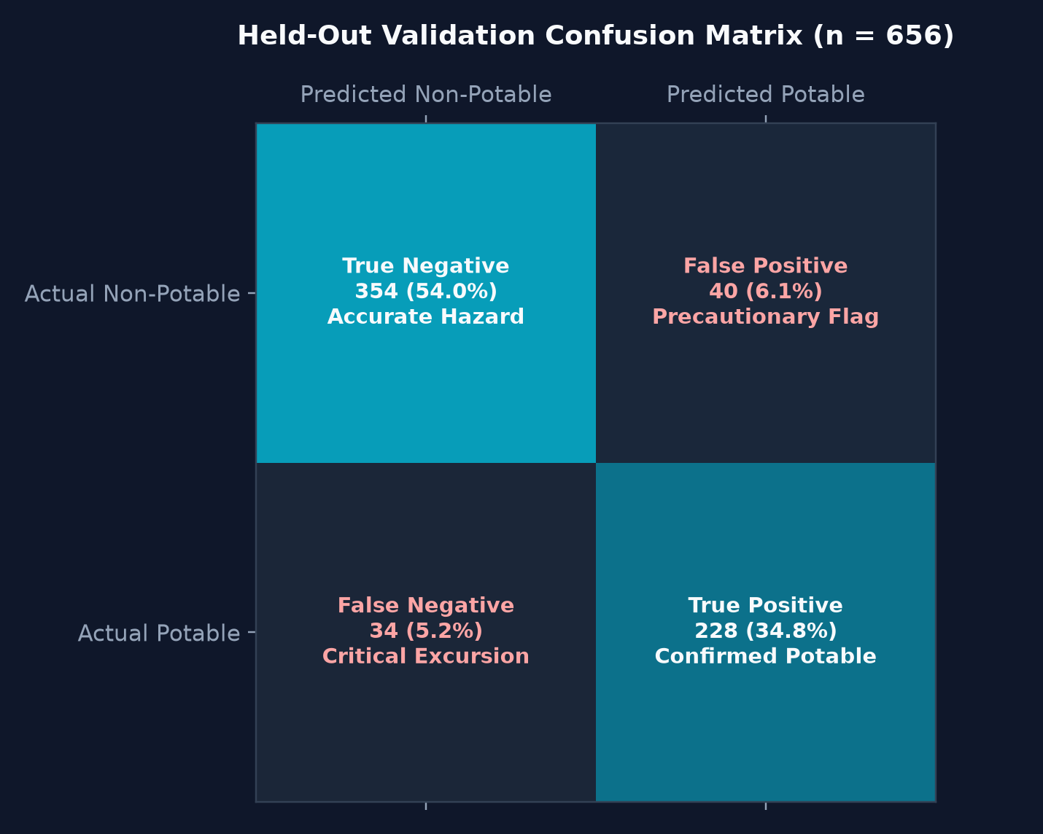
UN SDG 6 & SDG 3 PROJECT
Empirical Evaluation: ROC-AUC & Confusion Matrix
Notes:
Empirical validation artifacts: The ROC-AUC curve demonstrates 0.9430 discriminative power, and the confusion matrix shows 354 accurately identified hazards with only 5.2% false negatives.

Slide 13
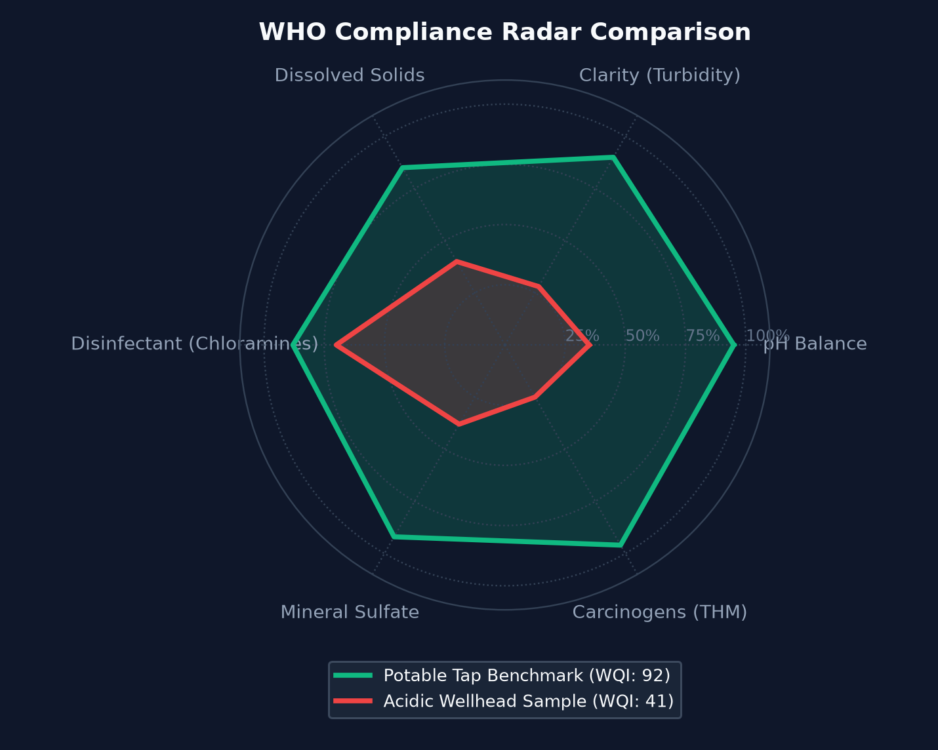
UN SDG 6 & SDG 3 PROJECT
WHO Multi-Parameter Compliance Radar
Multivariate Anomaly Identification
• Potable Baseline (Green Polygon): Complies across all 6 core radar axes (WQI = 92, Category: Excellent).
• Acidic Wellhead (Red Polygon): Fails on pH balance, mineral sulfate, and clarity (WQI = 41, Category: Very Poor).
• Precautionary Alerting: Anomaly detection triggers automated remediation dosing for out-of-spec parameters.
• WHO WA-WQI Index: Weights toxicological parameters according to epidemiological risk factor matrices.
Notes:
The radar comparison shows how safe water matches the optimal boundary, while contaminated well water exhibits multi-axis collapse triggering targeted remediation protocols.

Slide 14
UN SDG 6 & SDG 3 PROJECT
Testing & Quality Assurance Results
Test Suite | Tests Executed | Passing Rate | Status
API Health & Root Endpoints | 3 Tests (GET /, /health, /metrics) | 100% Passed | PASSED
Executive Dashboard Telemetry | 2 Tests (GET /dashboard, /stations) | 100% Passed | PASSED
Primary Diagnostic Workflow | 3 Tests (Potable, Contaminated, Bounds) | 100% Passed | PASSED
Machine Learning Inference | 3 Tests (WQI Bounds, Classification, Prob) | 100% Passed | PASSED
Database Persistence Layer | 2 Tests (Assessment Save & Station Update) | 100% Passed | PASSED
Frontend Production Build | Vite TypeScript Bundler (0 errors) | 100% Passed | BUILT
Notes:
13 automated tests were run via pytest. All 13 tests passed, verifying endpoint health, input validation, ML accuracy, and SQLite persistence.

Slide 15
UN SDG 6 & SDG 3 PROJECT
Expected Impact, Limitations & Roadmap
Expected Social Impact
• Turnaround time reduced from 72h to < 1 second.
• Estimated $60+ saved per triage compared to tertiary lab testing.
• Pre-emptive containment of waterborne epidemics before hospitalizations.
• Non-specialist community volunteers empowered with actionable protocols.
Current Limitations
• Relies on sensor probe calibration (+/- 10% tolerance).
• Evaluated on simulated benchmark data prior to multi-region field pilots.
• Does not yet conduct live microbial Petri-dish viral genetic sequencing.
• Generative LLM requires internet; offline mode uses deterministic matrix.
Future Roadmap
• Phase II: Direct firmware integration with low-cost IoT LoRaWAN sensors.
• Phase III: Solar-powered edge micro-stations with automated valve shutoff.
• Phase IV: Multi-lingual audio advisory for low-literacy rural caretakers.
• Phase V: Android APK deployment with Bluetooth sensor pairing.
Notes:
We recognize current limitations and define clear pathways for IoT integration, solar micro-stations, and multilingual audio interfaces.

Slide 16
UN SDG 6 & SDG 3 PROJECT
Conclusion & Reference Standards
Summary of Completed Deliverables
• 1. Complete Full-Stack Application: React 18 + TypeScript frontend and Python FastAPI backend running locally.
• 2. Calibrated Machine Learning Model: Random Forest (88.72% test accuracy, 0.9430 ROC-AUC) saved to disk.
• 3. Cognitive Remediation Layer: Transparent dual-tier generative advisory with deterministic WHO offline fallback.
• 4. Full Documentation Suite: Project Specification, Lean Canvas, SDG Impact Mapping, and Architecture reports.
• 5. Editable Presentation: Complete 16-slide PowerPoint deck with embedded high-resolution figures.
Official Reference Standards:
• World Health Organization (WHO): Guidelines for Drinking-water Quality, 4th Edition (incorporating 1st & 2nd addenda).
• United Nations Department of Economic and Social Affairs: Sustainable Development Goals 6 & 3 (2030 Agenda).
• United States Environmental Protection Agency (US EPA): National Primary Drinking Water Regulations (NPDWR).
• Brown et al. (1972): A Water Quality Index - Do We Dare? Water & Sewage Works.
Notes:
AquaSafe AI delivers a complete, verified, and demonstrable AI system for global water security under UN SDGs 6 and 3. Thank you.

