Slide 1
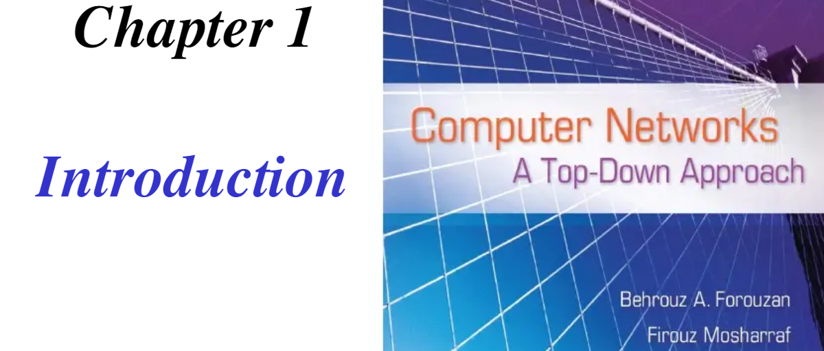

Slide 2
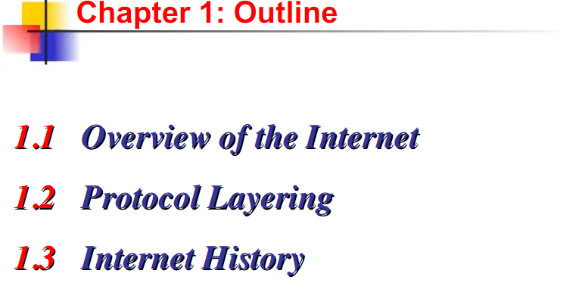

Slide 3
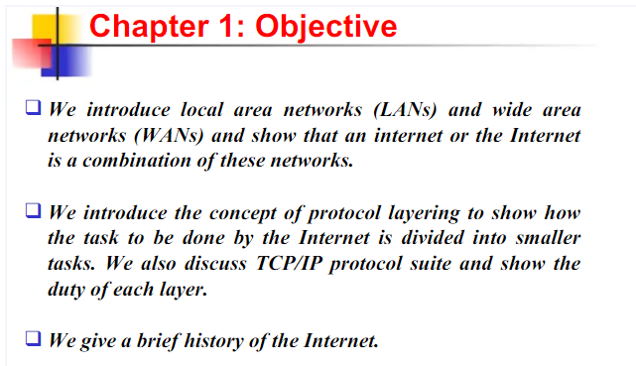

Slide 4

NETWORK DEFINITION
CONNECT NETWORKS TO FORM SMALL INTERNETWORKS
STRUCTURE OF THE INTERNET WHICH IS THE BASE TO UNDERSTAND THE FURTHER CONCEPTS IN COMPUTER NETWORKS

Slide 5
1.1 NETWORK
SET OF INTERCONNECTED DEVICES WHICH ARE CAPABLE OF COMMUNICATING WITH EACH OTHER.
DEVICES???
HOSTS – END SYSTEM
ROUTER-CONNECTING DEVICE- CONNECTS THE NETWORK TO ANOTHER NETWORK.
SWICTH- CONNECTS DEVICES TOGETHER
MODEM (MODULATOR-DEMODULATOR)– CHANGES THE FORM OF DATA.
TYPES OF NETWORK
LAN
WAN
MAN
PAN

Slide 6
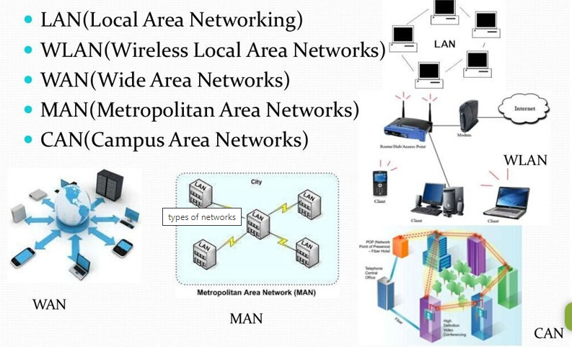

Slide 7
LAN (Local Area Network)
Covers up to 1 KM radius.
A group of computers and associated devices that share a common communications line or wireless link to a server. T
It encompasses computers and peripherals connected to a server within a distinct geographic area such as an office or a commercial establishment.
LAN is owned by privately owned companies.

Slide 8
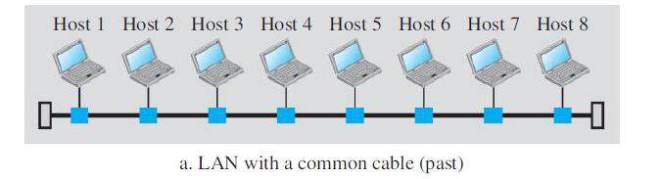
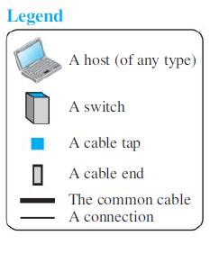
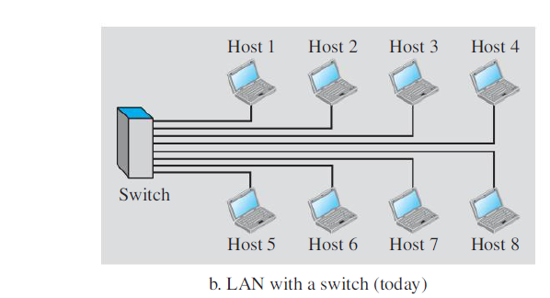

Slide 9
WAN (Wide Area Network)
No Limit.
A network that exists over a large-scale geographical area. Spans a town, a state, a country, or even the world.
A WAN connects different smaller networks, including local area networks (LANs) and metro area networks (MANs).
WAN interconnects connecting devices such as switches, routers, or modems.
It is ensures that computers and users in one location can communicate with computers and users in other locations.
WAN – created and run by communication companies and leased by an organization that uses it.

Slide 10
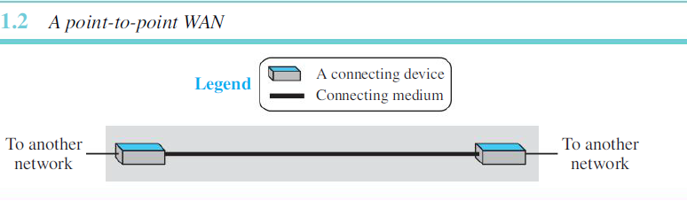
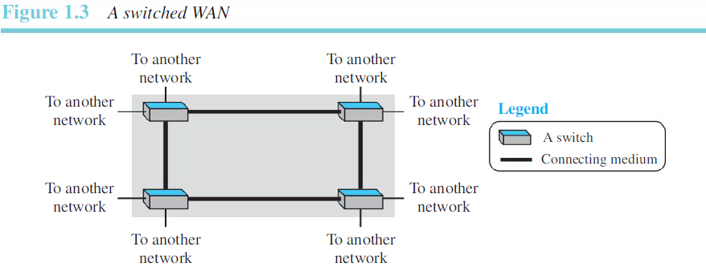

Slide 11
WLAN(Wireless Local Area Network)
Is a wireless computer network that links two or more devices using wireless communication within a limited area such as a home, school, computer laboratory, or office building.
This gives users the ability to move around within a local coverage area and yet still be connected to the network. Through a gateway, a WLAN can also provide a connection to the wider Internet.

Slide 12
MAN(Metropolitan Area Network)
A network is a computer network that interconnects users with computer resources in a geographic area or region larger than that covered by even a large local area network (LAN) but smaller than the area covered by a wide area network (WAN).
The interconnection of networks in a city into a single larger network. It is also used to mean the interconnection of several local area networks by bridging them with backbone lines. The latter usage is also sometimes referred to as a campus network.

Slide 13
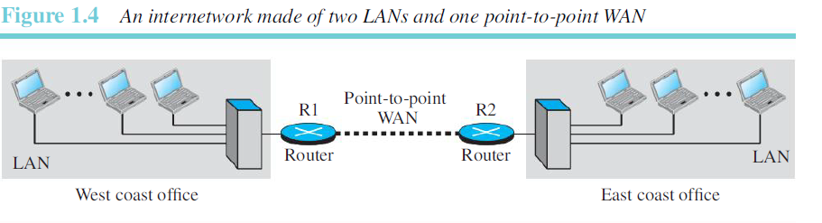
INTERNETWORK
WHEN A MESSAGE IS SENT WITHIN THE SAME NETWORK, THE ROUTER BLOCKS THE MESSAGE BUT THE SWITCH DIRECTS THE MESSAGE TO THE DESTINATION.
WHEN A MESSAGE HAS TO BE SENT FROM A HOST ON ONE NETWORK TO A HOST ON THE OTHER NETWORK, A ROUTER RECEIVES THE MESSAGE AND FORWARDS IT TO THE ROUTER CONNECTING TO THE DESTINATION NETWORK.

Slide 14
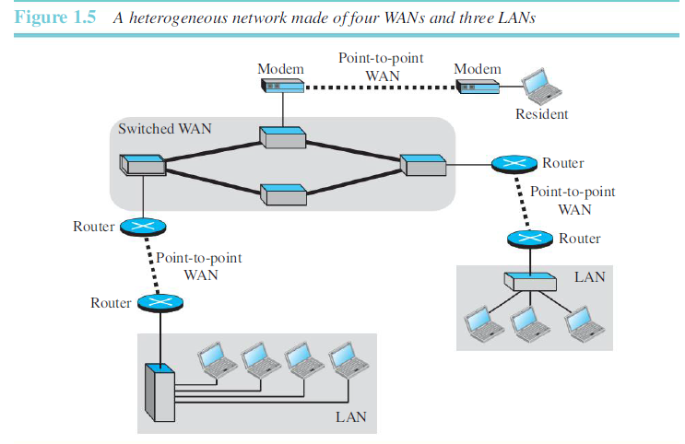

Slide 15
INTERNET- A COMBINATION OF LINKS AND SWITCHES.
1.1.2 SWITCHING
INTERNET IS A SWITCHED NETWORK IN WHICH A SWITCH CONNECTS ATLEAST TWO LINKS TOGETHER.
SWITCH FORWARDS DATA FROM ONE LINK TO ANOTHER.
TWO COMMON TYPES OF SWITCHED NETWORKS ARE:
CIRCUIT SWITCHED
PACKET SWITCHED

Slide 16
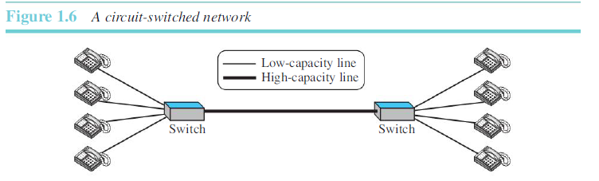
CIRCUIT SWITCHED NETWORK
THERE IS A DEDICATED CONNECTION BETWEEN TWO END SYSTEMS.
THE CONNECTION IS CALLED CIRCUIT. SWITCHES HERE CAN ONLY FORWARD, NO STORAGE.
IS EFFICIENT ONLY WHEN IT IS WORKING AT ITS FULL CAPACITY. INEFFICIENT WHEN IS WORKING AT PARTIAL CAPACITY.

Slide 17
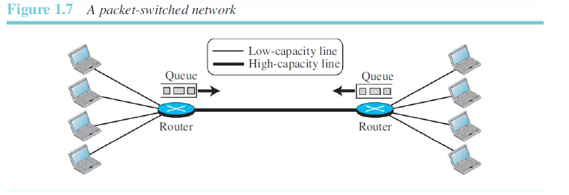
PACKET SWITCHED NETWORK
COMMUNICATION BETWEEN TWO END DEVICES IS DONE BY BLOCKS OF DATA.
THESE BLOCKS ARE CALLED AS PACKETS.
WHEN THE THICK CHANNEL IS AT ITS FULL CAPACITY AND SOME MORE PACKETS ARRIVE?????
PACKETS MUST BE STORED . -- ROUTERS

Slide 18
EFFICIENT???? WHY???? QUIZ CONDUCTED

Slide 19
NETWORKING DEVICES

Slide 20
ROUTER
CONNECTS MULTIPLE network segments.
Extending the network

Slide 21
Bridge
Bridge is used to divide a large network into smaller segments. Basic functions of the Bridge are the following: -
Breaking a large network into smaller segments.
Connecting different media types. Such as connects UTP with the fiber optic.
Connecting different network architectures. Such as connects Ethernet with the Token ring.

Slide 22
HUB
Hub is a centralized device that connects multiple devices in a single LAN network.
When Hub receives the data signals from a connected device on any of its port, except that port, it forwards those signals to all other connected devices from the remaining ports.
Passive Hub: - It forwards data signals in the same format in which it receives them. It does not change the data signal in any manner.
Active Hub: - It also works same as the passive Hub works. But before forwarding the data signals, it amplifies them. Due to this added feature, the active Hub is also known as the repeater.

Slide 23
Gateway
Gateway is used to forward the packets which are generated from the local host or network and but intended for the remote network.
If a data packet does not find its destination address in the local network then it takes the help of the gateway device to find the destination address in the remote network.

Slide 24
TOPOLOGIES
MESH
BUS
STAR
RING

Slide 25
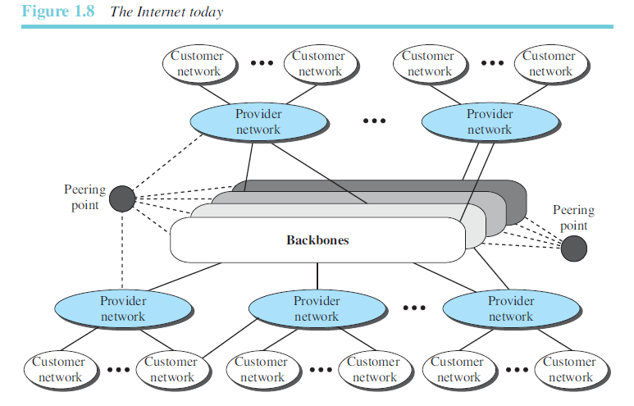

Slide 26
TOP LEVEL
Backbones:
Larger networks owned by some communication companies such as Verizon, AT &T. etc.
Peering systems:
Some complex switching systems, called peering points.
SECOND LEVEL
Provider Networks:
use the services of the backbones for a fee.
Customer networks:
Are networks at the edge of the Internet that actually use the services provided by the Internet.
They pay fees to provider networks for receiving services

Slide 27
1.1.4 ACCESSING THE INTERNET
The user needs to be physically connected to an ISP.
The physical connection is done through a point-to-point WAN.
Using Telephone networks
Using Cable networks
Using Wireless networks
Direct Connection to the Internet

Slide 28
Using Telephone networks
Change voice lines to point to point WAN.
Dial-up-service: include a modem to the telephone line.
Why modem??
Convert data to voice.
Advantages? – in rural areas where direct internet is not available.
Disadvantages? – slow service and when internet is connected cannot make a telephone call
DSL: Digital Subscriber Line
Some Telephone companies have upgraded to provide high internet speeds.
Modem.
DSL can be used for both data and voice.

Slide 29
Using Cable networks
using cable TV services instead of antennas to receive TV broadcasting. The cable companies have been
upgrading their cable networks and connecting to the Internet.
Using Wireless networks
Household or a small business can use a combination of wireless and wired connections to access the Internet.
With the growing wireless WAN access, a household or a small business can be connected to the Internet through a wireless WAN.

Slide 30
Direct Connection to the Internet
A large organization or a large corporation can itself become a local ISP and be connected to the Internet.
This can be done if the organization or the corporation leases a high-speed WAN from a carrier provider and connects itself to a regional ISP.

Slide 31
1.1.5 HARDWARE & SOFTWARE
Only hardware???
Needs Software too………
Protocol layering – helps in coordination of the hardware and software.

Slide 32
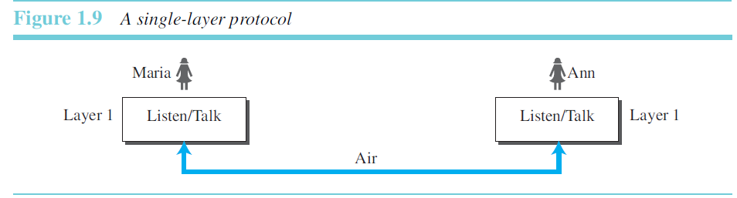

Slide 33
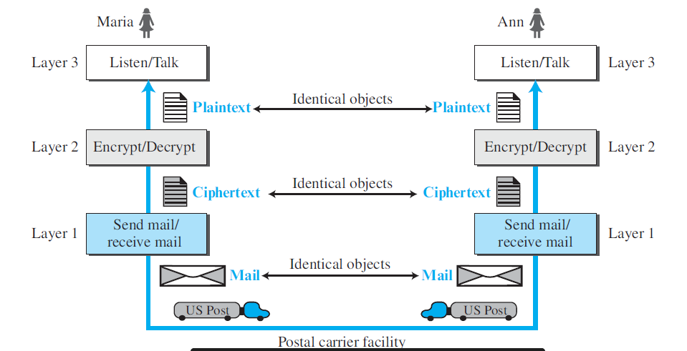

Slide 34
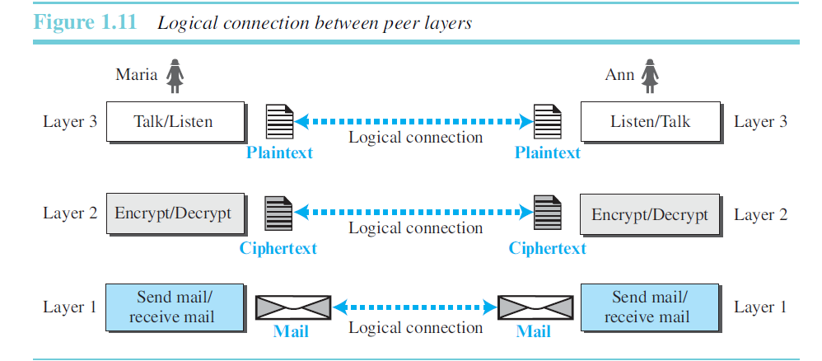

Slide 35
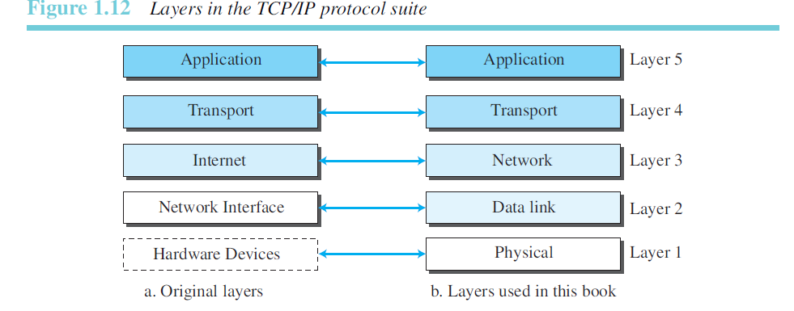

Slide 36
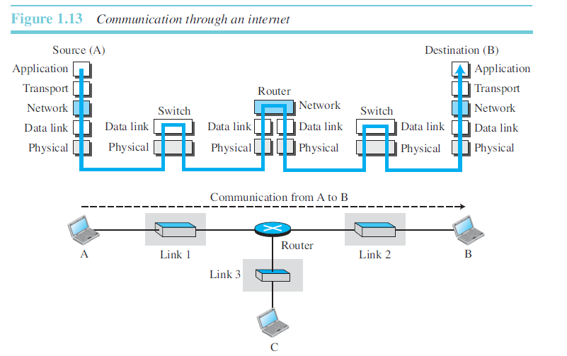

Slide 37
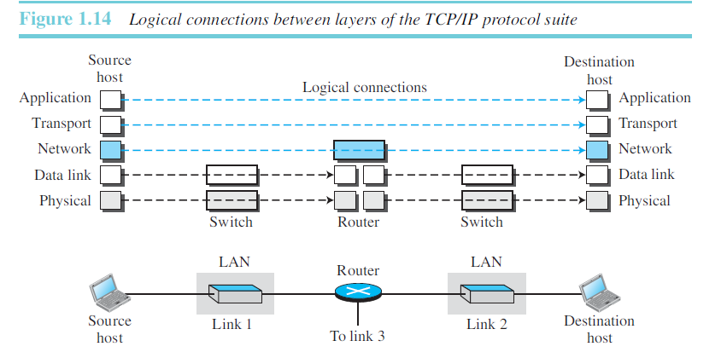

Slide 38
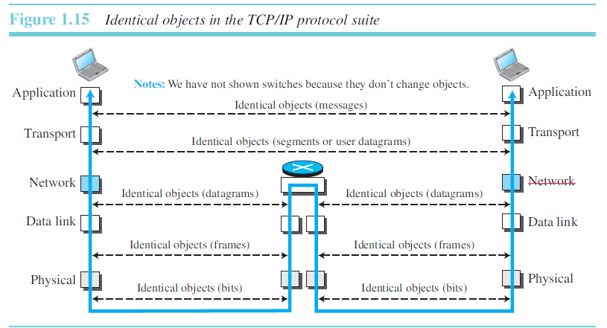

Slide 39
DESCRIPTION OF LAYERS
Application Layer
logical connection between the two application layers is end to- end.
exchange messages
Communication at the application layer is between two processes.
Process-to-process communication – duty

Slide 40
DIFFERENT PROTOCOLS IN AL
HTTP
FTP
SMTP
TELNET
SNMP
IGMP

Slide 41
Transport Layer
end-to-end-logical connection
gets the message from the application layer, encapsulates it in a transport layer packet.
a segment or a user datagram
sends it through the logical (imaginary) connection, to the transport layer at the destination host.

Slide 42
Protocols used in TL
TCP - transmission control protocol
provides
connection-oriented protocol
first establishes a logical connection between transport layers at two hosts before transferring data.
creates a logical pipe between two TCPs for transferring a stream of bytes.
Error control, flow control, congestion control

Slide 43
UDP – user datagram protocol
connectionless protocol that transmits user datagrams without first creating a logical connection.
each user datagram is an independent entity without being related to the previous or the next one
No error control, Flow control, congestion control

Slide 44
NETWORK LAYER
creating a connection between the source computer and the destination computer.
Communication is host-to-host.
The main protocol, Internet Protocol (IP)

Slide 45
IP – Internet Protocol -connectionless protocol
Defines the format of the packet, called a datagram at the network layer.
IP also defines the format and the structure of addresses.
Routing a packet from its source to its destination, which is achieved by each router forwarding the datagram to the next router in its path.
no flow control, no error control, and no congestion control services

Slide 46
NETWORK LAYER – ROUTING PROTOCOLS
Includes unicast (one-to-one) and multicast (one-to-many) routing protocols. A routing protocol does not take part in routing (it is the responsibility of IP),
But it creates forwarding tables for routers to help them in the routing process.

Slide 47
The Internet Control Message Protocol (ICMP) helps IP to report some problems when routing a packet.
The Internet Group Management Protocol (IGMP) helps IP in multitasking.
The Dynamic Host Configuration Protocol (DHCP) helps IP to get the network-layer address for a host.
The Address Resolution Protocol (ARP): helps IP to find the link-layer address of a host or a router when its network-layer address is given

Slide 48
DATA LINK LAYER
Internet is made up of LANs and WANs. Datagram may travel from source to destination through overlapping links.
Is responsible for taking the datagram and moving it across the link.
Any protocol that can take the datagram and carry it through the link suffices for the network layer. The data-link layer takes a datagram and encapsulates it in a packet called a frame

Slide 49
PHYSICAL LAYER
Is responsible for carrying individual bits in a frame across the link.
Two devices are connected by a transmission medium (cable or air).
Transmission medium does not carry bits; it carries electrical or optical signals.
logical unit between two physical layers in two devices is a bit

Slide 50
ENCAPSULATION AND DECPASULATION
At the source, we have only _____________?
Application Layer: Message- no header or trailer.
Transport layer takes the message as the payload.
adds the transport layer header to the payload
contains the identifiers of the source and destination application programs.
information that is needed for the end-to end delivery of the message.
Result is the transport-layer packet, which is called ____________________??

Slide 51
Network Layer: adds header to the payload.
header contains the addresses of the source and destination hosts and some more information used for error checking of the header, fragmentation information.
Result is the network-layer packet called as ____________????
Data link layer:
adds its own header, which contains the link-layer addresses of the host or the next hop (the router)

Slide 52
De-capsulation and Encapsulation at Router
At the router, we have both de-capsulation and encapsulation because the router is connected
to two or more links.
1. After the set of bits are delivered to the data-link layer, this layer de-capsulates the datagram from the frame and passes it to the network layer.
2. The network layer only inspects the source and destination addresses in the datagram header and consults its forwarding table to find the next hop to which the datagram is to be delivered through the next link. The datagram is then passed to the data-link layer of the next link.
3. The data-link layer of the next link encapsulates the datagram in a frame and passes it to the physical layer for transmission.

Slide 55
2-2 THE OSI MODEL
Established in 1947, the International Standards Organization (ISO) is a multinational body dedicated to worldwide agreement on international standards. An ISO standard that covers all aspects of network communications is the Open Systems Interconnection (OSI) model. It was first introduced in the late 1970s.

Slide 56

Note
ISO is the organization. OSI is the model.

Slide 57
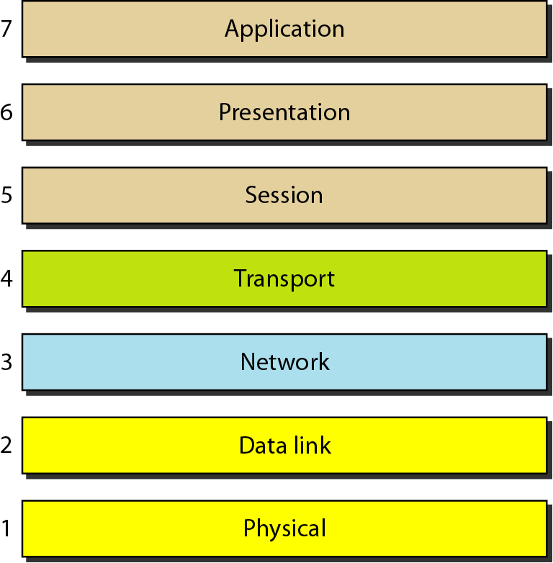
Figure 2.2 Seven layers of the OSI model

Slide 60
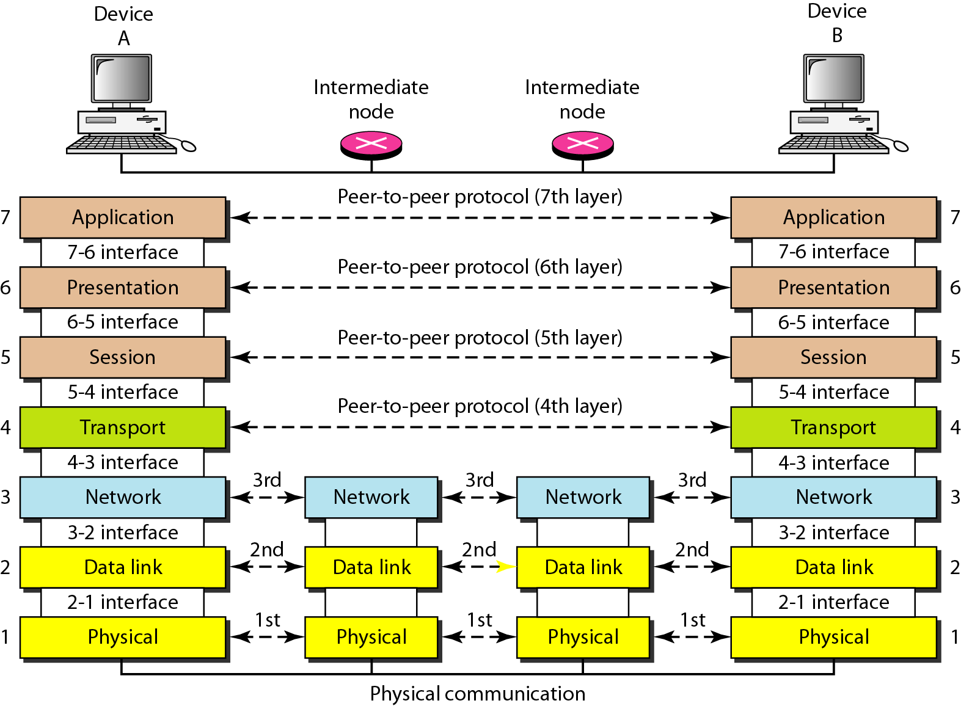
Figure 2.3 The interaction between layers in the OSI model

Slide 61
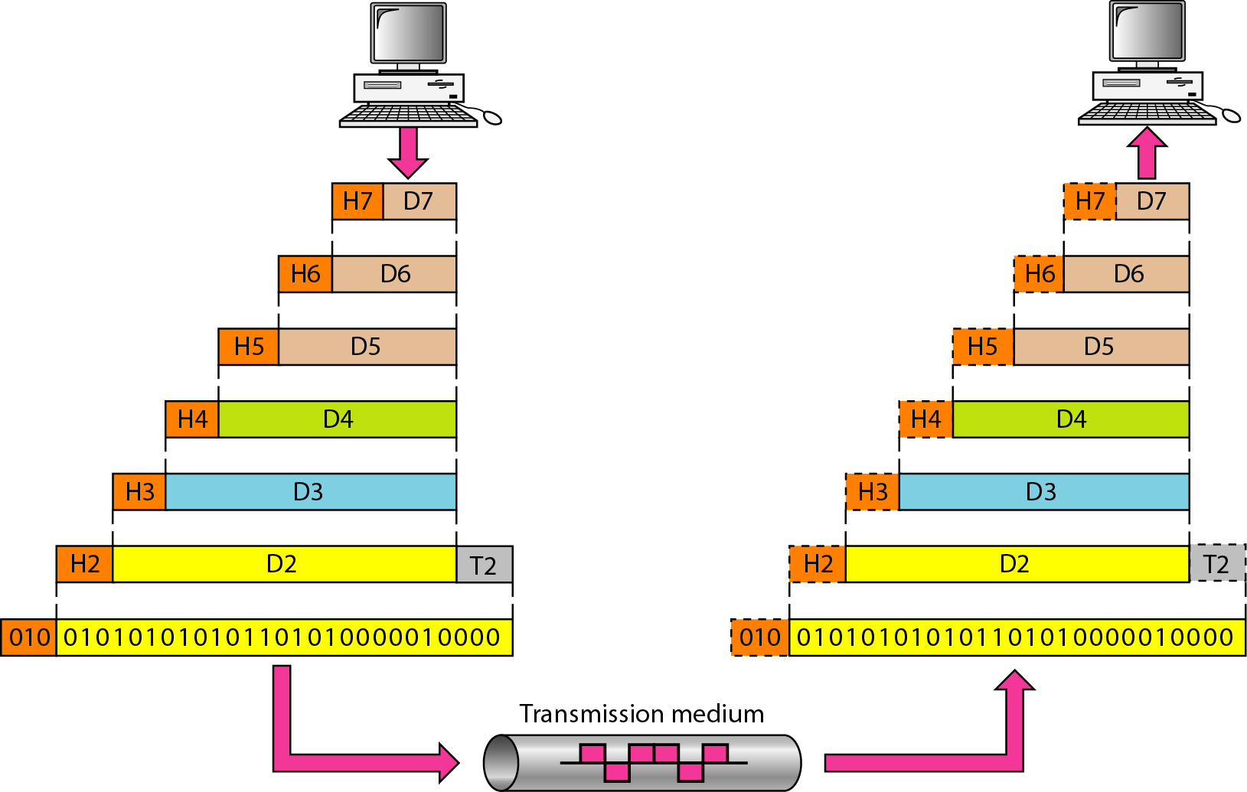
Figure 2.4 An exchange using the OSI model

Slide 62
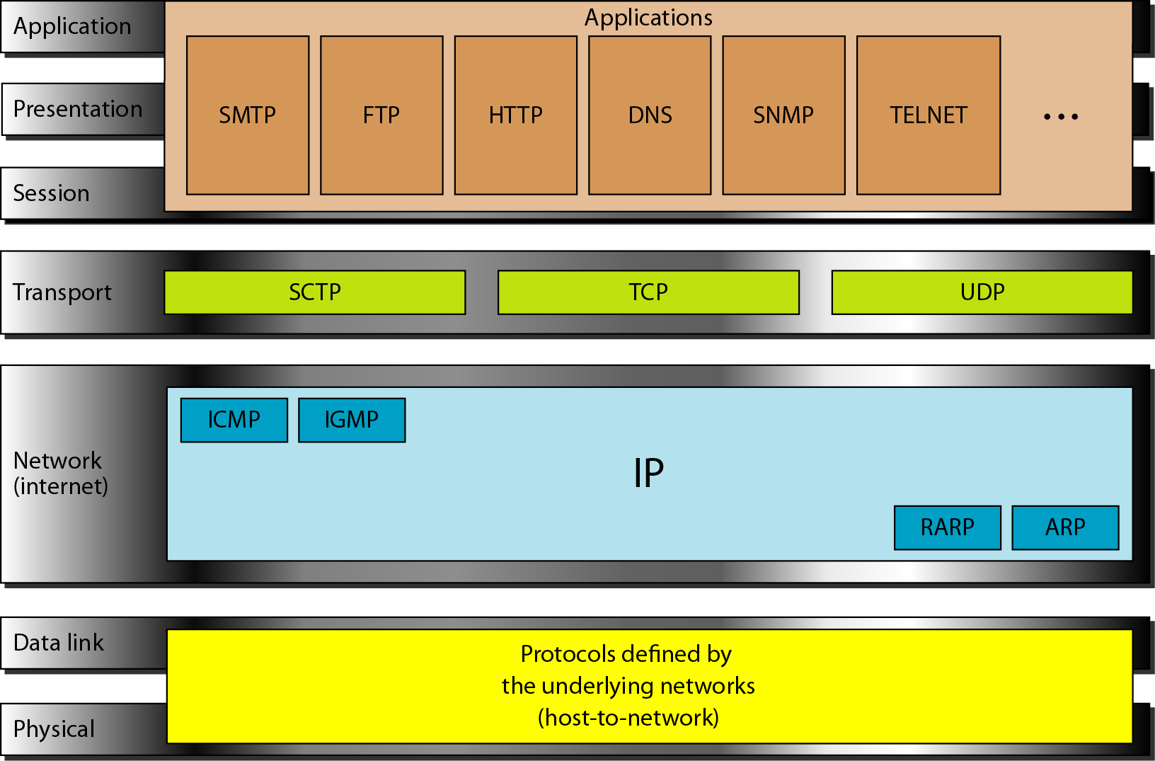
Figure 2.16 TCP/IP and OSI model

Slide 63
2-5 ADDRESSING
Four levels of addresses are used in an internet employing the TCP/IP protocols: physical, logical, port, and specific.
Topics discussed in this section:
Physical Addresses Logical Addresses Port Addresses Specific Addresses

Slide 64
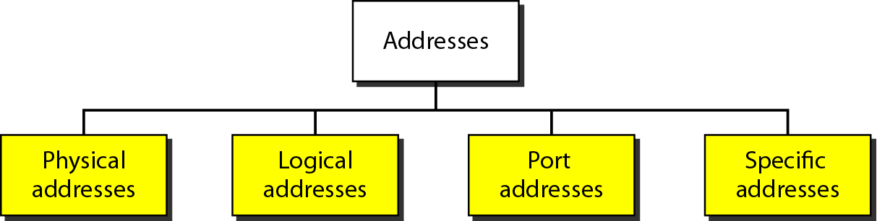
Figure 2.17 Addresses in TCP/IP

Slide 65
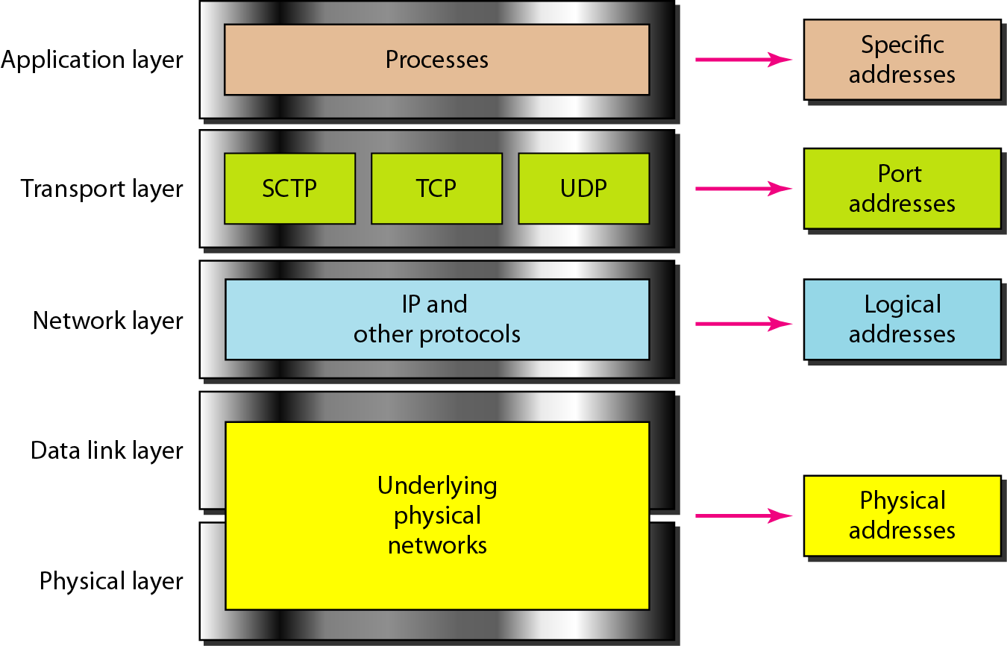
Figure 2.18 Relationship of layers and addresses in TCP/IP

Slide 66
Example 2.1
In Figure 2.19 a node with physical address 10 sends a frame to a node with physical address 87. The two nodes are connected by a link (bus topology LAN). As the figure shows, the computer with physical address 10 is the sender, and the computer with physical address 87 is the receiver.

Slide 67
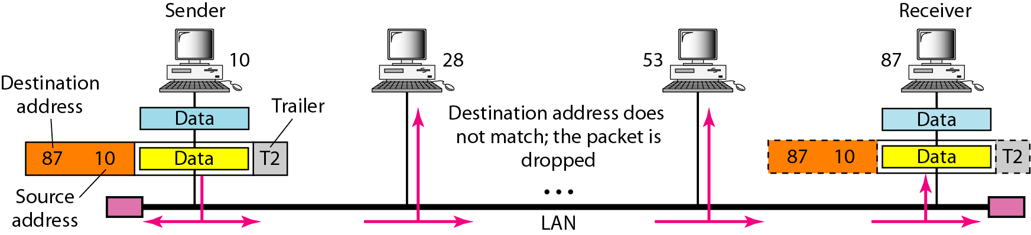
Figure 2.19 Physical addresses

Slide 68
Example 2.2
Most local-area networks use a 48-bit (6-byte) physical address written as 12 hexadecimal digits; every byte (2 hexadecimal digits) is separated by a colon, as shown below:
07:01:02:01:2C:4B
A 6-byte (12 hexadecimal digits) physical address.

Slide 69
Example 2.3
Figure 2.20 shows a part of an internet with two routers connecting three LANs. Each device (computer or router) has a pair of addresses (logical and physical) for each connection. In this case, each computer is connected to only one link and therefore has only one pair of addresses. Each router, however, is connected to three networks (only two are shown in the figure). So each router has three pairs of addresses, one for each connection.

Slide 70
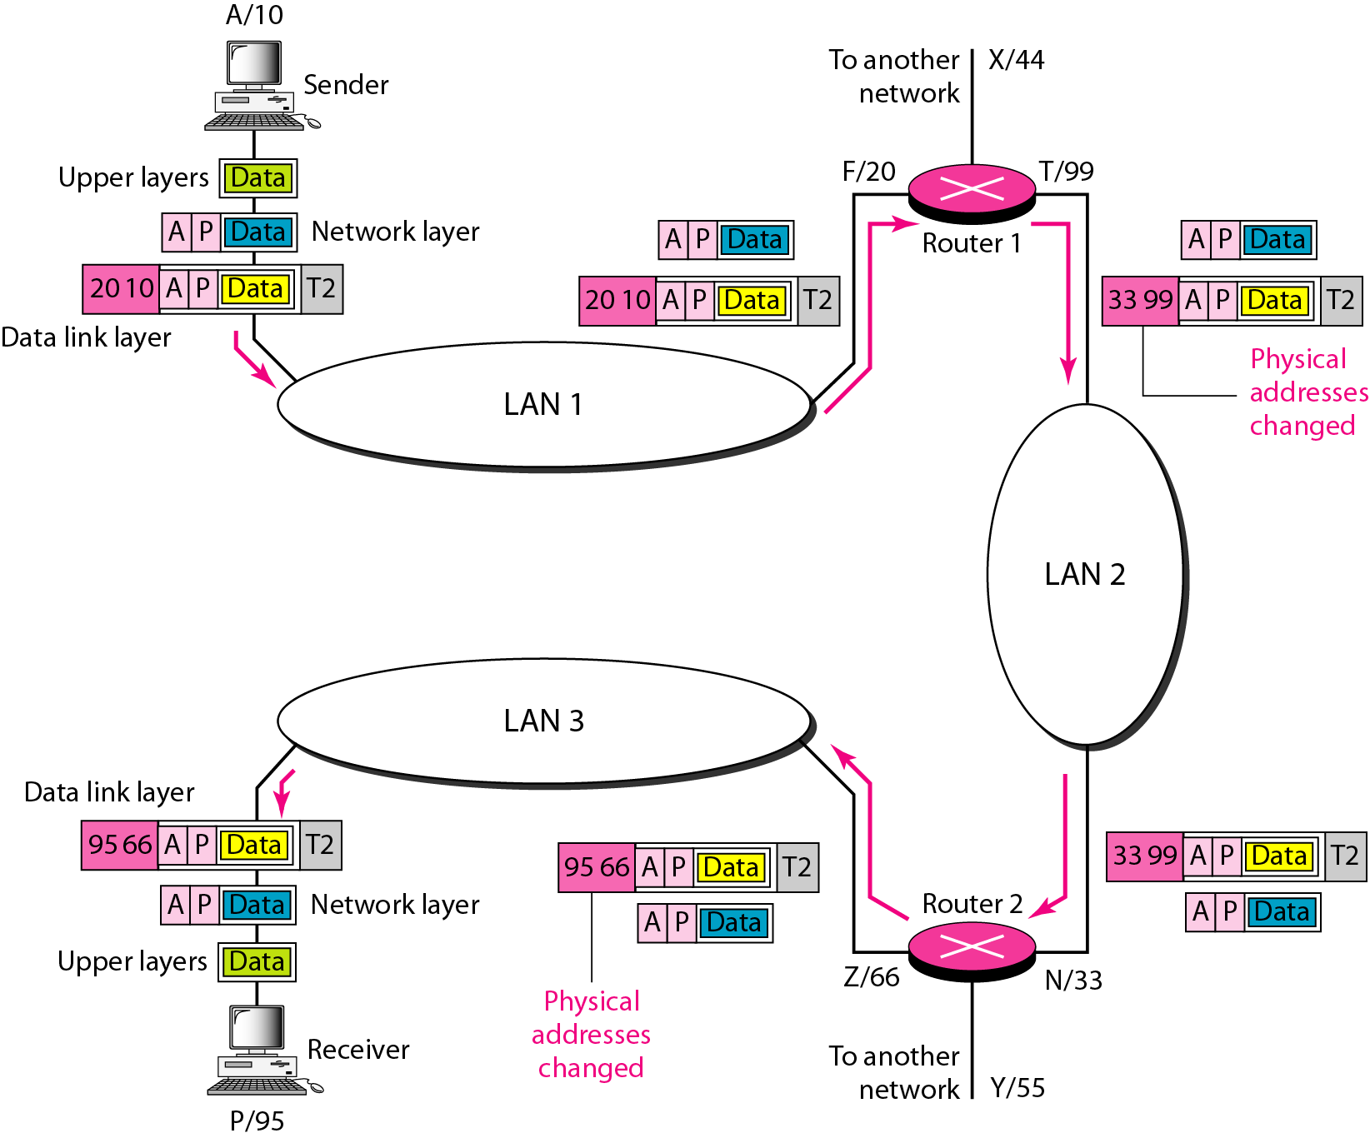
Figure 2.20 IP addresses

Slide 71
Example 2.4
Figure 2.21 shows two computers communicating via the Internet. The sending computer is running three processes at this time with port addresses a, b, and c. The receiving computer is running two processes at this time with port addresses j and k. Process a in the sending computer needs to communicate with process j in the receiving computer. Note that although physical addresses change from hop to hop, logical and port addresses remain the same from the source to destination.

Slide 72
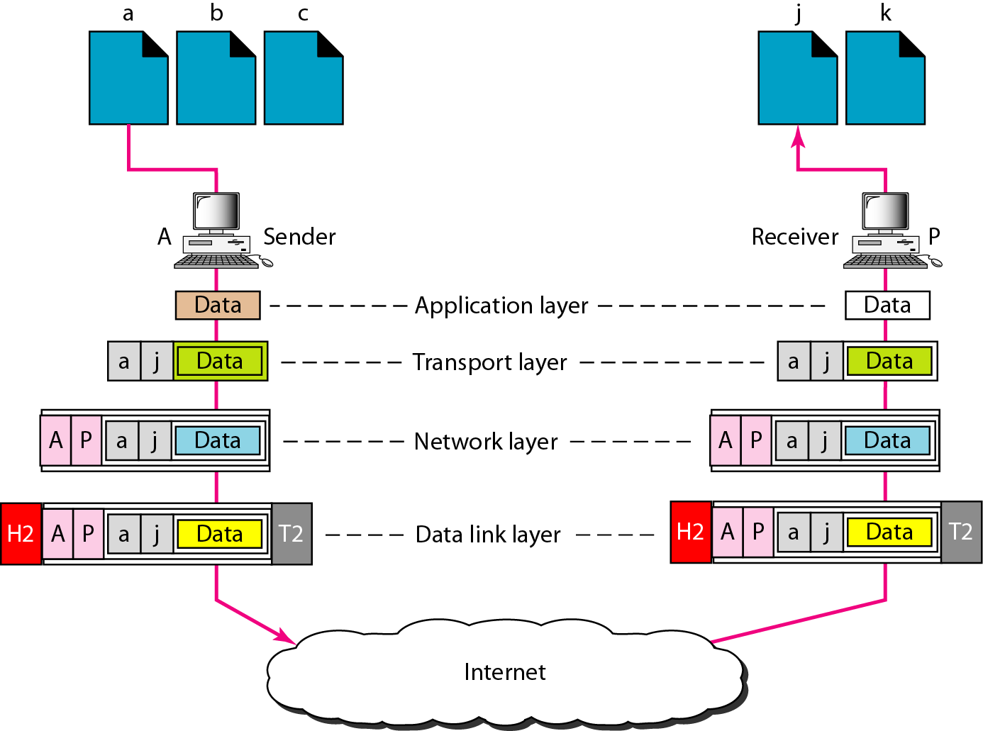
Figure 2.21 Port addresses

Slide 73
Note
The physical addresses will change from hop to hop,
but the logical addresses usually remain the same.

Slide 74
Assume that source S and destination D are connected through two intermediate routers labeled R. Determine how many times each packet has to visit the network layer and the data link layer during a transmission from S to D.
(A) Network layer – 4 times and Data link layer – 4 times (B) Network layer – 4 times and Data link layer – 3 times (C) Network layer – 4 times and Data link layer – 6 times (D) Network layer – 2 times and Data link layer – 6 times

