Slide 1
DESIGNING SUBNETS, FORWARDING IP PACKETS, ADDRESS AGGREGATION, MPLS

Slide 2
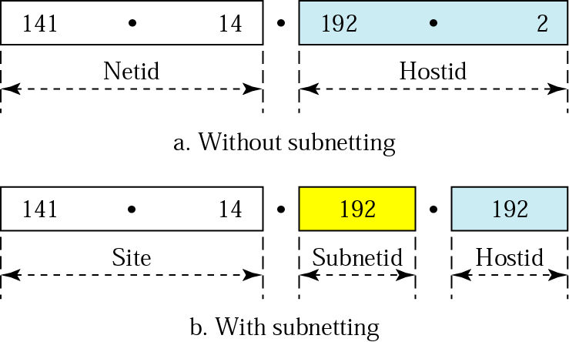
Figure 19.21 Addresses in a network with and without subnetting

Slide 3
The address 230.8.24.56 can belong to many blocks.
Prefix length:16 → Block: 230.8.0.0 to 230.8.255.255
Prefix length:20 → Block: 230.8.16.0 to 230.8.31.255
Prefix length:26 → Block: 230.8.24.0 to 230.8.24.63
Prefix length:27 → Block: 230.8.24.32 to 230.8.24.63
Prefix length:29 → Block: 230.8.24.56 to 230.8.24.63
Prefix length:31 → Block: 230.8.24.56 to 230.8.24.57

Slide 4
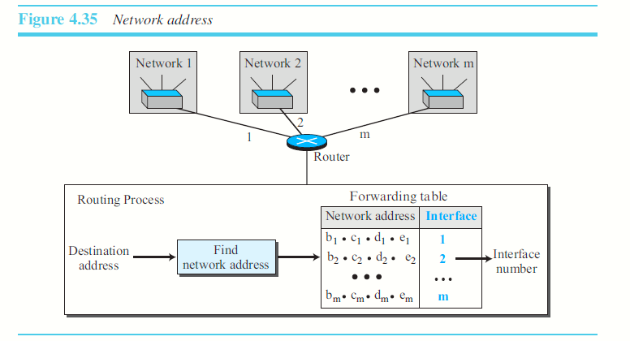

Slide 5
Let us assume that an internet is made of m networks and a router with m interfaces.
When a packet arrives at the router from any source host, the router needs to know to which network the packet should be sent: from which interface the packet should be sent out.
When the packet arrives at the network, it reaches its destination host using another strategy.
The router consults its forwarding table to find the corresponding interface from which the packet should be sent out.
The network address is actually the identifier of the network; each network is identified by its network address.

Slide 6

DESIGNING SUBNETS
Assume the total number of addresses granted to the organization is N, the prefix length is n, the assigned number of addresses to each sub-network is Nsub, and the prefix length for each sub-network is nsub.
The number of addresses in each sub-network should be a power of 2.
The prefix length for each sub-network should be found using the following formula:
The starting address in each sub-network should be divisible by the number of addresses in that sub-network. (first assign addresses to larger sub-networks).

Slide 7
An organization is granted a block of addresses with the beginning address 14.24.74.0/24. The organization needs to have 3 subblocks of addresses to use in its three subnets: one subblock of 10 addresses, one subblock of 60 addresses, and one subblock of 120 addresses. Design the subblocks.
Main network – prefix – ‘n’ = 24
14.24.74.0
3 sub networks????
Total addresses in each sub-network must be known.
Prefix for each sub-network. nsub=32-log2 Nsub.

Slide 8
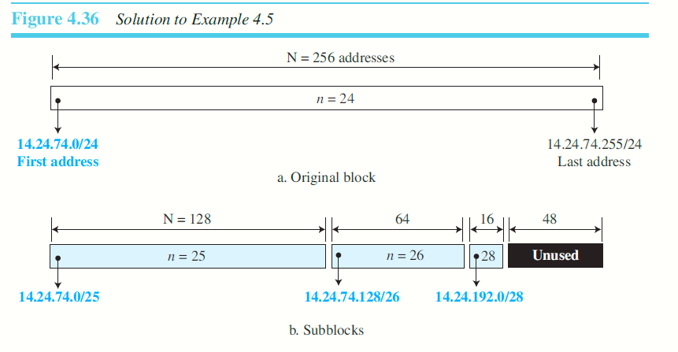

Slide 9
Address Aggregation
One of the advantages of the CIDR strategy is address aggregation. (sometimes called address summarization or route summarization).
When blocks of addresses are combined
to create a larger block, routing can be done based on the prefix of the larger block.
ICANN - (Internet Corporation for Assigned Names and Numbers)assigns a large block of addresses to an ISP.

Slide 10
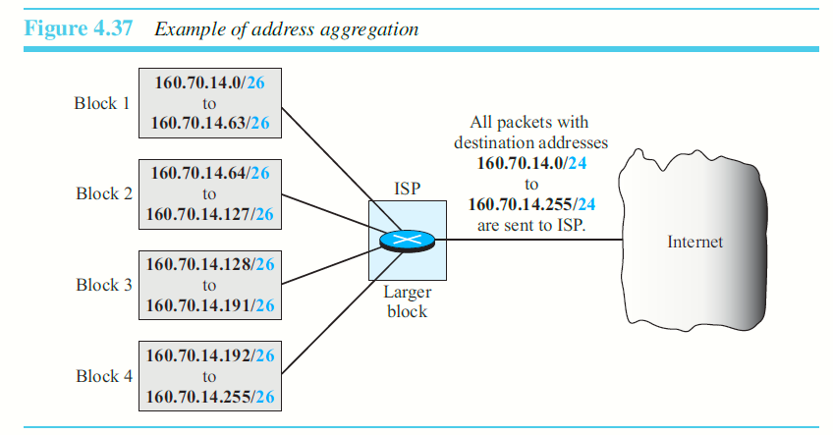

Slide 11
Special Addresses
This-host address:
Limited-broadcast address:
Loopback address:
Private addresses:
Multicast addresses:

Slide 12
Forwarding of IP Packets
Forwarding means to place the packet in its route to its destination.
In Internet (combinations of networks), forwarding means to deliver the packet to the next hop.
When IP is used as a connectionless protocol, forwarding is based on the destination address of the IP datagram.
When the IP is used as a connection-oriented protocol, forwarding is based on the label attached to an IP datagram.

Slide 13
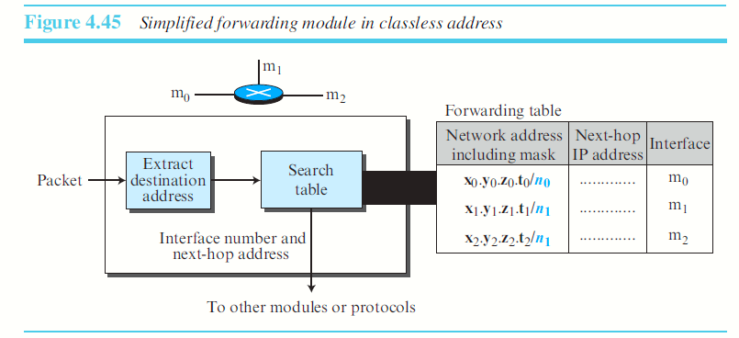
In each row, the n leftmost bits of the destination address (prefix) are kept and the rest of the bits (suffix) are set to 0s. If the resulting address (which we call the network address), matches with the address in the first column, the information in the next two columns is extracted; otherwise the search continues.

Slide 14
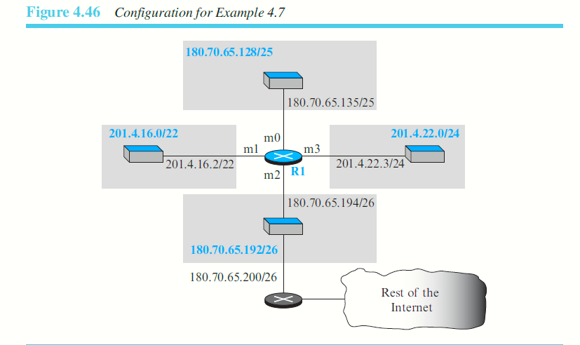
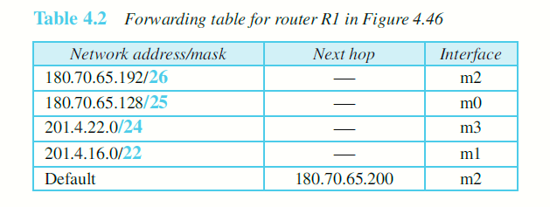
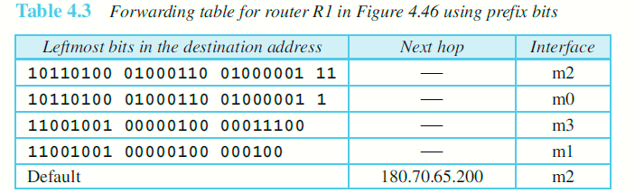
180.70.65.192/26

Slide 15
Show the forwarding process if a packet arrives at R1 in Figure with the destination address 180.70.65.140
The first mask (/26) is applied to the destination address. The result is 180.70.65.128, which does not match the corresponding network address.
The second mask (/25) is applied to the destination address. The result is 180.70.65.128, which matches the corresponding network address. The next-hop address and the interface number m0 are extracted for forwarding the packet

Slide 16
180.70.65.140
Apply the first row’s mask that is 26.
10110100 01000110 01000001 10000000
The network address does not match the first row’s network address.
Not sent to interface m2
180.70.65.140 / 25
10110100 01000110 01000001 10000000
The network address of 2nd row matches the destination’s network address.
Sent to interface m0.

Slide 17
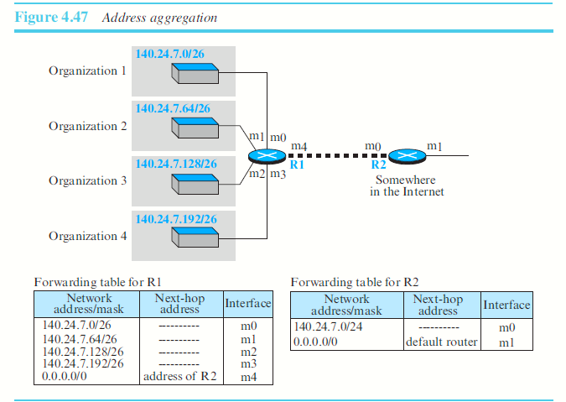
ADDRESS AGGREGATION

Slide 18
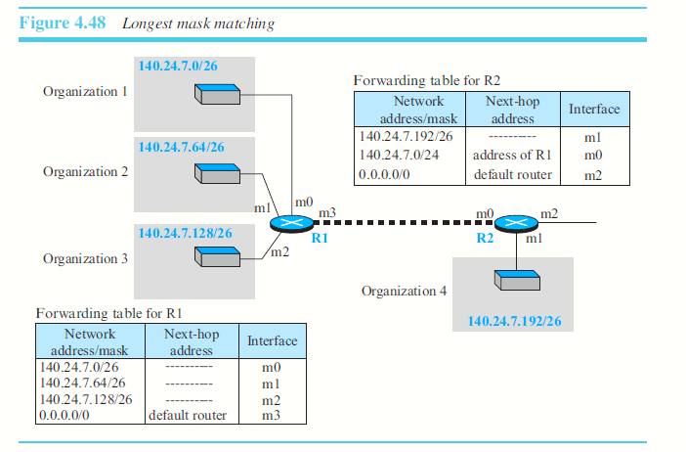

Slide 19
140.24.7.200
R2 FORWARDING TABLE
140.24.7.192 / 26
140.24.7.0 / 24
140.24.7. 11000000
140.24.7.0
140.24.7. 11001000

Slide 20
FORWARDING OF IP PACKETS BASED ON LABEL
In a connection-oriented network (virtual-circuit approach), a switch forwards a packet based on the label attached to the packet.

Slide 21
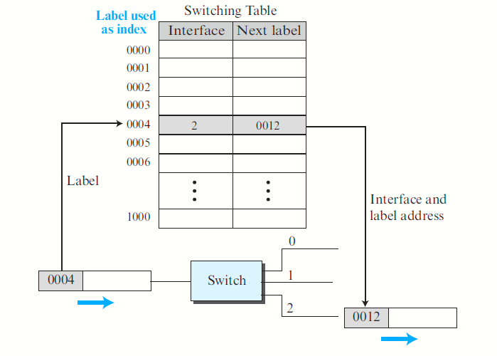

Slide 22
Multi-Protocol Label Switching (MPLS)
IETF approved this standard.
MPLS routers, can behave like a router and a switch.
When behaving like a router, MPLS can forward the packet based on the destination address; when behaving like a switch, it can forward a packet based on the label.
The MPLS header is actually a stack of sub-headers that is used for multilevel hierarchical switching.

Slide 23
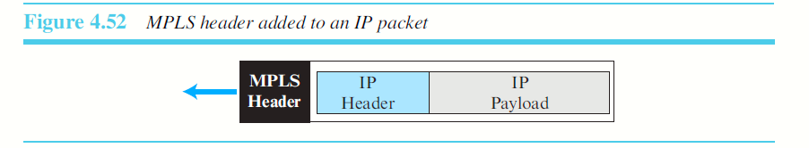
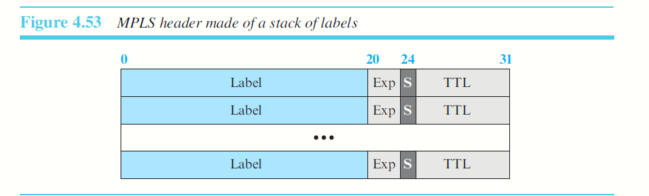

Slide 24
Label: This 20-bit field defines the label that is used to index the forwarding table in the router.
Exp: This 3-bit field is reserved for experimental purposes.
S: The one-bit stack field defines the situation of the sub-header in the stack. When the bit is 1, it means that the header is the last one in the stack.
TTL: This 8-bit field is similar to the TTL field in the IP datagram

Slide 25
Table 19.1 Default masks
Class | In Binary | In Dotted-Decimal | Using Slash
A | 11111111 00000000 00000000 00000000 | 255.0.0.0 | /8
B | 11111111 11111111 00000000 00000000 | 255.255.0.0 | /16
C | 11111111 111111111 11111111 00000000 | 255.255.255.0 | /24

Slide 26
Note:
The network address can be found by applying the default mask to any address in the block (including itself). It retains the netid of the block and sets the hostid to 0s.

Slide 27
Example 8
A router outside the organization receives a packet with destination address 190.240.7.91. Show how it finds the network address to route the packet.
Solution
The router follows three steps:
The router looks at the first byte of the address to find the class. It is class B.
The default mask for class B is 255.255.0.0. The router ANDs this mask with the address to get 190.240.0.0.
The router looks in its routing table to find out how to route the packet to this destination. Later, we will see what happens if this destination does not exist.

Slide 28
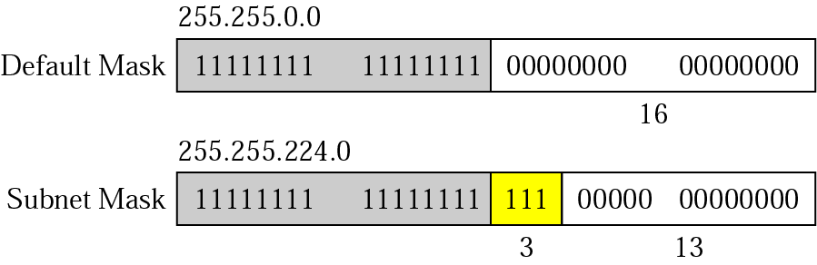
Figure 19.23 Subnet mask

Slide 29
Example 9
A router inside the organization receives the same packet with destination address 190.240.33.91. Show how it finds the subnetwork address to route the packet.
Solution
The router follows three steps:
The router must know the mask. We assume it is /19, as shown in Figure 19.23.
The router applies the mask to the address, 190.240.33.91. The subnet address is 190.240.32.0.
The router looks in its routing table to find how to route the packet to this destination. Later, we will see what happens if this destination does not exist.

Slide 30
Table 19.2 Default masks
Range | Total
10.0.0.0 to 10.255.255.255 | 2²⁴
172.16.0.0 to 172.31.255.255 | 2²⁰
192.168.0.0 to 192.168.255.255 | 2¹⁶

