Slide 1
MODULE – 1
Introduction to Databases
Overview of Database Languages and Architectures
Conceptual Data Modeling Using Entities and Relationships

Slide 2
Types of Databases and Database Applications
Numeric and Textual Databases
Multimedia Databases
Geographic Information Systems (GIS)
Data Warehouses and Online Analytical Processing (OLAP)
Real-time and Active Databases

Slide 3
Basic Definitions
Database: A collection of related data.
Data: Known facts that can be recorded and have an implicit meaning.
Mini-world or Universe of discourse(UoD): Some part of the real world about which data is stored in a database. For example, student grades and transcripts at a university.
Database Management System (DBMS): A collection of programs that enables users to create and maintain database. DBMS is a general-purpose software system that facilitates the processes of defining, constructing, manipulating and sharing databases among various users and applications.
Database System: The DBMS software together with the database. Sometimes, the applications are also included.

Slide 4
Typical DBMS Functionality
Define a database : In terms of data types, structures and constraints.
Construct or Load the Database on a secondary storage medium.
Manipulating the database : Querying, generating reports, insertions, deletions and modifications to its content.
Concurrent Processing and Sharing by a set of users and programs – yet, keeping all data valid and consistent.

Slide 5
Typical DBMS Functionality
Other features:
Metadata : The information present in the database in the form of data catalog or data dictionary.
Protection or Security measures to prevent unauthorized access
“Active” processing to take internal actions on data
Presentation and Visualization of data

Slide 6
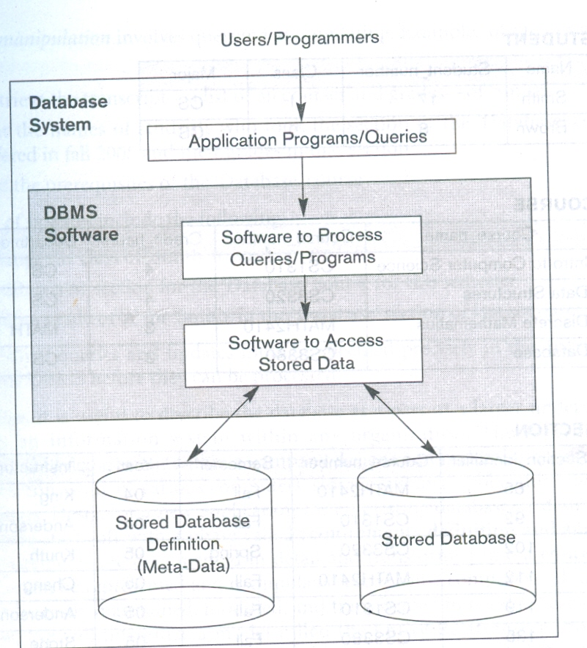
A Simplified Database System Environment

Slide 7
Example of a Database (with a Conceptual Data Model)
Mini-world for the example: Part of a UNIVERSITY environment.
Some mini-world entities:
STUDENTs
COURSEs
SECTIONs (of COURSEs)
(academic) DEPARTMENTs
INSTRUCTORs
Note: The above could be expressed in the ENTITY-RELATIONSHIP data model.

Slide 8
Example of a Database (with a Conceptual Data Model)
Some mini-world relationships:
SECTIONs are of specific COURSEs
STUDENTs take SECTIONs
COURSEs have prerequisite COURSEs
INSTRUCTORs teach SECTIONs
COURSEs are offered by DEPARTMENTs
STUDENTs major in DEPARTMENTs
Note: The above could be expressed in the ENTITY-RELATIONSHIP data model.

Slide 9
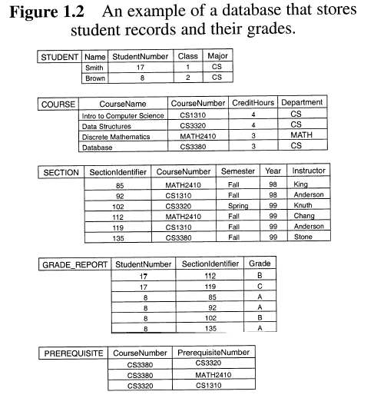
Example of a Database System

Slide 10
Main Characteristics of the Database Approach versus the file-processing approach
Self-describing nature of a database system:
A DBMS catalog stores the description of the database. The description is called meta-data. This allows the DBMS software to work with different databases.
Insulation between programs and data:
Program – data independence
Allows changing data storage structures and operations without having to change the DBMS access programs.
Program – operation independence
User application programs can operate on the data by invoking operations through their names and parameters regardless how operations are implemented.

Slide 11
Main Characteristics of the Database Approach
Data Abstraction:
The characteristics that allows program – data independence and program – operation independence is called data abstraction.
A data model is used to hide storage details and present the users with a conceptual view of the database.
Support of multiple views of the data:
Each user may see a different view of the database, which describes only the data of interest to that user.

Slide 12
Main Characteristics of the Database Approach
Sharing of data and multiuser transaction processing :
Allowing a set of concurrent users to retrieve and to update the database. Concurrency control within the DBMS guarantees that each transaction is correctly executed or completely aborted.
OLTP (Online Transaction Processing) is a major part of database applications.

Slide 13
Database Users
Users may be divided into those who actually use and control the content (called “Actors on the Scene”) and
those who enable the database to be developed and the DBMS software to be designed and implemented (called “Workers Behind the Scene”).

Slide 14
Database Users
Actors on the scene
Database administrators: responsible for authorizing access to the database, for co – ordinating and monitoring its use, acquiring software, and hardware resources, controlling its use and monitoring efficiency of operations.
Database Designers: responsible to define the content, the structure, the constraints, and functions or transactions against the database. They must communicate with the end-users and understand their needs.
End-users: they use the data for queries, reports and some of them update the database content.
System Analysts and Application Programmers(Software Engineers):
System Analyst determine the requirements of end users, especially Naïve and parametric end users and develop specifications for canned transactions that meet these requirements.
Application Programmers implement these specifications as programs, then they test, debug, document and maintain these canned transactions.

Slide 15
Categories of End-users
Casual : access database occasionally when needed
Naive or Parametric : they make up a large section of the end-user population. They use previously well-defined functions in the form of “canned transactions” against the database. Examples are bank-tellers or reservation clerks who do this activity for an entire shift of operations.

Slide 16
Categories of End-users
Sophisticated : these include business analysts, scientists, engineers, others thoroughly familiar with the system capabilities. Many use tools in the form of software packages that work closely with the stored database.
Stand-alone : mostly maintain personal databases using ready-to-use packaged applications. An example is a tax program user that creates his or her own internal database.

Slide 17
Database Users
Workers behind the scene
DBMS System Designers and Implementers: design and implement the DBMS modules and interfaces as a software package
Tool Developers: design and implement tools.
Operators and Maintenance Personnel: actual running and maintenance of the hardware and software environment for the database system.

Slide 18
Advantages of Using the Database Approach
Controlling redundancy in data storage and in development and maintenance efforts.
Restricting unauthorized access to data.
Providing persistent storage for program Objects
Providing Storage Structures for efficient Query Processing

Slide 19
Advantages of Using the Database Approach
Providing backup and recovery services.
Providing multiple interfaces to different classes of users.
Representing complex relationships among data.
Enforcing integrity constraints on the database.
Permitting Inferencing and Actions using rules

Slide 20
Additional Implications of Using the Database Approach
Potential for enforcing standards:
This is very crucial for the success of database applications in large organizations Standards refer to data item names, display formats, screens, report structures, meta-data (description of data) etc.
Reduced application development time:
Incremental time to add each new application is reduced.

Slide 21
Additional Implications of Using the Database Approach
Flexibility to change data structures:
Database structure may evolve as new requirements are defined.
Availability of up-to-date information:
Very important for on-line transaction systems such as airline, hotel, car reservations.
Economies of scale:
By consolidating data and applications across departments wasteful overlap of resources and personnel can be avoided.

Slide 22
Brief History of Database Applications
Early Database Applications: The Hierarchical and Network Models were introduced in mid 1960’s and dominated during the seventies. A bulk of the worldwide database processing still occurs using these models.
Relational Model based Systems: The model that was originally introduced in 1970 was heavily researched and experimented with in IBM and the universities. Relational DBMS Products emerged in the 1980’s.

Slide 23
Historical Development of Database Technology
Object-oriented applications: OODBMSs were introduced in late 1980’s and early 1990’s to cater to the need of complex data processing in CAD and other applications. Their use has not taken off much.
Data on the Web and E-commerce Applications: Web contains data in HTML (Hypertext markup language) with links among pages. This has given rise to a new set of applications and E-commerce is using new standards like XML (eXtended Markup Language).

Slide 24
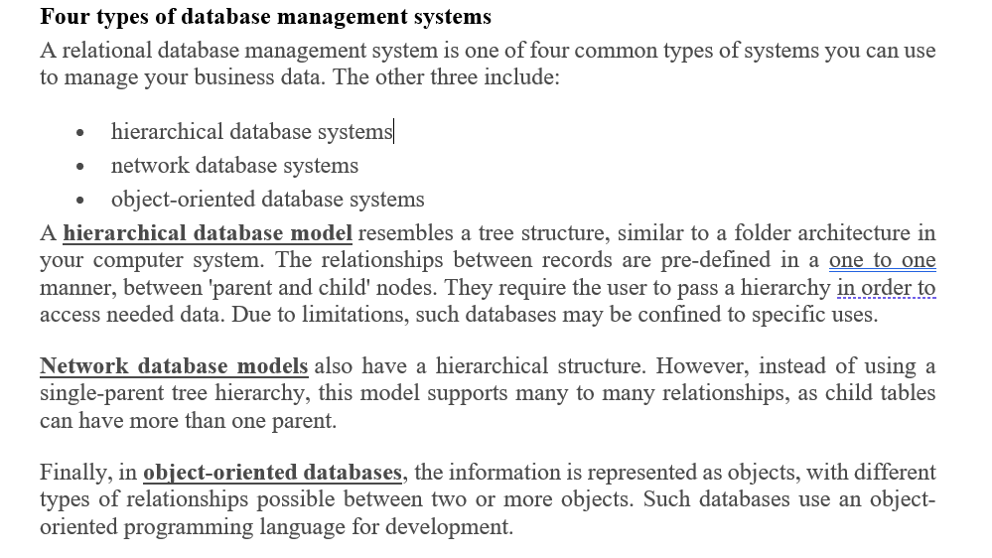

Slide 25
When not to use a DBMS
Main inhibitors (costs) of using a DBMS:
High initial investment and possible need for additional hardware.
Overhead for providing generality, security, concurrency control, recovery, and integrity functions.
When a DBMS may be unnecessary:
If the database and applications are simple, well defined, and not expected to change.
If there are stringent real-time requirements that may not be met because of DBMS overhead.
If access to data by multiple users is not required.

Slide 26
When not to use a DBMS
When no DBMS may suffice:
If the database system is not able to handle the complexity of data because of modeling limitations
If the database users need special operations not supported by the DBMS.

Slide 27
Data Models
Data Model: A set of concepts to describe the structure of a database, and certain constraints that the database should obey.
Data Model Operations: Operations for specifying database retrievals and updates by referring to the concepts of the data model. Operations on the data model may include basic operations and user-defined operations.

Slide 28
Categories of data models
Conceptual (high-level, semantic) data models
Provide concepts that are close to the way many users perceive data. (Also called entity-based or object-based data models.)
Physical (low-level, internal) data models
Provide concepts that describe details of how data is stored in the computer.
Implementation (representational) data models
Provide concepts that fall between the above two, balancing user views with some computer storage details.

Slide 29
Schemas, Instances and Database State
Database Schema
The description of a database. Includes descriptions of the database structure and the constraints that should hold on the database.
Schema Diagram
A diagrammatic display of (some aspects of) a database schema.
Schema Construct
A component of the schema or an object within the schema, e.g., STUDENT, COURSE.
Database State
The actual data stored in a database at a particular moment in time. Also called snapshot or instance or occurrence.

Slide 30
Database Schema Vs. Database State
Initial Database State
Refers to the database when it is loaded
Valid State
A state that satisfies the structure and constraints of the database.
Distinction
The database schema changes very infrequently. The database state changes every time the database is updated.
Schema is also called intension, whereas state is called extension.

Slide 31
Three-Schema Architecture
Proposed to support DBMS characteristics of:
Program-data independence.
Support of multiple views of the data.

Slide 32
Three-Schema Architecture
Defines DBMS schemas at three levels:
Internal schema at the internal level to describe physical storage structures and access paths. Typically uses a physical data model.
Conceptual schema at the conceptual level to describe the structure and constraints for the whole database for a community of users. Uses a conceptual or an implementation data model.
External schemas at the external level to describe the various user views. Usually uses the same data model as the conceptual level.

Slide 33
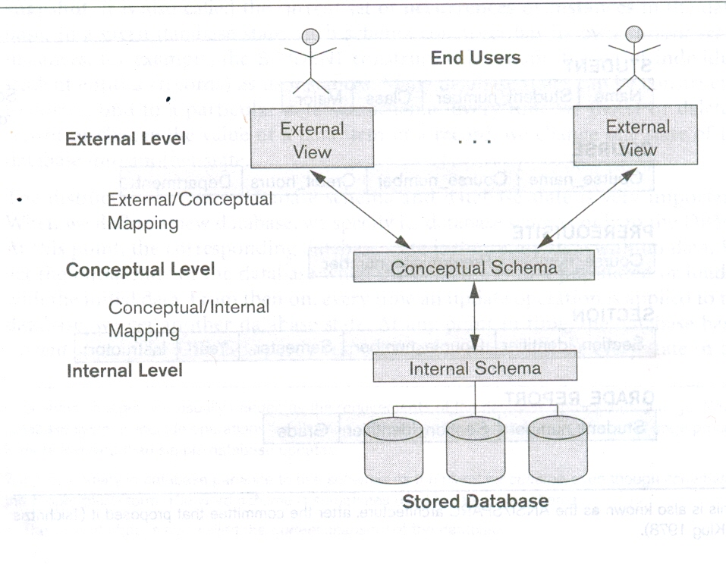
Three-Schema Architecture

Slide 34
Three-Schema Architecture
Mappings among schema levels are needed to transform requests and data. Programs refer to an external schema, and are mapped by the DBMS to the internal schema for execution.

Slide 35
Data Independence
The capacity to change the schema at one level of a database system without having to change the system at the next higher level.
Two types of data independences:
Logical Data Independence: The capacity to change the conceptual schema without having to change the external schemas and their application programs.
Physical Data Independence: The capacity to change the internal schema without having to change the conceptual schema.

Slide 36
Data Independence
When a schema at a lower level is changed, only the mappings between this schema and higher-level schemas need to be changed in a DBMS that fully supports data independence.
The higher-level schemas themselves are unchanged.
Hence, the application programs need not be changed since they refer to the external schemas.

Slide 37
DBMS Languages
Data Definition Language (DDL): Used by the DBA and database designers to specify the conceptual schema of a database. In many DBMSs, the DDL is also used to define internal and external schemas (views). In some DBMSs, separate storage definition language (SDL) and view definition language (VDL) are used to define internal and external schemas.

Slide 38
DBMS Languages
Data Manipulation Language (DML): Used to specify database retrievals and updates.
DML commands (data sublanguage) can be embedded in a general-purpose programming language (host language), such as COBOL, C or an Assembly Language.
Alternatively, stand-alone DML commands can be applied directly (query language).

Slide 39
DML Types
High Level or Non-procedural DML: e.g., SQL, are set-oriented and specify what data to retrieve than how to retrieve. Also called declarative languages.
Low Level or Procedural DML: record-at-a-time; they specify how to retrieve data and include constructs such as looping.

Slide 40
DBMS Interfaces
User-friendly interfaces:
Menu-based, popular for browsing on the web
Forms-based, designed for naïve users
Graphics-based (Point and Click, Drag and Drop etc.)
Natural language: requests in written English
Speech as Input and Output
Web Browser as an interface
Parametric interfaces (e.g., bank tellers) using function keys.
Interfaces for the DBA:
Creating accounts, granting authorizations
Setting system parameters
Changing schemas or access path

Slide 41
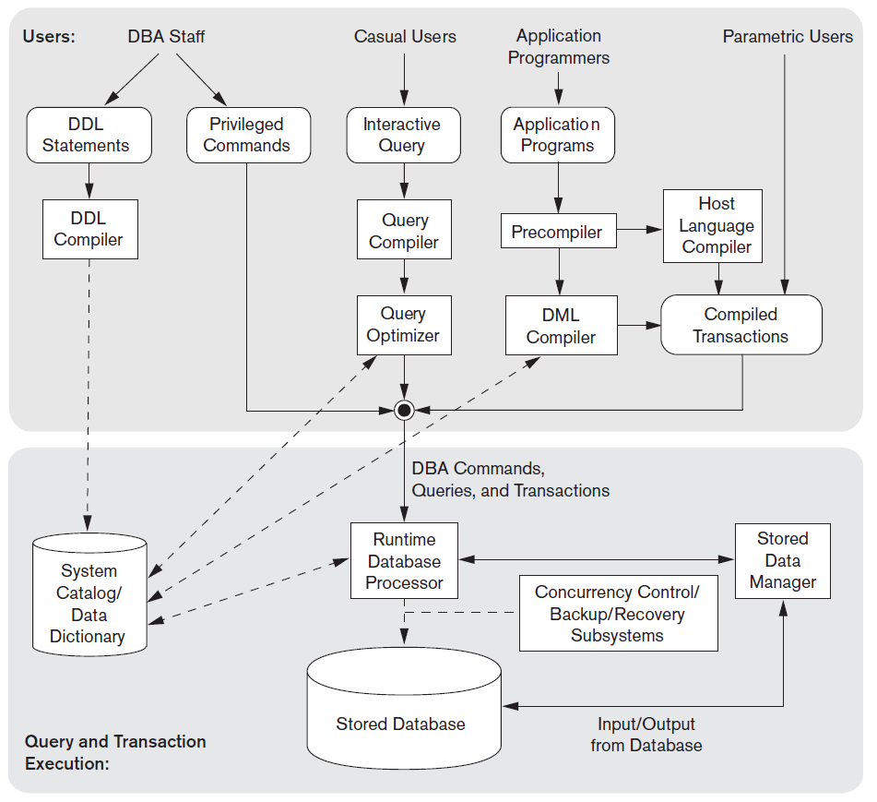
DBMS Component Modules

Slide 42
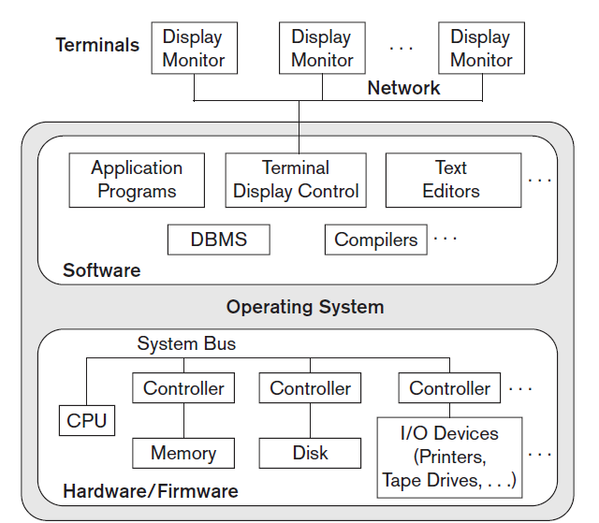
Centralized and Client/Server Architectures for DBMSs
Centralized DBMSs Architecture

Slide 43
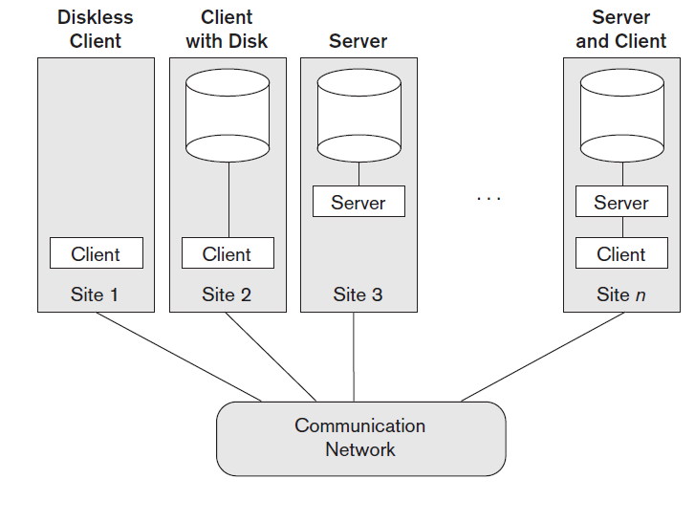
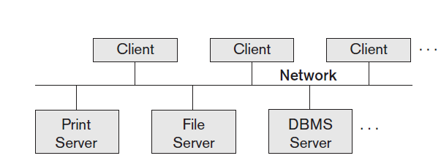
Basic Client/Server Architectures

Slide 44
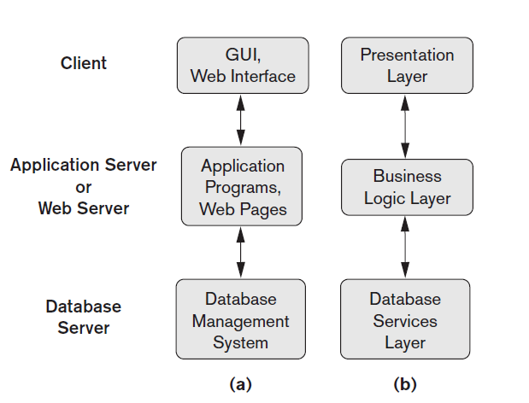

Slide 45
Classification of Database Management Systems
Based on
Data Models
The main data model used in many current commercial DBMSs is the relational data model, and the systems based on this model are known as SQL systems.
The object data model has been implemented in some commercial systems but has not had widespread use. Recently, so-called big data systems, also known as key-value storage systems and NOSQL systems, use various data models: document-based, graph-based, column-based, and key-value data models.
Many legacy applications still run on database systems based on the hierarchical and network data models.

Slide 46
The second criterion used to classify DBMSs is the number of users supported by the system. Single-user systems support only one user at a time and are mostly used with PCs. Multiuser systems, which include the majority of DBMSs, support concurrent multiple users
The third criterion is the number of sites over which the database is distributed. A DBMS is centralized if the data is stored at a single computer site. A centralized DBMS can support multiple users, but the DBMS and the database reside totally at a single computer site. A distributed DBMS (DDBMS) can have the actual database and DBMS software distributed over many sites connected by a computer network.
Finally, a DBMS can be classified as general purpose or special purpose.

Slide 47
UNIT 2 Data Modeling Using the Entity-Relationship (ER) Model

Slide 48
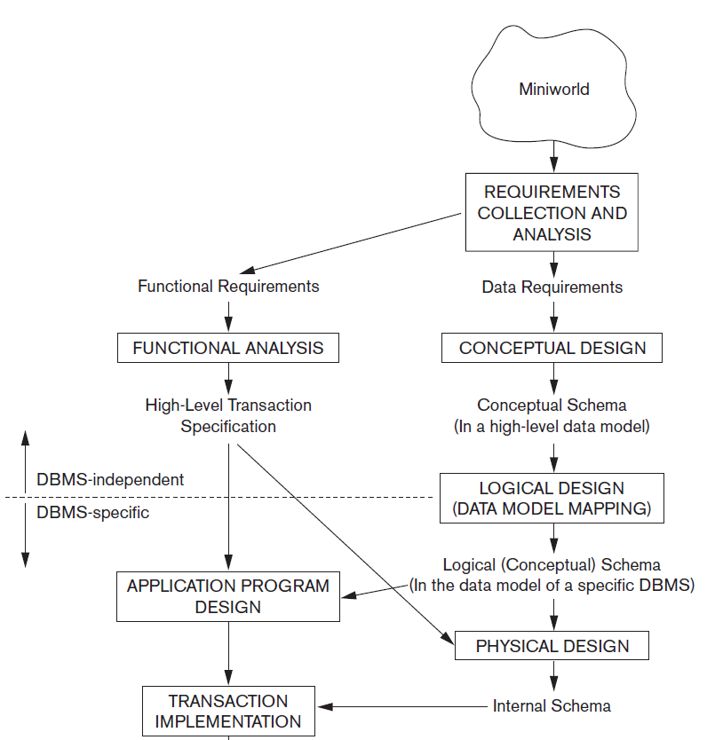

Using High – Level Conceptual Data Models for Database Design

Slide 49
An Example Database Application
Requirements of the Company (oversimplified for illustrative purposes)
The company is organized into DEPARTMENTs. Each department has a name, number and an employee who manages the department. We keep track of the start date of the department manager. A department may have several locations.
Each department controls a number of PROJECTs. Each project has a name, number and is located at a single location.

Slide 50
Contd…
We store each EMPLOYEE’s social security number, address, salary, gender, and birth date. Each employee works for one department but may work on several projects. We keep track of the number of hours per week that an employee currently works on each project. We also keep track of the direct supervisor of each employee.
Each employee may have a number of DEPENDENTs. For each dependent, we keep track of their name, gender, birth date, and relationship to employee.

Slide 51
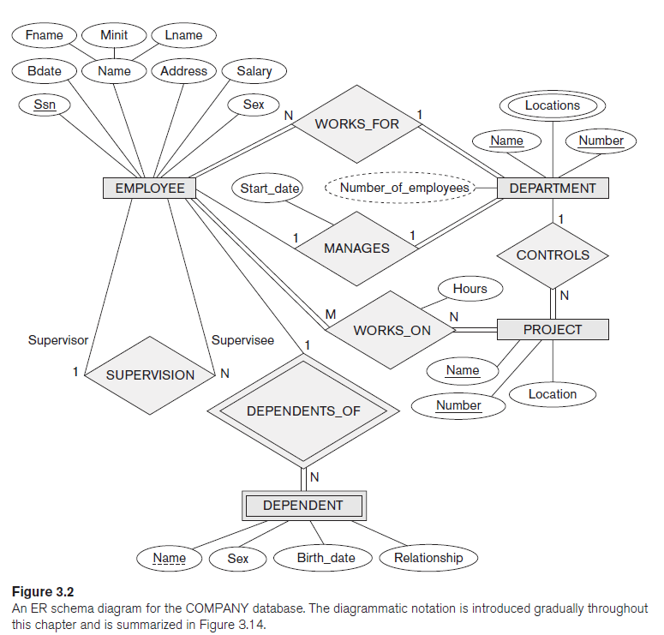

Slide 52
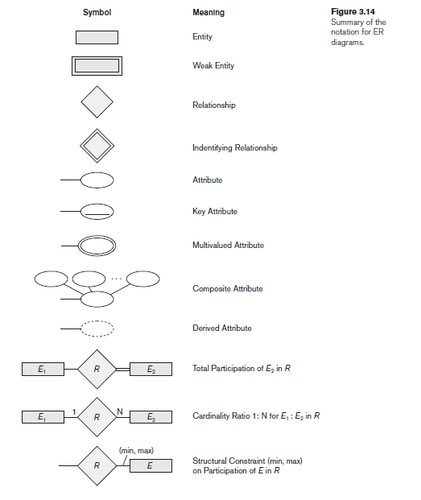

Slide 53
Entity Types, Entity Sets, Attributes and Keys
Entity
A thing in the real world with an independent existence.
Eg: A particular person, Car, House or an Employee
Attribute
The particular property that describes the entity.
Eg: An Employee’s name, age, address, salary and job

Slide 54
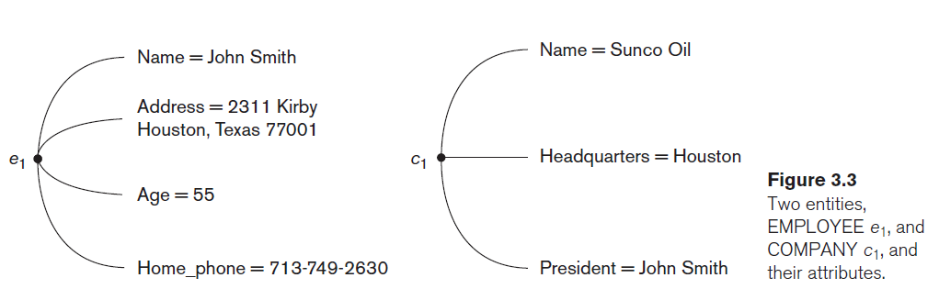

Slide 55
Types of Attributes
Composite versus simple(Atomic) Attributes
Single Valued versus Multivalued Attributes
Stored versus Derived Attributes
Complex Attributes
For example, {Address_phone({Phone(Area_Code, Phone_Number)}, Address(Street_Address(Number, Street, Apartment_Number), City, Zip_Code))}
Null Values

Slide 56
Entity Types
A collection of entities that have the same attributes.
Each entity type in the database is described by its name and attributes.
An entity type describes the schema or intension for a set of entities that share the same structure.
Eg: EMPLOYEE and COMPANY and a list of attributes for each.
An entity type is represented in ER diagrams as a rectangular box enclosing the entity type name.

Slide 57
Entity Set
The collection of entities of a particular entity type in a database at any point in time is grouped into an entity set.
This is also called as Extension of the entity type.

Slide 58
Key Attribute of an Entity Type
An entity type usually has an attribute whose values are distinct for each individual entity in the entity set.
Such an attribute is called as key attribute and its values can be used to identify each entity uniquely.
Eg: No two companies will have the same name, so name attribute is the key attribute in COMPANY.
In ER diagrammatic notation, each key attribute has its name underlined inside the oval.

Slide 59
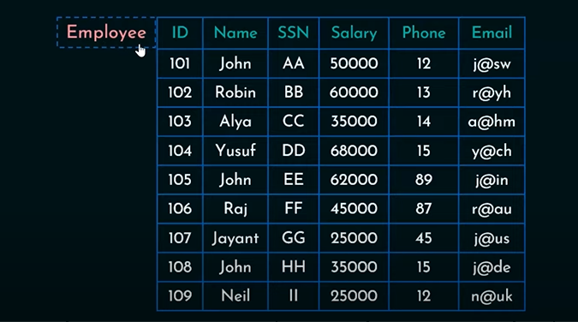
Need for keys in RDBMS

Slide 60
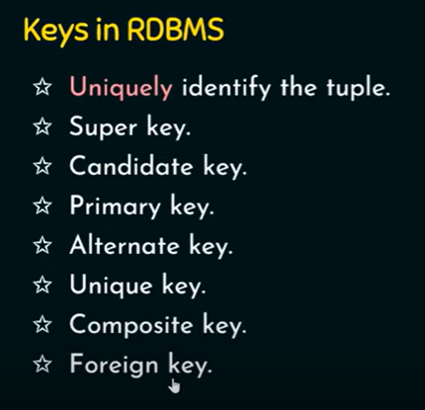

Slide 61
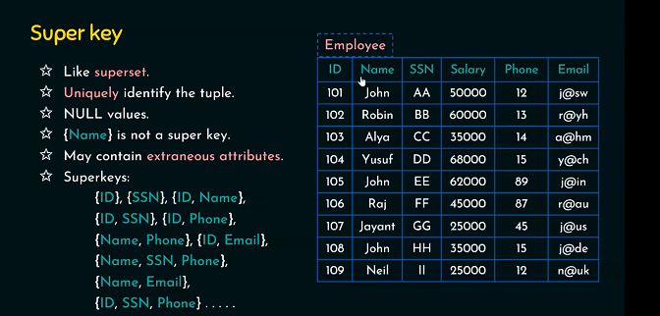
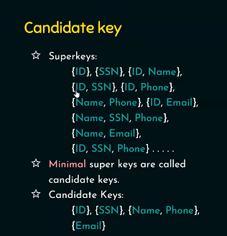

Slide 62
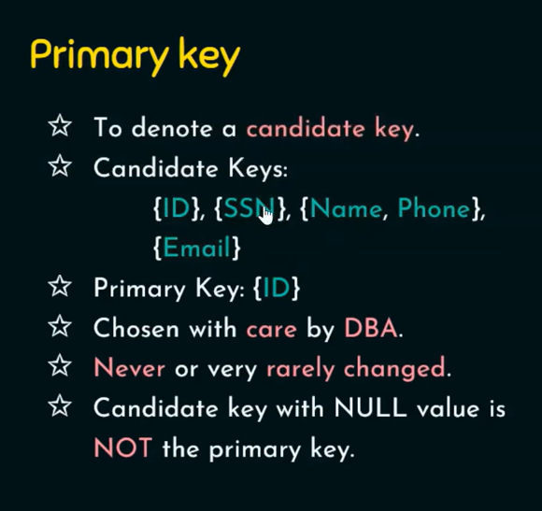
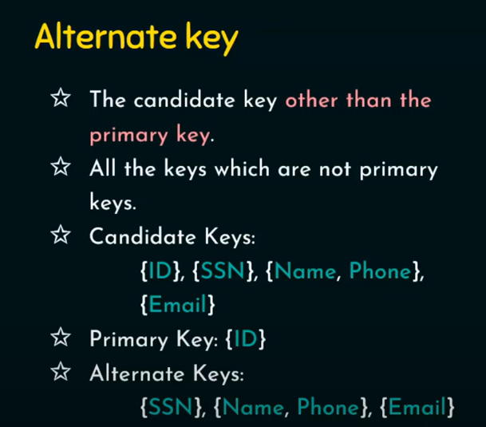

Slide 63
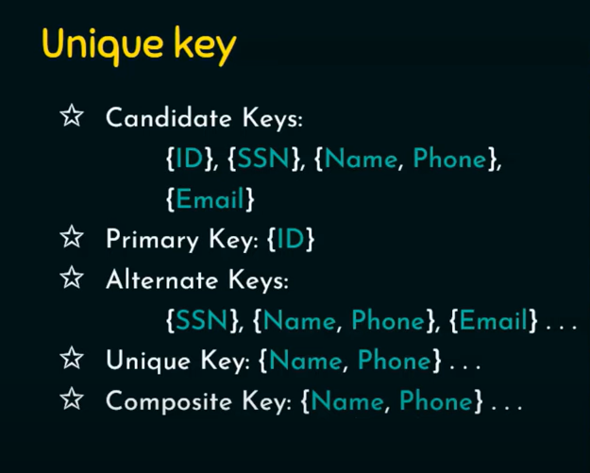
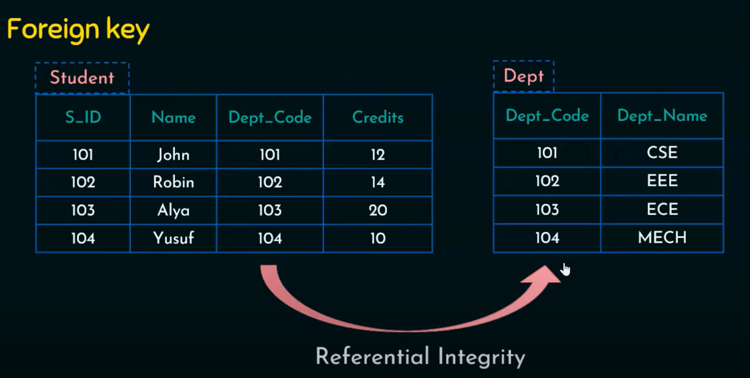

Slide 64
Value Sets (Domains) of Attributes
Each simple attribute of an entity type is associated with a value set (or domain of values), which specifies the set of values that may be assigned to that attribute for each individual entity.
Value sets are typically specified using the basic data types.

Slide 65
ENTITY SET corresponding to the ENTITY TYPE CAR
Entity Type
CAR
Registration(RegistrationNumber, State), VehicleID, Make, Model, Year, (Color)
car₁
((ABC 123, TEXAS), TK629, Ford Mustang, convertible, 1999, (red, black))
car₂
((ABC 123, NEW YORK), WP9872, Nissan 300ZX, 2-door, 2002, (blue))
car₃
((VSY 720, TEXAS), TD729, Buick LeSabre, 4-door, 2003, (white, blue))
.
.
.
Entity Set

Slide 66
Relationship Types, Relationship Sets, and Instances
A relationship type R among n entity types E₁, E₂, … E_{n} defines a set of associations – or a relationship set – among entities from these entity types.
Mathematically, the relationship set R is a set of relationship instances r_{i}, where each r_{i} associates n individual entities.

Slide 67
Example 1…
EMPLOYEE
WORKS_FOR
DEPARTMENT
e_{1 }
e_{2 }
e_{3 }
e_{4 }
e_{5 }
e_{6 }
e_{7 }
r₁
r₂
r₃
r₄
r₅
r₆
r₇
● d₁
● d₂
● d₃

Slide 68
Example 2…
EMPLOYEE WORKS_ON PROJECT
r₁
r₂
r₃
r₄
r₅
r₆
r₇
e_{1 }
e_{2 }
e_{3 }
e_{4 }
e_{5 }
e_{6 }
e_{7 }
r₉
● p₁
● p₂
● p₃
r₈

Slide 69
Relationship Degree
The degree of a relationship type is the number of participating entity types.
A relationship type of degree two is called binary, and one of degree three is called ternary.

Slide 70
Role Names and Recursive Relationships
Each entity type that participates in a relationship type plays a particular role in the relationship.
The role name signifies the role that a participating entity from the entity type plays in each relationship instance, and helps to explain what the relationship means.
Some entity types participates more than once in a relationship type in different roles. Such relationship types are called recursive relationships.

Slide 71
Example…
EMPLOYEE
SUPERVISION
e_{1 }
e_{2 }
e_{3 }
e_{4 }
e_{5 }
e_{6 }
e_{7 }
r₁
r₂
r₃
r₄
r₅
r₆
2
1
1
2
2
1
2
1
1
2
1
2
Supervisor Role
Subordinate Role

Slide 72
Constraints on Relationship Types
There are two types of relationship constraints:
Cardinality ratio
The cardinality ratio for binary relationship specifies the maximum number of relationship instances that an entity can participate in.
The possible cardinality ratio for binary relationship types are 1:1, 1:N, N:1 and M:N
Participation
The participation constraint specifies whether the existence of an entity depends on its being related to another entity via the relationship type.
This constraint specifies the minimum number of relationship instances that each entity can participate in.
The cardinality ratio and participation constraint together called as structural constraint.

Slide 73
1:1 Relationship
EMPLOYEE
MANAGES
DEPARTMENT
e_{1 }
e_{2 }
e_{3 }
e_{4 }
e_{5 }
e_{6 }
e_{7 }
r₁
r₂
r₃
.
.
.
● d₁
● d₂
● d₃

Slide 74
1:N Relationship
EMPLOYEE
WORKS_FOR
DEPARTMENT
e_{1 }
e_{2 }
e_{3 }
e_{4 }
e_{5 }
e_{6 }
e_{7 }
r₁
r₂
r₃
r₄
r₅
r₆
r₇
● d₁
● d₂
● d₃

Slide 75
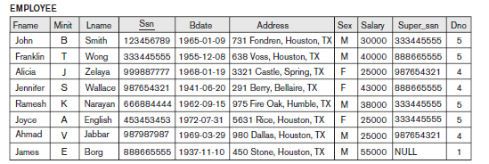
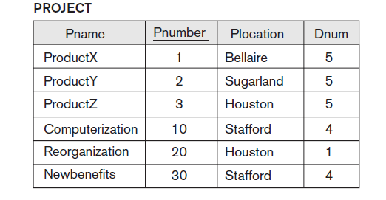
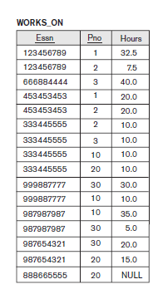

Slide 76
M:N Relationship
EMPLOYEE WORKS_ON PROJECT
r₁
r₂
r₃
r₄
r₅
r₆
r₇
e_{1 }
e_{2 }
e_{3 }
e_{4 }
e_{5 }
e_{6 }
e_{7 }
r₉
● p₁
● p₂
● p₃
r₈

Slide 77
Participation Constraint and Existence Dependence
The participation constraint specifies whether the existence of an entity depends on its being related to another entity via the relationship type.
This is also called as minimum cardinality constraint.
Two types of participation constraint:
Total Participation, also called as Existence Dependency
Partial Participation

Slide 78
Attributes as Relationship Types
A relationship type can have attributes; for example, HoursPerWeek of WORKS_ON; its value for each relationship instance describes the number of hours per week that an EMPLOYEE works on a PROJECT.

Slide 79
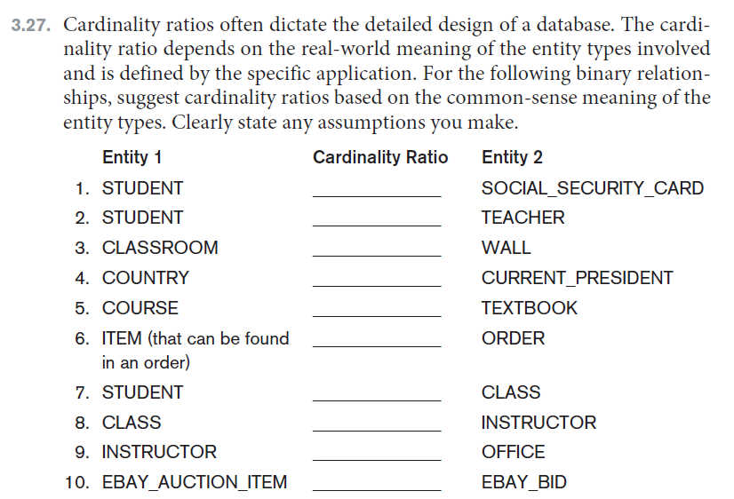

Slide 80
Weak Entity Types
Entity types that do not have key attributes of their own are called weak entity types.
The entity types which contain key attributes of their own are called regular entity types or strong entity types.
Entities belonging to weak entity type are identified by being related to specific entities from another entity type in combination with one of their attribute values. This other entity type is called as identifying entity type or owner entity type.
The relationship type that relates a weak entity type to its owner is called as identifying relationship of the weak entity type.
The weak entity type normally has a partial key, which is the set of attributes that can uniquely identify weak entities that are related to the same owner entity.

Slide 81
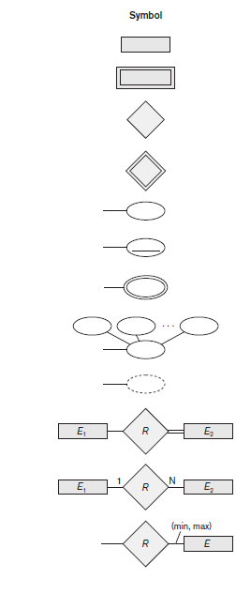

Slide 82
Notations Used in ER Diagrams
Symbol
Meaning
ENTITY TYPE
WEAK ENTITY TYPE
RELATIONSHIP TYPE
IDENTIFYING RELATIONSHIP TYPE
ATTRIBUTE
KEY ATTRIBUTE
MULTIVALUED ATTRIBUTE
COMPOSITE ATTRIBUTE
DERIVED ATTRIBUTE
TOTAL PARTICIPATION OF E₂ IN R
CARDINALITY RATIO 1:N FOR E₁:E₂ IN R
STRUCTURAL CONSTRAINT (min, max) ON PARTICIPATION OF E IN R
E₁
R
E₂
E₁
1
R
N
E₂
R
(min,max)
E

Slide 83
Proper Naming of Schema Constructs
Use singular names for entity types, rather than plural one.
Verbs tend to indicate the relationship types.
Another naming consideration involves choosing the binary relationship names to make the ER diagram of the schema readable from left to right and top to bottom.

Slide 84
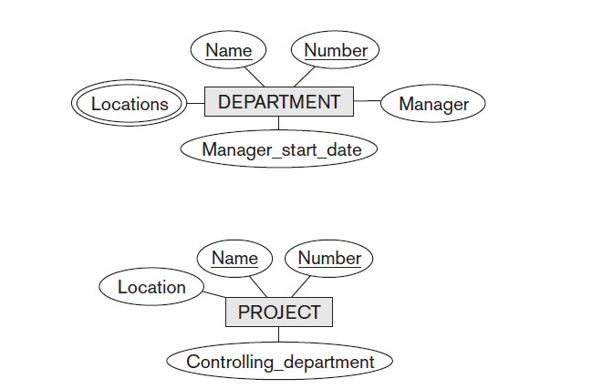
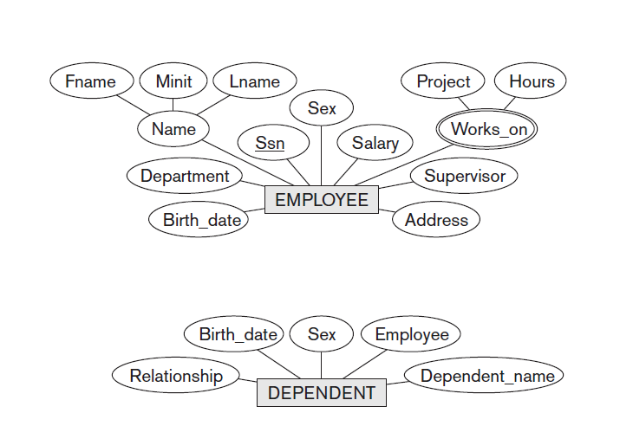

Slide 85
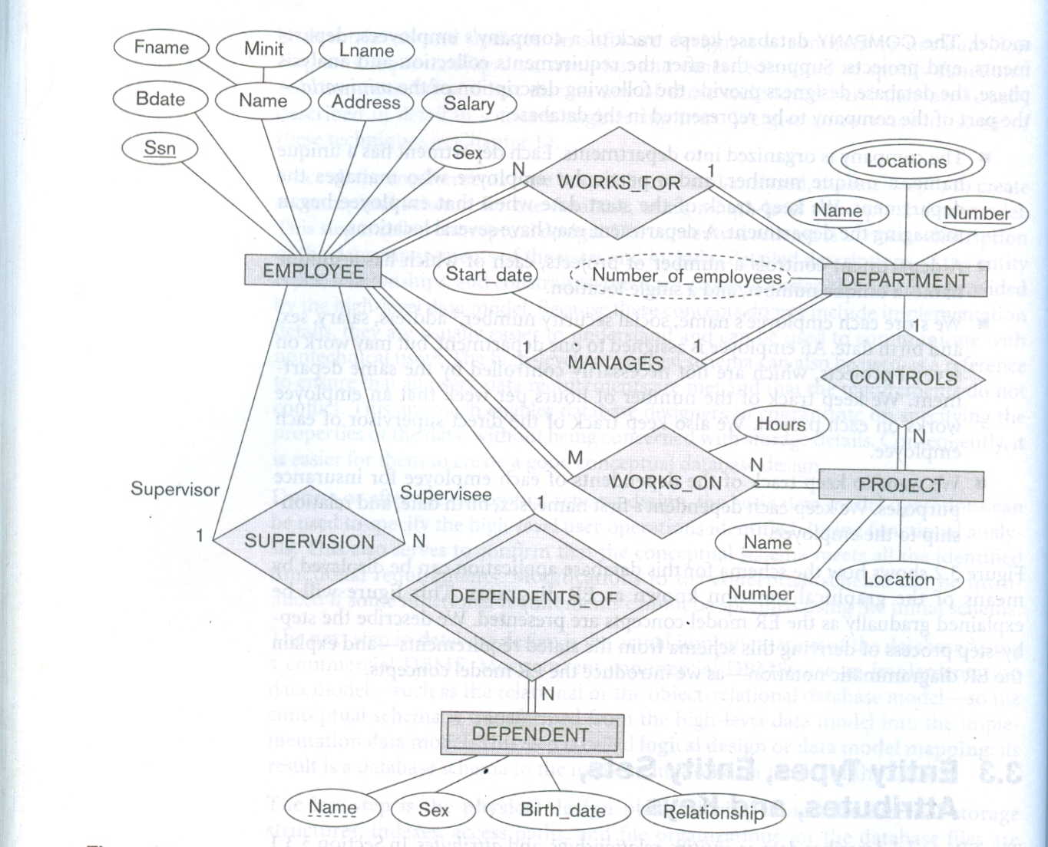
E – R Diagram for COMPANY

Slide 86
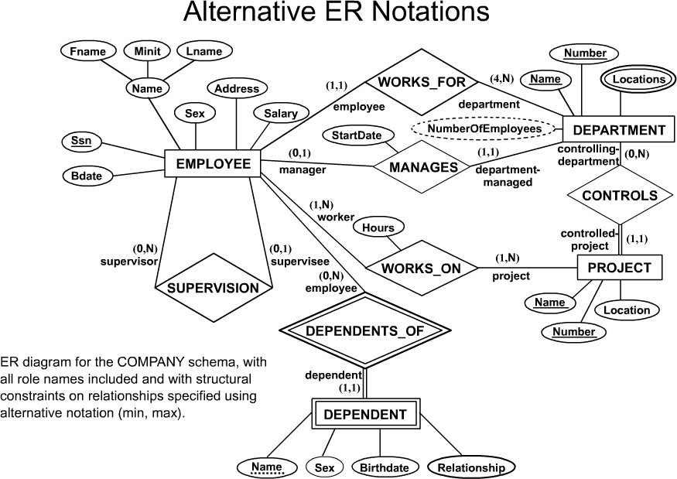
Alternative Notations for ER Diagrams

