Slide 1
UNIT – 4 Database Design Theory and Methodology

Slide 2
Informal Design Guidelines for Relational Databases
Functional Dependencies
Inference Rules
Normal Forms:
1NF, 2NF, 3NF, BCNF.

Slide 3
Informal Design Guidelines for Relational Databases (1)
What is relational database design?
The grouping of attributes to form "good" relation schemas
Two levels of relation schemas
The logical "user view" level
The storage "base relation" level
Design is concerned mainly with base relations
What are the criteria for "good" base relations?

Slide 4
Making sure that the semantics of the attributes is clear in the schema
Reducing the redundant information in tuples
Reducing the NULL values in tuples
Disallowing the possibility of generating spurious tuples

Slide 5
Informal Design Guidelines for Relational Databases (2)
We first discuss informal guidelines for good relational design
Then we discuss formal concepts of functional dependencies and normal forms
- 1NF (First Normal Form)
- 2NF (Second Normal Form)
- 3NF (Third Normal Form)
- BCNF (Boyce-Codd Normal Form)

Slide 6
Semantics of the Relation Attributes
GUIDELINE 1: Informally, each tuple in a relation should represent one entity or relationship instance. (Applies to individual relations and their attributes).
Attributes of different entities (EMPLOYEEs, DEPARTMENTs, PROJECTs) should not be mixed in the same relation
Only foreign keys should be used to refer to other entities
Entity and relationship attributes should be kept apart as much as possible.
Bottom Line: Design a schema that can be explained easily relation by relation. The semantics of attributes should be easy to interpret.

Slide 7
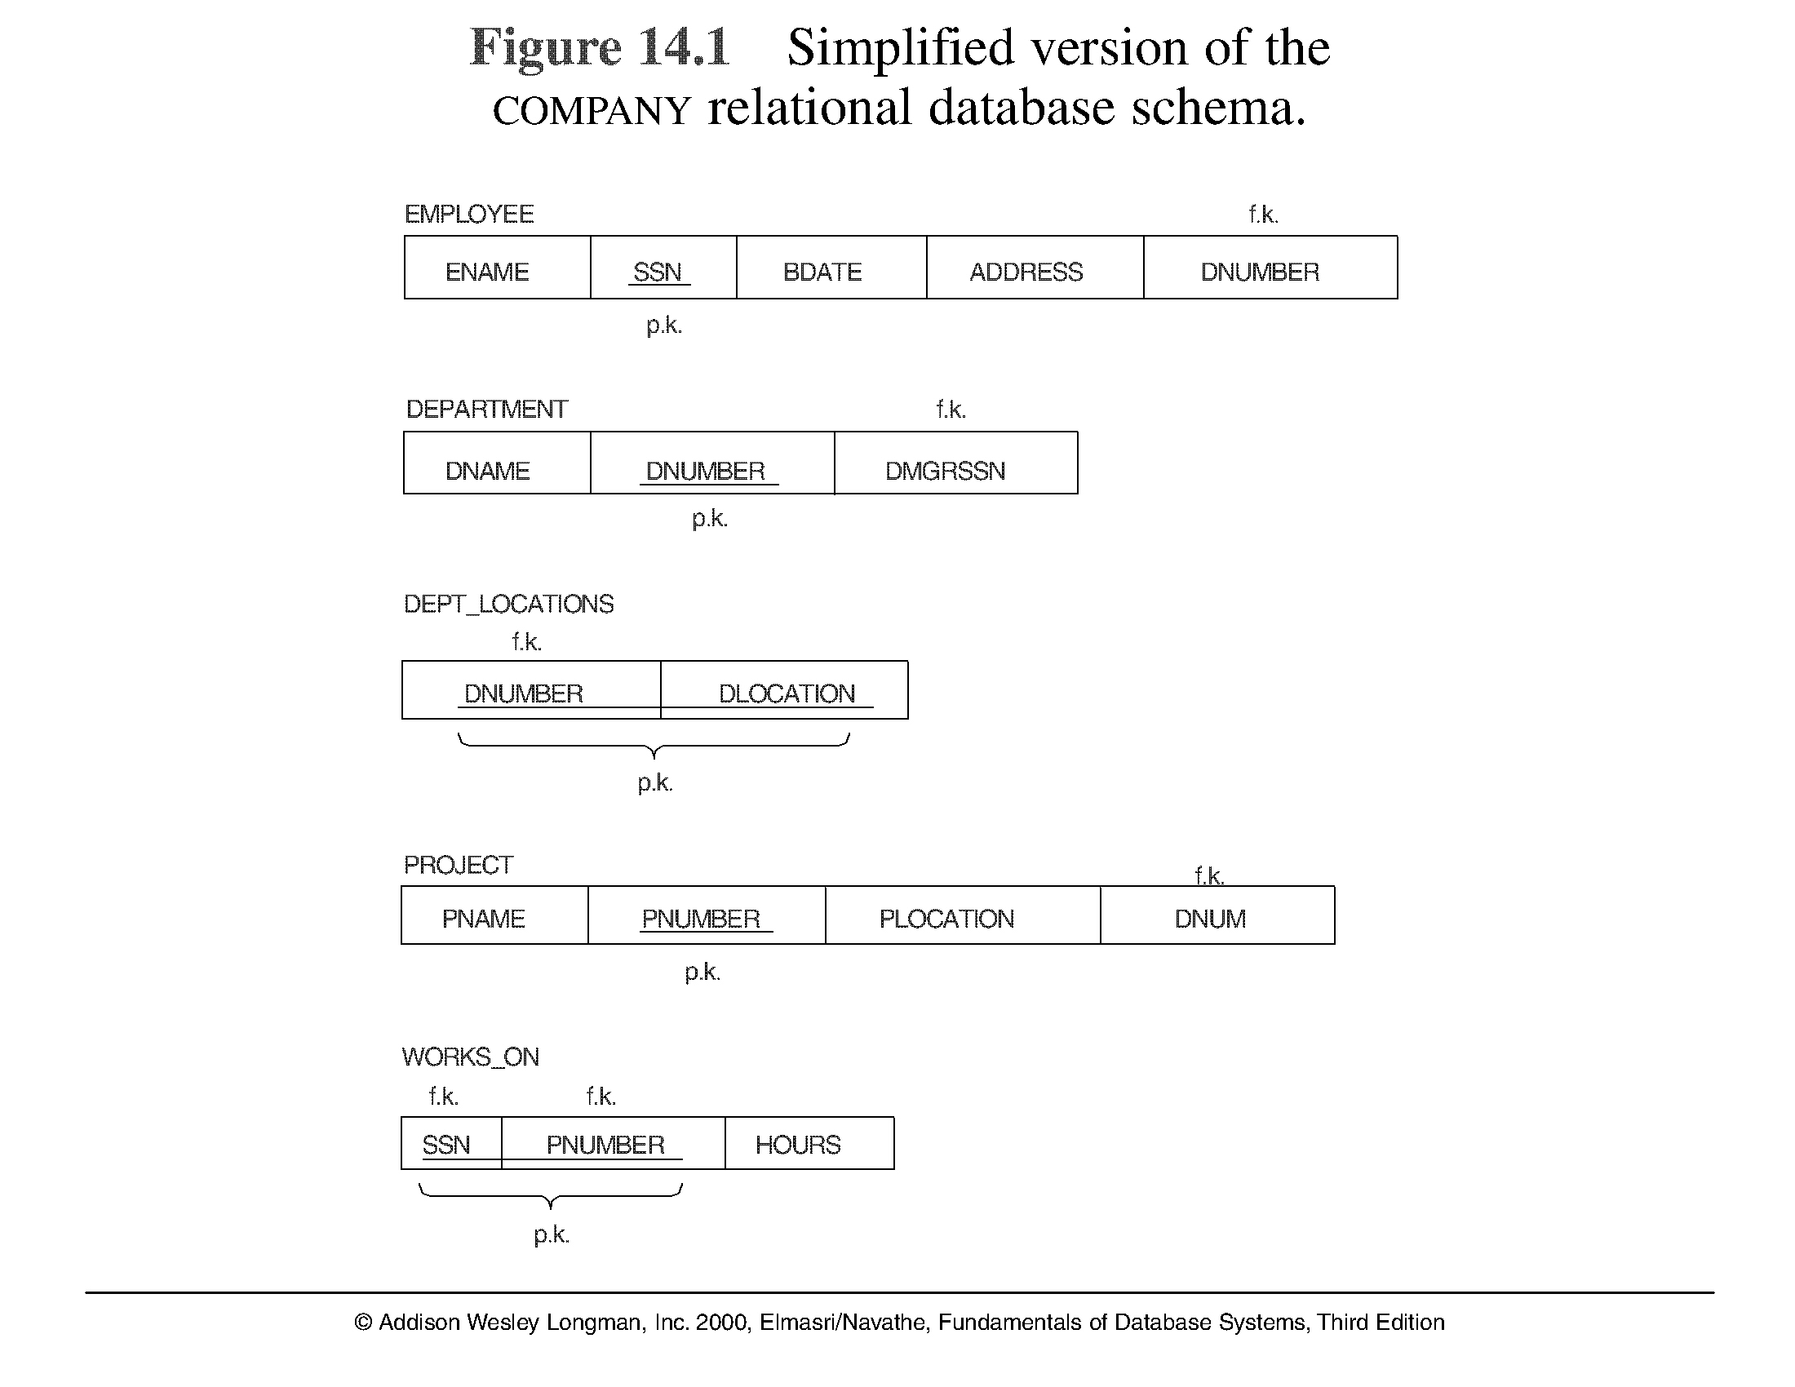
A simplified COMPANY relational database schema
Note: The above figure is now called Figure 10.1 in Edition 4

Slide 8
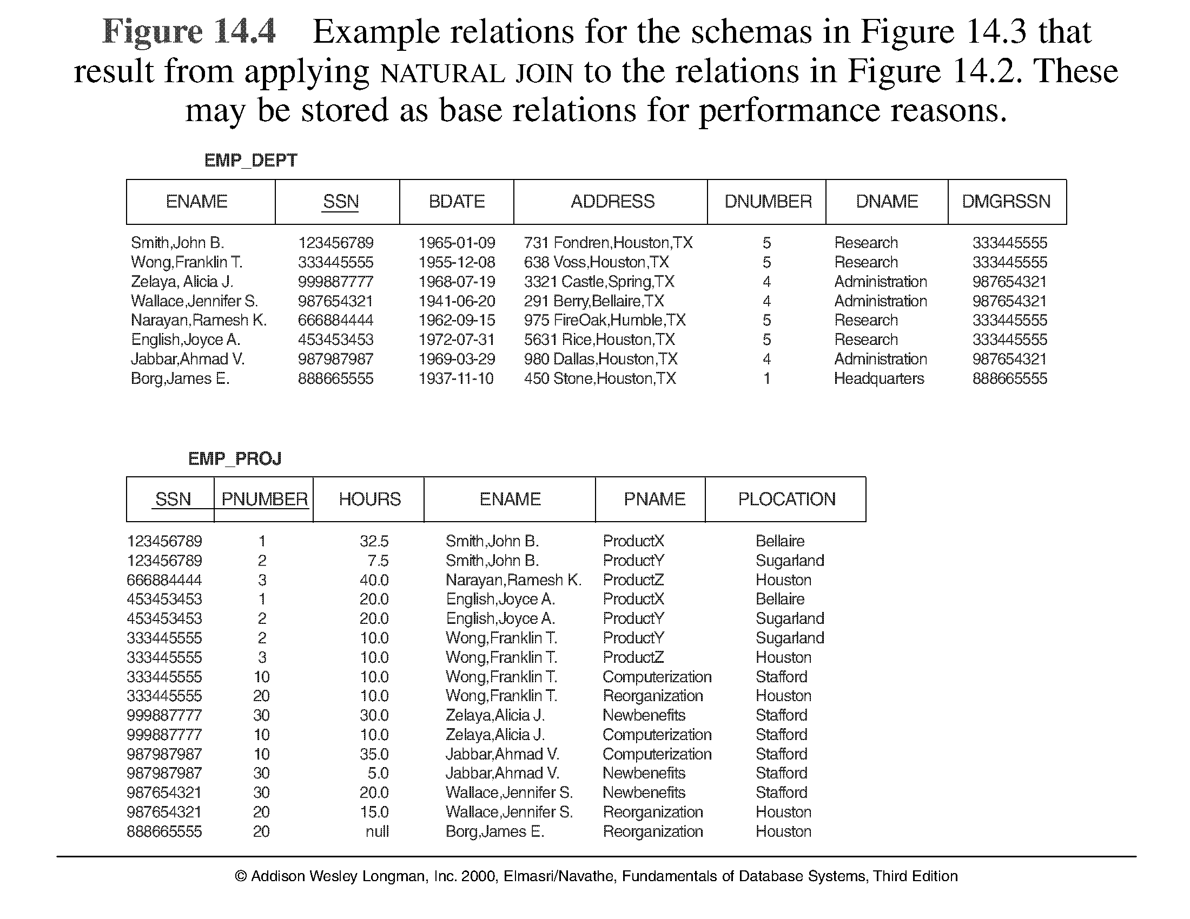
Example States for EMP_DEPT and EMP_PROJ

Slide 9
Redundant Information in Tuples and Update Anomalies
Mixing attributes of multiple entities may cause problems
Information is stored redundantly wasting storage
Problems with update anomalies
Insertion anomalies
Deletion anomalies
Modification anomalies

Slide 10
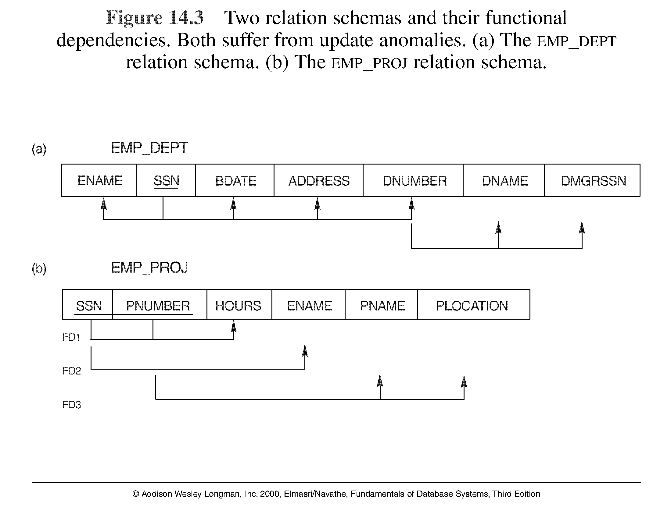
Two relation schemas suffering from anomalies

Slide 11
Guideline to Redundant Information in Tuples and Update Anomalies
GUIDELINE 2: Design a schema that does not suffer from the insertion, deletion and update anomalies. If there are any present, then note them so that applications can be made to take them into account

Slide 12
Null Values in Tuples
GUIDELINE 3: Relations should be designed such that their tuples will have as few NULL values as possible
Attributes that are NULL frequently could be placed in separate relations (with the primary key)
Reasons for nulls:
attribute not applicable or invalid
attribute value unknown (may exist)
value known to exist, but unavailable

Slide 13
Spurious Tuples
Bad designs for a relational database may result in erroneous results for certain JOIN operations
The "lossless join" property is used to guarantee meaningful results for join operations
GUIDELINE 4: The relations should be designed to satisfy the lossless join condition. No spurious tuples should be generated by doing a natural-join of any relations.

Slide 14
Spurious Tuples (2)
There are two important properties of decompositions:
non-additive or losslessness of the corresponding join
preservation of the functional dependencies.
Note that property (a) is extremely important and cannot be sacrificed. Property (b) is less stringent and may be sacrificed.

Slide 15
Functional Dependencies (1)
Functional dependencies (FDs) are used to specify formal measures of the "goodness" of relational designs
FDs and keys are used to define normal forms for relations
FDs are constraints that are derived from the meaning and interrelationships of the data attributes
A set of attributes X functionally determines a set of attributes Y if the value of X determines a unique value for Y

Slide 16
Functional Dependencies (2)
X -> Y holds if whenever two tuples have the same value for X, they must have the same value for Y
For any two tuples t1 and t2 in any relation instance r(R): If t1[X]=t2[X], then t1[Y]=t2[Y]
X -> Y in R specifies a constraint on all relation instances r(R)
Written as X -> Y; can be displayed graphically on a relation schema as in Figures. ( denoted by the arrow: ).
FDs are derived from the real-world constraints on the attributes

Slide 17
Examples of FD constraints (1)
social security number determines employee name
SSN -> ENAME
project number determines project name and location
PNUMBER -> {PNAME, PLOCATION}
employee ssn and project number determines the hours per week that the employee works on the project
{SSN, PNUMBER} -> HOURS

Slide 18
Examples of FD constraints (2)
An FD is a property of the attributes in the schema R
The constraint must hold on every relation instance r(R)
If K is a key of R, then K functionally determines all attributes in R (since we never have two distinct tuples with t1[K]=t2[K])

Slide 19
Normal Forms Based on Primary Keys
Normalization of Relations
Practical Use of Normal Forms
Definitions of Keys and Attributes Participating in Keys
First Normal Form
Second Normal Form
Third Normal Form

Slide 20
Normalization of Relations (1)
Normalization: The process of decomposing unsatisfactory "bad" relations by breaking up their attributes into smaller relations
Normal form: Condition using keys and FDs of a relation to certify whether a relation schema is in a particular normal form

Slide 21
Normalization of Relations (2)
2NF, 3NF, BCNF based on keys and FDs of a relation schema
4NF based on keys, multi-valued dependencies : MVDs; 5NF based on keys, join dependencies : JDs
Additional properties may be needed to ensure a good relational design (lossless join, dependency preservation)

Slide 22
Lossless join or nonadditive join property
Guarantees that the spurious tuples will not be generated
The dependency preservation property
Ensures that each functional dependency is represented in some individual relation resulting after decomposition

Slide 23
Practical Use of Normal Forms
Normalization is carried out in practice so that the resulting designs are of high quality and meet the desirable properties
The practical utility of these normal forms becomes questionable when the constraints on which they are based are hard to understand or to detect
The database designers need not normalize to the highest possible normal form. (usually up to 3NF, BCNF or 4NF)
Denormalization: the process of storing the join of higher normal form relations as a base relation—which is in a lower normal form

Slide 24
Definitions of Keys and Attributes Participating in Keys (1)
A superkey of a relation schema R = {A₁, A₂, ...., A_{n}} is a set of attributes S subset-of R with the property that no two tuples t₁ and t₂ in any legal relation state r of R will have t₁[S] = t₂[S]
A key K is a superkey with the additional property that removal of any attribute from K will cause K not to be a superkey any more.

Slide 25
Definitions of Keys and Attributes Participating in Keys (2)
If a relation schema has more than one key, each is called a candidate key. One of the candidate keys is arbitrarily designated to be the primary key, and the others are called secondary keys.
A Prime attribute must be a member of some candidate key
A Nonprime attribute is not a prime attribute—that is, it is not a member of any candidate key.

Slide 26
First Normal Form
Disallows composite attributes, multivalued attributes, and nested relations; attributes whose values for an individual tuple are non-atomic
Considered to be part of the definition of relation
1NF Definition:
It states that the domain of an attribute must include only atomic (simple) values and that the value of any attribute in a tuple must be a single value from the domain of that attribute

Slide 27
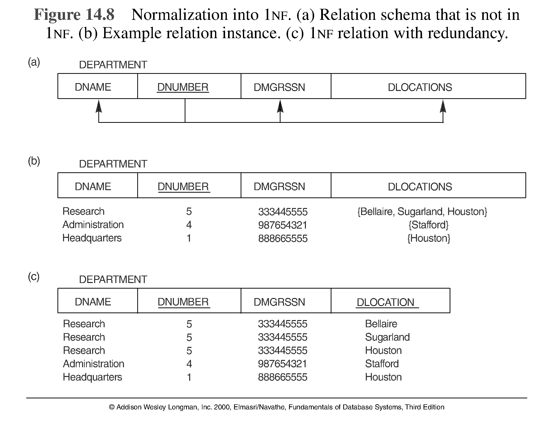
Normalization into 1NF

Slide 28
Second Normal Form (1)
Uses the concepts of FDs, primary key
Definitions:
Prime attribute - attribute that is member of the primary key K
Full functional dependency - a FD Y -> Z where removal of any attribute from Y means the FD does not hold any more
Examples: - {SSN, PNUMBER} -> HOURS is a full FD since neither SSN -> HOURS nor PNUMBER -> HOURS hold
- {SSN, PNUMBER} -> ENAME is not a full FD (it is called a partial dependency ) since SSN -> ENAME also holds

Slide 29
Second Normal Form (2)
2NF Definition
A relation schema R is in second normal form (2NF) if every non-prime attribute A in R is fully functionally dependent on the primary key of R
R can be decomposed into 2NF relations via the process of 2NF normalization

Slide 30
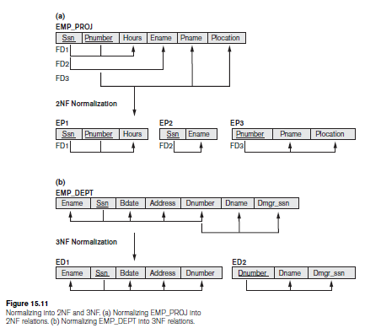
Normalizing into 2NF and 3NF
Note: The above figure is now called Figure 10.10 in Edition 4

Slide 31
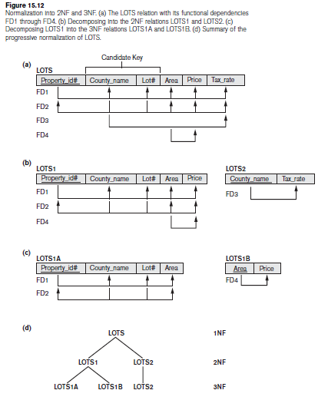
Normalization into 2NF and 3NF

Slide 32
Third Normal Form (1)
Definition:
Transitive functional dependency - a FD X -> Z that can be derived from two FDs X -> Y and Y -> Z
Examples:
- SSN -> DMGRSSN is a transitive FD since
SSN -> DNUMBER and DNUMBER -> DMGRSSN hold
- SSN -> ENAME is non-transitive since there is no set of attributes X where SSN -> X and X -> ENAME

Slide 33
Third Normal Form (2)
3NF Definition
A relation schema R is in third normal form (3NF) if it satisfies 2NF and no non-prime attribute of R is transitively dependent on the primary key
R can be decomposed into 3NF relations via the process of 3NF normalization
NOTE:
In X -> Y and Y -> Z, with X as the primary key, we consider this a problem only if Y is not a candidate key. When Y is a candidate key, there is no problem with the transitive dependency .
E.g., Consider EMP (SSN, Emp#, Salary ).
Here, SSN -> Emp# -> Salary and Emp# is a candidate key.

Slide 34
General Normal Form Definitions (For Multiple Keys) (1)
The above definitions consider the primary key only
The following more general definitions take into account relations with multiple candidate keys
A relation schema R is in second normal form (2NF) if every non-prime attribute A in R is fully functionally dependent on every key of R

Slide 35
General Normal Form Definitions (2)
Definition:
A relation schema R is in third normal form (3NF) if whenever a FD X -> A holds in R, then either:
(a) X is a superkey of R, or
(b) A is a prime attribute of R

Slide 36
BCNF (Boyce-Codd Normal Form)
A relation schema R is in Boyce-Codd Normal Form (BCNF) if whenever a non-trivial FD X -> A holds in R, then X is a superkey of R
Each normal form is strictly stronger than the previous one
Every 2NF relation is in 1NF
Every 3NF relation is in 2NF
Every BCNF relation is in 3NF
There exist relations that are in 3NF but not in BCNF
The goal is to have each relation in BCNF (or 3NF)

Slide 37
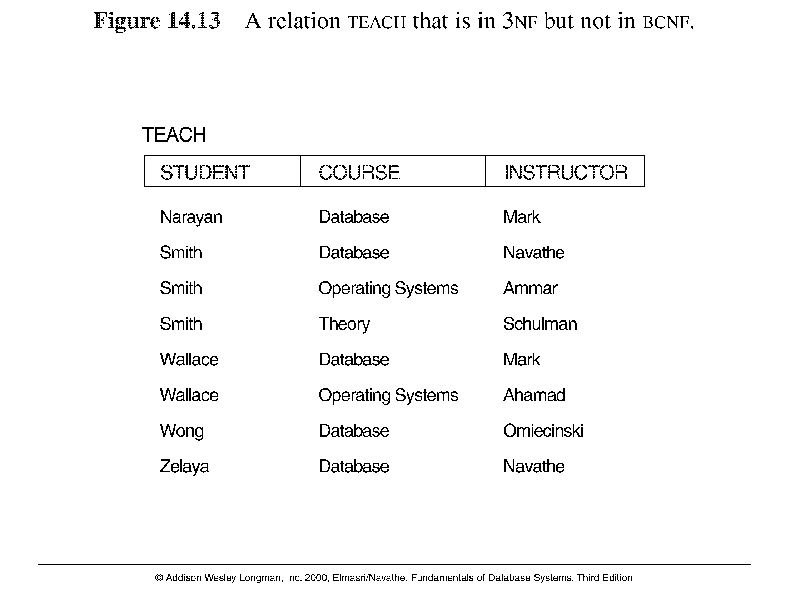
A relation TEACH that is in 3NF but not in BCNF

Slide 38
Achieving the BCNF by Decomposition (1)
Two FDs exist in the relation TEACH:
fd1: { student, course} -> instructor
fd2: instructor -> course
{student, course} is a candidate key for this relation and that the dependencies. Here this relation is in 3NF but not in BCNF
A relation NOT in BCNF should be decomposed so as to meet this property, while possibly forgoing the preservation of all functional dependencies in the decomposed relations.

Slide 39
Achieving the BCNF by Decomposition (2)
Three possible decompositions for relation TEACH
{student, instructor} and {student, course}
{course, instructor } and {course, student}
{instructor, course } and {instructor, student}
All three decompositions will lose fd1. We have to settle for sacrificing the functional dependency preservation. But we cannot sacrifice the non-additivity property after decomposition.
Out of the above three, only the 3rd decomposition will not generate spurious tuples after join.(and hence has the non-additivity property).
A test to determine whether a binary decomposition (decomposition into two relations) is nonadditive (lossless) is discussed in section 11.1.4 under Property LJ1. Verify that the third decomposition above meets the property.

Slide 40
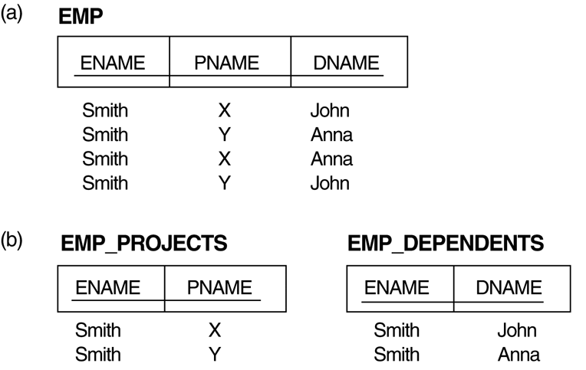
Multivalued Dependencies and Fourth Normal Form (1)
The EMP relation with two MVDs: ENAME —>> PNAME and ENAME —>> DNAME.
Decomposing the EMP relation into two 4NF relations EMP_PROJECTS and EMP_DEPENDENTS.

Slide 41
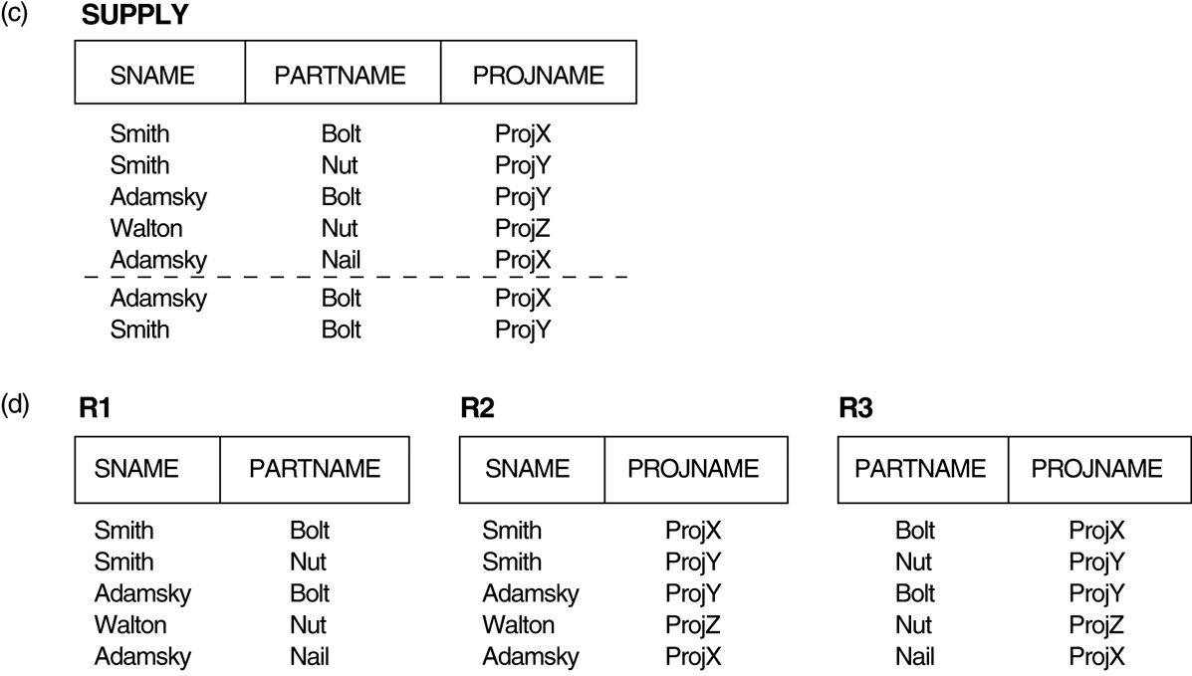
Multivalued Dependencies and Fourth Normal Form (1)
(c) The relation SUPPLY with no MVDs is in 4NF but not in 5NF if it has the JD(R1, R2, R3). (d) Decomposing the relation SUPPLY into the 5NF relations R1, R2, and R3.

Slide 42
Multivalued Dependencies and Fourth Normal Form (2)
Definition:
A multivalued dependency (MVD) X —>> Y specified on relation schema R, where X and Y are both subsets of R, specifies the following constraint on any relation state r of R: If two tuples t₁ and t₂ exist in r such that t₁[X] = t₂[X], then two tuples t₃ and t₄ should also exist in r with the following properties, where we use Z to denote (R - (X υ Y)):
t₃[X] = t₄[X] = t₁[X] = t₂[X].
t₃[Y] = t₁[Y] and t₄[Y] = t₂[Y].
t₃[Z] = t₂[Z] and t₄[Z] = t₁[Z].
An MVD X —>> Y in R is called a trivial MVD if (a) Y is a subset of X, or (b) X υ Y = R.

Slide 43
Multivalued Dependencies and Fourth Normal Form (3)
Inference Rules for Functional and Multivalued Dependencies:
IR1 (reflexive rule for FDs): If X ⊇ Y, then X –> Y.
IR2 (augmentation rule for FDs): {X –> Y} ⏐= XZ –> YZ.
IR3 (transitive rule for FDs): {X –> Y, Y –>Z} ⏐= X –> Z.
IR4 (complementation rule for MVDs): {X —>> Y} ⏐= X —>> (R – (X ∪ Y))}.
IR5 (augmentation rule for MVDs): If X —>> Y and W ⊇ Z then WX —>> YZ.
IR6 (transitive rule for MVDs): {X —>> Y, Y —>> Z} ⏐= X —>> (Z 2 Y).
IR7 (replication rule for FD to MVD): {X –> Y} ⏐= X —>> Y.
IR8 (coalescence rule for FDs and MVDs): If X —>> Y and there exists W with the properties that
(a) W ∩ Y is empty, (b) W –> Z, and (c) Y ⊇ Z, then X –> Z.

Slide 44
Multivalued Dependencies and Fourth Normal Form (4)
Definition:
A relation schema R is in 4NF with respect to a set of dependencies F (that includes functional dependencies and multivalued dependencies) if, for every nontrivial multivalued dependency X —>> Y in F⁺, X is a superkey for R.
Note: F⁺ is the (complete) set of all dependencies (functional or multivalued) that will hold in every relation state r of R that satisfies F. It is also called the closure of F.

Slide 45
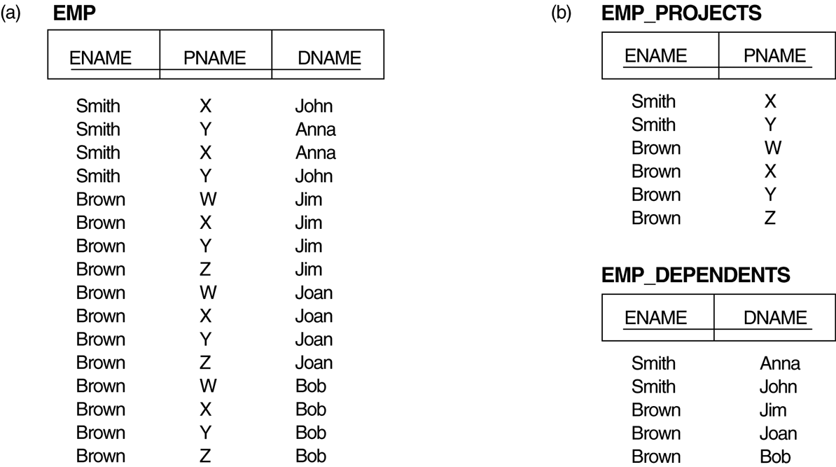
Multivalued Dependencies and Fourth Normal Form (5)
Decomposing a relation state of EMP that is not in 4NF:
EMP relation with additional tuples.
Two corresponding 4NF relations EMP_PROJECTS and EMP_DEPENDENTS.

Slide 46
Multivalued Dependencies and Fourth Normal Form (6)
Lossless (Non-additive) Join Decomposition into 4NF Relations:
PROPERTY LJ1’
The relation schemas R₁ and R₂ form a lossless (non-additive) join decomposition of R with respect to a set F of functional and multivalued dependencies if and only if
(R₁ ∩ R₂) —>> (R₁ - R₂)
or by symmetry, if and only if
(R₁ ∩ R₂) —>> (R₂ - R₁)).

Slide 47
Multivalued Dependencies and Fourth Normal Form (7)
Algorithm 11.5: Relational decomposition into 4NF relations with non-additive join property
Input: A universal relation R and a set of functional and multivalued dependencies F.
Set D := { R };
While there is a relation schema Q in D that is not in 4NF do {
choose a relation schema Q in D that is not in 4NF;
find a nontrivial MVD X —>> Y in Q that violates 4NF;
replace Q in D by two relation schemas (Q - Y) and (X υ Y);
};

Slide 48
Join Dependencies and Fifth Normal Form (1)
Definition:
A join dependency (JD), denoted by JD(R₁, R₂, ..., R_{n}), specified on relation schema R, specifies a constraint on the states r of R.
The constraint states that every legal state r of R should have a non-additive join decomposition into R₁, R₂, ..., R_{n}; that is, for every such r we have
* (π_{R1}(r), π_{R2}(r), ..., π_{Rn}(r)) = r
Note: an MVD is a special case of a JD where n = 2.
A join dependency JD(R₁, R₂, ..., R_{n}), specified on relation schema R, is a trivial JD if one of the relation schemas R_{i} in JD(R₁, R₂, ..., R_{n}) is equal to R.

Slide 49
Join Dependencies and Fifth Normal Form (2)
Definition:
A relation schema R is in fifth normal form (5NF) (or Project-Join Normal Form (PJNF)) with respect to a set F of functional, multivalued, and join dependencies if,
for every nontrivial join dependency JD(R₁, R₂, ..., R_{n}) in F⁺ (that is, implied by F),
every R_{i} is a superkey of R.

Slide 50
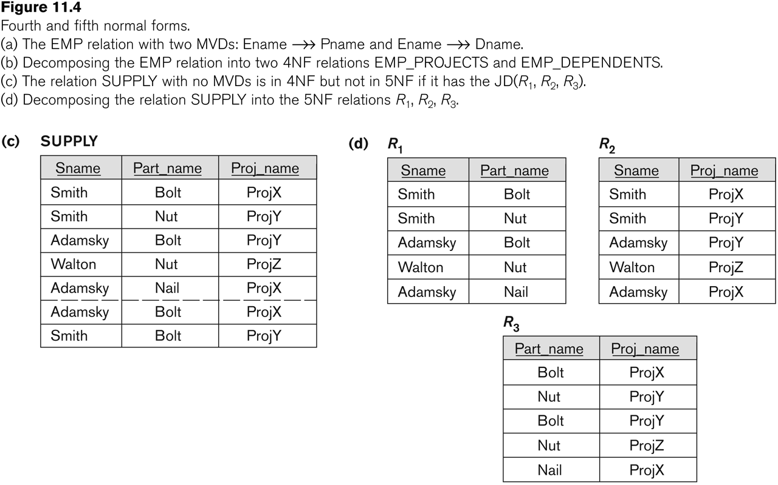
Relation SUPPLY with Join Dependency and conversion to Fifth Normal Form

Slide 51
NORMALIZATION ALGORITHMS

Slide 52
Closure of f
The set of all dependencies that include F as well as all dependencies that can be inferred from F is called the closure of F; it is denoted by F+.
Example…
F = {Ssn → {Ename, Bdate, Address, Dnumber}, Dnumber → {Dname, Dmgr_ssn} }
Some of the additional functional dependencies that we can infer from F are the following:
Ssn → {Dname, Dmgr_ssn}
Ssn → Ssn
Dnumber → Dname

Slide 53
2.2 Inference Rules for FDs (1)
Given a set of FDs F, we can infer additional FDs that hold whenever the FDs in F hold
Armstrong's inference rules:
IR1. (Reflexive) If Y subset-of X, then X -> Y
IR2. (Augmentation) If X -> Y, then XZ -> YZ
(Notation: XZ stands for X U Z)
IR3. (Transitive) If X -> Y and Y -> Z, then X -> Z
IR1, IR2, IR3 form a sound and complete set of inference rules

Slide 54
Inference Rules for FDs (2)
Some additional inference rules that are useful:
(Decomposition) If X -> YZ, then X -> Y and X -> Z
(Union) If X -> Y and X -> Z, then X -> YZ
(Psuedotransitivity) If X -> Y and WY -> Z, then WX -> Z
The last three inference rules, as well as any other inference rules, can be deduced from IR1, IR2, and IR3 (completeness property)

Slide 55
PROOF
Proof of IR1.
Suppose that X ⊇ Y and that two tuples t1 and t2 exist in some relation instance r of R such that t1 [X] = t2 [X]. Then t1[Y] = t2[Y] because X ⊇ Y; hence, X→Y must hold in r.
Proof of IR2 (by contradiction).
Assume that X→Y holds in a relation instance r of R but that XZ→YZ does not hold. Then there must exist two tuples t1 and t2 in r such that (1) t1 [X] = t2 [X], (2) t1 [Y] = t2 [Y], (3) t1 [XZ] = t2 [XZ], and (4) t1 [YZ] ≠ t2 [YZ]. This is not possible because from (1) and (3) we deduce (5) t1 [Z] = t2 [Z], and from (2) and (5) we deduce (6) t1 [YZ] = t2 [YZ], contradicting (4).
Proof of IR3.
Assume that (1) X → Y and (2) Y → Z both hold in a relation r. Then for any two tuples t1 and t2 in r such that t1 [X] = t2 [X], we must have (3) t1 [Y] = t2 [Y], from assumption (1); hence we must also have (4) t1 [Z] = t2 [Z] from (3) and assumption (2); thus X→Z must hold in r.

Slide 56
CONTD
Proof of IR4 (Using IR1 through IR3).
X→YZ (given).
YZ→Y (using IR1 and knowing that YZ ⊇ Y).
X→Y (using IR3 on 1 and 2).
Proof of IR5 (using IR1 through IR3).
X→Y (given).
X→Z (given).
X→XY (using IR2 on 1 by augmenting with X; notice that XX = X).
XY→YZ (using IR2 on 2 by augmenting with Y).
X→YZ (using IR3 on 3 and 4).
Proof of IR6 (using IR1 through IR3).
X→Y (given).
WY→Z (given).
WX→WY (using IR2 on 1 by augmenting with W).
WX→Z (using IR3 on 3 and 2).

Slide 57
The inference rules IR1 through IR3 are sound and complete
sound because given a set of functional dependencies F specified on a relation schema R, any dependency that we can infer from F by using IR1 through IR3 holds in every relation state r or R that satisfies the dependencies in F.
complete because using IR1 through IR3 repeatedly to infer dependencies until no more dependencies can be inferred results in the complete set of all possible dependencies that can be inferred from F.

Slide 58
Closure of x under f
For each set of attributes X, we determine the set X⁺ of attributes that are functionally determined by X based on F; X⁺ is called the closure of X under F.

Slide 59
Algorithm: Determining X+, the Closure of X under F
Input: A set F of FDs on a relation schema R, and a set of attributes X, which is a subset of R.
X⁺ := X;
repeat
oldX ⁺ := X ⁺;
for each functional dependency Y→Z in F do
if X ⁺ ⊇ Y then X ⁺ := X ⁺ ∪ Z;
until (X ⁺ = oldX ⁺);

Slide 60
Equivalence of sets of functional dependencies
A set of functional dependencies F is said to cover another set of functional dependencies E if every FD in E is also in F+; that is, if every dependency in E can be inferred from F; alternatively, we can say that E is covered by F.
Two sets of functional dependencies E and F are equivalent if E+ = F+. Therefore, equivalence means that every FD in E can be inferred from F, and every FD in F can be inferred from E; that is, E is equivalent to F if both the conditions—E covers F and F covers E—hold.

Slide 61
Minimal Sets of FDs
A set of functional dependencies F to be minimal if it satisfies the following conditions:
Every dependency in F has a single attribute for its right-hand side.
We cannot replace any dependency X → A in F with a dependency Y → A, where Y is a proper subset of X, and still have a set of dependencies that is equivalent to F.
We cannot remove any dependency from F and still have a set of dependencies that is equivalent to F.

Slide 62
Minimal cover
A minimal cover of a set of functional dependencies E is a minimal set of dependencies (in the standard canonical form and without redundancy) that is equivalent to E

Slide 63
Algorithm: Finding a Minimal Cover F for a Set of Functional Dependencies E
Input: A set of functional dependencies E.
Set F := E.
Replace each functional dependency X→{A1, A2, ..., An} in F by the n functional dependencies X→A1, X→A2, ..., X→An.
For each functional dependency X→A in F for each attribute B that is an element of X if { {F – {X→A} } ∪ { (X – {B} ) →A} } is equivalent to F then replace X→A with (X – {B} ) →A in F.
For each remaining functional dependency X→A in F if {F – {X→A} } is equivalent to F, then remove X→A from F.

Slide 64
Example
Find the minimal cover for the following set of functional dependencies:
E : {B→A, D→A, AB→D}.

Slide 65
SOLUTION
All above dependencies are in canonical form (that is, they have only one attribute on the right-hand side), so we have completed step 1 of Algorithm and can proceed to step 2. In step 2 we need to determine if AB→D has any redundant attribute on the left-hand side; that is, can it be replaced by B→D or A→D?
Since B →A, by augmenting with B on both sides (IR2), we have BB → AB, or B→AB (i). However, AB→D as given (ii).
Hence by the transitive rule (IR3), we get from (i) and (ii), B → D. Thus AB→D may be replaced by B→D.
We now have a set equivalent to original E, say E: {B→A, D→A, B→D}. No further reduction is possible in step 2 since all FDs have a single attribute on the left-hand side.
In step 3 we look for a redundant FD in E. By using the transitive rule on B → D and D → A, we derive B → A. Hence B → A is redundant in E and can be eliminated.
Therefore, the minimal cover of E is {B→D, D→A}.

Slide 66
DESIGNING A SET OF RELATIONS (1)
The Approach of Relational Synthesis (Bottom-up Design):
Assumes that all possible functional dependencies are known.
First constructs a minimal set of FDs
Then applies algorithms that construct a target set of 3NF or BCNF relations.
Additional criteria may be needed to ensure the set of relations in a relational database are satisfactory (see Algorithms 11.2 and 11.4).

Slide 67
DESIGNING A SET OF RELATIONS (2)
Goals:
Lossless join property (a must)
Algorithm 11.1 tests for general losslessness.
Dependency preservation property
Algorithm 11.3 decomposes a relation into BCNF components by sacrificing the dependency preservation.
Additional normal forms
4NF (based on multi-valued dependencies)
5NF (based on join dependencies)

Slide 68
1. Properties of Relational Decompositions (1)
Relation Decomposition and Insufficiency of Normal Forms:
Universal Relation Schema:
A relation schema R = {A1, A2, …, An} that includes all the attributes of the database.
Universal relation assumption:
Every attribute name is unique.

Slide 69
Properties of Relational Decompositions (2)
Relation Decomposition and Insufficiency of Normal Forms (cont.):
Decomposition:
The process of decomposing the universal relation schema R into a set of relation schemas D = {R1,R2, …, Rm} that will become the relational database schema by using the functional dependencies.
Attribute preservation condition:
Each attribute in R will appear in at least one relation schema Ri in the decomposition so that no attributes are “lost”.

Slide 70
Properties of Relational Decompositions (2)
Another goal of decomposition is to have each individual relation Ri in the decomposition D be in BCNF or 3NF.
Additional properties of decomposition are needed to prevent from generating spurious tuples

Slide 71
Properties of Relational Decompositions (3)
Dependency Preservation Property of a Decomposition:
Definition: Given a set of dependencies F on R, the projection of F on R_{i}, denoted by p_{Ri}(F) where R_{i} is a subset of R, is the set of dependencies X  Y in F⁺ such that the attributes in X υ Y are all contained in R_{i}.
Hence, the projection of F on each relation schema R_{i} in the decomposition D is the set of functional dependencies in F⁺, the closure of F, such that all their left- and right-hand-side attributes are in R_{i}.

Slide 72
Properties of Relational Decompositions (4)
Dependency Preservation Property of a Decomposition (cont.):
Dependency Preservation Property:
A decomposition D = {R1, R2, ..., Rm} of R is dependency-preserving with respect to F if the union of the projections of F on each Ri in D is equivalent to F; that is ((π_{R1}(F)) υ . . . υ (π_{Rm}(F)))⁺ = F⁺
(See examples in Fig 10.12a and Fig 10.11)
Claim 1:
It is always possible to find a dependency-preserving decomposition D with respect to F such that each relation Ri in D is in 3nf.

Slide 73
Properties of Relational Decompositions (5)
Lossless (Non-additive) Join Property of a Decomposition:
Definition: Lossless join property: a decomposition D = {R1, R2, ..., Rm} of R has the lossless (nonadditive) join property with respect to the set of dependencies F on R if, for every relation state r of R that satisfies F, the following holds, where * is the natural join of all the relations in D:
* (π _{R1}(r), ..., π_{Rm}(r)) = r
Note: The word loss in lossless refers to loss of information, not to loss of tuples. In fact, for “loss of information” a better term is “addition of spurious information”

Slide 74
Properties of Relational Decompositions (6)
Lossless (Non-additive) Join Property of a Decomposition (cont.):
Algorithm 11.1: Testing for Lossless Join Property
Input: A universal relation R, a decomposition D = {R1, R2, ..., Rm} of R, and a set F of functional dependencies.
1. Create an initial matrix S with one row i for each relation Ri in D, and one column j for each attribute Aj in R.
2. Set S(i,j):=bij for all matrix entries. (* each bij is a distinct symbol associated with indices (i,j) *).
3. For each row i representing relation schema Ri
{for each column j representing attribute Aj
{if (relation Ri includes attribute Aj) then set S(i,j):= aj;};};
(* each aj is a distinct symbol associated with index (j) *)
CONTINUED on NEXT SLIDE

Slide 75
Properties of Relational Decompositions (7)
Lossless (Non-additive) Join Property of a Decomposition (cont.):
Algorithm 11.1: Testing for Lossless Join Property
4. Repeat the following loop until a complete loop execution results in no changes to S
{for each functional dependency X Y in F
{for all rows in S which have the same symbols in the columns corresponding to attributes in X
{make the symbols in each column that correspond to an attribute in Y be the same in all these rows as follows:
If any of the rows has an “a” symbol for the column, set the other rows to that same “a” symbol in the column.
If no “a” symbol exists for the attribute in any of the rows, choose one of the “b” symbols that appear in one of the rows for the attribute and set the other rows to that same “b” symbol in the column ;};
};
};
5. If a row is made up entirely of “a” symbols, then the decomposition has the lossless join property; otherwise it does not.

Slide 76
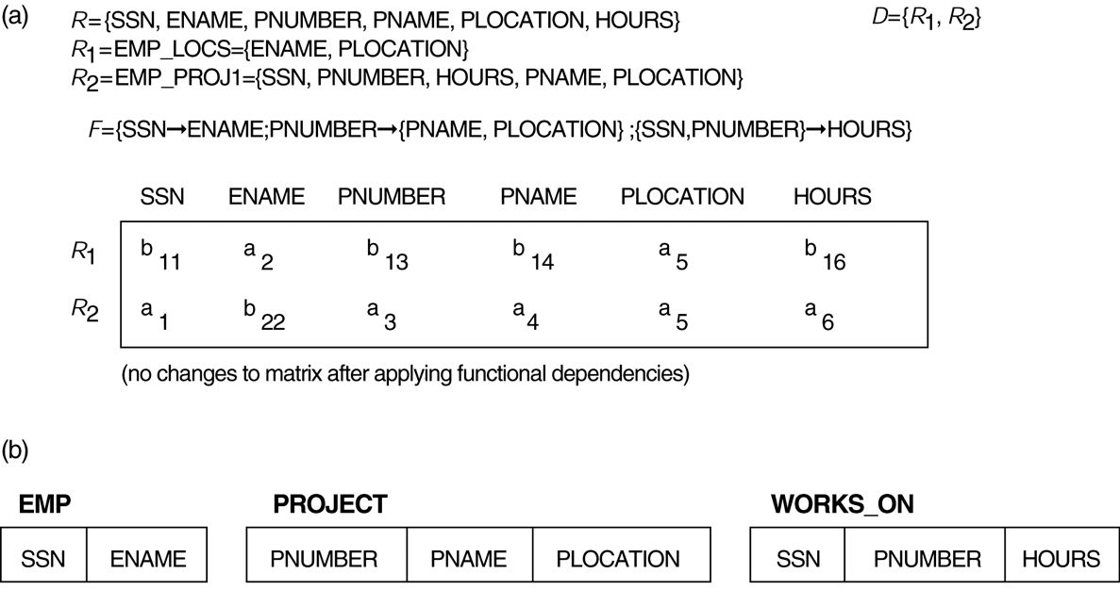
Properties of Relational Decompositions (8)
Lossless (nonadditive) join test for n-ary decompositions. (a) Case 1: Decomposition of EMP_PROJ into EMP_PROJ1 and EMP_LOCS fails test.
(b) A decomposition of EMP_PROJ that has the lossless join property.

Slide 77
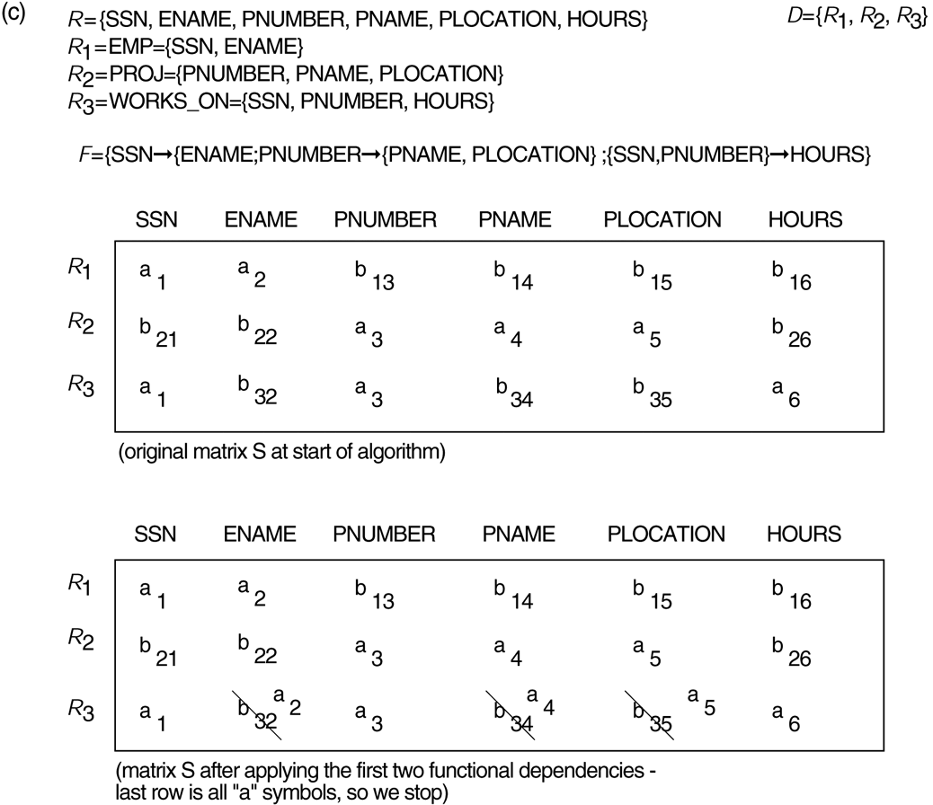
Properties of Relational Decompositions (8)
Lossless (nonadditive) join test for n-ary decompositions. (c) Case 2: Decomposition of EMP_PROJ into EMP, PROJECT, and WORKS_ON satisfies test.

Slide 78
Properties of Relational Decompositions (9)
Testing Binary Decompositions for Lossless Join Property
Binary Decomposition: Decomposition of a relation R into two relations.
PROPERTY LJ1 (lossless join test for binary decompositions): A decomposition D = {R1, R2} of R has the lossless join property with respect to a set of functional dependencies F on R if and only if either
The f.d. ((R1 ∩ R2)  (R1- R2)) is in F⁺, or
The f.d. ((R1 ∩ R2)  (R2 - R1)) is in F⁺.

Slide 79
Properties of Relational Decompositions (10)
Successive Lossless Join Decomposition:
Claim 2 (Preservation of non-additivity in successive decompositions):
If a decomposition D = {R1, R2, ..., Rm} of R has the lossless (non-additive) join property with respect to a set of functional dependencies F on R,
and if a decomposition Di = {Q1, Q2, ..., Qk} of Ri has the lossless (non-additive) join property with respect to the projection of F on Ri,
then the decomposition D2 = {R1, R2, ..., Ri-1, Q1, Q2, ..., Qk, Ri+1, ..., Rm} of R has the non-additive join property with respect to F.

Slide 80
2. Algorithms for Relational Database Schema Design (1)
Algorithm 11.2: Relational Synthesis into 3NF with Dependency Preservation (Relational Synthesis Algorithm)
Input: A universal relation R and a set of functional dependencies F on the attributes of R.
1. Find a minimal cover G for F (use Algorithm 10.2);
2. For each left-hand-side X of a functional dependency that appears in G,
create a relation schema in D with attributes {X υ {A1} υ {A2} ... υ {Ak}},
where X  A1, X  A2, ..., X  Ak are the only dependencies in G with X as left-hand-side (X is the key of this relation) ;
3. Place any remaining attributes (that have not been placed in any relation) in a single relation schema to ensure the attribute preservation property.
Claim 3: Every relation schema created by Algorithm 11.2 is in 3NF.

Slide 81
Algorithms for Relational Database Schema Design (2)
Algorithm 11.3: Relational Decomposition into BCNF with Lossless (non-additive) join property
Input: A universal relation R and a set of functional dependencies F on the attributes of R.
1. Set D := {R};
2. While there is a relation schema Q in D that is not in BCNF
do {
choose a relation schema Q in D that is not in BCNF;
find a functional dependency X  Y in Q that violates BCNF;
replace Q in D by two relation schemas (Q - Y) and (X υ Y);
};
Assumption: No null values are allowed for the join attributes.

Slide 82
Algorithms for Relational Database Schema Design (3)
Algorithm 11.4 Relational Synthesis into 3NF with Dependency Preservation and Lossless (Non-Additive) Join Property
Input: A universal relation R and a set of functional dependencies F on the attributes of R.
1. Find a minimal cover G for F (Use Algorithm 10.2).
2. For each left-hand-side X of a functional dependency that appears in G,
create a relation schema in D with attributes {X υ {A1} υ {A2} ... υ {Ak}},
where X  A1, X  A2, ..., X –>Ak are the only dependencies in G with X as left-hand-side (X is the key of this relation).
3. If none of the relation schemas in D contains a key of R, then create one more relation schema in D that contains attributes that form a key of R. (Use Algorithm 11.4a to find the key of R)

Slide 83
Algorithms for Relational Database Schema Design (4)
Algorithm 11.4a Finding a Key K for R Given a set F of Functional Dependencies
Input: A universal relation R and a set of functional dependencies F on the attributes of R.
1. Set K := R;
2. For each attribute A in K {
Compute (K - A)+ with respect to F;
If (K - A)+ contains all the attributes in R,
then set K := K - {A};
}

Slide 84
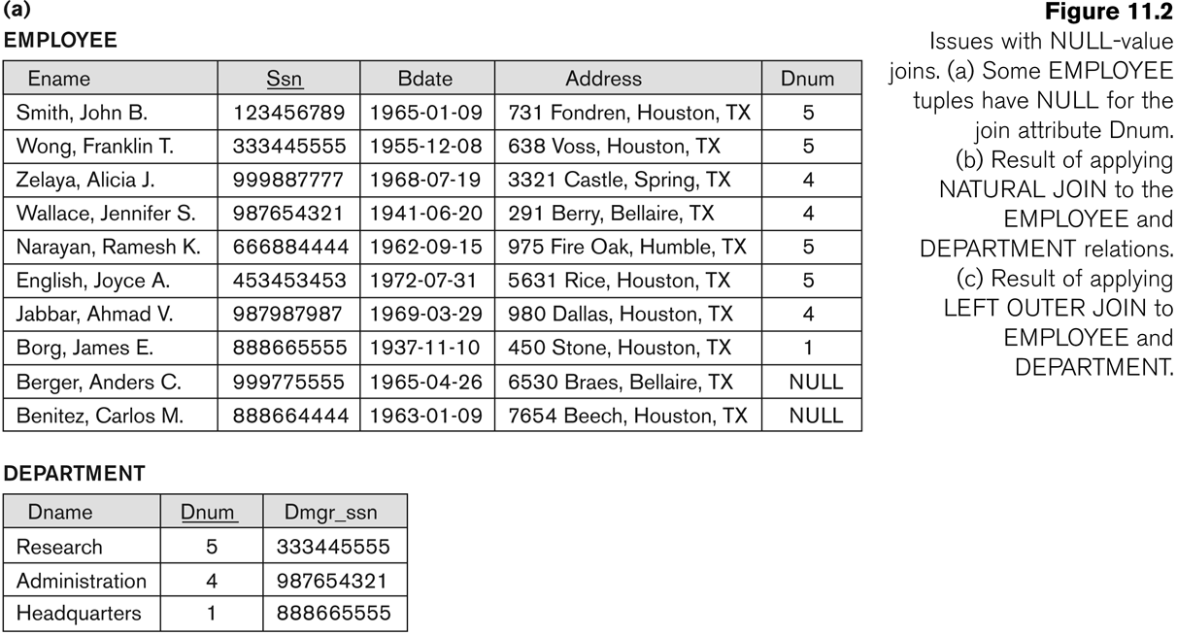
Algorithms for Relational Database Schema Design (5)

Slide 85
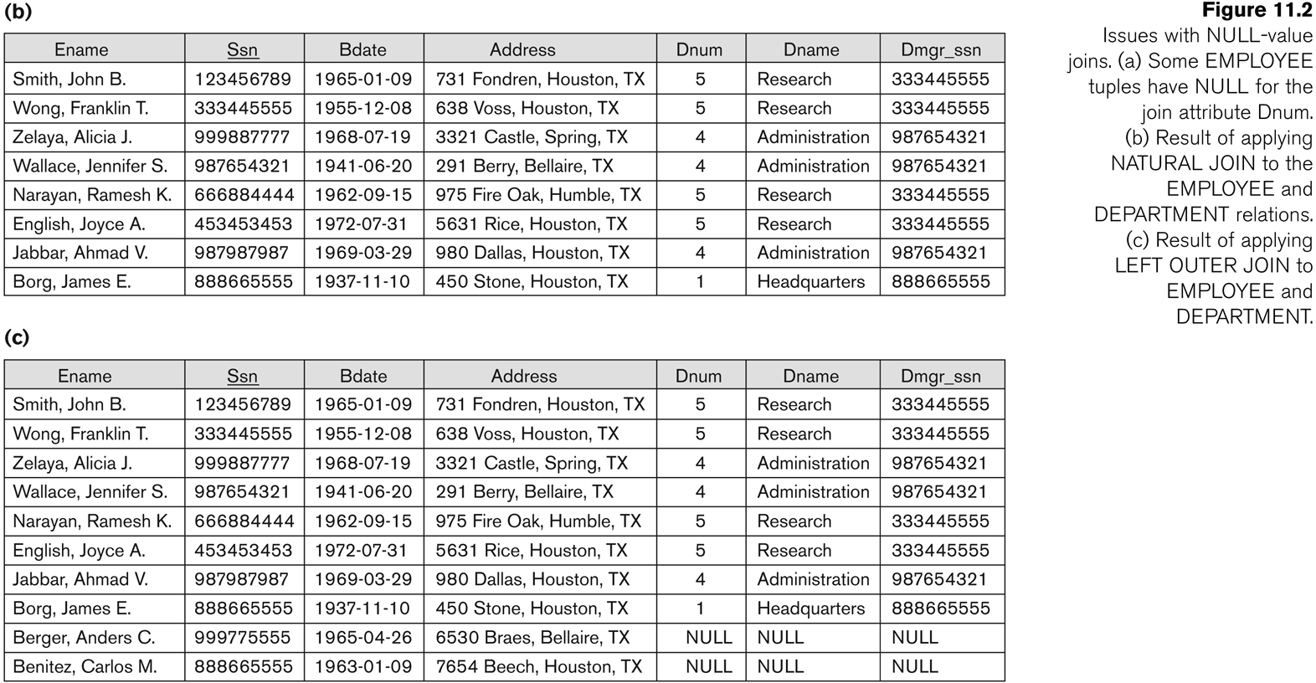
Algorithms for Relational Database Schema Design (5)

Slide 86
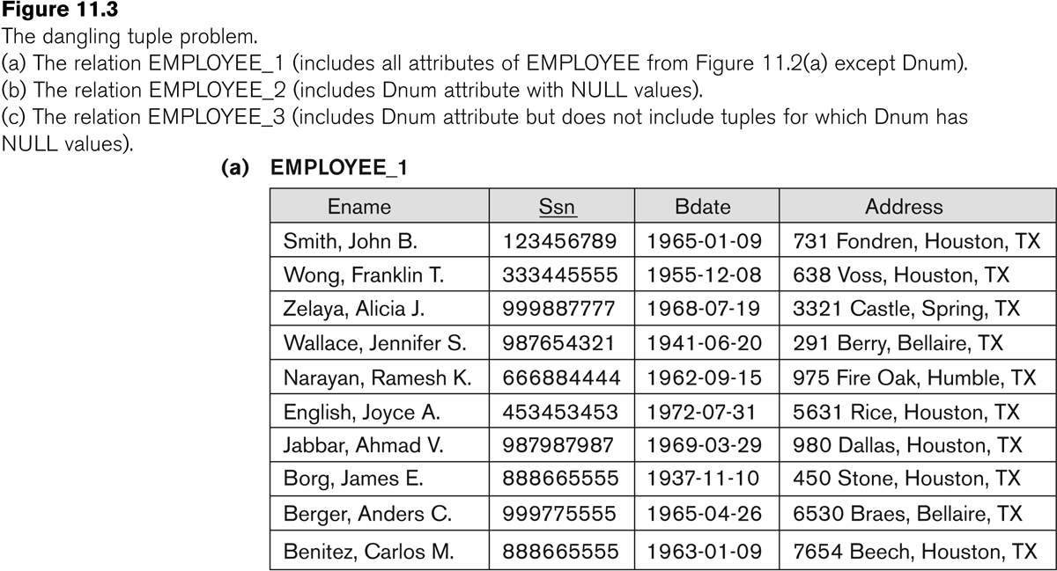
Algorithms for Relational Database Schema Design (6)

Slide 87
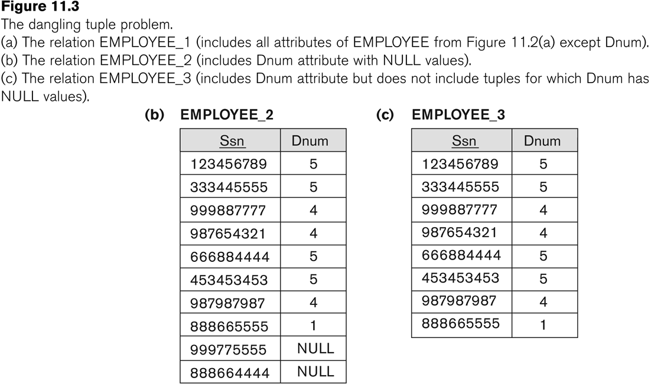
Algorithms for Relational Database Schema Design (6)

Slide 88
Algorithms for Relational Database Schema Design (7)
Discussion of Normalization Algorithms:
Problems:
The database designer must first specify all the relevant functional dependencies among the database attributes.
These algorithms are not deterministic in general.
It is not always possible to find a decomposition into relation schemas that preserves dependencies and allows each relation schema in the decomposition to be in BCNF (instead of 3NF as in Algorithm 11.4).

Slide 89
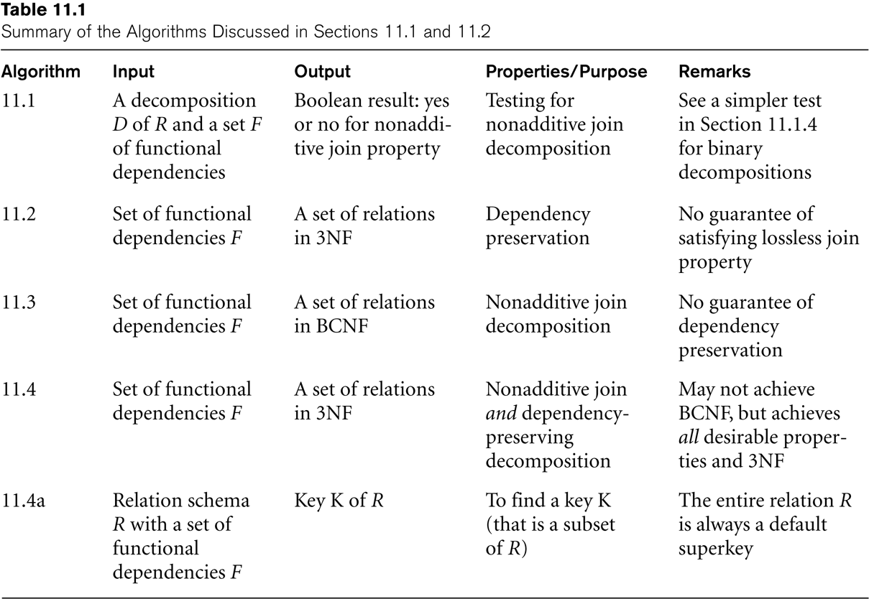
Algorithms for Relational Database Schema Design (8)

Slide 90
5. Inclusion Dependencies (1)
Definition:
An inclusion dependency R.X < S.Y between two sets of attributes—X of relation schema R, and Y of relation schema S—specifies the constraint that, at any specific time when r is a relation state of R and s a relation state of S, we must have
π_{X}(r(R)) ⊇ π_{Y}(s(S))
Note:
The ? (subset) relationship does not necessarily have to be a proper subset.
The sets of attributes on which the inclusion dependency is specified—X of R and Y of S—must have the same number of attributes.
In addition, the domains for each pair of corresponding attributes should be compatible.

Slide 91
Inclusion Dependencies (2)
Objective of Inclusion Dependencies:
To formalize two types of interrelational constraints which cannot be expressed using F.D.s or MVDs:
Referential integrity constraints
Class/subclass relationships
Inclusion dependency inference rules
IDIR1 (reflexivity): R.X < R.X.
IDIR2 (attribute correspondence): If R.X < S.Y
where X = {A₁, A₂ ,..., A_{n}} and Y = {B₁, B₂, ..., B_{n}} and A_{i} Corresponds-to B_{i}, then R.A_{i} < S.B_{i}
for 1 ≤ i ≤ n.
IDIR3 (transitivity): If R.X < S.Y and S.Y < T.Z, then R.X < T.Z.

Slide 92
6. Other Dependencies and Normal Forms (1)
Template Dependencies:
Template dependencies provide a technique for representing constraints in relations that typically have no easy and formal definitions.
The idea is to specify a template—or example—that defines each constraint or dependency.
There are two types of templates:
tuple-generating templates
constraint-generating templates.
A template consists of a number of hypothesis tuples that are meant to show an example of the tuples that may appear in one or more relations. The other part of the template is the template conclusion.

Slide 93
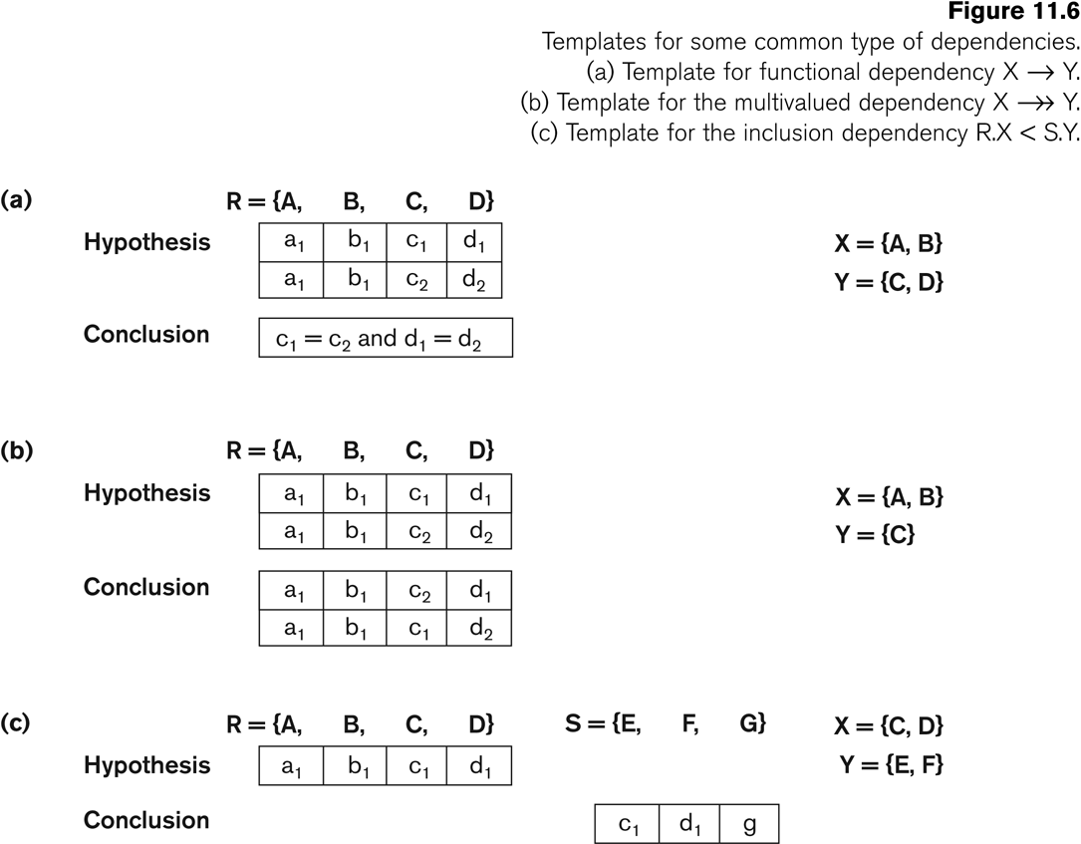
Other Dependencies and Normal Forms (2)

Slide 94
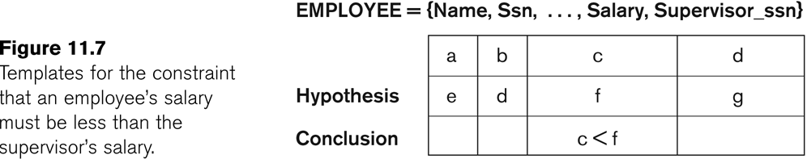
Other Dependencies and Normal Forms (3)

Slide 95
Other Dependencies and Normal Forms (4)
Domain-Key Normal Form (DKNF):
Definition:
A relation schema is said to be in DKNF if all constraints and dependencies that should hold on the valid relation states can be enforced simply by enforcing the domain constraints and key constraints on the relation.
The idea is to specify (theoretically, at least) the “ultimate normal form” that takes into account all possible types of dependencies and constraints. .
For a relation in DKNF, it becomes very straightforward to enforce all database constraints by simply checking that each attribute value in a tuple is of the appropriate domain and that every key constraint is enforced.
The practical utility of DKNF is limited

Slide 96
Questions
Explain the informal design guidelines for the database design.
Which normal form is based on full functional dependency? Explain the normal form which is based on this.
What is transitive dependency? Explain 3NF with example.
What is multivalued dependency? Explain 4NF with example.
Write an algorithm to find the minimal cover.

