Slide 1

Hotel Booking Analysis – Key Insights
By: Gaurav Yadav

Slide 2
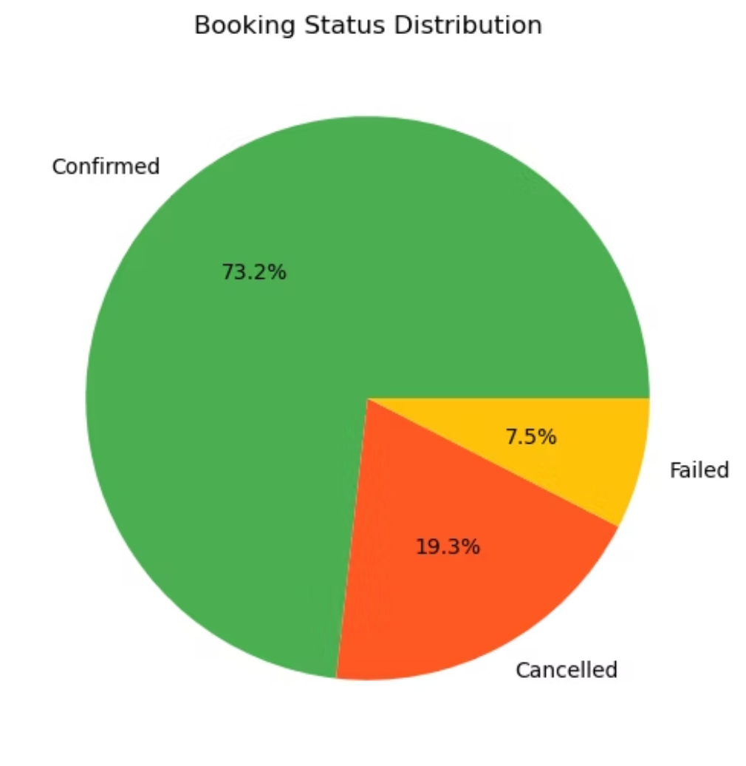
OVERVIEW
Booking Performance
Total Bookings Analyzed
I examined and analyzed 30,000 hotel bookings From the dataset given identify patterns, trends, and opportunities for optimization. The analyzed data show significant insights of the customers across multiple channels and segments.
Key Findings
Confirmed bookings represent the majority at 73% of total bookings.
Nearly 1 in 5 bookings result in cancellation, representing significant potential revenue loss.
Failed bookings represents the 7.5% of all, indicating potential technical or payment issues.
Most bookings are confirmed, but cancellations are the area we need to improve.

Slide 3
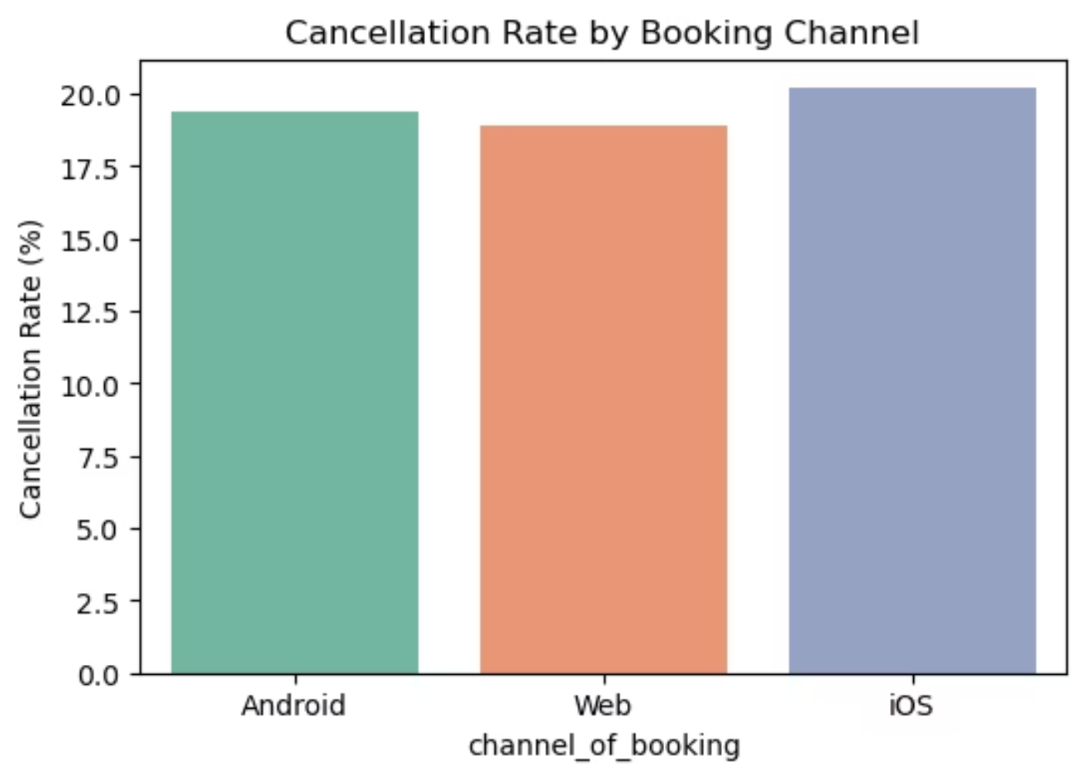

CHANNEL ANALYSIS
Cancellation Rates by Booking Channels
By seeing which channels of booking have the lowest cancellation, we can focus our marketing and improve the customer experience.
Cancellation patterns vary a little across these platforms and are roughly the same across all the three channels
iOS users have highest cancellation rates at 20.2%, Android users are in middle with 19.4% and web bookings are the most reliable at 18.9%.
This suggests that desktop users make more considered booking choices.

Slide 4
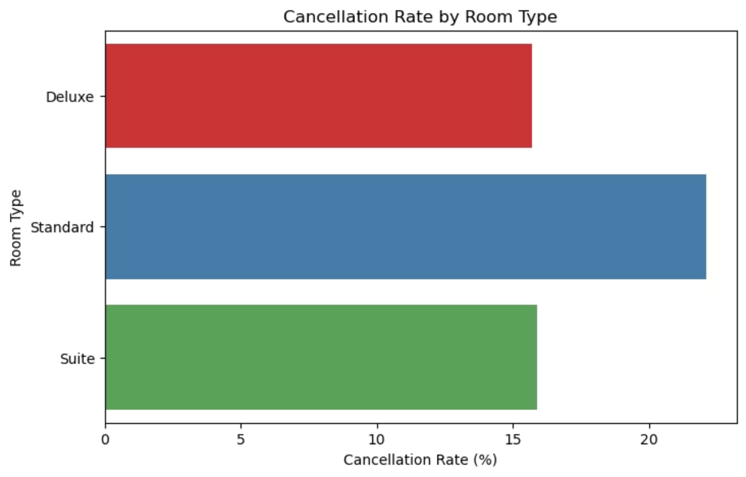
ROOM TYPE
Cancellation Rates by Room Type
Price and room category affect cancellations. Budget rooms see more cancellations, whereas premium rooms are more reliably booked, highlighting cautious behavior among budget-conscious travelers.
Critical Insight
Standard rooms have a 22% cancellation rate, which is about 40% higher than Deluxe rooms (15.7%). This indicates guests booking premium rooms are more committed towards their travel plan.

Slide 5
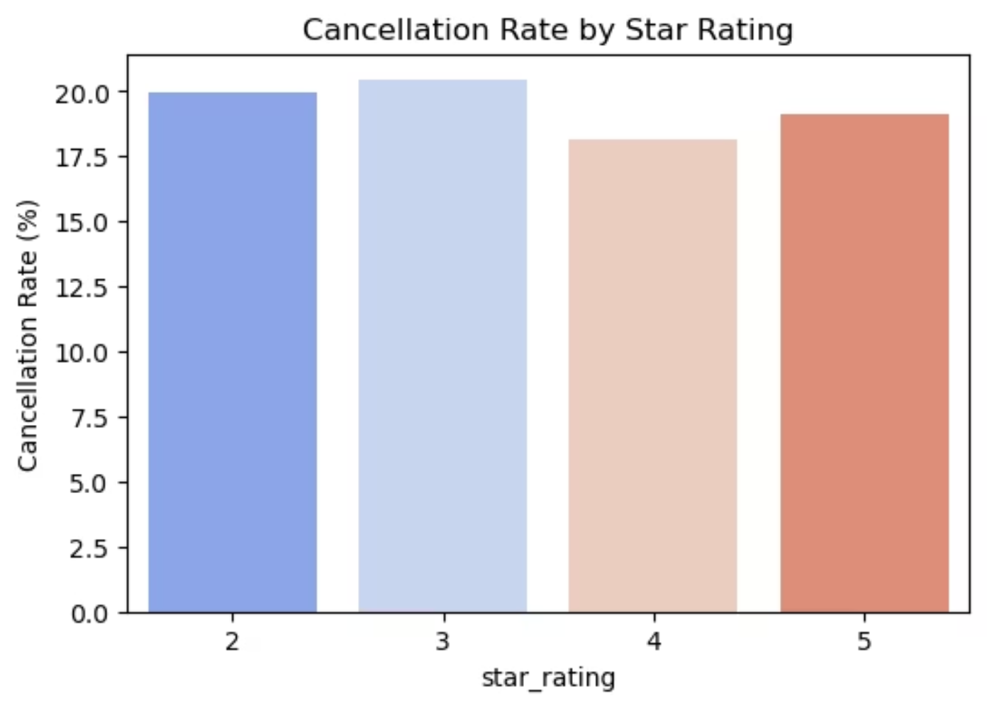
Cancellation Rate by hotels Star ratings
2-Star Hotels
3-Star Hotels
4-Star Hotels
5-Star Hotels
19.9% cancellation rate
20.4% cancellation rate
18.1% cancellation rate
19.1% cancellation rate
Indicating moderate cancellations for budget properties
Highest cancellation rate among all categories
Premium rooms shows strongest commitment
Luxury properties show stable and dependable booking patterns.
3-star properties have slightly higher cancellation rates compared to both budget and premium segments. In contrast, 4-star hotels show the strongest booking commitment at 18.1%, reflecting an optimal balance of value and quality that encourages guest reliability.

Slide 6
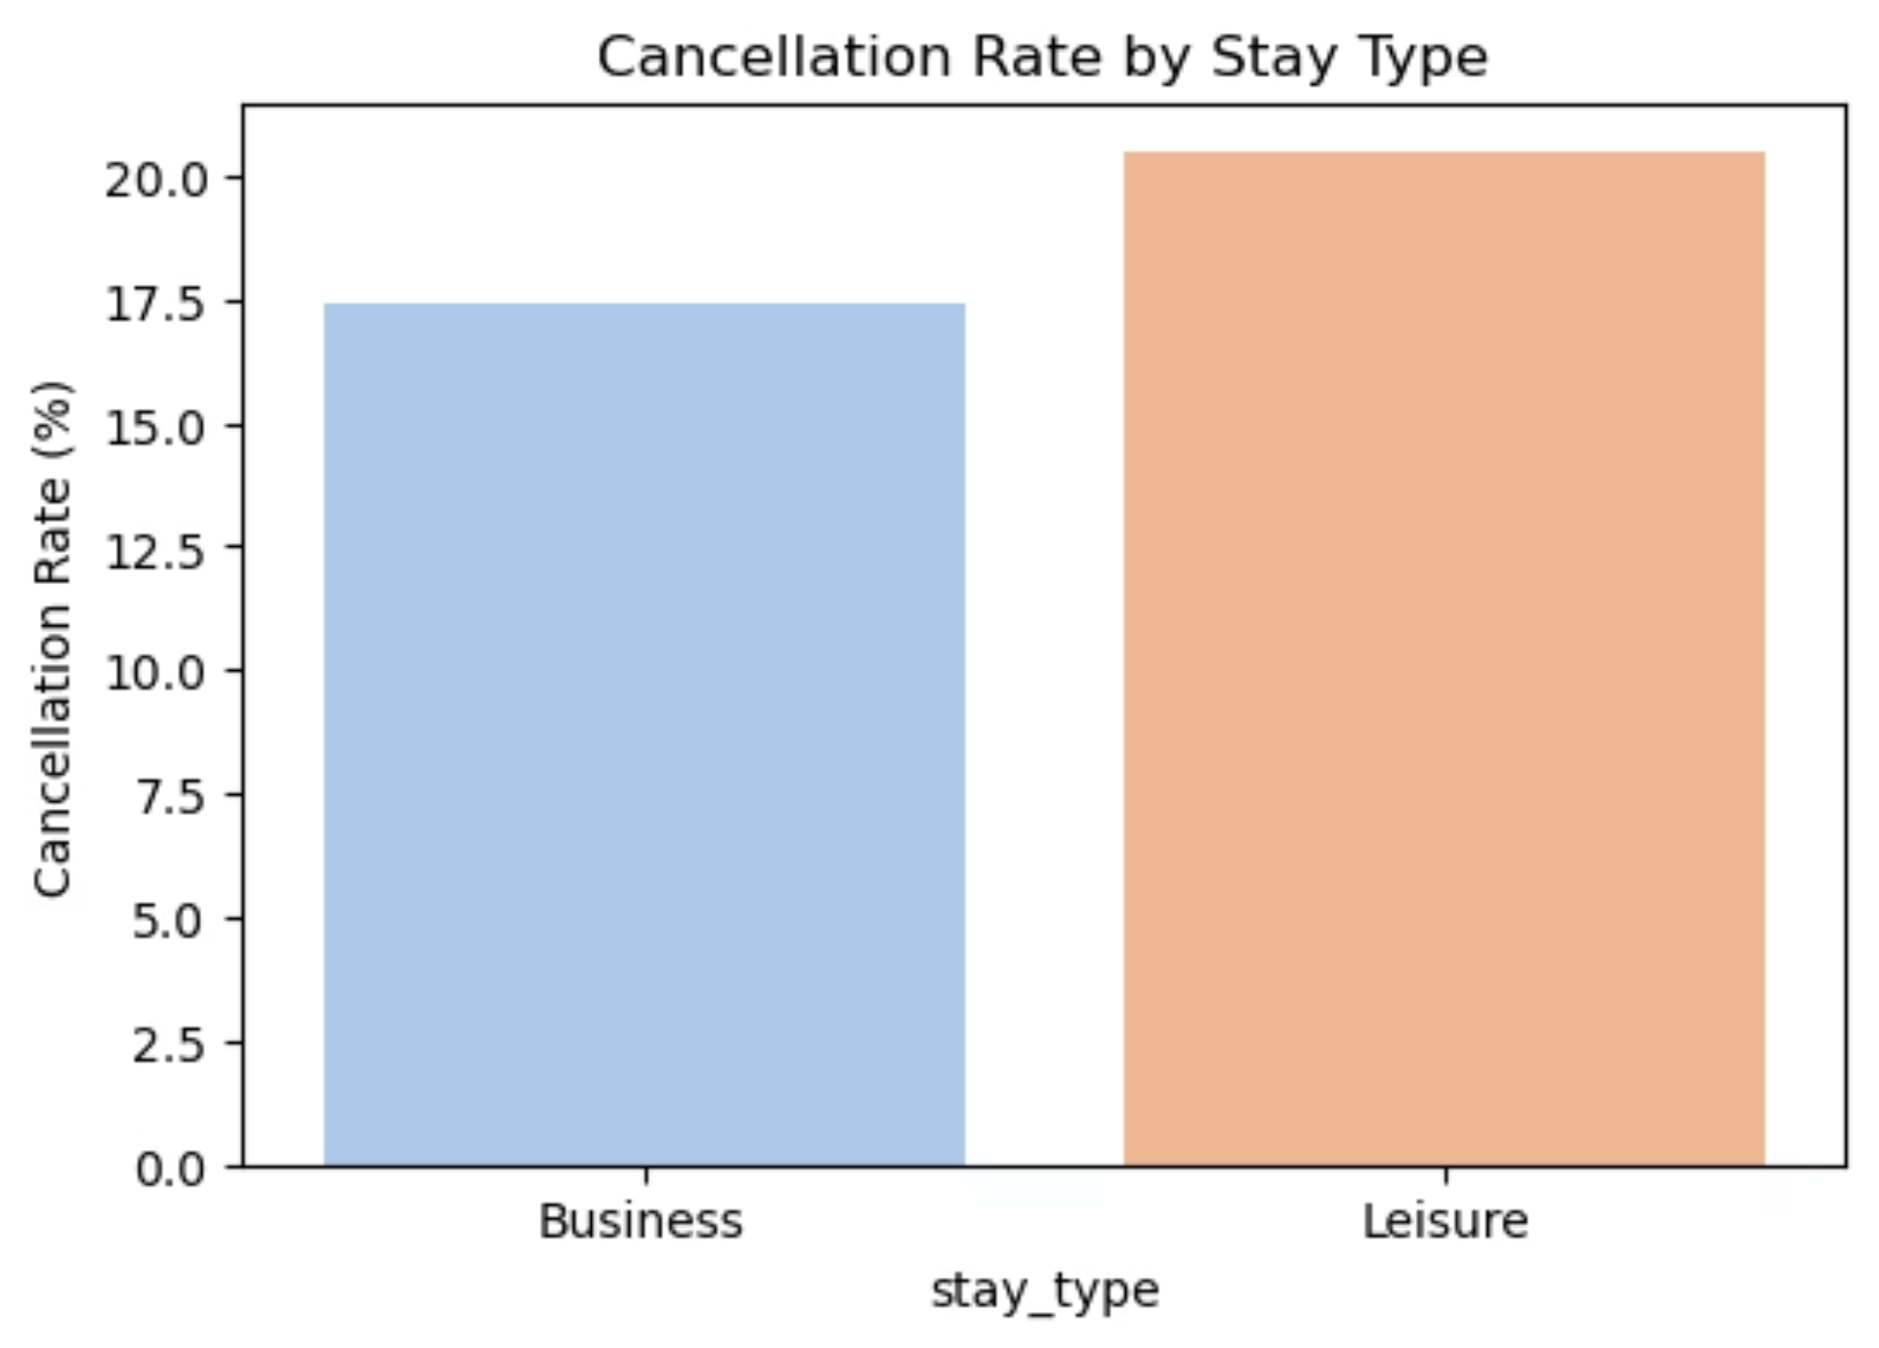
TRAVEL PURPOSE
Business vs Leisure Travel Patterns
Stay Type Analysis
The type of stay has a strong impact on booking behavior and cancellation rates.
Key Takeaway
Leisure travelers have a cancellation rate of 20.5%, about 18% higher than business travelers at 17.4%. This reflects the flexible nature of vacations compared to the fixed commitments of business travel.

Slide 7
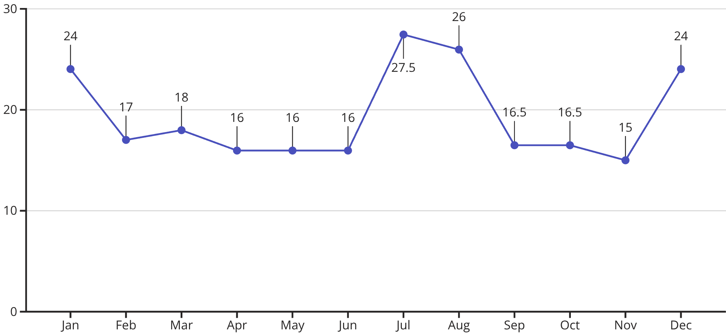
SEASONAL TRENDS
Monthly Cancellation Trend Throughout the Year
Cancellations vary by season, peaking during holidays and vacation months. Recognizing these patterns helps manage inventory and plan retention strategies for sustained growth.
Peak Cancellation Periods
Most Stable Periods
July-August (summer vacation) and December (year-end holidays) show cancellation rates exceeding 24%, nearly 80% higher than the most stable months.
May, June, and November represent the most reliable booking period with cancellation rates around 15-16%, ideal for revenue forecasting.

Slide 8
Root Cause Analysis:
To reduce cancellations and improve booking reliability, it’s important to understand the factors driving them.
01
02
Standard Room Risk
Mobile Platform Behavior
Standard rooms experience higher cancellations because they attract price-sensitive leisure travelers with flexible travel plans and a tendency to shop for better deals.
The higher cancellation rates for iOS bookings highlight the quick, convenience-oriented behavior of mobile users
03
04
Leisure Travel Flexibility
Seasonal Holiday
Cancellations are higher for vacation bookings, as leisure travelers adjust plans based on their personal circumstances, budget, or any other better rates.
Summer and Year-end holidays see the highest cancellation because of the complex planning and commitments of the customers

Slide 9



STRATEGY
Business Recommendations for Revenue Optimization
Reduce Cancellations
Increase Profitability
Optimize Channels
Flexible rescheduling lets guests change their dates easily to avoid cancelling.
Encourage guests to choose Deluxe or Suite rooms by highlighting extra value.
Give special deals on the website to attract users.
Offer rewards and incentives for bookings made through the mobile app.
Give discounts for booking that are paid in advance and cant be refunded.
Reward guests who book reliably with tiered benefits through programs.
Use dynamic pricing and early-bird offers to boost bookings.
send automatic remainders during busy months to remind customers of their bookings.
Partner with companies to get steady business bookings.
Test booking flows to make them easier and reduce cancellations.
Offer packages (like room + breakfast) to increase value and commitment.
charge a small fee for last-minute cancellation to discourage them

Slide 10
Key Takeaways & Action Plan
1
19.3% Cancellation Rate Represents Revenue Risk
Nearly one in five bookings are cancelled, representing significant lost revenue and inventory management challenges that require immediate strategic attention.
2
High-Risk Segments Clearly Identified
Standard rooms, leisure travelers, and mobile app users cancel most often. Targeting these groups can have the biggest impact.
3
Seasonal Patterns help planning
Cancellations peak in July–August and December. Policies, pricing, and overbooking can be adjusted ahead of time.
4
Strategic Actions Drive Results
Loyalty programs, better channel strategies, and dynamic pricing can reduce cancellations and increase booking value and guest loyalty.

