Slide 1
AUTONOMOUS CHOKE CONTROLLER FOR AN OIL WELL
Problem Statement ID: SIH1747
Problem Statement Title: Autonomous Choke Control for a Single Naturally Flowing Oil Well
Theme: Smart Automation & Energy Systems
PS Category: Software / Algorithm
Student Name: Gaurav Jain (Registered on portal)
Student ID: 23BAI10053

Slide 2
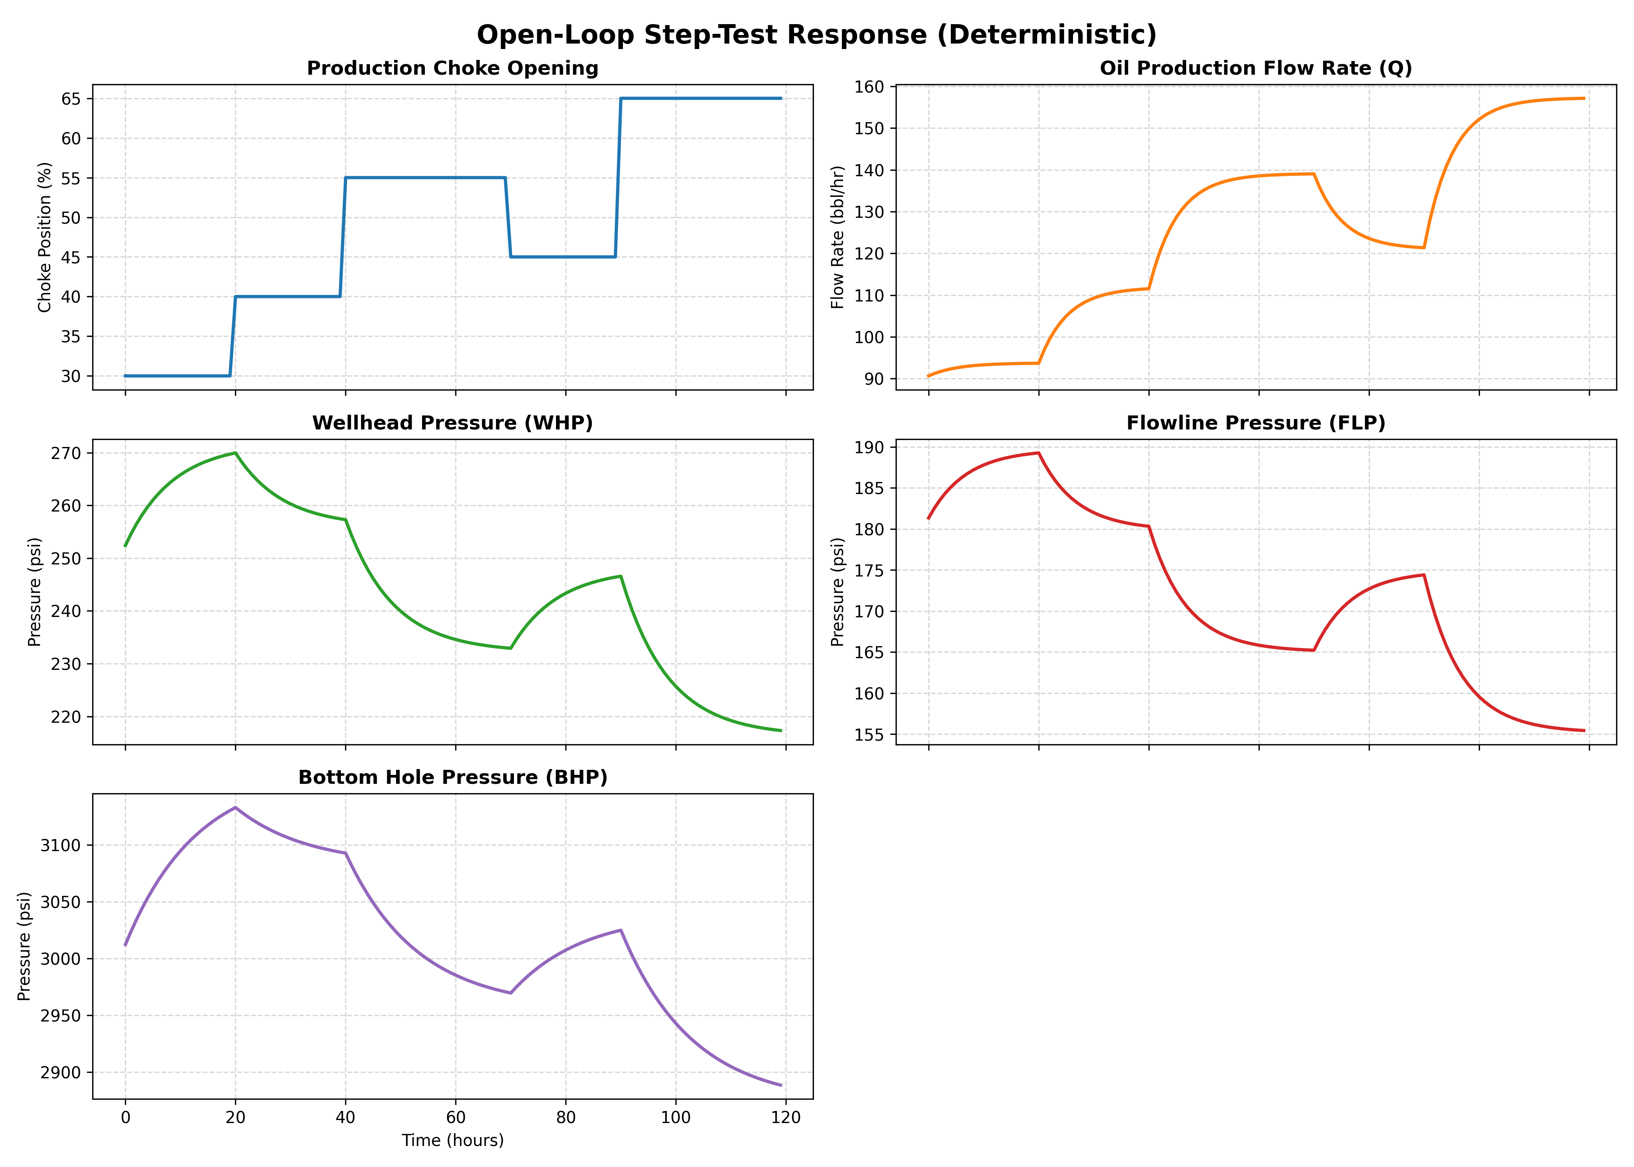
PROPOSED SOLUTION
AI-Driven Autonomous Choke Control
• Concept: Develops an Autonomous Production Choke Controller that automatically regulates choke opening (%) to track target production rates.
• Safe Operating Envelope: Prevents violations of key pressure constraints: Wellhead Pressure (WHP >= 220 psi), Flowline Pressure (FLP >= 150 psi), and Bottom Hole Pressure (BHP >= 2900 psi).
• Control Algorithm: Implements Model Predictive Control (MPC) using a candidate-evaluation approach (brute-force evaluation of 101 candidates per step).
• Long Horizon: Uses a 30-hour prediction horizon to anticipate slow BHP dynamics (tau ~ 13.5h), rejecting choke moves that cause future pressure violations.
• Steady-State Optimality: If the target is infeasible, it automatically settles on the boundary of the safe operating envelope, maximizing safe production.

Slide 3
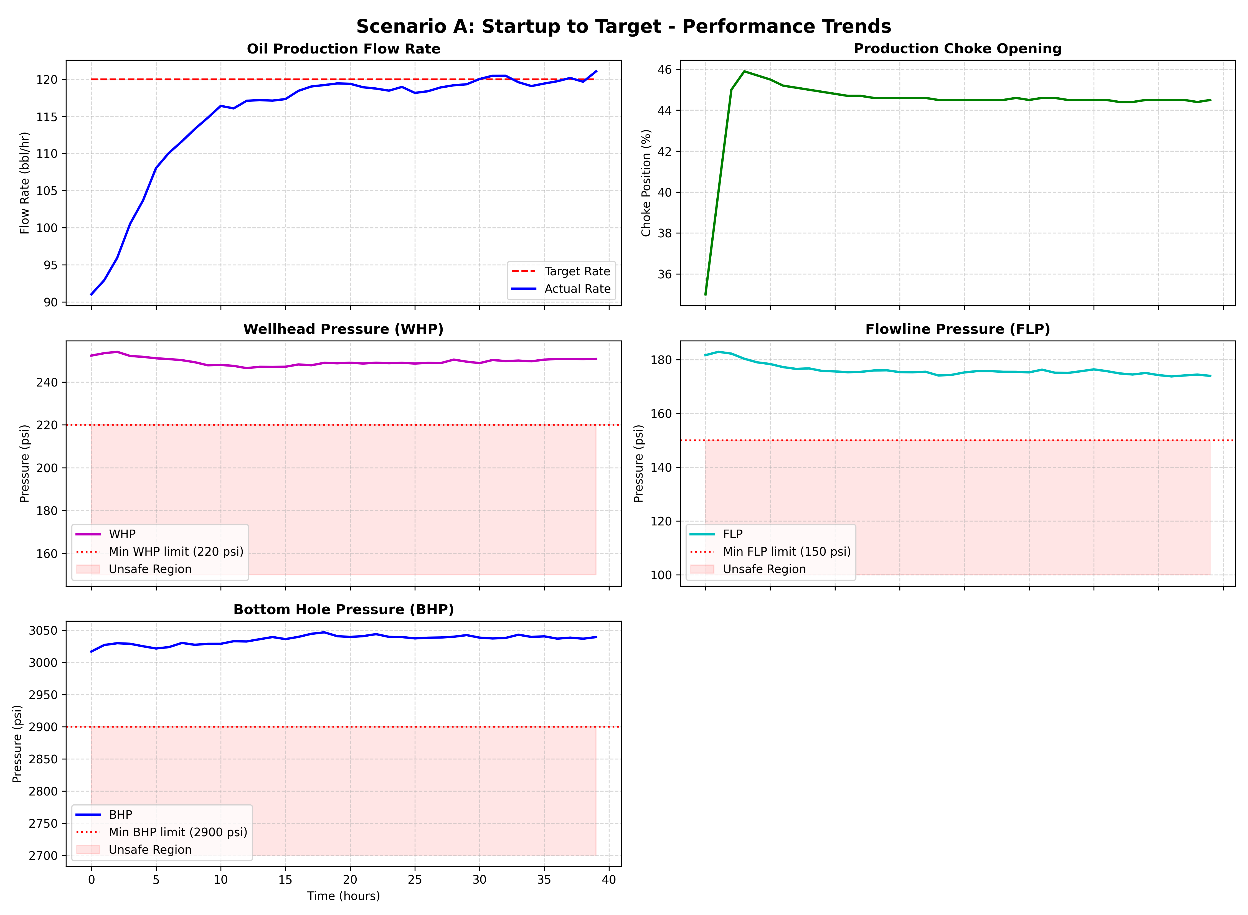
TECHNICAL APPROACH & DYNAMIC MODEL
System Modeling & Optimization
• System Modeling: Process dynamics are identified as decoupled first-order Autoregressive with Exogenous input (ARX) models from open-loop step test data:
- Oil Rate Q(t) = 0.8237*Q(t-1) + 0.3201*u(t-1) + 6.932 (Gain: +1.815 bbl/hr/%)
- WHP(t) = 0.8892*WHP(t-1) - 0.1756*u(t-1) + 35.376 (Gain: -1.586 psi/%)
- FLP(t) = 0.8625*FLP(t-1) - 0.1356*u(t-1) + 30.143 (Gain: -0.986 psi/%)
- BHP(t) = 0.9257*BHP(t-1) - 0.6225*u(t-1) + 253.761 (Gain: -8.383 psi/%)
• Choke Constraints: Max ramp rate of +/- 5% choke opening per hour is strictly enforced by the candidate set boundaries.
• Cost Optimization: Evaluates 101 choke trajectories and optimizes tracking error while penalizing constraint violations by a factor of 1e6.

Slide 4
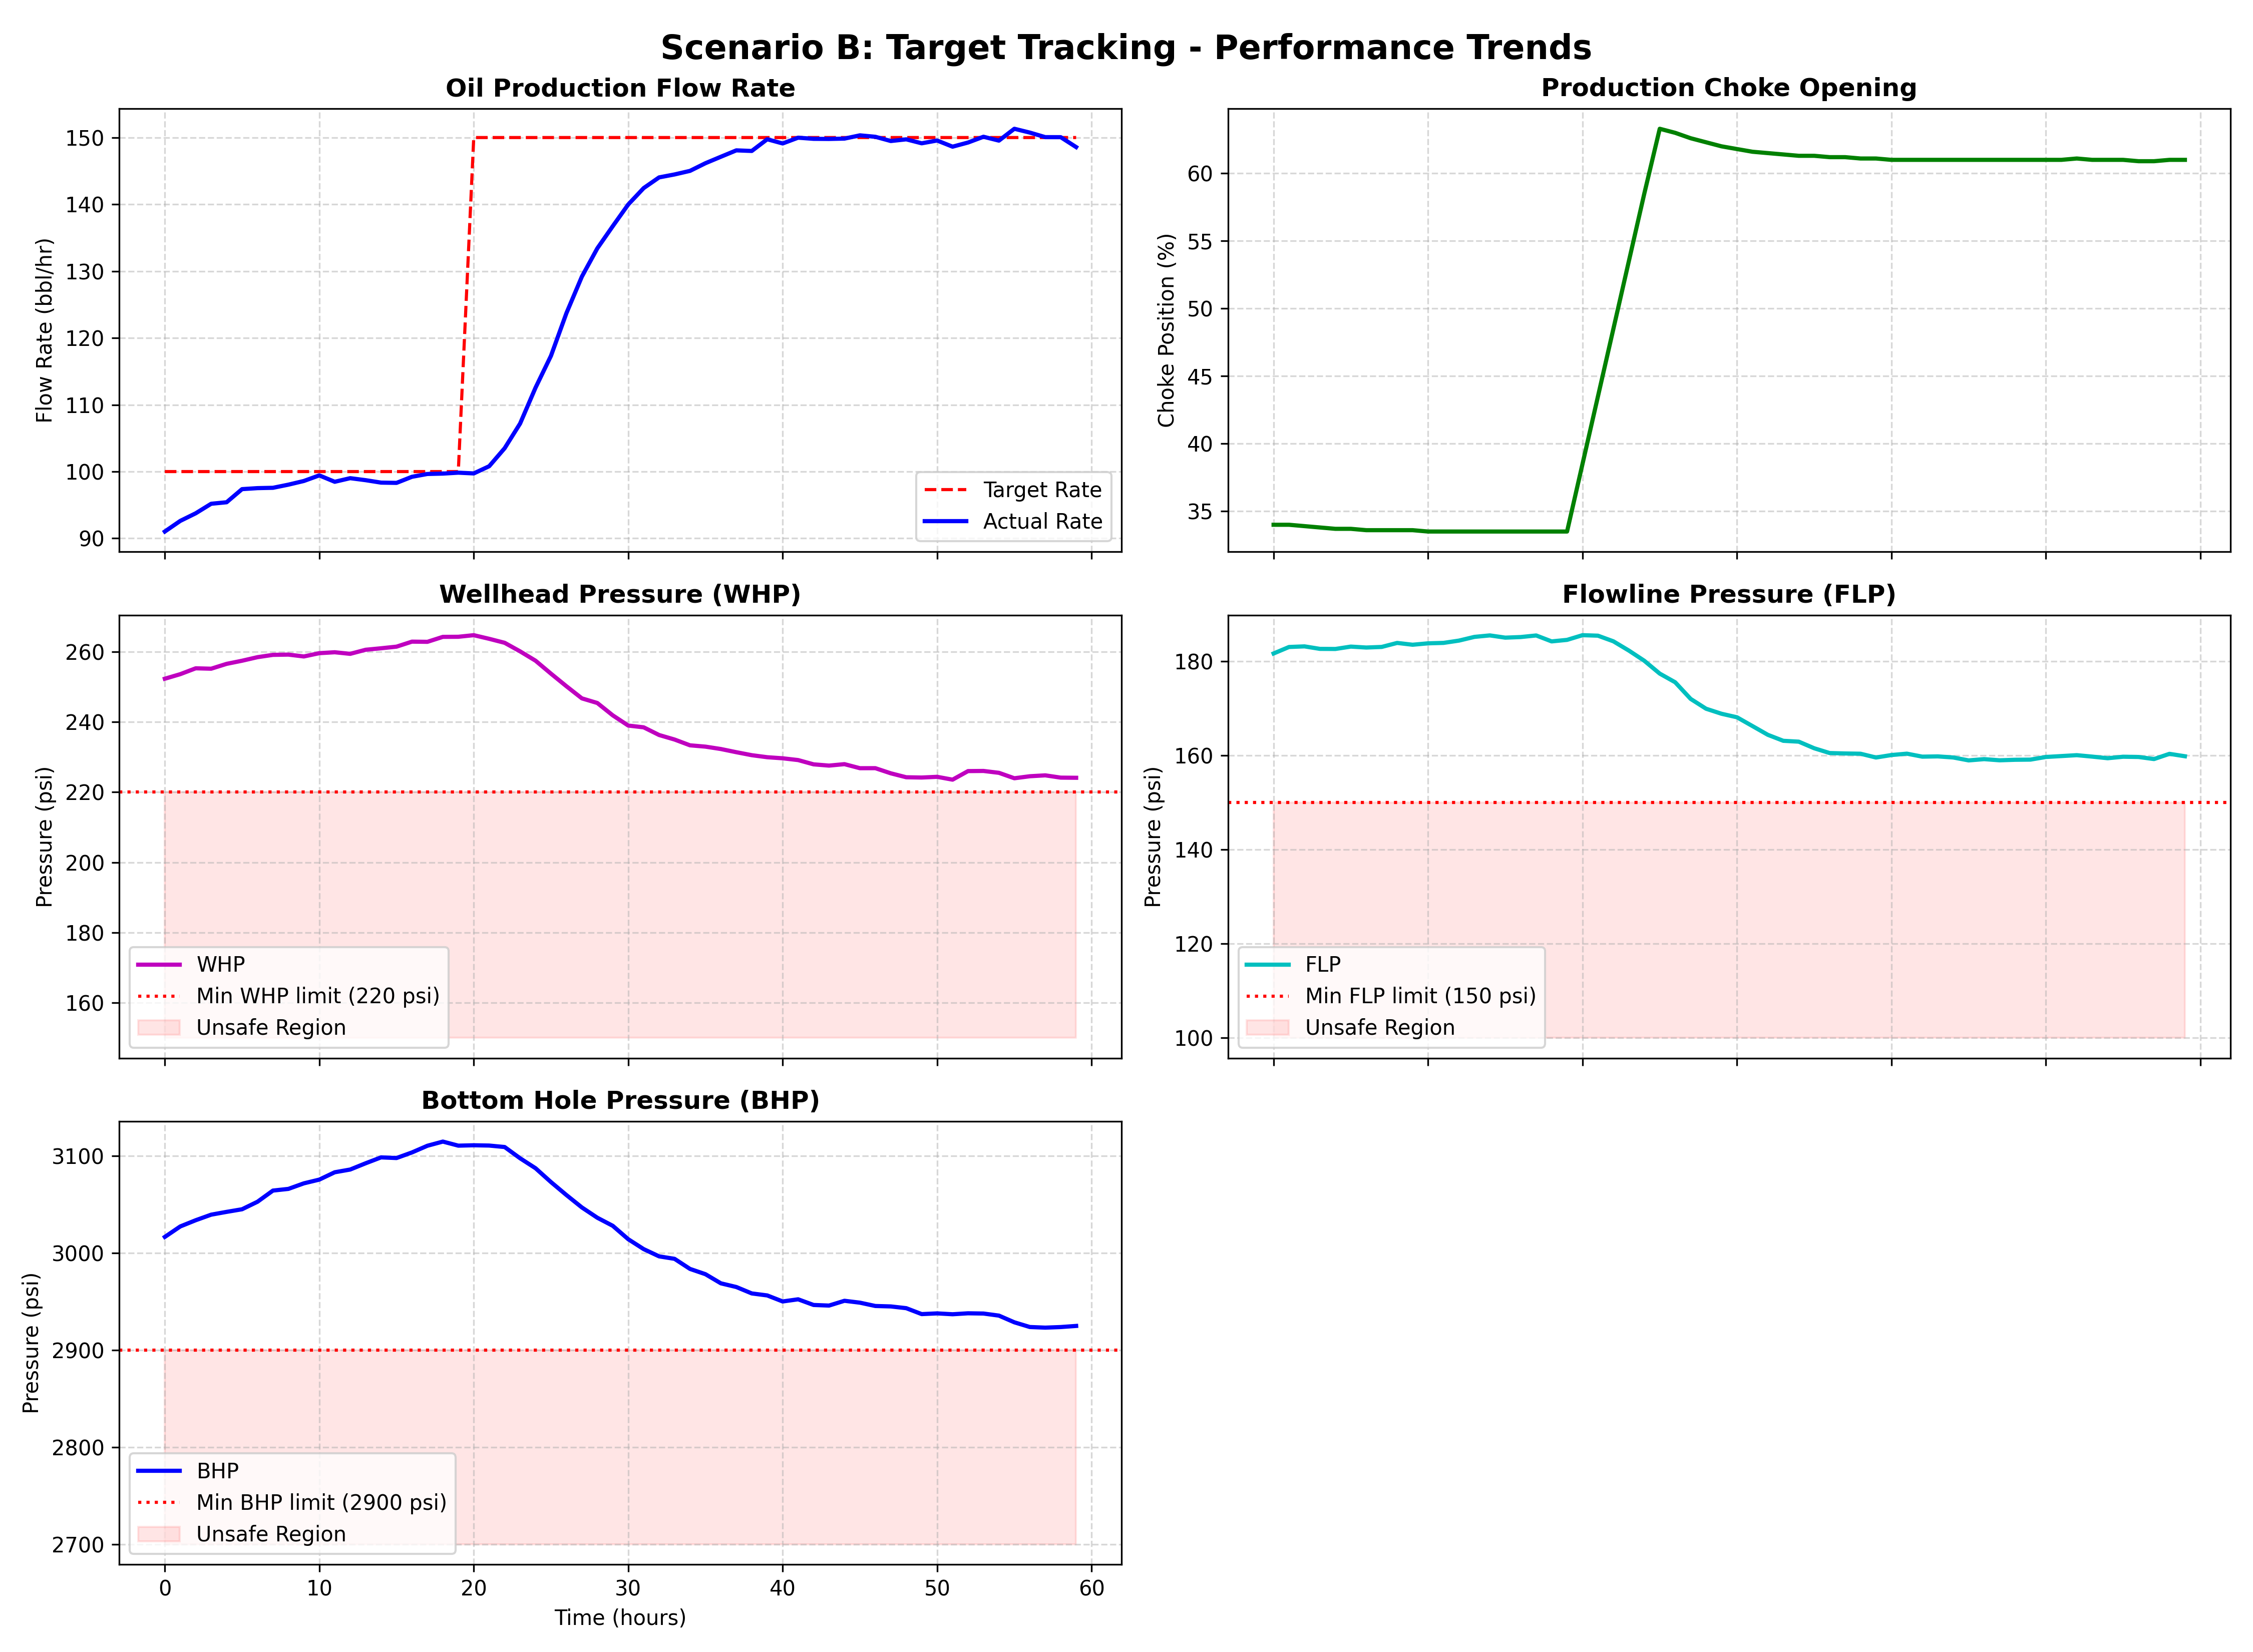
FEASIBILITY, VIABILITY & SAFETY
Safety Envelope & Feasibility Analysis
• Low Computational Cost: Evaluating 101 candidate trajectories takes < 10 ms on standard industrial edge compute modules (e.g. Raspberry Pi, Siemens IOT2050, or DCS). No optimization solver library is required.
• Process Safety Envelope: Safety constraints are verified over the prediction horizon Hp = 30h. Unsafe choke openings are blocked.
• Process Noise Tolerance: Uses deterministic ARX equations for predictive models while successfully handling process noise (Q_sigma = 0.73, BHP_sigma = 2.91) in actual operations.
• Economic Value: Maximizes production by safely tracking target rate, or backing off to maximum safe rate when targets are infeasible.

Slide 5
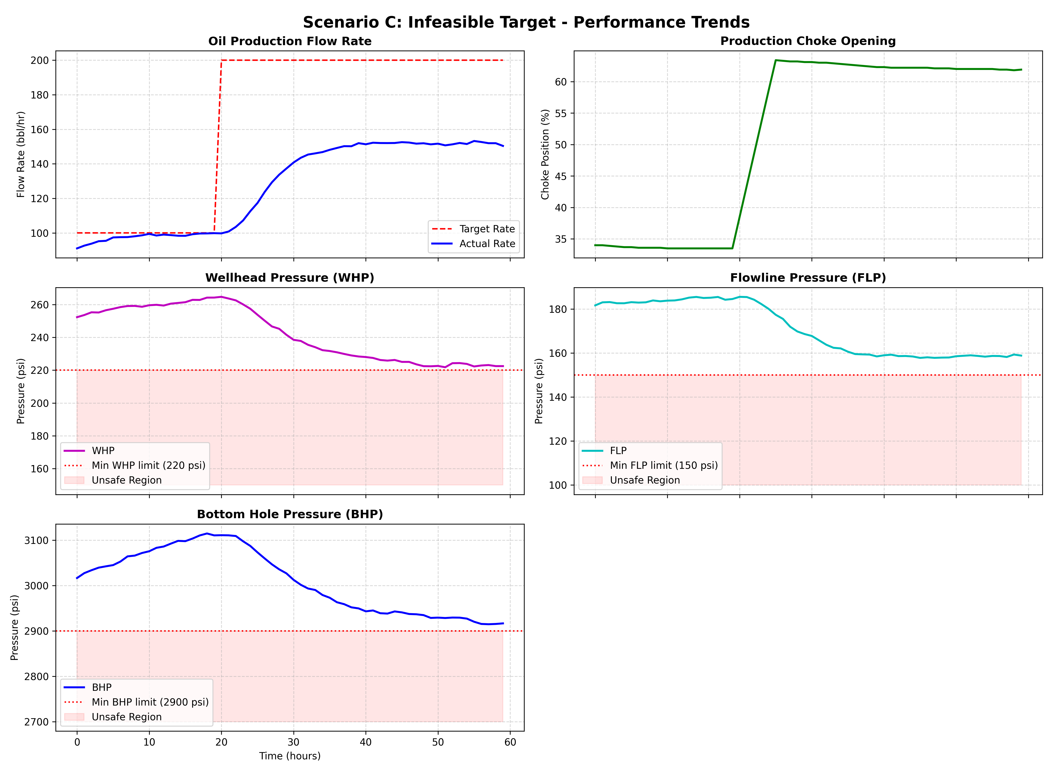
SIMULATION RESULTS & ARTIFACTS
Demonstrated Performance in Control Scenarios
• Scenario A (Startup): Ramps choke at max 5%/hr, smoothly reaching 120 bbl/hr target with zero violations.
• Scenario B (Tracking): Setpoint steps to 150 bbl/hr. Controller regulates choke to 60.9% and tracks rate smoothly. Pressures remain safe (BHP = 2931 psi).
• Scenario C (Infeasible Target = 200 bbl/hr): Caps choke opening at 61.9% to maintain BHP >= 2900 psi limit, settling at maximum safe flow rate of 151.7 bbl/hr.
• Candidate Search Logging: Logs 101 candidate evaluations per hour showing Safe vs. Rejected moves (e.g., 'Evaluated: 101 | Safe: 51 | Rejected: 50') with physical rejection reasons.
• Summary Analytics: Terminal prints a clear summary block detailing requested rate (200 bbl/hr), maximum safe production (151.7 bbl/hr), active limits (BHP, WHP), and safe boundary settlement.
• DCS Streamlit Dashboard: Operates as a live operator screen supporting custom setpoints, horizon adjustments, constraint limits, and real-time trend plots.

Slide 6
RESEARCH & REFERENCES
Academic & Industrial References
[1] Camacho, E. F. and Alba, C. B. 'Model Predictive Control', 2nd Edition, Springer-Verlag, 2013. URL: https://link.springer.com/book/10.1007/978-3-642-18189-4
[2] Economides, M. J., Hill, A. D. and Ehlig-Economides, C. 'Petroleum Production Systems', Prentice Hall, 2012. URL: https://www.pearson.com/en-us/subject-catalog/p/petroleum-production-systems/P200000003290
[3] Golan, M. and Whitson, C. H. 'Well Performance', 2nd Edition, Prentice Hall, 1991. URL: https://www.onepetro.org/books/SPE/Well-Performance
[4] Foss, B., Grimstad, B., Shakerian, M. and Sureshkumar, K. 'Control structure design for oil fields - a case study', Journal of Process Control, Vol. 68, pp. 112-124, 2018. URL: https://doi.org/10.1016/j.jprocont.2018.05.006
[5] Shinskey, F. G. 'Process Control Systems: Application, Design, and Adjustment', McGraw-Hill, 1996. URL: https://www.accessengineeringlibrary.com/content/book/9780070571013

