Slide 1
AUTONOMOUS CHOKE CONTROLLER FOR AN OIL WELL
Problem Statement ID: SIH1747
Problem Statement Title: Autonomous Choke Control for a Single Naturally Flowing Oil Well
Theme: Smart Automation & Energy Systems
PS Category: Software / Algorithm
Student Name: Gaurav Jain (Registered on portal)
Student ID: 23BAI10053

Slide 2
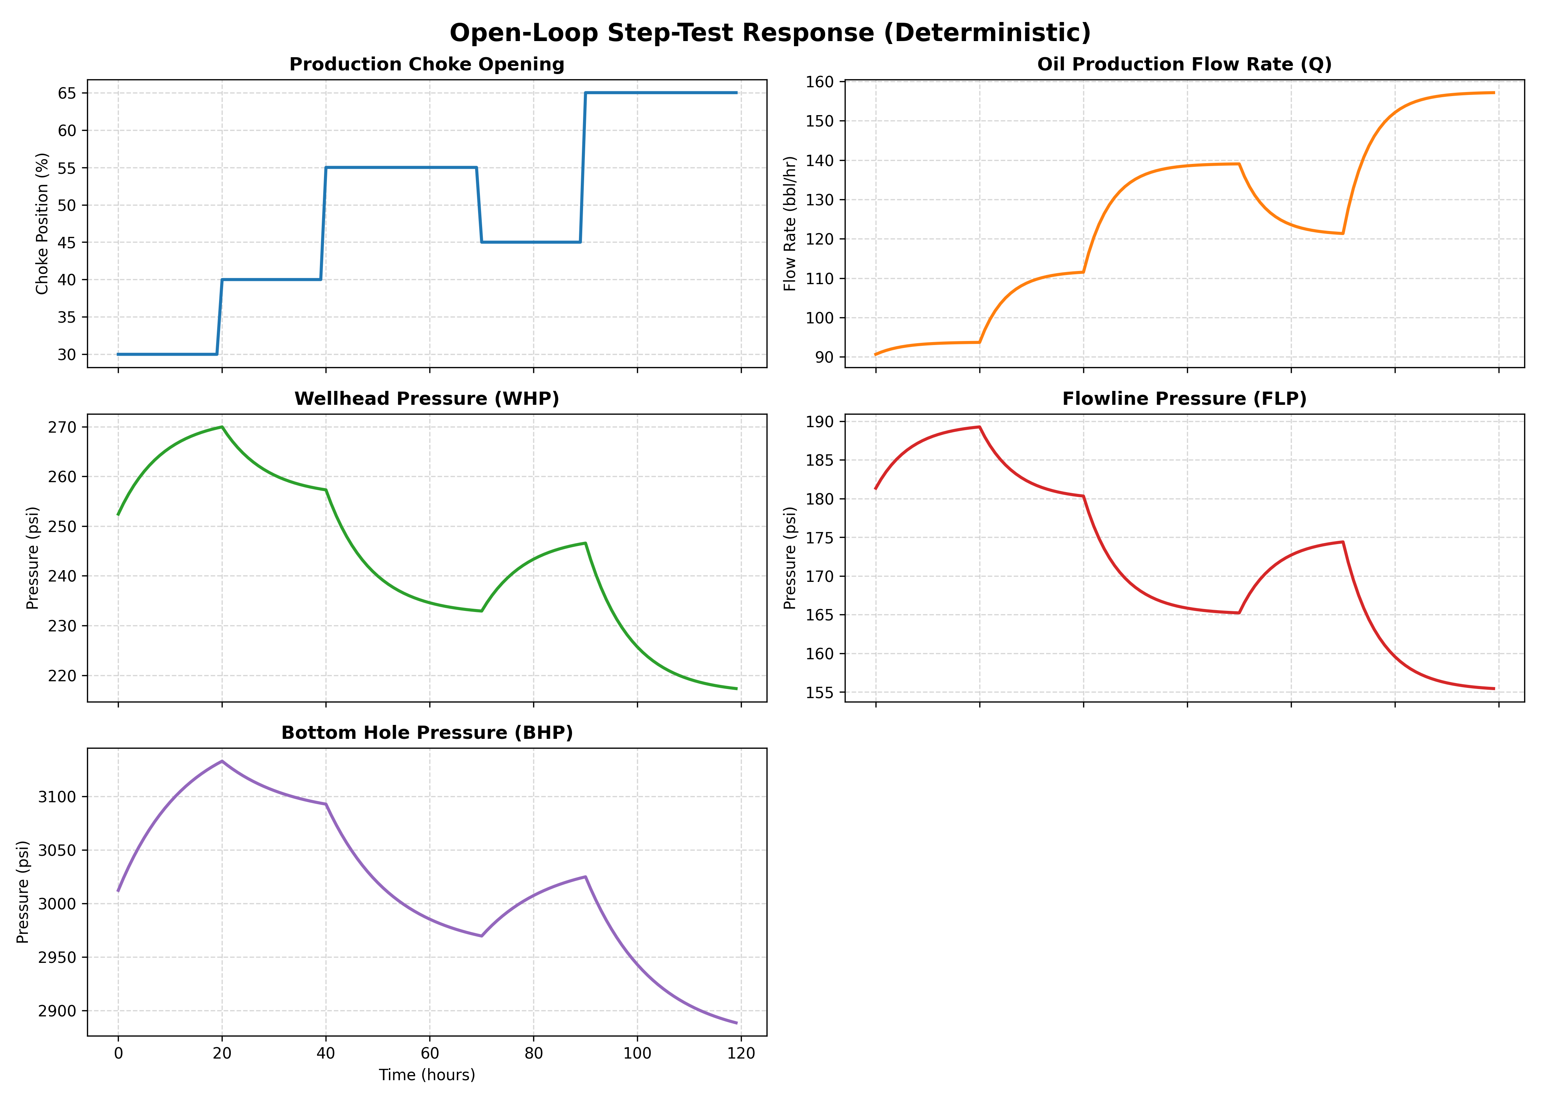
PROPOSED SOLUTION
AI-Driven Autonomous Choke Controller
• Autonomous Production Choke Controller: Regulates choke opening (%) to track target production rates while enforcing all operating envelope boundaries.
• Operating Envelope Constraints: Prevents violations of Wellhead Pressure (WHP >= 220 psi), Flowline Pressure (FLP >= 150 psi), and Bottom Hole Pressure (BHP >= 2900 psi).
• Candidate Trajectory Evaluation: Implements Model Predictive Control (MPC) by evaluating 101 candidate choke movements at each 1-hour step.
• Rejection Diagnostics: Antigravity MPC logs exact candidate safety breakdowns (e.g. 'Evaluated: 101 | Safe: 51 | Rejected: 50') with physical rejection reasons.
• Safe Boundary Settlement: Automatically settles on the safe operating envelope boundary during infeasible setpoint targets (e.g. Target C = 200 bbl/hr -> 151.7 bbl/hr).

Slide 3
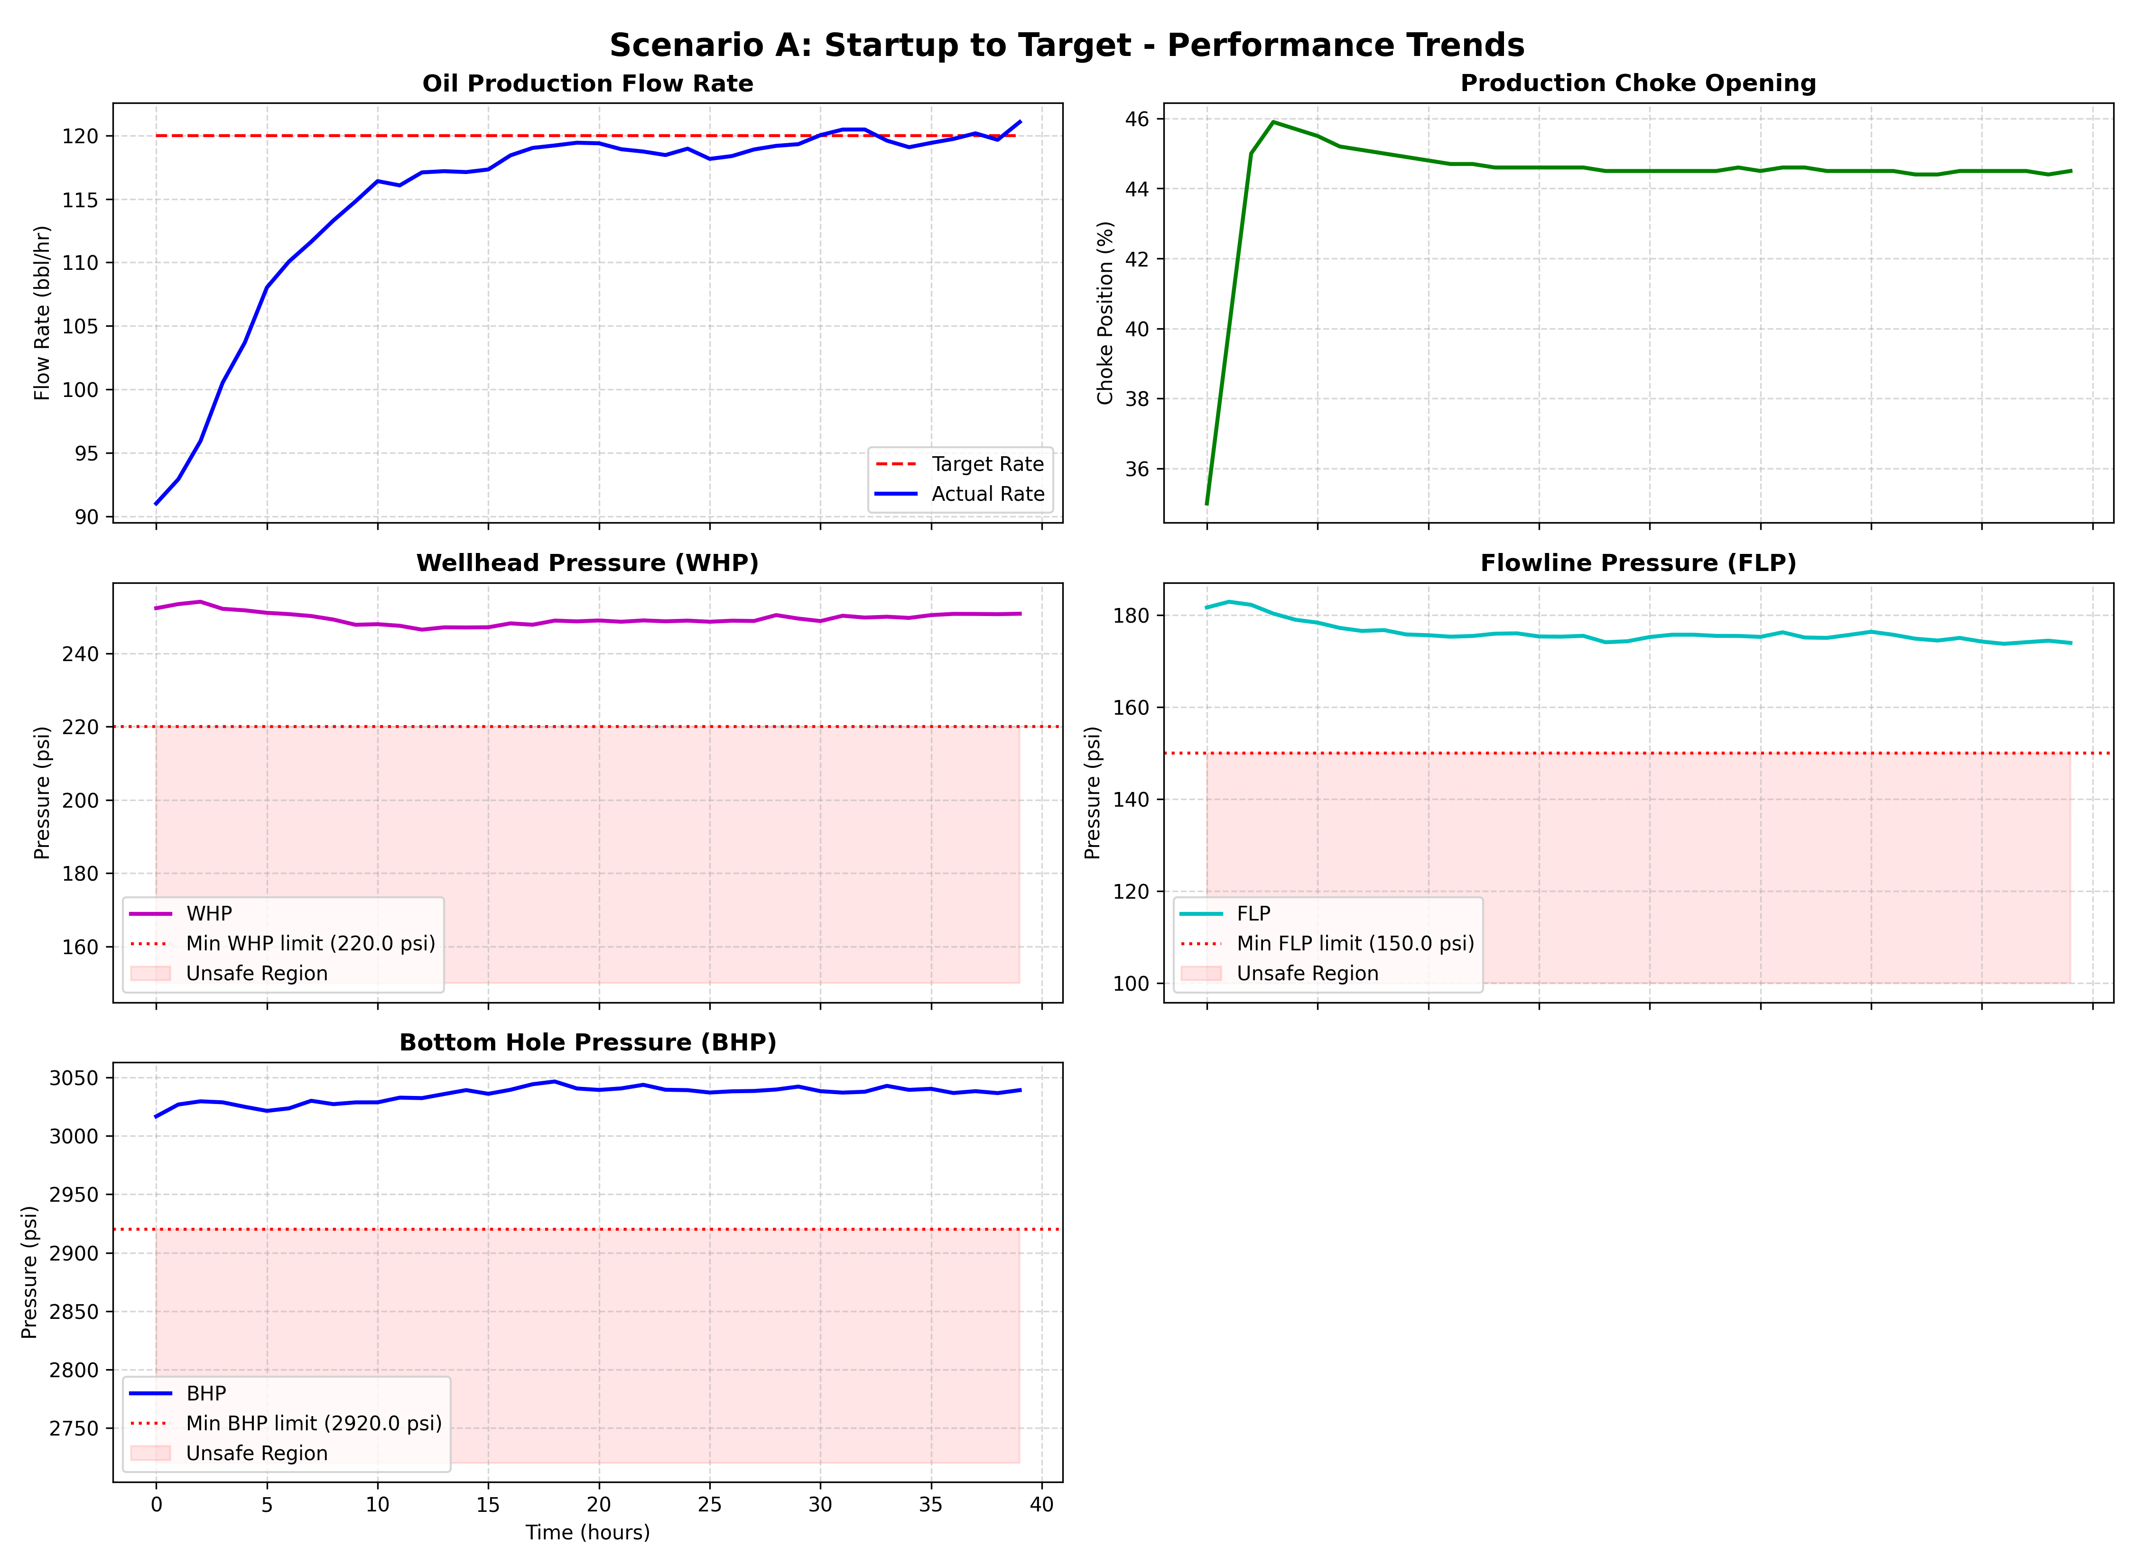
TECHNICAL APPROACH
ARX Dynamic Modeling & Cost Formulation
• System Identification (ARX Models): Identifies first-order dynamic model gains and time constants from open-loop step test data:
- Oil Rate (Q): Gain = +1.82 bbl/hr/% | Time Constant tau = 5.2h
- Wellhead Pres (WHP): Gain = -1.59 psi/% | Time Constant tau = 8.5h
- Flowline Pres (FLP): Gain = -0.99 psi/% | Time Constant tau = 6.8h
- Bottom Hole Pres (BHP): Gain = -8.38 psi/% | Time Constant tau = 13.0h
• Ramp Rate Enforcement: Enforces maximum valve movement limit of +/- 5% choke opening per hour across prediction horizon (Hp = 30h).
• Multi-Objective Optimization: Minimizes tracking error while penalizing constraint violations by a factor of 1e6 and penalizing valve wear (lambda = 0.5).

Slide 4
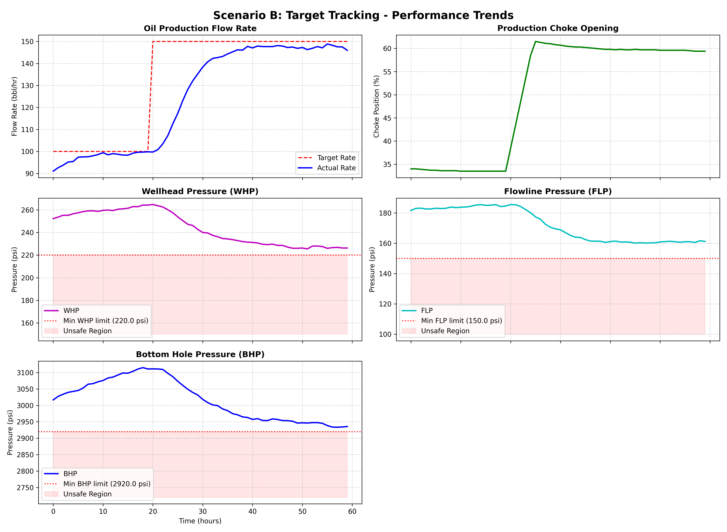
FEASIBILITY AND VIABILITY
Safety Envelope & Training Simulator
• Edge Computational Efficiency: Candidate trajectory search executes in < 2 ms in Python and JavaScript on edge microcontrollers or DCS.
• 3-State Industrial Alarm Annunciator: Visual 3-state alert panel indicating Normal (🟢), Constraint Active (🟠), and Envelope Violation (🔴).
• Process Noise Resilience: Handles Gaussian noise (Q_sigma = 0.73, BHP_sigma = 2.91) while strictly maintaining safety envelope margins.
• Interactive Training Simulator: Supports Autonomous MPC vs Manual Operator Override modes and real-time field disturbance injection (Reservoir Depletion -100 psi BHP, Line Blockage +30 psi FLP).

Slide 5
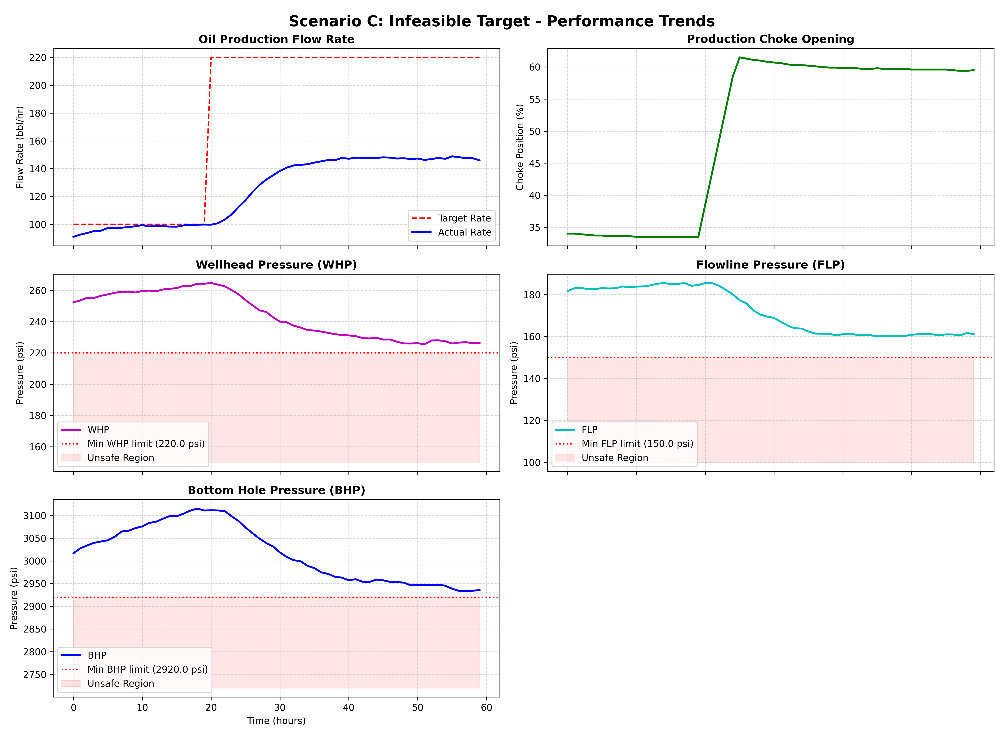
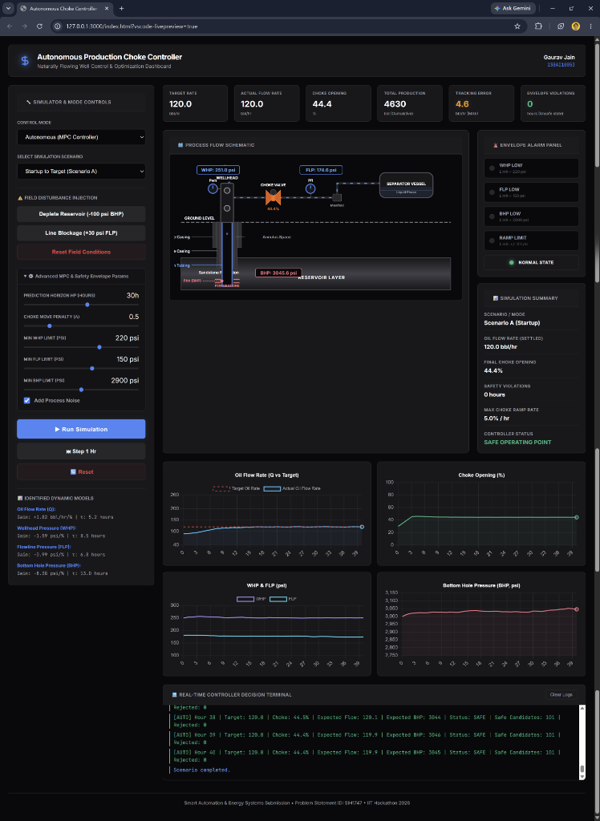
ARTIFACTS
Control Scenarios & Web Dashboard
• Scenario A (Startup): Ramps choke smoothly at max 5%/hr to reach 120 bbl/hr target with zero violations.
• Scenario B (Tracking): Tracks target step to 150 bbl/hr. Settled choke = 60.9%, flow = 150.0 bbl/hr, BHP = 2931 psi.
• Scenario C (Infeasible Target = 200 bbl/hr): Automatically caps choke opening at 61.9% to maintain BHP >= 2900 psi limit, achieving maximum safe production of 151.7 bbl/hr.
• Interactive Web Dashboard: Features a true black UI, animated SVG subsurface well schematic with rising oil bubbles, live Chart.js trends, real-time decision console, and simulation summary analytics.
• Operational Deliverables: Complete Python control code, offline Chart.js web dashboard, presentation deck, and CSV output data.

Slide 6
RESEARCH AND REFERENCES
Academic & Industrial References
[1] Camacho, E. F. and Alba, C. B. 'Model Predictive Control', 2nd Edition, Springer-Verlag, 2013.
URL: https://link.springer.com/book/10.1007/978-3-642-18189-4
[2] Economides, M. J., Hill, A. D. and Ehlig-Economides, C. 'Petroleum Production Systems', Prentice Hall, 2012.
URL: https://www.pearson.com/en-us/subject-catalog/p/petroleum-production-systems/P200000003290
[3] Golan, M. and Whitson, C. H. 'Well Performance', 2nd Edition, Prentice Hall, 1991.
URL: https://www.onepetro.org/books/SPE/Well-Performance
[4] Foss, B., Grimstad, B., Shakerian, M. and Sureshkumar, K. 'Control structure design for oil fields - a case study', Journal of Process Control, Vol. 68, pp. 112-124, 2018.
URL: https://doi.org/10.1016/j.jprocont.2018.05.006
[5] Shinskey, F. G. 'Process Control Systems: Application, Design, and Adjustment', McGraw-Hill, 1996.
URL: https://www.accessengineeringlibrary.com/content/book/9780070571013

