Slide 1
Registration Number- 19BCE2119
Name- Gaurav Kumar Singh
Course- CSE2005 Operating Systems Component (EPJ) L7+L8

Slide 2
An improved context switching algorithm for a Round Robin (RR) with Dynamic Time Quantum Assignment.
TITLE

Slide 3
Abstract
Process Management is considered a very important function of any OS as it is the backbone of the system. There are several kinds of scheduling algorithms to perform the given task each of which have their own pros and cons. Round Robin is among the most prominent scheduling algorithms. Round Robin schedulers preempt the task based on a specific time quantum and switches to next task and run it for the same time quantum and repeat this process until no tasks are left in the ready queue. The performance and efficiency of a Round Robin scheduler is heavily dependent upon one’s choice of the time quantum. If time quantum is too high, the scheduler tends to morph into a First in First Out scheduler while if it is too small, it causes a lot of context switches wasting a lot of time performing unnecessary task. This project revolves around how to dynamically pick an appropriate time quantum for one cycle and at the same time prevent context switching for tasks that use a very small portion of time quantum otherwise.

Slide 4
Literature Review
1) Tithi Paul Rahat Hossain Faisal Md. Samsuddoha (September 2019).
IMPROVED ROUND ROBIN SCHEDULING ALGORITHM WITH PROGRESSIVE TIME QUANTUM
The authors of this research paper emphasize on the how time quantum of a Round Robin Scheduler affects its performance and context switching time. They propose an algorithm where the time quantum is selected dynamically and numerous experiments have been conducted to prove its efficiency. The performance of an Round Robin Scheduler is heavily dependant upon the choice of Time Quantum selected. A very large TQ might mean the RR scheduler morphed into FCFS and when it becomes too small, the context switch skyrockets.
However this algorithm does not work where priority based scheduling is required and also the selection of time quantum by the system becomes obnoxious towards the end of the processes if the remaining burst times of the processes are very distinct after every cycle resulting in heavily compromised waiting times for some set of processes depending on type of processes.
2) Sohrawordi , Ehasn Ali , Palash Uddin and Mahabub Hossain (Feb 2019).
A MODIFIED ROUND ROBIN CPU SCHEDULING ALGORITHM WITH DYNAMIC TIME QUANTUM.
In This Research paper, the authors propose a Round Robin with Dynamic Time Quantum (RRDTQ) system for enhancing the CPU performance using dynamic time quantum assignment. In their proposed algorithm the burst time of all the processes in the ready queue are noted and the TQ’s value is assigned based on that average value. It reduces the number of context switches required however might not be the best if the burst times of all processes are very close to each other but not equal to mean.

Slide 5
3) Debashree Nayak, Sanjeev Kumar Malla, Debashree Debadarshini (January 2012).
IMPROVED ROUND ROBIN SCHEDULING USING DYNAMIC TIME QUANTUM
This Research paper also uses RRDTQ to reduce the number of context switches but instead of using mean to calculate TQ of a certain process, Median is used to calculate effective time quantum. This algorithm fails when the burst times of the processes does not follow any sort of consistent trend.
4) O. Oyetunji and E. Oluleye (August, 2009).
PERFORMANCE ASSESSMENT OF SOME CPU SCHEDULING ALGORITHMS.
In this report the authors compare various aspects of a CPU scheduling algorithms with each other, namely waiting time, turnaround time, CPU utilization, Throughput etc amongst FCFS, PS and SJF schedulers to find optimum scheduling algorithms for different kind of needs.
5) Abdulaziz A. Alsulami , Qasem Abu Al-Haija , Mohammed Thanoon , Qian Mao (April 2019). PERFORMANCE EVALUATION OF DYNAMIC ROUND ROBIN ALGORITHMS FOR CPU SCHEDULING
In this paper, the authors throw light upon different RR algorithms and their performance statistics such as RR with static time quantum, RR with Dynamic time quantum, RRDTQ using Manhattan distance(RRDTQ), Improved time quantum RR(static TQ RR), Adaptive RR and Best Time Quantum RR to give insight upon the pros and cons of each type of Round Robin Scheduler.
6) Sonia Zouaoui , Lotfi Boussaid , Abdellatif Mtibaa (February 2019). PRIORITY BASED ROUND ROBIN CPU SCHEDULING ALGORITHM (PBRR) CPU SCHEDULING ALGORITHM
In this paper the author present a priority based Round Robin system to avoid starvation of core system applications and priority based system management.

Slide 6
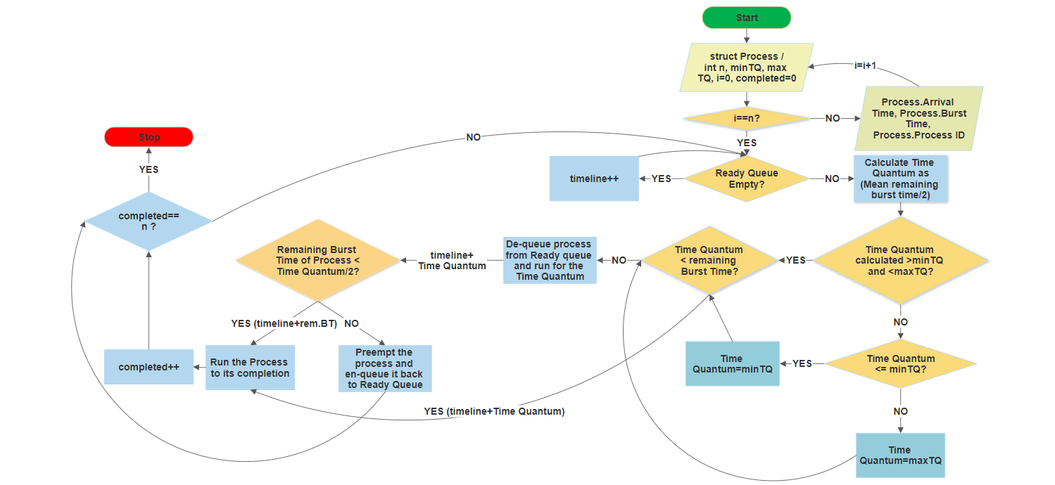
Details of Algorithm

Slide 7
T→Time Quantum for normal Round Robin *→Means Process Completion No. of Process=3 →P1,P2,P3
Process | Arrival Time (AT) | Burst Time (BT)
P1 | 0 | 2T
P2 | T/2 | T+dx
P3 | T | T

Slide 8
Normal Round Robin (TQ=T)
P1 Remaining BT=T | P2 Remaining BT=dx | P3* Remaining BT=0 | P1* Remaining BT=0 | P2* Remaining BT=0
0 T 2T 3T 4T 4T+dx
Number of context switches=4
Time wasted for switching tasks for a process with very small remaining Burst Time.

Slide 9
Round Robin extended Time quantum for small remaining BT (TQ=T)
P1 Remaining BT=T | P2 Remaining BT=dx | P2* Remaining BT=0 | P3* Remaining BT=0 | P1* Remaining BT=0
0 T 2T 2T+dx 3T+dx 4T+dx
No Context switch at time 2T.
Number of context switches=3
Time Saved by reducing context switches but approaching FCFS approach

Slide 10
RR with Dynamic Time Quantum (min TQ= T/2, max TQ=3T/2)
P1 Remaining BT=T | P2 Remaining BT=T/9 | P3 Remaining BT=11T/27 | P1 Remaining BT=T/6 | P2* Remaining BT=0 | P3* Remaining BT=0 | P1* Remaining BT=0
0 T 3T/2 2T 5T/2 3T+dx 7T/2+dx 4T+dx
Number of context switches=6
Potential for saving time used for context switching without having the algorithm approach FCFS.

Slide 11
System Specifications
Windows 7 or later or Linux based computer.
GNU GCC Compiler (Codeblocks)
Python 3
Python IDE
Code Editor (Visual Studio Code)
Python 3 libraries (matplotlib, plotly, pandas, os)

Slide 12
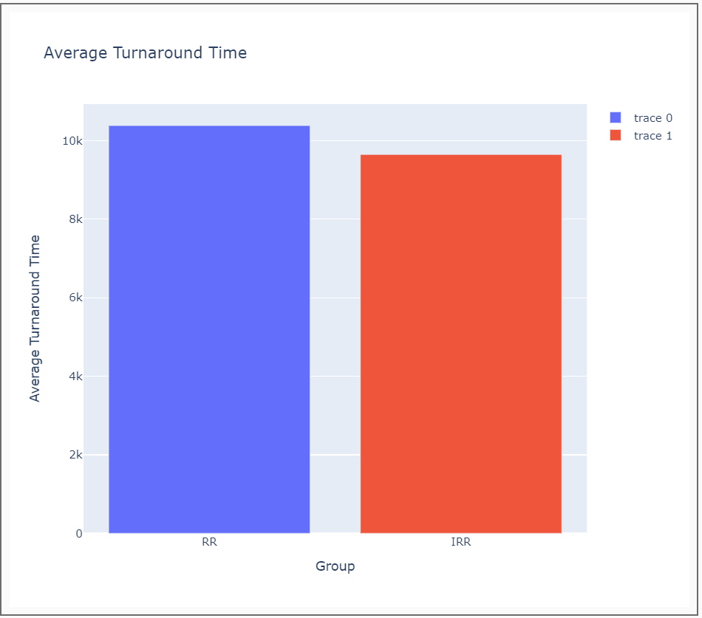

Performance Analysis
Average Turnaround Time
Average Waiting Time

Slide 13
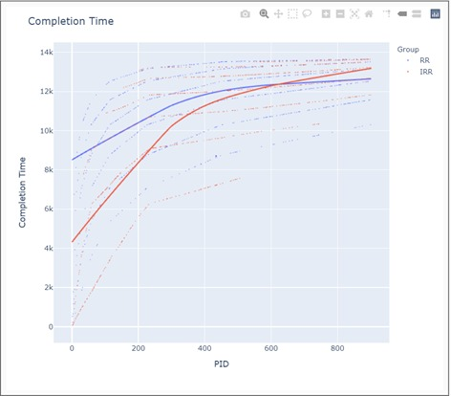
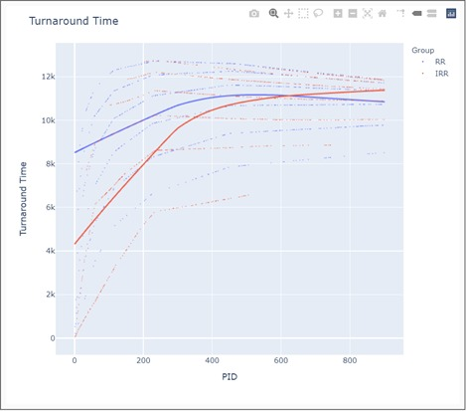

Slide 14
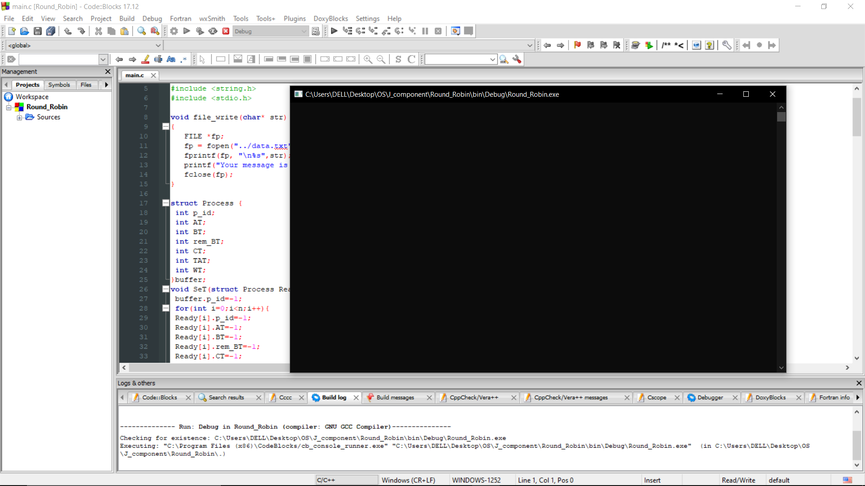
Implementation
Round Robin
Compile and run the program.

Slide 15
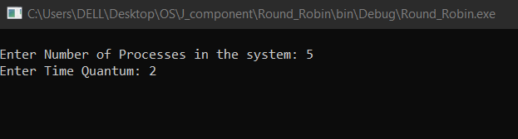
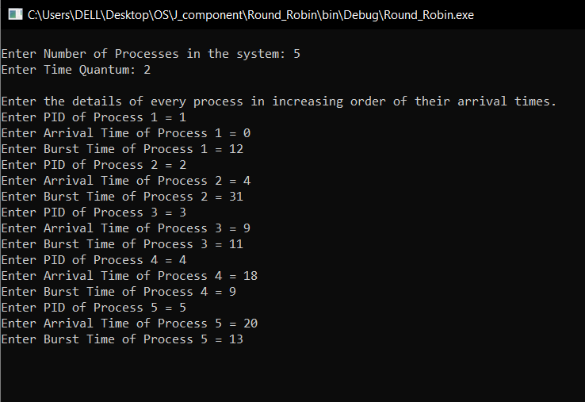
Give input for number of tasks and the time quantum of the RR.
Enter initialization details of all the processes.

Slide 16
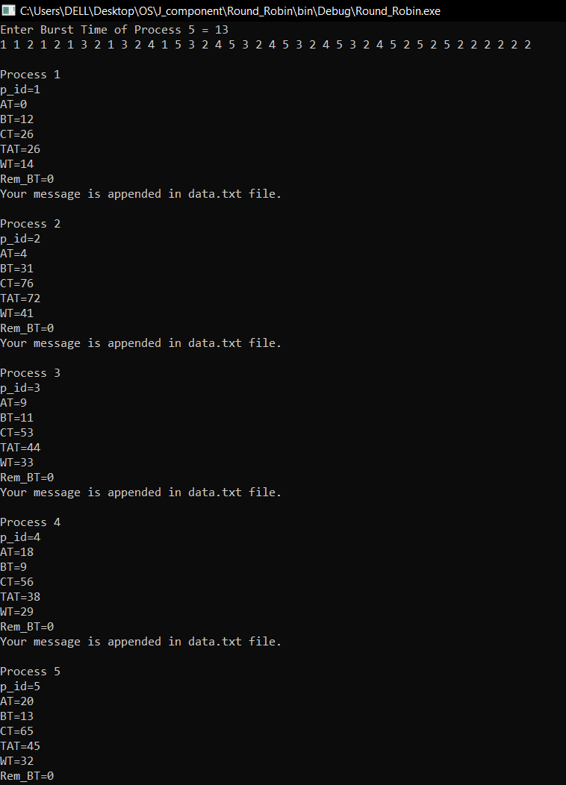
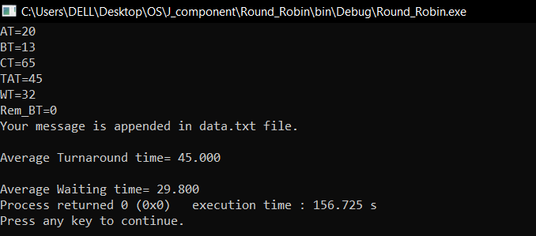
Obtain Output

Slide 17
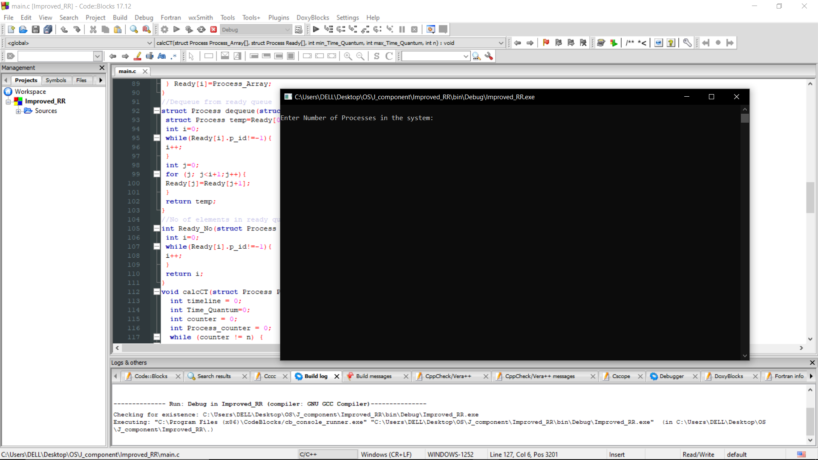
IMPROVED ROUND ROBIN
Compile and run the program.

Slide 18
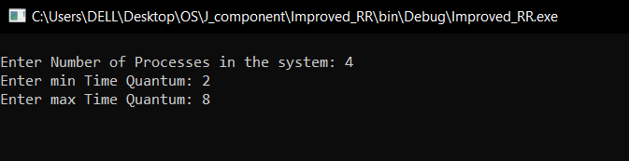
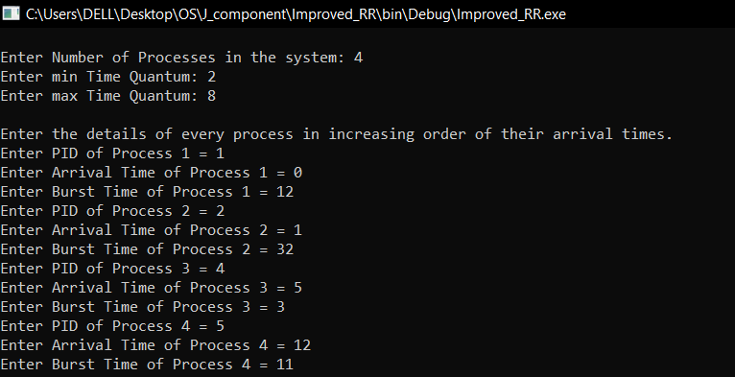
Give input for number of tasks and the min. time quantum and max. time quantum of the IRR.
Enter initialization details of all the processes.

Slide 19
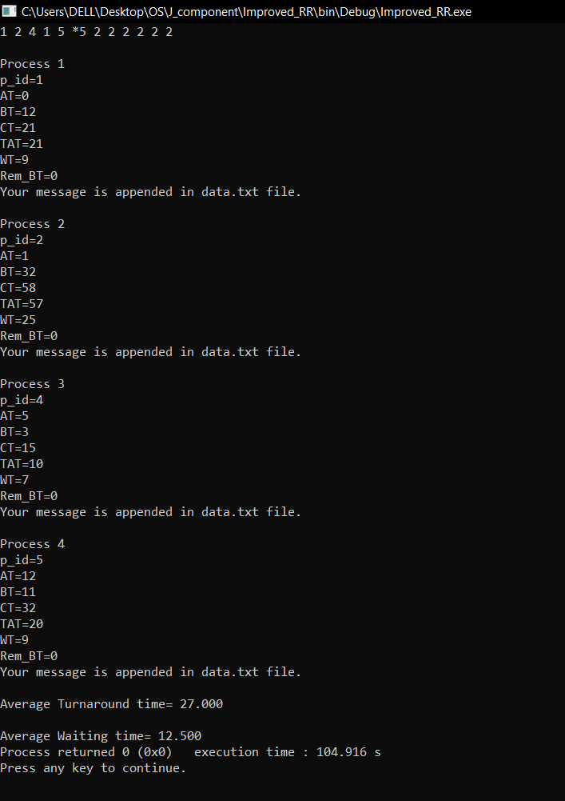
Obtain Output

