Slide 2
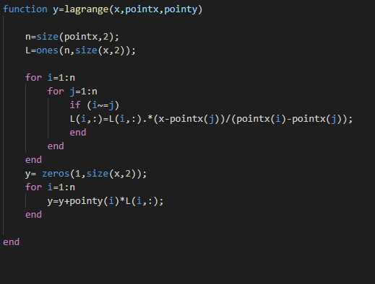
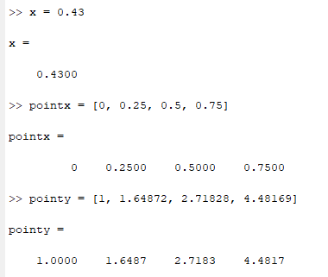
3/ Larange matlab code
Chapter 3.1, problem 6, we need to find f(x_query)
with x_query = 0.22 nad 0.43, and the value table is:
x | 0 | 0.25 | 0.5 | 0.75
y | 1 | 1.64872 | 2.71828 | 4.48169

Slide 3
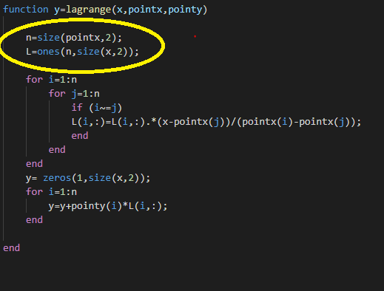

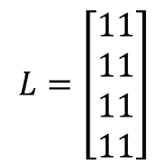
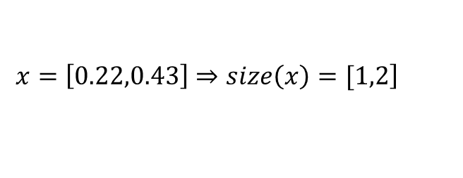
$$\left.x=\left[0.22,0.43\right]⇒size\left(x\right)=[1,2\right]$$
$$n=4$$
$$L=\left[\begin{matrix}1 \\ 1 \\ 1 \\ 1\end{matrix}\begin{matrix}1 \\ 1 \\ 1 \\ 1\end{matrix}\right]$$

Slide 4
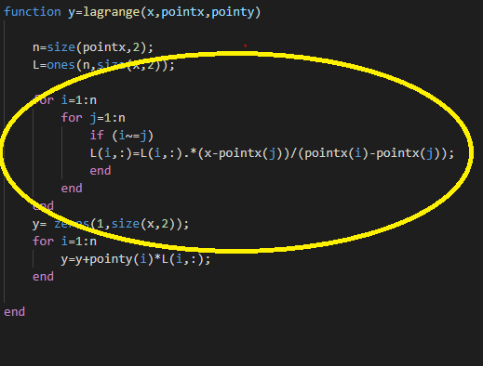


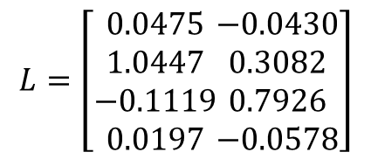
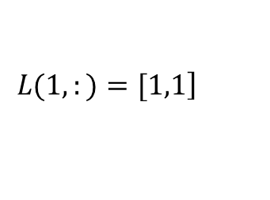
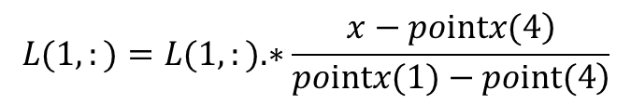
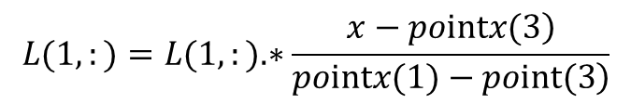
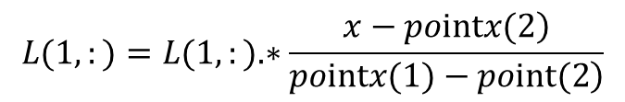
$$L(1,:)=L(1,:).∗\frac{\left.x−pointx(3\right)}{\left.pointx(1)−point(3\right)}$$
$$L(1,:)=L(1,:).∗\frac{\left.x−pointx(4\right)}{\left.pointx(1)−point(4\right)}$$
$$L=\left[\begin{matrix}0.0475 \\ 1.0447 \\ −0.1119 \\ 0.0197\end{matrix}\begin{matrix}−0.0430 \\ 0.3082 \\ 0.7926 \\ −0.0578\end{matrix}\right]$$
$$\left.L(1,:)=[1,1\right]$$
$$L(1,:)=L(1,:).∗\frac{\left.x−pointx(2\right)}{\left.pointx(1)−point(2\right)}$$
$$L(1,:)=[1,1].∗\frac{\left[0.22,0.43]−0.25\right.}{0−1}=[1,1].∗[0.03,−0.18]=[0.03−0.18].$$

Slide 5
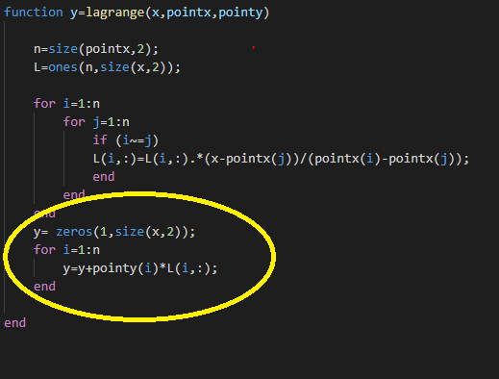
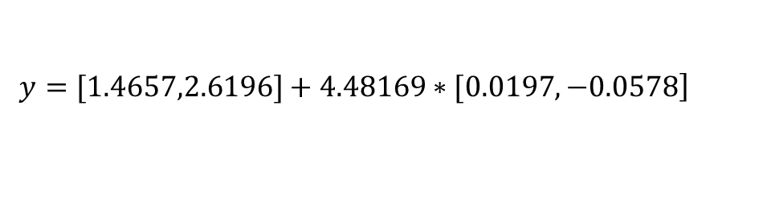

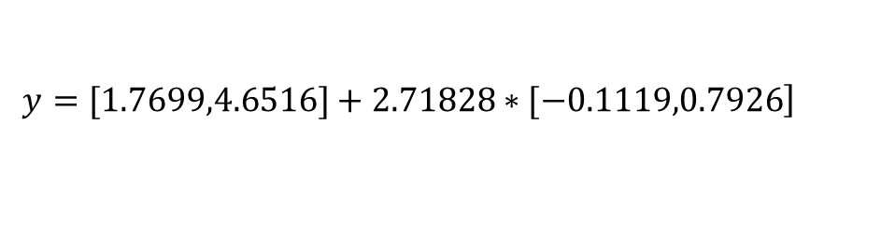
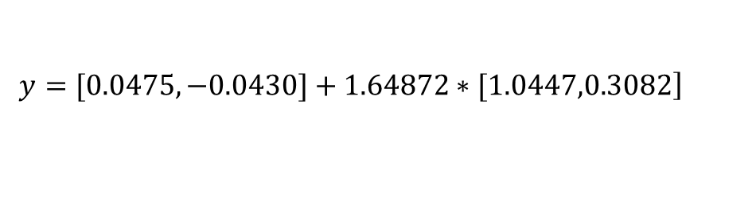
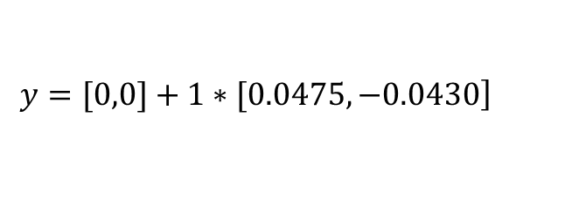
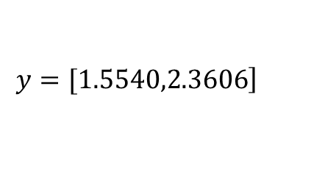
$$\left.y=[0,0]+1∗[0.0475,−0.0430\right]$$
$$\left.y=[0.0475,−0.0430]+1.64872∗[1.0447,0.3082\right]$$
$$y=\left[0,0\right]$$
$$\left.y=[1.7699,4.6516]+2.71828∗[−0.1119,0.7926\right]$$
$$\left.y=[1.4657,2.6196]+4.48169∗[0.0197,−0.0578\right]$$
$$\left.y=[1.5540,2.3606\right]$$

