Slide 1

Articulation The Art of Speech
Presented by Gaurav P Kumar
Date : 20/05/2024

Slide 2
What is Articulation
Definition
the expression of an idea or a feeling in words (Oxford Learners Dictionaries)
Importance
Effective articulation ensures accurate transmission of ideas and enhances understanding in communication.
the act of expressing something in a coherent verbal form, or an aspect of pronunciation involving the articulatory organs (Vocabulary.com)

Slide 3
What are the Components of Articulation?
Phonemes:
The smallest distinctive sound units in a language
Syllables:
Units of sound containing a vowel sound and, usually, accompanying consonant sounds.
Words and Phrases:
Units of language that express ideas or convey information.
Example: words – ball, apple
Phrases – thank you, goodbye
Examples : /b/, /p/, /d/
Examples : “cat”, “table”, “banana”

Slide 4
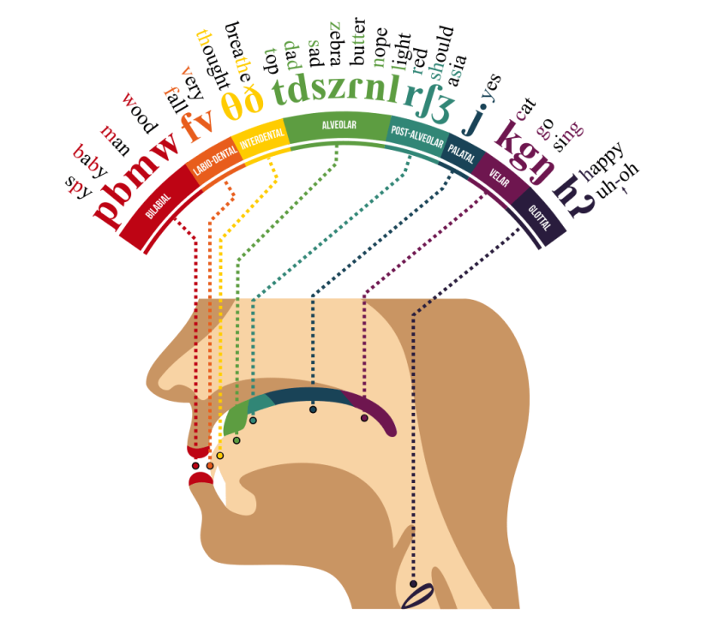
What are the Various Sounds in Articulation?
Various Sounds in Articulation :
Vowels: Examples: /a/ as in "apple", /e/ as in "bed"
Consonants: Examples: /k/ as in "cat", /s/ as in “snake”
Diphthongs: Combination of two vowel sounds within the same syllable. Examples: /ai/ as in "time", /oi/ as in "boy"

Slide 5
Articulation vs. Pronunciation
Articulation:
The action of producing speech sounds.
Pronunciation:
The way in which a word is pronounced.
Example:
Articulation - The correct formation of the "th" sound in "this".
Pronunciation - Saying "schedule" as "sked-ule".

Slide 6

Why do Articulation Abilities Vary?
Physical Factors:
Relating to the body and its movements.
Cognitive Factors:
Relating to the mental processes of perception, memory, judgment, and reasoning.
Environmental Factors:
Relating to the surroundings or conditions in which a person lives or operates.

Slide 7
What Hinders Articulation? Common Speech Hurdles
Examples:
1. Lisping : A speech disorder characterized by difficulty in pronouncing sibilant sounds like "s" and "z," often resulting in a "th" sound.
2. Stuttering : A speech disorder involving disruptions in the flow of speech, such as repetitions, prolongations, or blocks of sounds or syllables.
3. Slurring : The indistinct articulation of speech, often due to muscle weakness, lack of coordination, or other neurological issues.

Slide 8
How can we improve Articulation?
Exercises:
Tongue twisters : "She sells seashells by the seashore“ , "Peter Piper picked a peck of pickled peppers."
Reading aloud: : Reading a passage from a book or a speech text, focusing on clear enunciation.
Mouth exercises : Practicing exaggerated mouth movements like wide opening and closing, lip trills, and tongue stretches.
Techniques:
Slowing down speech
Emphasizing enunciation
Utilizing recording tools
Tools:
Instruments or utensils used for a particular purpose.

Slide 9
Where does Articulation Occur?
Public Speaking:
The act or process of making speeches in public.
Everyday Conversation:
Informal talk involving a small group of people or only one person.
Professional Settings:
Situations in which one’s behaviour is subject to formal regulations or expectations.

Slide 10
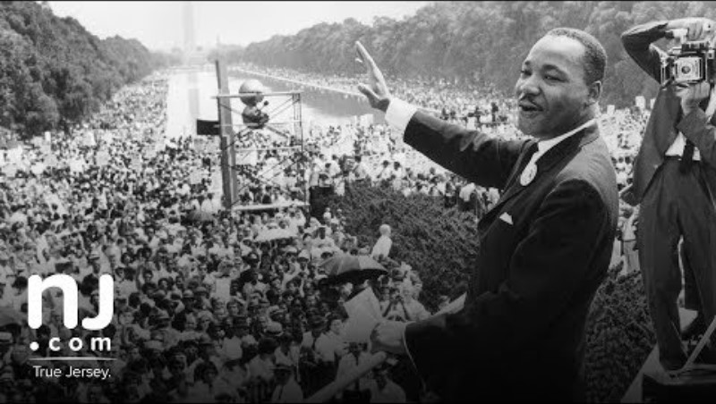
Case Study
Martin Luther King, Jr. was a Baptist minister and social activist who played a pivotal role in the U.S. civil rights movement. His iconic “I Have a Dream” speech, delivered on August 28, 1963, called for equal rights for all citizens, irrespective of their skin color. His legacy continues to inspire generations.

Slide 11
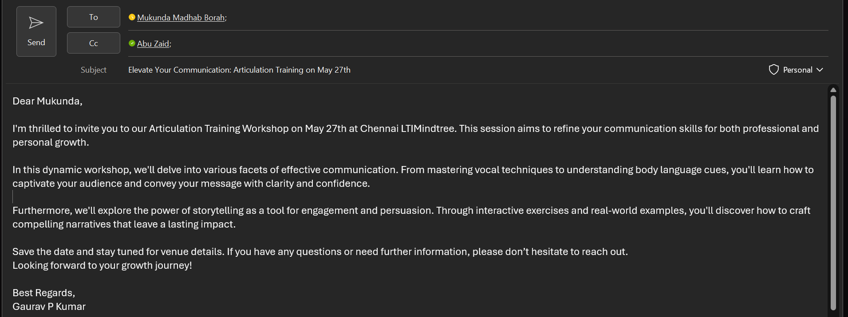
Conclusion and Sample Email

Slide 12
THANK YOU

