Slide 1

Articulation The Art of Speech
Presented by Gaurav P Kumar
Date : 20/05/2024

Slide 2
Introduction to Articulation
Definition
the expression of an idea or a feeling in words (Oxford Learners Dictionaries)
Importance
Effective articulation ensures accurate transmission of ideas and enhances understanding in communication.
the act of expressing something in a coherent verbal form, or an aspect of pronunciation involving the articulatory organs (Vocabulary.com)

Slide 3
Components of Articulation
Phonemes:
The smallest distinctive sound units in a language.
Syllables:
Units of sound containing a vowel sound and, usually, accompanying consonant sounds.
Words and Phrases:
Units of language composed of one or more morphemes.

Slide 4
Articulation vs. Pronunciation
Articulation:
The action of producing speech sounds.
Pronunciation:
The way in which a word is pronounced.
Example:
Articulation - The correct formation of the "th" sound in "this".
Pronunciation - Saying "schedule" as "sked-ule".

Slide 5

Factors Affecting Articulation
Physical Factors:
Relating to the body and its movements.
Cognitive Factors:
Relating to the mental processes of perception, memory, judgment, and reasoning.
Environmental Factors:
Relating to the surroundings or conditions in which a person, animal, or plant lives or operates.

Slide 6
Common Articulation Problems
Examples:
1. Lisping
2. Stuttering
3. Slurring
Causes:
Factors that bring about a result or situation.

Slide 7
Improving Articulation
Exercises:
Tongue twisters
Reading aloud
Mouth exercises
Techniques:
Slowing down speech
Emphasizing enunciation
Utilizing recording tools
Tools:
Instruments or utensils used for a particular purpose.

Slide 8
Articulation in Different Contexts
Public Speaking:
The act or process of making speeches in public.
Everyday Conversation:
Informal talk involving a small group of people or only one person.
Professional Settings:
Situations in which one’s behaviour is subject to formal regulations or expectations.

Slide 9
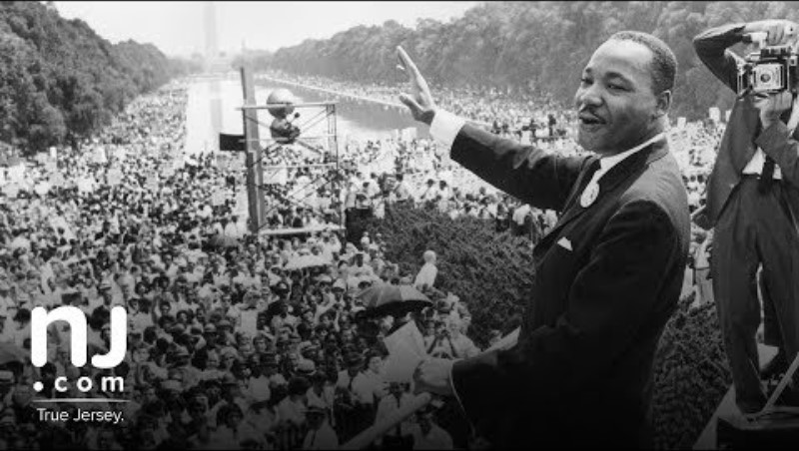
Case Study
Martin Luther King, Jr. was a Baptist minister and social activist who played a pivotal role in the U.S. civil rights movement. His iconic “I Have a Dream” speech, delivered on August 28, 1963, called for equal rights for all citizens, irrespective of their skin color. His legacy continues to inspire generations.

Slide 10
Conclusion
Summary:
Articulation is a crucial aspect of effective communication, ensuring clarity and understanding. By understanding the components, addressing common problems, and practicing techniques, individuals can improve their articulation skills across various contexts.
Q&A: I welcome any questions from the Audience

Slide 11
THANK YOU

