Slide 1

Data Source :- BRO (Zomato2) file

Slide 2

Introduction
This is an Exploratory Data Analysis of the Zomato Dataset. Here, we'll look into the Zomato dataset, visualize it, discuss it, and try to find patterns, if any.
The dataset has 7 columns and 2735 entries. There are 2 columns with float.
Data contains following columns.
Name
Off
Ratings
Price for one
Delivery Review
Cuisine
Location

Slide 3
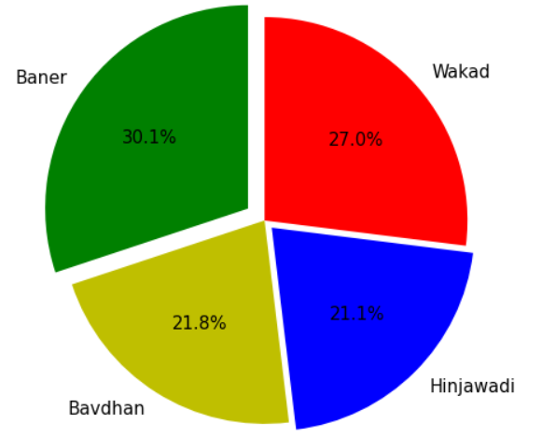

Locations:-
Baner 823
wakad 738
Bavdhan 597
Hinjawadi 577

Slide 4
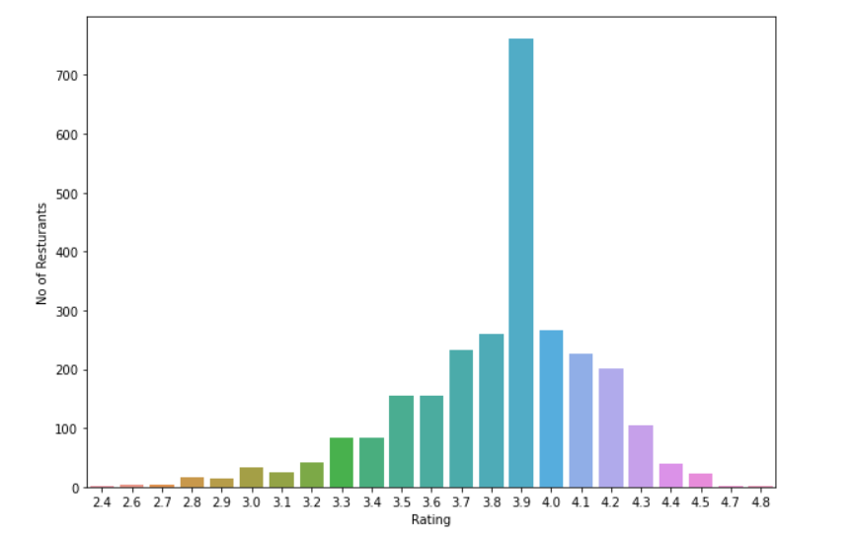
Restaurants | Ratings
761 266 261 232 227 202 155 154 105 84 83 42 40 33 25 23 16 15 4 3 2 1 1 | 3.9 4.0 3.8 3.7 4.1 4.2 3.6 3.5 4.3 3.3 3.4 3.2 4.4 3.0 3.1 4.5 2.8 2.9 2.7 2.6 4.7 2.4 4.8

Slide 5
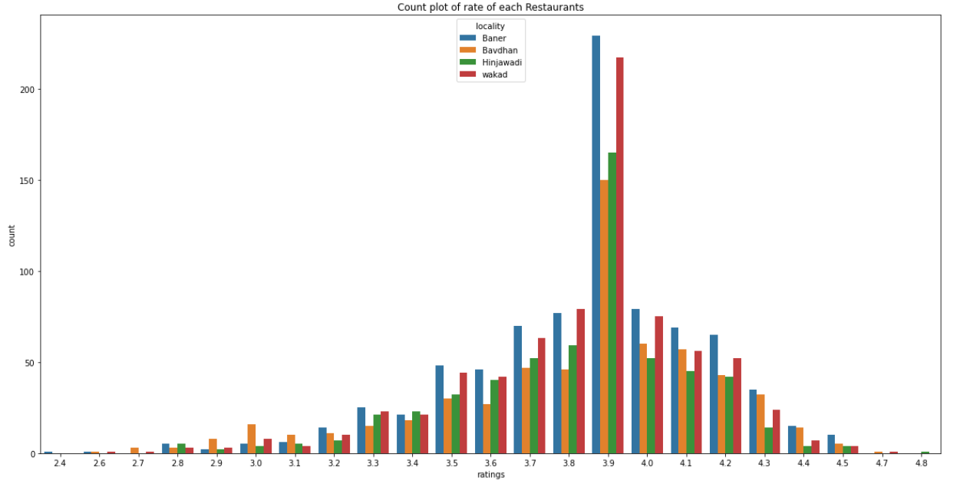

Slide 6
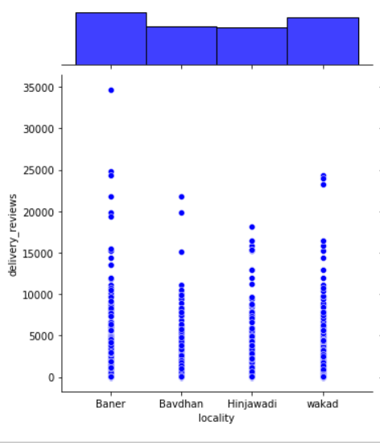
Baner and Wakad has more number of restaurants who’s delivery reviews in between (0-15K).
Only one restaurants in Baner have more than 30k delivery review.

Slide 7
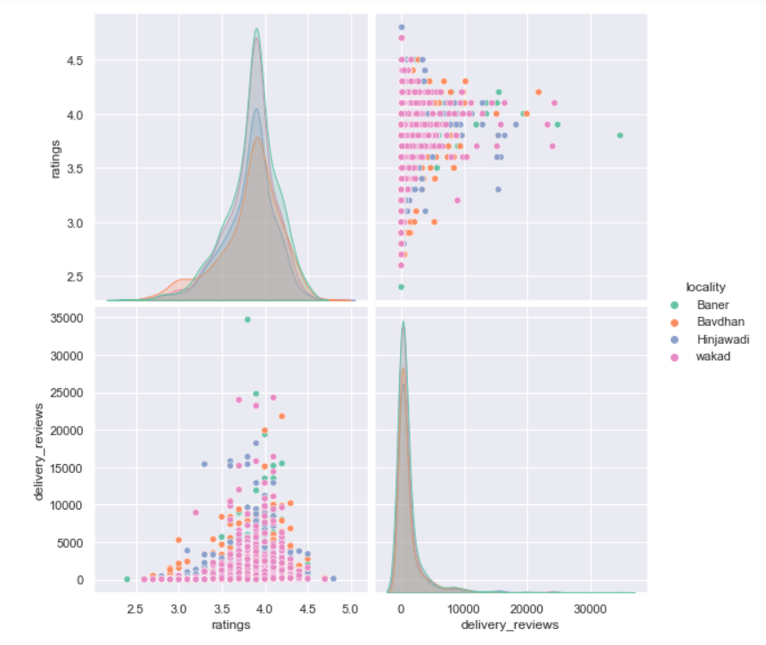

Slide 8
