Slide 1


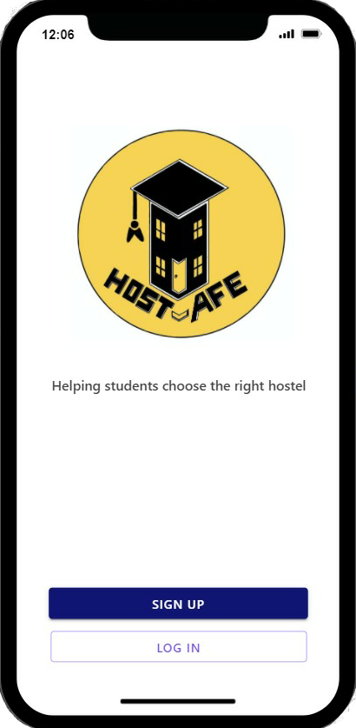
~ Find your second home...
Helping students choose the right hostel

Slide 2

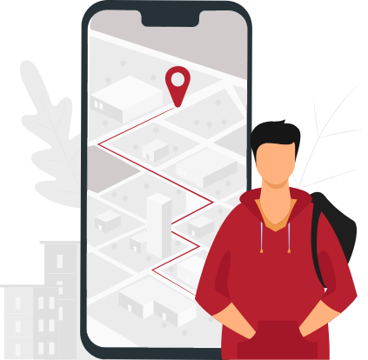
The Problem
Planning hostel booking is messy - Word, emails, hard copies, hostel documents is quite a mess . What if you can have it in one place ??
More choices More confusion - With lots to explore in the vicinity, in the city and the country ; the number of available options are never ending.
What if you can filter all the choices according to the requirement ??
The best still awaits - In the hostel selection process many of them loses the best option available for them. What if you are provided with the best option available for you ??
Present Situation - 18 months of hostel shutdown students are ready to travel they are ready to be back at hostels…!

Slide 3

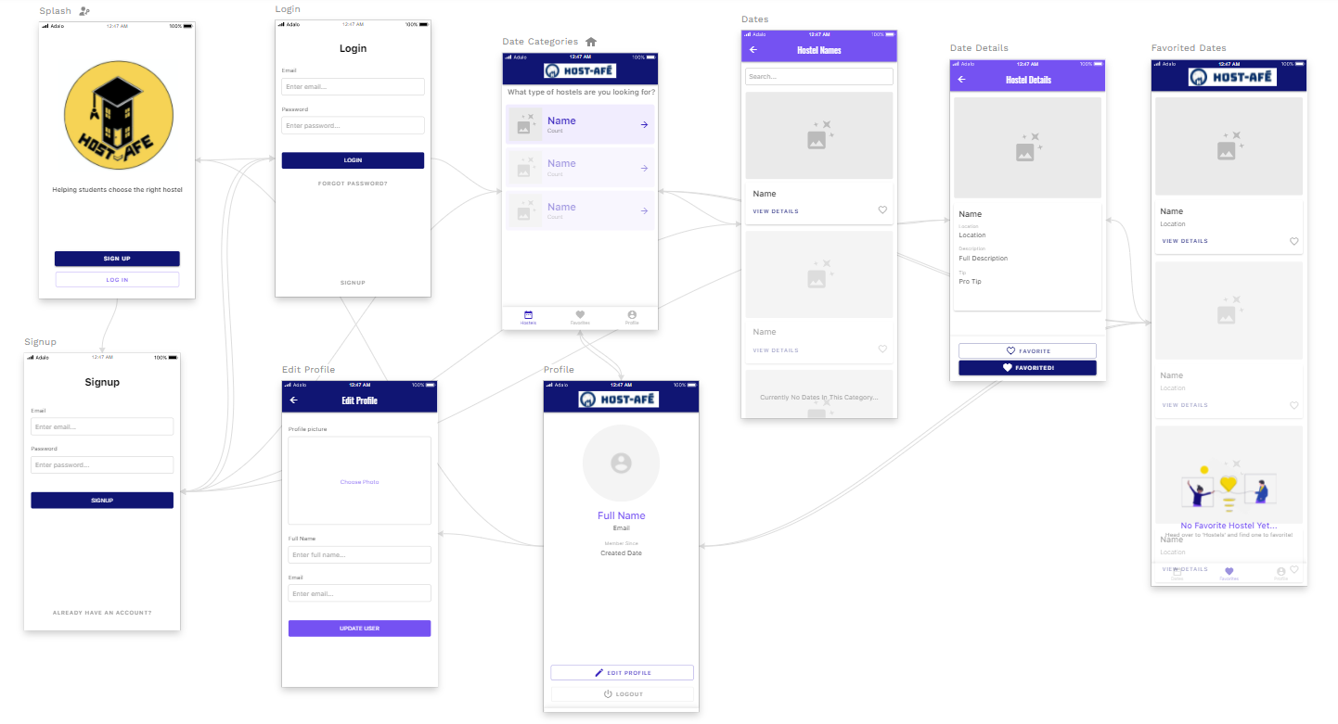
*App design yet to be finalised.

Slide 4

BUSINESS PLAN
Phase 1
Monthly Subscription Fees (*) from Hostel Owners to post their Hostel on the platform.
Phase 2
Yearly Advance Payment (*) for showcasing maximum 3 Hostels as Featured Hostels in a Specific City.
Phase 3
Showcasing Advertisement for associated Student Services as part of Hostel’s Detail Page (*).
(*) value yet to be discussed.

Slide 5

PERKS OF CHOOSING HOST-AFE
User has to just create a host-afe account and then can explore the world of hostels.
The special feature of host-afe will allow the users to get a 360 degree real life experience of their hostel room without actual visit.
Easily sort hostels on the basis of the requirements by using the instant comparison and filtering feature including
Exact location.
Range of prices.
Number of partners.
With or without mess.
Availability of necessities.

Slide 6




The Team
Matching real life problem with solution...
A wonderful idea to link India’s largest online leading chain of efficient and standardized hostel space for students according to their requirements.
Gaurav Boob
Kushal Bhattad
Co-founder
Also, it’s worth noting that if you have an app for your hostel , the kind of data that the app can generate is nothing short of a goldmine. You can get a much closer view of your business performance and really understand where you can improve services. The benefits of a mobile app or a website for hotels are far too many to ignore any longer.
Founder
Yash Patil
Sohan Joshi
Co-founder
UI/UX Designer

Slide 7
CONTACT US
Kushal Bhattad
kushalbhattad07@gmail.com
https://www.linkedin.com/in/kushal-bhattad-a12b87200
Gaurav Boob
gauravboob5@gmail.com
https://www.linkedin.com/in/gaurav-boob-161ab3200
Yash Patil
yashp9145@gmail.com
https://www.linkedin.com/in/yash-patil-9b4650205
Sohan Joshi
sohanjoshi02@gmail.com
https://www.linkedin.com/in/sohan-joshi-942949206

Slide 8


