Slide 1


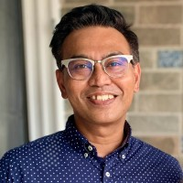
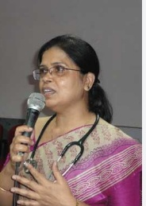
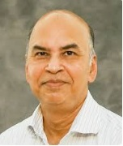
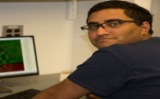
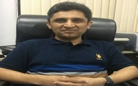


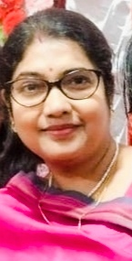
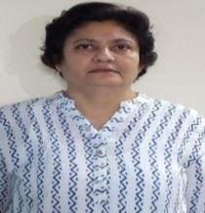
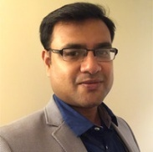
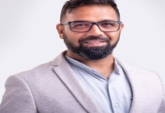
Faculty Development Program
on
“Computational Genomics: Path to Precision Medicine”
Jointly Organized by
Resource Persons
Dr. Saurav Guha, Director, Molecular Diagnostics, New York Genome Center
International Institute of Information Technology (IIIT), Hyderabad
Dr. Maitreyee Bhattacharya, Director, Institute of Hematology and Transfusion Medicine, Medical College, Kolkata
&
Dr. Sujoy Ghosh, Professor and Director, Bioinformatics and Computational Biology Pennington Biomedical Research Center, U.S.A.
Heritage Institute of Technology (HIT), Kolkata
Objective of FDP - To provide a unique collaborative platform and facilitate knowledge exchange among Academicians, Industry leaders, and Medical Practitioners from all over the world, focusing on emerging trends and addressing practical challenges in Genomics. By exploring new dimensions in this field, the FDP seeks to drive innovation and contribute to societal well-being.
Date: 24th-28th March, 2025
Mode: Online
Time: 7.00 PM – 10.00 PM
Registration: Link
Dr. Surajit Bhattacharya, Scientist, Children's National Hospital, Washington, D.C., U.S.A.
Dr. Shandar Ahmad, Professor JNU & Coordinator DBT-Bioinformatics Center,
Key Focus Areas: (1) AI in Genome Analyses and its application in Clinical Genomics and Diagnostics
(2) Computational approaches for understanding the role of Genetic Variations in Tumorigenesis
(3) Explore the Future of AI in Precision Medicine, (4) Harness the power of OMICS in Health Analytics
Dr. Suman Paine, Chief Scientific Officer, PDxRL, Kolkata
Dr. Anirban Dutta, Principal Scientist in Life Sciences R&D,TCS Research
Dr. Rituparna Sinha,
Coordinator of the FDP
Asst. Professor
Dept. of IT
Heritage Institute of Technology Kolkata
Dr. Nita Parekh,
Coordinator & FDP Speaker,
Associate Professor, CCNSB,
International Institute of Information Technology Hyderabad
Mr. Arindam Halder, Senior Consultant, Health Care Industry, TCS Research
Dr. Sameer Phalke, Director Laboratory Sciences, Strand Life Sciences, Bangalore

