Slide 1
DATA SCIENCE PROJECT
PYTHON + POWER BI
Credit Card Transaction Analytics
Dashboard using Power BI
Data Cleaning, Statistical Hypothesis Testing & Dashboard Insights
on Indian Credit Card Transactions
Presented by: Gaurav Kumar Gupta (2401003062)
An end-to-end analytics project — from a deliberately messy 10,658-row transaction dataset to a statistically validated, cleaned dataset and a 5-page interactive Power BI dashboard.

Slide 2
DATASET
Dataset Overview
credit_card_transactions_INDIA.csv is a synthetic dataset, self-generated for coursework to simulate realistic — and intentionally messy — Indian credit card transaction behaviour, for practicing end-to-end data cleaning, EDA and hypothesis testing.
Raw Data Snippet
TransactionID | Age | TransactionDate | Category | CardType
TXN0017996 | 43 | 07 November 2024 | Coffee Shops | American Express
TXN0010335 | 51 | 21/03/2025 | pharmacy | visa
TXN0000645 | 40 | 02-07-2024 | Software Subscription | American Express
TXN0016227 | 21 | 17 October 2025 | groceries | Mastercard
Source: Self-generated / synthetic dataset, created for summer-training coursework
Notice the inconsistent capitalisation (“pharmacy” vs “Coffee Shops”) and three different date formats in one column — exactly the mess Section 2 of the notebook was built to fix.
850
21
16
5
CUSTOMERS
CATEGORIES
STATES
REGIONS
df.info() — 22 columns, 10,658 entries
df.info()
# Column Dtype
0 TransactionID object
4 Age float64
9 Category object
11 Amount_INR object *
17 RewardPoints float64
21 MonthlyIncomeINR float64
* stored as text -> hidden formatting issues
Dataset Shape
10,658 × 22
10,059 × 22
RAW · ROWS × COLUMNS
CLEANED · +3 ENGINEERED
GAURAV KUMAR GUPTA · 2401003062
02

Slide 3




PYTHON · NOTEBOOK
Data Cleaning — Taming a Messy Dataset
Case & whitespace noise
Key Python Snippet — Section 2, Data Cleaning
'Airlines', 'AIRLINES', ' Airlines ' inflated 21 real categories into 84 spellings.
# normalize text + brand map
df[c] = df[c].str.strip().str.title()
card_map = {'amex': 'American Express',
'mc': 'Mastercard', 'rupay': 'RuPay'}
df['CardType'] = df['CardType'].str
.str.lower().map(card_map)
# parse 4 mixed date formats
for fmt in ('%d %B %Y','%d-%m-%Y',
'%d/%m/%Y','%Y-%m-%d'):
try: return pd.to_datetime(x, fmt)
except: continue
Inconsistent brand naming
'AMEX', 'American Express', 'Amex' split one card brand across multiple labels.
Mixed boolean encoding
IsEMI stored as a jumble of 0 / 1 / True / False / Yes / No in the same column.
Mixed date formats
84 → 21
12 → 4
105
30
'14-02-2024', '14/02/2024', '29 September 2025' all appear in TransactionDate.
CATEGORY SPELLINGS
CARD-BRAND SPELLINGS
NEGATIVE SIGNS FIXED
IMPLAUSIBLE ENTRIES REMOVED
GAURAV KUMAR GUPTA · 2401003062
03

Slide 4

PYTHON · NOTEBOOK
Missing Values, Outliers & Feature Engineering
Missing Values Per Column
Outliers — Flagged, Not Deleted
Column | Missing
Amount_INR | 216
Category | 164
MonthlyIncomeINR | 164
Age | 132
Merchant | 111
CardType | 111
PaymentMode | 88
City | 54
How Each Gap Was Closed
IQR method → upper fence ₹3,862.70. 1,530 legitimate high-value transactions flagged for awareness, concentrated in Fine Dining (281), Jewelry (201), Luxury Retail (197) & Electronics (197).
Numeric (Age, MonthlyIncomeINR) → filled with column median
Categorical (Category, Merchant, PaymentMode, CardType, City) → filled “Unknown”
145 duplicate TransactionIDs → dropped, kept earliest by date
Amount_INR coerced to numeric; rows still missing it were excluded when filtering out implausible values
+3 Engineered Features
AgeGroup · IncomeBracket · TransactionMonth
10,658 → 10,059 rows final cleaned dataset, zero remaining nulls, ready for analysis
GAURAV KUMAR GUPTA · 2401003062
04

Slide 5
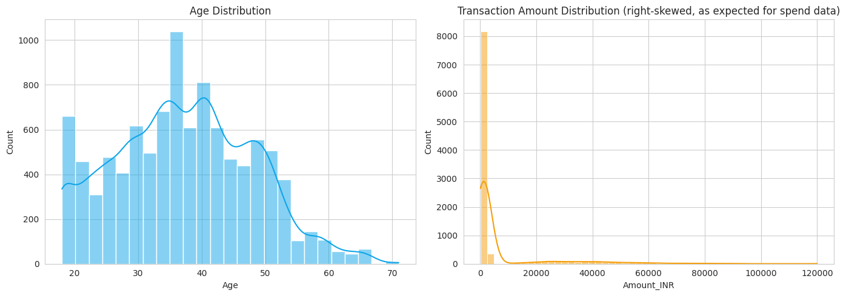
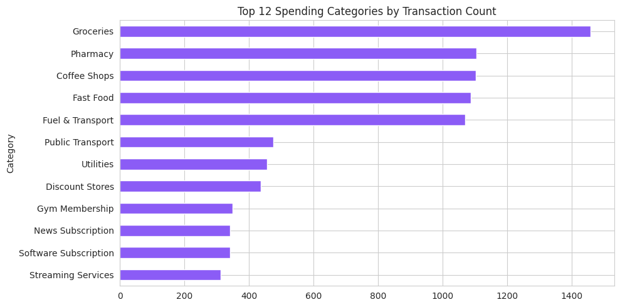
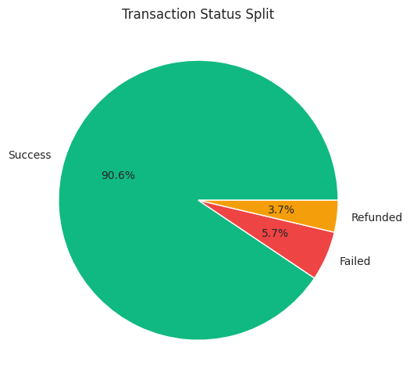
PYTHON · NOTEBOOK
Exploratory Data Analysis — Univariate
Age concentrates in the 30–45 band. Transaction amount is heavily right-skewed — many small purchases, few large ones — so the median, not the mean, is the reliable centre here.
Groceries, Pharmacy, Coffee Shops, Fast Food and Fuel & Transport are the most frequent categories by transaction count.
90.6% of transactions succeed; 5.7% fail and 3.7% are refunded — a healthy, low-risk baseline.
GAURAV KUMAR GUPTA · 2401003062
05

Slide 6
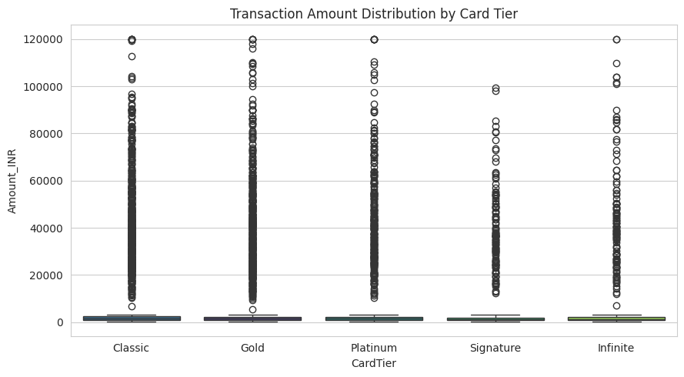
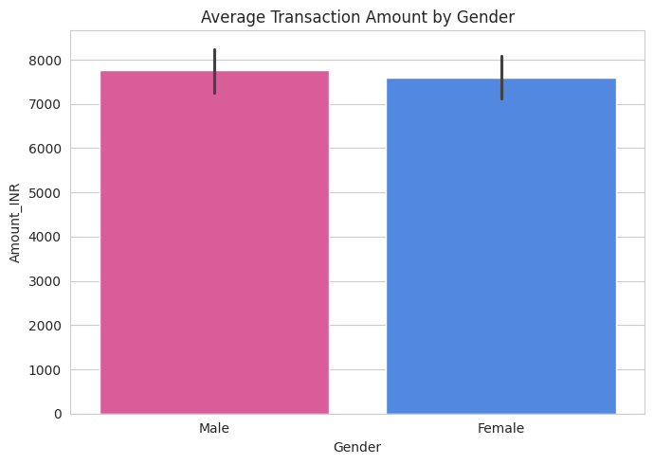
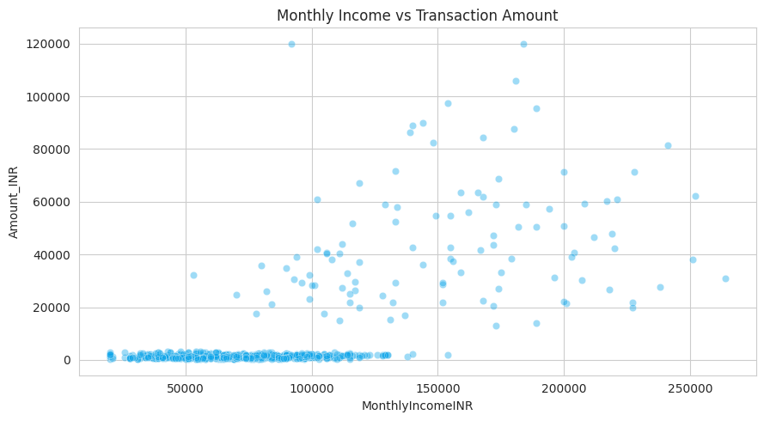
PYTHON · NOTEBOOK
Exploratory Data Analysis — Bivariate
Classic tier shows the widest spread and highest median spend — an early hint of the counter-intuitive tier finding confirmed later by ANOVA.
Average spend is close between genders — Male ₹7.76K vs Female ₹7.59K — a gap later confirmed as statistically borderline (p ≈ 0.056).
A clear upward trend: higher monthly income associates with higher transaction amounts (confirmed later: r ≈ 0.668).
GAURAV KUMAR GUPTA · 2401003062
06

Slide 7
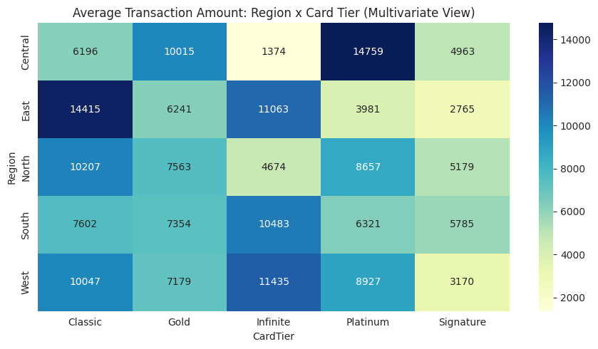
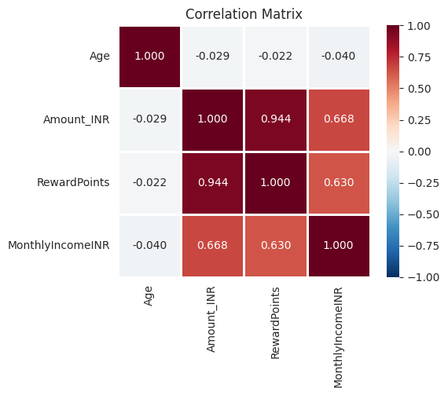
PYTHON · NOTEBOOK
Multivariate View & Correlation Analysis
Pearson Correlations
Amount ↔ RewardPoints
r = 0.944 very strong
Amount ↔ Income
r = 0.668 moderate–strong
RewardPoints ↔ Income
r = 0.630 moderate
Age ↔ Amount / Income
r ≈ −0.03 negligible
All correlations significant at p<0.05. Reward points scale almost linearly with spend, as designed.
Region × Card Tier heatmap: average spend varies sharply by combination — e.g. Central/Platinum (₹14,759) and East/Classic (₹14,415) run far above the overall average, showing spend drivers interact rather than acting independently.
GAURAV KUMAR GUPTA · 2401003062
07

Slide 8
PYTHON · NOTEBOOK
Statistical Hypothesis Testing (α = 0.05)
Test | Comparison | Statistic | p-value | Result
H1 · t-test | Weekend vs weekday spend | t = −0.75 | 0.451 | FAIL TO REJECT
H2 · ANOVA | Spend across 5 card tiers | F = 24.39 | 4.08e-20 | REJECT H0
H3 · Chi-square | Gender vs transaction status | χ² = 5.77 | 0.056 | FAIL TO REJECT
H4 · Chi-square | Payment mode vs status | χ² = 10.75 | 0.216 | FAIL TO REJECT
H5 · t-test | EMI vs non-EMI spend | t = 40.50 | 2.8e-165 | REJECT H0
Headline Result
Card tier genuinely affects spend (p<0.001) — but counter to intuition, Classic tier shows the highest average transaction (₹9,802.86), not the premium tiers. EMI transactions run ~8× larger than non-EMI (₹45,313 vs ₹5,649, p<0.001). Weekend spend and payment mode show no significant effect on amount or risk.
GAURAV KUMAR GUPTA · 2401003062
08

Slide 9
POWER BI · DASHBOARD
Power BI Dashboard — Five Analytical Pages
Built on the cleaned 10,059-row dataset in Power BI Desktop. Each page answers one business question about customer spending behaviour and risk.
1
Where Does Spending Concentrate?
Category, merchant and regional breakdown of total transaction value.
2
Who Is Spending?
How age, gender and income shape transaction behaviour.
3
How Do Payment Choices Affect Risk?
Success, failure and refund patterns across payment mode, tier and card type.
4
When Do People Spend?
Day-of-week, weekend, monthly and time-of-day spending patterns.
5
What Drives Higher Spending?
Customer segments, payment preferences and tiers linked to bigger transactions.
GAURAV KUMAR GUPTA · 2401003062
09

Slide 10
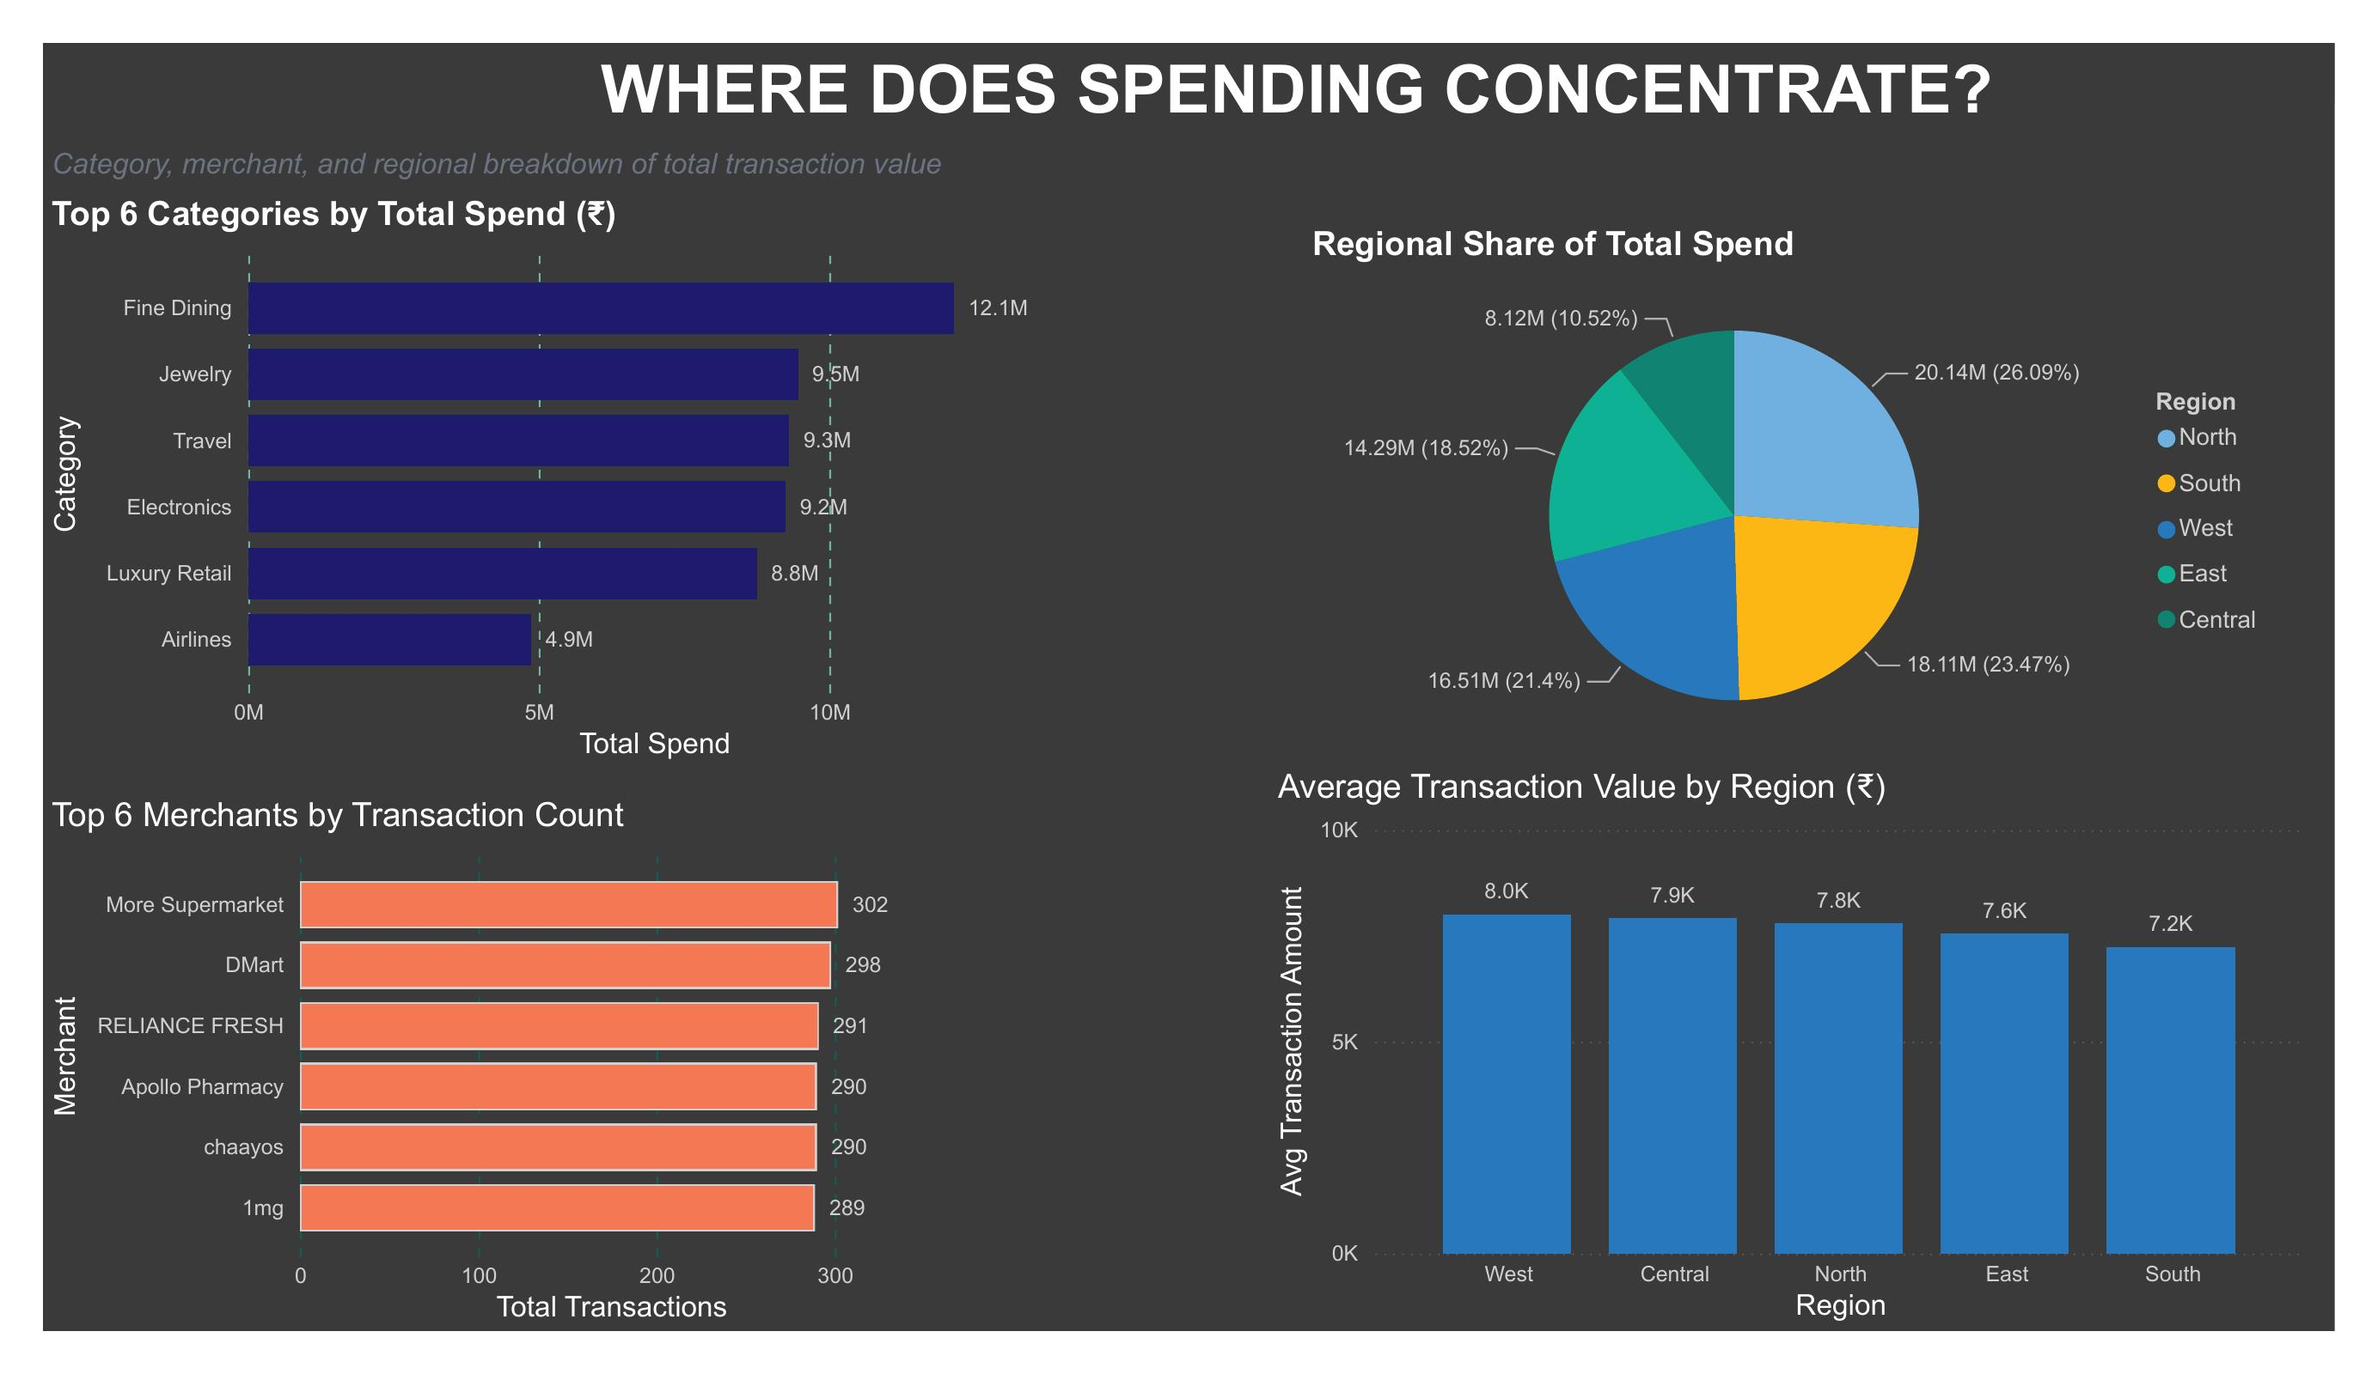




POWER BI · DASHBOARD
Where Does Spending Concentrate?
Category, merchant and regional breakdown of total transaction value
What Each Chart Shows
Top Categories by Spend
Fine Dining leads at ₹12.1M, followed by Jewelry (₹9.5M) and Travel (₹9.3M).
Top Merchants by Count
More Supermarket (302), DMart (298) and Reliance Fresh (291) lead by transaction count.
Regional Share of Spend
North holds the largest share at 26.09% (₹20.14M); Central the smallest at 10.52%.
Avg Transaction by Region
West has the highest average ticket (₹8.0K); South the lowest (₹7.2K).
Dashboard page 1 of 5
GAURAV KUMAR GUPTA · 2401003062
10

Slide 11
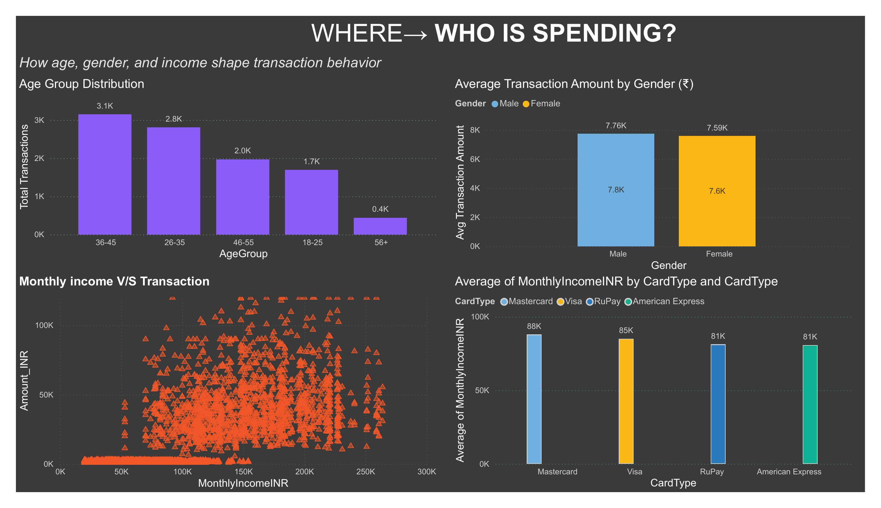


POWER BI · DASHBOARD
Who Is Spending?
How age, gender and income shape transaction behaviour
What Each Chart Shows
Age Group Distribution
36–45 year-olds transact most often (3.1K transactions), ahead of 26–35 (2.8K).
Avg Amount by Gender
Male ₹7.76K vs Female ₹7.59K — a narrow gap, later confirmed as statistically borderline.
Income vs Transaction
Higher monthly income tracks with larger transaction amounts.
Income by Card Type
Mastercard holders report the highest avg income (₹88K); RuPay/Amex the lowest (₹81K).
Dashboard page 2 of 5
GAURAV KUMAR GUPTA · 2401003062
11

Slide 12
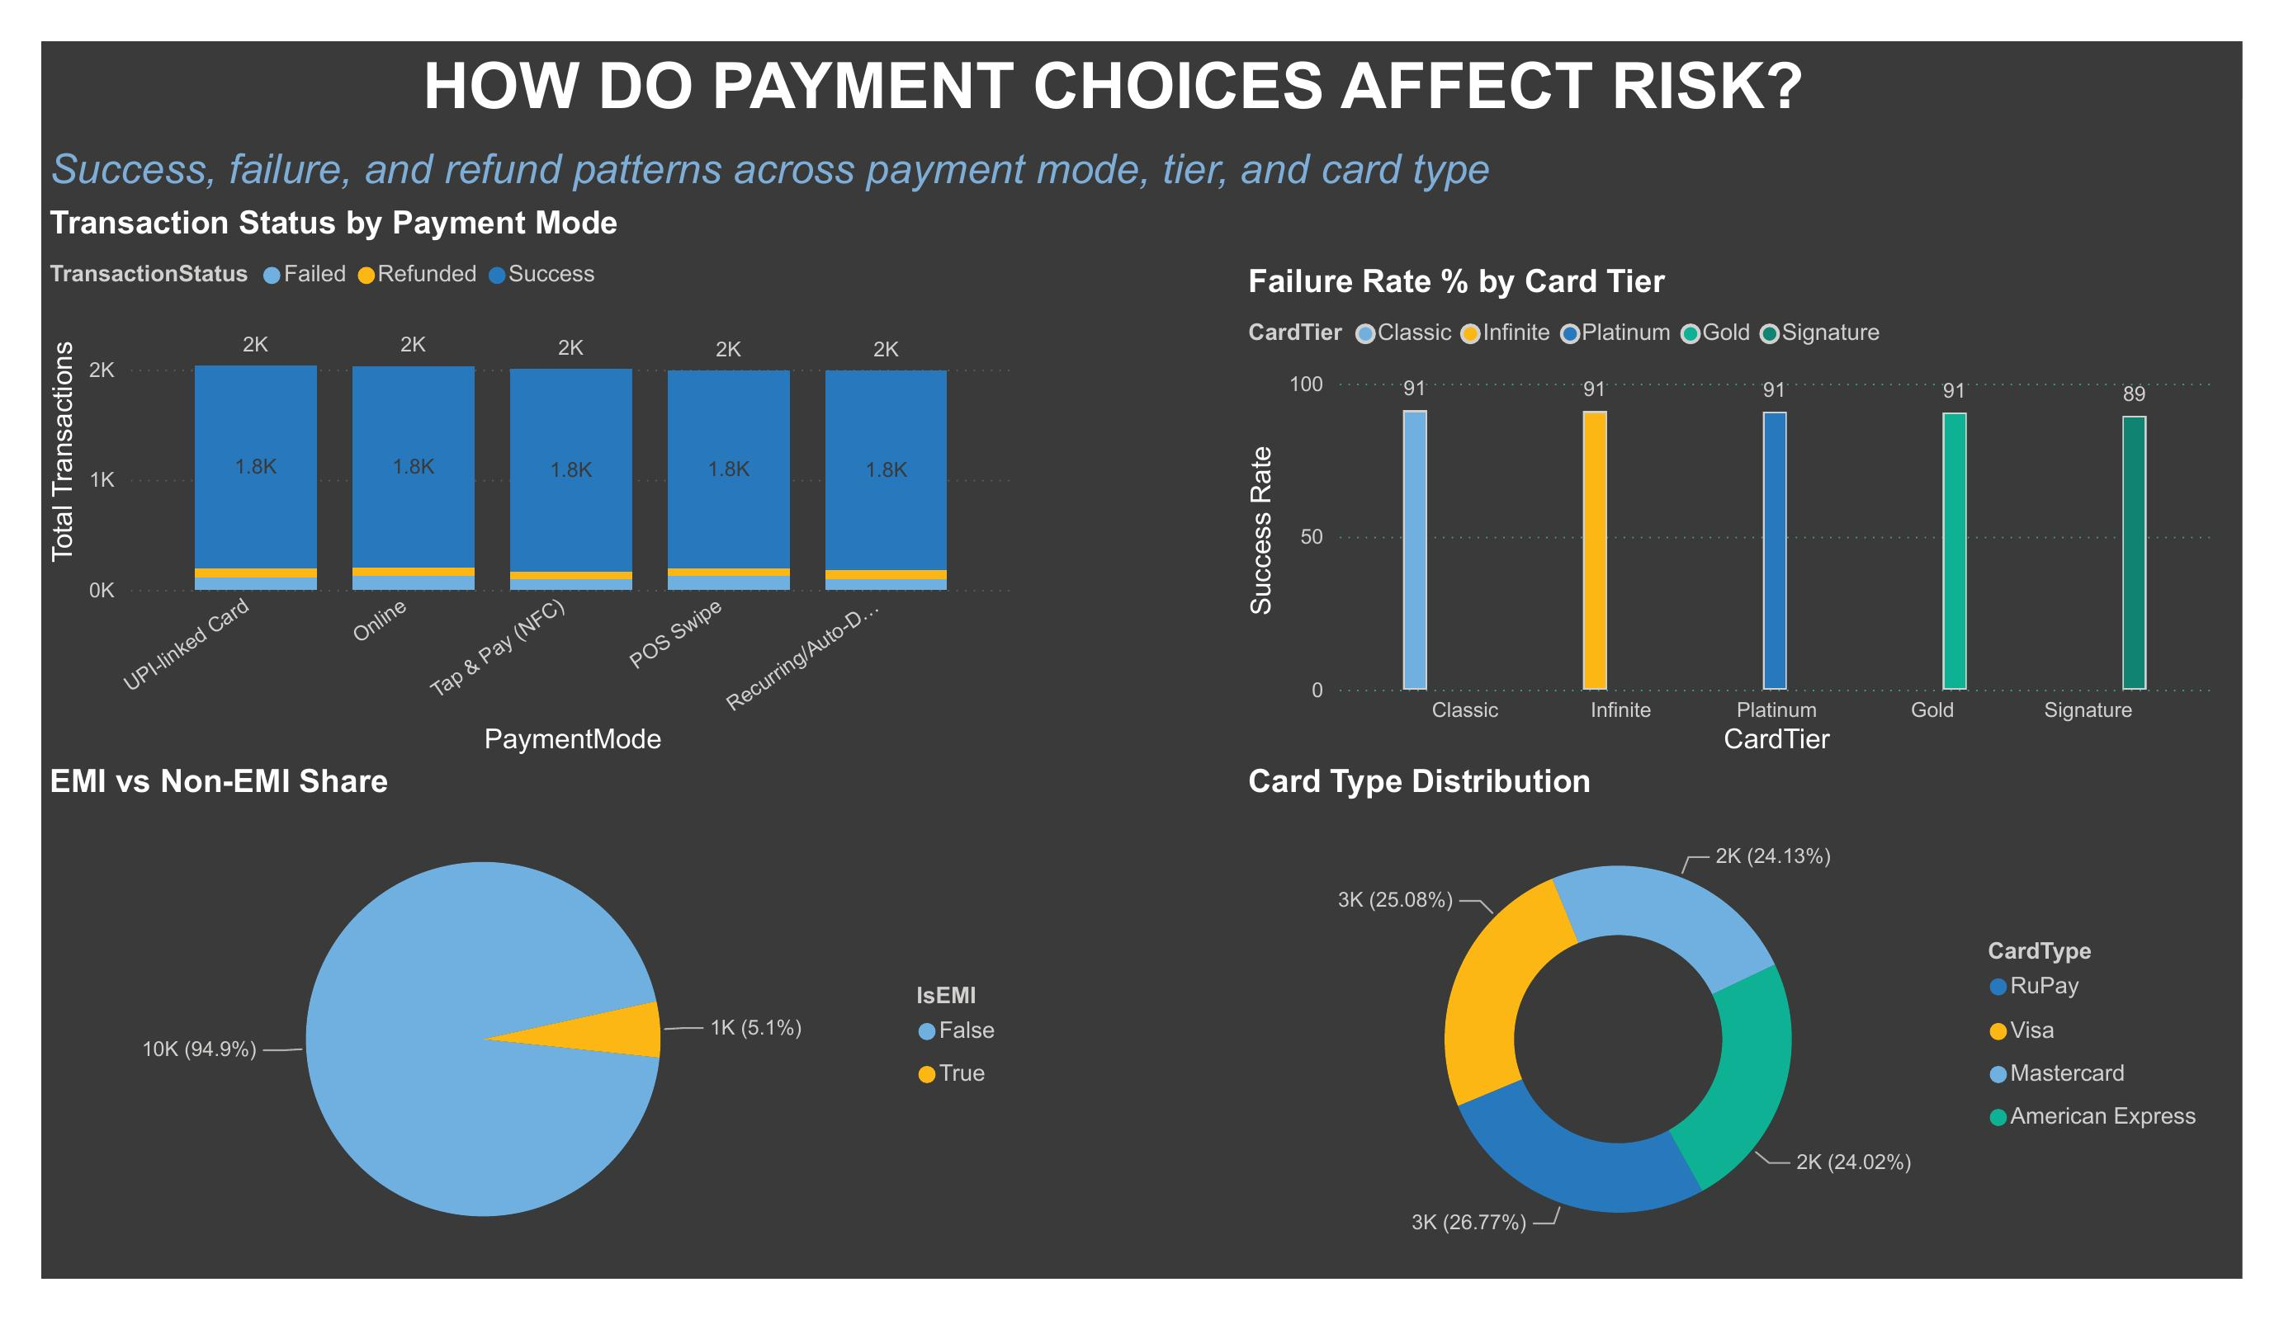



POWER BI · DASHBOARD
How Do Payment Choices Affect Risk?
Success, failure and refund patterns across payment mode, tier and card type
What Each Chart Shows
Status by Payment Mode
Success rates are consistent across all 5 modes — failure isn't concentrated in one channel.
Failure Rate by Card Tier
Classic through Gold hold ~91% success; Signature dips slightly to 89%.
EMI vs Non-EMI Share
Just 5.1% of transactions are EMI — but they carry far higher average value.
Card Type Distribution
RuPay leads usage at 26.77%, closely followed by Visa (25.08%).
Dashboard page 3 of 5
GAURAV KUMAR GUPTA · 2401003062
12

Slide 13
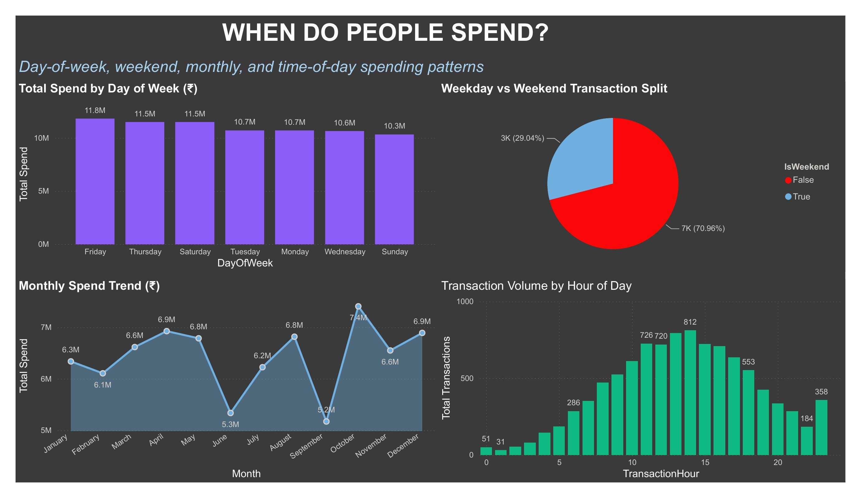

POWER BI · DASHBOARD
When Do People Spend?
Day-of-week, weekend, monthly and time-of-day spending patterns
What Each Chart Shows
Spend by Day of Week
Friday is the top spending day (₹11.8M); Sunday the lowest (₹10.3M).
Weekday vs Weekend
70.96% of spend happens on weekdays — just 29.04% on weekends.
Monthly Spend Trend
March peaks at ₹7.4M; April dips to ₹5.2M — no single runaway season.
Volume by Hour
Activity clusters in late-morning and early-evening windows, tracking typical shopping hours.
Dashboard page 4 of 5
GAURAV KUMAR GUPTA · 2401003062
13

Slide 14
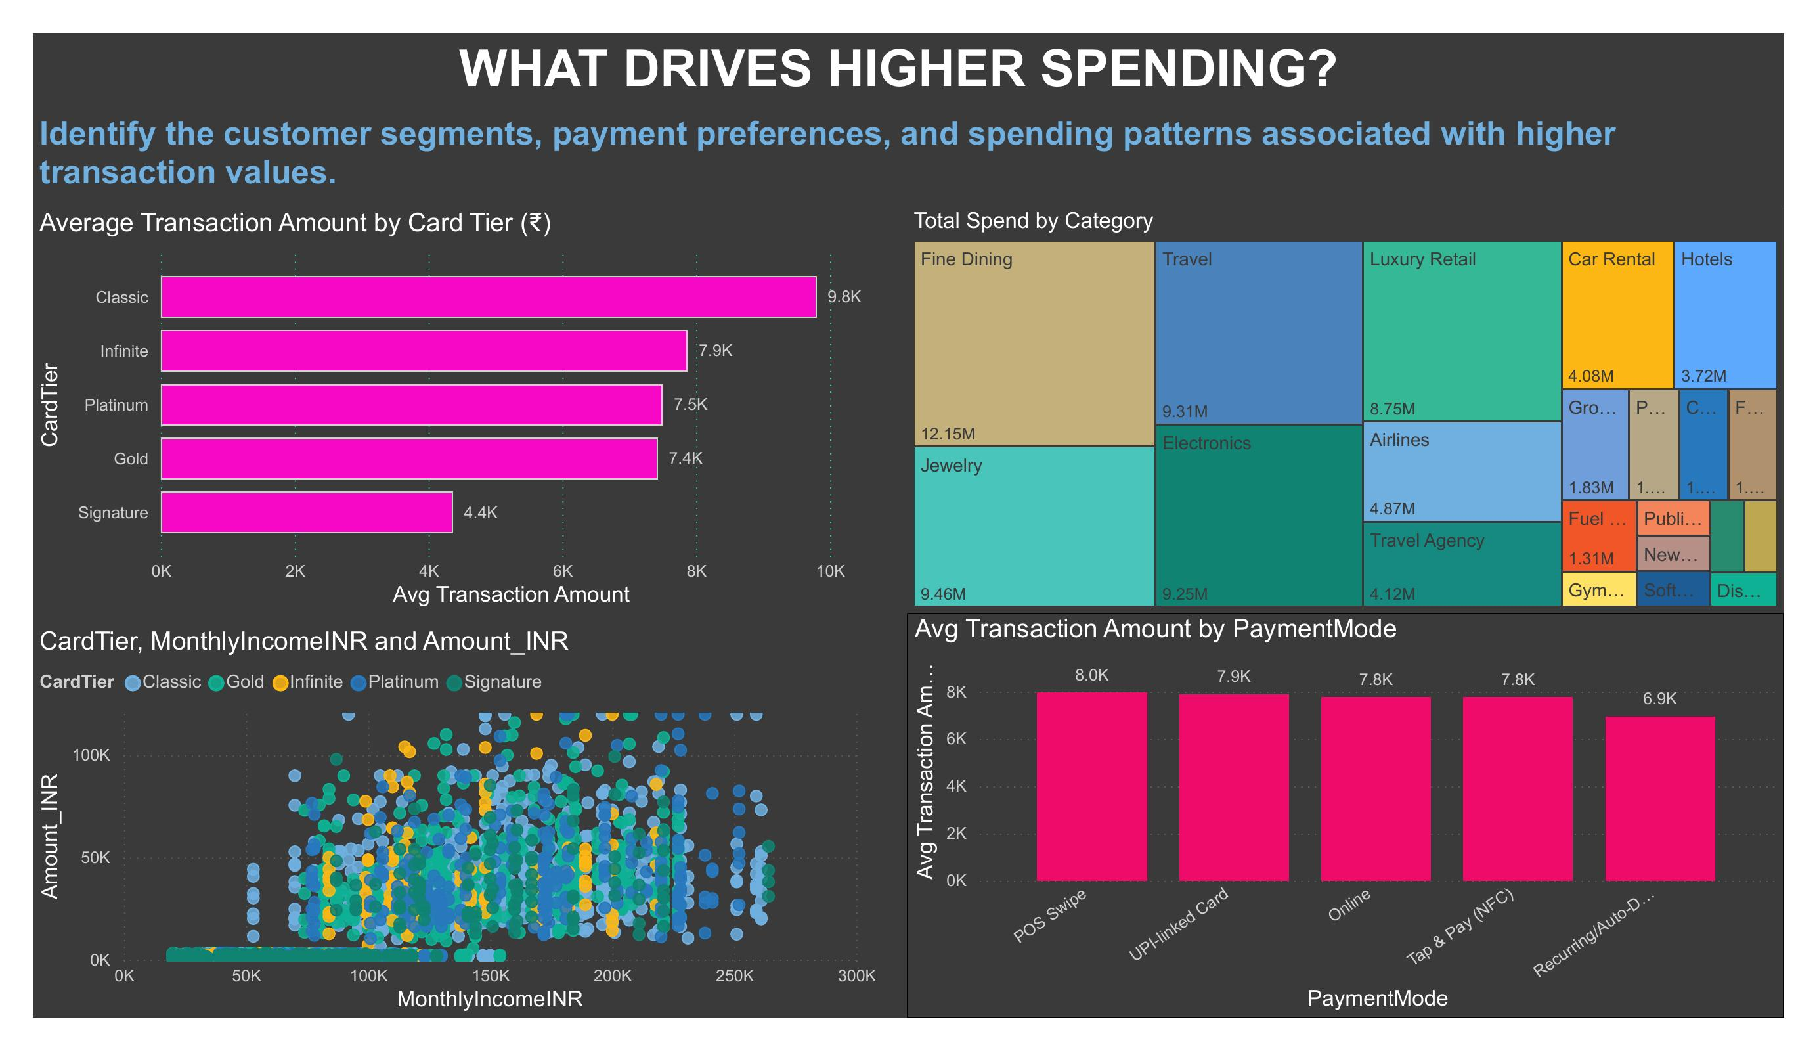

POWER BI · DASHBOARD
What Drives Higher Spending?
Customer segments, payment preferences and tiers linked to bigger transactions
What Each Chart Shows
Avg Amount by Card Tier
Classic tops every tier at ₹9.8K — independently confirming the notebook's ANOVA finding.
Total Spend by Category
Fine Dining again leads at ₹12.15M, with Jewelry and Travel close behind.
Tier, Income & Amount
Spend still scales with income within every individual card tier.
Avg Amount by Payment Mode
POS Swipe carries the highest avg ticket (₹8.0K); Recurring/Auto-Debit the lowest (₹6.9K).
Dashboard page 5 of 5
GAURAV KUMAR GUPTA · 2401003062
14

Slide 15
SYNTHESIS
Key Insights — Notebook × Dashboard
Classic Tier
~8×
Fine Dining
Highest avg spend of any tier (₹9,802.86, p<0.001) — not the premium tiers. Confirmed independently on the Power BI side.
EMI transactions average ₹45.3K vs ₹5.6K for non-EMI (p<0.001) — the dataset's clearest, most intuitive finding.
#1 category by total spend in both the notebook (₹12.1M) and the dashboard (₹12.15M) — fully consistent.
Statistically Supported Findings
Weekend vs weekday spend: no significant difference (p = 0.45) — a myth worth retiring.
Payment mode has no significant link to failure/success/refund rate (p = 0.22).
Gender vs transaction status is borderline (p ≈ 0.056) — not significant at α = 0.05.
Reward points scale almost linearly with spend (r = 0.944), as designed.
Amount ↔ Income shows a moderate–strong link (r = 0.668) across both notebook and dashboard.
North region concentrates the largest regional share of spend (26.09%).
Recommendation: Investigate the Card Tier ↔ Amount relationship further — it's the most business-relevant and least intuitive finding, and likely has a real operational explanation (e.g. how tiers are assigned, or category mix per tier).
GAURAV KUMAR GUPTA · 2401003062
15

Slide 16
DATA SCIENCE PROJECT
THANK YOU
Credit Card Transaction Analytics Dashboard using Power BI — from a deliberately messy 10,658-row dataset to a statistically validated, cleaned dataset and a 5-page interactive dashboard.
Gaurav Kumar Gupta · 2401003062

