Slide 1
Project Title: "Sales Insights Using SQL: Data-Driven Business Decisions"

Slide 2
Introduction: This project focuses on analyzing sales data using SQL queries to extract meaningful insights from a sales database. By utilizing SQL, we aim to uncover key trends in customer purchases, employee performance, and order fulfillment. The insights derived from this analysis can help businesses improve their decision-making, optimize operations, and enhance customer satisfaction.

Slide 3
QUESTIONS
Identify the total no of products sold.
Other than Completed, display the available delivery status’s
Display the order id, order date and Product Name for all the completed orders.
Sort the above query to show the earliest orders at the top. Also, display the customer who purchased these orders.
Display the total no of orders corresponding to each delivery status
How many orders are still not completed for orders purchasing more than 1 item?
Find the total number of orders corresponding to each delivery status-- by ignoring the case in the delivery status. The status with highest no of orders should be at the top.

Slide 4
QUESTIONS
Write a query to identify the total products purchased by each customer .
Display the total sales and average sales done for each day.
Display the customer name, employee name, and total sale amount of all orders -- which are either on hold or pending.
Fetch all the orders which were neither completed/pending or were handled by the employee Abrar. -- Display employee name and all details of order.
Fetch the orders which cost more than 2000 but did not include the MacBook Pro. -- Print the total sale amount as well.
Identify the customers who have not purchased any product yet.
Write a query to identify the total products purchased by each customer. Return all customers irrespective of whether they have made a purchase or not. -- Sort the result with the highest no of orders at the top.

Slide 5
QUESTIONS
Identify the total no of products sold.
Corresponding to each employee, display the total sales they made of all the completed orders. -- Display total sales as 0 if an employee made no sales yet.
Re-write the above query to display the total sales made by each employee corresponding to each customer. If an employee has not served a customer yet then display "-" under the customer.
Re-write the above query to display only those records where the total sales are above 1000.
Identify employees who have served more than 2 customers.
Identify the customers who have purchased more than 5 products.
Identify customers whose average purchase cost exceeds the average sale of all the orders.

Slide 6


1. Identify the total no of products sold?

Slide 7
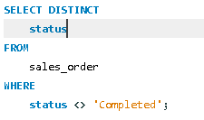
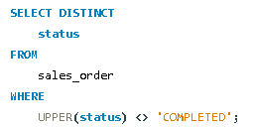
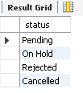
2. Other than Completed, display the available delivery status’s?

Slide 8
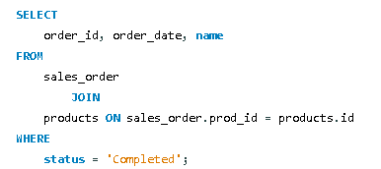
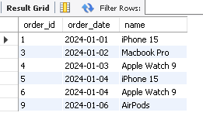
3. Display the order id, order_date and product_name for all the completed orders?

Slide 9
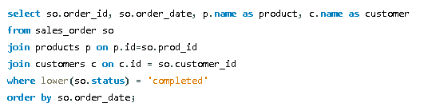
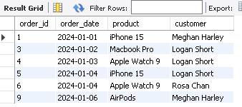
4. Sort the above query to show the earliest orders at the top. Also, display the customer who purchasedthese orders?

Slide 10

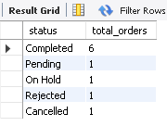
5. Display the total no of orders corresponding to each delivery status?

Slide 11


6. How many orders are still not completed for orders purchasing more than 1 item?

Slide 12
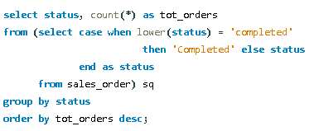

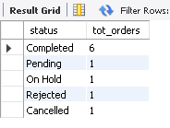
7. Find the total number of orders corresponding to each delivery status-- by ignoring the case in the delivery status. The status with highest no of orders should be at the top?

Slide 13

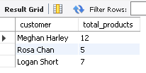
8. Write a query to identify the total products purchased by each customer?

Slide 14
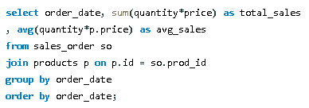
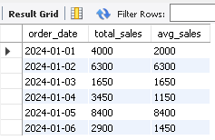
9. Display the total sales and average sales done for each day?

Slide 15
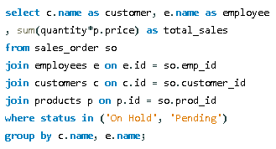

10. Display the customer name, employee name, and total sale amount of all orders, which are either on hold or pending?

Slide 16
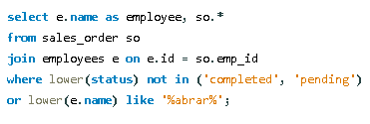
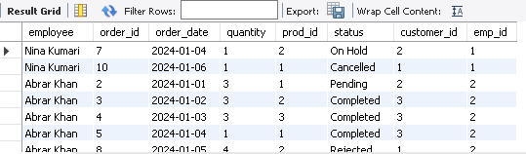
11. Fetch all the orders which were neither completed/pending or were handled by the employee Abrar. Display employee name and all details of order?

Slide 17
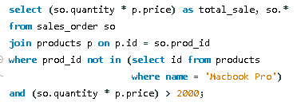

12. Fetch the orders which cost more than 2000 but did not include the MacBook Pro. Print the total sale amount as well?

Slide 18



13. Identify the customers who have not purchased any product yet?

Slide 19
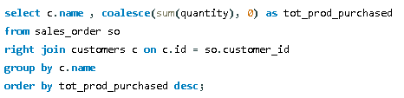
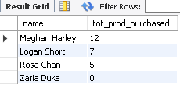
14. Write a query to identify the total products purchased by each customer. Return all customers irrespective of whether they have made a purchase or not. Sort the result with the highest no of orders at the top?

Slide 20
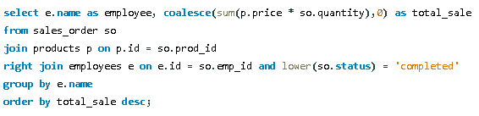

15. Corresponding to each employee, display the total sales they made of all the completed orders. Display total sales as 0 if an employee made no sales yet?

Slide 21
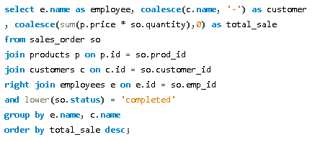
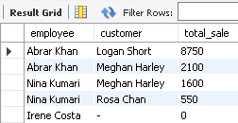
16. Re-write the above query to display the total sales made by each employee corresponding to each customer. If an employee has not served a customer yet then display "-" under the customer?

Slide 22
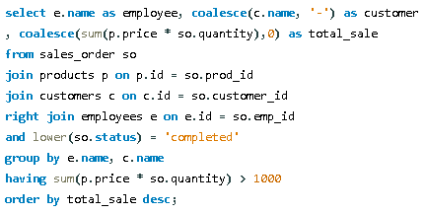
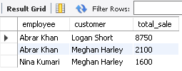
17. Re-write the above query to display only those records where the total sales are above 1000?

Slide 23
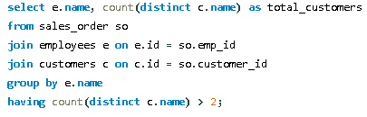

18. Identify employees who have served more than 2 customers?

Slide 24
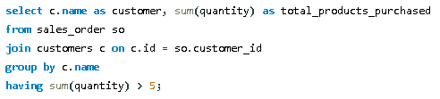

19. Identify the customers who have purchased more than 5 products?

Slide 25
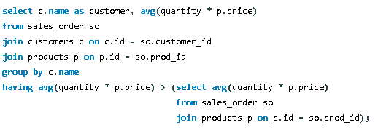

20. Identify customers whose average purchase cost exceeds the average sale of all the orders?

Slide 26
Key Insights: Total Sales and Product Performance Identified the total number of products sold. Analyzed daily sales trends, including total and average sales. Order Status and Delivery Trends Extracted all unique order statuses apart from “Completed.” Counted the total number of orders under each delivery status. Ranked statuses based on the highest number of orders. Customer Purchase Behavior Identified customers who made the most purchases. Listed customers who have not made any purchases. Found customers whose average purchase cost exceeds the overall average sale. Employee Performance Metrics Displayed total sales made by each employee. Identified employees who served more than two customers. Highlighted employees with total sales above 1000. Product and Order Analysis Filtered orders that exceeded a total cost of 2000 but did not include MacBook Pro. Displayed orders containing more than one item that were still not completed.

Slide 27
Thanks Gaurav
9711407364
panwargaurav813@gmail.com

