Slide 1
REPORT
Data Analytics

Slide 2
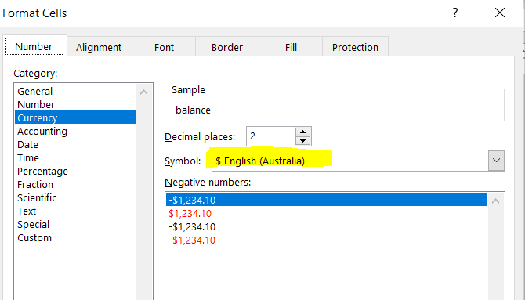
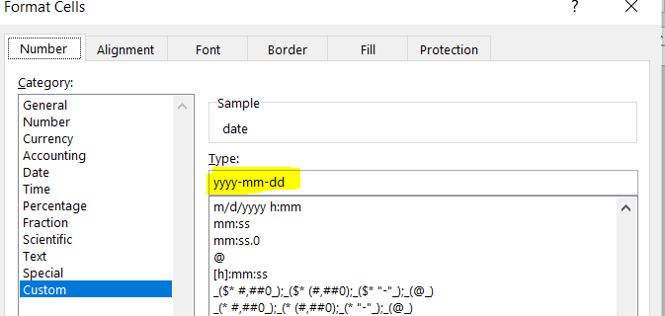
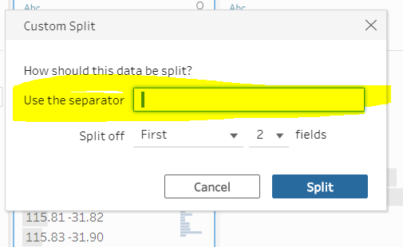
Steps 1: Data Cleanining Phase
Format the column of date in YYYY-MM-DD format as well as format the amount and Balance in Australian Dollar .
Removed some column which does not contribute in the result like merchant code
Split some data like Longtitde and Latitude (this is not necessary steps )

Slide 3
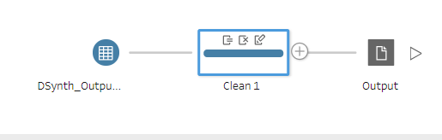
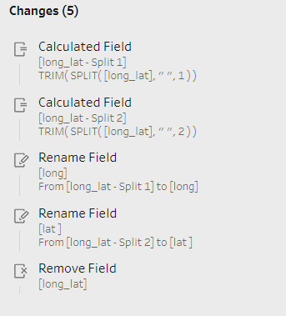
Steps 2: Data Cleanining Phase
Take the data into tableau prep and has done some basic steps like split , rename,etc.
Finally after cleaning the data we have Made one csv file ready to analyze the data.

Slide 4
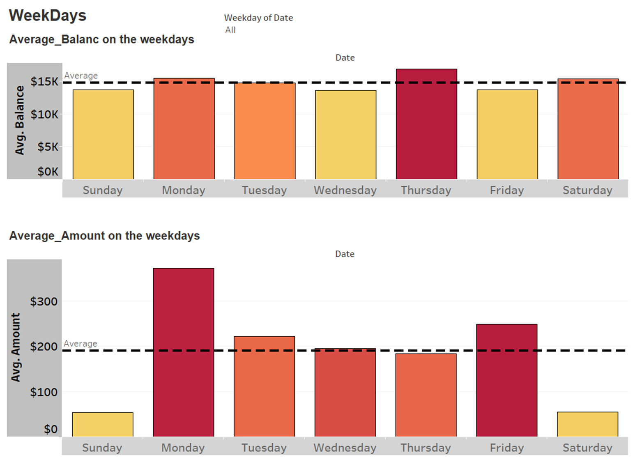
Steps 3.1: Data Visualization(Weekdays)
If we observe the visualization 1 as per weekdays you will find that on Monday Thursday and Saturday the Balance is Above the average $15 k.
If we observe the visualization 2 as per weekdays you will find that on Monday Tuesday and Friday the amount is Above the average $222 .

Slide 5
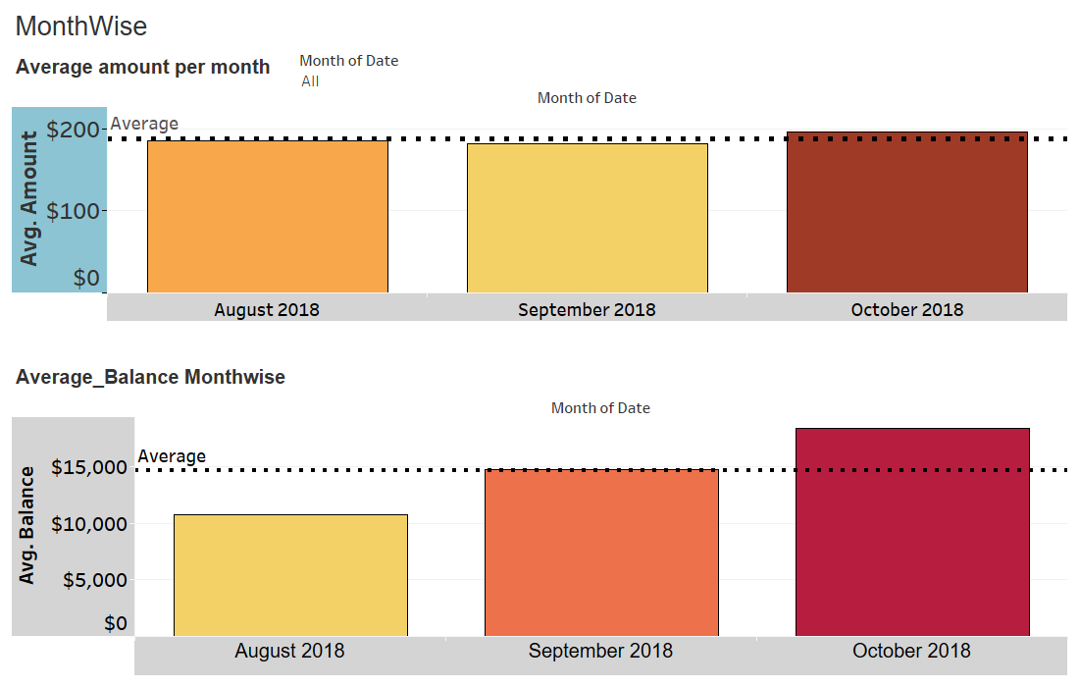
Steps 3.2: Data Visualization(MonthWise)
If we observe the visualization 1 you will observe that in October it crossed the average amount that is $188
If we observe the visualization 2 you will find that in September and october the amount is above the average $18,451 .

Slide 6
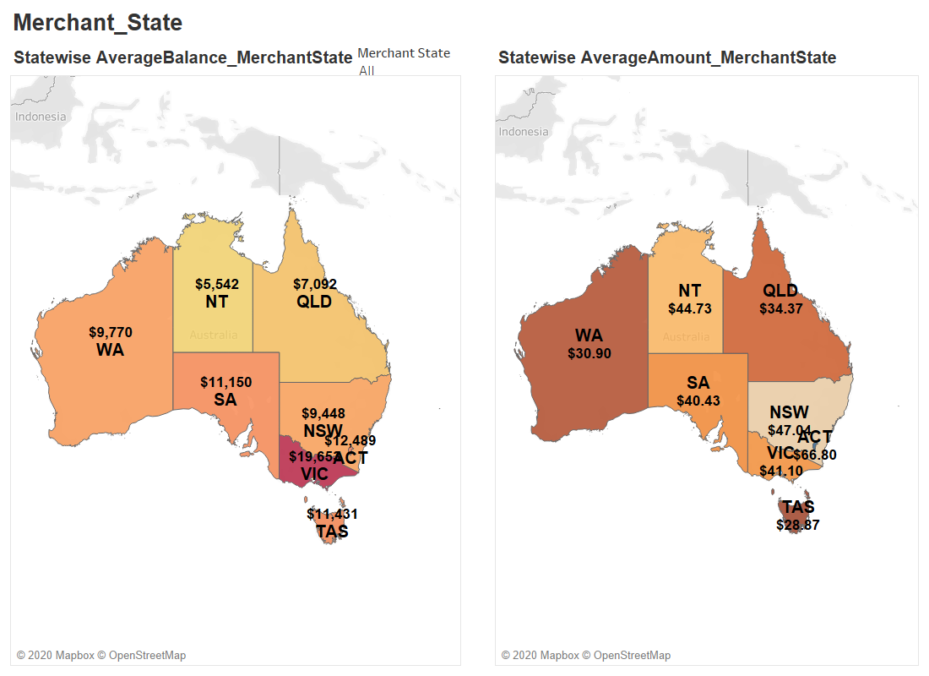
Steps 3.3: Data Visualization(Merchant_State)
If we look the visualization 1 you will find that Merchant who is in the VIC State has maximumAverageBalance($19,653) and NT has minimumAverage Balance($5,542)
If we observe the visualization 2 you will find that Merchant State ACT has maximum average amount ($66.80) and Merchant State TAS has Minimum average amount ($28.87)

Slide 7
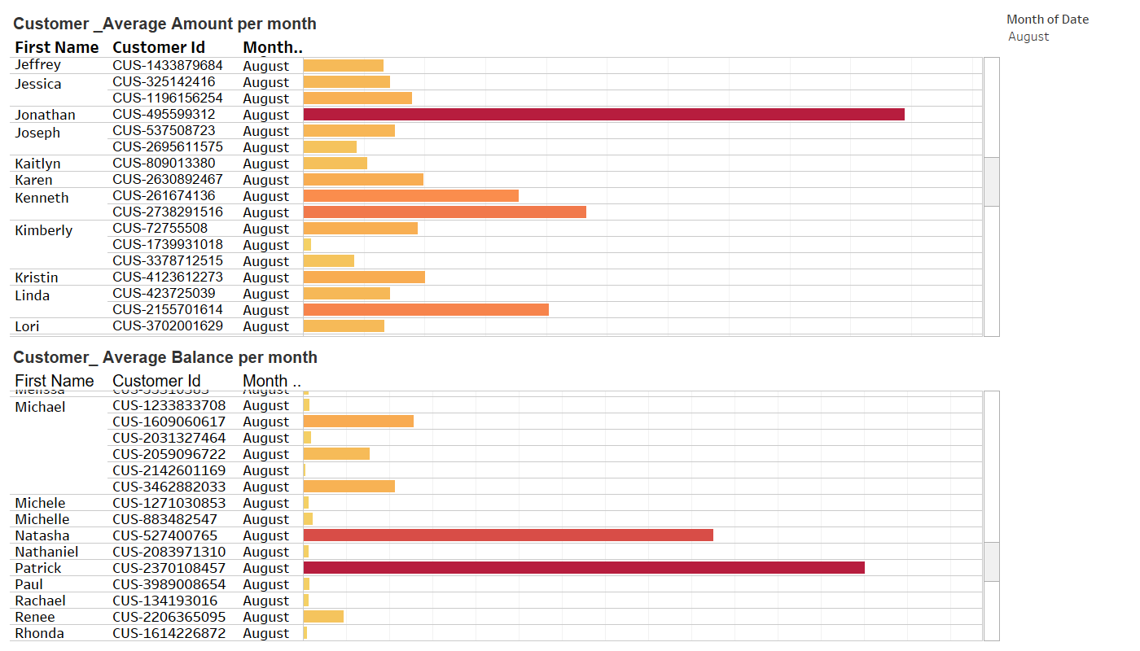
Steps 3.4: Data Visualization(Customer)
If we Look the visualization 1, you will find that in August month Jonathan spent Most ($989.42)
If we observe the visualization 2 you will find that in August month Patrick has highest ($260,326)

Slide 8
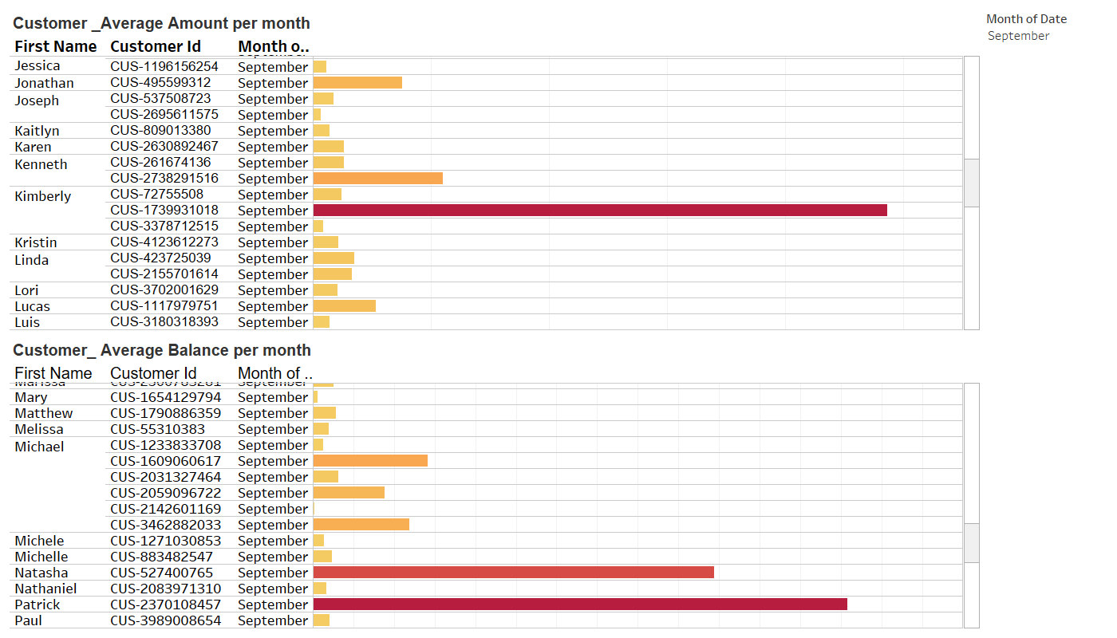
Steps 3.5: Data Visualization(Customer)
If we look the visualization 1, you will find that in September month Kimberly spent most ($4863.42)
If we observe the visualization 2 you will find that in September month patrick has highest ($263,418)

Slide 9
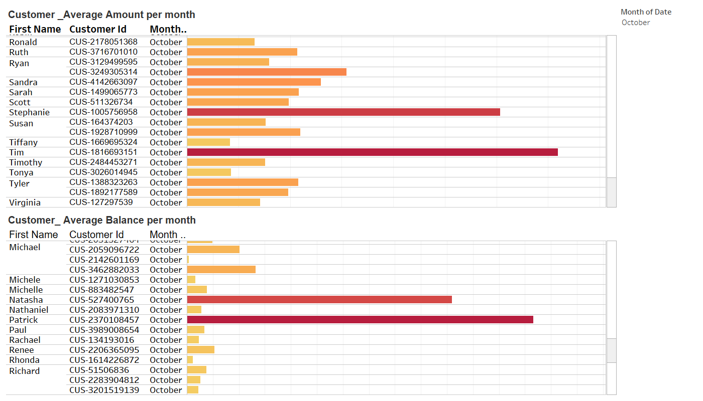
Steps 3.6: Data Visualization(Merchant_State)
If we look the visualization 1, you will find that in October month Tim spent most ($719.26)
If we observe the visualization 2 you will find that in october month patrick has highest ($265,208)

Slide 10
Resource
I am attaching the .tbwx file ,please find the attachment

Slide 11
Submission By
Name : Gaurav Kumar
MaiID: gauravkumarjha1195@gmail.com
Mobile: 017687389578

