Slide 1
REPORT
Data Analytics

Slide 2
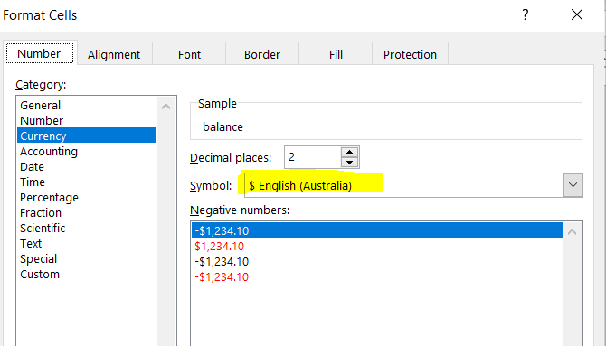
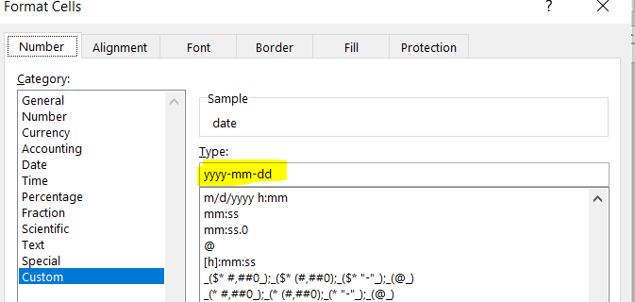
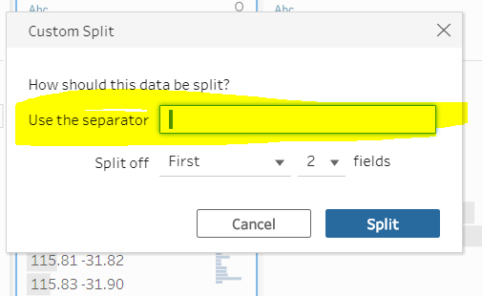
Steps 1: Data Cleanining Phase
Format the column of date in YYYY-MM-DD format as well as format the amount and Balance in Australian Dollar .
Removed some column which does not contribute in the result like merchant code
Split some data like Longtitde and Latitude (this is not necessary steps )

Slide 3
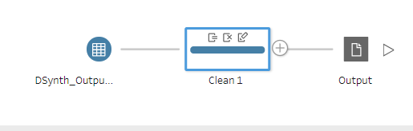
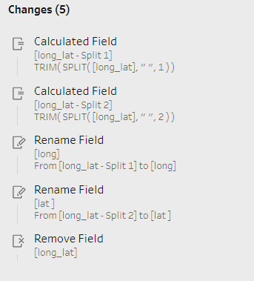
Steps 1: Data Cleanining Phase
Take the data into tableau prep and has done some basic steps like split , rename.
Finally after cleaning the data we have make one csv file ready to analyze the data.

Slide 4
Steps 2:Load the data into Tableau
Take the data into tableau prep and has done some basic steps like split , rename.
Finally after cleaning the data we have make one csv file ready to analyze the data.

Slide 5
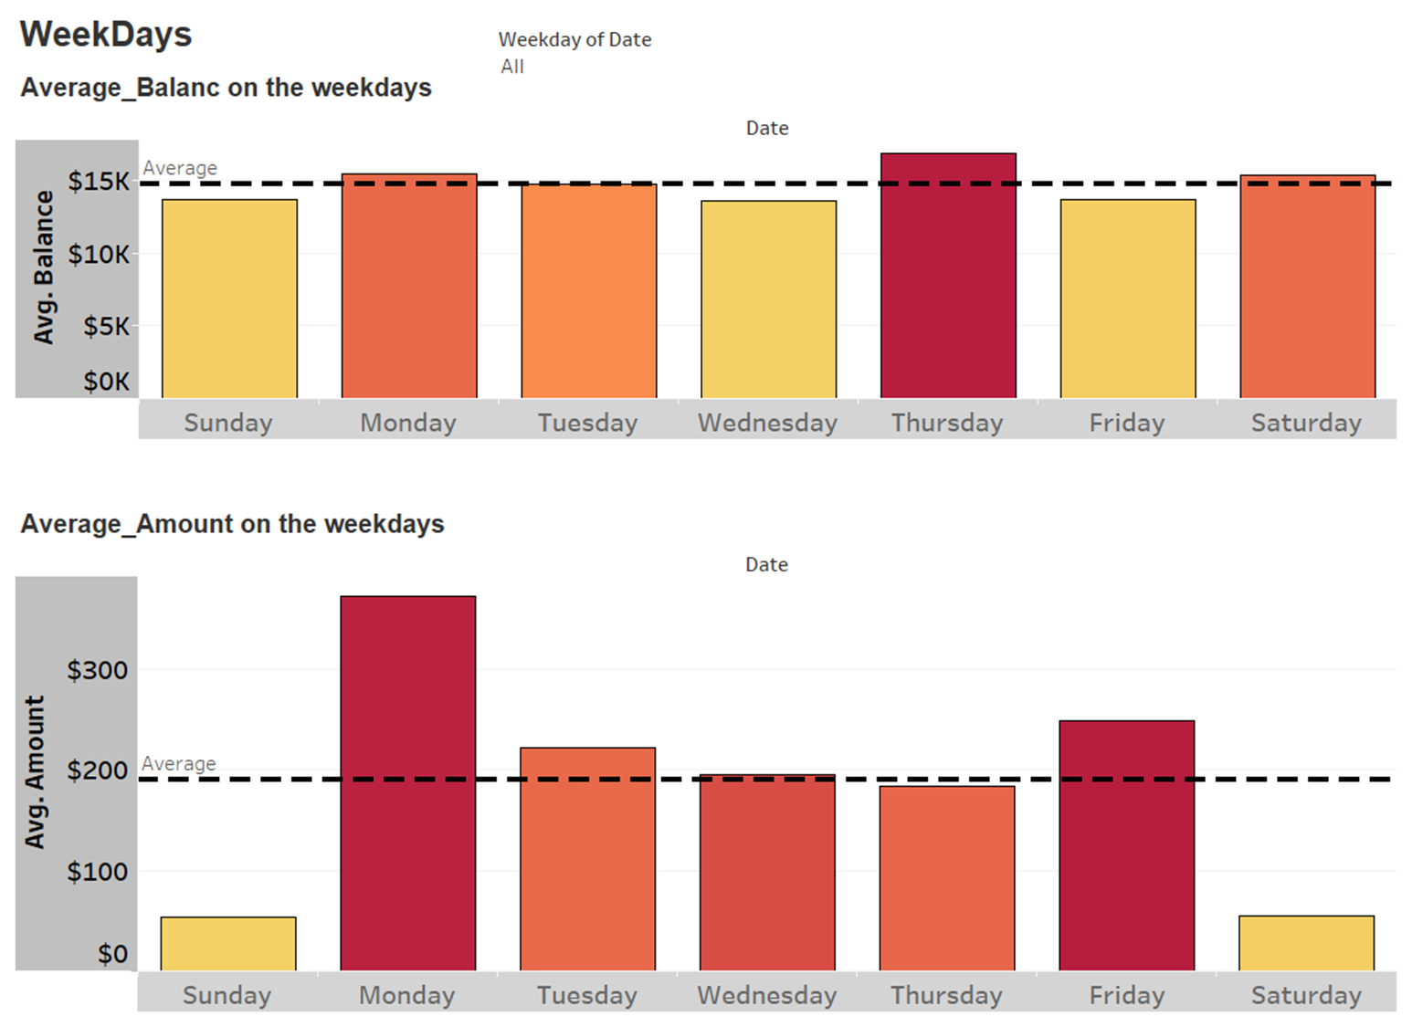
Steps 3: Data Visualization(WeekDays)
If we observe the visualization as per weekdays you will find that on Monday Thursday and Saturday the balance is above the average $15 k.
If we observe the visualization as per weekdays you will find that on Monday Tuesday and Friday the amount is above the average $222 .

Slide 6
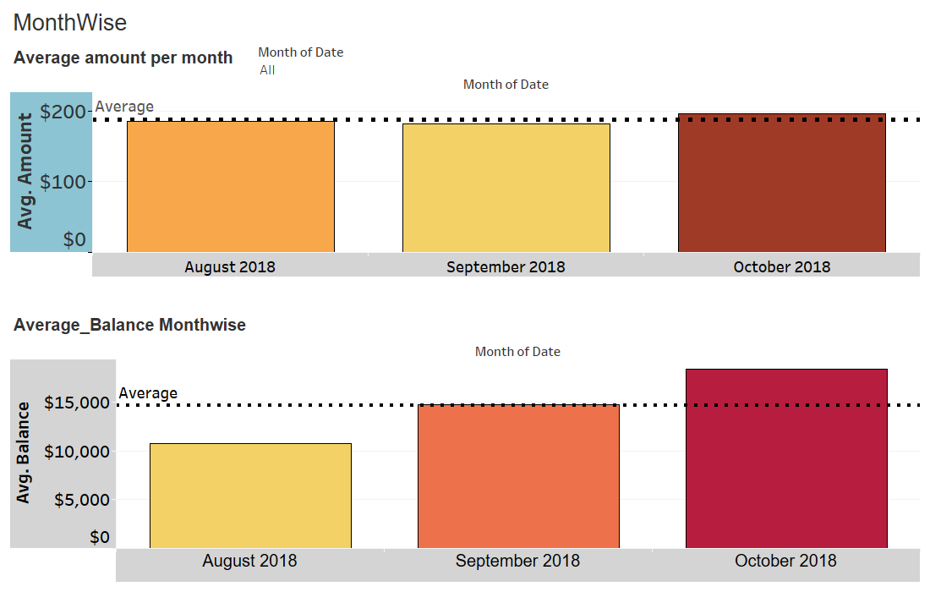
Steps 3: Data Visualization(MonthWise)
If we observe the visualization 1 you will obvserve that in october it crossed the average amount that is $188
If we observe the visualization 2 you will find that in september and october the amount is above the average $18,451 .

Slide 7
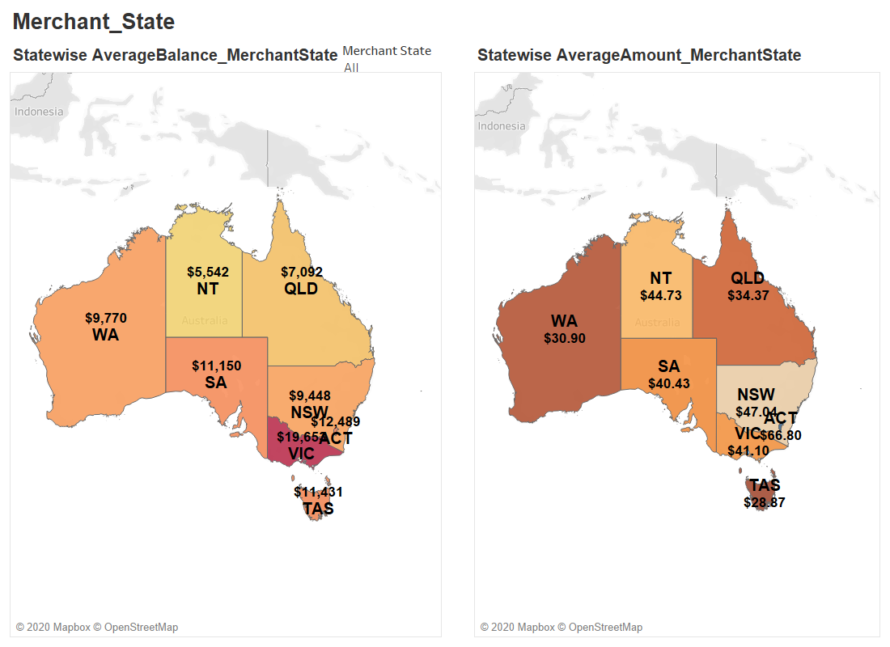
Steps 3: Data Visualization(Merchant_State)
If we look the visualization 1 you will find that Merchant who is in the VIC State has maximumAverageBalance($19,653) and NT has minimumAverage Balnce($5,542)
If we observe the visualization 2 you will find that Merchant state ACT has maximum average amount ($66.80) and Merchant state TAS has minimum average amount ($28.87)

Slide 8
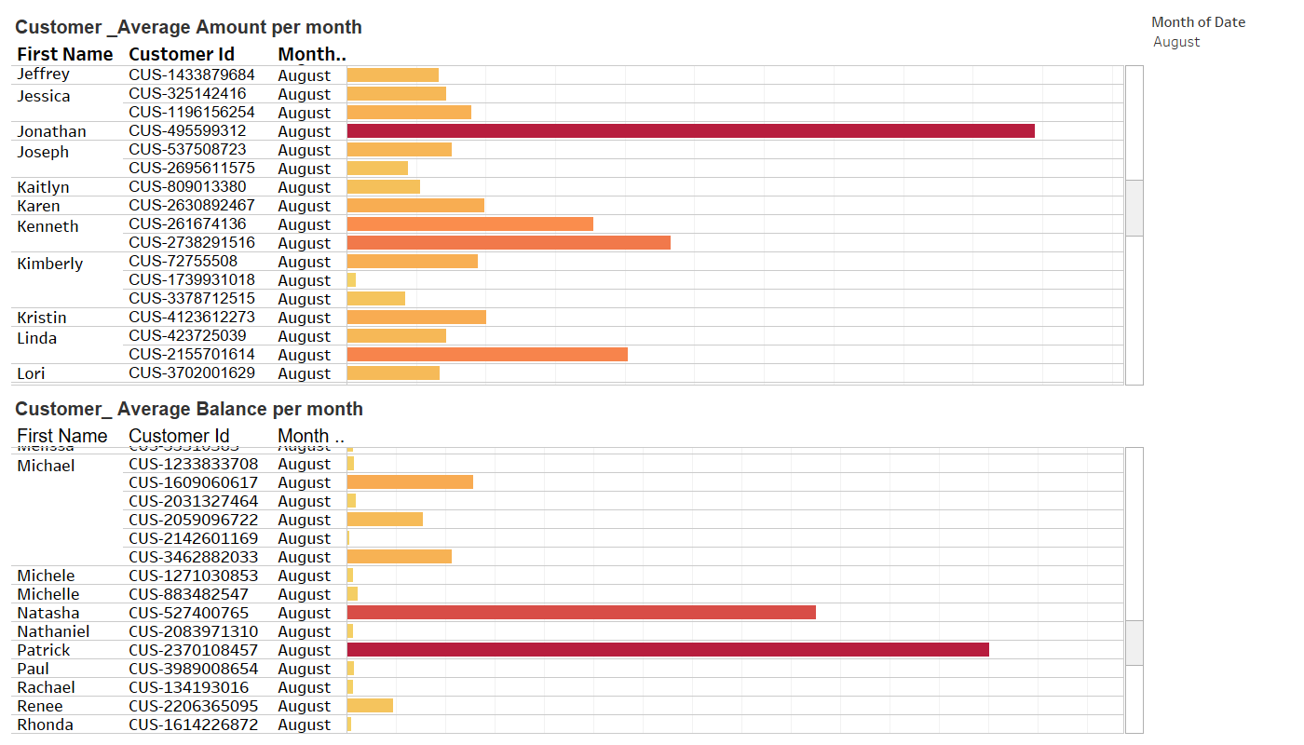
Steps 3: Data Visualization(Customer)
If we look the visualization 1, you will find that in august month Jonathan spent most ($989.42)
If we observe the visualization 2 you will find that in august month patrick has highest ($260,326)

Slide 9
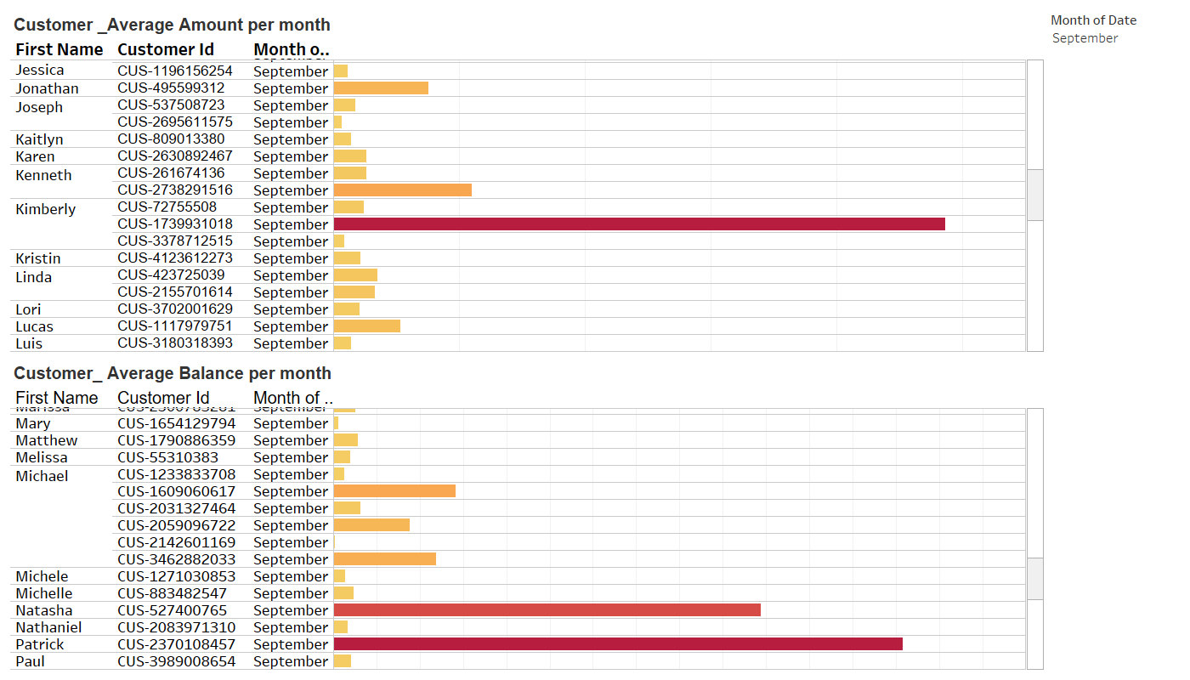
Steps 3: Data Visualization(Customer)
If we look the visualization 1, you will find that in September month Kimberly spent most ($4863.42)
If we observe the visualization 2 you will find that in September month patrick has highest ($263,418)

Slide 10
Steps 3: Data Visualization(Merchant_State)
If we look the visualization 1 you will find that Merchant who is in the VIC State has maximumAverageBalance($19,653) and NT has minimumAverage Balnce($5,542)
If we observe the visualization 2 you will find that Merchant state ACT has maximum average amount ($66.80) and Merchant state TAS has minimum average amount ($28.87)

