Slide 1
Amazon Smbhav Hackathon 2024
Automated Amazon Product Generator
Team AAGen

Slide 2
CONTENT
Team Details
Idea and Approach Details
Theme Details
Methodology/Architecture Diagram
01
03
02
04

Slide 3
Team Composition
Akash Gupta
Aman Tiwary
Gaurav Kumar
AI/ML Integration : LLM(gemini-1.5-pro)
UI/UX
Tech stack : React
Backend : Django

Slide 4
Theme Details

Slide 5
Theme Overview
01
Main Theme Description
Social Media to Amazon Product Listing Automation
02
Objectives of the Theme
A system that seamlessly converts social media content into comprehensive Amazon product listings, enabling buyers to easily compare and purchase products.
03
Target Audience
Influencers those who wanted to scale and sell product more easily

Slide 6
Theme Challenges
01
02
03
Key Issues
Impact Analysis
Expected Innovations
Lack of automated product categorization with machine learning models.
Need for AI tools to extract product details from multimedia.
Absence of unified pipeline to manage listings across platforms.
Enhanced Listing Quality and Follower Engagement
Seller Efficiency and Business Growth
Competitive Advantage and Higher Visibility on Amazon
Automatically detect products in audio and video frames or image thumbnails from influencer post to link with Amazon Product Catalogue.

Slide 7
Idea and Approaches

Slide 8
Proposed Approach
Solution Outline
User Experience Plan
Social Media Integration
Automated Listing Draft
Customizable Templates
Performance Tracking
One-Click Conversion: influencers can convert a social post into a ready-to-publish Amazon product listing in one click
Seamless Social Media Integration: This solution connects social platforms like Instagram, YouTube, or TikTok with Amazon. Followers can go directly from watching an influencers video to purchasing the product without needing to search for it separately. Reducing the steps from discovery to purchase simplifies the journey, making shopping feel spontaneous and easy.

Slide 9

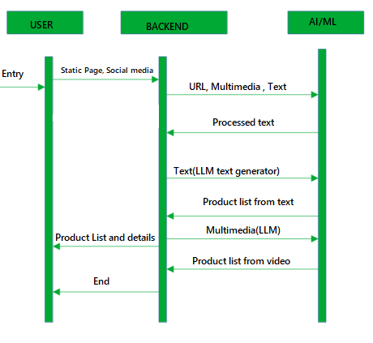
Sequence Diagram

Slide 10
Methodology
When a user posts on their social media or webpage, the backend system scrapes the page to retrieve text and multimedia content.
The scraped content is categorized into multimedia, text, and URLs and sent to specific LLMs for processing:
- Text content is sent to a dedicated text-processing LLM.
- Images and videos are sent to an LLM for multimedia analysis.
Each LLM is prompted to identify the product and extract relevant details.
The processed information is combined and sent as a response to the user.

Slide 11
Thank you

