Slide 1
Mutual Fund Analytics & Investor Insights
Bluestock Fintech Capstone Project
Submitted By:
Gaurav Kumar
Technologies Used:
Python • SQLite • Power BI • GitHub • VS Code
June 2026

Slide 2
Problem Statement & Objectives
Problem Statement
Mutual fund data is scattered across multiple sources.
Investors struggle to compare fund performance and risk.
Manual analysis is time-consuming.
Objectives
Build an ETL pipeline
Perform Exploratory Data Analysis
Calculate financial performance metrics
Build Power BI Dashboard
Develop Mutual Fund Recommendation System

Slide 3
Data Sources
Datasets Used
Fund Master
NAV History
Scheme Performance
Investor Transactions
Portfolio Holdings
Benchmark Indices
Industry Statistics
Technologies
Python
Pandas
SQLite
Power BI
Git & GitHub

Slide 4
Project Architecture (ETL)
Insert this diagram using SmartArt → Process
Raw CSV Files
↓
Data Cleaning
↓
Data Transformation
↓
SQLite Database
↓
Power BI Dashboard
↓
Reports & Insights
Bottom of slide
Tools
Python → Pandas → SQLite → Power BI

Slide 5
EDA Highlights (Part 1)
Insert 4 charts:
AUM Growth
Folio Growth
Gender Distribution
Age Group Distribution
Bottom:
Key Insights
Industry AUM increased steadily.
Folio count increased every year.
Most investors belong to working-age groups.
Investor participation continues to grow.

Slide 6
EDA Highlights (Part 2)
Insert:
State-wise Investment
Sector Allocation
Category Heatmap
T30 vs B30
Bottom:
Insights
Maharashtra and Karnataka contributed high investments.
Equity sector dominated portfolios.
Smaller cities showed increasing participation.
Investment categories showed clear diversification.

Slide 7
Performance Analytics
Financial Metrics Calculated
Daily Returns
CAGR
Sharpe Ratio
Sortino Ratio
Alpha
Beta
Maximum Drawdown
Key Result
Risk-adjusted metrics helped identify the best-performing mutual funds.
(Optional: Insert Rolling Sharpe chart.)

Slide 8
Advanced Analytics
Advanced Features
Historical VaR (95%)
CVaR
Rolling Sharpe Ratio
Investor Cohort Analysis
SIP Continuity Analysis
HHI Concentration Analysis
Mutual Fund Recommendation System
Outcome
Investors receive risk-based fund recommendations.

Slide 9
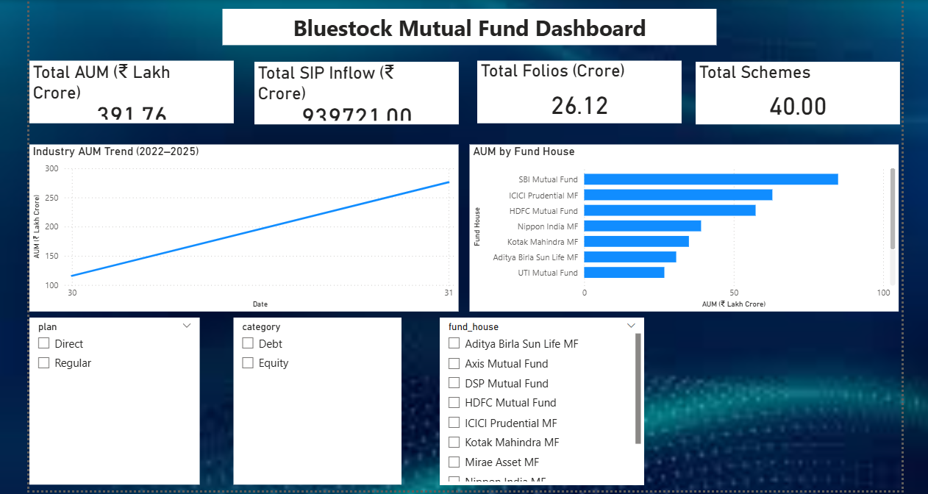
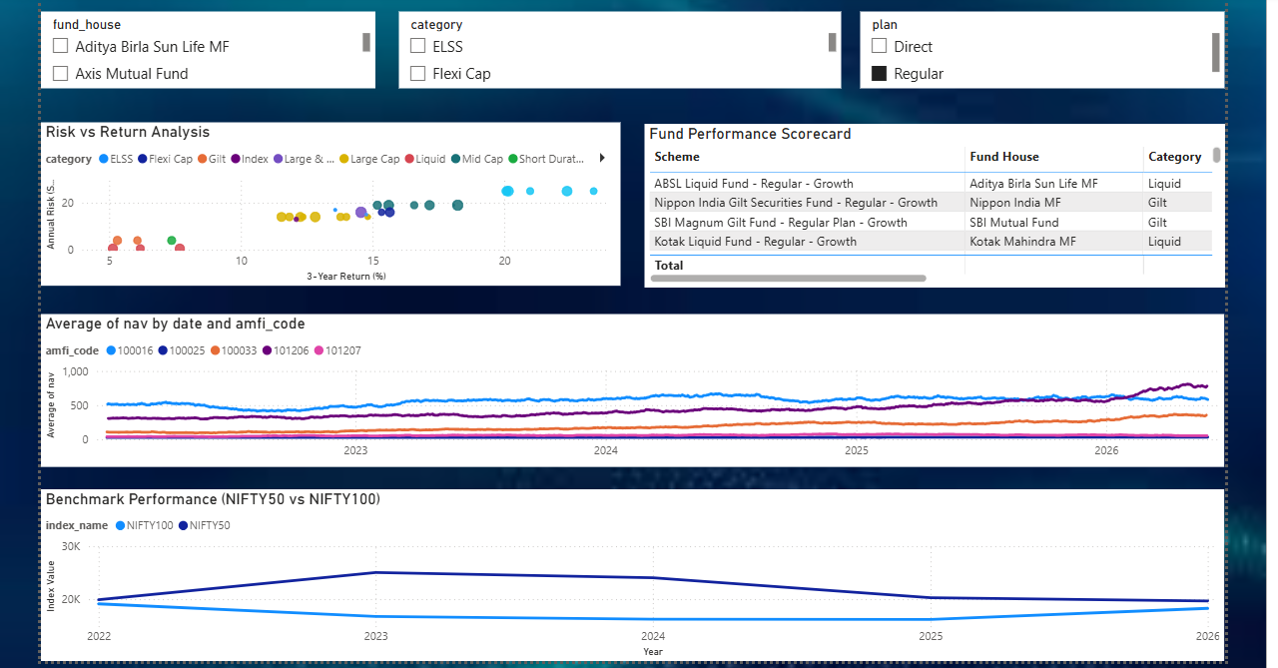
Power BI Dashboard (Pages 1 & 2)
Insert screenshots of:
Industry Overview
Fund Performance

Slide 10
Dashboard Features
KPI Cards
AUM Trend
Risk vs Return Scatter
Fund Scorecard
Interactive Filters

Slide 11
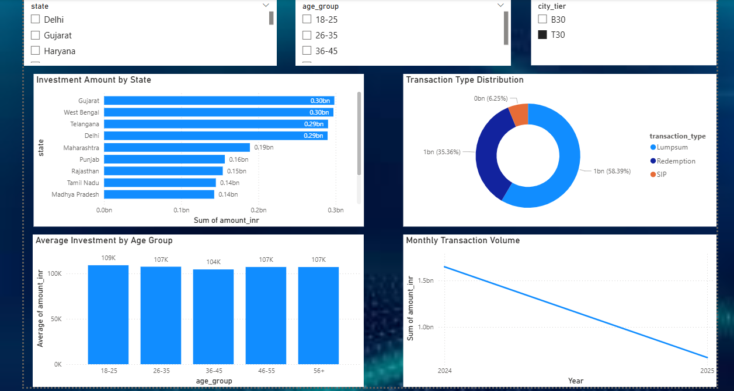
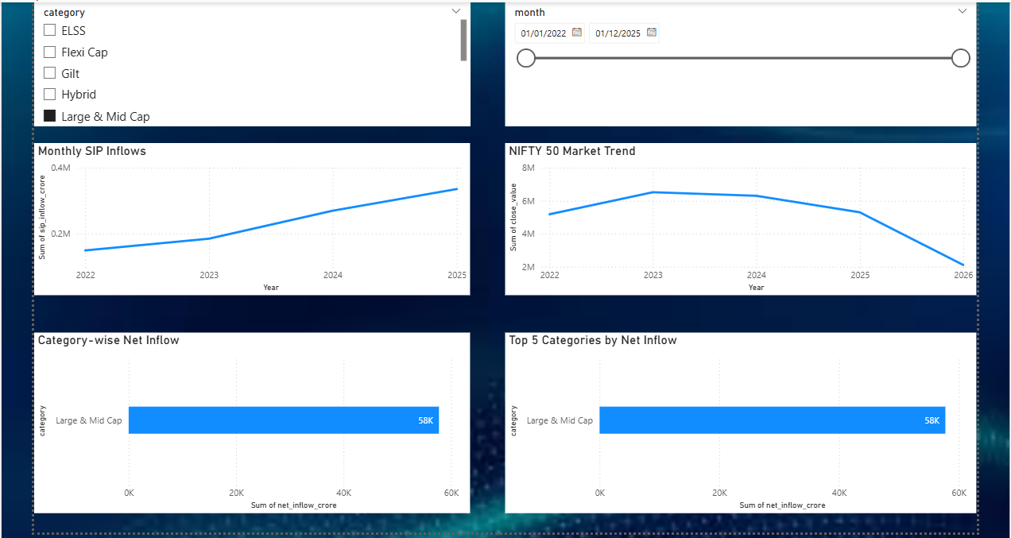
Power BI Dashboard (Pages 3 & 4)
Insert screenshots of:
3. Investor Analytics
4. SIP & Market Trends

Slide 12
Dashboard Features
State Analysis
SIP Distribution
Monthly Transactions
Market Trend Analysis
Drill-through
Tooltips

Slide 13
Key Findings
Major Findings
Mutual fund industry experienced consistent growth.
SIP inflows increased steadily.
Risk-adjusted metrics improved fund comparison.
Investor cohorts showed changing investment behavior.
Power BI dashboard enabled interactive analysis.
Recommendation system suggested top-performing funds based on risk.

Slide 14
Thank You
Questions?
Mutual Fund Analytics & Investor Insights
Bluestock Fintech Capstone Project
Presented by
Gaurav Kumar
Thank You!

