Slide 1

cv
Efficient Algorithmic models for Adversarial attacks and Defenses in Deep learning
Team Members
1. Durgesh Nandini M [1DS19CS711]
2. Gagandeep B K [1DS19CS714]
3. Gaurav Sarkar [1DS19CS715]
4. Faizan Khurshid [1DS19CS713]
Under the Guidance of
Mrs. Sarala DV
Assistant Professor, Dept of Computer Science and Engineering
Department of Computer Science & Engineering, DSCE

Slide 2
cv
Introduction
With the rapid developments of artificial intelligence (AI) and deep learning (DL) techniques, it is critical to ensure the security and robustness of the deployed algorithms.
Recently, the security vulnerability of DL algorithms to adversarial samples has been widely recognized. The fabricated samples can lead to various misbehaviors of the DL models while being perceived as benign by humans.
Successful implementations of adversarial attacks in real physical-world scenarios further demonstrate their practicality.
Hence, adversarial attack and defense techniques have attracted increasing attention from both machine learning and security communities and have become a hot research topic in recent years.
Department of Computer Science & Engineering, DSCE

Slide 3
cv
A trillion-fold increase in computation power has popularized the usage of deep learning (DL) for handling a variety of machine learning (ML) tasks, such as image classification, natural language processing, and game theory.
However, a severe security threat to the existing DL algorithms has been discovered by the research community : Adversaries can easily fool DL models by perturbing benign samples without being discovered by humans.
Perturbations that are imperceptible to human vision/hearing are sufficient to prompt the model to make a wrong prediction with high confidence.
Thus adversarial sample is considered to be a significant obstacle to the mass deployment of DL models that are in production.
Department of Computer Science & Engineering, DSCE

Slide 4
cv
Adversarial Attacks :
Adversarial attacks are crafted malicious inputs(image, text, and voice) that are fed to the machine learning models in order to cause them make a mistake or a wrong prediction.
The objective of these attacks can be anything. For instance, it can be either to:
perform a targeted attack against an entity, organization or individual,
evade fake news detection systems to alter political discourse,
poison training data for artificial intelligence systems to produce inaccurate results
Department of Computer Science & Engineering, DSCE

Slide 5
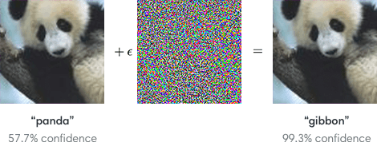
cv
A small demonstration of adversarial examples :
An adversarial attack could involve feeding a model false or misleading data while training or adding maliciously prepared data to trick an already trained model.
Starting with an image of a panda, the attacker adds a small perturbation that has been calculated to make the image recognized as a gibbon with high confidence.
Department of Computer Science & Engineering, DSCE

Slide 6
cv
Objectives :
1. Demonstrate different kinds of attacks on ML/DL models.
2. Demonstrate Defense mechanisms
3. Build robust models
4. Successful implementations of adversarial attacks in real physical-world scenarios further demonstrate their practicality and provide defense mechanisms for various attacks.
Department of Computer Science & Engineering, DSCE

Slide 7
cv
Types of adversarial attacks :
1. Back Door Attack :
This is a specialized type of adversarial machine learning technique that manipulates the behavior of AI algorithms. It aims to implant adversarial vulnerabilities in the machine learning model during the training phase.
2. Blackbox Attack :
Here the attacker has no knowledge of algorithms and working mechanisms of the target device. Attackers execute queries against the target, and analyze the resulting changes and outputs, and try to build a copy of the target device using that data.
3. White-box Attack :
It exploits model-internal information. It assumes complete knowledge of the targeted model, including its parameter values, architecture, training methods and more.
Department of Computer Science & Engineering, DSCE

Slide 8
cv
4. Integrity Attack :
Here, the data, and algorithms used to train a model is tempered that causes the model to behave differently.
5. Confidentiality attacks :
Here the data, and algorithms used to develop and train an model is leaked and used to create a copy of the original
Department of Computer Science & Engineering, DSCE

Slide 9
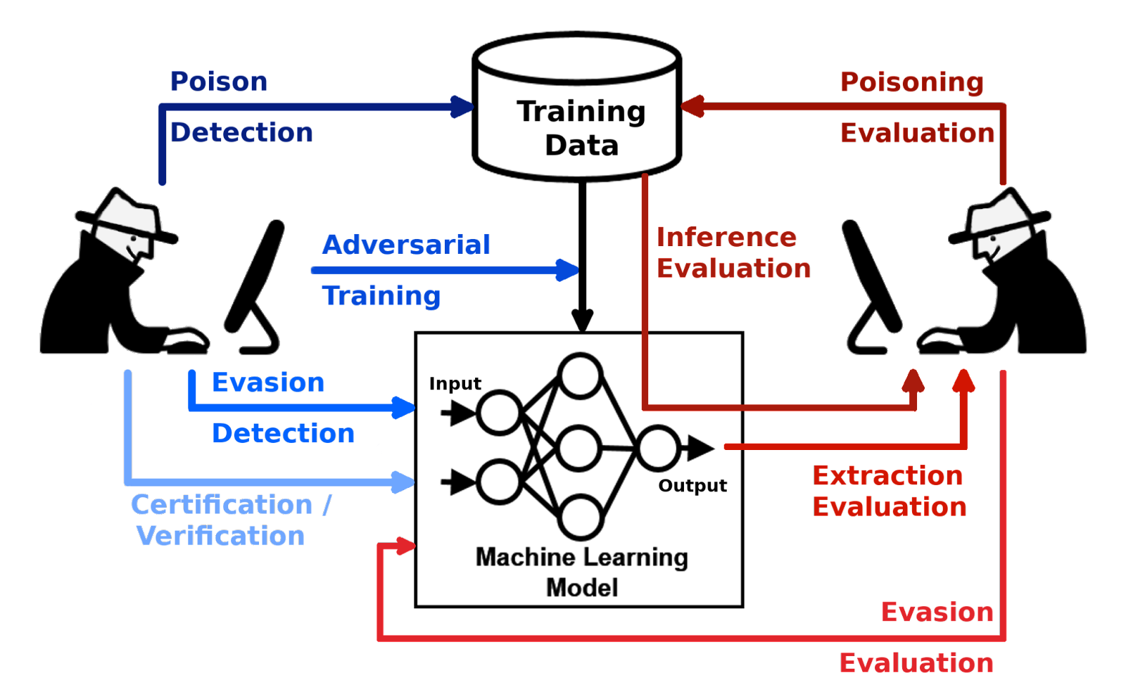
cv
Defensive Mechanisms :
The representative defenses developed in recent years, mainly includes adversarial training, randomization-based schemes, denoising methods, provable defenses, and some other new defenses. We also aim to present a brief discussion on their effectiveness against different attacks under different settings.
Department of Computer Science & Engineering, DSCE

Slide 10
cv
Types of Defensive Mechanisms :
1. Adversarial training
Adversarial training is an intuitive defense method against adversarial samples, which attempts to improve the robustness of a neural network by training it with adversarial samples. Formally, it is a min–max game that can be formulated as follows:
min h max Dðx;x0Þ<g Jðh; x0; yÞ ð15Þ
where Jðh; x0; yÞ is the adversarial loss, with network weights h, adversarial input x0, and ground-truth label y. Dðx; x0Þ represents a certain distance metric between x and x0.
The inner maximization problem is to find the most effective adversarial samples, which is solved by a well-designed adversarial attack, such as FGSM and PGD.
Department of Computer Science & Engineering, DSCE

Slide 11
cv
2. PGD adversarial training
Extensive evaluations demonstrate that a PGD attack is probably a universal first-order L1 attack . If so, model robustness against PGD implies resistance against a wide range of first-order L1 attacks. Based on this conjecture, Madry et al. propose using PGD to train a robust network adversarially. Surprisingly, PGD adversarial training indeed improves the robustness of CNNs and ResNets against several typical first-order L1 attacks, such as FGSM, PGD, and CW1 attacks under both black-box and whitebox settings.
3. Ensemble adversarial training
To avoid the large computational cost brought by PGD adversarial training, proposes to adversarially train a robust ImageNet model by FGSM with random starts. However, the adversarially trained model is even vulnerable to black-box attacks. To tackle this problem, the authors propose a training methodology that incorporates adversarial samples transferred from multiple pre-trained models; namely, ensemble adversarial training (EAT) . Intuitively, EAT increases the diversity of adversarial samples used for adversarial training, and thus enhances network robustness against adversarial samples transferred from other models.
Department of Computer Science & Engineering, DSCE

Slide 12
cv
4. Randomization
Many recent defenses resort to randomization schemes for mitigating the effects of adversarial perturbations in the input/feature domain. The intuition behind this type of defense is that DNNs are always robust to random perturbations. A randomization based defense attempts to randomize the adversarial effects into random effects, which are not a concern for most DNNs. Randomization-based defenses have achieved comparable performance under black-box and gray-box settings, but in the white-box setting, the EoT method can compromise most of them by considering the randomization process in the attack process.
5. Denoising
Denoising is a very straightforward method in terms of mitigating adversarial perturbations/effects. Previous works point out two directions to design such a defense: input denoising and feature denoising. The first direction attempts to partially or fully remove the adversarial perturbations from the inputs, and the second direction attempts to alleviate the effects of adversarial perturbations on high-level features learned by DNNs.
Department of Computer Science & Engineering, DSCE

