Slide 1
System Encryptor (Ransomware)
Gaurav Agarwal

Slide 2


What is Ransomware:
Ransomware is a form of malware that encrypts a victim's files. The attacker then demands a ransom from the victim to restore access to the data upon payment.
Users are shown instructions for how to pay a fee to get the decryption key. The costs can range from a few hundred dollars to thousands, payable to cybercriminals in Bitcoin.

Slide 3

What is Cryptography?
Cryptography is the art of protecting information by transforming the original message, called plaintext into an encoded message, called a cipher or ciphertext.
ABC (meaningful message)-> ZYX(cipher)

Slide 4

What is AES?
AES is an encryption standard chosen by the National Institute of Standards and Technology(NIST), USA to protect classified information. It has been accepted world wide as a desirable algorithm to encrypt sensitive data.
It is a block cipher which operates on block size of 128 bits for both encrypting as well as decrypting.
Each Round performs same operations.

Slide 5

Why AES?
In 1990's the cracking of DES algorithm became possible.
Around 50hrs of brute forcing allowed to crack the message.
NIST started searching for new feasible algorithm and proposed its requirement in 1997.
In 2001 Rijndael algorithm designed by Rijment and Daemon of Belgium was declared as the winner of the competition.
It met all Security, Cost and Implementation criteria.

Slide 6
How Does it works?
AES basically repeats 4 major functions to encrypt data.It takes 128 bit block of data and a key[laymans term password] and gives a ciphertext as output.The functions are:
Sub Bytes
II. Shift Rows
III. Mix Columns
IV. Add Key

Slide 7

How Does it works?
The number of rounds performed by the algorithm strictly depends on the size of key.
The following table gives overview of no. Of rounds performed with the input of varying key lengths:

Slide 8

How Does it works?
The number of rounds performed by the algorithm strictly depends on the size of key.
The following table gives overview of no. Of rounds performed with the input of varying key lengths:
Key Size(in bits) Rounds 128.................................................10
192.................................................12
256.................................................14
The larger the number of keys the more secure will be the data. Thetime taken by s/w to encrypt will increase with no. of rounds.

Slide 9
How Does it works?
Here, E=encryption function for a symmetric block cipher
m=plaintext message of size 128bits
n=ciphertext
k=key of size 128bits which is same for both encryption and decryption
D= Decryption function for symmetric block cipher
E(m,k)
D(n,k)
m(128bits)
E
n(128bits)
n(128bits)
D
m(128bits)
k
k

Slide 10
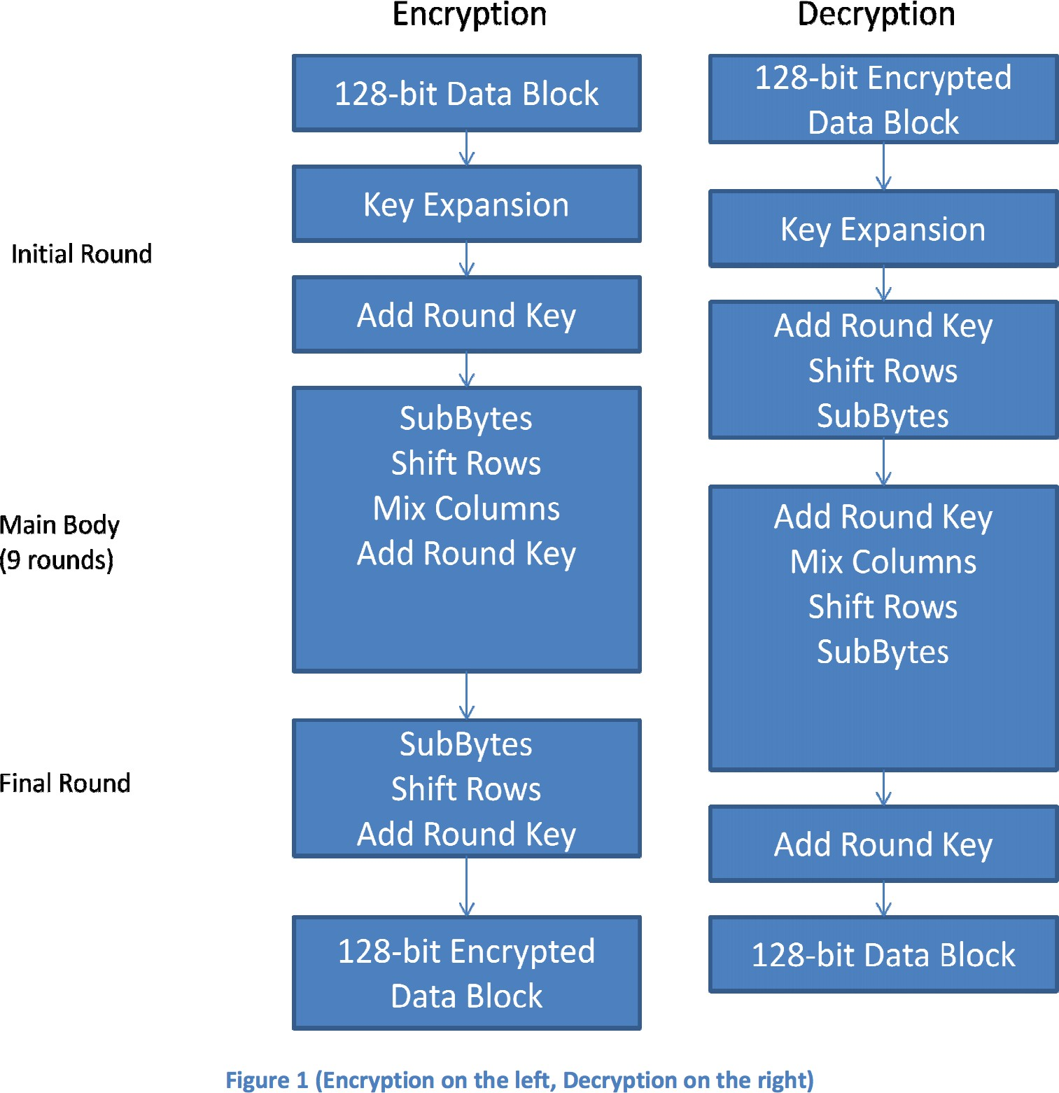
Steps for encryption and decryption
.

Slide 11

Attack Phases
The Ransomware will work in 4 phases to encrypt the user files and exchanging key to the attacker. It includes four phases: Phase 1: Delivery and Execution- During this phase, the actual ransomware executables are delivered to the victim’s system. Through which it can attack to the victim’s system.

Slide 12
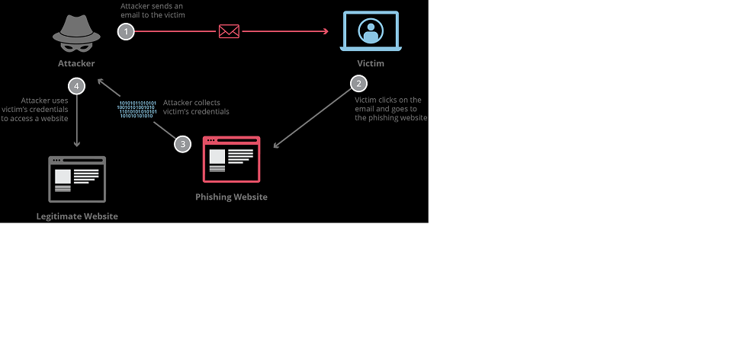
Phase 2: Exploitations and Infection- When attack has successfully done, the malicious ransomware file needs to execute on a computer. Through some techniques like phishing attack and exploit kit exploitation has been done. In the case of the Crypto Locker malware, the Angler Exploit Kit is a preferred method to gain execution

Slide 13
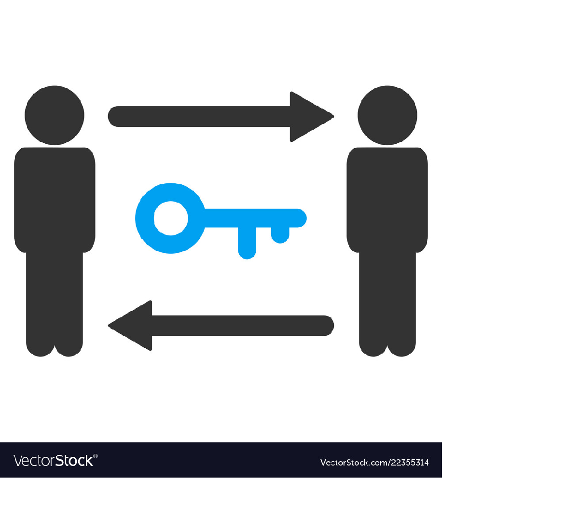
Phase 3: File Encryption- Once the phase 2 has completed, the malware will perform a secure key exchange with the command and control server. Those encryption keys are used on the local system.
Phase 4: User Notification and Clean-up- After removing the Backup files and encryption dirty work done, the demand instructions for extortion and payment are displayed. The victim is given time limit to pay, after that time the ransomware increases

Slide 14
THANK YOU!
Gaurav Agarwal

