Slide 1
Graphical Password Authentication System
Shri Shankaracharya Institute of Professional Management & Technology, Raipur
Major Project(Phase-II) Report on
CSE 8th Semester
Department of Computer Science and Engineering,
Batch 2019-2023
Session Jan - June 2023
Presentation Date: 12.06.2023
Project Group Members:
Vivek Yadav
Gaurav Yadav
Project Guide
Mrs. Upasana Khadatkar
(Assistant Professor, CSE)

Slide 2
Introduction about Project
Passwords play a huge role in keeping your data safe online as well as offline platforms. Passwords are the default method of authentication to get access to our accounts.
A graphical password authentication is a form of authentication using images rather than letters, digits, or special characters.
The type of images used and the ways in which users interact with them vary between implementations.
In a graphical password authentication system, the user has to select from images, in a specific order, presented to them in a graphical user interface (GUI).

Slide 3
Application Area
Why we opt to work on Graphical Password Authentication
Graphical Password authentication system has not been used generally in websites, generally websites uses normal text verification password technique .
Applications and Benefits of this project
Graphical password authentication gives extra security than traditional password and it provides strong security against bot attacks or hackers.
End Users of Graphical Password Authentication
mobile lock screen, banking, shopping websites, email system, college website, government high security websites.

Slide 4
Literature Review
[1] Paper Name: A Survey on Different Graphical Password Authentication Technique
Author: Saranya Ramanan, Bindhu J S
Year: 2014
Conclusion: A literature survey of papers regarding graphical password techniques shows that the techniques can be categorized into four groups as follows
Recognition-Based
Pure Recall-Based
Cued recall-based
Hybrid Schemes
[2] Paper Name: Enhancement of Password Authentication systemusing Graphical Images
Author: Amol Bhand, Vaibhav desale, Swati Shirke, Suvarna Pansambal Shirke
Year: 2015
Conclusion: Cued Click Points (CCP) graphical password scheme is simply the interaction of user with sequence of images. where users select one click point per image until selected images. The user's engagement with a succession of five images is the core idea behind this system.

Slide 5
[3] Paper Name: A Shoulder Surfing Resistant Graphical Authentication System
Author: Hung-Min Sun,Shiuan-Tung Chen,Jyh-Haw Yeh and Chia-Yun Cheng
Year: 2016
Conclusion: Attackers can observe directly or use external recording devices to collect users' credentials. To overcome this problem, we proposed a novel authentication system PassMatrix, based on graphical passwords to resist shoulder surfing attacks. With a one-time valid login indicator
[5] Paper Name: When the Password Doesn’t Work: Secondary Authentication for Websites
Author: Robert Reeder, Stuart Schechter
Year: 2011
Conclusion: The article discusses secondary authentication mechanisms as passwords might be lost, forgotten, or stolen. In this case, users will require a form of secondary authentication to prove that they are who they say they are and regain account access

Slide 6
Problem Identification
Passwords play a huge role in keeping your data safe online as well as offline platforms. Passwords are the default method of authentication to get access to our accounts.
The alphanumeric passwords can be easily cracked by guessing, permutations and combinations. Also, users generally keep the same passwords for all their accounts because it is difficult to remember a lot of them.
So to increase the security of the system, we are here introducing a graphical password authentication system.

Slide 7
Methodology
Registration: Password registration typically refers to the process of creating a new account or user profile for a particular service or platform, where a password is required to secure the account. It is a crucial step in setting up a personal or user-specific login credential.
1. User Enters Username and Email Address
2. A user creates a graphical password by selecting 3 images from a 3*3 grid. The system records the password securely
3. User reviews the form details and submit.
4. The system securely stores the user's graphical password information, typically by encrypting or hashing it.
7

Slide 8
Login: It is the authentication mechanism that verifies the identity of the user and grants access to the account.
1. The user enters their registered username or email address
2. The user must enter the registered images in the correct sequence to successfully login.
3. The system compares the entered graphical password with the stored password information.
4. Based on the comparison result, the system determines whether the entered graphical password matches the stored password.
5. If the authentication process is successful, the user gains access to their account.
6. In case of multiple failed login attempts, the user will be notified via message through email.
7. Account Recovery: In case the user forgets their password, a password recovery or reset option is available.

Slide 9
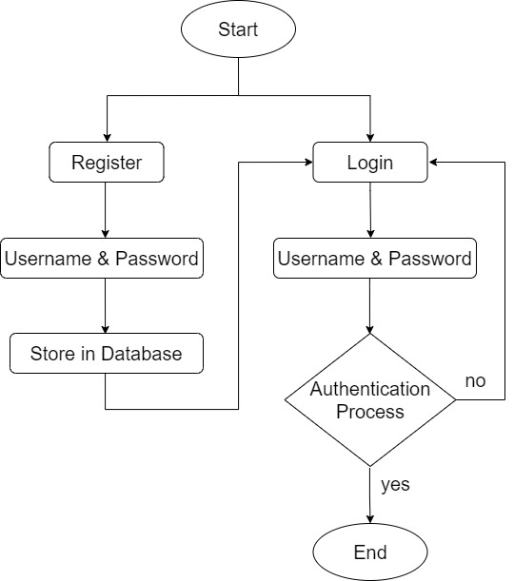
Project Work Flow Diagram

Slide 10
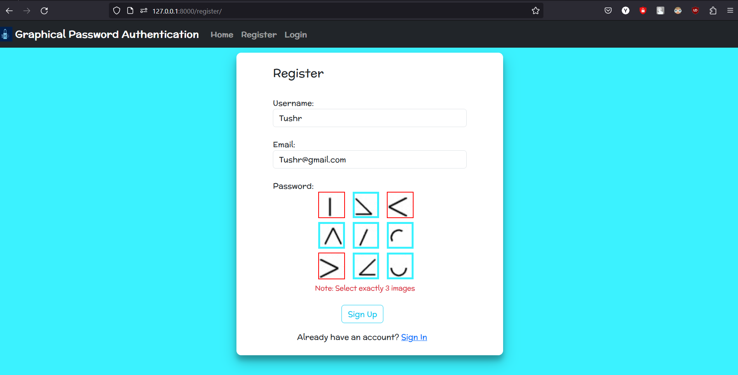
Result

Slide 11
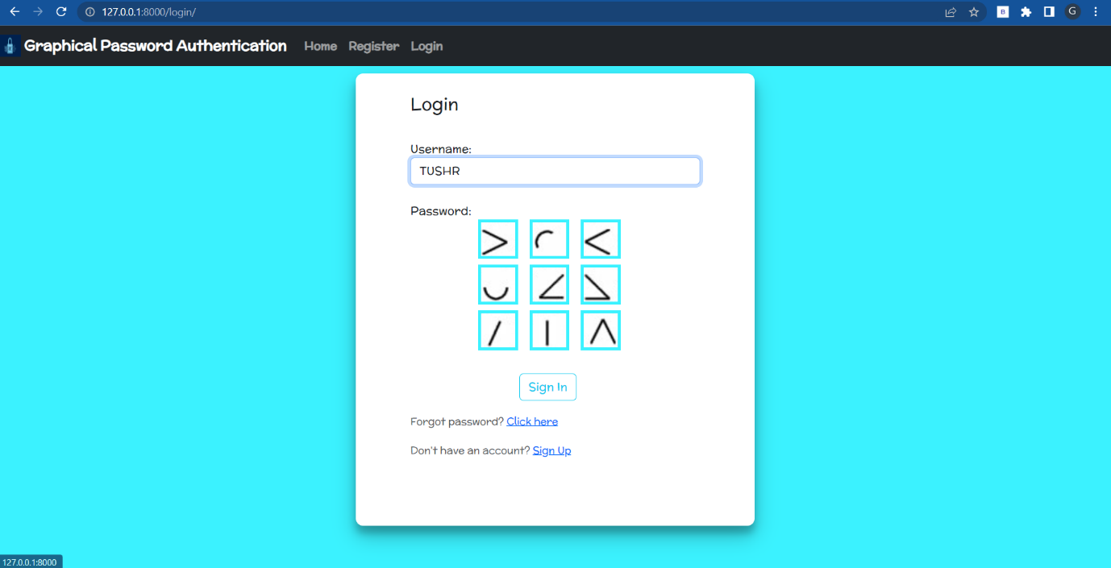

Slide 12
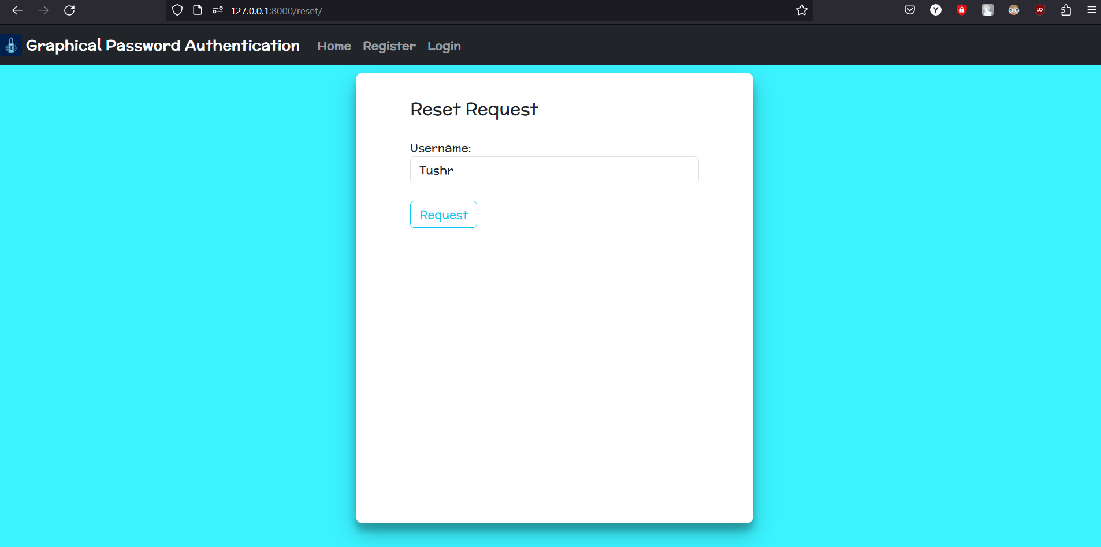

Slide 13
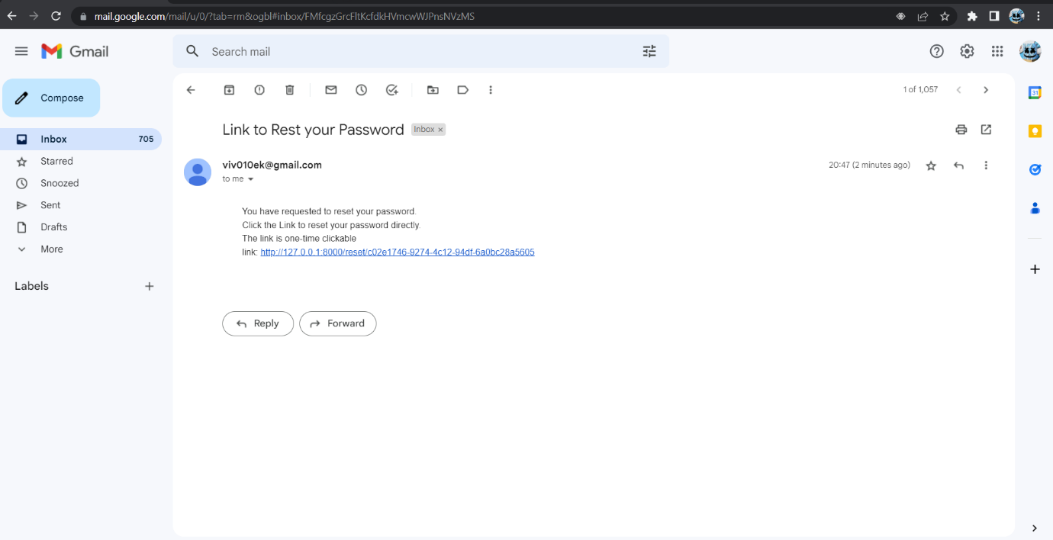

Slide 14
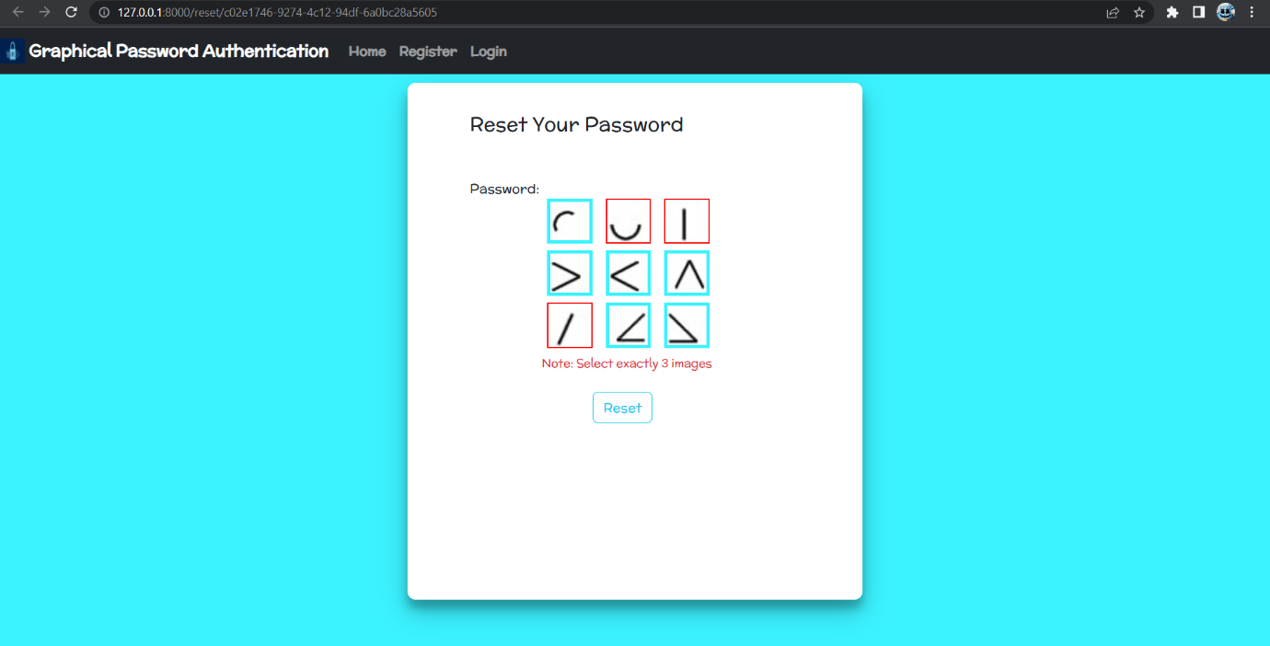

Slide 15
Conclusion
The Graphical Password Authentication system works as follows
At the time of registration, the system will display a 3*3 grid consist of 9 images for password.
Each thumbnail image is assigned a numerical value, and the sequence of selection will generate a numerical password.
A user creates a graphical password by selecting 3 images from a 3*3 grid. In graphical password during the authentication.
During the authentication, the user must enter the registered images in the correct sequence to successfully login.
This project provide a new and more reliable way to protect users against potential external threats.

Slide 16
References
[1] Saranya Ramanan, Bindhu J S,” A Survey on Different “Graphical Password Authentication Technique”, International Journal of Innovative Research in Computer and Communication Engineering, Vol. 2, Issue 12, December 2014.
[2] Amol Bhand, Vaibhav desale, Swati Shirke, Suvarna Pansambal (Shirke), “Enhancement of Password Authentication systemusing Graphical Images”. 2015 International Conference on Information Processing (ICIP) Vishwakarma Institute of Technology. Dec 16-19, 2015.
[3] Hung-Min Sun,Shiuan-Tung Chen,Jyh-Haw Yeh and Chia-Yun Cheng, “A Shoulder Surfing Resistant Graphical Authentication System” DOI10.1109/TDSC.2016.2539942IEEE.
[4] Sarojini, Priya, Bhuvaneshwari, “Graphical Authentication System Using Pass Matrix“.International Journal of Computer Trends and Technology(IJCTT) Special Issue April – 2017.
[5] Robert Reeder, Stuart Schechter, “When the Password Doesn’t Work: Secondary Authentication for Websites”. IEEE Security & Privacy (Volume: 9, Issue: 2, March-April 2011).
[6] G. Blonder. “Graphical passwords”. United States Patent, 5,559,961, 1996.

Slide 17
[7] D. Davis, F. Monrose, and M. K. Reiter, "On user choice in graphical password schemes," in Proceedings of the 13thUsenix Security Symposium. San Diego, CA, 2004.
[8] Lashkari, A. H., Gani, A., Sabet, L. G., & Farmand, S. (2010). A new algorithm on Graphical User Authentication (GUA) based on multi-line grids. Scientific Research and Essays, 5(24), 3865–3875.
[9] Aakansha Gokhale, & Vijaya Waghmare. (2013). Graphical Password Authentication Techniques: A Review. 7.
[10] K. Renaud, “Guidelines for designing graphical authentication mechanism interfaces,” International Journal of Information and Computer Security, vol. 3, no. 1, pp. 60–85,June 2009.
[11] A.De Angeli, L. Coventry, G. Johnson, and K. Renaud, “Is a picture really worth a thousand words? Exploring the feasibility of graphical authentication systems,” International Journal of Human-Computer Studies, vol. 63, no. 1-2, pp. 128–152, 2005.
[12] K.P. L. Vu, R. Proctor, A. Bhargav-Spantzel, B.-L. Tai, J.Cook, and E. Schultz, “Improving password security and memorability to protect personal and organizational information,” International Journal of Human-Computer Studies, vol. 65, pp. 744–757, 2007.

Slide 18
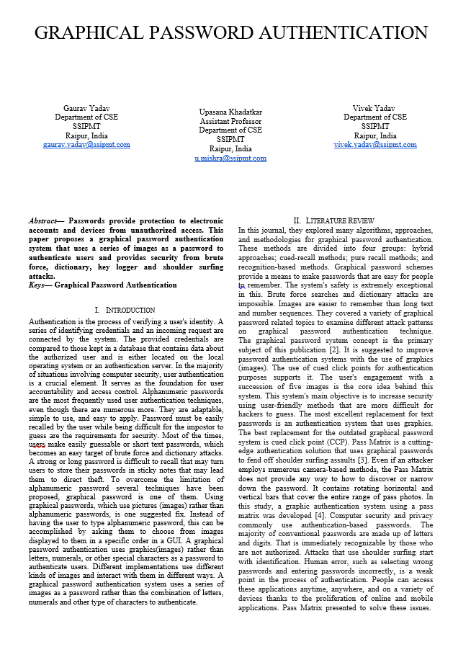
Paper Publication Details

