Slide 1

AIR QUALITY MONITORING SYSTEM WITH CLOUD INTEGRATION
Dr. DY PATIL college of Engineering management and research
PROJECT BASED LEARNING - II

Slide 2
INDEX
SR.NO. | TOPIC | SLIDE
01 | INTRODUCTION | 04
02 | DETAILS OF DESIGN | 05
03 | EXPERIMENTAL STUDY | 06
04 | RESULTS | 07
05 | APPLICATION OF PROJECT | 09
06 | ADVANTAGES AND DISADVANTAGES | 10
07 | CONCLUSION | 11

Slide 3
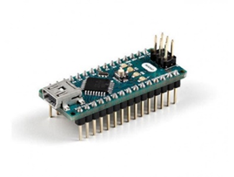
INTRODUCTION
Air Pollution is a concerning topic in 21st Century and beyond.
It has adverse impact on living organisms such as humans, animals, food or on any living organism.
To comply with the growing effects of Air Pollution, the project provides basic monitoring of Dust Particulate Matter, Temperature, Humidity and presence of any other gases.
Using Raspberry Pi as a cost effective solution to create a server and manage everything including sensors and dashboard – UI.
Arduino Nano

Slide 4
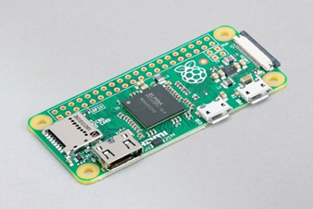
DETAILS OF DESIGN
The Project comprises of four sensors :- MQ135 , MQ7 Gas Sensors, DHT11 Temperature and Humidity Sensor and GP2Y1010AU0F Dust Particle Sensor.
Raspberry Pi 4 (2GB) is being used as a node-red server host and is used to manage all of the sensors.
Node-red-dashboard is used to create UI/UX design for user to interact with sensors and their respective graphs.
User can access the UI/UX page using IP provided by Raspberry Pi on any browser, especially Google Chrome.
Raspberry Pi Zero Wireless

Slide 5
EXPERIMENTAL STUDY
With the help of all four sensors, the data gets collected daily, which is shown on the dashboard page.
As per weekly analysis, the compiled data shows that there are fluctuations in Dust Quality daily.
Temperature stays between 26°C and 35°C as per the graph shown on the next slide.
Humidity varies from 60% and 90% within a week.
PM2.5 values have been measured between 99 µg/m³ and 150 µg/m³.
Carbon Monoxide and Carbon Dioxide values have been decreasing daily since the weather is changing from Summer to Rainy season.
Observed value was in between 100-150 ppm.

Slide 6
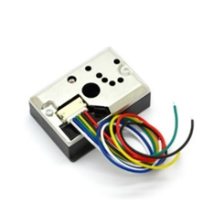
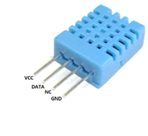
RESULTS
Results will be displayed on the User’s Browser window.
Dust Sensor
DHT11 Sensor

Slide 8
APPLICATION OF PROJECT
This Project can be implemented on various hazardous locations such as Industries, Polluted Areas, MIDC regions, Cities, etc.
Since the Monitoring system uses Raspberry Pi and cloud services, a number of such systems can be collectively placed in a region to monitor it daily and provide accurate results for years.
A single unit is Node and as a collective product, System of Nodes is created that can be managed by user, all at once.
Database is included to store vast amount of data into IBM server. (can be changed to personal server too)

Slide 9
ADVANTAGES AND DISADVANTAGE
ADVANTAGES | DISADVANTAGES
Inexpensive and Cost Effective Project | Maximum susceptible temperature is 60°C, can be changed.
Small in Size, can be placed anywhere. | No Power Surge protection, can be implemented
In-case of failure, Sensors are replaceable. | Extra Sensors can increase price.
Cloud Computing is feasible as data is stored on servers. | Rain can affect the performance, no water resistance if a node is exposed.
Low power consumption | Cloud networking needs proper internet connection.
Data-management using DataBase software. | Database Software should be operated only by professionals.
User interface(front end)/user interaction can be accessed using any browser. | Security of data can be compromised if Raspberry Pi gets logged in by unauthenticated individual.

Slide 10
CONCLUSION
The proposed system provides low cost, low power, compact and highly accurate system for monitoring the environment with the dedicated sensors remotely from any place in this world.
A perfect tradeoff between accuracy and cost is achieved by making use of single board minicomputer Raspberry pi and appropriate sensors leading to a well-grounded system.
Graphs, Sources and Sensor Outputs are visible to User on browser window.

