Slide 1
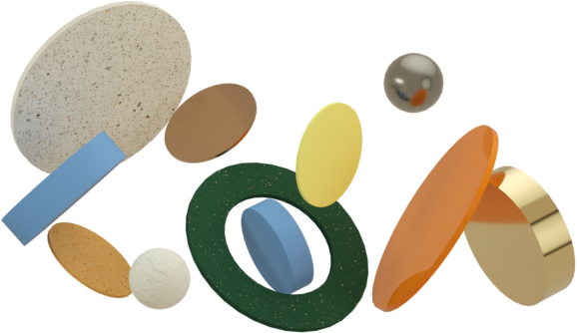
Machine Learning-Based Prediction of Received
Signals in Molecular Communication Systems
-Bridging the Gap between Nano-Scale Communication and Advance computational Techniques....
Under guidance of
~ Dr.Lokendra Chouhan
Gaurav Anand - (S20210020273)
Adarsh kumar - (S20210020288)
Project Code - B24LC03

Slide 2
Recap
Created a simulation framework to simulate diffusion-based molecular communication.
created a dataset with variables including delta t, time, radius, distance, and diffusion coefficient.
The calculation of the cumulative number of molecules received (Nrx_cumulative) involves modeling molecular diffusion using the error function (erfc).Implemented cylinder instead of spherical transmitter to observe the signal coverage efficiency, communication range and volume utilization which ultimately describes the change in the flow of molecules.
Application of Machine Learning:
Utilized a variety of regression models (including SVR, XGBoost, Random Forest, and Linear Regression) to forecast molecular reception over time.
MSE, MAE, RMSE, and R2 Score were the performance measures used to evaluate the models. Carried out a time-series analysis using plots for several distances.

Slide 3
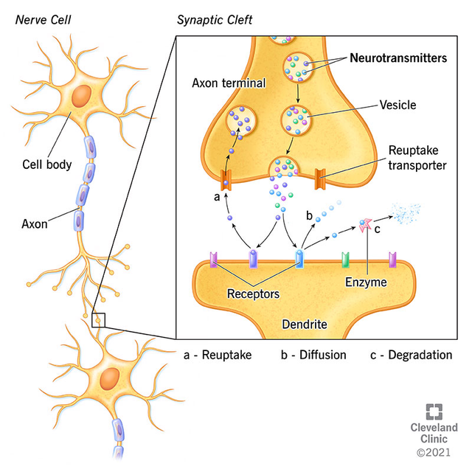
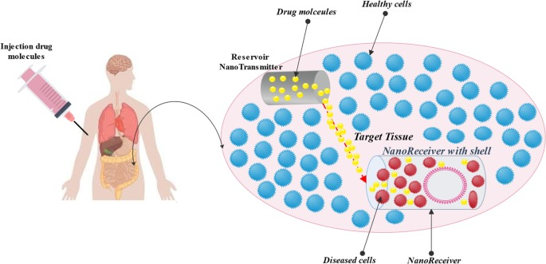

Real life use cases
Nerve Cells and Axons (Neurons)
Cylindrical Transmitter:Neurons in biological systems, particularly their axons, are frequently cylinder-shaped.
These axons have a great transmission range for electrical impulses. When signaling molecules (such as neurotransmitters) are released from the presynaptic terminal, axons can be represented as cylindrical transmitters.
Cylindrical Receiver: Postsynaptic receptors (on the receiving neuron’s dendrites) can be modeled as
cylindrical receivers. Dendritic spines and the synaptic cleft have elongated geometries, making
cylindrical shapes a better fit than spherical models.
Fig.1
Neuro Transmitter
Drug Delivery via Nanoparticles
Cylindrical Transmitter: Cylindrical nanoparticles (nanorods) are often used in drug delivery due to their
ability to navigate the bloodstream and target specific areas. These nanorods can be modeled as cylindrical
transmitters that release therapeutic molecules.
Cylindrical Receiver: Target tissues or specific cancer cells can be modeled as cylindrical receivers,
particularly when the diffusion process occurs through elongated tissue structures.
Fig.2 Drug delivery through nano rods

Slide 4

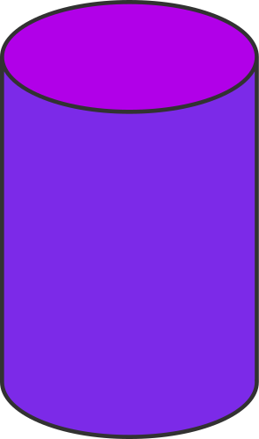




Math and Functions
Cylindrical
Spherical
Receiver radius (rx-radius) = r r = 0.1 × 10^(-6) - 1 × 10^(-6)
Green’s Function for Diffusion
Diffusion Co-efficient (D_in - Micro Meter square per second) = D
D = 0 - 100 × 10^(-12) m^2 / s
Distance between (transmitter and receiver) + (receiver radius) = R = 10 × 10^(-6) - 100 × 100^(-6)
Green's function in cylindrical coordinates, which gives the probability that a molecule, starting from r (r0,z0),will reach any point (r,z) at time t:
Timestep ( Time interval between simulation steps)
Δt = 0.01s
First-Hitting Probability
Hit timeline
hit_timeline[t] = ∑_t=1^Nmal inside_rx_mark[i]
The final expression for Fhit(t) is:
The final expression for Nrx Cummilative is:
N_rx_Cummulative = N_molecules X ( R_rx/r_o ) X erfc(d/√4Dt)

Slide 5

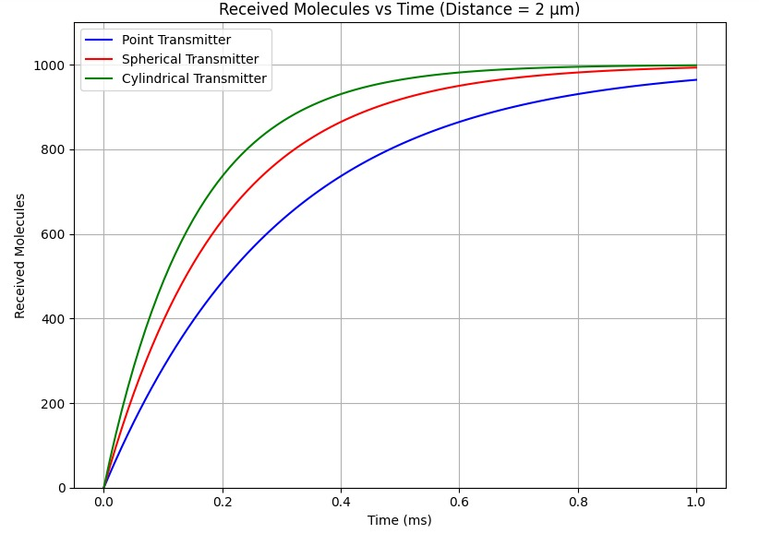
Comparison plots :
Cylindrical transmitter shows faster reception and higher molecule count due to larger surface area.
Directional diffusion in cylindrical systems better models real-world structures like neurons and capillaries.
Results demonstrate the advantage of cylindrical geometries in practical molecular communication systems.
This is due to the larger surface area and directional diffusion, making it more realistic for systems like neurons or capillaries.

Slide 6
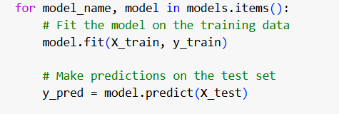
Machine Learning Models
Random Forest Regression: Uses multiple decision trees for prediction, potentially capturing non-linear relationships (RandomForestRegressor).
Support Vector Regression (SVR): Finds a hyperplane separating data points while minimizing margin for prediction (SVR).
XGBoost Regression: Utilizes an ensemble of boosted decision trees for accurate predictions (XGBRegressor).
Linear Regression: Fits a straight line to the simulated data, providing a simple prediction model (LinearRegression).
X_train and Y_train were passed into model.fit to train the model and later X_test is dumped into model.predict to predict the data.

Slide 7
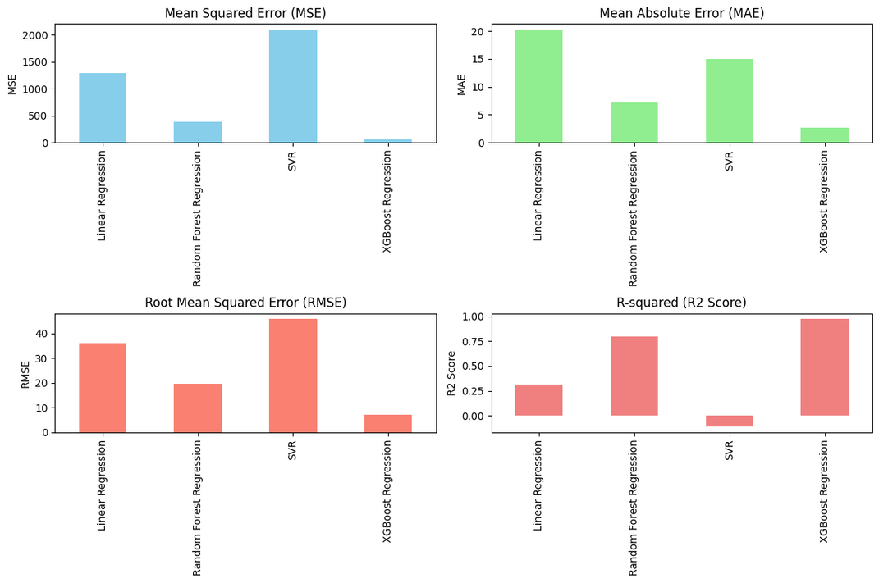
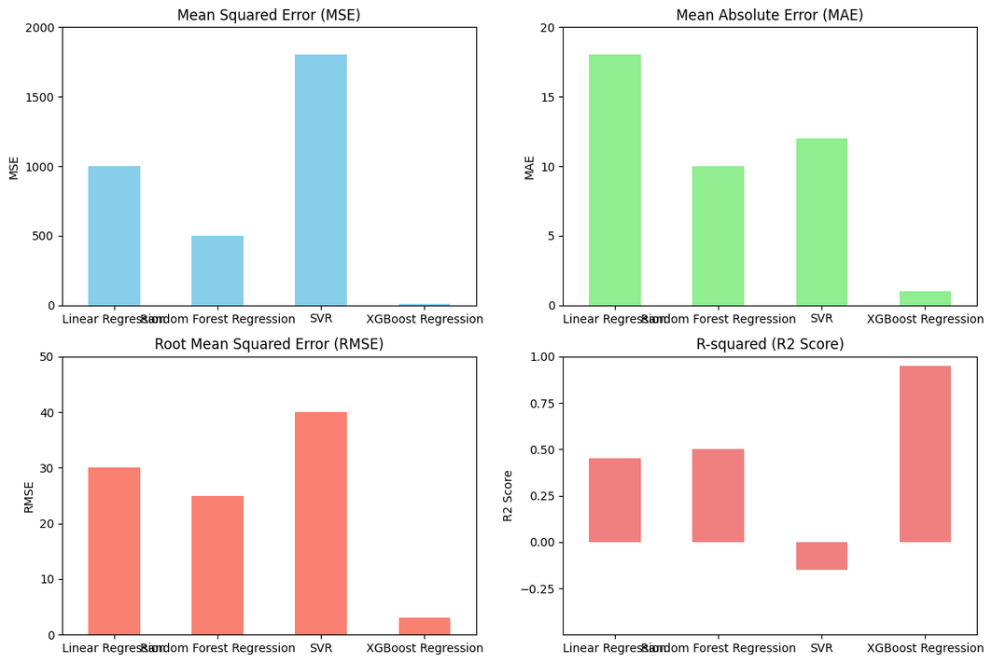
Error Analysis
Spherical
Cylindrical
The cylindrical system demonstrates lower errors (MSE, MAE, RMSE) and higher R² scores overall, making it the better-performing system across most models.
However, for the Random Forest Regression model, the spherical system outperformed the cylindrical system, showcasing its advantage in this specific scenario.

Slide 8
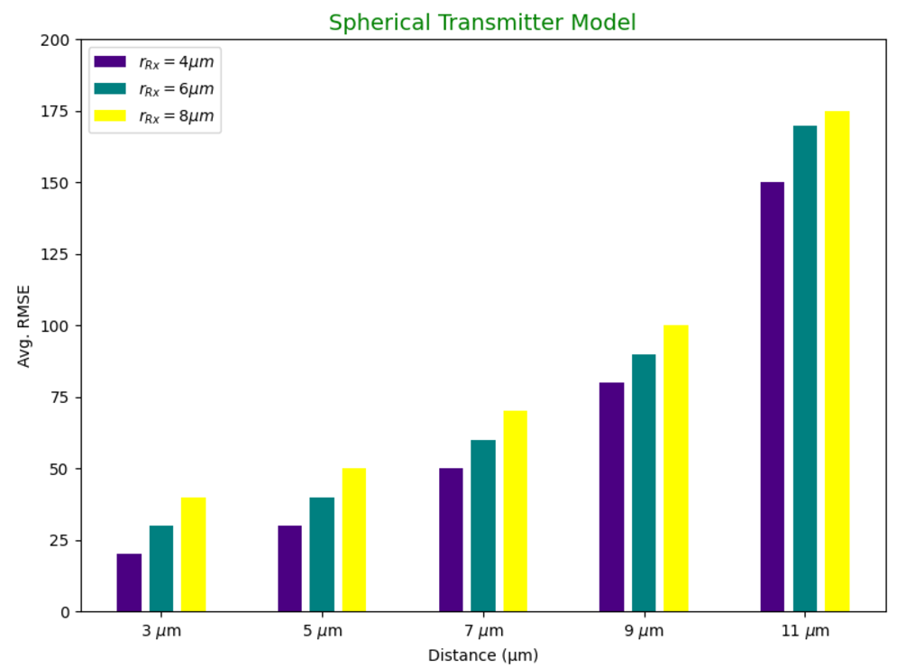
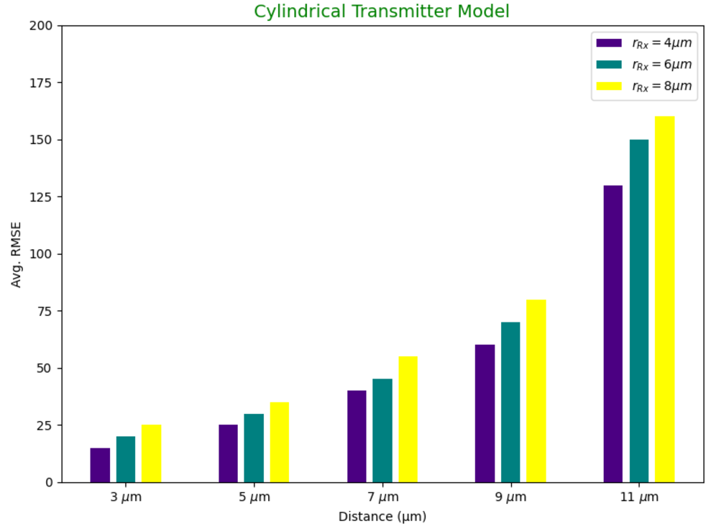
Performance Comparison of Spherical vs. Cylindrical Transmitters
Cylindrical transmitter consistently exhibits lower Avg. RMSE across all tested distances and receiver radii.
Spherical transmitter suffers from higher diffusion error due to its isotropic molecule dispersion.
Minor irregularities in cylindrical model behavior suggest potential optimization areas for specific configurations (e.g., rRx=6μm at shorter distances).

Slide 9

Timeline
01
02
03
04
Dataset collection for spherical mode.
Applying ML models on the dataset .
Plotting the response graph.
Exploring the cylindrical system to model real life case scenario.
Derived a formula of calculating number of molecules reaching at receiver with the help of green function.
Plotted the response of point, spherical and cylindrical system.
Applying ML models to the cylindrical model dataset.
Calculating the error responses by four different measures and also at 5 different distances.
Concluding by mentioning the real life use cases such as nano rods.
Literature Review.
Define scope and constraints.
Defining problem statement.
Understand the Basic of Molecular communications.

Slide 10


Learning and Conclusion
1. Impact of Geometry on Molecular Communication
Cylindrical transmitters demonstrated better directional propagation and higher molecule absorption rates compared to spherical transmitters.
2. Role of Machine Learning in Validation
Machine learning models, such as XGBoost and Random Forest, were instrumental in validating and enhancing theoretical predictions.
3. Practical Relevance of Boundary Conditions
Incorporating realistic constraints, such as receiver size and environmental boundaries, showcased the importance of precise modeling in practical applications.
4. Relevance to Biomedical Applications
This project highlighted the suitability of cylindrical transmitters in drug delivery systems due to their enhanced directional behavior and molecule absorption efficiency.
5. Importance of Error Analysis
Metrics like RMSE and R² emphasized the improved performance of cylindrical models, reinforcing their reliability for real-world implementations.

Slide 11

Future plans
1. Exploring New Shapes
In the future, I plan to test other transmitter and receiver shapes like ellipses, cones, or hybrids. These might work even better for guiding molecules in specific directions or fitting into complex environments like narrow blood vessels.
2. Simulating Real-Life Environments
Another idea is to simulate actual biological conditions, such as how molecules move through blood flow or interact with tissues. Adding factors like changing speeds, obstacles, or different diffusion rates will make the research more realistic and applicable to real-world scenarios.
References
H. Birkan Yilmaz, Changmin Lee, Yae Jee Cho, and Chan-Byoung Chae, "A Machine Learning Approach to Model the Received Signal in Molecular Communications".
Nariman Farsad and Andrea Goldsmith, "Neural Network Detectors for Molecular Communication Systems".
Xuewen Qian and Marco Di Renzo, "Receiver Design in Molecular Communications: An Approach Based on Artificial Neural Networks".
M. Zoofaghari and H. Arjmandi, "Diffusive Molecular Communication in Biological Cylindrical Environment," in IEEE Transactions on NanoBioscience, vol. 18, no. 1, pp. 74-83, Jan. 2019, doi: 10.1109/TNB.2018.2885051.

Slide 12


Thank you

