Slide 1

Swami Keshvanand Institute of Technology, Management and Gramothan, Jaipur
Project – 2D Platformer Game
Submitted To :
Mr. Ankit Kumar
Assistant Prof.
Submitted By :
Gaurav Biyani
17ESKCS723
CS-D (G1)

Slide 2
Content
Introduction
Technology
Existing Projects
Conclusion

Slide 3
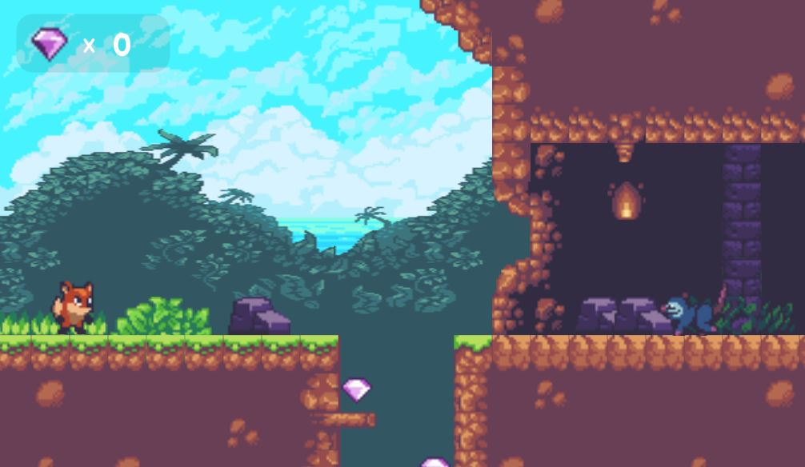
Introduction
A two dimensional platform game includes several things such as player, enemies, their movements, coins, powers, player’s life, different levels, game store to purchase different game items. Level will be cleared if you reached to end of the stage or stage will restart if you die.

Slide 4
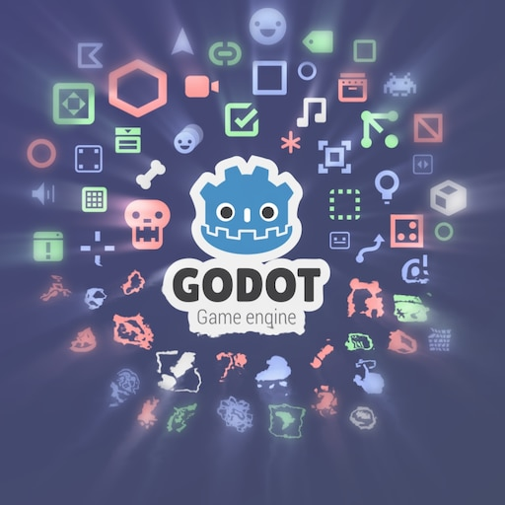
Technology
Godot Game Engine
Godot offer a fully integrated game development environment. It allows developers to create a game, needing no other tools beyond those used for content creation (visual assets, music, etc.). The engine's architecture is built around the concept of a tree of "nodes". Nodes are organized inside of "scenes", which are reusable, instanceable, inheritable, and nestable groups of nodes. All game resources, including scripts and graphical assets, are saved as part of the computer's file system (rather than in a database).

Slide 5
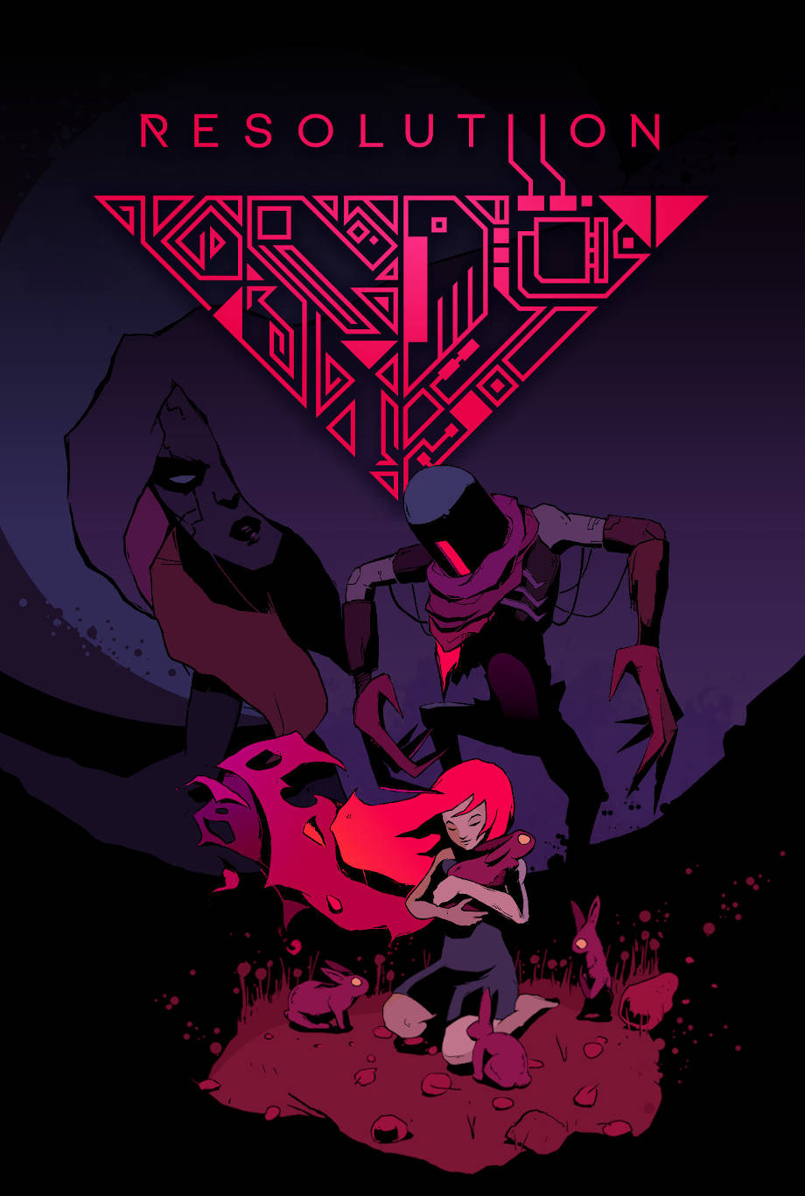
Existing Projects
Resolutiion
Resolutiion is a Zelda-like action-adventure game, where an old killer and his AI explore a vast, mysterious world, full of mighty weapons, surreal abilities and awesome boss fights.

Slide 6
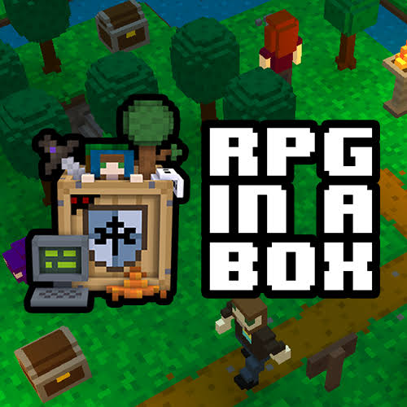
RPG In A Box
RPG in a Box lets you easily create 3D grid-based, voxel-style RPGs and adventure games! As its name suggests, it will contain every tool necessary for turning your ideas into games, all packaged together "in a box".

Slide 7
Conclusion
2D Games requires some basic physics to provide movement and shooting mechanism to player and enemy, we also need to understand the theme of game according to audience before starting game development in order to provide best gaming experience. Some artistic skills are also needed to create your own sprites so that you can change game looks the way you want.

Slide 8


